Slide 1
Housekeeping
Some basic probability concepts. (This part is pretty simple).
  We need a bit now, but this will largely be background.
  Discreet distributions.
  Odds and logits.

Slide 2
More Housekeeping
Some of the ideas here are really important to understand for future.
  Probability, odds, logit, models, estimation…
  The next 3-4ish days will cover the basics, they are somewhat all connected.
Especially on the simulation stuff, you really need to try to do some unguided.
  We are going to be dealing with many sets of data, and need to stay organized.
  We’ll have some loops and need to tabulate data each run.
  Several things have partially overlapping terms and definitions.
Make sure the examples make sense and exercises are doable – ask if issue.
  Exercises in workbooks and book, can also reproduce examples with tweaks.
  Generalizing any distribution also works pretty similarly.

Slide 3
Probability

Slide 4
Side Note - Discreet vs Continuous
Most things we’ve dealt with thus far have been continuous.
We also regularly deal with discreet data:
  Votes.
  Purchases.
Discreet data has similar distribution patterns.
We usually think of discreet things in terms of probability – likelihood that value X occurs.

Slide 5
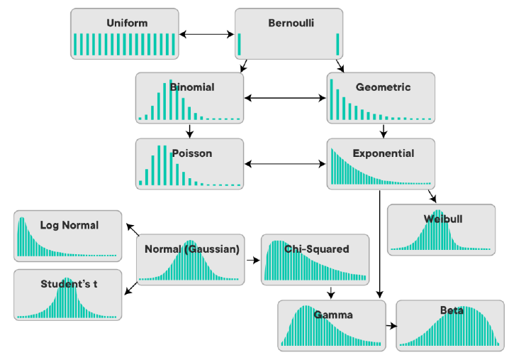

Slide 6
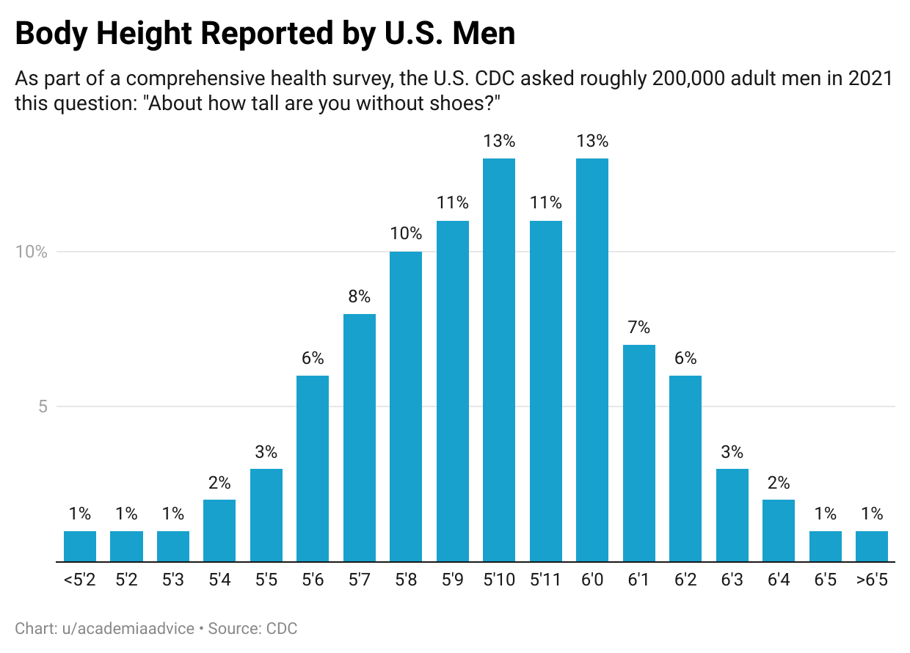
Discreet vs Continuous
Continuous variables express density as a % likeliness in a bin range.
Discreet expresses density as a % of a specific value.
Bonus – spot any errors?

Slide 7
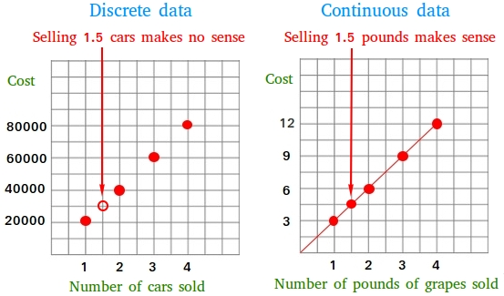
Remember – Fit reality as Best You can
Some things can be reasonably modeled with either discreet or continuous.
  Domain knowledge decision.
E.g. foot size:
  Continuous – cm measurements for medical data.
  Discreet – size measurements for shoe production.
We want (in all respects) to model reality best.
  The goal is to simulate the real thing for predictions.
  “Math” rules are practical/logistical.

Slide 8
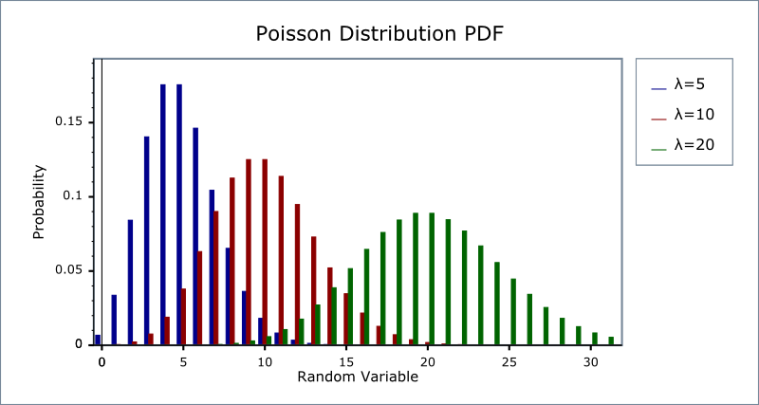
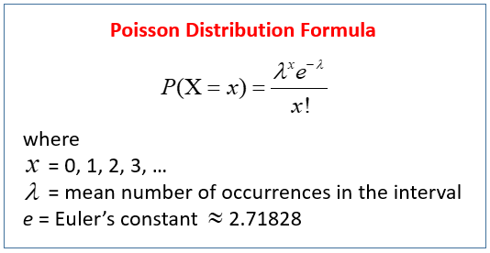
Discreet Example - Poisson
Poisson distributions are discreet, often used for things like goals, customers per hour, or other things that happen regularly but unpredictably.
Estimator is the mean – expected events per time.
  Ensure time steps are consistent.

Slide 9
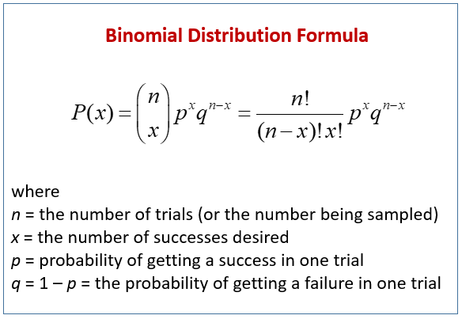
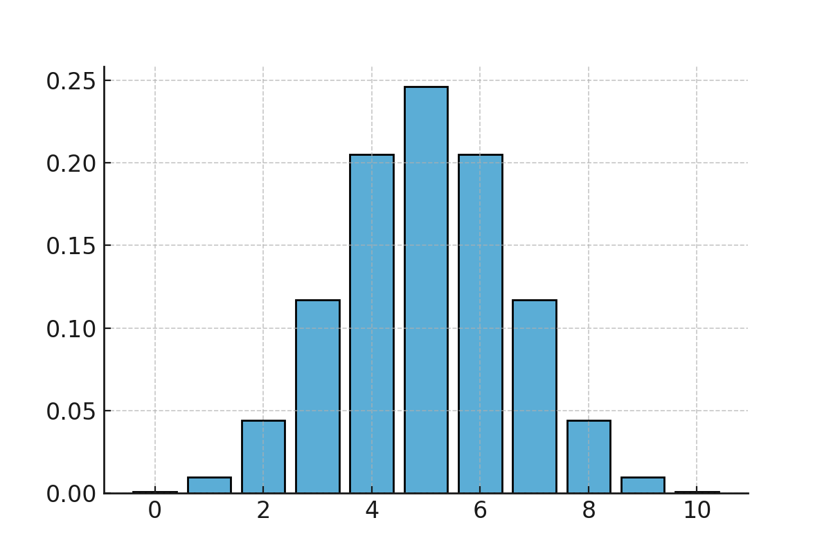
Binomial
Binomial distributions model multiple attempts of a two-outcome process.
  E.g. coin flip, T/F.
  10 flips, # heads – many 5s, fewer 4/6, 7/3, 8/2, 9/1, 10/0 is exceedingly rare.
Histogram shows (for many flips):
  X = # of successes.
  Y = count or density.
Estimator is the probability of one event.

Slide 10
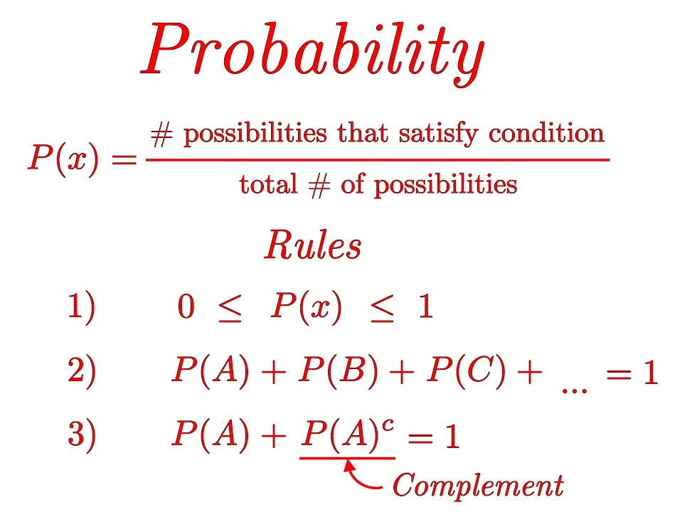
What’s the Probability?
Probability = the chances something happens.
  Or: The fraction of a total possibilities.
  E.g. the chances you roll a die and get a 5 = 1/6
What does probability matter to us?
  They matter – a little.
  Probabilities are common – e.g. gambling.
  Probability is often misunderstood.
  Probability provides an alternate view of what we are looking at.
    Can reach things like distributions, by looking at probability, instead of data.

Slide 11
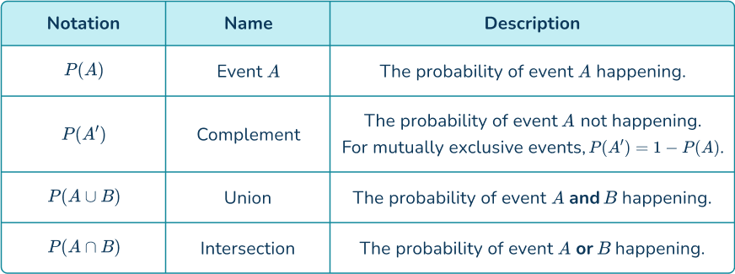
Probability Notation
P(A) = Probability that A is true.
P(A and B) = P(A) * P(B). Probability that A and B are true.
P(A or B) = P(A) + P(B). Probability that A or B are true.
P(A^{c}) = 1-P(A) = P(not A). Probability that is is false.
Simple probability assumes mutual exclusivity (only one is true), and one thing is true.
  P(A and B) = 0, P(A or B) = 1.

Slide 12
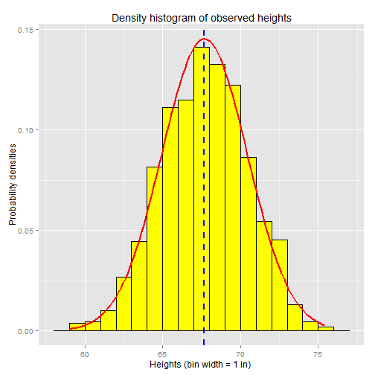
Probabilistic Statistics
With our datasets, we often look at density – the percentage that falls in M range.
  Looking backwards, this is a percentage.
  Looking forwards, this is a likelihood a thing will happen.
Our distribution defines the probability that a new item on that distribution will be X.
If we’ve chosen a model that actually matches the data, all new occurrences should follow the defined pattern.

Slide 13
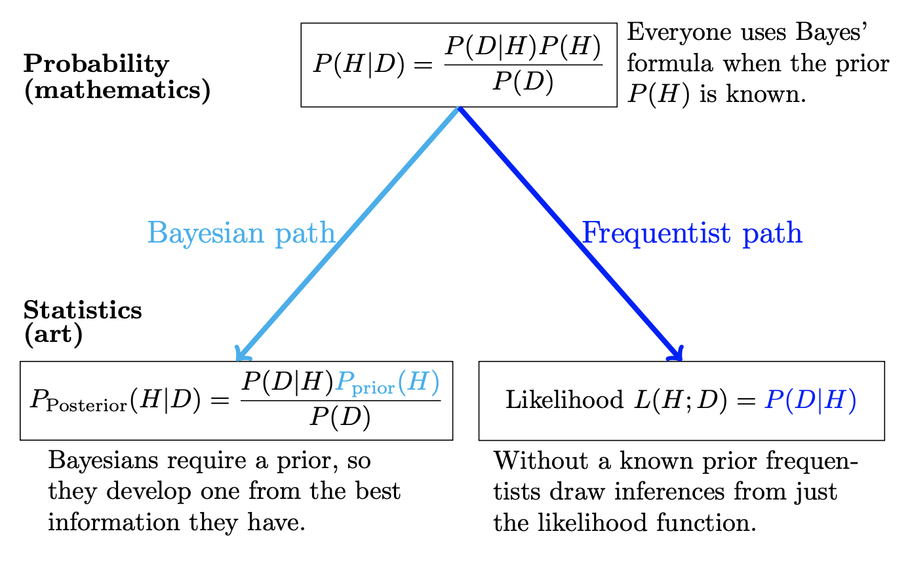
Different View on Statistics
Stats and probability (especially inferential) are two sides of a coin.

Slide 14

Using Probability – Will We live?
We need to win at 5 simple games.
We are really, really good at games, we win 90% of the time.
Are we dead?

Slide 15
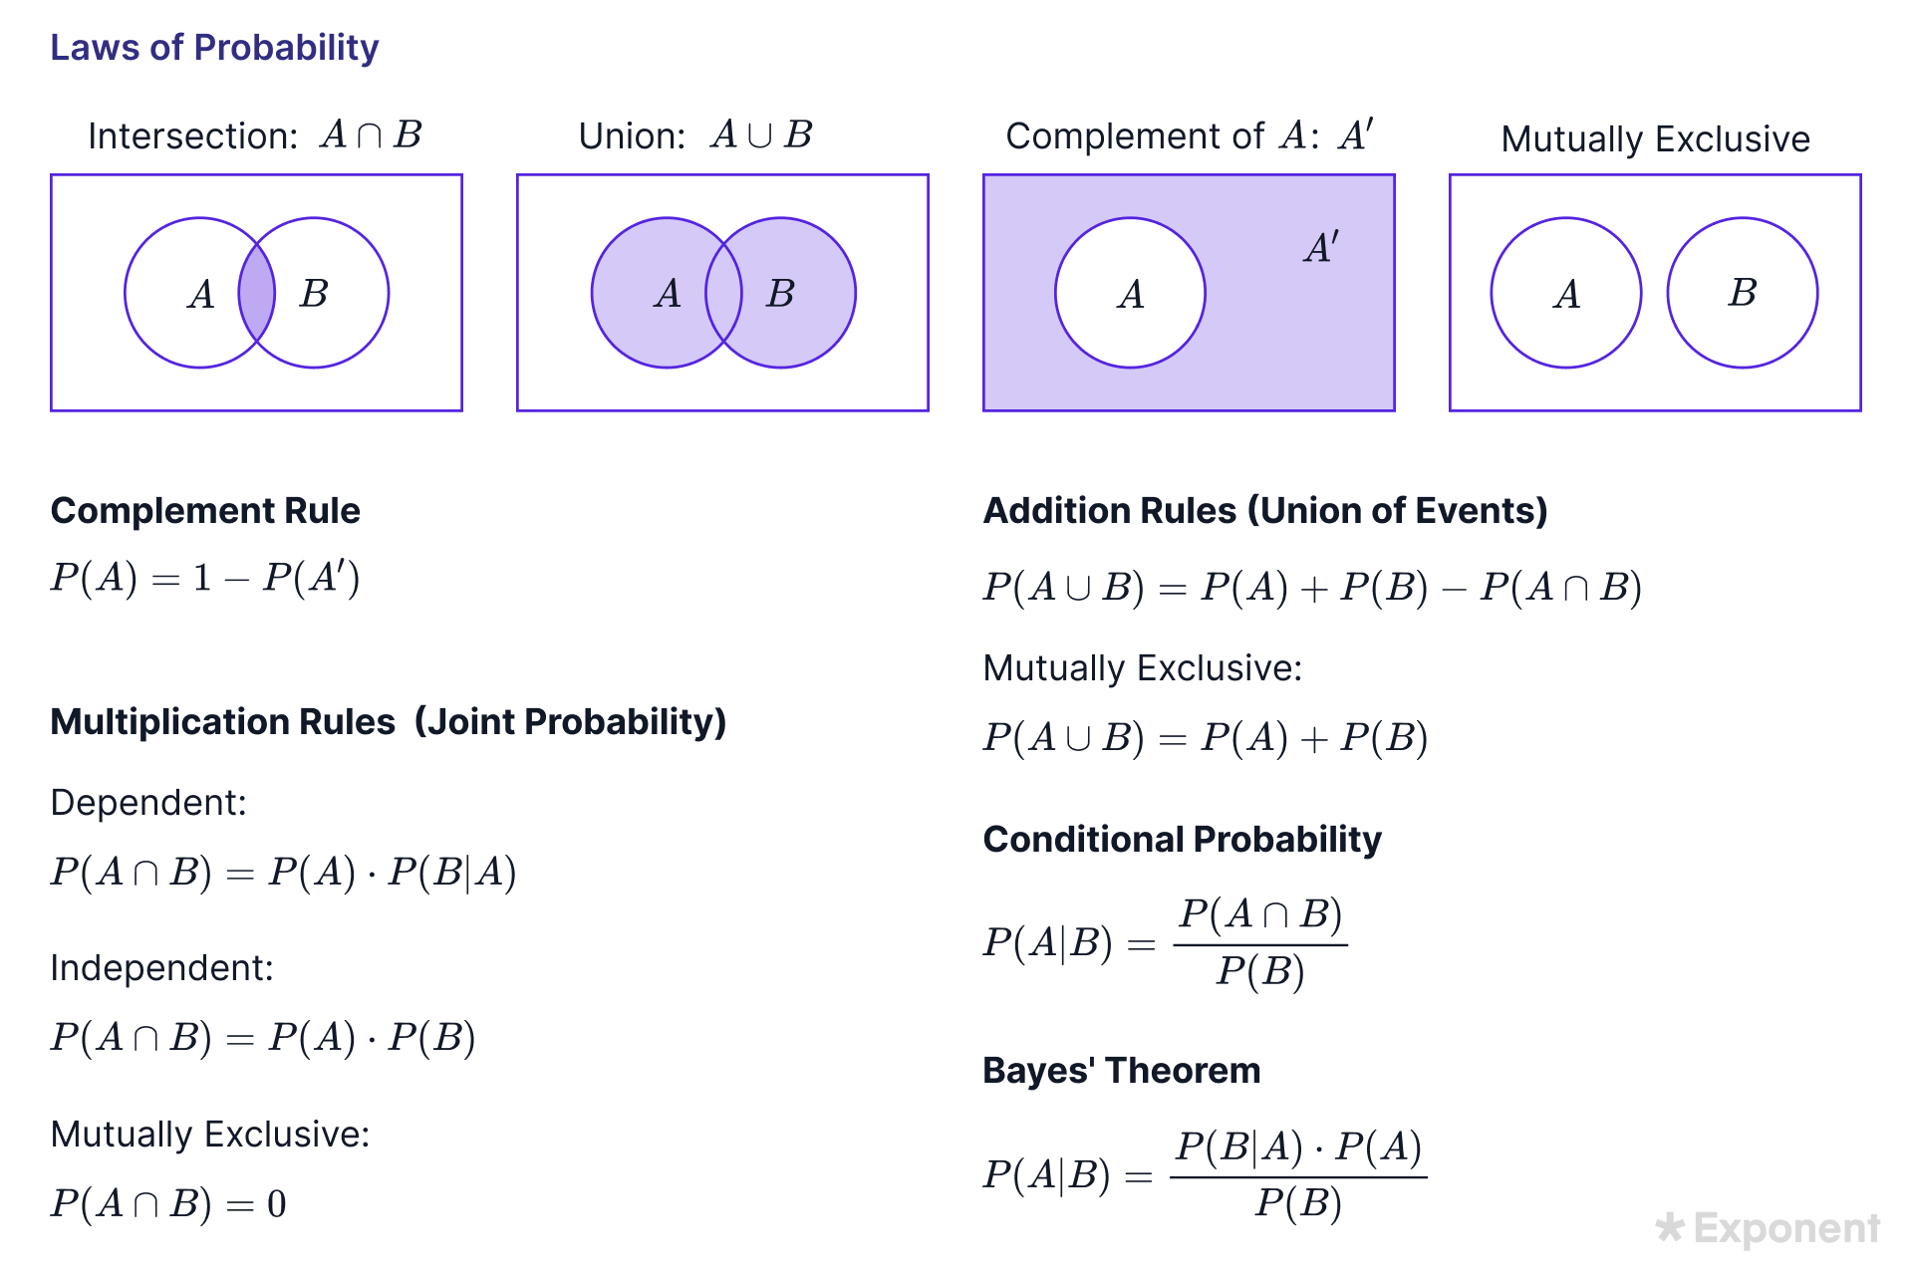
Calculations
We must be ok with basic calculations.
  Generally, assume independence.
Most notably:
  Joint probability. (Multiply)
  Union. (Add)
The hardest part can be translating things to consistent probability notation.

Slide 16
Will we Live?
P(Win) = .9
Odds we are alive after:
  1 Game – 90%
  2 Games: P(W1 and W2) = .9 * .9 = .81 = 81%
  3 Games P(W1&W2&W3) = .9^3 = .729 = 73%
  4 Games P(W1&W2&W3&W4) = .9^4 = .66 = 66%
  5 Games P(W1&W2&W3&W4&W5) = .9^5 = 59%
Damn it.
Even if we are better – 95% win rate, we only survive 77% of the time.

Slide 17

Choose Carefully
Probabilities, especially when there’s more than one involved, are not always intuitive (i.e. don’t buy parlays).
E.g. Jackpot odds for 6/49 lottery are roughly 1 in 14 million.
If your work buys 10 tickets every week, for 30 years.
  10*52*30 = 15,600 chances to win.
  Expected value:
    Cost: 15,600*$5 = $78,000.
    Income: $10 million avg jackpot.
    P(win) = (1/14mill) * 15600
  Even so, some people in my old job won ~$3.5m each.

Slide 18
So…
We can frame any (discreet*) thing we’ve collected a sample on as probabilistic.
  The samples tells us the # of times it occurred vs not.
  If we have a model of the distribution, that gives us an expectation of what will happen.
  Looking forward, that percentage is the expected probability.
  *with continuous data this usually equates to <>, or similar.
This depends on how well the model matches reality.

Slide 19
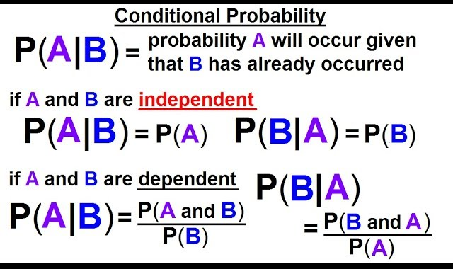
Conditional Probability
P(A | B) = probability that A is true, given that B is true.
Conditional probability is allows us to say “how likely is X if something happens?”
  E.g. If we are over 7’0” how likley are we to make the NBA?
  In the 90s someone calculated that at about 14%
Some quick covid tests have reported about a 20% false negative rate.
  P(Test Positive | Have Covid) = 80%

Slide 20
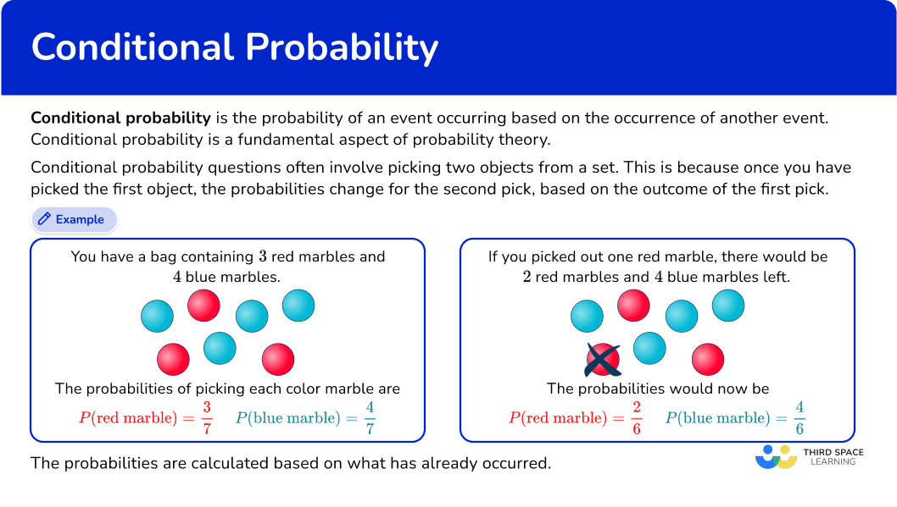

Slide 21
Conditional Probabilities
Conditional probabilities allow us to learn more details from data.
E.g. the risk of getting cancer at all is something like 45%.
  That risk doesn’t apply the same to all people in Canada.
  The risk for white-collar, clean eating, exercise enthusiasts is comparatively low.
  The risk for chronic smoking, tanning addicts is high.
  If we need to plan for future cancer clinic capacity, this can matter.
Framed differently, we can also imagine this as our expectation getting updated each time we ‘learn something’, or get information from a ‘new’ variable.
  This idea will come up again soon…

Slide 23
Probability at work – Comparing Distributions

Slide 24
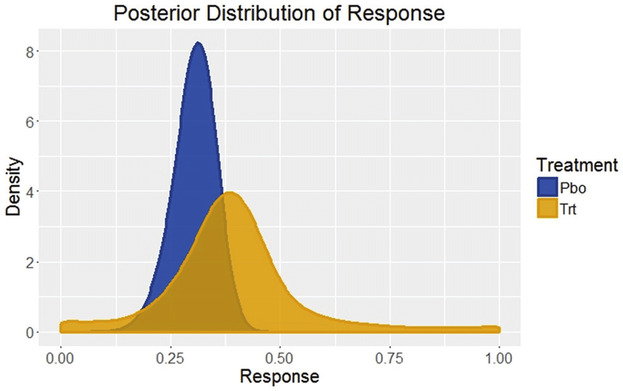
Distribution Comparison
A difference between distributions is an effect.
  Can’t just calculate one value like mean to compare.
  We need some concept of ‘different enough’ to compare all items in the set.
  The overall shape of the distribution matters, not just stats like mean.
Therefore, we don’t really have an answer like ‘regular’ equality/inequality.
We saw one way to compare, effect sizes.
Let’s look deeper at how we can compare…

Slide 25
Distribution Comparisons
We can think of comparing distributions in 3 ways.
How large is the effect?
  What is the difference between distributions A and B?
  This is what effect size measures.
Is the effect significant?
  Is the effect something that would not occur randomly?
  Hypothesis testing, next week.
Does this difference matter?
  This requires domain knowledge and context.
  A judgement call.

Slide 26
Odds and Effect Sizes
We’ve seen one way to compare distributions – effect sizes.
  The effect size measures, in context of the variance, how different two distributions are.
  I.e. is the difference between groups significant compared to differences within groups.
We can also think of this in terms of probability.
  Are these two samples likely from the same population – hypothesis tests.
  Does this data come from a normal population – normality test.
More generically – superiority.
  Two distributions that are totally different will not/barely overlap.
  Two distributions that are from the same population will overlap a lot.

Slide 27
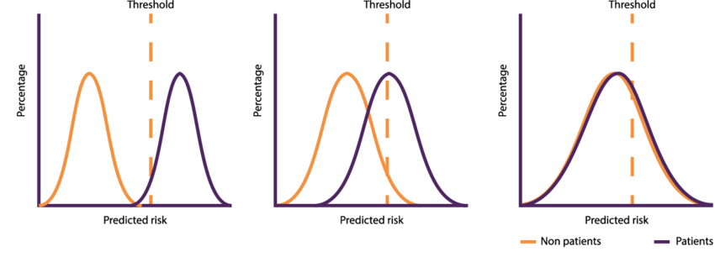
Thresholds on Overlap
The most simple way to compare dists is to a threshold.
  The threshold is a cutoff point that we can use to separate classes (distributions).
There are a couple of threshold calculations:
  Simple – average of the means.
  Complex – calculation with means and standard deviations.
Can be cutoff – over is a distribution, under is the other.
  The purity of the two groups is the quality of the threshold.
  A perfect cutoff means that we can use one value to separate the groups with no errors.

Slide 28
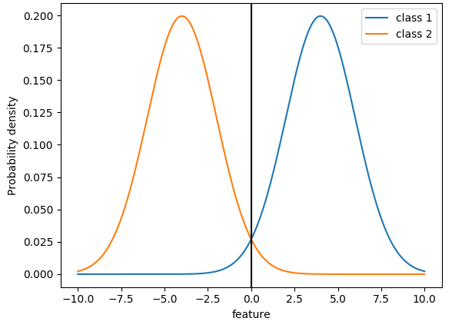
Overlap
If the two dists don’t overlap much at all, we can clearly classify into group A or B.
  The overlap area is where we might make mistakes.
  On either side of the overlap, we know exactly what class a value belongs to.
E.g. a value of .5 could be in either group.
  A value of 8 can only be blue.
More different distributions have less overlap.

Slide 29
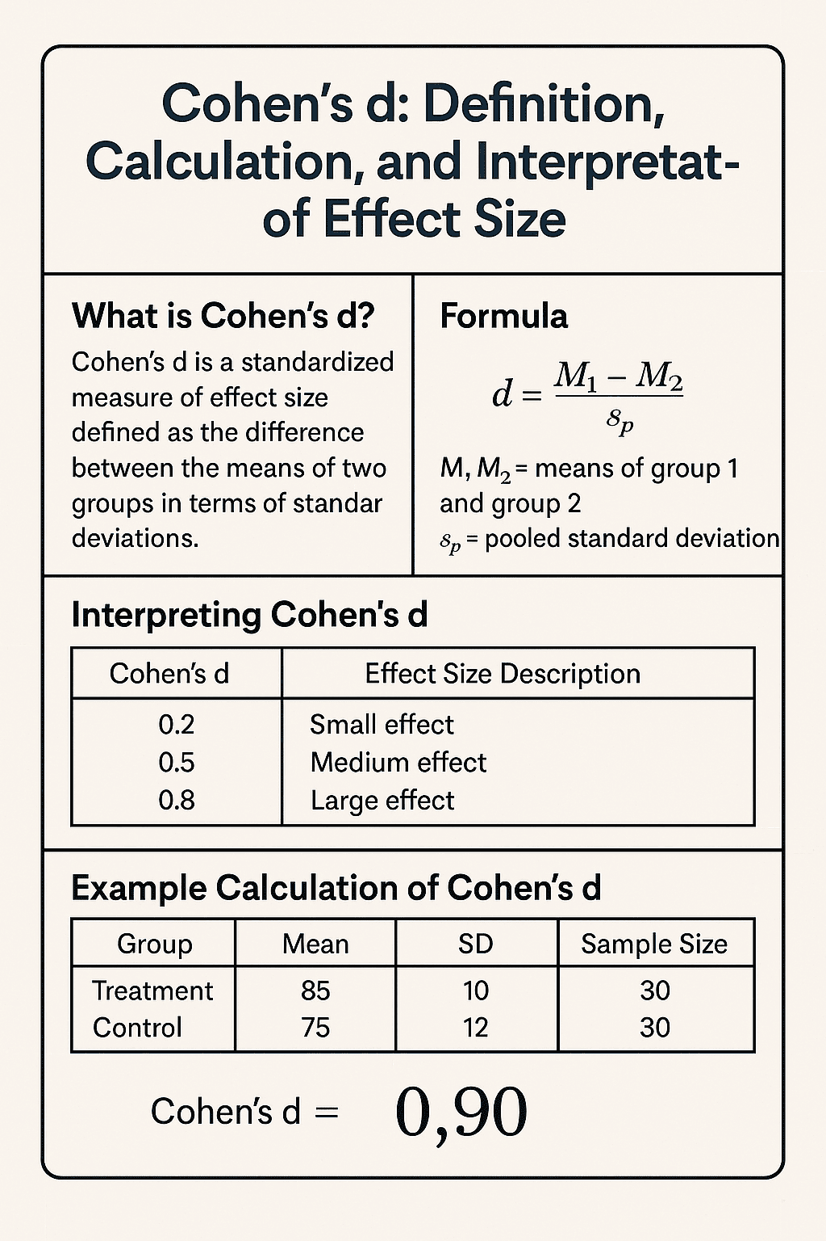
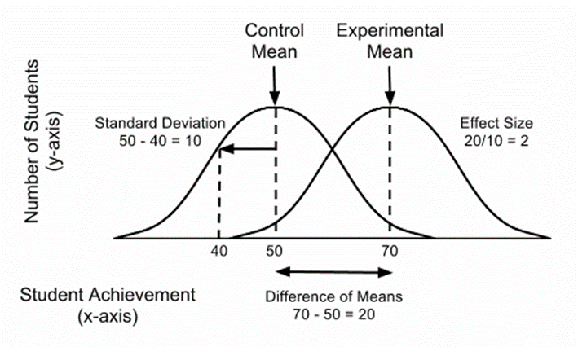
Effect Size Review
Effect size shows us differences.
  Compares the means, with consideration of the variance.
If data varies little, small differences matter more.
If data varies a lot, differences between groups matters less.
”Difference within groups vs differences between groups.”

Slide 30
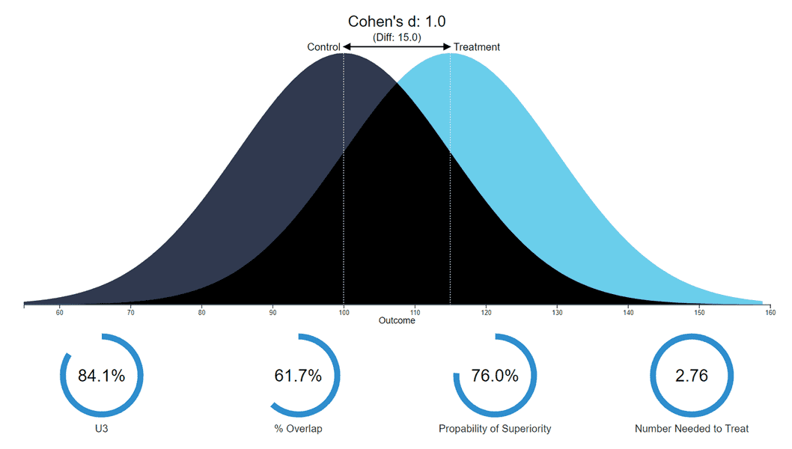
Probability of Superiority
The overlap and threshold ideas can be formed into the Probability of Superiority.
  If we pick a random value from the higher group what is the probability it is larger than a random value from the lower group.
  E.g. does a random treatment person live longer than a random placebo person?
  This is in line with the overlap is we plot the PDFs.
https://rpsychologist.com/cohend/
If there’s a big diff, samples from high groups should almost always be higher than lower one. If not a diff than we’d see lots of the opposite occurring.

Slide 31
Comparison Tools
All of these things allow us to do a comparison of distributions.
  Effect size, overlap, superiority. None give a definitive result.
  We’ll soon add another, hypothesis tests.
Each leaves us with some uncertainty.
  Each thing is evidence of difference/similarity.
This is a less simple question than it appears here, and often really matters.
  We have large-ish sample sizes, so comparisons look simple.
  Picture a drug trial, big decisions on small datasets.
  Outcomes of public vs catholic school – high variance by nature, many confounding factors.

Slide 32
Understanding Cohen’s D
Is d precisely estimated?
  Do we have enough of a sample? Is it likely representative?
What is the field norm?
  Depending on what exactly you’re dealing with, the expected d differs.
What are the stakes? What does the outcome variable mean?
  In real life, what is the impact of the difference?
The difference and the significance are independent.
  We can have a small difference that is statistically significant, or a large one that isn’t.
  We can have a small difference that matters, or a large one that doesn’t.
  More than one value* is needed to draw conclusions.

Slide 33
Odds
All of this probability talk leads us to one of the most important ML concepts – odds.
Odds are an alternate expression of probability.

Slide 34
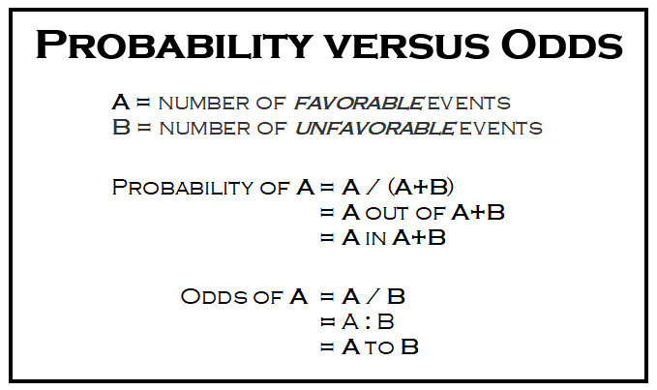
Odds
Odds are ratio to 1 to 0.
  Binary – ‘true’ can be either.
  We can translate at will.
Example - 80% chance of winning.
  P(win) = .8 = 80%
  .8 / .2 = 4. 4 to 1 odds of winning.
  .2 / .8 = .25. 1 to 4 odds of losing.
Translating probability to odds is needed in some places…

Slide 35
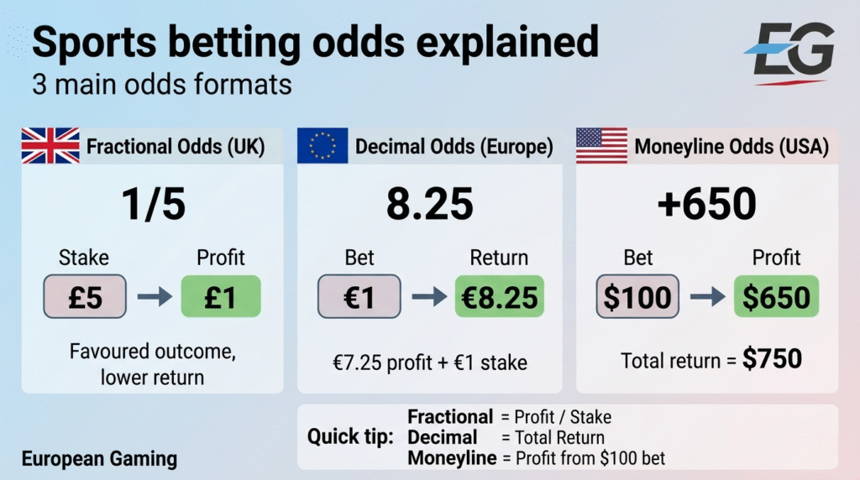
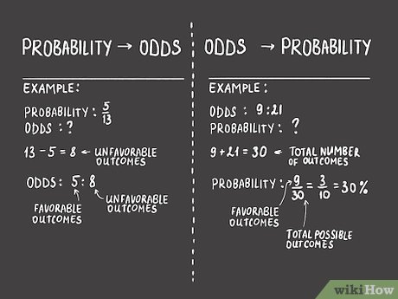
Gambling Odds
If you like gambling, odds are your old best friend.
In gambling we see both ratios and +/- (American) odds, as well as European odds.
All of these odds, and probability, can be translated to each other with a little algebra.
  Note: sports betting odds aren’t actually set based on probability of winning, they are largely set to balance amounts bet on each side.

Slide 36
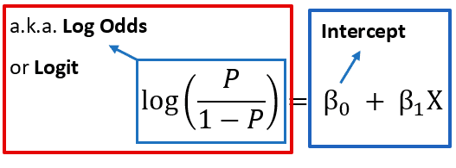
Log Odds
Probabilities have one problem (that will matter soon) – changes in each direction.
  Going from 100 to 10 is a 90% reduction.
  Going from 10 to 100 is a 900% increase.
Odds are useful in comparing probabilities in combination with logs.
By taking the log of the odds, the value becomes symmetrical.
This is called the logit – important later in ML.
Allows for comparisons of probabilities that is comparable.
*intercept bit of the formula can be ignored for now.

Slide 37
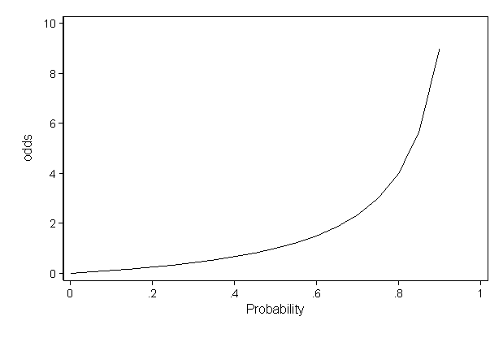
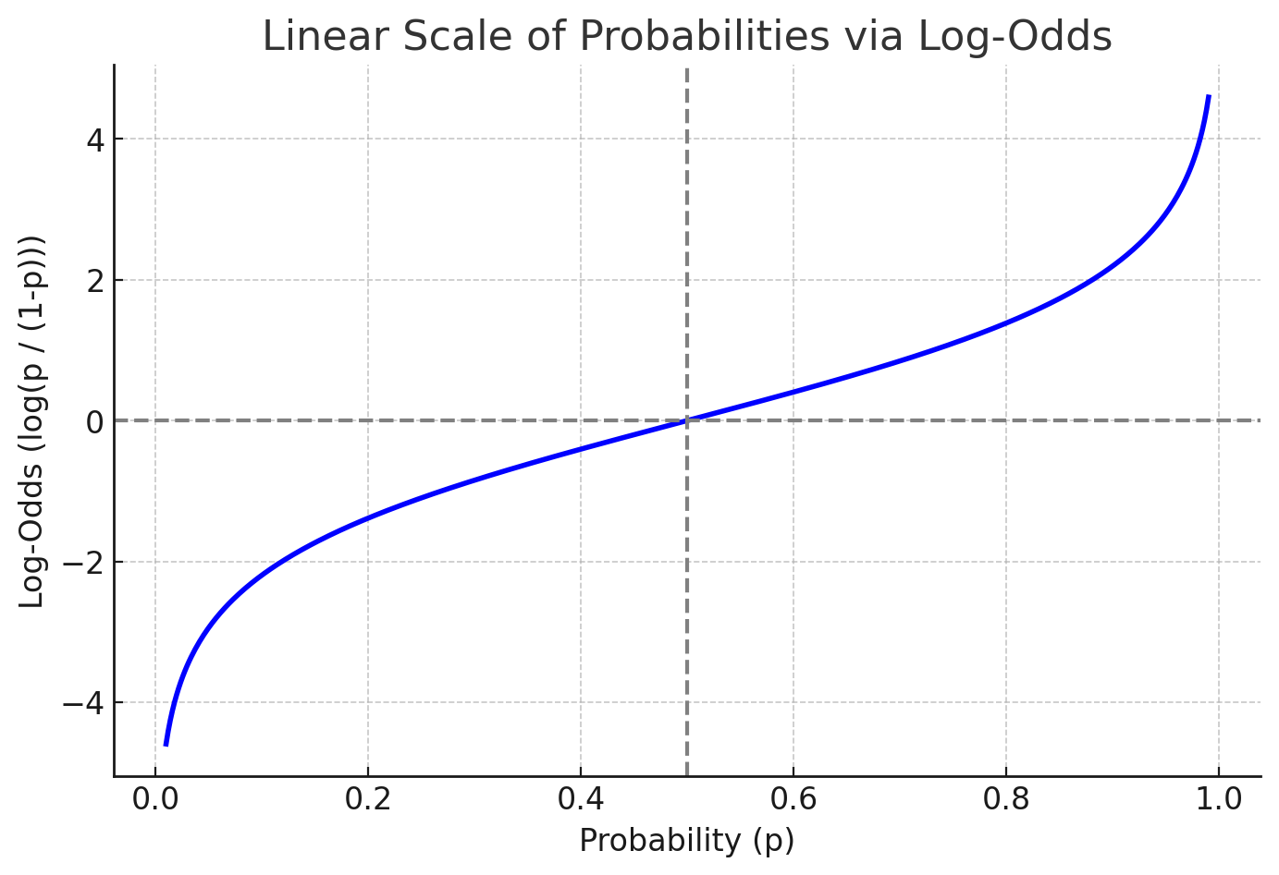
Preview - More log Odds
The log odds, or logit will become important later.
The symmetry of the math allows for logistic regression to work.

Slide 38
Bayes
Bayes theorem expands on the idea of conditional probability.
We can derive it pretty easily, by looking at examples.
It is the basis of Bayesian statistics, which we will touch on a little, but not do in great depth.

Slide 39
Probability and Estimation
The idea of probability underlies much of the analysis we want to do.
  When dealing with samples, we rarely know ’the’ answer, we have uncertainty.
Core idea – based on this expectation, does the reality match that.
  I.e. Hypothesis testing – what are the odds these two things are different?
  Generalization – if we expand from a sample to population, how confident are we?
Answering a question is (usually) not a yes/no thing:
  Are the life expectancies of treatment/placebo different after a drug trial?
  Some treated people will die quick, some placebo people will live a long time.
  What is the likelihood that drug people outlive placebo people?
There’s an alternative branch of stats, Bayesian, that does all basic stats via probability.

