Slide 1
Housekeeping
Wrap up hypothesis testing.
More on power specifically, from question last time.
You might be asked a theory thing on power, but nothing deep in exam.
Expand a bit on Monte Carlo simulation (the loop stuff).
Assignment 3 – basic inference.
Two parts – election simulation (can do now) and regression (after next week-ish, it’s simple).
The election simulation is a larger version of the workbook example.
The basic concept is the same – we have probability and want expected outcome.
The details here are a bit more complex and open ended.
There isn’t one specific solution, there’s a range of reasonable ways to construct it.

Slide 2
Upcoming stuff
Next big topic – regression (and stuff leading to it).
Really important, key foundation for ML stuff next semester.
We’ll do this, do an assignment, and the last exam.
Other stat-y stuff afterwards.
We have a few other stats-specific things (survival, Bayes, etc…) to cover.
These aren’t really as critical for ML knowledge.
We’ll do them in the last week or two, while working on the ML assignment stuff.

Slide 3
Power and Monte Carlo

Slide 4
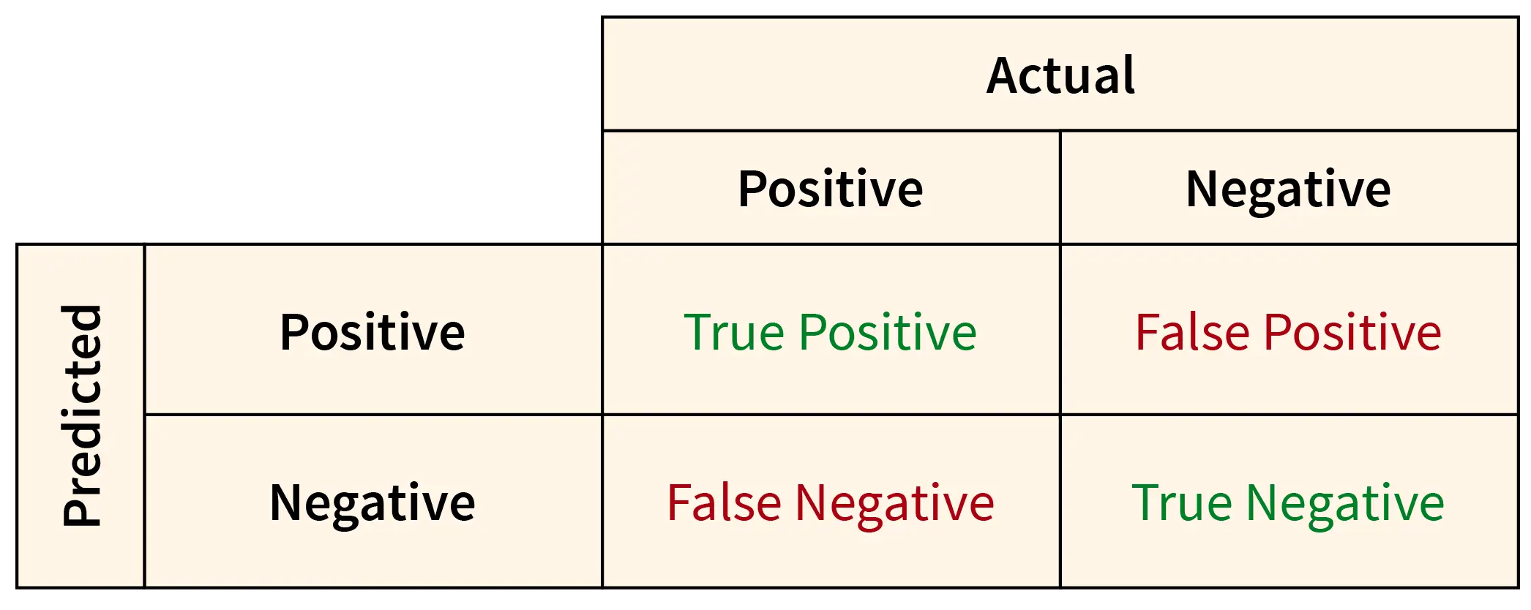

Power and Alpha
Recall the errors when predicting.
Type 1 – false positive (we see an effect where there’s none). P value in a test.
Type 2 – false negative (we see no effect where there is one).
Power – (1 – Type 2 error rate).
80% normally the default value used.
In calculations, power fits with other ‘indicators’.
Power.
Effect size.
Sample size.
P-value.

Slide 5
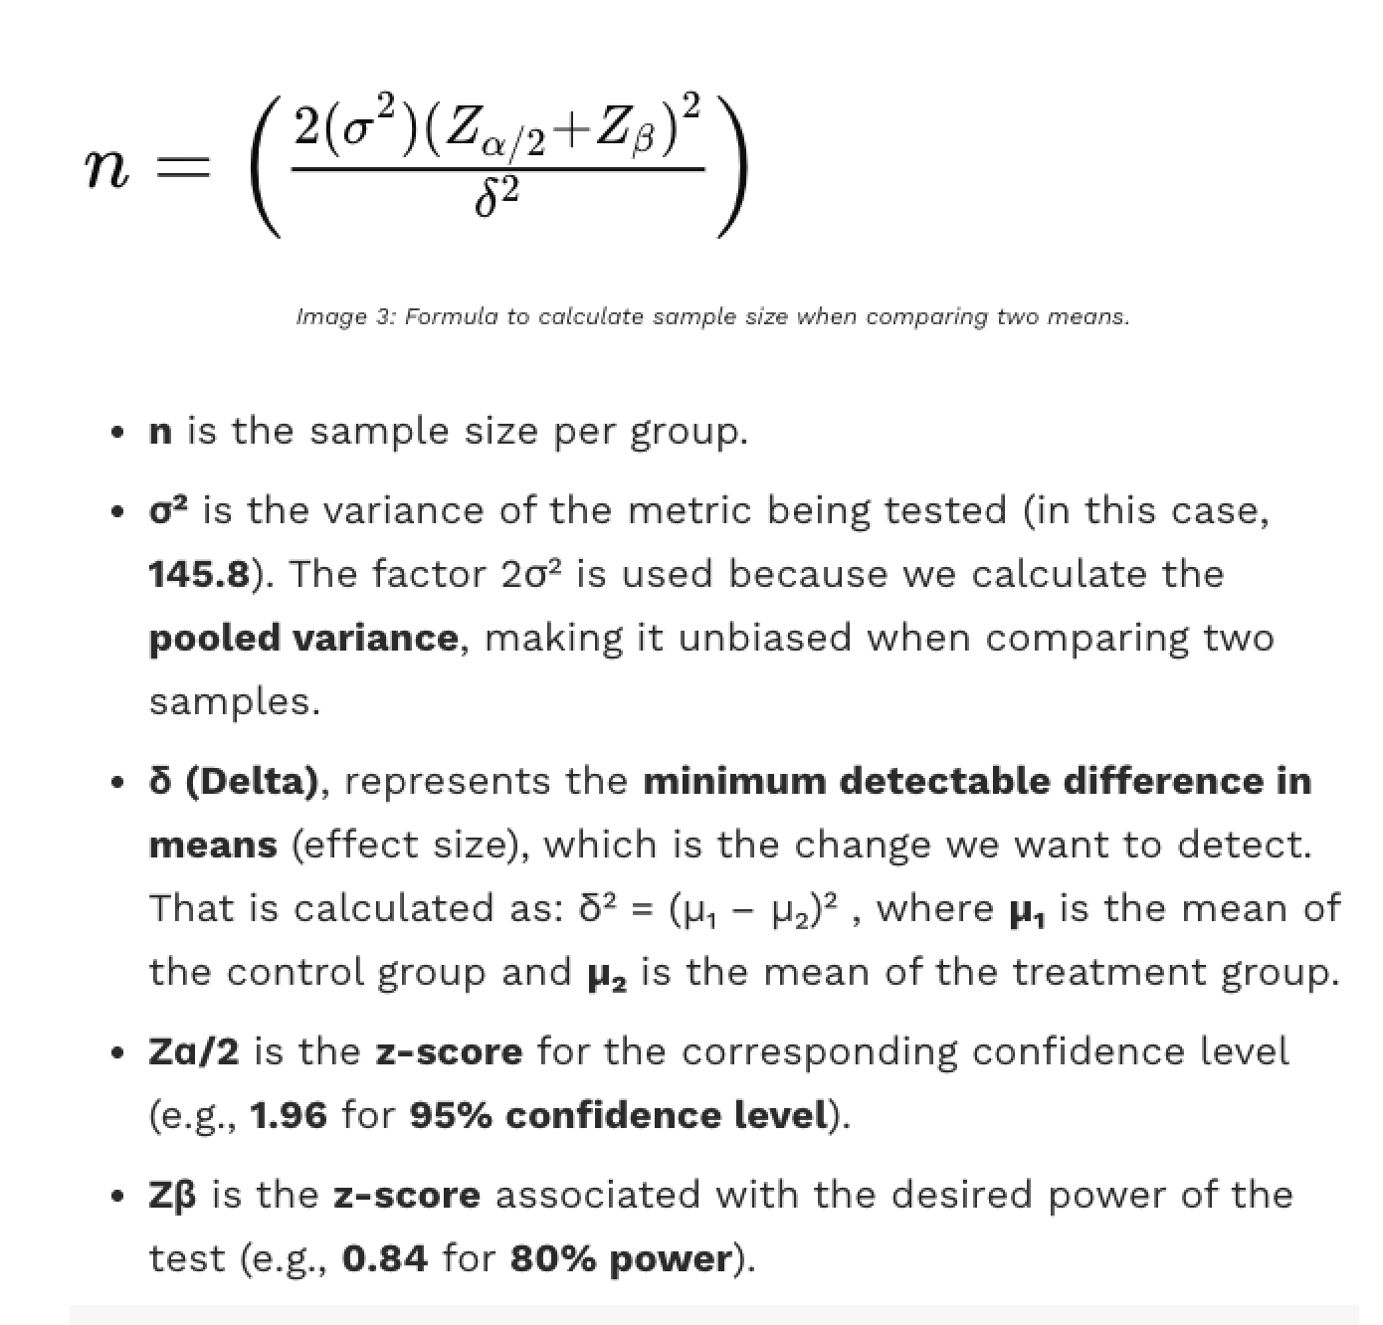
Calculating Power
Our calculation for power finds one of the four.
All impact if two samples are the same or different.
As long as the assumptions are met, this calculation will be accurate.
‘Normal’ isn’t on/off, there’s degrees.
The more varaiance differs, the less accurate.
The z-scores are post-standardization.

Slide 6

An Example
Using a random sample of balls, we perform the following hypothesis test:
Sample size = 25, sample mean = 172
Population mean = 170
Null hypothesis: sample u = population u = 170 = (squiggly) <= 172
Alternative hypothesis: u > 172*
If the engineer decides to reject the null hypothesis if the sample mean is 172 or greater, that is, if , what is the probability that the engineer commits a Type I error?
One sided test, comparing against a fixed number.
We simulate a distribution (or calculate it), observe the mean, count # over 172 randomly.
If it rarely happens, it probably isn’t random, and the effect is real (diff pops).

Slide 7
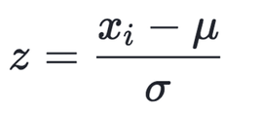
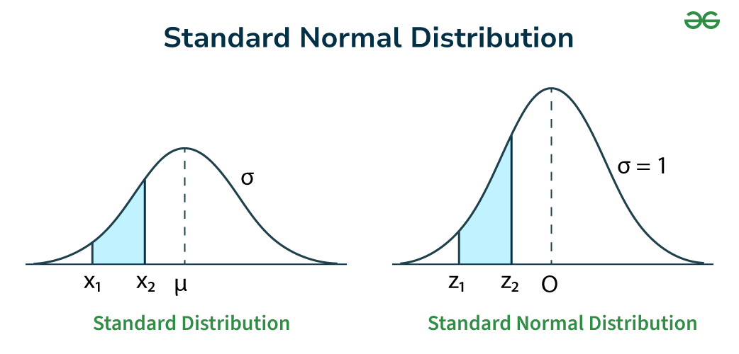

Side Note – Data is Standardized
In stats-y examples for this stuff the data will often be standardized.
Mean of 0, std of 1, symmetrical.
“10 less than the mean” becomes “M std. less than mean.
We can use z-scores instead of values.
Dealing with distributions of sample means.
The data will be normal (via clt).
The concepts don’t change at all.
We’ll cover this in depth a bit later.
Usually rescale variables so they are all similar.

Slide 8
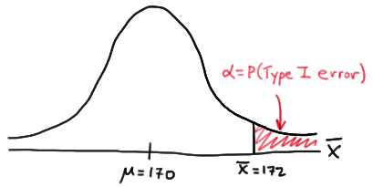
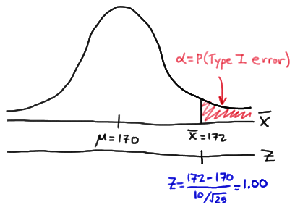
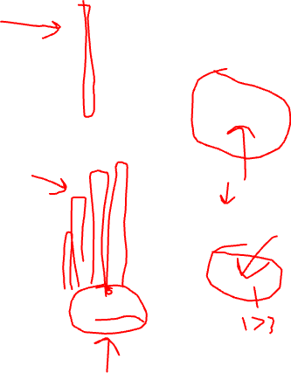
Run some Sims
Each simulation round we make a new sample, calculate the mean, and plot it here.
If the new sample mean is < 172(ts), it matches pop.
If the sample-pop mean is really 170, we expect values here.
If the new sample mean is > 172, it’s from diff.
An error – we see effect where there’s “none”. Type 1 error.
Recall, null hyp means means should be the same.
Being different indicates an effect.
This could be done as a difference of 2 as test stat.
Does it make sense why…?
Can equate to a 2 value test (u1=170, u2=172, same pop?)

Slide 9
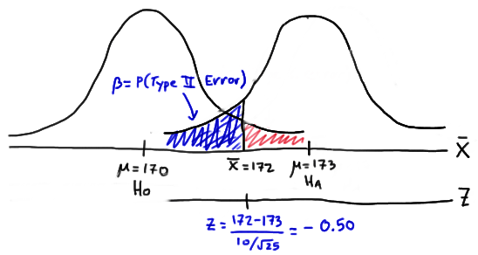
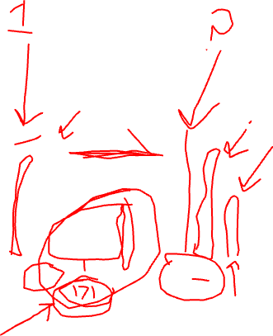
Go the Other Way
Type 2 errors happen when we don’t see effect in sample and there is in population.
In this example, that means the population means are actually different. (e.g. 173).
I.e. the sample’s true pop mean is 173 (???)
Our null hypothesis is that mean = 170.
The true (unknown) mean is actually higher.
The “too high” prediction for population is “too low” for the unknown “true” mean.

Slide 10
Difference in Error Types
The last two slides show the two types of errors (kinda) clearly.
Type 1 (p value).
The populations are assumed to be the same (one bell), so “too different” indicates error.
Type 2 (power testing).
The populations are assumed to be different (two bells), so “too similar” indicates error.
Don’t have a true, known definition of the population mean, so we don’t know which.

Slide 11
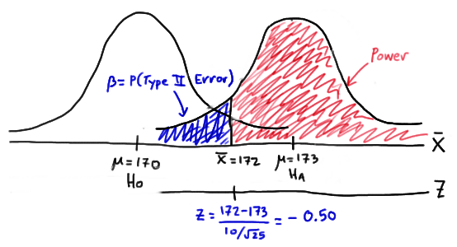
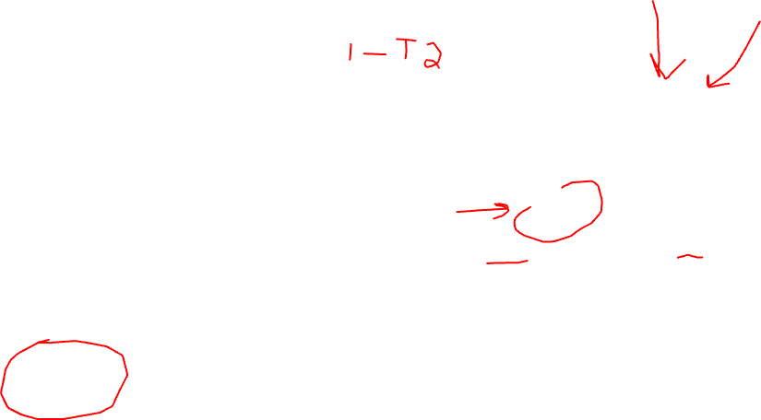
Power
The power is all samples that don’t do this.
The pop means are different, and we see it.
They may be type 1 errors – good!
They’d be picked up in the hyp. Test.
The leftmost ones are the issue here.
But, we don’t know the ‘true’ sample-pop…
We need one more addition:
Sample size.
Effect size.

Slide 12
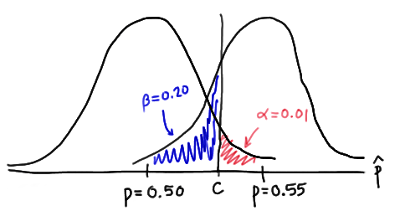

Collecting Errors
Sample size or effect size is needed along with cutoffs.
Effect size will tell us the separation between dists.
Sample size will set shapes of dists.
We can calculate the one we are missing.
These errors are from different ‘realities’.
If the pop means are actually equal, alpha is error.
If the pop means are actually different, beta is error.
We don’t know either, we are estimating w/ error.

Slide 13
Using Power
The power tells us, “if there’s an effect, how likely are we to detect it?”.
A.k.a. Sensitivity – the more sensitive, the more likely to notice some effect.
Often/usually done pre-survey/collection.
Determine the sample size needed to meet reqs – e.g. we need X level of confidence.
The bigger the sample size, the more confident in the answer, so we can calculate it.
You can calculate it post-hoc (after running a test).
Requires assumption that sample effect = population effect.
Kind of questioned in usefulness by real statisticians, it is an actual debate.
To indicate a ‘real’ effect, the best bet is to show all evidence.
We can demonstrate an effect of this size, it appears to not be due to random variation in data.

Slide 14
Power is used less after the fact. Why?
Look at the design of a typical hypothesis tested example – a drug trial.
There are two groups, control and treatment.
Generally the treatment group show some effect – lower tests, longer life, etc…
The p-value in this shows a very important value – false positives.
We see some difference between C and T (e.g. they are healthier) and we want to confirm this isn’t just luck of the draw with our group selection.
The power shows the opposite – our drug is useless, but we see an effect.
Is this realistic and important? From stats perspective yes, from reality perspective... Maybe.
Having one randomly selected group be noticeably healthier than another is unlikely.
Mitigated in reality by things like participant selection, and repeated trials (which do happen).

Slide 15

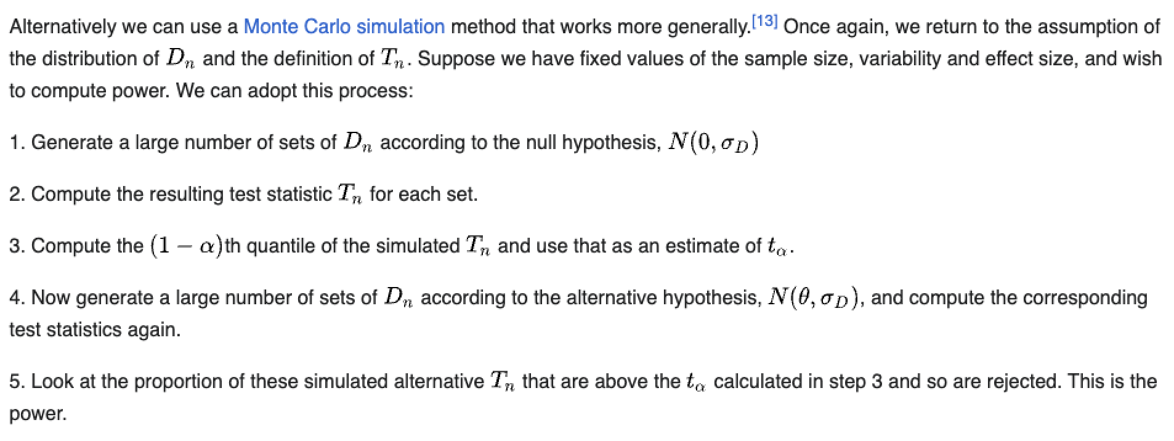
From Wikipedia and the book – Bet on it!
Wikipedia gives a general explanation of the simulation things we’ve done, for power!

Slide 16

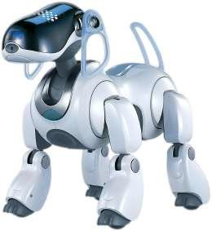

Let’s Hit Monte Carlo!
All of our simulation loops trials are an example of monte carlo simulation.
Monte carlo simulations are based on repeated random sampling.
There’s not a strict definition, basically things that resemble what we’re doing.
The concept of monte carlo simulation are used in several places.
Back when I was a kid, we used it for robot navigation in school.
In finance, used with portfolio planning.
Different assets can have their performance modeled with some distribution.
Generate many samples of asset performance.
Tabulate the results, and see the expected outcome.
If you’ve heard of the 4% rule for long-term retirement planning, this can test that.
Quality of prediction is mostly based on how well the model fits reality (and variance).

Slide 17
The Coolness of Monte Carlo
The concept of monte carlo simulation is very useful, if a bit confusing at first.
We require relatively few assumptions.
As long as we have a model (of expectations), we can do it.
We may have to do some work to frame the problem in the correct terms.
If sample sizes are small, MC may be much better (as long as we can fit a model).
For us – focus on what (specifically and literally) is being tested.
Any probability thing can be simulated if we can define a good model.
Hypothesis tests are specific implementations that don’t require code/data.
Can calculate a direct estimate, as long as requisites are met.
We can tackle almost any problem, even if we don’t know the theory of what it is.

Slide 18
How to simulate
In the simulation loops we saw several approaches, without much justification.
Create analytical model, generate new sample sets.
Use permutation – take the original data, reshuffle the sets.
Discreet data (coin flips) calling a probability model.
All run a ‘trial’ and tabulates the results, but the details of the trial seem open.
How do we know which one works in which situation?
If it fits a pattern we’ve seen (ttest=permutation, generalization=model), we can use that.
Beyond that, it is judgment – which method best approximates (models) reality.

Slide 19
Example – Permutation vs Analytical models
Suppose you’re doing a ttest – we see a difference in means between G1 and G2.
Is it real, or is it likely due to randomness?
More wordily – w/ a difference this large, how likely is it to get that if each are from same pop.
Permutation (what we’ve done here and in book).
Randomly reshuffle G1 and G2 together(pseudo-pop), split into two new groups, measure difference.
Analytical model simulation.
Create analytical model representing population, create new groups, measure difference.
Which one is the better approach? Kind of depends on N (sample size).
As N increases, the two approaches will converge…
Permutation introduces fewer assumptions, so that’s what the book did. We could choose others…

Slide 20
What To do in Practice?
When we encounter situations like this, we need to select the correct tool.
Ensure that what exactly you’re checking/testing is clear.
This may involve some arithmetic, rearranging how the problem is written, etc…
Framing the question/problem to meet our patterns can be weird sometimes.
If we have the values, assumptions are met, we can calculate with formula.
In other scenarios, or if we think the calc isn’t sufficient, we can simulate.
Assumptions not met, forgot test needed, need more ‘evidence’, complex scenario, etc…
As long are our model is accurate, this works.
Accurately modeling real life into a probability is the major roadblock here, not method.

Slide 21
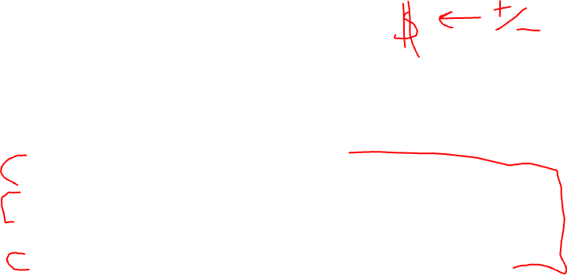
Try (this isn’t Trivial)
Simulate retirement drawdown (take money out) for early retirement.
$1.4 million invested at the start, we want to live for 50 years post retirement.
Monte Carlo modelling (I assumed monthly calculations for all):
Determine a model for “expected stock returns” (yfinance).
You may need to manipulate the data from prices to returns.
Determine a model for “money withdrawn” – your living expenses. Assume $5k/m to start.
This may be flat, or increasing over time. Should be based on some input from user.
Determine a model for inflation (reduction in money value).
(Optional) They’re American, so in each year there is a 1% chance of a medical issue costing $100k.
Month you take cash, investment move, inflation reduces the spending power.
All of this requires research and approximation, there’s not one correct answer.
Start with a simple model (e.g. inflation is 2%), then get more advanced (we have a dist. Of values).

