Slide 1
Power and Alpha
Recall the errors when predicting.
Type 1 – false positive (we see an effect where there’s none). P value in a test.
Type 2 – false negative (we see no effect where there is one).
Power – (1 – Type 2 error rate).
80% normally the default value used.
In calculations, power fits with other ‘indicators’.
Power.
Effect size.
Sample size.
P-value.

Slide 2
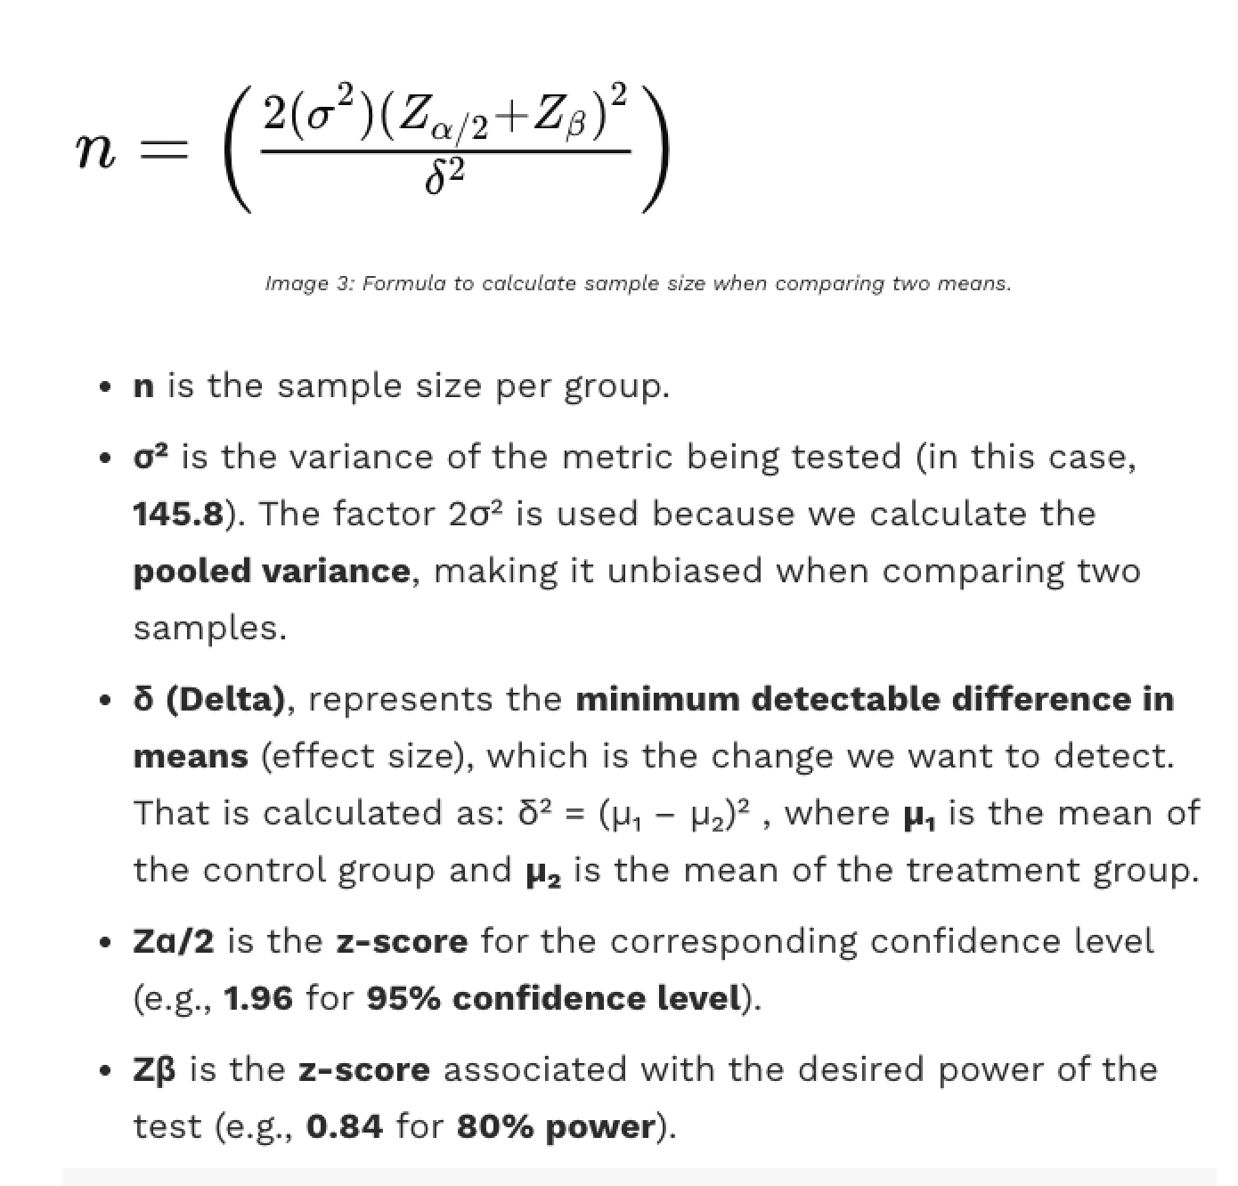
Calculating Power
Our calculation finds one of the four.

Slide 3
An Example
Using a random sample of balls, we perform the following hypothesis test:
Sample size = 25, sample mean = 172
Population mean = 170
Null hypothesis: sample u = population u = 170 = (squiggly) <= 172
Alternative hypothesis: u > 172*
If the engineer decides to reject the null hypothesis if the sample mean is 172 or greater, that is, if , what is the probability that the engineer commits a Type I error?
One sided test, comparing against a fixed number.
We simulate a distribution (or calculate it), observe the mean, count # over 172 randomly.
If it rarely happens, it probably isn’t random, and the effect is real (diff pops).

Slide 4
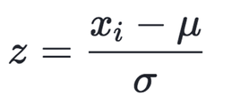
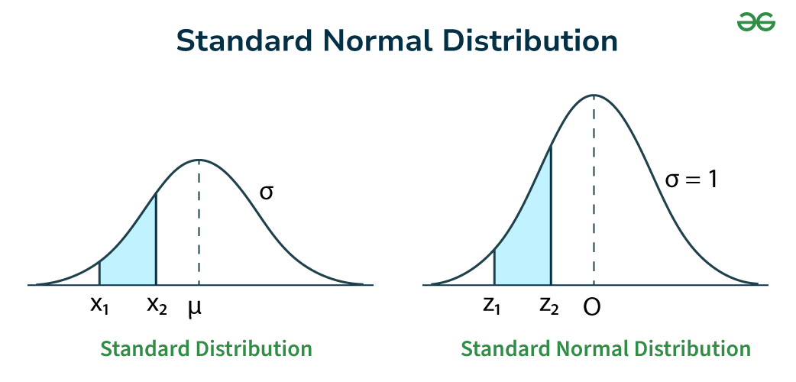
Side Note – Data is Standardized
In stats-y examples for this stuff the data will often be standardized.
Mean of 0, std of 1, symmetrical.
We can use z-scores instead of values.
Dealing with distributions of sample means.
The data will be normal (via clt).
The concepts don’t change at all.
We’ll cover this in depth a bit later.

Slide 5
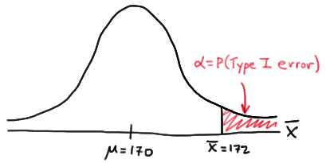
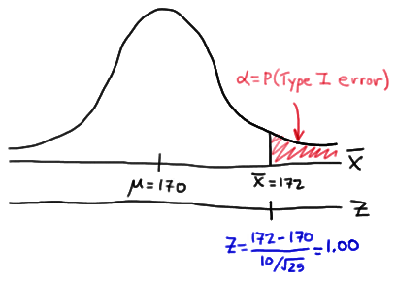
Run some Sims
Each simulation round we make a new sample, calculate the mean, and plot it here.
If the new sample mean is < 172(ts), it matches pop.
If the sample-pop mean is really 170, we expect values here.
If the new sample mean is > 172, it’s from diff.
An error – we see effect where there’s “none”. Type 1 error.
Recall, null hyp means means should be the same.
Being different indicates an effect.
This could be done as a difference of 2 as test stat.
Does it make sense why…?

Slide 6
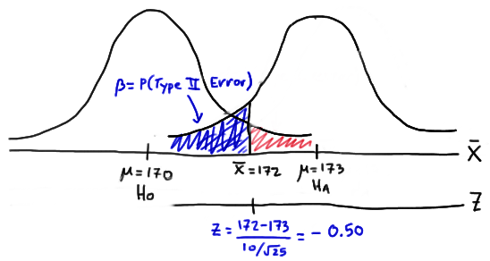
Go the Other Way
Type 2 errors happen when we don’t see effect in sample and there is in population.
In this example, that means the population means are actually different. (e.g. 173).
I.e. the sample’s true pop mean is 173 (???)
Our null hypothesis is that mean = 170.
The true (unknown) mean is actually higher.
The “too high” prediction for population is “too low” for the unknown “true” mean.
Higher values would trigger T1 errors.

Slide 7
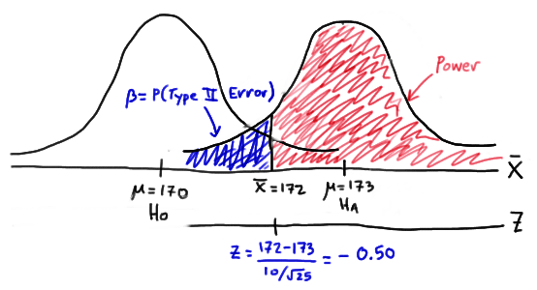
Power
The power is all samples that don’t do this.
They may be type 1 errors – good!
They’d be picked up in the hyp. Test.
The leftmost ones are the issue here.
But, we don’t know the ‘true’ sample-pop…
We need one more addition:
Sample size.
Effect size.

Slide 8
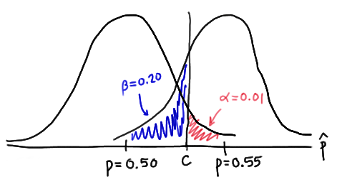
Collecting Errors
Sample size or effect size is needed along with cutoffs.
Effect size will tell us the separation between dists.
Sample size will set shapes of dists.
We can calculate the one we are missing.
These errors are from different ‘realities’.

Slide 9

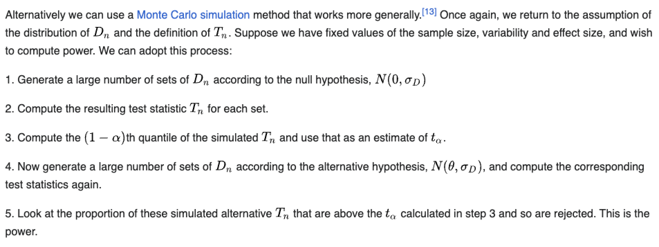
From Wikipedia and the book – Bet on it!
Wikipedia gives a general explanation of the simulation things we’ve done, for power!

Slide 10

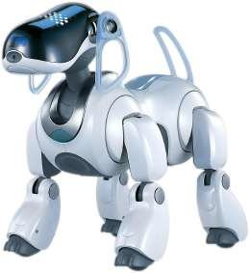
Let’s Hit Monte Carlo!
All of our simulation loops trials are an example of monte carlo simulation.
Monte carlo simulations are based on repeated random sampling.
There’s not a strict definition, basically things that resemble what we’re doing.
The concept of monte carlo simulation are used in several places.
Back when I was a kid, we used it for robot navigation in school.
In finance, used with portfolio planning.
Different assets can have their performance modeled with some distribution.
Generate many samples of asset performance.
Tabulate the results, and see the expected outcome.
If you’ve heard of the 4% rule for long-term retirement planning, this can test that.
Quality of prediction is mostly based on how well the model fits reality (and variance).

Slide 11
Using Power
The power tells us, “if there’s an effect, how likely are we to detect it?”.
A.k.a. Sensitivity – the more sensitive, the more likely to notice some effect.
Often/usually done pre-survey/collection.
Determine the sample size needed to meet reqs – e.g. we need X level of confidence.
Given available sample, what can we achieve?
You can calculate it post-hoc (after running a test).
Requires assumption that sample effect = population effect.
Kind of questioned in usefulness by real statisticians.

Slide 12
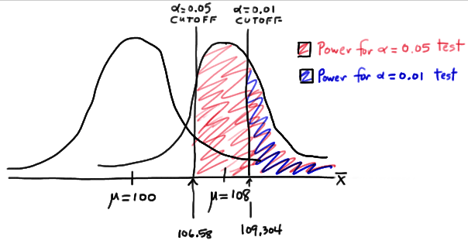
Power Calculations
When calculating power both can be set.
Alpha moves the cutoff for a type 1 error.
The dists are the same, and we cut on right.
Beta move the cutoff for type 2.
The dists are different, we cut on left.

Slide 13
housekeeping
Today:
Hypothesis testing #2 – power and alternate hyp tests. (017)
Open ended exercise on hyp test. (018)
Linear least squares – foundation of regression (Maybe – if there happens to be time) – Actual ML!!!
Note:
Due to (likely) impending layoffs I looked at LinkedIn – a bunch of last year’s students have data-ish job titles!
Quiz:
Due to holidays pushing back initial quiz, we’ll do the next on the 11th. Unless there’s objection.
Analytical distributions, hypothesis testing, correlation, errors.
(Honestly, I don’t care much when these things happen, and would prefer to just place them as we go. You’re entitled to an advance schedule though, so if the ambiguity is an issue, let me know and I can set fixed dates.)

Slide 14
Housekeeping
Get hype tested! With more power. (Finish chapter 9).
A brief look at classes.
You'll do this later in programming, we just want to understand the examples in book.
There’s a guide to test topics online on Brightspace.
Nov 3.
I’ll post the next assignment this afternoon or in the morning.
I just want to update some parts of the instructions to be more specific.

Slide 15
Hypothesis Testing #2

Slide 16
Hypothesis Test Errors
When doing a hypothesis test, we are testing for one specific error:
False positives, aka…
There is no real difference in the samples, but we think there is.
This is ”capped” by the p-value – you can’t have over p-value likelihood of a FP.
For many cases this is sensible – we are looking for evidence that there is a difference.
What about other errors?
What about a false negative – there is no difference, but we think there is.
I.e. we think a drug is helping, but it is actually useless.
Power tells us – if there is a real effect, how likely are we to detect it?

Slide 17
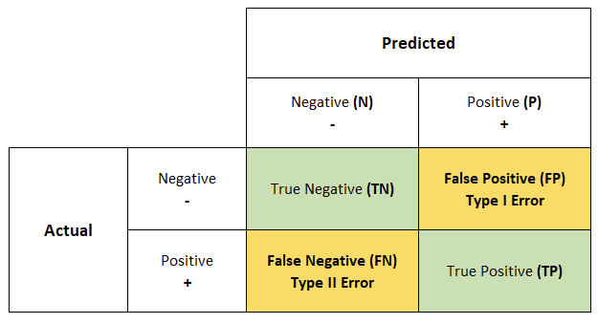
Error Types
We can split (classification) errors into two types:
Type 1 – False Positives.
# of actual negatives we predict as positive.
Type 2 – False Negatives.
# of actual positives we predict as negative.
We can examine this via a confusion matrix.
This will be our friend in classifications later.
We need to know/understand this, but can look at it as a reference as we do stuff.

Slide 18
Power
Power descriptions:
Power is the probability of rejecting the null hypothesis when, in fact, it is false.
Power is the probability of making a correct decision (to reject the null hypothesis) when the null hypothesis is false.
Power is the probability that a test of significance will pick up on an effect that is present.
Power is the probability that a test of significance will detect a deviation from the null hypothesis, should such a deviation exist.
Power is the probability of avoiding a Type II error.
In a hypothesis test, we can calculate something to measure the false negative errors – power.
Power is the probability of wrongly classifying an actually true result.
Hypothesis tests give us the probability of wrongly classifying an actually false result.
Power can be calculated by (1 – False Negative Rate).

Slide 19
Using Power
Power is a percentage, on a 0 to 1 scale.
Powers over .8 (80%) are generally considered “good enough”.
Similar to how p-values of .05 are a default cutoff for type 1 errors.
Power is dependent on:
Alpha (type 1 errors).
Effect size.
Sample size.
The alpha and power together tell us how reliable our hypothesis test is overall.
The power function can also back calculate other inputs – such as sample size required.

Slide 20
Weird Hypothesis Tests
The idea of a hypothesis test here is transferable to other scenarios.
Non-normal data – Mann Whitney.
Basically a t-test for non-parametric data.
Categorical data - Chi2.
Basically a t-test for categorical data.
Do counts of different categories meet our expected distributions?
Multiple sets – ANOVA.
Basically a t-test to detect if any of a group are different.
The basic idea is the same – is there a statistically significant difference between 2+ sets.
The mechanics of doing that comparison differs with the data, the concepts are the same.

Slide 21
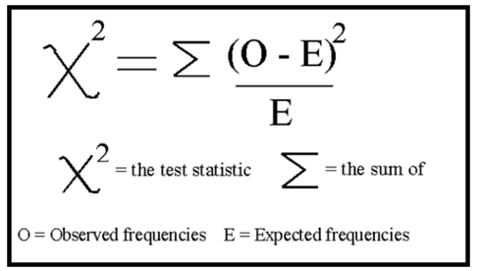
Chi Squared
Chi-squared tests are based on deviation from expectation for categorical things.
Example – is a die loaded?
We expect a fair die to have an even count for each number. That’s our null hypothesis.
We run the test – roll the die a bunch, like 60 times to make the math easy.
The expectation is 10 rolls per number.
The observation is the actual counts.
The chi2 calculation aggregates these roughly similar to residuals into MSE.
The division normalizes the calculation, in case counts are different.
If we get counts of 8,9,19,5,8,11, how likely is that with a fair die?

Slide 22
Chi2
The chi-squared goodness of fit test is based on the chi-squared distribution.
We don’t need too many details beyond the basics.
This is a big topic in production stuff like six sigma.
I frame it as “amount of deviation”.
Most results “should” have counts that are quite near the expectation.
The chi2 calculation gets larger the more deviation from expectation there is.
The simulation rounds count up the number of times that happened.
Null hypothesis is that things are happening as expected.
Test statistic is the observed deviation.
As long as we can frame things in terms of expectation and observed, we can likely use.

Slide 23
Multiple Groups - ANOVA
ANOVA, or analysis of variance, can compare means of multiple groups.
Tests if any of the groups appears different.
Null hypothesis – they all have the same mean.
Alternative hypothesis – at least one has a different mean.
*we don’t get more detail, like an indication of which.
Assumptions:
Data is close to normal.
Groups have similar variances.

Slide 24
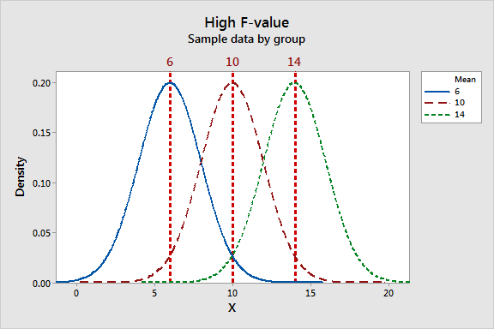
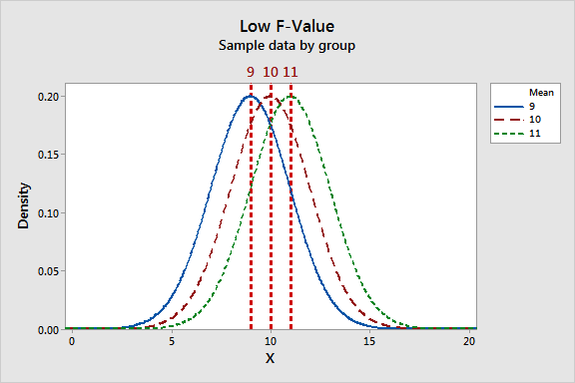
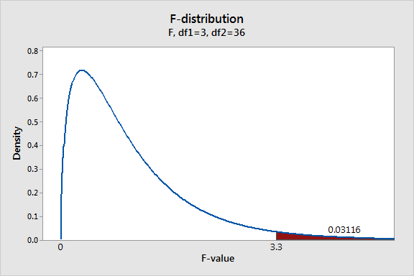
ANOVA Says F This!
The ANOVA is based on a value called the F-statistic:
(variation between groups) / (variation within groups).
Larger variance between groups will segregate them.
Larger within groups will increase blending areas.
We are testing if the difference we see is real/random.
F calculation compares in this context.
P value is probability of seeing this size effect randomly.

Slide 25
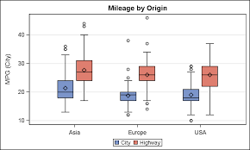
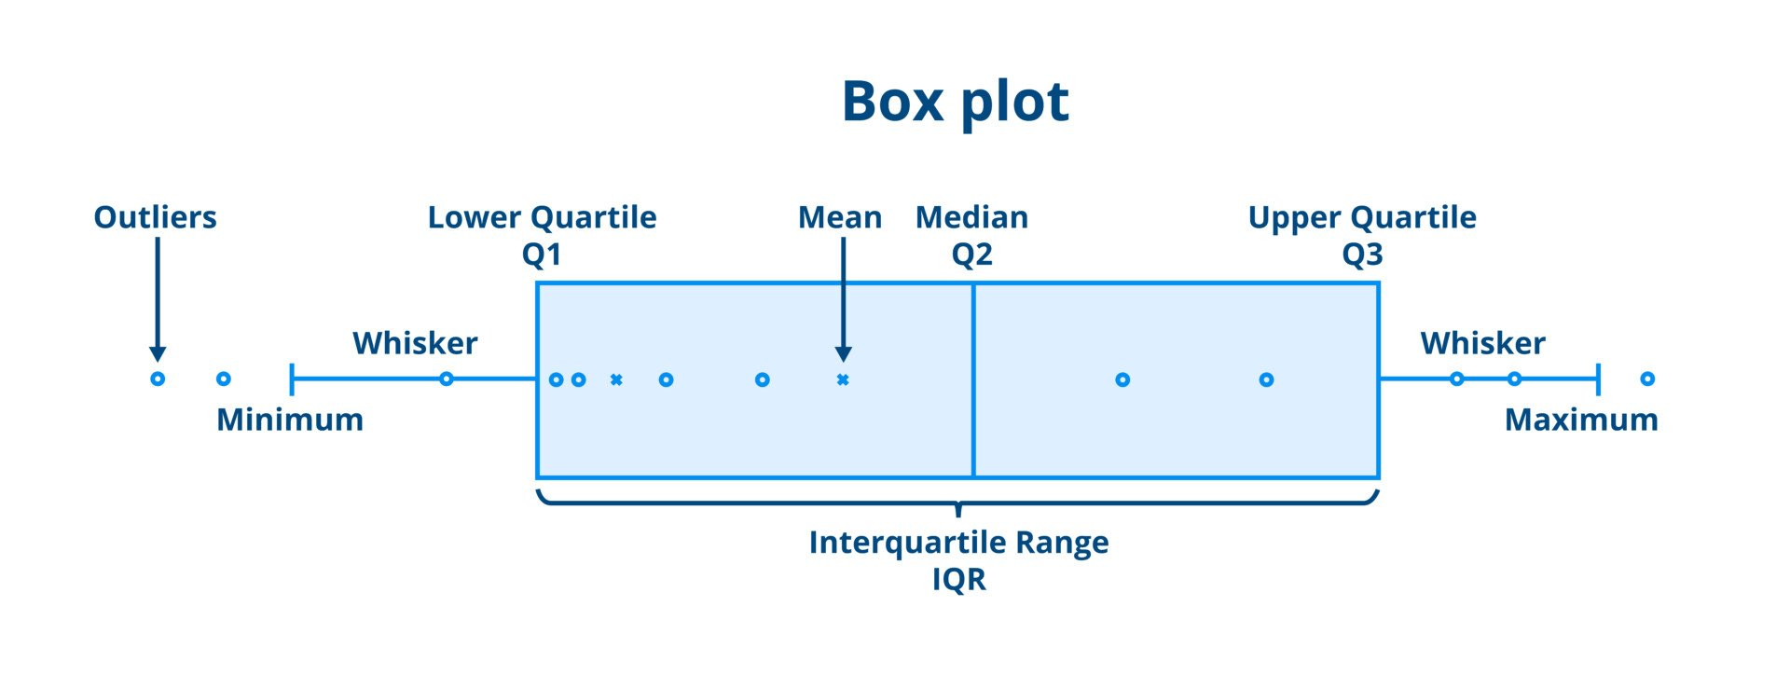
Boxplots
ANOVA-type scenarios can be visualized with a boxplot.
The default boxplots are similar to the top picture.
Good for comparison.
Box is middle 50% of data.
Box and whisker plots have more detail.

Slide 26
The Duality of Hypothesis Testing
The concept behind the hypothesis test is always the same:
What is the likelihood what we observed here is ‘real’ vs due to chance?
We can look at hypothesis testing from two perspectives.
Classical stats – there are many tests with formulas that we can apply in certain scenarios.
Book and us – as long as we have model, we can run a simulation for that.
These things can overlap (t-tests, chi2, etc), but we don’t need the test to run it.
As long as we can frame what we want to test, we can likely do one.
We should be aware of common tests (t-tests,anova,chi2) and comfortable with others.
The examples in the workbook are mostly using library stats tests, not simulations.
This is a code complexity thing, you should be able to do the things in the book eventually.

Slide 27
Classes and Objects
Pretty much everything you use in Python is an object.
Strings, dataframes, integers, etc…
Each variable declaration is (usually) a creation of an object.
Objects can be made to do whatever we need, each object has:
Some things it knows – the data stored in the object.
Some things it can do – the methods (functions) that can take action.
Examples:
Dataframe: ”things known” – data, “things done” – describe(), info(), etc…
Integer: “Thing known” – data, “things done” – all the operators, etc…

Slide 28
Custom Objects (classes)
We can create classes that let us use custom objects.
We can add any other objects to it to store data inside.
We can create methods (functions) to add functionality.
For example – a college registration record.
Data – student, class, date, grade, status, etc…
Methods – cancelRegistration(), print(), changeGrade(), changeStatus()…
Once created we can use them just like anything else.
Create by calling the constructor, usually in a variable declaration.
Interact by using functions on those objects – newObject.theNewFunction(parameter_1).

Slide 29
Inheritance
We have another feature, the one thing that matters in the modern economy, inheritance.
Inheritance is a hierarchy with an “is-a” relationship.
We can define types that share data/methods.
We can change the different parts as needed.
We can still access the common stuff directly.
Example – a large company with employees.
Parent class – “Worker”. Common stuff - wage, address, changePay, etc…
Children – Full time employee, part time, contractor, temporary. Pay/benefit things change.
We can leave common stuff in Worker and make specific versions for children.

Slide 30
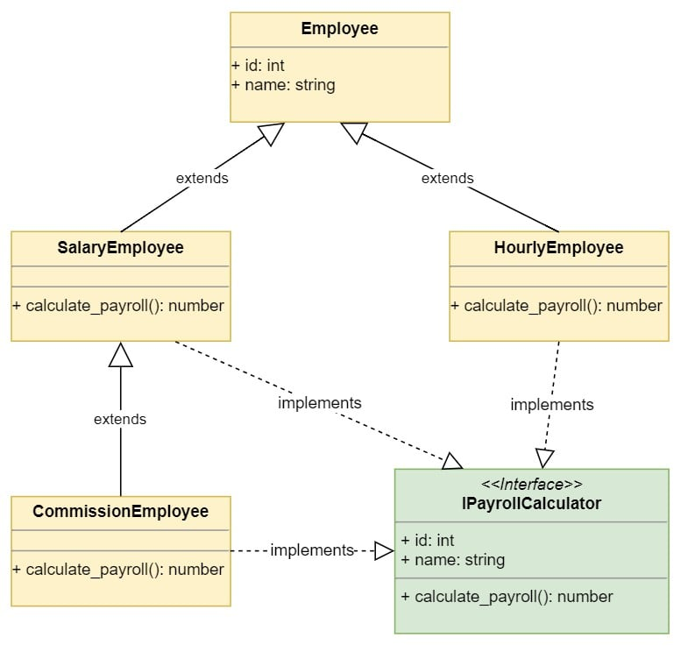
Simple example
This is s simple example.
Ignore the green part.
An employee is the parent.
Employees all have names and ID.
All employees need pay calculated.
Each child has a separate method.
When told to “calc pay” each does it.
A loop could “calc pay” for all employees, each ’knows’ how to do it.

Slide 31
In the Book
The simulation mechanics are mostly identical.
The details of the probability of each round change.
The book example shows a simulation inheritance setup:
We need to redo the testing and tabulating each time.
The way ‘events’ (the values) are generated changes (different models).
As long as we can provide the probability part, the rest can happen without change.
The parent is a generic simulator harness.
The children change the specifics for that scenario.
This can be repurposed to almost any application.

Slide 32
Using the Classes
We use and take advantage of this all the time.
Shared functionality – the parent can provide data/functions that are shared.
Different implementations – each child can implement the same functionality differently.
Interchangeability:
As long as one object can do what is asked of it, it works.
We can create new objects that work differently, as long as we don’t break other stuff.
When we do basic data processing, we can feed most functions data as:
Dataframe, list, array, series, etc…
All of these can do “storage container” stuff, so we can usually swap them out for each other.

