Slide 1
Housekeeping
Today – Survival and Hazards (ch 13, wb19A – pull for updates).
Exam marks up.
There’s a new assignment:
  One part probability simulation, one part regression (should get there soon enough)

Slide 2
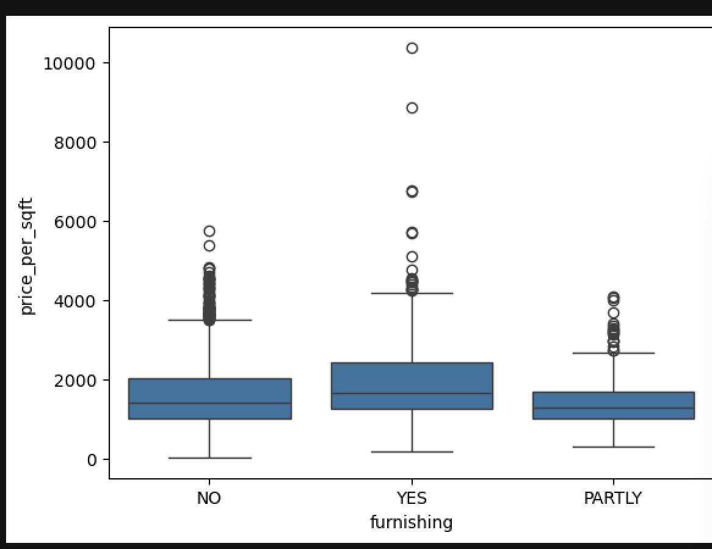
Exam
Overall good.
Comparing groups – need anova or similar.
  Mean difference or effect size isn’t enough.
  With anova, should have a variance test first.

Slide 3
Survival and Hazards

Slide 4
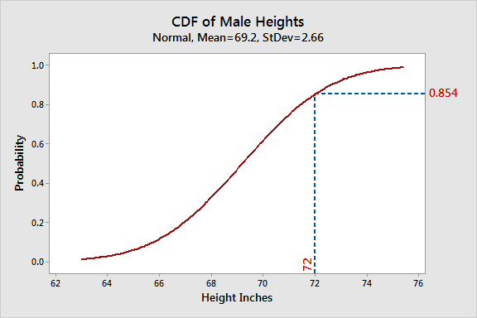
Think CDF
Recall the cumulative distribution functions.
Show the proportion of values that are less than a certain point.

Slide 5
Think Backwards
Now, think about the opposite – what is left to happen and when will it happen?
This is survival analysis.
We are examining an event, and when it happens.
  Event – the “thing”, patient dies, person quits, thing explodes…
  Time – how many time periods have elapsed.

Slide 6
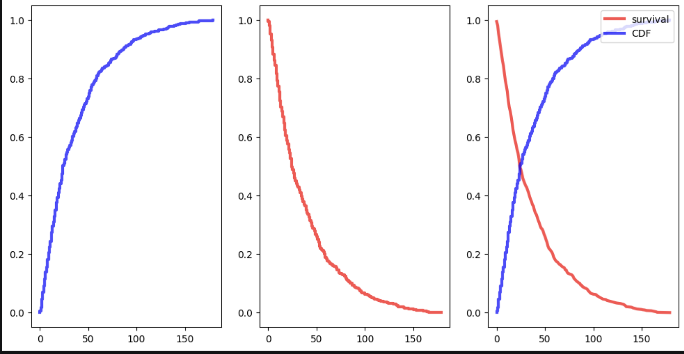
Survival Basics – Survival Function
The survival function defines the probability of survival beyond a time point.
  S(t) = P(T > t)
  T is one survival time, t is a time point.
The survival function can be estimated by:
  Number remaining / total number.
It is also:
  S(t) = 1 – CDF(t)

Slide 7

Survival Analysis – do We Live?

Slide 8
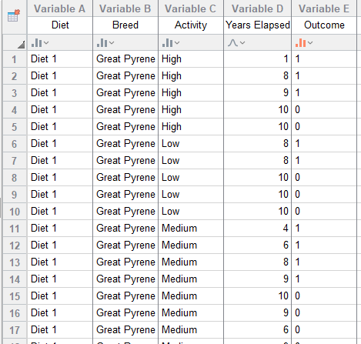
Survival Data and Tools
The data in survival needs two things:
  Has the event happened?
  The time period.
Can also be framed as the birth and death of a datapoint.
Libraries and tools:
  We’ll use a library called “survival”, there are others, “lifelines” is probably most popular.
  Libraries can do lots of heavy lifting for us.
Data prep work may be needed.

Slide 9
Get Granular
Survival works over time.
Time can be aggregated many different ways (per day/week/month/second…)
It is important that you are consistent.
Some data (especially sensors, iot type stuff) may generate data at 1000hz.
If condensing, think about a reasonable approach.
  Aggregate several time steps to one – take mean, median or similar.
  Sample one of every Y steps – take a step unchanged, lose data.
  Domain knowledge thing (e.g. how fast is a “thing” on this sensor).
Use datetime library if you need to do date related math.

Slide 10
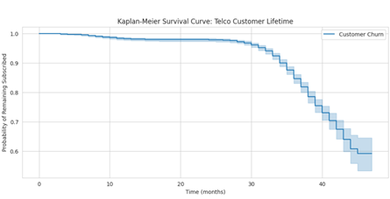
Survival Functions
Survival functions look like this(–ish) when plotted.
Track total up to that point.
  How many are left?

Slide 11
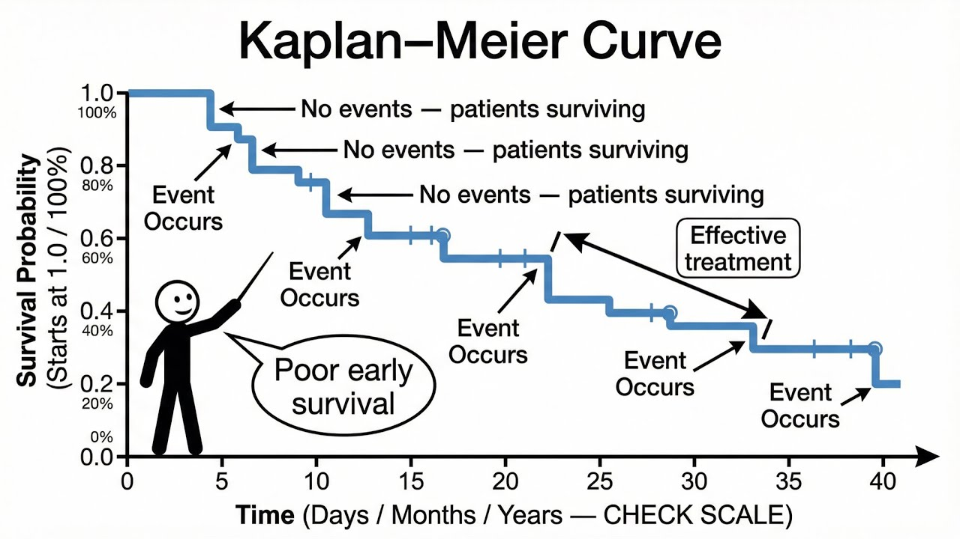
Kaplan Meier Curve
This type of plot is a KM curve, and is common in survival.
  Y – probability.
  X – time scale.

Slide 12
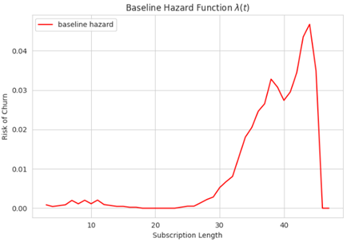
Survival’s Buddy - Hazard
We can also think of things in terms of hazard.
  How likely is it that the event will happen at this point in time?
Hazard function:
  H(t) = ( S(t) – S(t-1)) / S(t)
  H(t) = F(t)/S(t), F=pdf.
Survival = CDF(-ish): cumulative.
Hazard = PDF: at this time.

Slide 13
Usefulness of Libraries
In general, we can use library functions to swap between hazard and survival.

Slide 14
If we have formulas…
If we have formulas for PDF/CDF/whatever, we can calculate the survival/hazard.
  There is lots of fancy calculus based stats to use analytical models.
In many (and probably most real life) cases we don’t have this.
  Data is something like “how long have they been customers at Telus”.
Survival analysis often uses estimation from empirical.
  Have partially complete data.
  Use estimation process to create survival/hazard functions. (KDE-ish).
  Libraries can do most of the hard work for us.
In general, we can use library functions to swap between hazard and survival.

Slide 16
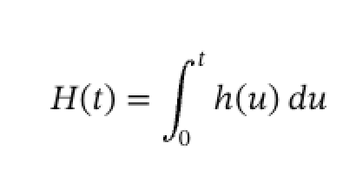
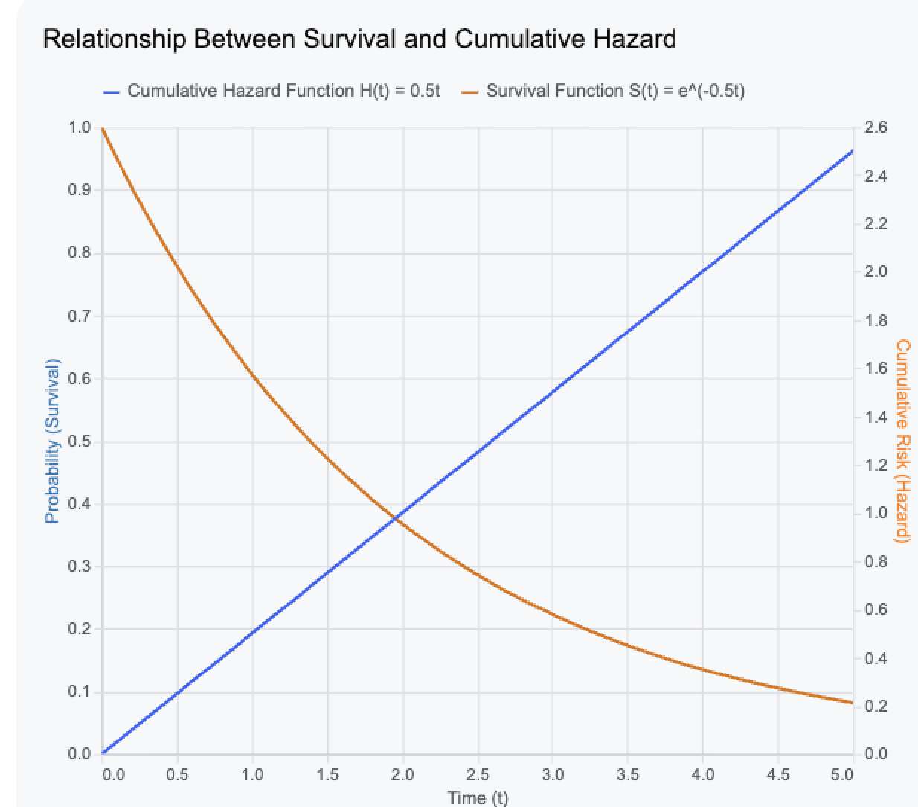
Cumulative Hazard
The cumulative hazard function sits ‘between’ the hazard and survival functions mathematically.
The “accumulated risk” over time.
We don’t really care about it too much.

Slide 17
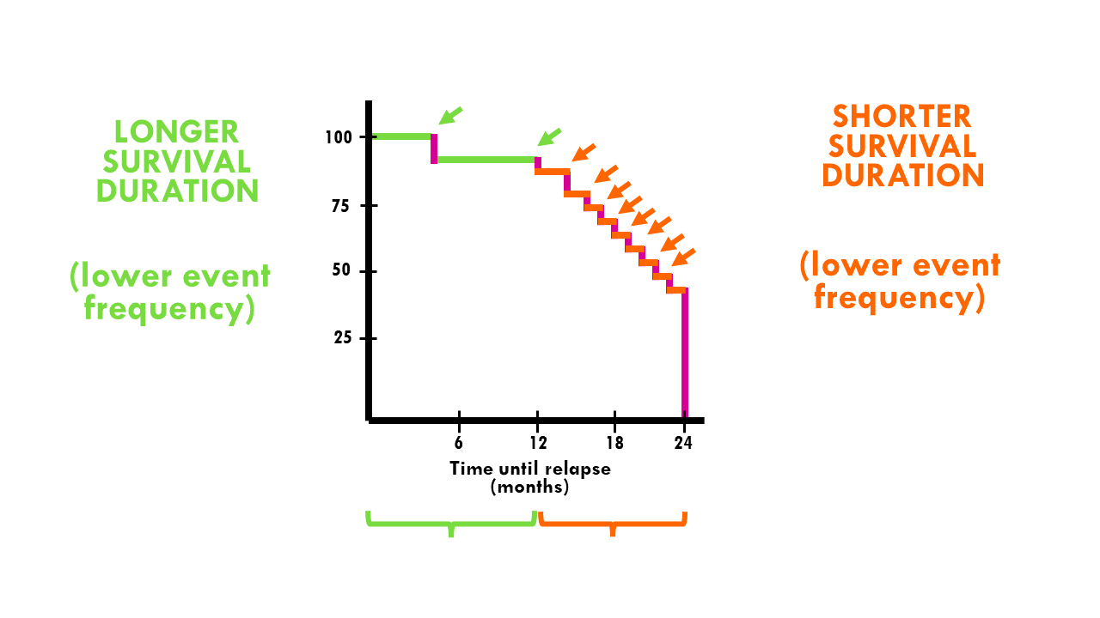
If you don’t have formulas
If we don’t have a model, we need to make one.
Data->model.
But first, we need to overcome…

Slide 18
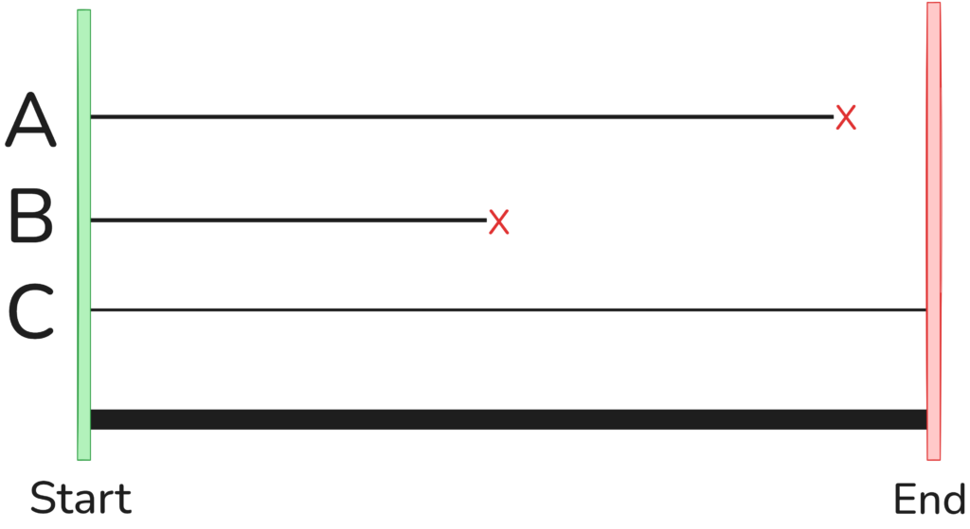

Censorship
In survival analysis, some events haven’t happened yet.
Data points where we don’t have an event are censored.
There are different arrangements:
  Left censored – event happened before our data.
  Right censored (normal) – event happens after our data.
This allows us to deal with data of incomplete things.
  Something like life expectancy would be impossible/impractical otherwise.

Slide 19
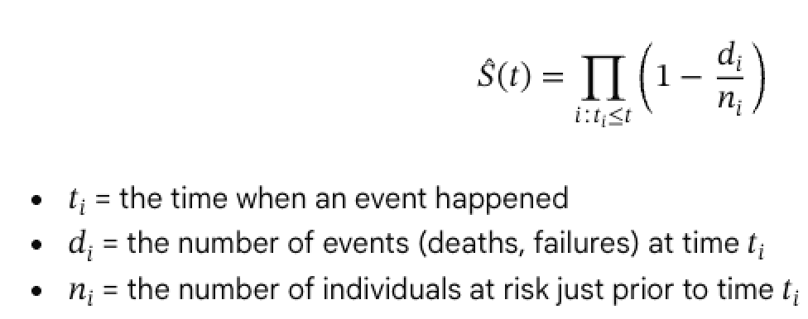
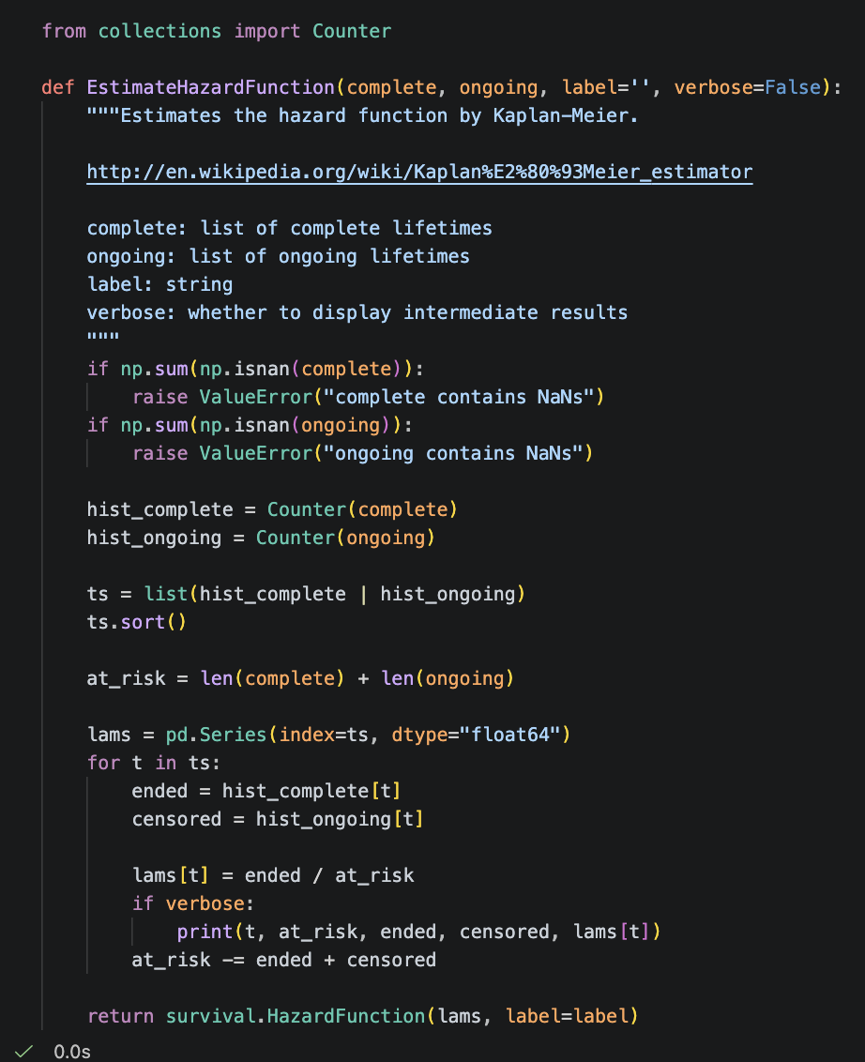
Kaplan-Meier
KM creates an estimate of survival/hazard functions.
  Non-parametric.
  Accommodates right censored data.
This simple example gets hazard that we can convert.
Libraries will get survival directly.
We can get the functions from this process.
  Once we have functions, we can calculate!
There are other estimation methods as well.

Slide 20
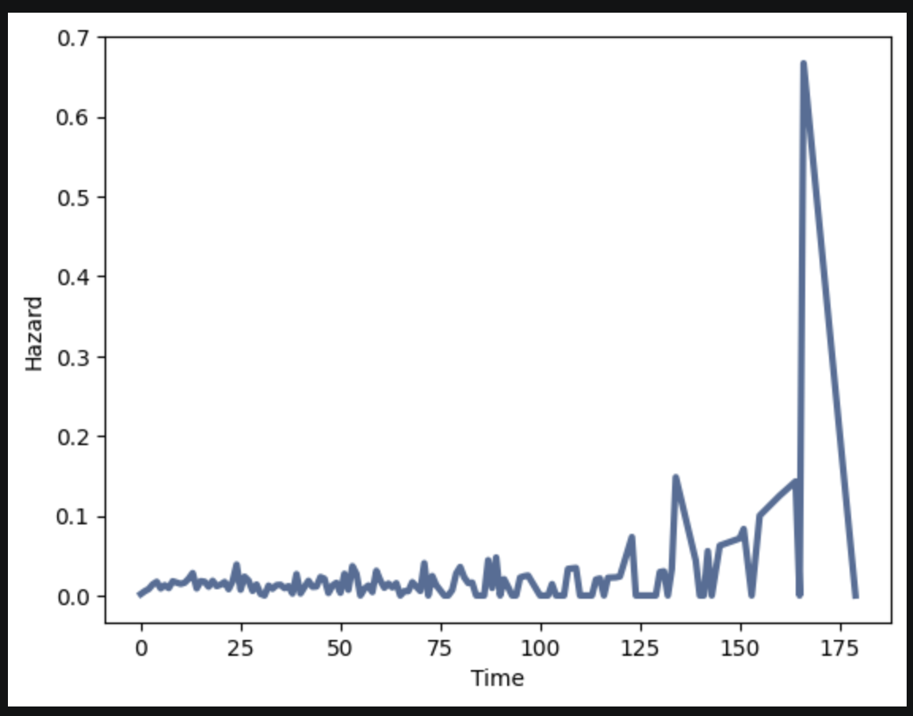
Hazard Functions are the Result
Out of the other end, we get a hazard function.
We can convert to survival as needed.
Hazard functions from empirical data are often weird and jagged.

Slide 21
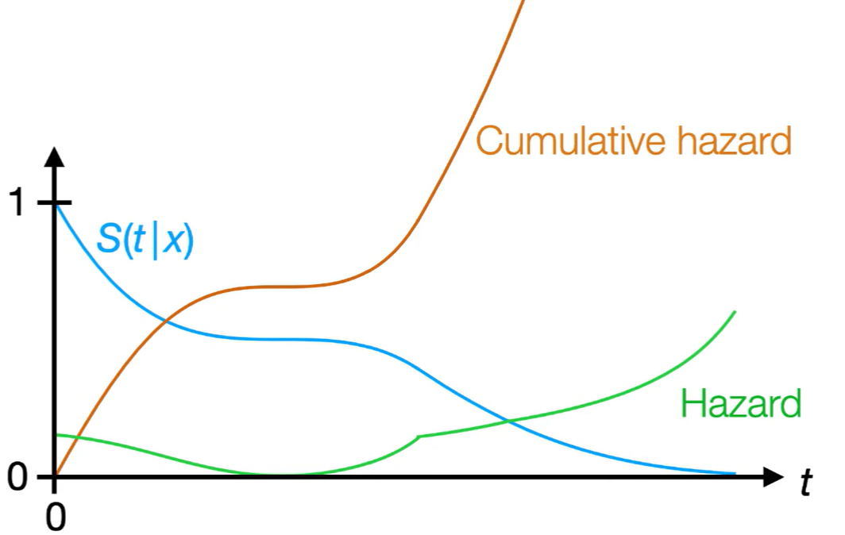
The Super Survivors!
Survival can be expressed through different views.
Since these are mathematically defined, we can calculate one from another.
  Libraries will do it for us.

Slide 22
Remaining Lifetime
We can generate an estimation of remaining lifetime.
  Given that you’ve made it this far, how long do you have left?

Slide 23
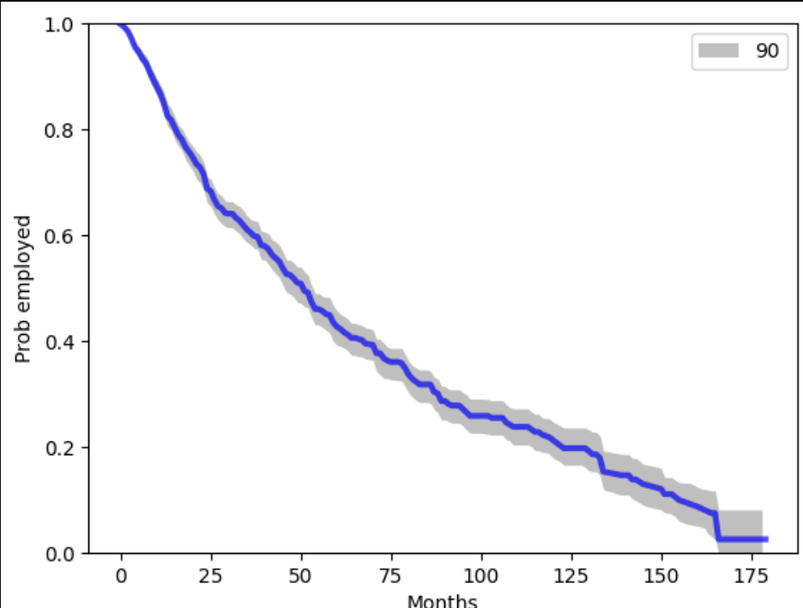
Confidence Intervals and Simulation
Survival is, obviously, something where we don’t have all the info.
Our survival projections have error.
We can show the confidence with CI.
We can generate CI via monte carlo processes.
  Take the data, resample with replacement, calculate survival.
  Do many times, calculate where 99/95/90% of results lie.

Slide 24
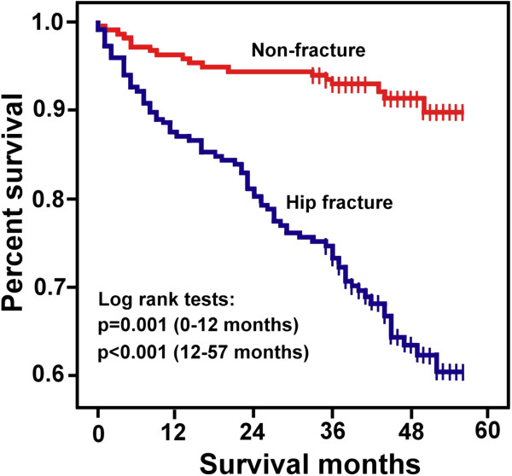
Cohort Comparisons
These types of lifetime projections are often useful with comparing cohorts.
We can do this by splitting data in prep and doing one set of calculations for each cohort.
If we are comparing two cohorts, these two seem to be different…. But are they?

Slide 25
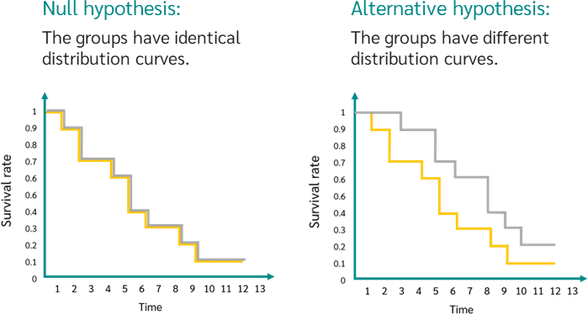
Application – Log-Rank Test
A log-rank test is roughly analogous to a hypothesis test for a distribution.
  Do these two samples appear to come from the same population.
  Null hypothesis: The groups have the same survival function over time.
  Alternative hypothesis: At least one group has a different survival function.
E.g. are employees quitting this McD for some reason, or just normal turnover?

Slide 26
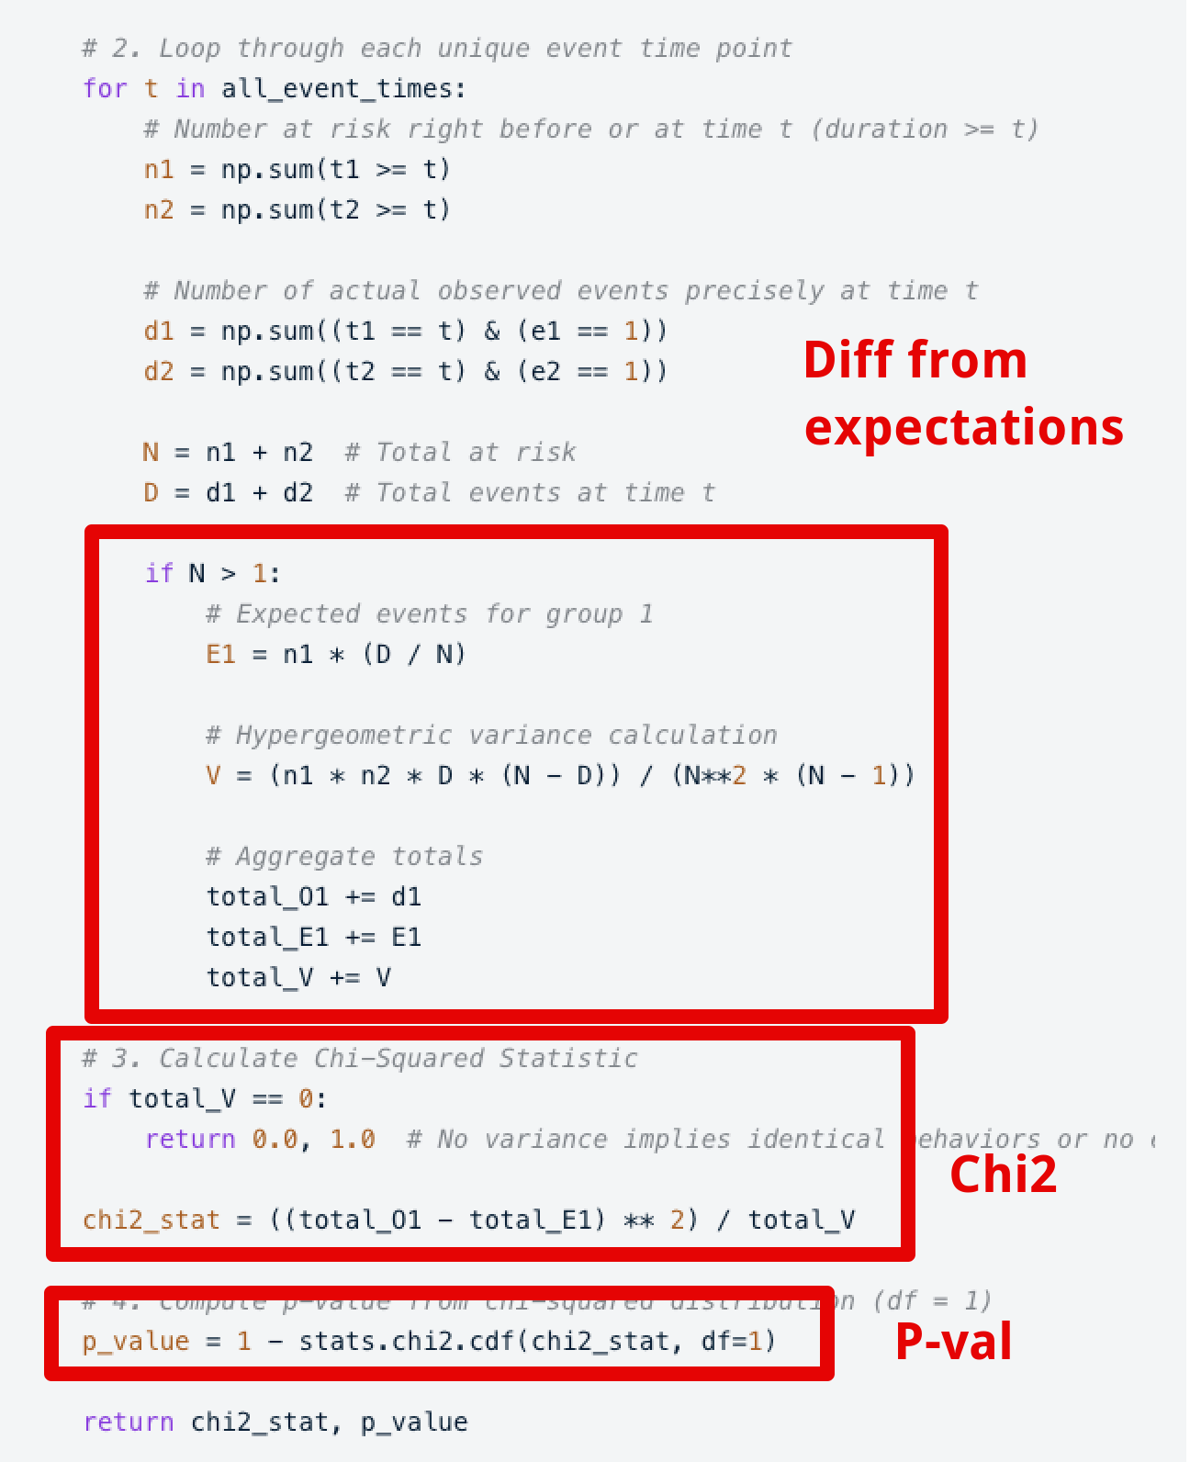
Log Ranking
We don’t need to worry about implementation of this.
Similar in concept to chi2 – diff from expectation.
The final p-value check is the same as Chi2:
  The difference from expectation is calculated differently.
  The idea is identical – quantification of diff.
If this big of a difference rarely (low p) happens randomly, then there is probably a difference in the datasets.
Other options like Wilcoxon

Slide 27
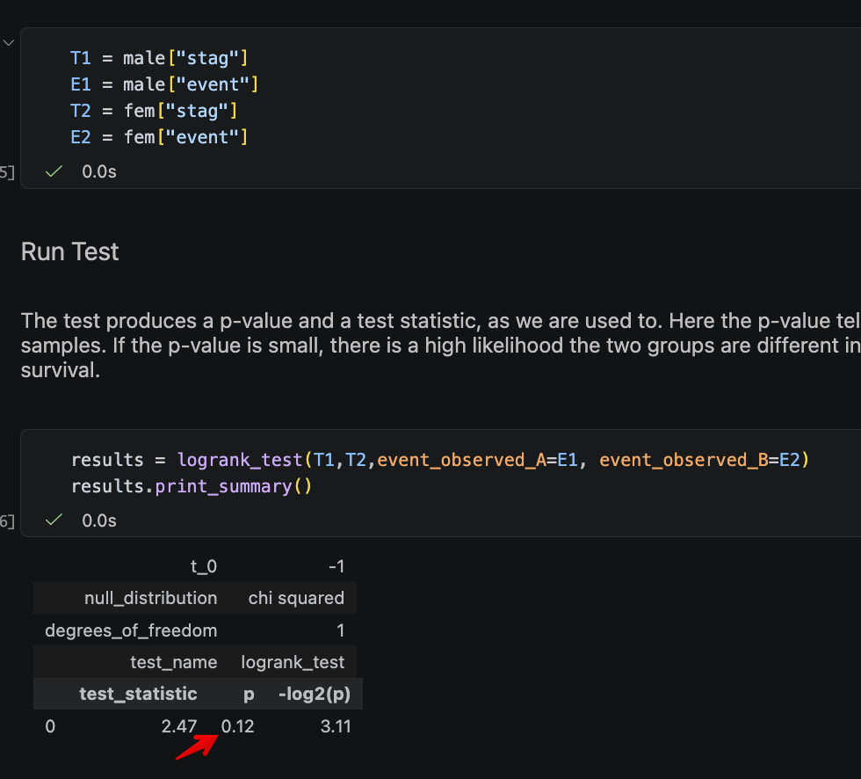
Log-Rank Usage
Performing a log-rank test is relatively simple.
Assumptions:
  Events are independent.
  Events over time are similar between groups.
  No/low crossing – if which survives better switches after the start, may lower accuracy.
We must provide the data as two groups of times and events.

Slide 28
Detour – Data Preparation
As noted, there is often specific data preparation needed.
This is a good chance to make a prep function.
  Input – original data format.
  Output – what you need.
  Arguments (optional) – can you configure different options to handle more scenarios.
This isn’t mandatory (unless specified) but is good practice.

Slide 29
What do I need to Remember?
The workbook contains several examples done by hand, this is for info, use libraries.
  Some are slightly simplified, all are more annoying than using premade functions.
  You don’t

Slide 30
Drive to Survive
Survival is relevant in many real-world applications.
May need to prep data, but after that most things are easy.
  Time/event may not exist in that format in original data – e.g. “end date” needs math.
Not critically important to most other topics we need, but may come up…
  Put the basics in your toolbox and be ready to expand on details as needed.
  The project in the next semester might have some survival relevant stuff…

