Slide 1
Review – Get Hyp’d!
Last time we looked a bit at hypothesis tests.
Tests if effects seen in samples are ‘real’ – due to actual differences in population values.
We can construct a hypothesis test with some code:
Define test statistic – the effect we want to test.
Create null hypothesis – assertion negating what we have seen (e.g. samples from same pop).
Design a test – create a loop that runs a trial of the test stat ‘happening’.
Interpret – the number of times ‘it’ happens randomly is probability.
This process is generic as long as we can define:
Some test statistic that we are checking.
Some test that simulates likelihood.

Slide 2
Test Framework
The structure of a hypothesis test is mostly the same each time.
We generally only need to change the test stat and the simulation process.
Test statistic – the effect that is observed in the sample.
We saw this happen; we want to check if there’s any change that randomness yielded it.
Usually something like a difference in means, but can be almost anything.
Simulation – we need to do many trial runs, to observe the results.
This will basically be a test of whatever check yielded the test statistic.
Permutation – for differences between group, reshuffle and see if effect happens.
For other things, we can just replace it – more later….

Slide 3
Common usages for Hypothesis Tests
Is an improvement effect seen between two groups real or due to randomness.
E.g. treatment group lives longer in a drug trial, is that due to drug?
Do two samples differ in reality, or is it just due to sampling variation.
Checking BMI between 2 samples – are they different sizes, or just random?
Probabilistic outcomes.
We flipped a coin 100 times and got 60 heads, is that possible with a fair coin?
The test gives us an idea of how likely it is that these things happen random.
If it is very unlikely, we can call our result “statistically significant”.
E.g. Life expectancy increases by 7.8% with treatment, and that result is trustworthy.

Slide 4
Housekeeping
Disclaimer – stuff on old housekeeping slides doesn’t apply.
Sometimes I save the new updates before updating. Pleases ignore the ones I don’t show.
Less stuff for you!
We’ll kill a quiz, not an assignment, that’s more sensible.
I need the day more than anything, we lose several to holidays.
I believe the quiz marks are pretty good, so that helps you all. Tell me if you have an issue.
Moved stuff for you?
Is it ok if the test is moved from Friday 31 to Monday 3?
Other stuff for you, more hypothesis test simulation stuff.
Hypothesis test review, specific tests, usage, p-hacking, practice, practice, practice.

Slide 5
Don’t Get Scammed By my Exam
Contents: chapters 1-9 (hypothesis testing).
Big things: basic stats, distributions, histogram/pmf/pdf/cdf, analytical distributions, error, models, correlation, estimation, hypothesis testing.
Types of stuff:
Multiple choice and short answer on theory.
‘Calculate this’
Provide a function body.
I’ll write a slightly more detailed guide this weekend.

Slide 6
Don’t get Scammed by my Exam, cont.
Know:
Major concepts.
How things relate to each other (e.g. pdf, histogram, cdf, relationship).
Usage (e.g. why would someone need this in real life).
Logistics of cloning and submitting.
Don’t need to know:
You don’t really need to memorize definitions or similar.
You don’t need to manually calculate anything without using code.

Slide 7
Don’t get Scammed by my Exam, cont.
Know how to do:
Utilize the major objects we touched on (dataframes, analytical dists, thinkstats, charts).
Including changing parameters, requiring looking at documentation.
Explore and describe data – you get some data, can you find ‘stuff’.
Outliers, range, distributions, etc…
Relate that to the meaning of the original data. (e.g. if # of customers is exponential, what does that mean?)
Make a function from spec – the input/outputs are provided, you need to make the innards.
If I give you a dataset can you tell (and show) me all about it?

Slide 8
Housekeeping:
Assignment – date extended to Monday, noon.
Quiz – We can do it on the 11th , let me know if that poses a problem.
Estimating and testing.
Today:
Hypothesis testing.

Slide 9

Some Stuff
Question – in chapter 9 (e.g. 9.2) do the “class…” code parts make sense or no?
Today – recap simulation and (maybe) first part of hypothesis testing (<=9.5).
Game 7.
More generalization, confidence, and election simulation.
Hypothesis testing from scratch.
Depending on what you all know, a bit about classes to make sense of book.
Note: we’ll look at the ‘from scratch’ stuff now and worry about t/z/p tests next time.
Exam, in a couple of weeks (31):
Set a cutoff on hypothesis testing (ch9 - we’ll be more specific at the end of the week).
It’ll involve answering some questions, and submitting some code bits.

Slide 10
Hypothesis Testing
Does it Matter?

Slide 11
Hypothesis Test
Hypothesis testing is a reasonably large topic.

Slide 12
Recall - Estimation

Slide 13
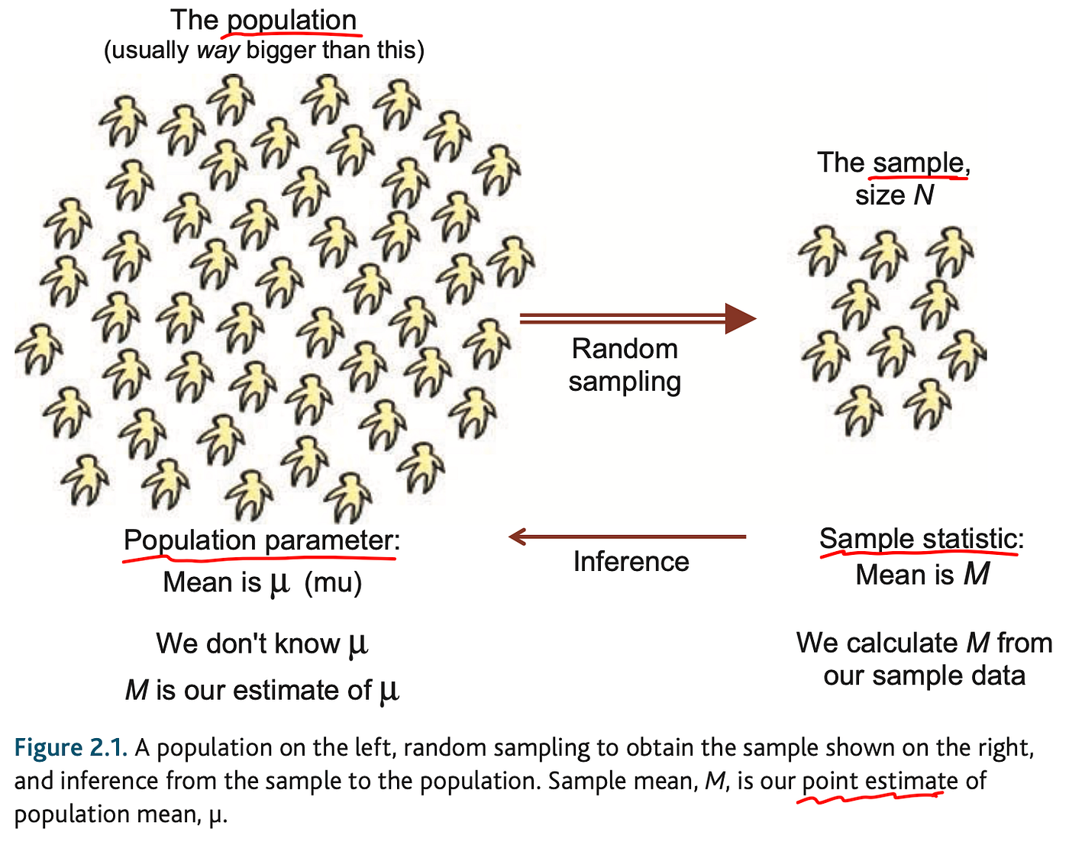
Recall - Estimation
We looked at estimating for a population from a sample.
Take sample, calculate stats.
Make model, run trials.
Conclusions are probabilistic.
We have uncertainty.
Conclusions have confidence intervals.
Indication of prediction acc.

Slide 14
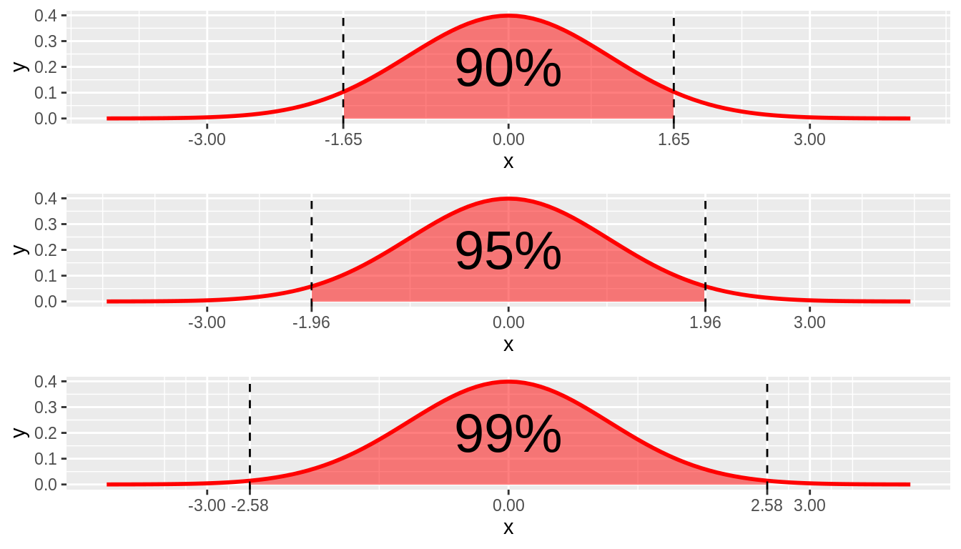
Making Predictions
When generalizing, we have a range and a likelihood.
Errors stem from:
Sampling.
Sampling bias.
Measurement error.
Some errors are beyond us.

Slide 15
Using Simulations
We can do this with our simulation loops.
We have a model for data expectations (analytical distribution) made from sample.
We can generate many new samples from that distribution.
We can count where the results of those samples fall.
These counts are an estimate of what we can expect going forward.
The more clustered they are, the more confident we are in predictions.
The range that 90/95/99% fall into is our confidence interval.
As long as we have some model of the distribution, we can do the same thing.

Slide 16
Effects Flashback – Cohen’s Effect Size
Effects are just differences between samples.
Effect size is very good for showing how big of a difference there is between groups.
How ”big” is the difference between A and B
Easy to calculate, symmetrical, comparable across studies.
Downside – the value doesn’t have obvious meaning.
Table is a list of approximate significance, by Cohen himself.
Book’s author a huge proponent of effect size!

Slide 17
Inferencing Effects
One big thing we want to do in stats is project these effects to a population.
If people treated with drugs live longer than people in control group, is that difference real?
If we tutor one group of students extra, is their grade change due to randomness or learning?
Like with generalizing, this isn’t direct, it is probabilistic.
We have natural variance in data, and each sample may differ slightly normally.
Depending on sample size, we might see swings in means that are random.
Real life things are often limited in sample size, so variations can be big.
So… if we see some effect in our samples, can we trust that effect is in the population?
Is what we see in our samples real?
Our hypothesis test will give us a probability it was due to random variation.

Slide 18
What’s a Hypothesis Test?
A hypothesis test evaluates two mutually exclusive statements about a population to determine which statement the sample data best supports.
Null Hypothesis: The effect does not exist in the population.
Alternative Hypothesis: The effect does exist in the population.
Effect = difference. Specifically, here it is the difference we see between the samples.
Hypothesis testing lets us say that effects have statistical significance, indicating that an effect in sample data also likely exists in the population after accounting for:
Random sampling error.
Variability in the data.
Sample size.

Slide 19
Don’t Get too Confident
Like with generalizing to a population, this is probabilistic.
Our findings here are evidence, not assertions.
E.g. if we do a hypothesis test that shows an effect is real, that’s only an indicator.
To make solid findings, we probably want several pieces of evidence.
More is better, as we’ll see…

Slide 20
Hypothesis Testing From Scratch
We can use fast computers and coding skillz to do some hypothesis testing from scratch.
To start, we see some effect – such as a difference in our samples.
We can do a sort of two-part check:
Comparison between two things (e.g. sample means).
Generalization to the population.
Our hypothesis test answers the question, “Given this effect we see in our sample, what is the probability of the same effect existing in the population by chance (randomly)?”.
We see X thing in the sample data (the effect).
Is effect ‘real’ in the population or could it just be randomness due to sample and variance?

Slide 21
Realistic Example
We are conducting a drug trial and have two separate samples:
Treatment group – count 31, average life expectancy 12.5 years.
Control group – count 39, average life expectancy 11.1 years.
The treated people live longer, but is that difference significant?
Given the sample size and variance of data, could the observed sample effect be random?
This is a probabilistic decision.
The effect we see in the sample could be real, or could be just random variation.
The hypothesis test tests the likelihood it is random.
If the likelihood this effect is random is low enough, we judge it to be significant - real.

Slide 22
Build a Hypothesis
Select a test statistic – the thing calculated.
For the life expectancy this would be mean life expectancy of the samples.
Define null hypothesis – assertion that this thing is not true.
There is no difference between the population means of treatment and control.
Calculate the p-value – the likelihood the null hypothesis is true.
Probability treatment and control populations are the same and effect is random variation.
We can do simulating here, but we need to build the right model to generate tests.
Interpret the result – is the likelihood of it being random low enough?
If the probability of the treatment and control populations being the same is very low, we can conclude the drug actually made the two populations differ.

Slide 23
Ok, so… Do it!
This process is something that can extend on our simulations.
The test statistics are defined by some model, usually a normal distribution.
We can generate multiple samples can tabulate where they lie.
If the p-value is the probability of the effect being random, we can count that.
Generate many trials and count the number of times that randomness yielded a result.
This process is mostly generic – the process is the same, the details vary.
The textbook has an example of inheritance and classes that we can hopefully use.
We can rotate test statistics and models to test almost anything!
The important part is framing the problem correctly.

Slide 24
Specific Implementations
There are several common-ish setups that we can test:
Things are different – permutation (in book), shuffle randomly data and observe results.
Greater/less - permutation + greater/less than.
In general:
What is the opposite of the null hypothesis. (e.g. Means are equal).
This is the NH – mean1=mean2, mean1 > mean2, std1 = std2, etc…
Create test that can try this – permutation, generate samples, etc….
Count how many times ‘it’ happens.

Slide 25

It’s Science!!
Hypothesis testing uses samples to infer about populations.
What is the probability this effect is due to random variation?
We see some difference, the effect.
Is that difference ‘real’, or not just due to randomness?
Or can we expect this difference to be seen in the population?
For example, a new drug treatment and life expectancy.
The sample of drugged people live longer.
Is that difference likely real – big enough to mean the drug did it?
This is used all over in science and research.

Slide 26
The Results - Significance
Hypothesis tests yield an estimate of some effect occurring by chance.
P value is the probability of this thing happening randomly.
The cutoff we set for “good enough” can vary depending on scenario.
.05, or 5% is a common cutoff. (This isn’t that unlikely…)
If the likelihood of randomness < cutoff, the result is “statistically significant”.
This is irrespective of the size of the effect, it could be small but significant.
This doesn’t mean it is true, this is just one piece of evidence.

Slide 27
Hypothesis Testing throwback
Our simulation based hypothesis testing is very flexible but requires a computer.
Hypothesis tests are older and can work computer free.
There isn’t the generic framework that the simulation offers, only specific tests.
Tests combine parametric assumptions with data to allow calculations.
In classical stats, you’d do this since you can’t simulate.
We’ll look at next time.

Slide 28
Workin’ on the ‘P’
If you’ve ever seen/interacted with some sort of clinical trial you’ve seen this.
We have one group that got a medical treatment.
We have one group that got a placebo.
Is the improvement in life expectancy/quality/symptoms real?
Observing differences with samples (many values) isn’t straightforward.
We always have some variation in values, even between ‘equal’ groups.
This is why grad school students need stats.

Slide 29
Hypothesis Tests
Notice a difference (effect) in data, test to see if is “real”, or due to variation.
E.g. these people live longer.
Real can be highly situation dependent:
Different situations yield different criteria.
Problem – there’s no definitive way to go from probabilities and results of samples to definitive declarations for an entire population. We are always making an inference, not showing a law.
Reliable conclusions will require domain knowledge, and likely more than one calc.
All of these things are “ways to demonstrate a difference”, not absolute rules.
Similar to predictions later – we are stating a conclusion, and offering evidence of its truth.

Slide 30
What’s a Hypothesis Test?
A hypothesis test evaluates two mutually exclusive statements about a population to determine which statement the sample data best supports.
Null Hypothesis: The effect does not exist in the population.
Alternative Hypothesis: The effect does exist in the population.
Effect = difference. Specifically, here it is the difference we see between the samples.
Hypothesis testing lets us say that effects have statistical significance, indicating that an effect in sample data also likely exists in the population after accounting for:
Random sampling error.
Variability in the data.
Sample size.

Slide 31
Flashback – Cohen’s Effect Size
Effect size is very good for showing how big of a difference there is between groups.
How ”big” is the difference between A and B
Easy to calculate, symmetrical, comparable across studies.
Downside – the value doesn’t have obvious meaning.
Table is a list of approximate significance, by Cohen himself.
Book’s author a huge proponent of effect size!

Slide 32
Hypothesis Test process
A hypothesis test will seek to answer if two samples that show a difference have that difference due to real effects, or random variation.
A.K.A. did these two samples come from the same population.
Define the test statistic – normally the mean.
Define a null hypothesis – “there is actually no difference in the means of the two groups.”
Compute the p-value – this is what the test does. The probability the NH is true.
Compare to the cutoff (alpha) – if the p-value is smaller, we can reject the NH, therefore the difference is statistically significant.
A.K.A. how likely is that that the two samples are from the same pop, and the difference in their means is just random variation.

Slide 33
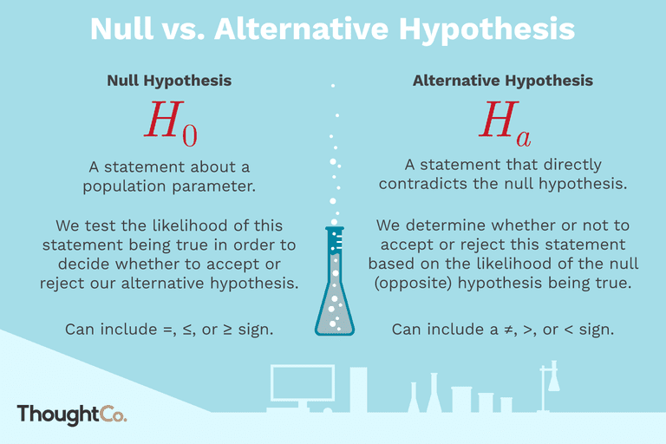

Slide 34
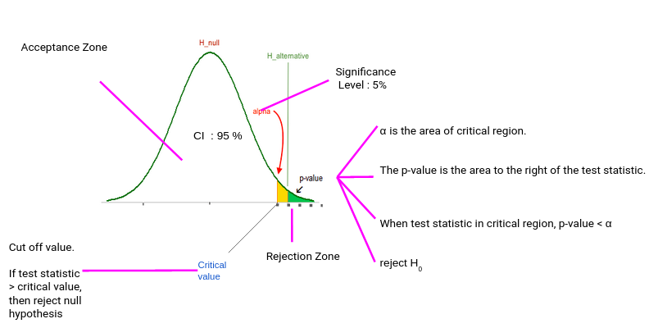

Slide 35
T-Tests
T-tests allow us to make an estimate of, “is this difference likely real, or could it be due to chance?”
Extremely common in basic stats and scientific papers/reports.
Weakness – subject to manipulation, becoming less relied on over time.
One sample – tests mean against some value.
Two sample – tests two means against each other.
Sidedness:
One side tests if lesser/greater.
Two-sided tests if different at all.

Slide 36
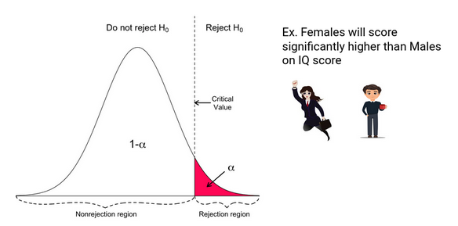
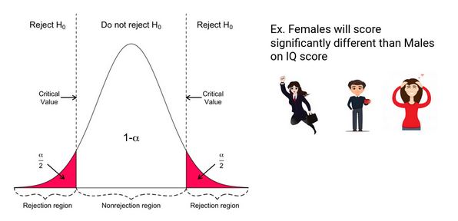
Sides
Check the examples in 9.3 and 9.4, they show this in the simulation.
We need a different test depending on what difference we need.

Slide 37
Z-tests
Z-tests do the same basic thing as t-tests, they can be used when:
Sample size is large. (50ish is a rule of thumb), or…
Population variance is known.
If that’s not true, use a t-test. (Results will converge with larger samples)
Test has more assumptions, so if our data follows that, it is a good option.
More simple if calculating by hand, we kind of don’t really need to care about it…

Slide 38
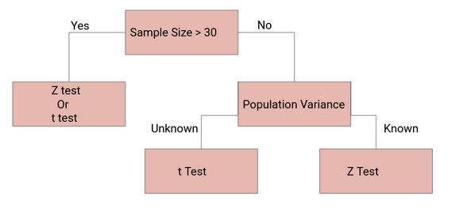

Slide 39
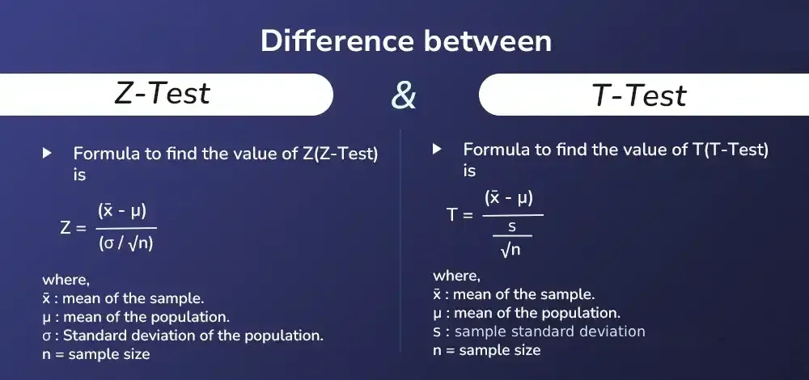

Slide 40
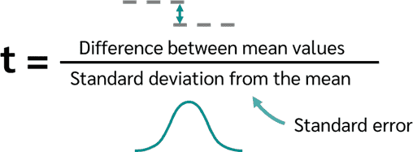
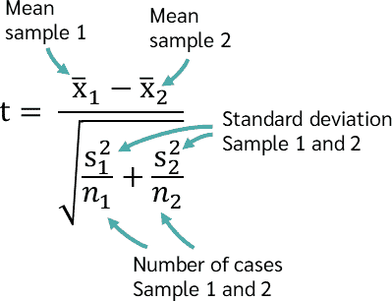
Calculating the tests

Slide 41
Test Assumptions – Parametric TEst
Data is normally distributed.
Central limit theorem (more on this later) – as you get more data, samples of many things become more normal.
Non-normal data can sometimes be transformed (e.g. log income from last week)
Equal variance:
Argument in scipy t-test.
Normal t-test assumes true, Welch’s does not.
Observations are independent.
No/minimal outliers.
There’s a “trim” option to take out outliers in the scipy stuff.

Slide 42
Other Tests
There are many other statistical tests that can be useful in other scenarios.
We’ll look at a couple next week in more detail.
We can look one up based on our scenario, if needed. Some common ones:
ANOVA (analysis of variance) – Test means of 3+ groups.
Chi2 – dealing with discreet data expectations.
Mann-Whitney – T-test equivalent with no assumption of distributions.
For most of these we can call their function directly in scipy.
Will run the test based on the calculations, with assumptions inbuilt.
Our simulation loops are generic versions of this – we can build anything.
We don’t need to know the test theory as long as we have the probability model.

Slide 43

Demise of Hypothesis Testing
P-values are (somewhat) on their way out.
Banned from some medical journals as too easy to pass.
NHST = null hyp. significance testing.
Unfortunately, and surprisingly, there’s no perfect alternative.
What do we do???
Effect size.
Estimate mean with standard error and confidence intervals.
Bayesian estimation (we might touch on this later)
Real statisticians are actively debating this – we don’t have a firm answer.

Slide 44


P Hacking

Slide 45
What is P-Hacking?
Generally, we (the royal one) are looking to demonstrate significance:
This drug works – the people who took it live longer.
This thing I noticed in my thesis is real – some effect is due to a real thing, not randomness.
This difference matters – group A really is different from group B.
95% confidence is only 19 times out of 20.
If we just want to show something is significant:
Manipulate variables
Repeat testing with different details (test stats, sample size, etc…)
Find a small p
Publish!!!!!!!
Notes:
https://fivethirtyeight.com/features/science-isnt-broken/#part1

Slide 46
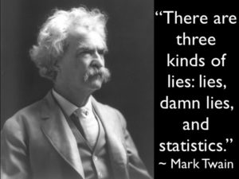
Data Dredging
P Hacking is one example of Data Dredging:
Manipulating analysis to find justification for a predetermined result.
E.g. if I want to show correlation, predictive value, or similar for an example, I can:
Remove (or add) data arbitrarily to change results.
Transform data in some way.
Run a test, then change things to get what I want.

Slide 47
Don’t be a P Hacker (Unless Maybe if grant Funding Depends on it)
Share process, not just results.
Look for multiple metrics of significance that agree with each other.
Just “don’t” – avoid searching for ways to force data to show what you want.
P hacking usually involves extra work – changing test statistics, filtering data, etc…
If an experiment is well designed, we live with the results.
This is a malicious application of stats – we should be offended!!!!!
Biologists, doctors, etc… misuse our precious math to make their crap sciences look legit.
If you need to show your research shows significance, then hack away at your p.

Slide 48
.05 is Arbitrary
.05 is the ‘standard’ p value that is almost always taken as a default.
When I learned science stuff in jr. high this was an unexplained rule.
.05 means that there is a 5% chance that the effect could occur randomly.
That’s not really very unlikely in many situations.
Depending on what we are dealing with, other cutoffs may make sense.
Book gives a good order-of-magnitude based rule of thumb:
< 1% is very unlikely to occur by chance.
> 10% is likely to occur by chance.
1% to 10% are plausible to occur by chance, and require more detailed examination.

Slide 49
What does P Really mean
The P value shows us one important source of error.
Probability that the effect seen appears real but is fake (doesn’t hold in population).
Is there any other way that we could be wrong?...
What if a drug works but we observe in a sample that it doesn’t?

Slide 50
Hypothesis tests and you!
These hypothesis tests are specific parametric applications of our simulation loops.
Each hypothesis tests says, “out of N trials how many…”
E.g. out of 100 times, how many will randomly show a difference in life exp.
Or, what is the probability of this difference being due to random selection.
If we can create some function for one trial/round we can run this directly.
Analytical distribution, probability function, etc…
Hypothesis test formulas rely on assumptions since they didn’t have computers.
Our loops are flexible, we can do hypothesis tests and more.
This is actually very cool and big, we can do much of inferential stats with these two things.

Slide 51
Key Model Bits…
Some parts of the model idea are really important as we move to ML.
Create a model – the analytical model is our expectation of what this data will look like.
We create it from the patterns of the old data.
Once a model exists, we can use it to make predictions for future data.
Our predictions can be used to figure stuff out, probabilistically:
Generalizing from a sample to a population.
Comparing distributions/values in a hypothesis test.
Our predictions will be better with a better fit between model and reality.
The closer our data follows the pattern we assign, the better (less error, more conf.).

