Slide 1
Review and Today
Remember from last time:
Load data from a csv file into a dataframe.
Run functions “on” that dataframe variable (head, tail, info, describe, …).
Slice columns out of dataframe.
Examine those variables for type (num. v. cat) and basic stats (“middle” and “spread”).
Today:
Samples and populations.
Segmenting data into groups.
More dataframe manipulation and basic python.
Distributions and thinkstats/thinkplot packages.
Textbook references.

Slide 2
Distributions

Slide 3
So Much Data!
Our datasets are normally very large.
Too big to deal with individual records.
Especially large when we move into ML (potentially millions of records).
We understand our data by examining its distribution, rather than the specifics.
Lots of data falls into patterns, and we can use that to more easily understand it.

Slide 4
Populations and Samples
In general, we don’t have all the data, we only have some subset.
E.g. a political poll takes several thousand (or less) responses to estimate an election.
Population:
All the data that exists on whatever we are looking at.
Relative to the question asked – e.g. data on college student means the pop is all students, not all humans.
Sample:
The data we have.
Some (maybe very small) fraction of the population.
We want samples that are representative – they mirror the population. More here when we do errors.

Slide 5
What’s a Distribution?
The distribution is a count of:
Which values are in the dataset.
How many times each value occurs.
This is known as the Empirical Distribution – based on the actual data. (More later).
Distribution is normally best illustrated visually:
Histograms.
Density plots.
Can think of the distribution as the ‘shape’ of our data.

Slide 6
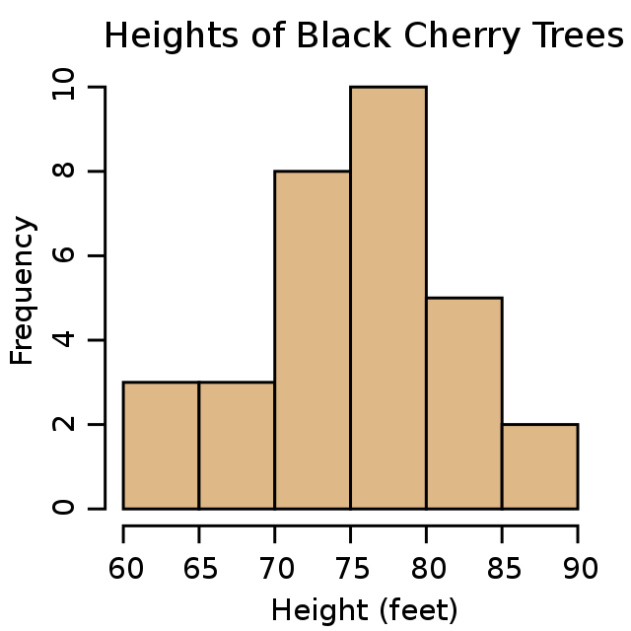
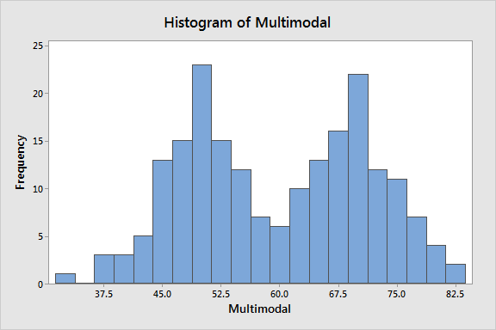
Histograms

Slide 7
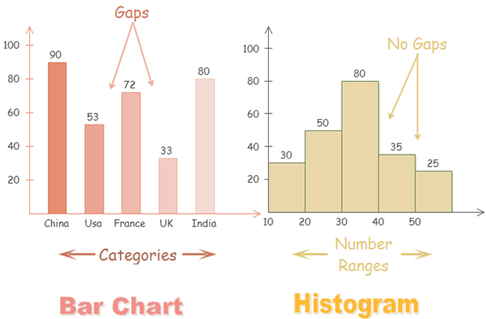
So… A Bar Graph?

Slide 8
Histogram Keys
The size of the bars, or the width of the bins* is flexible:
Choose to illustrate the pattern in the data.
The Y axis is always a count of how many times something occurs.
The X axis is some numerical value – we are breaking that range into parts to generate the graph.
When there is a continuous value, it is “binned” or split into segments and grouped.

Slide 9
Density Plots
Density plots are effectively a “continuous line” version of a histogram.
Still counts how likely something is to occur.
Y axis is the density, or the percentage of values that have that value.
Can visualize it as if the bins of a histogram got infinitely small.
Useful even when we don’t have the ability to count all the data (more on this later).
Provides a smoothed estimation of the exact counts found in a histogram.
While a histogram is based on sums, a density plot is based on calculus.

Slide 10
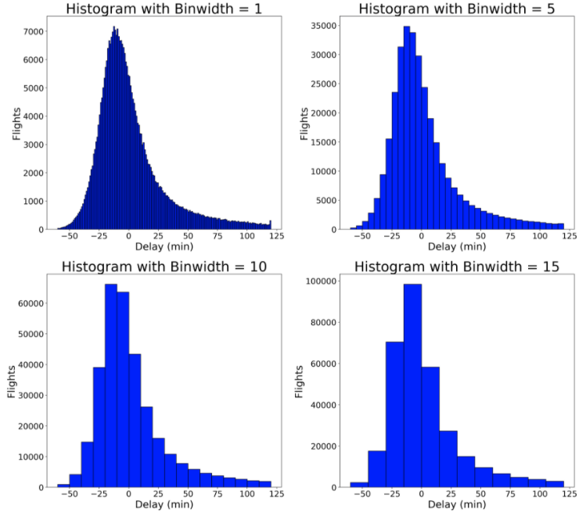

Slide 11
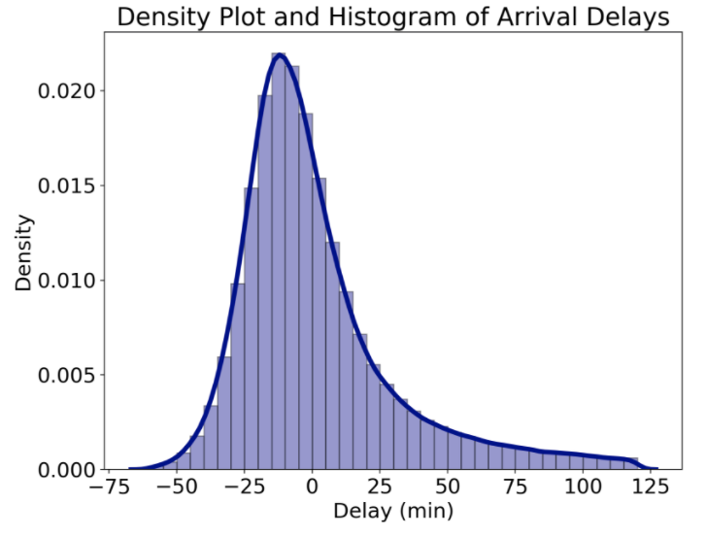
Density Plot on A Histogram

Slide 12
Distribution Patterns
The shape of our empirical distribution could be anything.
Many/most pieces of data will follow some preexisting pattern:
Many natural things are normally distributed (bell curve).
The larger our sample is, the more we can expect it to fit a distribution pattern.
The density plot is easier to match to a distribution – the smoothing deals with randomness.

Slide 13
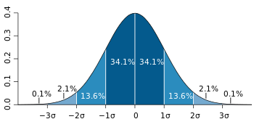
Normal Distribution

Slide 14
Comparisons
Histograms and especially density plots help us see differences between groups.
Why the “especially” there?
We can compare on a more advanced level than comparing means or medians:
See if the two groups are the same shape.
See if one is more “spread” than the other.
Are there tails that make the averages look more similar?

Slide 15
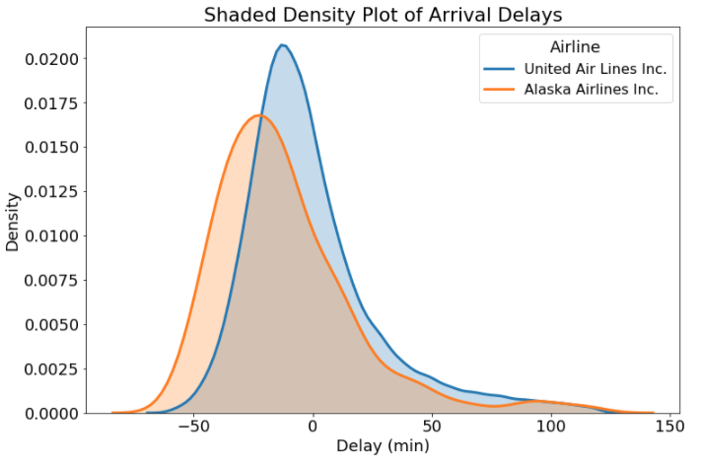
Comparisons on a Density Plot

Slide 16

Analytical Distributions
Analytical distributions define the shape of a distribution mathematically.
Don’t rely on a particular set of data.
Exact shape is determined by parameters.
E.g. mean and standard deviation.
We can ‘match’ our empirical data to a similar analytical distribution.
We can then use the properties of that distribution on our data.

Slide 17
Example – Generalizing from Sample
Goal – “How many NAIT students are <5’5” or >6’5””?
Process:
Take a sample of N students, measure them. Calculate mean and std.
We ”know” height is normally distributed. (This is the logical leap).
Generate a normal distribution matching mean and std from sample.
Use standard normal distribution stuff (e.g. z-scores) to answer question.
We are able to take a small subset of know heights, generalize that to the population, and then perform analysis on that generalization.
What may hurt or improve the reliability of this analysis.
If you see a Stats Canada estimate from census data, it is likely done like this.

Slide 18
