Slide 1
Keeping of House
Quiz:
Corrections made for my mistakes, should be reflected in the grade now.
I updated the percentage ones to give %50 marks for percent vs decimal.
Test:
Guide on Moodle.
Theory, no calculations.
Assignment 2:
Description is up. Largely analytical distributions and correlation.
Today:
Error (workbook 012…). First part of chapter 8.
Peek at time series data.

Slide 2
Errors

Slide 3
Data and Estimates
So far we’ve looked at two main types of ”things”:
Empirical data – real values. Generally a sample of a population.
Models – a representation of some data. Analytical distributions and the line of best fit (regression line) are both models.
A model is a simplified representation of the data.
How good is a model? So far, we’ve mainly looked to eyeball it.
The models always differ from the empirical data somewhat.
We want to use our models to make predictions:
If we do, how can we measure if those predictions are accurate?

Slide 4
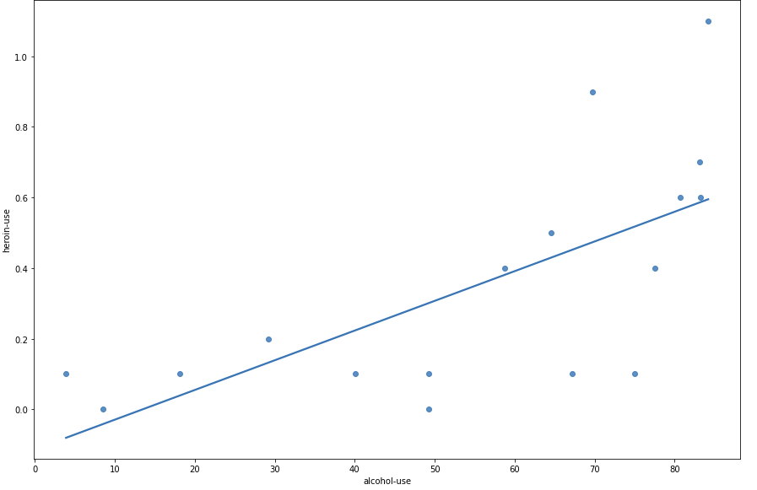

Slide 5
Errors
When matching empirical data to analytical distributions our match is never perfect.
Each point is “off” the analytical distribution by some amount.
The less the total amount of “off” is, the more closely matched the distribution.
Predictions work the same way:
Predict what a value should be.
Measure our error.
Summarize these errors to estimate overall accuracy.

Slide 6
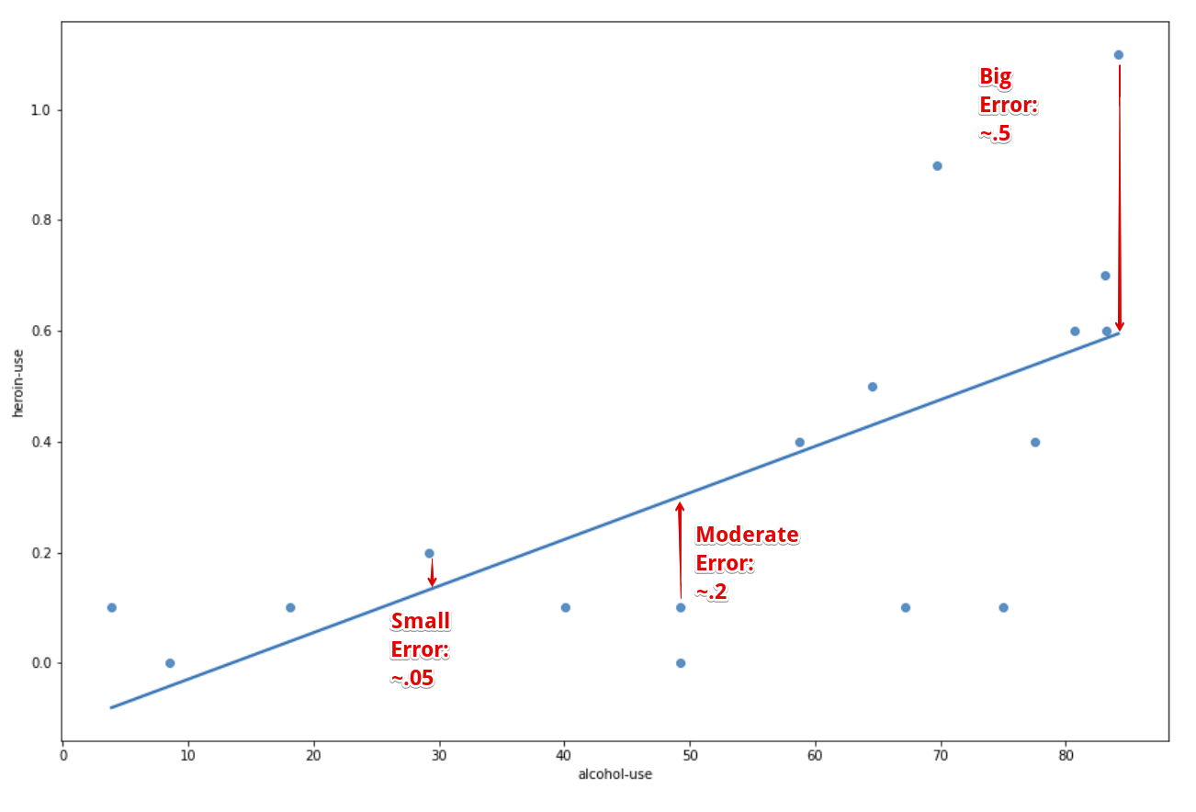
Residuals
A residual is how much one prediction is off from reality.
Each point in our data has its own residual – how “off” was the model vs that real value.
Here – LoBF is a prediction.
Next – Analytical model is a prediction.

Slide 7
In Analytical Distributions
The idea of error works in the same way when matching empirical vs analytical distributions.
Empirical is the real data.
The analytical distribution is the prediction.
E.g. Consider matching a lognormal looking distribution to the lognorm analytical one:
Empirical data tells us how many values we have in a bin.
The analytical distribution tells us how many we expect (if the data follows that dist).
The difference between the two is the residual, or amount of error.

Slide 8
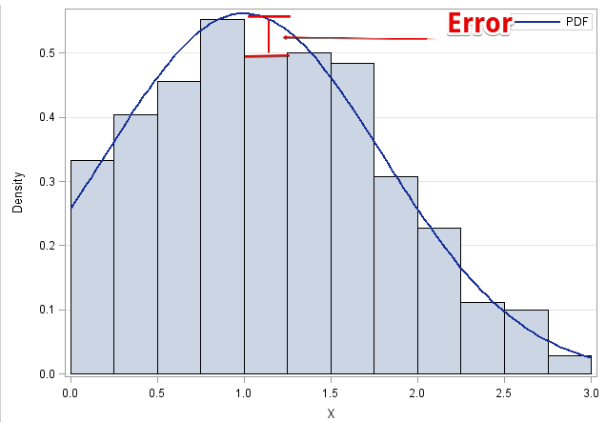

Slide 9
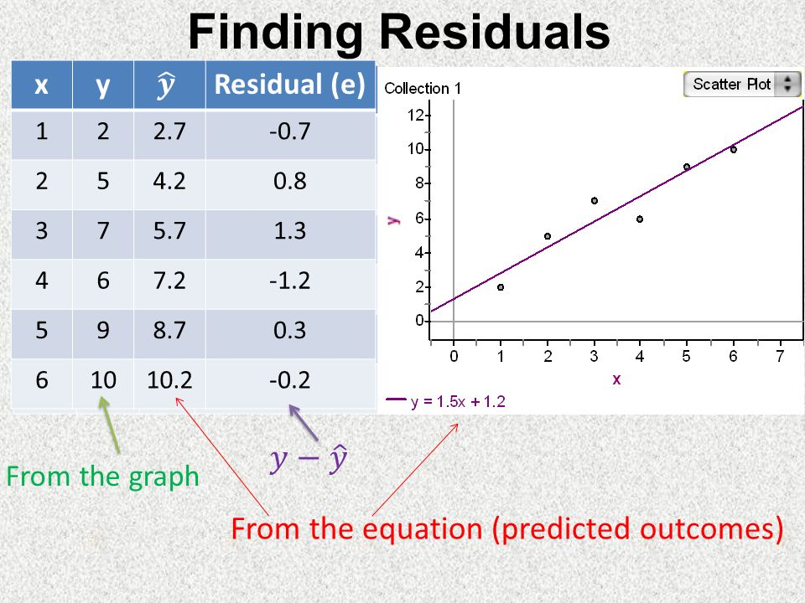
Calculating Residuals
If we have an expectation (analytical model, ML prediction, guess) and a true (empirical) value, we can calculate the residual.
At each empirical point, how accurate is the model?
We get one residual for each row of data (point):
Y_predicted – Y_actual

Slide 10
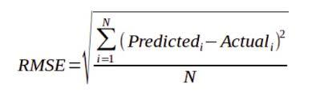
Summarization of Errors
When dealing with many points, a list of residuals is impractical.
Think of a dataset with 10,000,000 rows – a list of that many residuals is impractical.
We can summarize residuals into one measure of error.
There are several ways to summarize error, e.g.
MSE – Mean squared error. Square residuals and average them.
RMSE – Root mean squared error. Take the square root of MSE.
MAE – Mean absolute error. Average the absolute values of the residuals.
RMSE is the most common error measure for us.
Lower error amounts tell us that the model and the empirical are similar.

Slide 11
Why Squared?
The error measures either squared or took the absolute value of the residual.
Squaring does a couple of things:
Eliminates negatives. We get a measure of the magnitude. (MAE* also does this.)
Penalizes large residuals.
Having residuals that are small are good, even though they’ll never be perfect.
Having large residuals indicates massive misses.
MSE/RMSE tends to reward models without many large residuals.
Few large misses.
*Absolute values make for weird math, which is one reason it is less common.

Slide 12
R-Squared
R-squared is another measure of model quality.
Likely to pop-up if searching about this stuff.
We’ll deal with it later.
It is a measure of “how much” the model captures.

Slide 13
Errors
Moving forwards, error is a critical metric for us.
We want to build models to make predictions.
Error indicates how well we are doing.
Less error = closer match between expectations and reality.
We’ll build an error calculation from scratch and look at the library functions.
This stuff carries over directly to the error calculations we need for ML.

