Slide 1
Probability

Slide 2
What’s the Probability?
Probability = the chances something happens.
Or: The fraction of a total possibilities.
E.g. the chances you roll a die and get a 5 = 1/6
What does probability matter to us?
They matter – a little.
Probabilities are common – e.g. gambling.
Probability is often misunderstood.
Probability provides an alternate view of what we are looking at.
Can reach things like distributions, by looking at probability, instead of data.
probability something happens = share of data where that happens (apx)

Slide 3
Probability Notation
P(A) = Probability that A is true.
P(A and B) = P(A) * P(B). Probability that A and B are true.
P(A or B) = P(A) + P(B). Probability that A or B are true.
P(A^{c}) = 1-P(A) = P(not A). Probability that is is false.
Simple probability assumes mutual exclusivity (only one is true), and one thing is true.
P(A and B) = 0

Slide 4

Using Probability – Will We live?
We need to win at 5 simple games.
We are really, really good at games, we win 90% of the time.
Are we dead?

Slide 5
Will we Live?
P(Win) = .9
Odds we are alive after:
1 Game – 90%
2 Games: P(W1 and W2) = .9 * .9 = .81 = 81%
3 Games P(W1&W2&W3) = .9^3 = .729 = 73%
4 Games P(W1&W2&W3&W4) = .9^4 = .66 = 66%
5 Games P(W1&W2&W3&W4&W5) = .9^5 = 59%
Damn it.
Even if we are better – 95% win rate, we only survive 77% of the time.

Slide 6
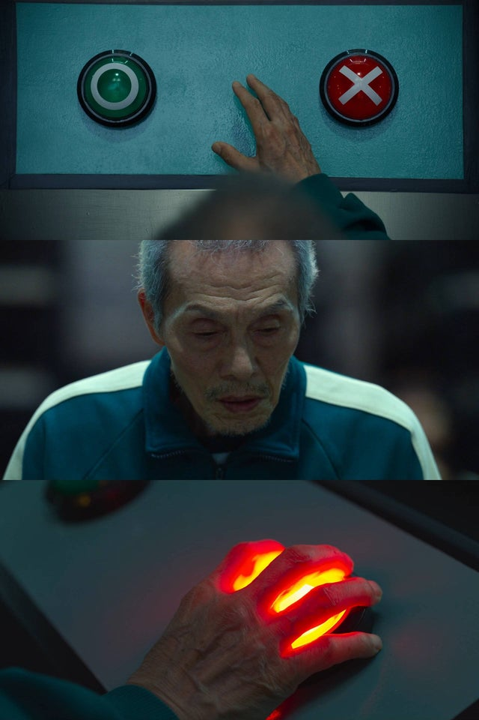
Choose Carefully
Probabilities, especially when there’s more than one involved, are not always intuitive.
E.g. Jackpot odds for 6/49 lottery are roughly 1 in 14 million.
If your work buys 10 tickets every week, for 30 years.
10*52*30 = 15,600 chances to win.
= .1%
Expected value:
15,600*$5 = $78,000
$10 million avg jackpot – $10,000 / people in pool
Even so, some people in my old job won ~$3.5m each.

Slide 7
Conditional Probability
Conditional probability is allows us to say “how likely is X if something happens?”
E.g. If we are over 7’0” how likey are we to make the NBA?
In the 90s someone calculated that at about 14%
P(A | B) = probability that A is true, given that B is true.
Some quick covid tests have reported about a 20% false negative rate.
P(Test Positive | Have Covid) = 80%

Slide 8
Bayes
Bayes theorem expands on the idea of conditional probability.
We can derive it pretty easily, by looking at examples.
It is the basis of Bayesian statistics, which we will touch on a little, but not do in great depth.

