Slide 1
Housekeeping
Today:
Notebook (012A) – I reordered a few things, so the numbers are different.
Estimating populations from samples.
Intro to inferential statistics.
Types of errors from samples.

Slide 2
Sampling and Estimation

Slide 3
Population and Samples
Recall:
Population – the entirety of whatever we are examining.
Sample – some subset that we pull from the population for analysis.
We can’t generally get a population wide dataset.
If the average height of our sample is 5’10”, we can’t just say that’s true for the population.
Our sample should mirror our population, but there is always some difference.
This introduces some error – the sampling error.
Here, we will use our sample to make estimates of the population.

Slide 4

Think Intuitively…
If we are attempting to estimate the height of people:
If our sample is the full population, we can calculate it directly – 0 difference.
If our sample is just one person, that person could be any height – Danny DeVito or Yao Ming.
As the sample size grows, the randomness of getting a non-representative sample becomes less likely.
The larger the sample size, the more reliably it matches the population, in general.

Slide 5
Error Types
Sampling error:
We are taking a sample of a population. It should be random and the stats for the sample should match the distribution, but there’s always some error.
E.g. if you randomly sample heights, and you randomly get three 7ft people, that’s bad luck.
Sampling bias:
Is the sample that we are taking representative of the population?
Easiest to think of with polling – landlines may not represent the whole population.
Measurement error:
How “off” is the actual measurement of the data?
E.g. when measuring heights, a ruler has some error.
We can’t address the last two – they happen before we get the data.

Slide 6
Estimation
We can use a sample to draw inferences about the population as a whole:
This is what statisticians do with a census or pollsters with polls (soon-ish).
This is called inferential statistics – using stats to predict. ML grows from this.
The process is:
Match our sample to an analytical distribution.
Generate random values that fit that distribution.
Use the aggregates of those trails along with error measures to draw inferences about the population.

Slide 7
Estimators
Estimators are a bigger thing in math-y stats than data analytics-y stats.
The estimator is basically the thing we use from the sample to estimate the population.
For normal distribution type of things, it’ll be the mean.
In layman's terms, our estimators are what we use to create the analytical distributions from the empirical data. We want those to not introduce any error themselves.

Slide 8
Trials
Once we have a matching distribution, we can make predictions via running trials.
Each trial has a few steps:
Create an analytical distribution from the estimator(s).
Generate a bunch of values from that distribution.
Calculate the (usually) mean of those generated values.
Create a CDF of all of the means.
In effect, we are predicting what we expect the mean to be, based on the values from the empirical data, then making a distribution of those means.
Our estimate is the mean of those means – but how accurate is it…

Slide 9
Confidence Intervals
Confidence intervals are something that we can derive from our CDF.
The CDF is a distribution of our predicted means.
SE – Standard Error is the std of these means.
The CI is the range in which we can expect X% of values to fall:
A 90% confidence interval means that 90% of the values fall between the two CI limits.
Alternative phrasing – “We are 90% confident that the value will lie within X amount of this value”.
E.g. ”Poll is accurate to within +/- 2%, 19 times out of 20”.
Remember: those means that we generated in the trial are a distribution…

Slide 10
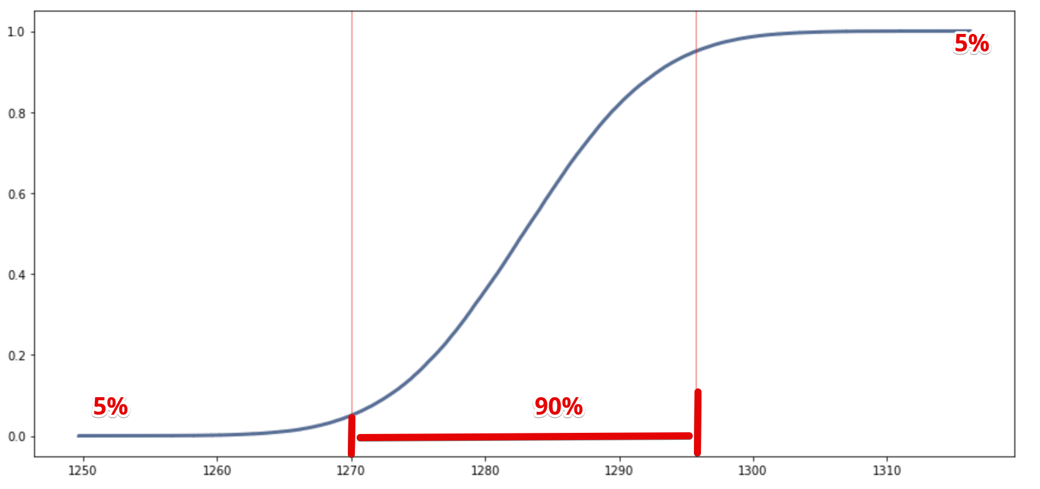

Slide 11
Estimation
We can do this type of estimation anytime we are generalizing from sample to population.
The details of what estimators are used, and the analytical distributions differs, the process is generally the same.
We’ll look at estimation from discreet distributions, like we’d see in election polling, a bit later on.
We end up with both an estimate of the population, and the bounds of how accurate we expect that answer to be!

