Slide 1
Housekeeping:
Assignment – date extended to Monday, noon.
Quiz – We can do it on the 11th , let me know if that poses a problem.
Estimating and testing.
Today:
Hypothesis testing.

Slide 2
Hypothesis Testing
Does it Matter?

Slide 3

It’s Science!!
At least it is commonly used in science.
E.g. Give some people a vaccine
How many got sick?
How many didn’t?
Is the difference significant?
Can we state that there’s a difference between two groups? And that difference is due to something real, not chance?

Slide 4
Hypothesis Tests
Notice a difference (effect) in data, test to see if is “real”, or due to variation.
Real can be highly situation dependent:
Different situations yield different criteria.
Problem – there’s no definitive way to go from probabilities and results of samples to definitive declarations for an entire population. We are always making an inference, not showing a law.
Reliable conclusions will require domain knowledge, and likely more than one calc.
All of these things are “ways to demonstrate a difference”, not absolute rules.
Similar to predictions later – we are stating a conclusion, and offering evidence of its truth.

Slide 5
Flashback – Cohen’s Effect Size
Effect size is very good for showing how big of a difference there is between groups.
How ”big” is the difference between A and B
Easy to calculate, symmetrical, comparable across studies.
Downside – the value doesn’t have obvious meaning.
Table is a list of approximate significance, by Cohen himself.
Book’s author a huge proponent of effect size!

Slide 6
Hypothesis Test process
A hypothesis test will seek to answer if two samples that show a difference have that difference due to real effects, or random variation.
A.K.A. did these two samples come from the same population.
Define the test statistic – normally the mean.
Define a null hypothesis – “there is actually no difference in the means of the two groups.”
Compute the p-value – this is what the test does. The probability the NH is true.
Compare to the cutoff (alpha) – if the p-value is smaller, we can reject the NH, therefore the difference is statistically significant.
A.K.A. how likely is that that the two samples are from the same pop, and the difference in their means is just random variation.

Slide 7
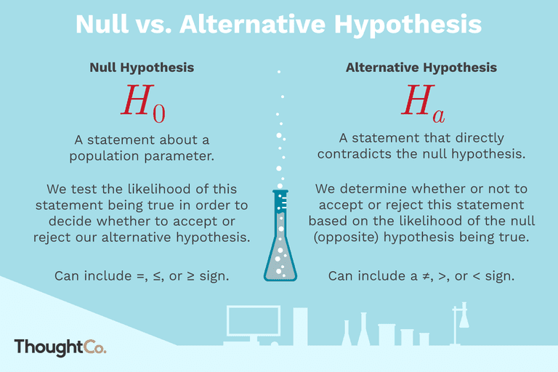

Slide 8
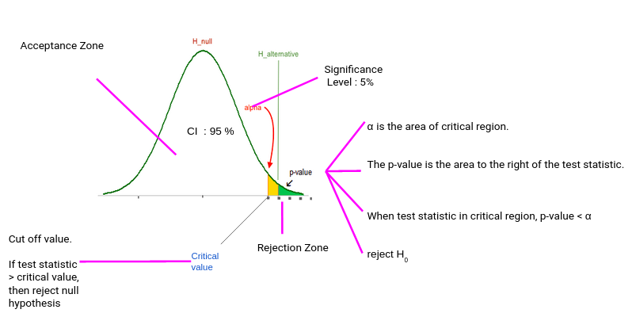

Slide 9
T-Tests
T-tests allow us to make an estimate of, “is this difference likely real, or could it be due to chance?”
Extremely common in basic stats and scientific papers/reports.
Weakness – subject to manipulation, becoming less relied on over time.
One sample – tests mean against some value.
Two sample – tests two means against each other.
Sidedness:
One side tests if lesser/greater.
Two-sided tests if different at all.

Slide 10
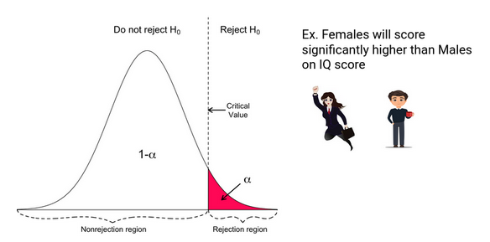
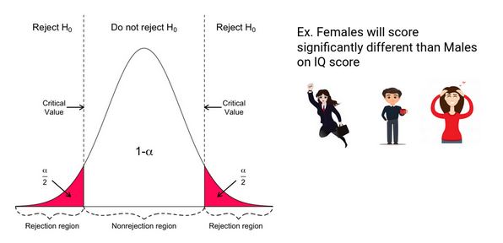

Slide 11
Z-tests
Z-tests do the same basic thing as t-tests, they can be used when:
Sample size is large. (50ish is a rule of thumb), or…
Population variance is known.
If that’s not true, use a t-test. (Results will converge with larger samples)
More simple if calculating by hand, we kind of don’t really need to care about it…

Slide 12
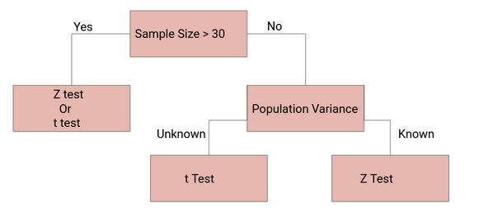

Slide 13
Test Assumptions – Parametric TEst
Data is normally distributed.
Central limit theorem (more on this later) – as you get more data, samples of many things become more normal.
Non-normal data can sometimes be transformed (e.g. log income from last week)
Equal variance:
Argument in scipy t-test.
Normal t-test assumes true, Welch’s does not.
Observations are independent.
No/minimal outliers.
There’s a “trim” option to take out outliers in the scipy stuff.

Slide 14
Other Tests
There are many other statistical tests that can be useful in other scenarios.
We can look one up based on our scenario, if needed. Some common ones:
ANOVA (analysis of variance) – Test means of 3+ groups.
Mann-Whitney – T-test equivalent with no assumption of distributions.
Application to ML – can test if an individual variable/feature matters to a model.

Slide 15

Demise of Hypothesis Testing
P-values are (somewhat) on their way out.
Banned from some medical journals as too easy to pass.
NHST = null hyp. significance testing.
Unfortunately, and surprisingly, there’s no perfect alternative.
What do we do???
Effect size.
Estimate mean with standard error and confidence intervals.
Bayesian estimation (we might touch on this later)
Real statisticians are actively debating this – we don’t have a firm answer.

Slide 16


P Hacking

Slide 17
What is P-Hacking?
Generally, we (the royal one) are looking to demonstrate significance:
This drug works – the people who took it live longer.
This thing I noticed in my thesis is real – some effect is due to a real thing, not randomness.
This difference matters – group A really is different from group B.
95% confidence is only 19 times out of 20.
If we just want to show something is significant:
Manipulate variables
Repeat testing with different details
Find a small p
Publish!!!!!!!
Notes:
https://fivethirtyeight.com/features/science-isnt-broken/#part1

Slide 18
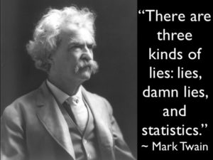
Data Dredging
P Hacking is one example of Data Dredging:
Manipulating analysis to find justification for a predetermined result.
E.g. if I want to show correlation, predictive value, or similar for an example, I can:
Remove (or add) data arbitrarily to change results.
Transform data in some way.
Run a test, then change things to get what I want.

Slide 19
Don’t be a P Hacker (Unless Maybe if grant Funding Depends on it)
Share process, not just results.
Look for multiple metrics of significance that agree with each other.
Just “don’t” – avoid searching for ways to force data to show what you want.

