Slide 1
housekeeping
Today:
Hypothesis testing #2 – power and alternate hyp tests. (017)
Open ended exercise on hyp test. (018)
Linear least squares – foundation of regression (Maybe – if there happens to be time) – Actual ML!!!
Note:
Due to (likely) impending layoffs I looked at LinkedIn – a bunch of last year’s students have data-ish job titles!
Quiz:
Due to holidays pushing back initial quiz, we’ll do the next on the 11th. Unless there’s objection.
Analytical distributions, hypothesis testing, correlation, errors.
(Honestly, I don’t care much when these things happen, and would prefer to just place them as we go. You’re entitled to an advance schedule though, so if the ambiguity is an issue, let me know and I can set fixed dates.)

Slide 2
Hypothesis Testing #2

Slide 3
Hypothesis Test Errors
When doing a hypothesis test, we are testing for one specific error:
False positives, aka…
There is no real difference in the samples, but we think there is.
This is ”capped” by the p-value – you can’t have over p-value likelihood of a FP.
For many cases this is sensible – we are looking for evidence that there is a difference.
What about other errors?
What about a false negative – there is no difference, but we think there is.
Power tells us – if there is a real effect, how likely are we to detect it?

Slide 4
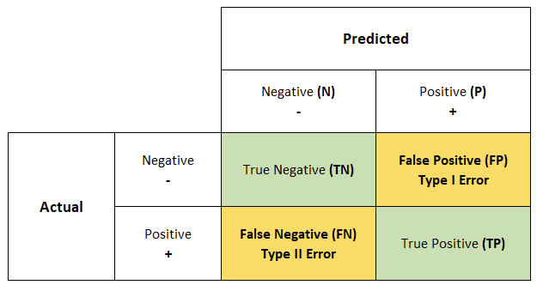
Error Types
We can split errors into two types:
Type 1 – False Positives.
# of actual negatives we predict as positive.
Type 2 – False Negatives.
# of actual positives we predict as negative.
We can examine this via a confusion matrix.
This will be our friend in classifications.

Slide 5
Power
In a hypothesis test, we can calculate something to measure the false negative errors – power.
Power is the probability of wrongly classifying an actually true result.
Hypothesis tests give us the probability of wrongly classifying an actually false result.
Power can be calculated by (1 – False Negative Rate).
Power descriptions:
Power is the probability of rejecting the null hypothesis when, in fact, it is false.
Power is the probability of making a correct decision (to reject the null hypothesis) when the null hypothesis is false.
Power is the probability that a test of significance will pick up on an effect that is present.
Power is the probability that a test of significance will detect a deviation from the null hypothesis, should such a deviation exist.
Power is the probability of avoiding a Type II error.

Slide 6
Using Power
Power is a percentage, on a 0 to 1 scale.
Powers over .8 (80%) are generally considered “good enough”.
Similar to how p-values of .05 are a default cutoff for type 1 errors.
Power is dependent on:
Alpha (type 1 errors).
Effect size.
Sample size.
The alpha and power together tell us how reliable our hypothesis test is overall.
The power function can also back calculate other inputs – such as sample size required.

Slide 7
Weird Hypothesis Tests
The idea of a hypothesis test here is transferable to other scenarios.
Non-normal data – Mann Whitney.
Basically a t-test for non-parametric data.
Categorical data - Chi2.
Basically a t-test for categorical data.
Do counts of different categories meet our expected distributions?
Multiple sets – ANOVA.
Basically a t-test to detect if any of a group are different.
The basic idea is the same – is there a statistically significant difference between 2+ sets.
The mechanics of doing that comparison differs with the data, the concepts are the same.

