Slide 1
Housekeeping
Some basic probability concepts. (This part is pretty simple).
We need a bit now, but this will largely be background.
Discreet distributions.
Odds and logits.
Sampling and estimation. (Chapter 8 now, read ch9 soon-ish as well)
Population vs sample, confidence.
Simulation and trial coding and tabulation.
Generalizing from a sample, yay inferential stats!
Next – comparing distributions (similar, slightly more complex).

Slide 2
More Housekeeping
Some of the ideas here are really important to understand for future.
Probability, odds, logit, models, estimation…
The next 3-4ish days will cover the basics, they are somewhat all connected.
Especially on the simulation stuff, you really need to try to do some unguided.
We are going to be dealing with many sets of data, and need to stay organized.
We’ll have some loops and need to tabulate data each run.
Several things have partially overlapping terms and definitions.
Make sure the examples make sense and exercises are doable – ask if issue.
Exercises in workbooks and book, can also reproduce examples with tweaks.
Generalizing any distribution also works pretty similarly.

Slide 3
Probability

Slide 4
Side Note - Discreet vs Continuous
Most things we’ve dealt with thus far have been continuous.
We also regularly deal with discreet data:
Votes.
Purchases.
Discreet data has similar distribution patterns.
We usually think of discreet things in terms of probability – likelihood that value X occurs.

Slide 5
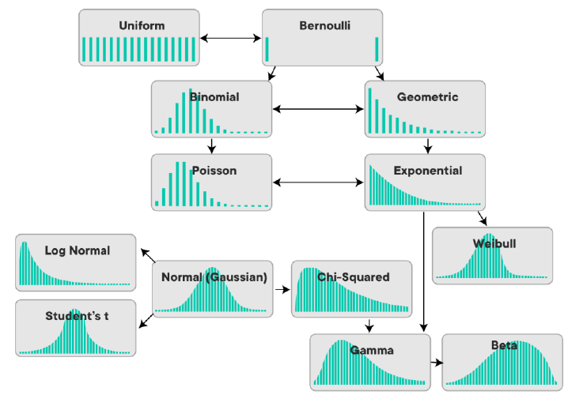

Slide 6
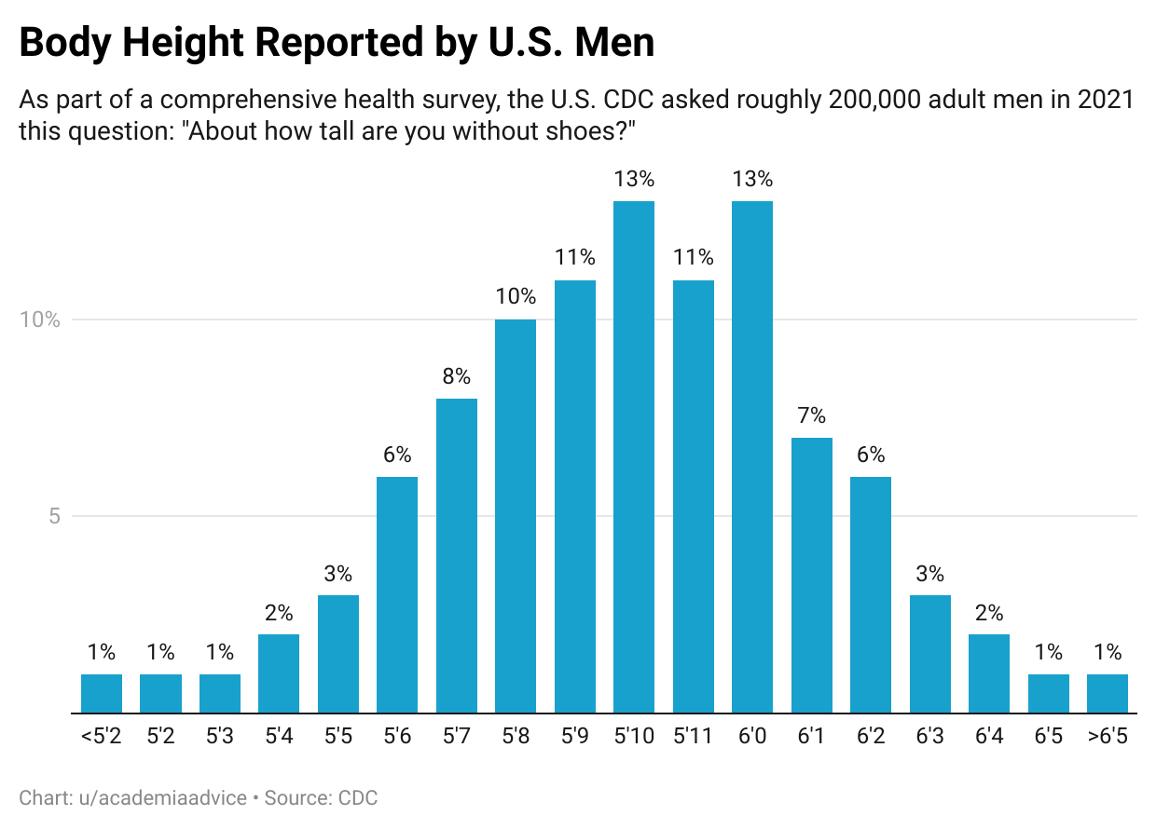
Discreet vs Continuous
Continuous variables express density as a % likeliness in a range.
Discreet expresses density as a % of a specific value.
There can be some questionable ones:
Does the midpoint make sense?
What matters for your scenario?
Bonus – spot any errors?

Slide 7
What’s the Probability?
Probability = the chances something happens.
Or: The fraction of a total possibilities.
E.g. the chances you roll a die and get a 5 = 1/6
What does probability matter to us?
They matter – a little.
Probabilities are common – e.g. gambling.
Probability is often misunderstood.
Probability provides an alternate view of what we are looking at.
Can reach things like distributions, by looking at probability, instead of data.
probability something happens = share of data where that happens (apx)

Slide 8
Probability Notation
P(A) = Probability that A is true.
P(A and B) = P(A) * P(B). Probability that A and B are true.
P(A or B) = P(A) + P(B). Probability that A or B are true.
P(A^{c}) = 1-P(A) = P(not A). Probability that is is false.
Simple probability assumes mutual exclusivity (only one is true), and one thing is true.
P(A and B) = 0

Slide 9
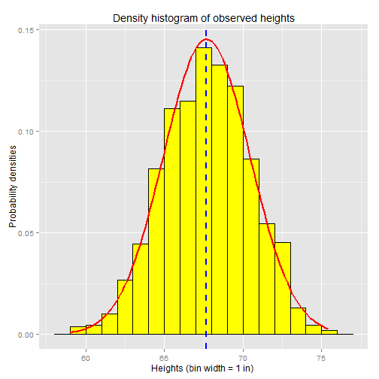
Probabilistic Statistics
With our datasets, we often look at density – the percentage that falls in M range.
Looking backwards, this is a percentage.
Looking forwards, this is a likelihood.
Our distribution defines the probability that a new item on that distribution will be X.
If we’ve chosen a model that actually matches the data, all new occurrences should follow the defined pattern.

Slide 10

Using Probability – Will We live?
We need to win at 5 simple games.
We are really, really good at games, we win 90% of the time.
Are we dead?

Slide 11
Will we Live?
P(Win) = .9
Odds we are alive after:
1 Game – 90%
2 Games: P(W1 and W2) = .9 * .9 = .81 = 81%
3 Games P(W1&W2&W3) = .9^3 = .729 = 73%
4 Games P(W1&W2&W3&W4) = .9^4 = .66 = 66%
5 Games P(W1&W2&W3&W4&W5) = .9^5 = 59%
Damn it.
Even if we are better – 95% win rate, we only survive 77% of the time.

Slide 12
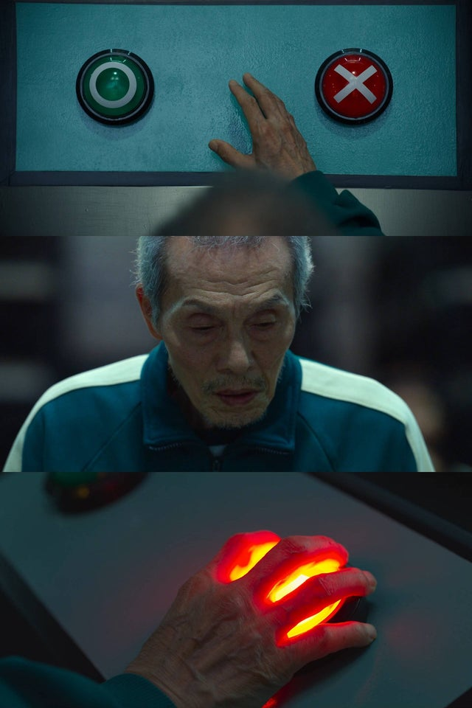
Choose Carefully
Probabilities, especially when there’s more than one involved, are not always intuitive.
E.g. Jackpot odds for 6/49 lottery are roughly 1 in 14 million.
If your work buys 10 tickets every week, for 30 years.
10*52*30 = 15,600 chances to win.
= .1%
Expected value:
15,600*$5 = $78,000
$10 million avg jackpot – $10,000 / people in pool
Even so, some people in my old job won ~$3.5m each.

Slide 13
Conditional Probability
P(A | B) = probability that A is true, given that B is true.
Conditional probability is allows us to say “how likely is X if something happens?”
E.g. If we are over 7’0” how likey are we to make the NBA?
In the 90s someone calculated that at about 14%
Some quick covid tests have reported about a 20% false negative rate.
P(Test Positive | Have Covid) = 80%

Slide 14
Probability at work

Slide 15
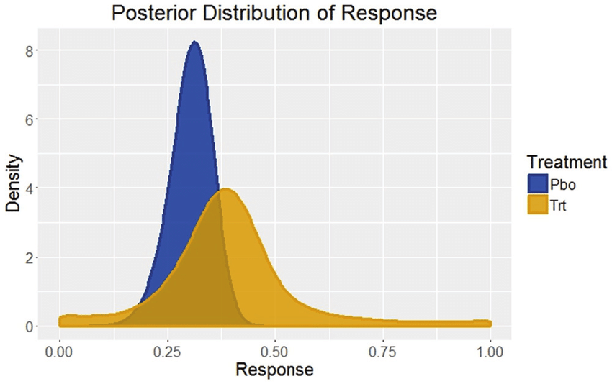
Distribution Comparison
Comparing distributions of data for a difference involves probability.
We can’t just calculate one value like mean and compare.
We need some concept of ‘different enough’ to compare all items in the set.
The overall shape of the distribution matters, not just stats like mean.
Therefore, we don’t really have an answer like ‘regular’ equality/inequality.

Slide 16
Odds and Effect Sizes
We’ve seen one way to compare distributions – effect sizes.
The effect size measures, in context of the variance, how different two distributions are.
We can also think of this in terms of probability.
Are these two samples likely from the same population – hypothesis tests.
Does this data come from a normal population – normality test.
More generically – superiority.
Two distributions that are totally different will not/barely overlap.
Two distributions that are from the same population will overlap a lot.

Slide 17
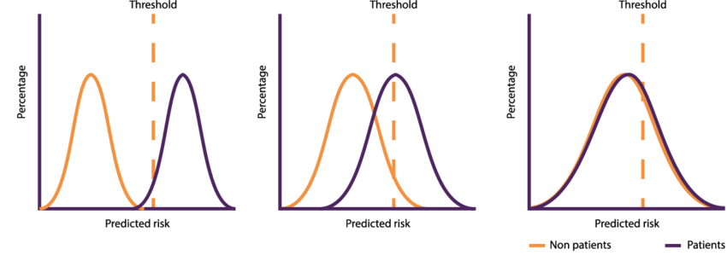
Thresholds on Overlap
Can also compare distributions by looking at their overlap.
We can extend this thinking to the idea of a threshold.
The threshold is a cutoff point that we can use to separate classes (distributions).
There are a couple of threshold calculations:
Simple – average of the means.
Complex – calculation with means and standard deviations.
Can act as a cutoff – over is one distribution, under is the other.
The purity of the two groups is the quality of the threshold.
A perfect cutoff means that we can use one value to separate the groups with no errors.

Slide 18
Using a Threshold

Slide 19
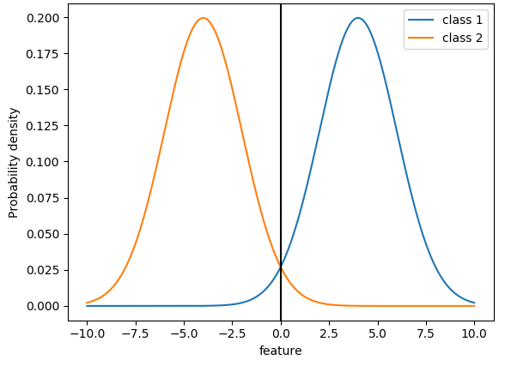
Overlap
If the two dists don’t overlap much at all, we can clearly classify into group A or B.
The overlap area is where we might make mistakes.
On either side of the overlap, we know exactly what class a value belongs to.
E.g. a value of .5 could be in either group.
A value of 8 can only be blue.
More different distributions have less overlap.

Slide 20
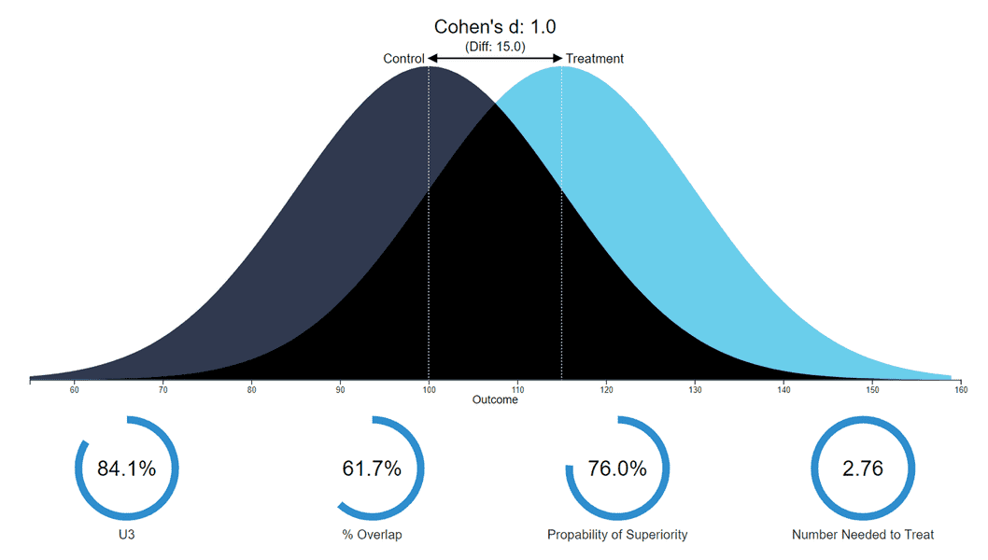
Probability of Superiority
The overlap and threshold ideas can be formed into the Probability of Superiority.
If we pick a random value from the higher group what is the probability it is larger than a random value from the lower group.
E.g. does a random treatment person live longer than a random placebo person?
This is in line with the overlap is we plot the PDFs.
https://rpsychologist.com/cohend/

Slide 21
Comparison Tools
All of these things allow us to do a comparison of distributions.
Effect size, overlap, superiority.
None give a definitive <>= result.
After we do estimation we’ll add another, hypothesis tests.
Each leaves us with some uncertainty.
Each thing is evidence of difference/similarity.
We need ‘reasonable doubt’.

Slide 22
Odds
All of this probability talk leads us to one of the most important ML concepts – odds.
Odds are an alternate expression of probability.

Slide 23
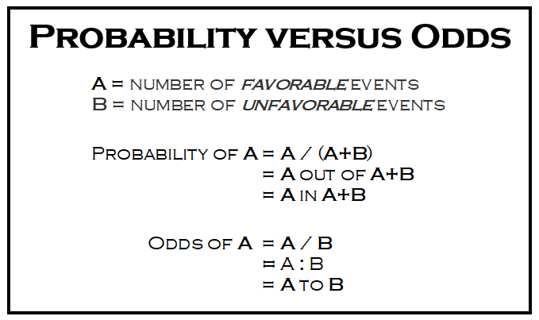
Odds
Odds are ratio to 1 to 0.
Binary – ‘true’ can be either.
We can translate at will.
Example - 80% chance of winning.
.8 / .2 = 4. 4 to 1 odds of winning.
.2 / .8 = .25. 1 to 4 odds of losing.
Translating probability to odds is needed in some places…

Slide 24
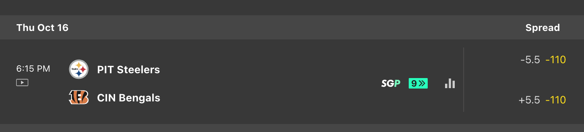
Gambling Odds
If you like gambling, odds are your old best friend.
In gambling we see both ratios and +/- (American) odds.
We often see payouts expressed in odds:

Slide 25
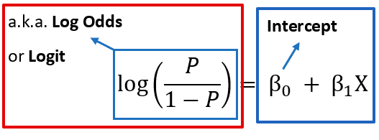
Log Odds
Probabilities have one problem (that will matter soon) – changes in each direction.
Going from 100 to 10 is a 90% reduction.
Going from 10 to 100 is a 900% increase.
Odds are useful in comparing probabilities in combination with logs.
By taking the log of the odds, the value becomes symmetrical.
This is called the logit – important later in ML.
Allows for comparisons of probabilities that is comparable.
*intercept bit of the formula can be ignored for now.

Slide 26
Bayes
Bayes theorem expands on the idea of conditional probability.
We can derive it pretty easily, by looking at examples.
It is the basis of Bayesian statistics, which we will touch on a little, but not do in great depth.

Slide 27
Probability and Estimation
The idea of probability underlies much of the analysis we want to do.
When dealing with samples, we rarely know ’the’ answer, we have uncertainty.
Core idea – based on this expectation, does the reality match that.
I.e. Hypothesis testing – what are the odds these two things are different?
Generalization – if we expand from a sample to population, how confident are we?
Answering a question is (usually) not a yes/no thing:
Are the life expectancies of treatment/placebo different after a drug trial?
Some treated people will die quick, some placebo people will live a long time.
What is the likelihood that drug people outlive placebo people?
There’s an alternative branch of stats, Bayesian, that does all basic stats via probability.

