Slide 1
Analytical Distributions and You
We can use an analytical distribution to generalize.
From the book:
Suppose we are measuring the weight of gorillas.
We have a small sample of 9 (its expensive and hard to measure them).
What if we got big gorillas randomly? Or small ones.
We don’t know the true mean and standard deviation for the population.
We have estimates, captured from the sample.
What do we know about the population and how sure are we?

Slide 2
Sampling Distributions
How can we evaluate quality of the estimations?
Play a game – the estimation game.
Generate a ‘new’ distribution from the analytical one.
Measure its stats.
Repeat and collect (means).
If the sample is bad (small, large std) we get widely varied results.

Slide 3
Housekeeping
Today (Workbook 14 and revisit 12A):
Estimating populations from samples.
Intro to inferential statistics.
Types of errors from samples.

Slide 4
Sampling and Estimation

Slide 5
Population and Samples
Recall:
Population – the entirety of whatever we are examining.
Sample – some subset that we pull from the population for analysis.
We can’t generally get a population wide dataset.
If the average height of our sample is 5’10”, we can’t just say that’s true for the population.
Our sample should mirror our population, but there is always some difference.
This introduces some error – the sampling error.
Here, we will use our sample to make estimates of the population.

Slide 6
Sample Some stuff
We frequently want to be able to use stats to draw conclusions or make predictions.
We may want to compare two distributions.
Drug trials, societal wide comparisons, testing for normality, hypothesis tests. etc…
We may want to generalize from sample->population.
How many schools vs old folks homes are needed?
These actions are probabilistic – we are calculating likelihoods.
These things aren’t definitive, we get a probability something is true.
We can also measure our certainty – if we predict it, can we trust that?

Slide 7
Matching Analytical Distributions
An analytical distribution is a model – how we expect a value to fall.
Our main goal with analytical distributions has been to match one to data.
May need some transformation like log.
Calculate the parameters from the empirical data.
Create a model that follows empirical as closely as possible.
We can use this model to generalize about the population.
E.g. how many people wear size 9 or earn over $92,000.
How do we quantify the quality of that estimate?
We can always make an analytical model, but how good is it?

Slide 8

Think Intuitively…
If we are attempting to estimate the height of people:
If our sample is the full population, we can calculate it directly – 0 difference.
If our sample is just one person, that person could be any height – Danny DeVito or Yao Ming.
As the sample size grows, the randomness of getting a non-representative sample becomes less likely.
The larger the sample size, the more reliably it matches the population, in general.

Slide 9
Error Types
Sampling error:
We are taking a sample of a population. It should be random and the stats for the sample should match the distribution, but there’s always some error.
E.g. if you randomly sample heights, and you randomly get three 7ft people, that’s bad luck.
Sampling bias:
Is the sample that we are taking representative of the population?
Easiest to think of with polling – landlines may not represent the whole population.
Measurement error:
How “off” is the actual measurement of the data?
E.g. when measuring heights, a ruler has some error.
We can’t address the last two – they happen before we get the data, we’d need to act earlier.

Slide 10
Sampling error
Any time we deal with sampling and estimation, we introduce errors.
We can’t measure perfectly, our random selection isn’t perfectly representative, etc…
These errors can stem from these sources.
Our estimations are better with less error.
We can’t mitigate or measure measurement error at our level.
We can estimate error from sampling.

Slide 11
Finally, inferential Statistics!
Our sample tells us something.
We use that something to generate a model of expectation.
I.e. if we generate new data it will follow that pattern.
We measure our confidence in those expectations.

Slide 12
Estimation
We can use a sample to draw inferences about the population as a whole:
This is what statisticians do with a census or pollsters with polls (soon-ish).
This is called inferential statistics – using stats to predict. ML grows from this.
The process is:
Match our sample to an analytical distribution.
Generate random values that fit that distribution in many trials.
Use the aggregates of those trails along with error measures to draw inferences about the population.

Slide 13
In other words…
In the matching a distribution part we establish a model for data of this distribution.
This is made from estimators drawn from the empirical data.
The model (anal. Dist.) is effectively an expectation for the population distribution.
In simulating things we:
Generate a new random dataset from the model.
Tabulate stats of that new dataset (usually the mean of the generated data).
Evaluate the results of many trials.
A.k.a. If I took many (1000+) samples from my ‘population’, what would they look like?
The population here is the model – analytical distribution.

Slide 14
Estimators
Estimators are what we capture from a sample to make a model.
Estimators are a bigger thing in math-y stats than data analytics-y stats.
The estimator is basically the thing we use from the sample to estimate the population.
For normal distribution type of things, it’ll be the mean and standard deviation.
In layman's terms, our estimators are what we use to create the analytical distributions from the empirical data. We want those to not introduce any error themselves.

Slide 15
Simple Estimator Error
We want estimators that are unbiased – or don’t introduce error.
There is error in our generalization, but these don’t add to it.
For example, mean in a normal distribution.
The mean is an estimator used to create the analytical distribution.
If you generate dist data, we expect the mean of each new sample to have similar mean.
Some will be a bit larger, some a bit smaller, but most very close.
The estimator is not introducing error – the average mean of sample matches empirical.
In biased estimators, we see a drift – new random samples aren’t centered.

Slide 16
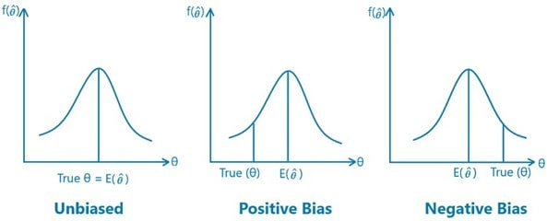
Avoiding Bias
If an estimator is biased, the samples won’t match empirical.
Get systemic errors higher or lower.
We don’t really need to know the details of this much.
In stat-y predictions this is more important.
With DS tools, we can avoid.

Slide 17
Odd Estimators
For the most part, our estimators are just mean and standard deviation.
There are scenarios where other estimators are used.
In outlier/skew data, median may make a better estimator.
Specific scenarios – there are baseball ones, but I don’t know the details.
Standard deviation – see book.
All models are wrong! All we care about are accurate predictions!

Slide 18
Making predictions – Trial Runs

Slide 19
Trials
Once we have a matching distribution, we can make predictions via running trials.
Each trial has a few steps:
Create an analytical distribution from the estimator(s).
Generate a bunch of values from that distribution.
Calculate the (usually) mean of those generated values.
Create a CDF of all of the means.
In effect, we are predicting what we expect the mean to be, based on the values from the empirical data, then making a distribution of those means.
Our estimate is the mean of those means – but how accurate is it…

Slide 20
Example - Heights
Capture sample of size N and calculate estimators (mean and std most likely).
Create analytical distribution using sample estimators.
Generate many (like 1000+) new distributions of size N from the analytical one.
Each should be mostly identical to the empirical data, but not perfectly.
For each of those new dists, calculate the mean.
Plot the distribution of the new means. (Note: diff from orig values)
If they vary little, the prediction is more trustworthy.
If they vary widely, the prediction is less trustworthy.
If the fit is good, each sample drawn from dist should match the population.

Slide 21
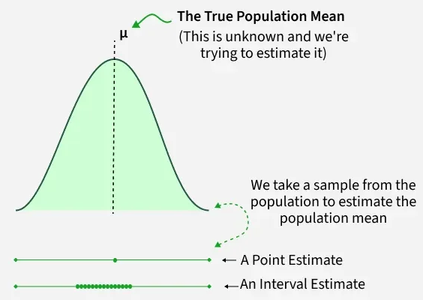
Many, many, trials
Our model defines how new data will fall.
Each trial generates one set of that data.
Our predicted mean will have values:
Varying a little bit from the sample mean.
Normal, with mean at center.
Our predicted population mean is avg.
Assuming no bias.
Our ‘confidence’ is greater the less variance.
I.e. if all generated means are the same, high conf.

Slide 22
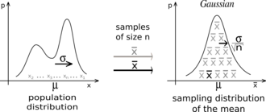
Detour/preview - Central Limit Theorem
As a note, this is an example of the central limit theorem.
The distribution of sample means is normal.
I.e. if we take a bunch of samples from a population, the means of each sample is normal.
The original data doesn’t need to be normal for this to be true.
Really important in math-y stats – parametric tools can be used.
Things like confidence intervals can rely on normal properties.

Slide 23
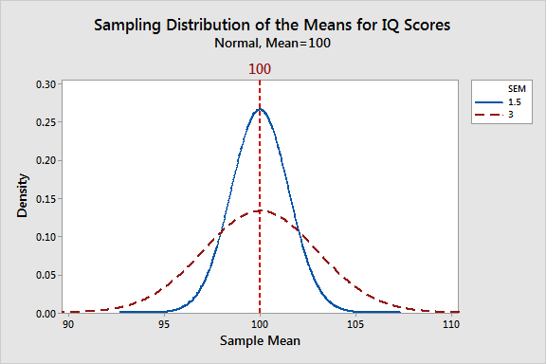
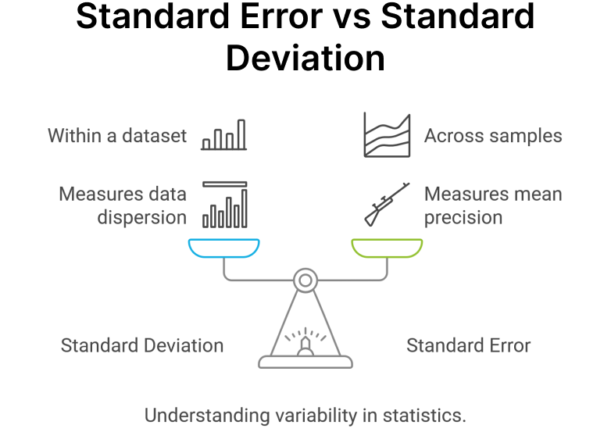
Quantifying – Standard Error
The distribution of the new means shows how similar new samples are.
Hopefully most sample means are similar.
In theory, they would be the same in a perfect world.
This is the standard deviation of the new means.
I.e. how much do the new samples vary on average.
SE = ~if we predict the population mean, how much do predictions vary.

Slide 24
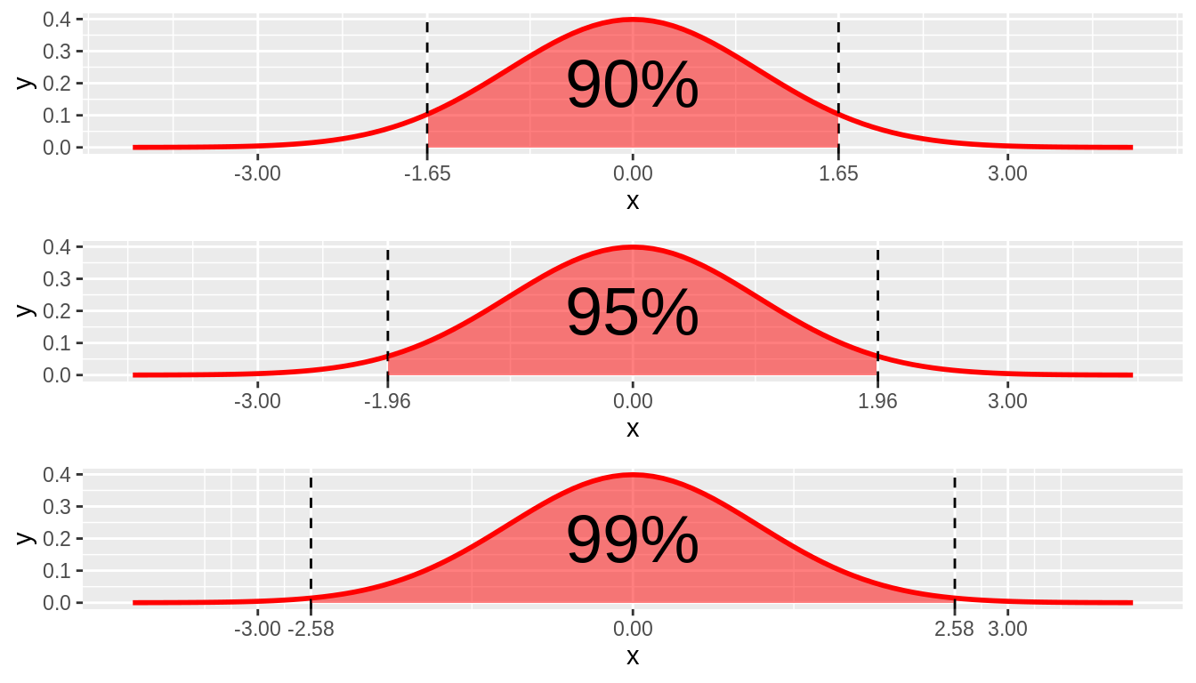
Confidence Intervals
The CI is the range in which we can expect X% of values to fall:
A 90% confidence interval means that 90% of the values fall between the two CI limits.
Confidence intervals are something that we can derive from our predictions and CDF.
The CDF is a distribution of our predicted means.
Can use the cdf/percentile calculations to get details.
A.k.a. – “We are 90% confident that the value will lie within X amount of this value”.
E.g. ”Poll is accurate to within +/- 2%, 19 times out of 20”.
Could also be a range – 90% between 18 and 22.5 - same meaning.
Remember: those means that we generated in the trial are a distribution…

Slide 25
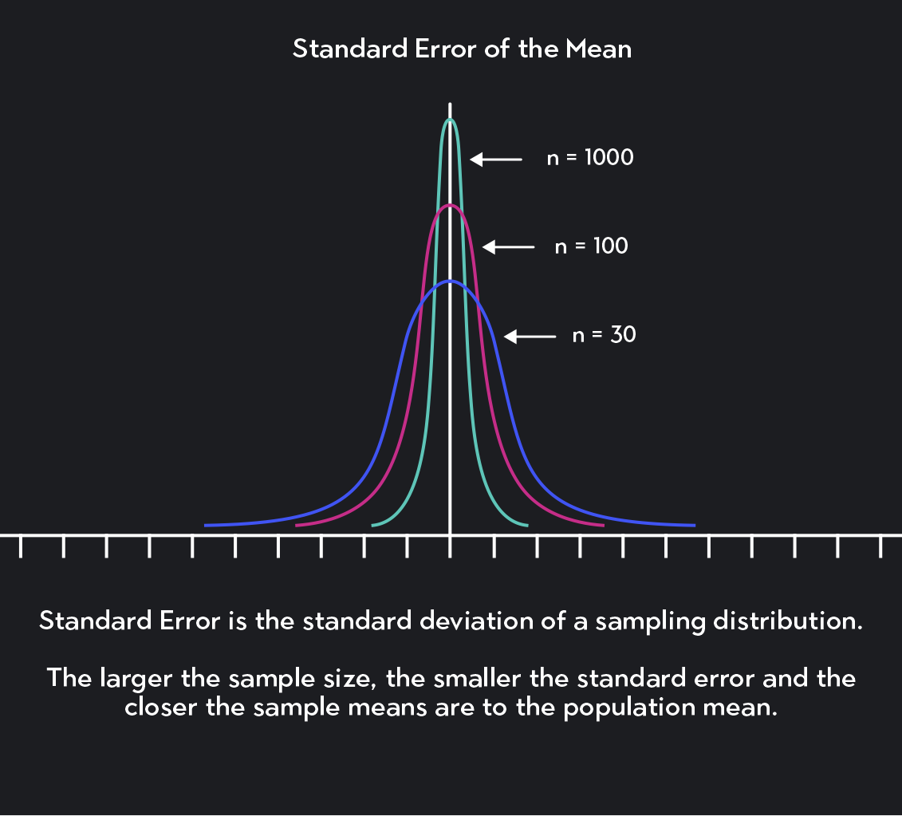
Improving
Each error source can be addressed.
Sample error:
Bigger and more representative.
Measurement error:
Better tools/process.

Slide 26
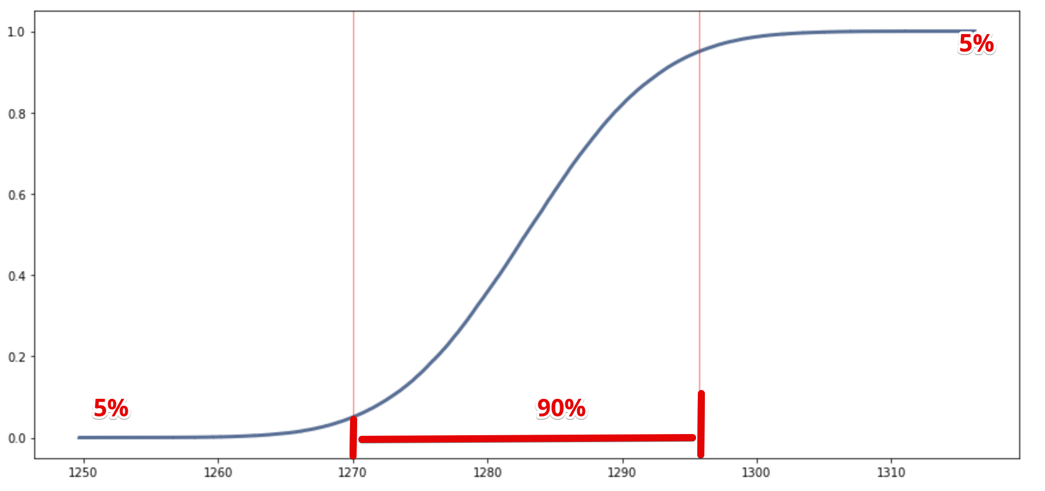

Slide 27
Estimation
We did two types of estimation:
Point estimation – predict a value, like the mean.
Interval estimation – predict a range, like the confidence interval.
We can do this type of estimation anytime we are generalizing from sample to population.
The details of what estimators are used, and the analytical distributions differs, the process is generally the same.
We’ll look at estimation from discreet distributions, like election polling, a bit later on.
We end up with both an estimate of the population, and the bounds of how accurate we expect that answer to be!

Slide 28
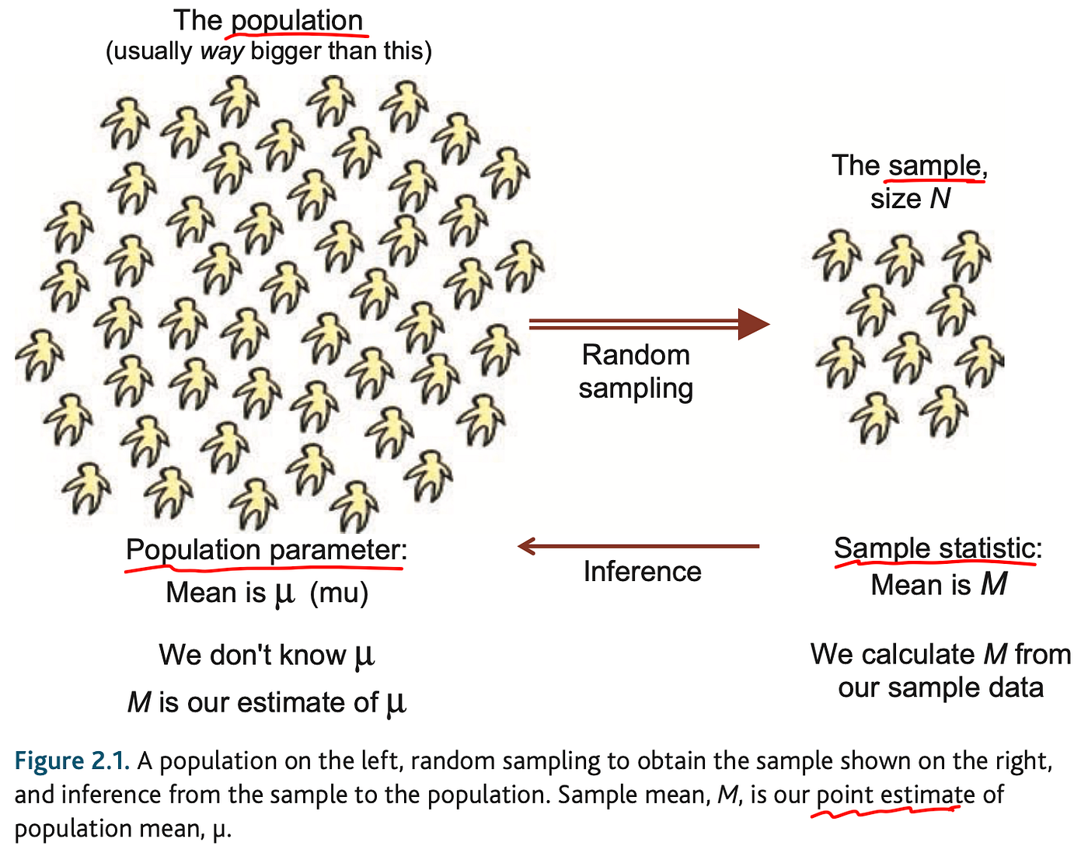

Slide 29
Estimating and Confidence
In picking analytical distribution, we state that the expected distribution is [that].
In a perfect world, every sample from a population will have the same distribution.
This won’t be true, but can be mostly true.
So, if we were to take several samples from the analytical distribution, they should match.
If we take many samples (e.g. 1000), we can observe the stats of those samples.
What range do (90%/95%/99%) fall in - +/- N, M times out of 20.
E.g. we take election poll, run fake elections with those probabilities, and observe results.
Candidate A polls at 52% +/- 2, 19 times out of 20.
When creating data on this dist, 95% of tests fell within 50-54, the other 5% outside that.

Slide 30
Accuracy and Stability
Our estimates for a population can be pretty accurate with good data.
Larger samples, more dist-like data, less variance all help accuracy.
Big application – statistics Canada and census.
Take a low-detail collection of (almost) population data.
Take a detailed collection of a random sample.
Use sample data to generalize for different populations (regional, demographic, etc…).
Estimate things like age cohorts, population change, etc… by generalizing.
Based on experience, apply corrections to data for better projections (e.g. undercounting).

Slide 31
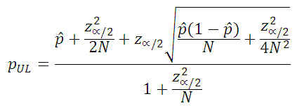
Simulations and Stats
A sample binomial CI calculation
Note: this should come together as a concept more post hypothesis testing.
In math-y stats, tools like t-tests, normal test, etc… let us do analysis.
In ml stats, our simulations can do the same/similar things directly.
For example – voting predictions (binomial distributions):
We have a sample of people (usually 500-1500), and their intended votes.
Traditional – parametric assumptions, we can calculate CI with stats from sample and premade calcs.
ML (us) – we can build a simulation based on the distribution, test it many times, and count.
The two do the same – math works but requires assumptions, simulations are flexible.
Big reason why matching a dist and making data normal matters – need its tools.

Slide 32
Simulations Continued…
With our trusty toolset, we could use any probability to simulate and predict.
We have a probability (could be anything) of X happening or of having X value.
We can build that probability into a model (analytical dist or it could be anything).
Once we have the model, generate many sample distributions.
Tabulate results into answer and confidence.
The only part that really changes is defining the probability distribution.
Our judgement determines its accuracy – “what dist pattern does this data follow…”
We are saying that model (anal. Dist.) is the shape of the data, so generated data follows.
Think of any other scenario….

Slide 33
Conclusion
We can use estimation to predict population stats with small samples.
We can use probability and errors to establish confidence in our prediction.
This is inferential statistics - making predictions of the unknown.
Also the foundation for machine learning models.
Our future ML models are kind of super complex versions of this.
Always depends on judgment.
We need to match distributions, assert ‘good enough’, choose estimators, filter, etc…
We don’t really care about matching stats, we care about accurate predicting.
Chapter 8, workbooks 12A and 14 have some similar exercises – should be doable.

