Slide 1
Cumulative Distributions

Slide 2
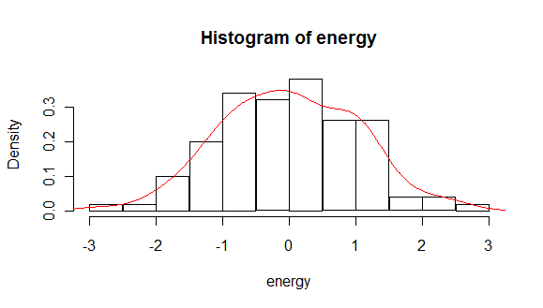
Distribution Charting
We normally plot distributions using a histogram or some histogram-esqe plot.
This shows how many results occur ‘here’.

Slide 3
Cumulative Plots
We can also look at distributions cumulatively.
How many occurrences happened ‘below’ this point.
Foundational for several concepts:
Hypothesis testing.
Percentiles.

Slide 4
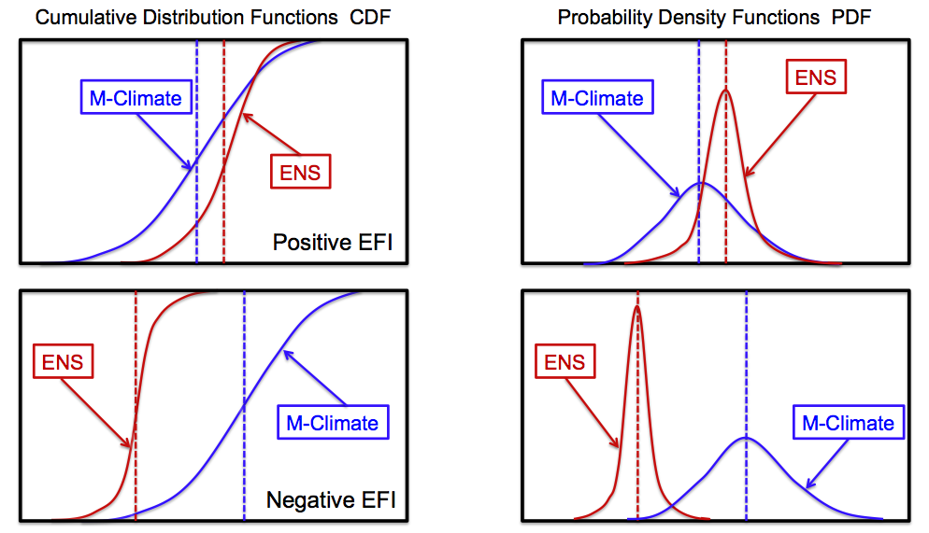

Slide 5
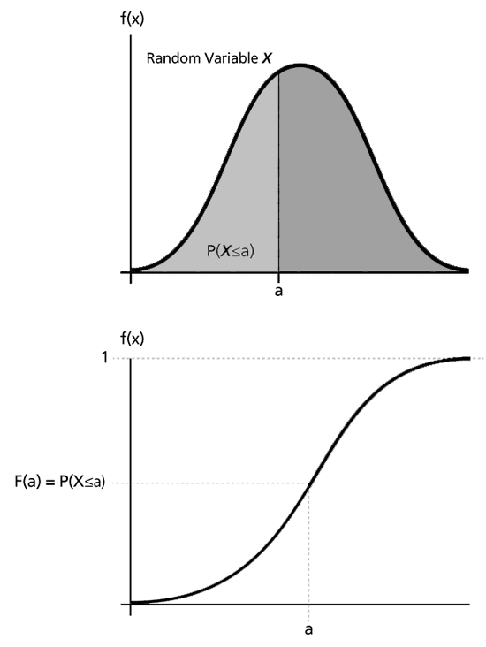
Math me, Bro!
If you’ve done some calculus, the relationships here should show.
The cumulative chart shows the total of the PDF ‘up to this point’ – the integral.
The PDF shows the slope, or rate of increase in total, at this point – the derivative.
This means there’s a calculus calculation that translates between the two.

Slide 6
Bonus – Arrays!
For this workbook we’ll look at arrays.
You’ll do this in more detail in the programming class, but these are common.
An array is roughly a fixed length/type list – one type, set length.
We can refer to a position via an index in square bracket – e.g. my_list[7]
No ‘appending’, every item goes to a preexisting spot.
Pandas specific functions don’t apply - .info(), .mean(), etc… are ‘part of’ pandas.
Otherwise, they are mostly interchangeable.
We’ll use arrays here to get some exposure – we commonly mix container types.
Many/most functions we use implement ‘duck typing’ and can be used interchangeably.
You can always convert if confused – make it work, then make it elegant.

Slide 7
What’s an Array?
An array is one of the OG data structures of modern computing.
The array represents a physical slice of memory that size.
This is why the size can’t change; it also makes it fast to access and go through.
Resizable containers are relatively new – they are an abstraction of the physical memory.
Arrays are commonly used now when we need speed, not flexibility.
If we have a fixed size set of data, doing stuff to it as an array will be faster and mem efficient.
Algorithms commonly require or convert data to an array before processing. (NN)
We typically need to convert data to an array, and commonly interact with arrays.
Python makes this a minor concern to us – thank someone for that.

