Slide 1
Housekeeping
Today:
  Analytical distributions – normal and lognormal, using analytical distributions.
    Revised/simplified workbook (009) on some of the scipy stuff. Pull for update.
  Normal testing and plots.
There’s a quiz in a week!
  It isn’t really all that hard, exceedingly complex, or super long.
  Some mc/short answer on theory + you’ll get data and calculate answers.
  Responses only in Brightspace, no code submissions, github stuff, etc…
  Cutoff for content today, analytical dists. I’ll write the quiz and a small guide this weekend.

Slide 2
Using Analytical #1

Slide 3
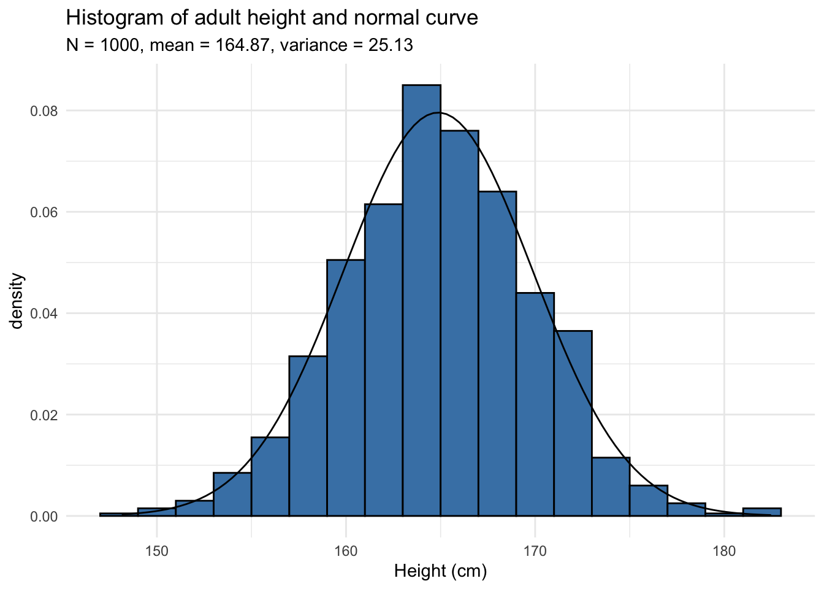
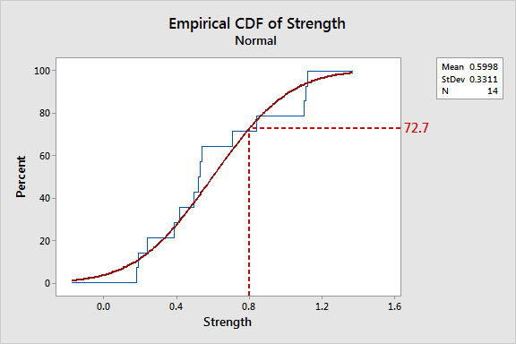
Are you Normal?
We can generally identify matching distribution patterns visually with either:
  Histogram, pmf, pdf
  Cdf
Match the shape!

Slide 4
Calculating Normality
Normal data is the most common and we have lots of tools for dealing with it.
  Including make-normal transformations to make data normal.
There are other methods of evaluating “is this normal”.
  Alternate graphs.
  Calculations.

Slide 5
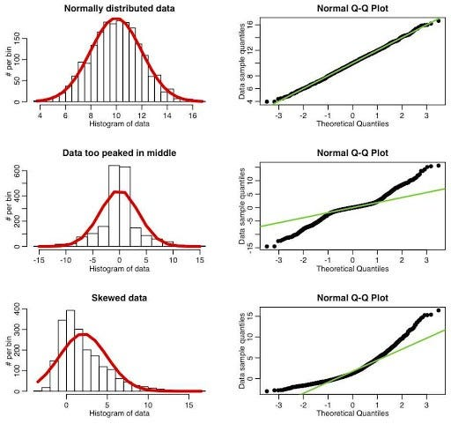
Normality Plot
The normal plot compares data to expected normal distribution.
  The line is a generated dataset with same mean, std, and count as data. Sorted.
  Dots are our data. Sorted.
Each point is the n^{th} point in a series:
  X = theoretical value.
  Y = actual value.
Chart shows discrepancies.
  Above line – values higher than exp.
  Below line – values lower than exp.

Slide 6
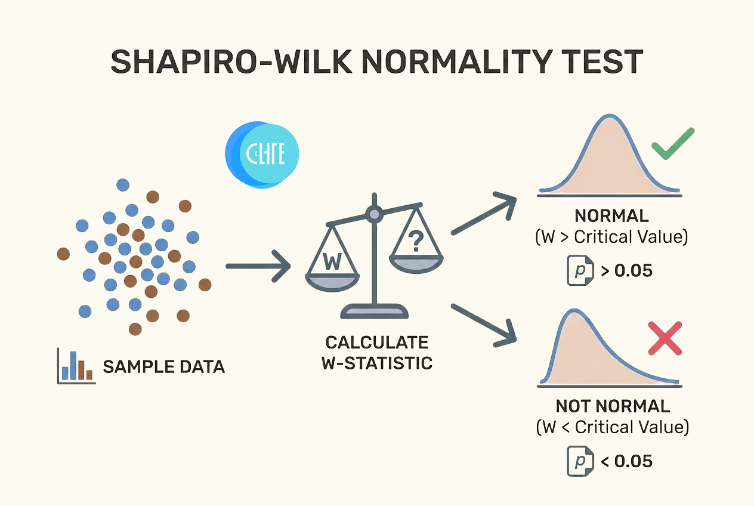
Normality Testing
We can also do a mathematical test for normality.
Version of a hypothesis test (that we’ll do later).
Null hypothesis – the data is normal.
  If p value (confidence) is than .05 (generally), reject it.
  I.e. Data is not normal.
  What are the odds the differences are due to randomness?
This isn’t necessarily better, but it is automatable.

Slide 7
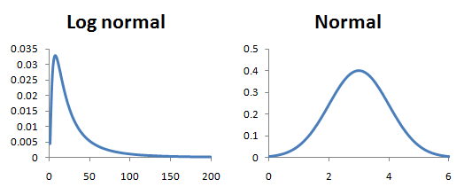
Adaptation and Transformations
This is the same concept as comparing exponential data to a line on log scale.
  The line is the expectation.
  The dots are data.
We can use the normal version on data that can become normal.
  Most common lognormal to normal.

Slide 8
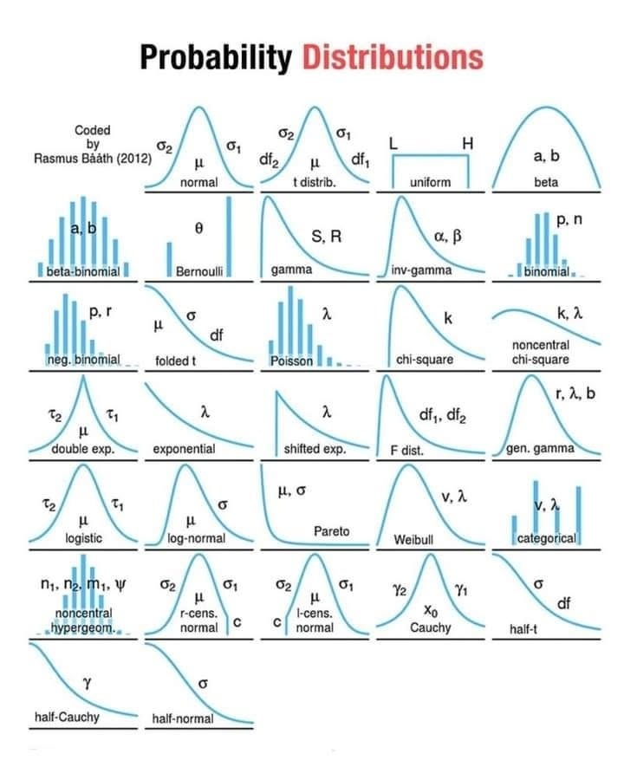
Other Distributions in (Some) Detail

Slide 9
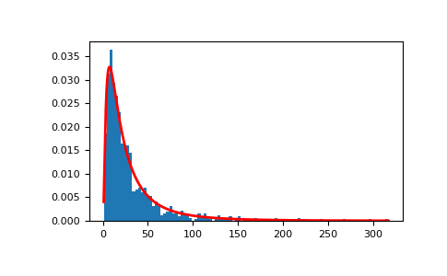
LogNormal
Lognormal distributions are defined as having a normal log.
  Y = ln(X) is normally distributed
  We need to do transformations to get normal-denominated data.
Defined by:
  Mean of underlying normal data.
  Standard deviation of underlying normal data.
Scipy variables:
  Loc = mean( log(DATA) )
  Scale = std( log(DATA))

Slide 10
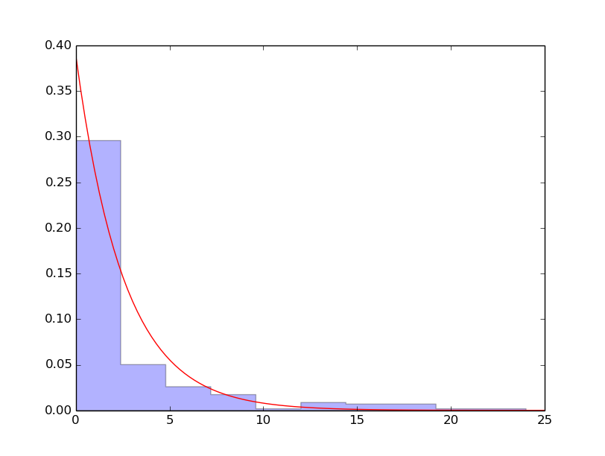
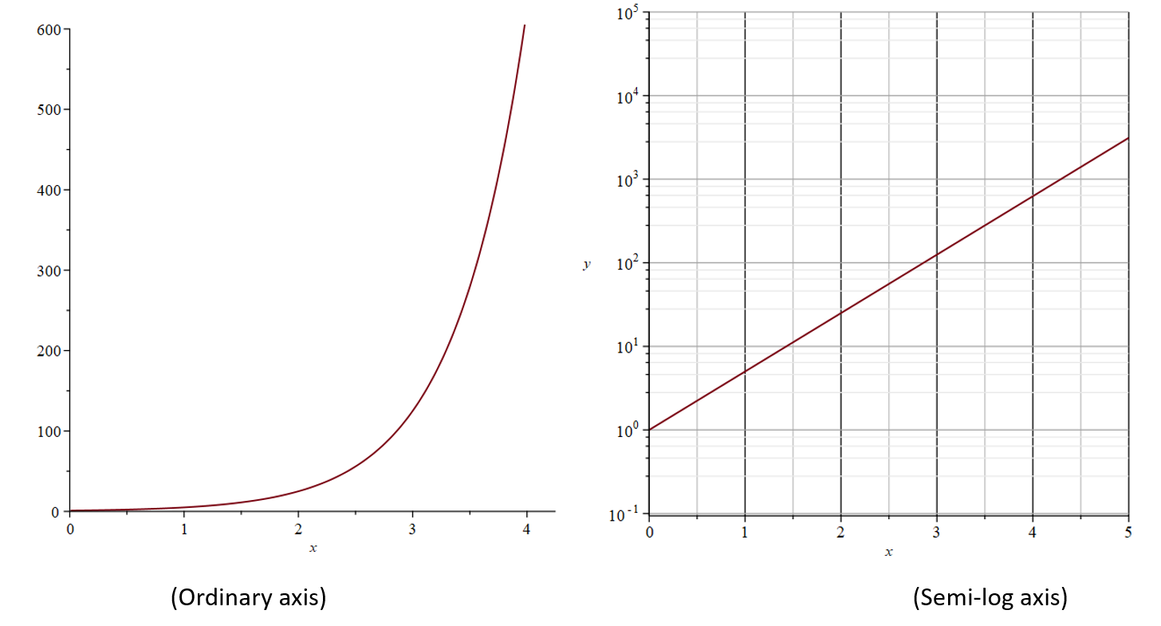
Exponential.
Defined by:
  Lambda: rate of things happening.
  Threshold: lowest possible value.
Scipy variables:
  Scale = mean.
  Loc = minimum.
Frequent in viral spread, rare occurrences.
Can do log plots to check fit.

Slide 11
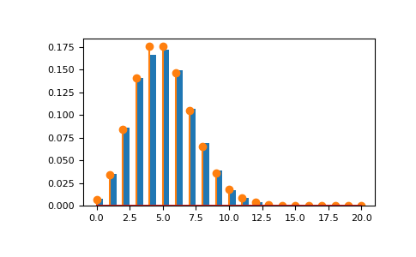
Poisson
Poisson distributions discreet distributions, commonly used for things like number of customers or goals in a game.
  Only takes on discreet values.
  No fit function, we have to do it by hand.
Defined by:
  Mean: mu.
Scipy Parameters:
  Mu.

Slide 12
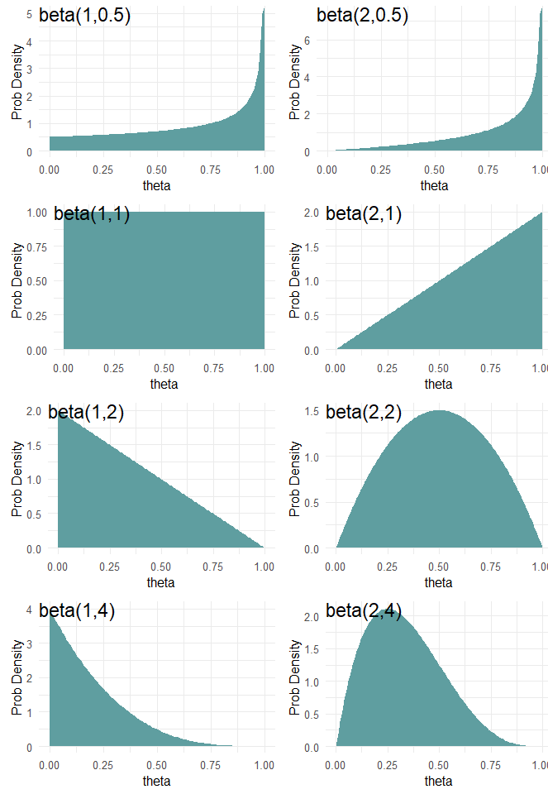
Beta
Beta distributions are continuous distributions that can take on many shapes.
  We need to fit it to get good results.
Defined by:
  A,b: shape parameters.
Scipy parameters:
  Use fit, we can’t calculate them practically.

Slide 13
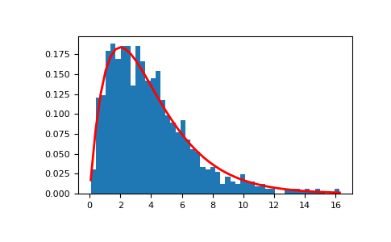
Gamma
Gamma is a continuous model commonly used for things like wait times or customer counts.
Defined by:
  A: shape parameter.
Scipy parameters:
  Use fit, unrealistic to calculate.

Slide 14
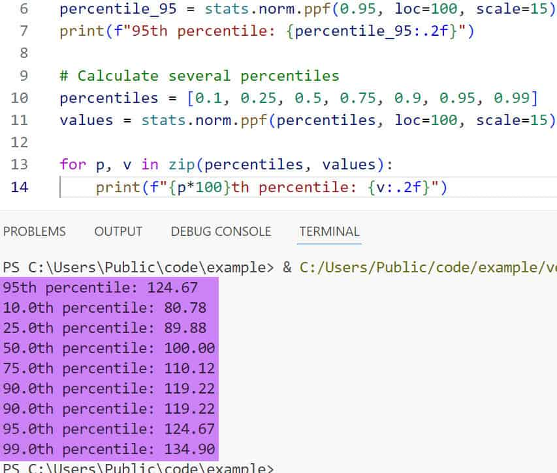
Using Scipy Distributions
We can calculate almost any distribution related stuff once one exists:
  Rvs – generate a sample following this distribution. We’ll use this lots soon.
  Cdf – cumulative calculation for percentile rank.
  Ppf – cumulative calculation for percentile.
  Pdf/pmf – probability of having *this* value.
Model is representation of empirical distribution.
  Anything we do should respond like real data.

Slide 15
Distributions to Models
These models are all

Slide 16
Key concepts
We can match empirical to analytical with charts and/or calculations.
Once the analytical is established, we know the expected shape of population data.
  We can calculate the mean and std (or other values) that define the shape.
We are making an assertion, with error – this distribution models this data well enough.
  Well enough varies, depending on application.
  More representative and larger samples mean less error introduced.
In practice, in code, the analytical distribution is a source of new values.
  We can generate samples that match the distribution.
  We can use these to test or generalize.

