Slide 1
Ravel – Why???
Sometimes you get an error that has a big explanation then says, “…use Ravel()”.
Ravel flattens data 2D->1D here.
  This contradicts the “always reshape” thing I normally say.
  If you look in sklearn docs, some require 1D, some take either.
I stick by the ”always reshape” (even though it isn’:
  It will make the prep stuff the same for every scenario.
  With neural networks, you can stick with the same process.
  If you need to change, that ravel message will warn you.
Ultimately, look up the needed shape for model’s fit() and do that
  The “always reshape” rule is a shortcut that gets us something that will work, or warn us.

Slide 2
Housekeeping
Today (workbook 025 – I updated it, so pull if you haven’t. Same content, a little cleaner):
  Classification - predicting yes/no instead of a number.
  Gradient descent basics with regression.
  Logistic regression models wth GD.
  Important – the code for this barely changes, but the GD concept is important. The math isn’t something we need, but the concept and process are. Please ask if something doesn’t make sense, it isn’t the most intuitive concept.
  Get used to looking at documentation, sklearn especially.
Plan:
  This week – classification and logistic regression.
  Next week – Bayes and probability. Survival depending on time.
  We will focus more on the non-linear stuff in January, it is the first thing we do.

Slide 3
Project
You’ll need groups of up to 4 (direct groupwork is limited).
  Open in the last week, during the exam time for normal classes.
You’ll need to generate a few classification models and choose the best.
More specifically, each group will submit one workbook, containing:
  A shared/common EDA section where the initial exploration and cleanup is done.
  A choice, based on EDA of K approaches to make models.
  Each person’s specific prep, model, results.
  A shared/common discussion of those results and evaluation of the best.
We’ll cover enough to start today, enough to finish next week.

Slide 4
Classification and Logistic Regression

Slide 5
Recall – Linear Regression
Until now, we’ve only looked at linear regression – a regression model.
  Regression models predict a value – price, sales, # of cycles before failure…
  Regression models are defined by their target – a raw number.
To this point we should be able to:
  Load some data, perform EDA, do some cleaning/preparation steps.
  Do some pre-processing, such as encoding categorical data.
  Manage shape/structure of data to go from DF-> train/test, x/y arrays.
  Create a model with sklearn (or LLS if one X).
  Evaluate the accuracy of the model with MSE/RMSE and R2.
We don’t need to know all of this like the back of our hand, but you should be able to do it with the help of time and documentation.

Slide 6
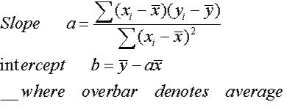
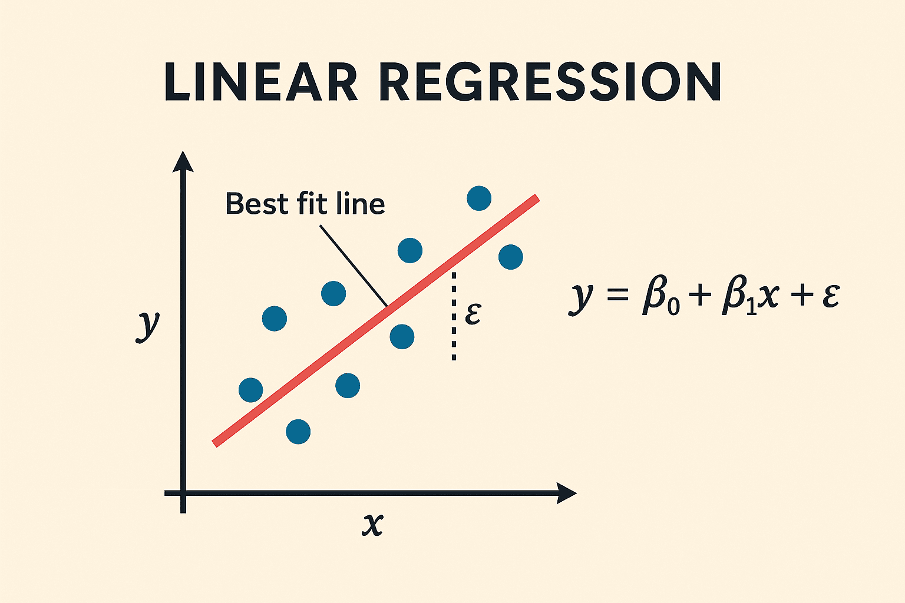
Regression Learning
A regression model predicts an output given 1+ inputs.
The “model” itself is the linear equation.
  Xs go in as an input.
  Coefficients (term we use) are ‘learned’ by LLS.
  A Y prediction can be generated for any X.
In simple linear regression, LLS can calculate coefs.
  Old (training) examples are used to calculate coefs.
Residuals can calculate error/fit – MSE and R2.

Slide 7
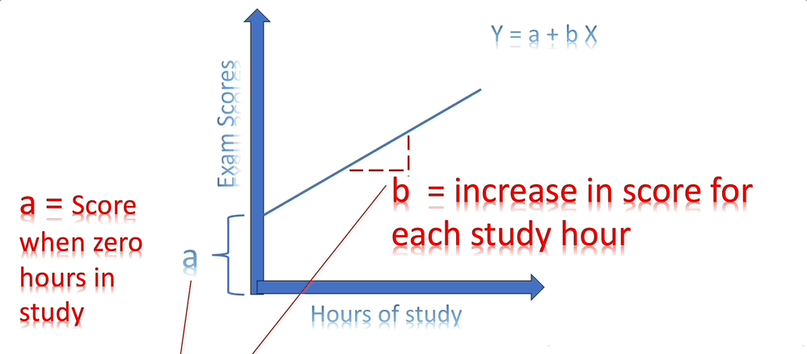

Slide 8
The Coefficients
The coefficients represent the slope(s) and intercept.
  Slopes scale relative importance of Xs.
  Intercept shifts entire model up/down.
LLS provides the correct values directly.
In most cases, this isn’t done, we use different methods.
  If data is very large, LLS can be slow.
  We may have millions+ of X values.
Other models (SVM, NN…) use linear models as a base, small performance differences matter when done millions of times.

Slide 9
So how do you do it…
We can find the coefficients using a process called gradient descent.
Iterative:
  Make a guess.
  Observe error.
  Adjust values.
  Observe error…
We will look at a quick example of the concept of GD in regression, then look at how we can use it in classification – same idea, more complex math.

Slide 10
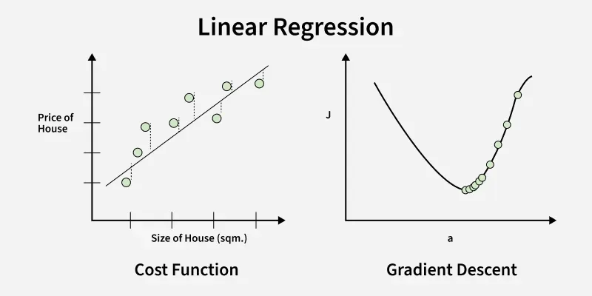





Gradient Descent
First, make sure these assertions make sense to you:
  Left chart is the data. X=size, y=price.
  Right chart is error. X=slope, y=error.
  For each coef., B, there’s a value that minimizes error.
  If B got larger/smaller from there, error would increase.
  We could plot this as a curve and call it “cost” (right).
The process of gradient descent is:
  Make some guess for B, measure error (right).
  Move B to improve error (more on how later).
  Repeat until can’t improve more.

Slide 11
Adjustments
The adjustment part can look magical.
  How to know if coef. should be bigger or smaller?
  There is a learning rate to control adjustment size.
Calculus has the answer – the derivative.
  The right chart is the error (cost) curve.
  MSE w.r.t. that coef.
The derivative is the slope of a curve at a point.
  Algo. Takes derivative of cost (MSE) at B, go opposite.
  On right, slope is positive, decrease B to improve.
  At bottom derivative is 0, that’s the best!

Slide 12
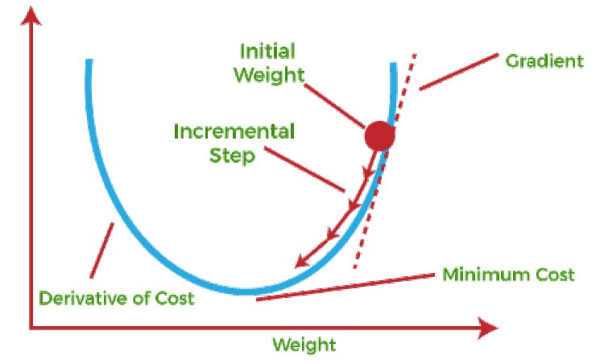
Cost Curves
The second plot is X value vs cost.
  Every different X value yield different cost.
Minimum value:
  X that yields lowest total cost.
  Derivative = 0, no slope.
This is per X variable, each is independent.
  Note: this is an LR assumption.
Can plot/find the X values that yields lowest cost.
  Dynamic – can’t calculate, we need to see.

Slide 13
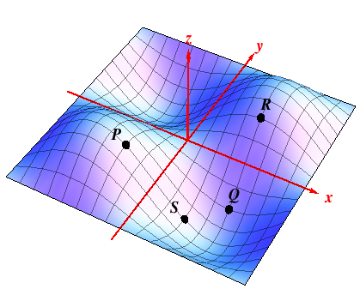
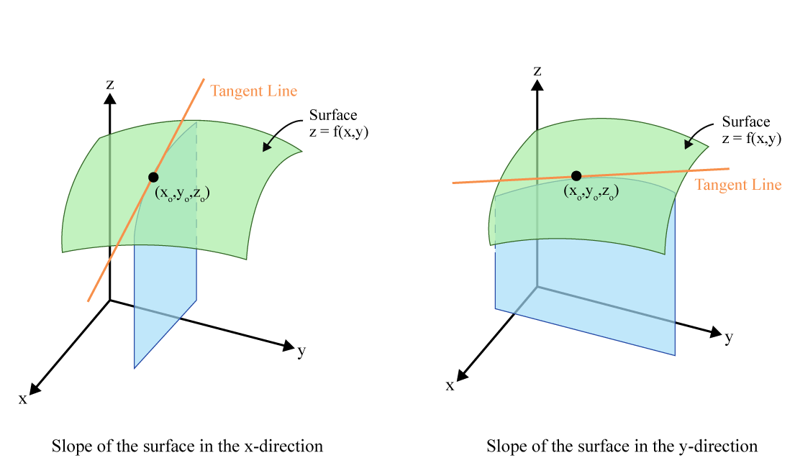
With Respect to What?
With many Xs, each has its own cost curve.
To do the adjustments, we take the slope w.r.t. that X.
There’s a separate slope for each X.
We are optimizing each X to get a minimized shared error.
  They can’t be done one by one, they’ll interact.

Slide 14
Gradients Keep Descending
This gradient descent loop is the “training” that can take a long time.
  Try a value, see if it is good, calculate improvements (derivatives), adjust, repeat…
This process is a direct replacement for LLS calculation.
  GD is faster as data gets large.
  Outcome is an estimate, while LLS is correct.
  There are several varieties of GD that can be swapped with each other.
  In theory, any process/calculation to get good parameters would work ok.
Each coefficient is decided like this on its own.
  Values can impact each other – that’s part of the issue.

Slide 15
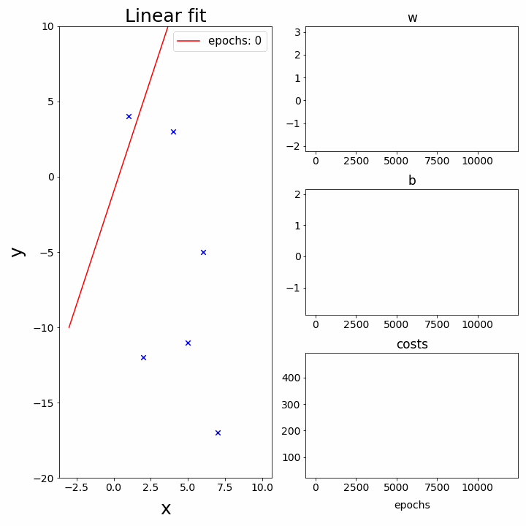
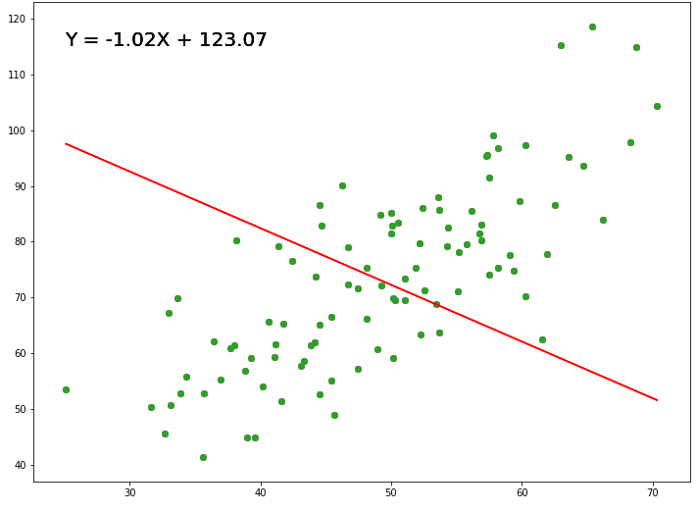
Fitting
Training can take place over many rounds (epochs).
Each one gets slightly closer to the best coefficient values.
With large X, this can take a while.

Slide 16
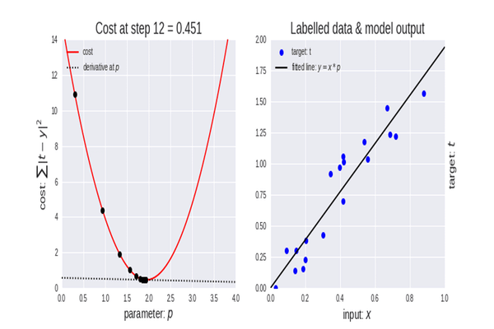
Incremental Improvement
Algorithm can start anywhere and will converge on a solution.
  Better starting improves convergence.
This is mathematically simple with convex cost curves – they are bowls.
With many dimensions, can be worse…

Slide 17
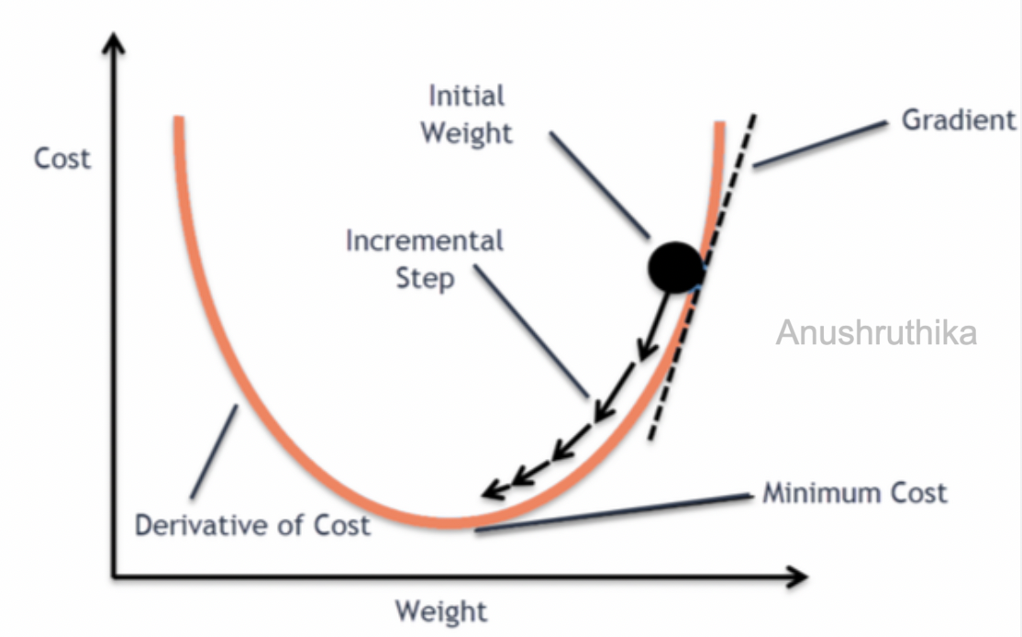
Gradient Descending
Gradient descent is one of the most important concepts in ML.
It is used in many algorithms, including neural networks (LLMs).
  Works well, but can be computationally intense.
Can allow other optimization techniques internally.
  LLS will calculate solution directly, GD can have solution found modified for reasons*.
For us:
  We don’t need to know the math, particularly calculus, but we need to understand process.
  Thinking about the results of changes to GD will matter later.

Slide 18
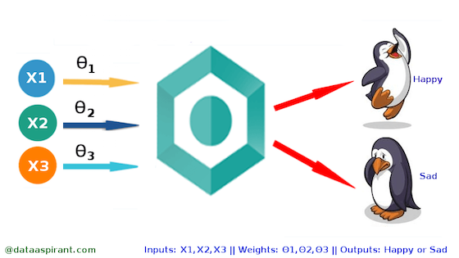
But…
What if we want to predict classes – yes/no, True/False, customer/not customer…

Slide 20
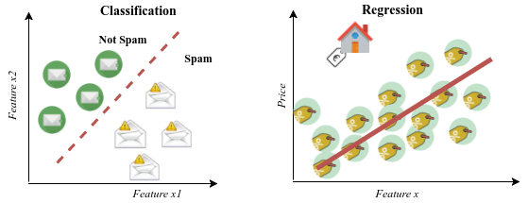
Classification Models
Classification models predict class membership, rather than raw values.
  Split the data we have into two (or more, to worry about later) separate groups.
Classification is also supervised learning.
Rather than the model ‘being’ a line, it is a dividing plane – called a hyperplane.
  The linear regression model (y=mx+b) is the same, but now splits the groups.
Most of the mechanics are the same in code.

Slide 21
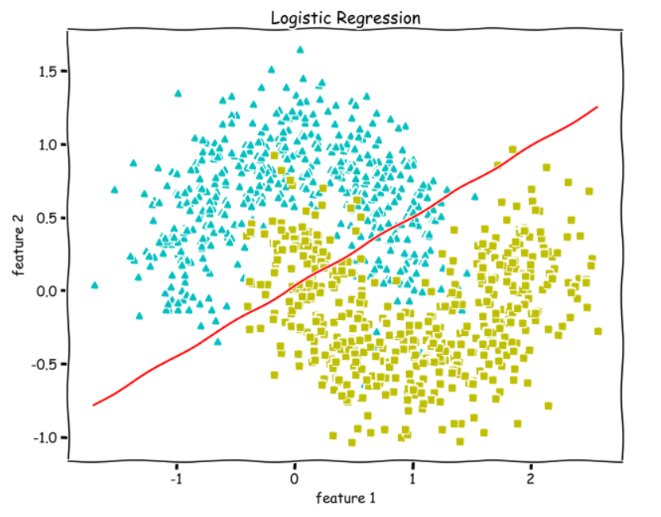

Slide 22
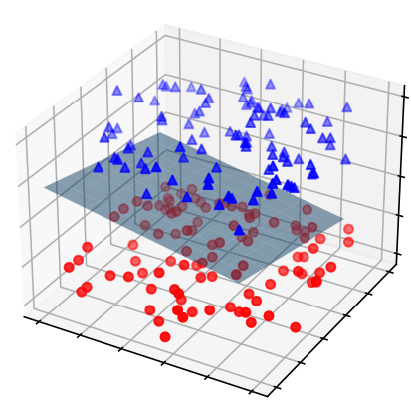

Slide 23
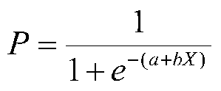
Classification and Gradient Descent
Our classifying models produce a class as their label – usually 1 or 0.
The internal calculations produce a probability:
  The probability of a 1 occurring.
The “closeness” of our predicted probability to the true value is our loss.
Just like in a linear regression, we:
  Set the weights (still the slope and intercept, but the logit arranged ones)
  Observe the cost of the model.
  Use gradient calculations to “attribute” the cost (error) to the weights.
  Update the weights to move “downwards” on the cost curve.
  Repeat until stopped or optimal.

Slide 24
Logistic Regression
The classification version of a linear regression is called a Logistic Regression.
  Logistic regression models divide data into two groups, using an internal linear regression.
  The internal process of how the model is trained (remember – in lin. reg. we can get m and b using linear least squares calculation) is more complex than in linear regression.
Logistic regression uses an algorithm to find the solution – gradient descent.
Big Note:
  In models we call the things that are “trained” the weights. Often use beta symbol.
  In a linear model, the slopes and the intercept (m and b) are the weights.
  LLS calculates these directly for linear regression, we’re finding them differently here.
  Classification is framed on probability of “an event”. Which is labeled 1 doesn’t matter.

Slide 25
Logistic Regression Baseline
Logistic regression is a classification model – separates True from False.
  I.e. one outcome is 1, the other is 0.
It uses an internal linear regression, along with some math, to work.
The ”line” is now the decision boundary – each class prediction on one side.
Each prediction is more complex than with linear regression.
  Predictions are made for “percent confidence”, which is then used to calculate error.
  These predictions are translated to T/F predictions by another step - >.5?
The model’s weights can’t be calculated directly, we need to find them.
  Make a guess, calculate error, adjust to lower error, repeat…

Slide 26
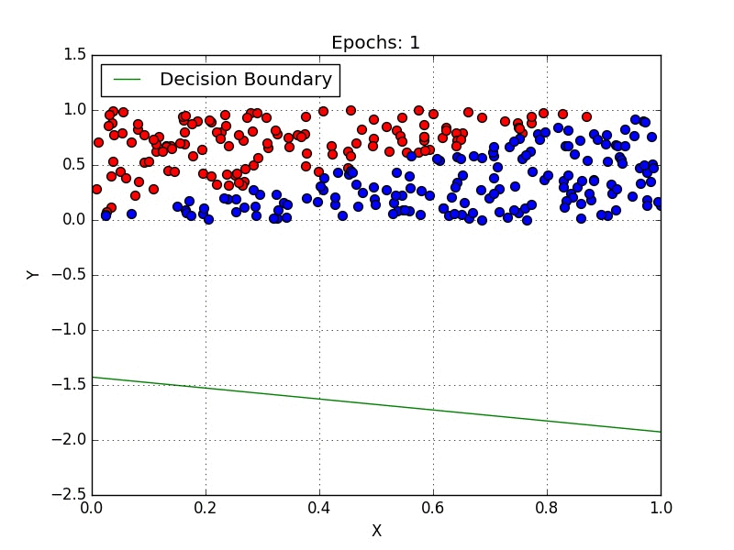
Creating a Logistic Regression Model

Slide 27
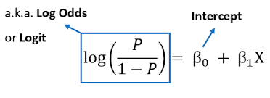
Regression and Odds
Logistic regression is a linear regression, with a few more steps to classify.
We need to define the problem that our model is predicting specifically.
  A yes/no model can be though of as predicting if the target is True or not.
  Internally, the model is predicting the probability of that yes being true.
At its core there is a linear regression that predicts probability – more specifically the odds.
  The logit is the log-odds, or a reframing of probability.
  The linear regression predicts this logit value from the Xs and weights – like any linear regression.
This definition is, for our purposes, totally pulled out of thin air – we do it because it works.

Slide 28
Logistic Regression Steps

Slide 29
Make a Guess for the Weights
The gradient descent process starts by making a guess for the model’s weights.
  A random number is made up for the slopes and the intercept.
  This guess could be anything, a better guess just “speeds convergence”.
Generate predictions for each test data row.
  Each prediction is made by the regression model.
  Each prediction is a logit – the log of the odds.
  Each logit prediction is then translated into a percent probability.

Slide 30
Each Prediction Generation
The regression provides us a prediction of the log-odds, or logit.
  Logit = ln(p / 1– p)
  The logit that the model created can be translated back into a probability (i.e. [0,1])
  That probability can be compared to the real value – 0 or 1.
  That distance is used for the cost calculation.
In training data – we know P (1 or 0) as well as Xs, just like in linear regression.
  This means we can train the model to learn the coefficients.
The translation of the logit to a percentage is done by “putting it through” the sigmoid.
  Sigmoid function takes in a logit and outputs a probability prediction between 0 and 1.
  This probability is the model’s “prediction” – it is turned into T/F later, after training.

Slide 31
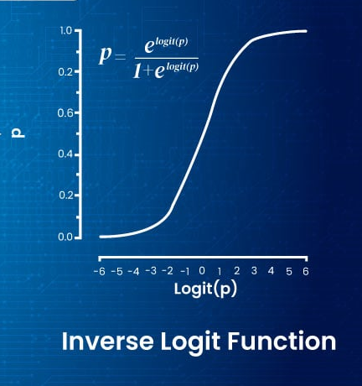
Sigmoid Function
Rearranging the logit-regression function for p yields this formula, the sigmoid.
The sigmoid function is a function that has some useful properties.
  The y values are bounded between 0 and 1, for any X.
The sigmoid takes in an input of the logit, and spits out the ‘answer’ of the probability.
  There’s some math rearranging that we can ignore going on in the background.

Slide 32
So…
There is a linear model that can be used to model probability.
  This model works like any other, only Y is logit, not raw value.
  If we have coefficients, we have a model to predict Y (and thus P).
Rearranging the function for P shows a function called the sigmoid.
  Takes in any X value as input.
  Transforms most Xs to a value much nearer 1 or 0 – closer = more confident.
With some math, we can use training data to predict P.
  Regression to logit can determine coefficients.
  Solving result for P can give model to predict.

Slide 33
Prediction Interlude
So, at this point, our model (with random weights) has made predictions for train data.
Each prediction gets “put through” the sigmoid function.
The output of sigmoid is a probability of the record being True.
Our real training data target is either True or False.
The distance of this predicted probability [0,1] and the real value (0 or 1) is the residual.
  The cost is based on distance of prediction from truth, not actual accuracy.
  The model doesn’t care about right/wrong, only residuals (which correlate)

Slide 34
Measuring Error of a Model - Cost

Slide 35
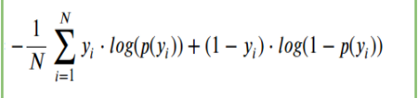
Calculate the Cost (error)
We now calculate the cost, or the amount of error in the model.
  This is just like collecting all of the residuals in a linear regression.
The cost here is not accuracy, it is defined by a Cost Function.
  The cost function is a function that… calculates the cost.
  MSE/RMSE are cost functions for regression models.
  This cost is used to determine internal model quality - it isn’t the accuracy of the final model.
Cost and loss are often interchanged, technically loss is one prediction, cost is all.
  This distinction is rarely significant, and the terms are largely used interchangeably.

Slide 36
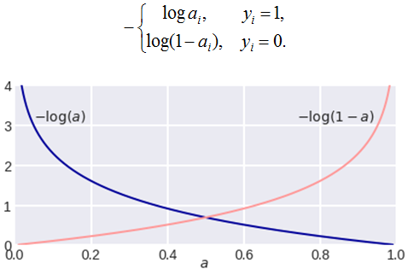
Cost Function
In a two-class classification we use Log-Loss, or Binary Cross Entropy.
Log-log is based on the distances from the probability to the true answer.
Works similarly to MSE in a regression.
  Small misses are small errors, large misses penalized more.
The problem is structured as “probability that the target is True (1)”.
  Our prediction comes out as a prediction of that probability.
  Each row of training data is either True or False – 1 or 0.
  The more confident the model is in a prediction, the less the error – if correct!
The total of this cost isn’t the accuracy, but it is a measure of the model’s current quality.

Slide 37
Adjusting the Weights (Using Gradients)
After all of this, we have a model that makes predictions for our target.
  But, they aren’t really based on the data, we just made up the weights.
After the cost of the model is calculated, we need to improve it.
  The way to make a model more accurate is to adjust the weights to make the plane ‘better’.
This part seems a little magic, but it is just some calculus.
  The algorithm takes the derivative of the cost w.r.t. each of the weights.
  This “attributes” the error to each term in the equation (m1*x1 + m2*x2 +… b)
  Each is adjusted up or down in the direction that will improve the error (also via calculus).
  The size of the jumps are determined by another hyperparameter – the learning rate.
The weights are adjusted, and we start again from step 2. Until error is a min.

Slide 38
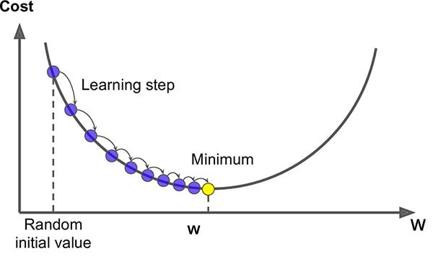
Gradient Descent Basics
Gradient descent is one, common and effective, method of optimizing.
We use it to optimize the cost function (more in a second).
The idea of gradient descent if very simple:
  Make a guess.
  Calculate the gradient (the slope of the cost curve).
  Move to make that cost lower (down the curve)
  Repeat until you’re at the bottom.
Each move gives a slightly more accurate model.

Slide 39
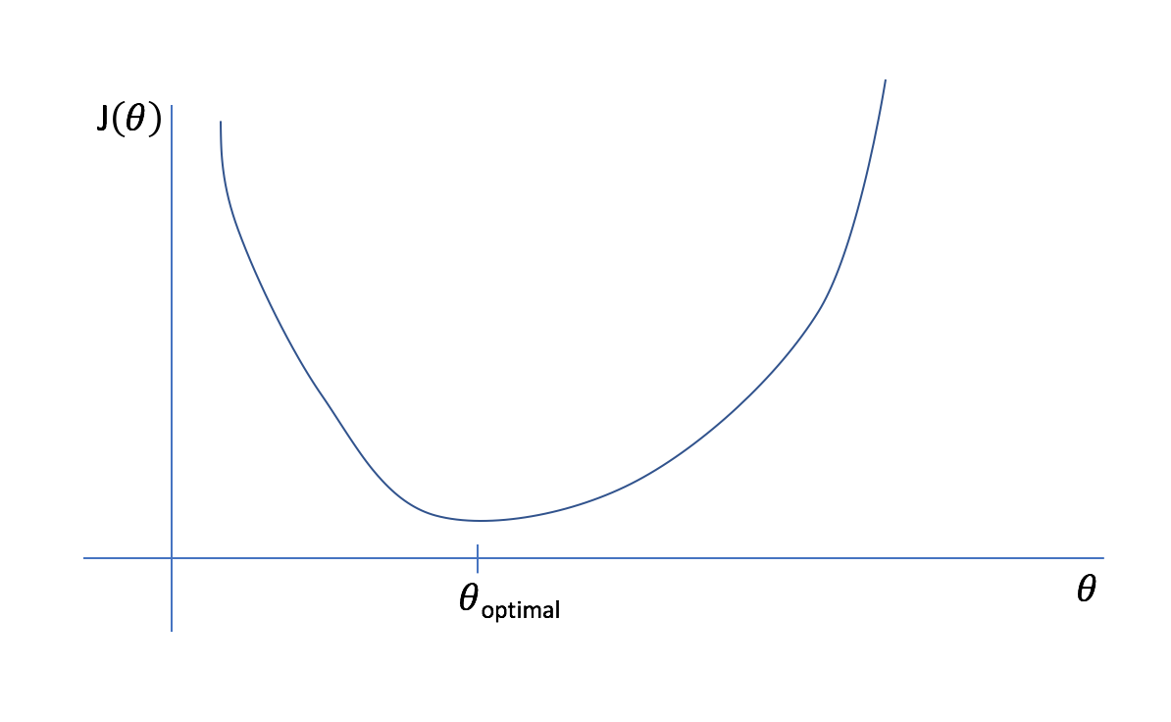







Plot of Error vs Coefficient Value (for One Weight)
Other linear models have more error.
Y = m*x + b with different m and b values.
model has the lowest error.

Slide 40
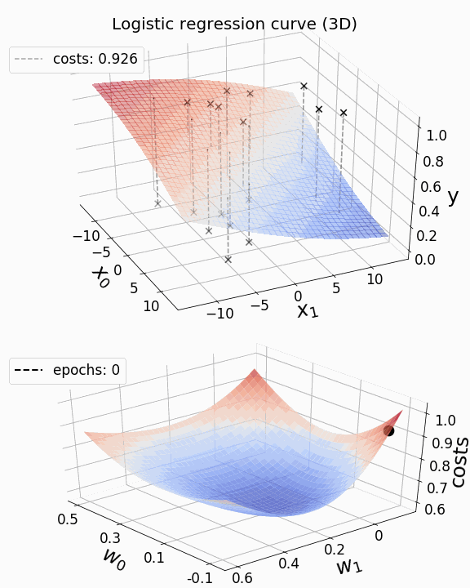
Model and Cost
This shows the model (top) and the cost (bottom) as a logistic regression is trained.
The model gets better and better at separating the data.
The loss gets lower and lower.

Slide 41
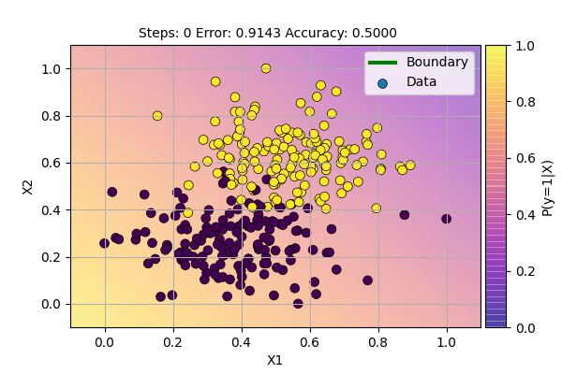

Slide 42
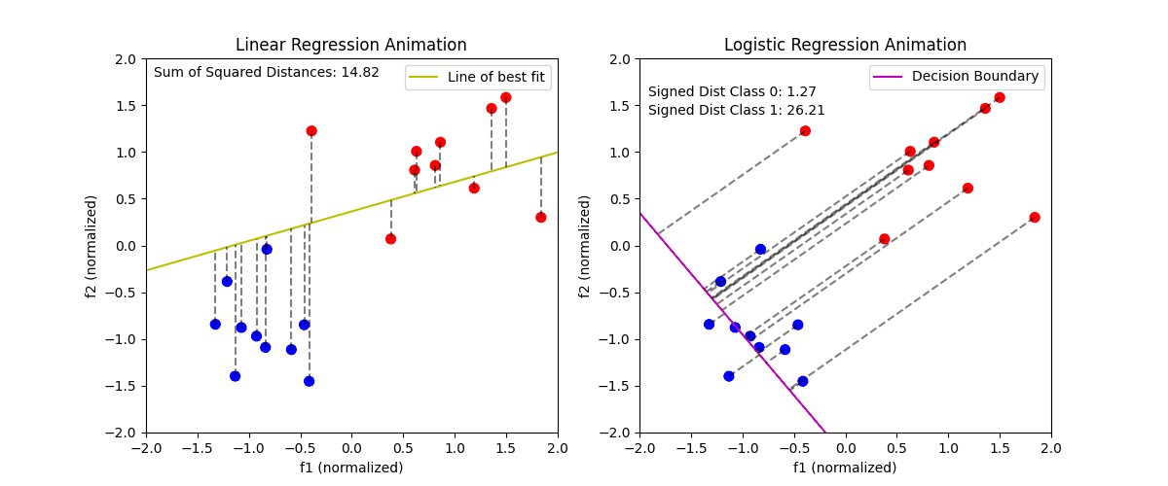

Slide 43
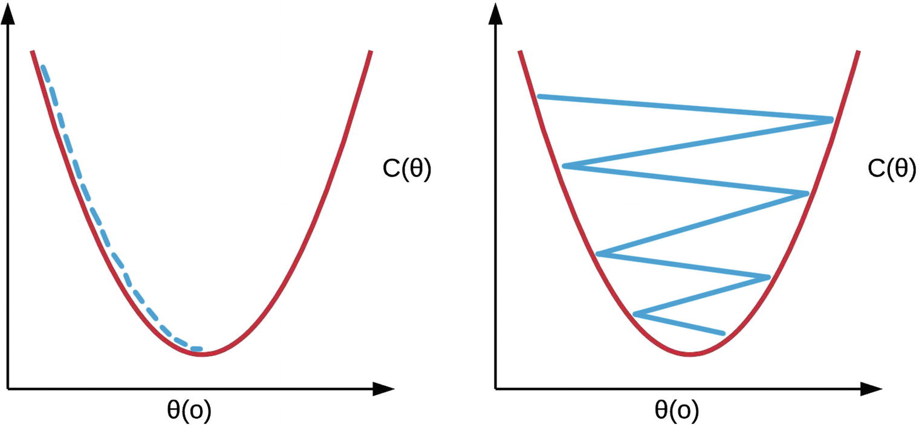
Learning Rate
In gradient descent we also have a learning rate.
The LR determines how big the jumps are.
Small LR – slow changes, unlikely to “skip around”.
Large LR – large changes, unlikely to “get stuck”.
In practice (sklearn) start big, and slow down as we converge on an answer.

Slide 44
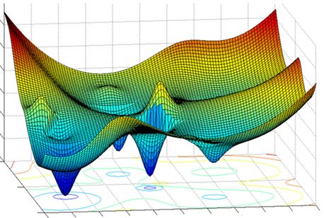
Skip Around?
With more complex data, with many features, the cost isn’t a simple curve.
There may be local minima – places where the cost dips low, but not the lowest points.
The LR needs to be high enough that we don’t get stuck.
Sklearn – jump around initially, scale down when close.

Slide 45
Gradient Descent Wrapped
Create a model that predicts the target, pick anything for the weights.
Calculate the cost (using log-loss, not accuracy) of the model at that point.
Use the gradient descent math to determine which terms are causing the error.
Adjust each weight to lessen the amount of error from that term.
Calculate the cost until we reach a min (cost doesn’t change) or hit a limit.
  This is called Convergence – the model converges on a solution.

Slide 46
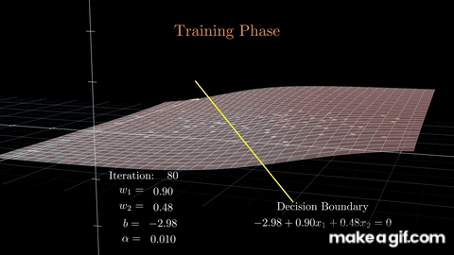

Slide 47
Gradient Descent
Gradient descent is one of the most important concepts in machine learning.
Many/most algorithms use this process (or a close equiv) to find solutions.
  Direct calculations like linear least squares is rare for actual models.
  Neural networks in particular have many rounds of GD, that’s why they can take weeks to train.
Components of the GD process (cost function, learning rate – and similar ideas) can be swapped.
  The process works in the same way as soon as there’s a cost, and the math works out.
  In our case, the details don’t matter much, but in larger models some of the details can really impact the performance and outcome of the model.

Slide 48
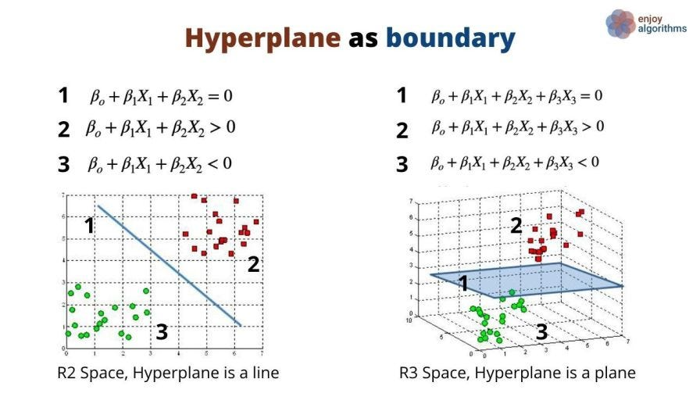

Slide 49
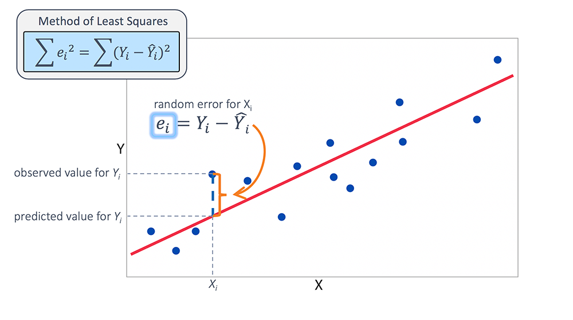
Linear Regression Error
In linear regression we normally take the mean squared error – the linear regression model is calculated by getting the linear least squares.
If we were to move our model around (up/down/angle), we’d get worse errors – the LLS point is optimal.
Think about if we were to plot that amount of error – there’d be a minimum at the current spot, and everywhere else would have slightly more error…

Slide 50
Cost Function
Gradient descent depends on the idea of a cost function.
A cost function is just a function that calculates “cost” for a model – or error.
The best model has the lowest cost, or the least error.
Common cost functions:
  Regression – mean squared error, mean absolute error.
  Categorical – cross entropy, hinge.
  Anything could be a cost function, if you had weird needs!
Cost functions are often called loss functions. Loss is technically for one input, cost is for all. 99% of the time they are interchangeable.

Slide 51
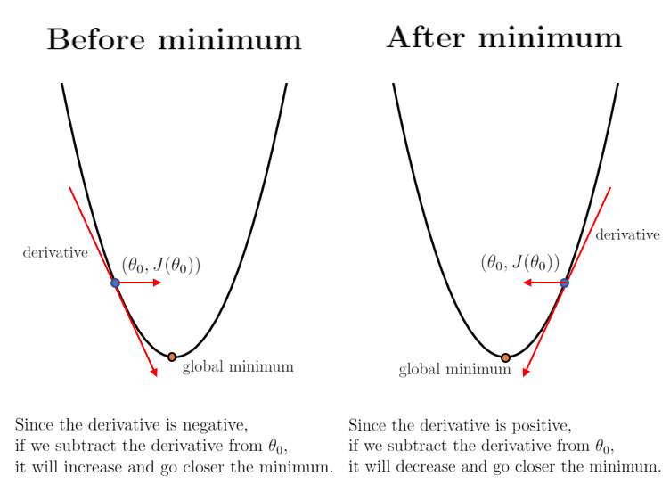
Linear Regression Cost and Descent
For linear regression the cost is normally just MSE.
So doing gradient descent we:
  Calculate the cost for where we are.
  Calculate the gradient, or the slope of the cost curve.
  Move so that we are going down the slope.

Slide 52
Shortcuts and Stochastic GD
There are a few shortcuts that we can take to save time:
  Calculating all of those derivatives can be slow!
Enter Stochastic, or random, Gradient Descent.
Instead of calculating all of the gradients, stochastic just randomly does one.
  More ’randomness’ in finding a solution, but faster iterations.
Sklearn’s implementation is Stochastic Gradient Descent (SGD).
There is also mini-batch GD, which randomly chooses a group.
Stochastic can be better when cost curves are not simple curves, as the randomness can avoid minima.

Slide 53
Conclusion and Use
Gradient descent is an excellent method for finding an optimal solution.
For linear regression, we can calculate solutions, but this is often not true.
As long as we can define a cost function, we can optimize to it.
Other applications:
  Regularization – a way to make models perform better by penalizing “growth”.
  Neural networks – GD is commonly used in neural networks to find solutions.
Using NN in particular is big on incremental improvement while minimizing costs.

