Slide 1
Housekeeping
Today – analytical distributions, part 1.
  Roughly chapter 5 today, workbook 8.
    We’ll rearrange a little – workbooks 8, 9, then 7.
    7 largely overlaps, but I think is easier to look at after.
  Matching empirical to analytical, creating analytical distributions, samples, random.

Slide 2









Coding
If you suck at coding now, that’s fine.
I know it is annoying, I genuinely apologize. You’re in a time-crunched spot.
Tips:
  Do pseudocode – list steps monotonically, in detail, in English(-ish).
  Translate each step to python, look up or search if you don’t know one.
  Use print satements and/or variable window to see values, line-by-line if needed.

Slide 3
Analytical Distributions
Part Uno

Slide 4
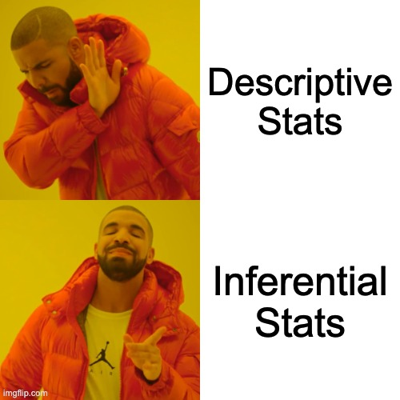
Counting is Boring, Let’s Predict Stuff!

Slide 5
Empirical Distributions
We’ve used empirical distributions, or distributions we observe from collecting and analyzing data, up until now.
Empirical distributions are the distributions of our actual data sample.
Empirical:
  Collect data.
  Look at it to see what the distribution is.
Problem - you need to collect data first.

Slide 6
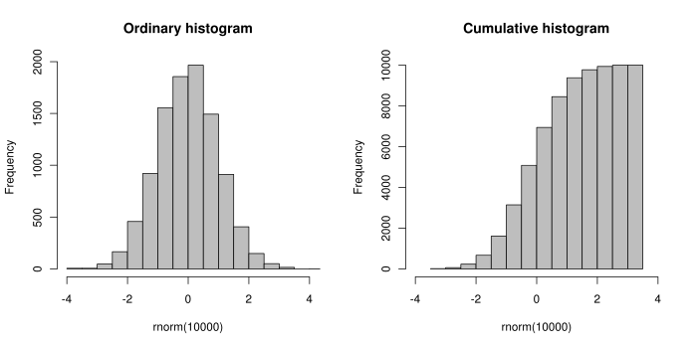
Empirical Distribution Data

Slide 7
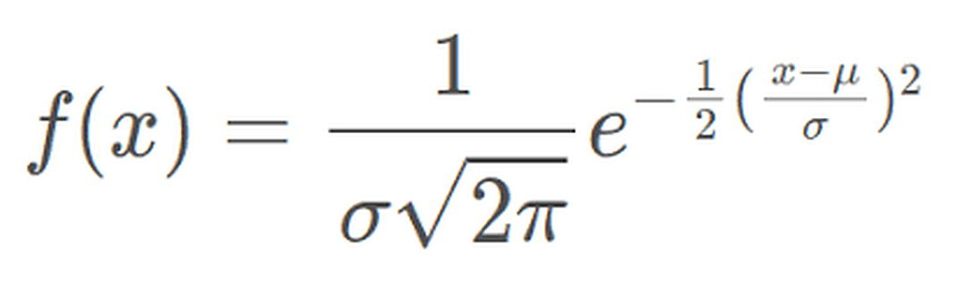
Analytical Distributions
Analytical distributions are mathematical formulas, or models, that describe a distribution with an equation.
Allow for analysis and inference without collecting all that data*.
  * More on this later.
The models of analytical distributions are simplifications of the distributions we can observe in data.
E.g. a normal distribution is:

Slide 8
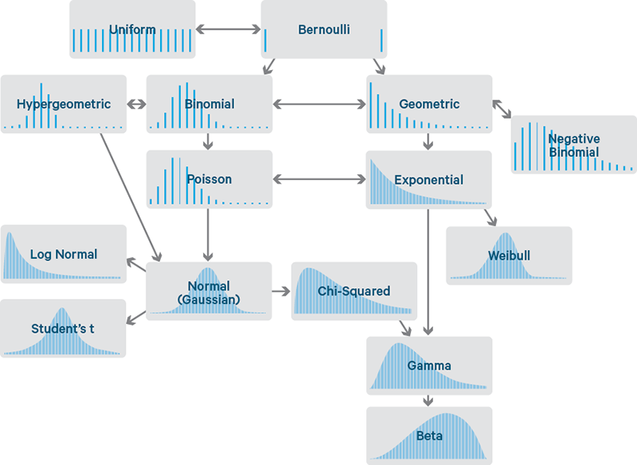

Slide 9
Be Discrete, or not
Take note of if your data is discreet or not when matching distributions.
  I.e. can the value only be specific values (shoe size) or can it be anything within the range.
Things will often work with a mismatch, but the details will be off.
  A continuous distribution may generate a shoe size of 8.353, while a discreet one would be 8.5.
We are mostly doing continuous, when not it is usually obvious.

Slide 10
Approximation
Using a simplified model instead of real raw data requires that the model closely fits, or can be made to closely fit the distribution of the real-world data.
The closer an analytical distribution is in shape to the empirical data, the more accurate and better that analytical distribution will be.
  The normal distribution on the previous slide is defined by mean and standard dev.
  If our empirical distribution is normal, we can make a “matching” one from the mean and std.
  Generalizing from our sample to a broad definition of the distribution.
Note: The book looks mainly at CDFs. I think it is a little easier/more intuitive to look at the the histogram/pmf perspective at first.

Slide 11
So…
Empirical distributions are the shapes of the datasets we collect.
  Based on reality, we actually have to count and crunch numbers.
  Limited to the data we have access to.
Analytical distributions are mathematical formulas that define distribution patterns.
  Not directly based on any real-world count, it is defined by formula.
  Not constrained by any data, values are theoretical.
We are usually searching for a analytical pattern that looks like our empirical one.

Slide 12
Side Note
The analytical distribution is a model.
  Simplified representation of a real thing.
It is never a perfect formula for reality, but it can be very close.
We use models to predict things.
  The model defines what should happen (based on the data used to make it).
  The more accurate our data matches reality, the better the model will work.

Slide 13
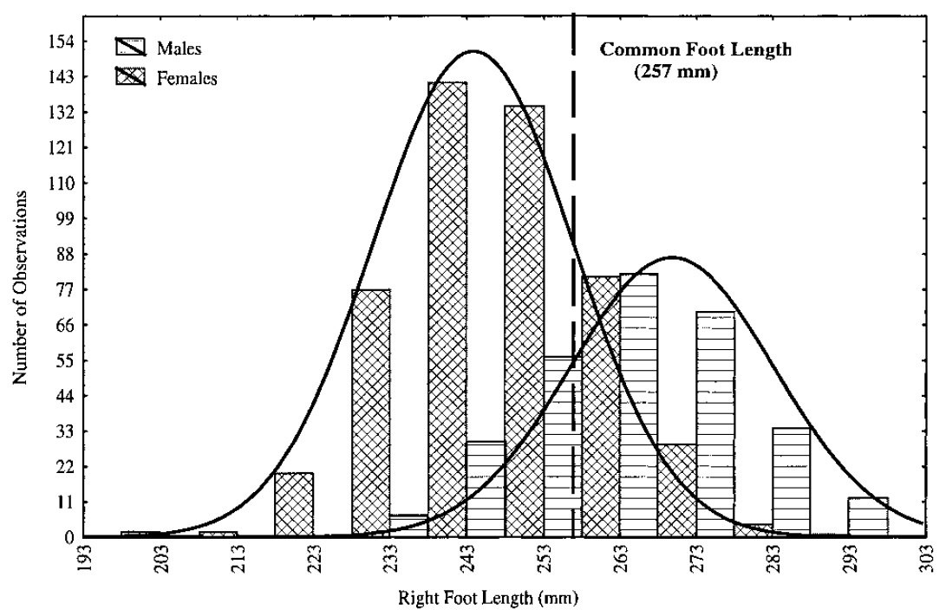
Are you Normal?
The normal distribution is used to model many real-world distributions.
E.g. shoe size - most people are close to the mean size, as you get bigger and smaller, there’s fewer people there.
A normal dist. “fits” the shape of the dist. so we can analyze that mathematical curve and infer that real data will follow that pattern.

Slide 14
Meet your Match
When we say that the data “is normal” or matches a distribution, we are saying:
  We can approximate the distribution of the data with this function.
  We expect further data to follow this pattern.
  We can use the properties of this analytical distribution to draw inference about the population*.
  We can use properties, like z-scores.
* Not without error.

Slide 15
Normal Distribution
Many phenomena can be modeled with a normal distribution.
  Shoe size, weight, grades in school…
  Most things where people tend to be close to average, and values farther away are more rare, are often normal (or close).
Key normal distribution facts:
  Symmetrical on either side of the mean.
  Median and mean are equal.
  Defined by standard deviation and mean.
  Known amounts fall within X standard deviations (~68%, 97%, 99%, etc…)
    We can use this to estimate how many records we can expect to fall in a range.

Slide 16
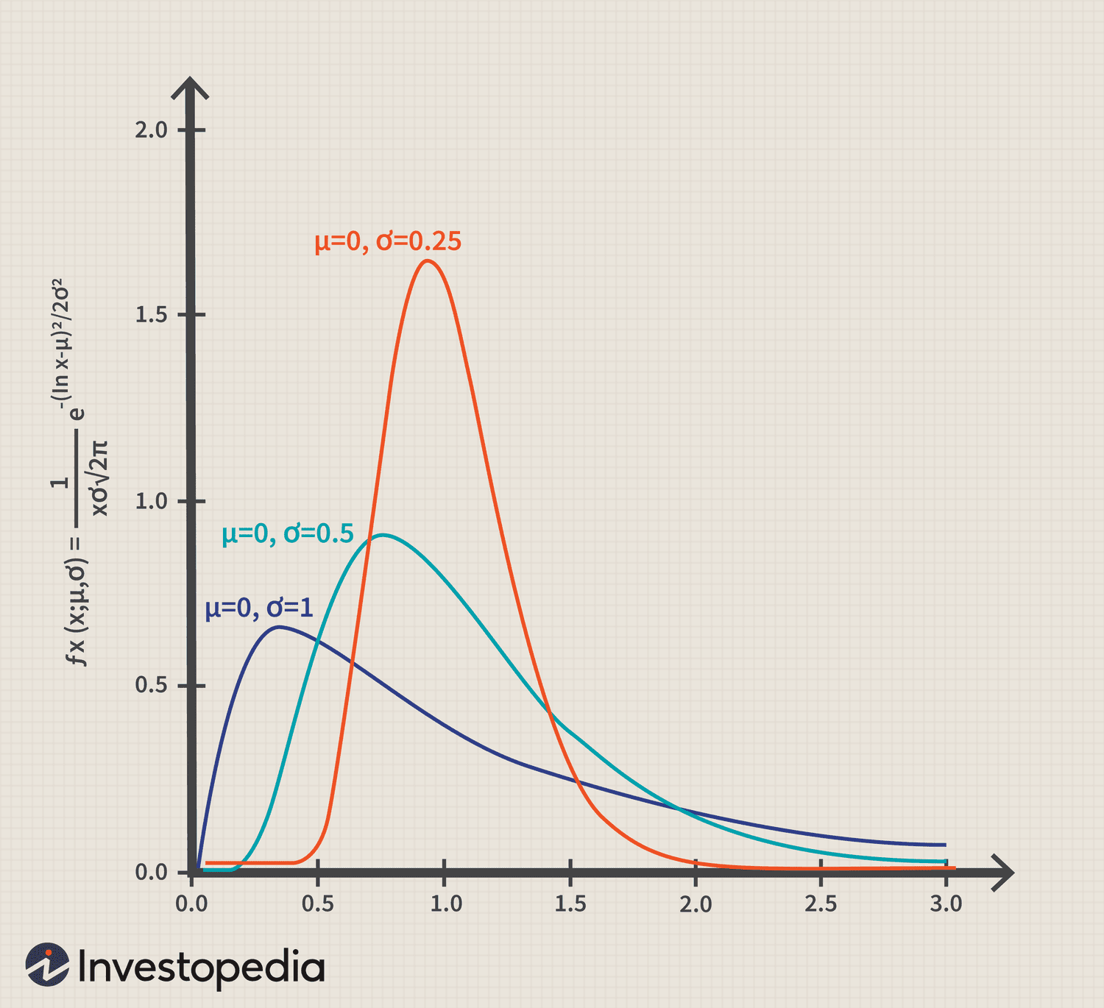
Other Distributions - LogNormal
Lognormal distributions are similar to normal, but slightly ‘tweaked’.
They have a longer right side tail.
  It is skewed to the right.
E.g. Wave heights – there are few that are really large.
Heights are slightly more lognormal than normal.
Many wealth/income things.

Slide 17
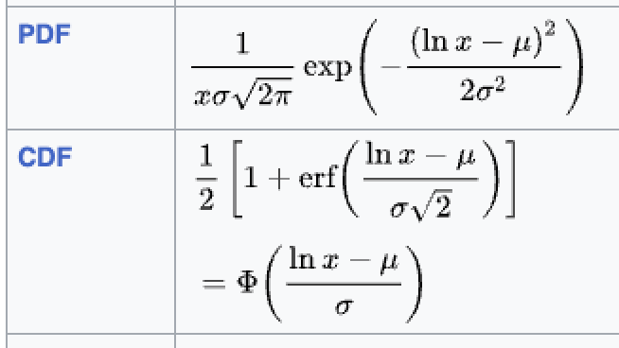
Lognormal
Lognormal data is has a normally distributed log.
  Y = ln(X)
Lognormal data can often be transformed to normal…

Slide 18
Other Distributions - Exponential
Topical – viral spread can be modeled exponentially.
The “R” value often quoted is a measure of how many people an average infected person will infect. If it is greater than one, the virus spreads; if lower, it eventually dies out.
E.g. an R value of 1.1 would mean that 100 infected people generate 110 infections, who in turn generate 121 infections, etc…
Real world models are more complex – vaccine penetration, population behavior, restrictions, etc… all complicate the math.
Note: The book looks at a slightly different exponential distribution, more on that next time.

Slide 19
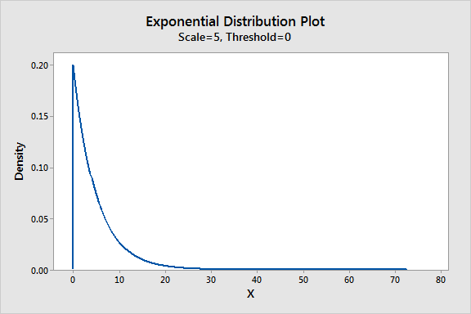
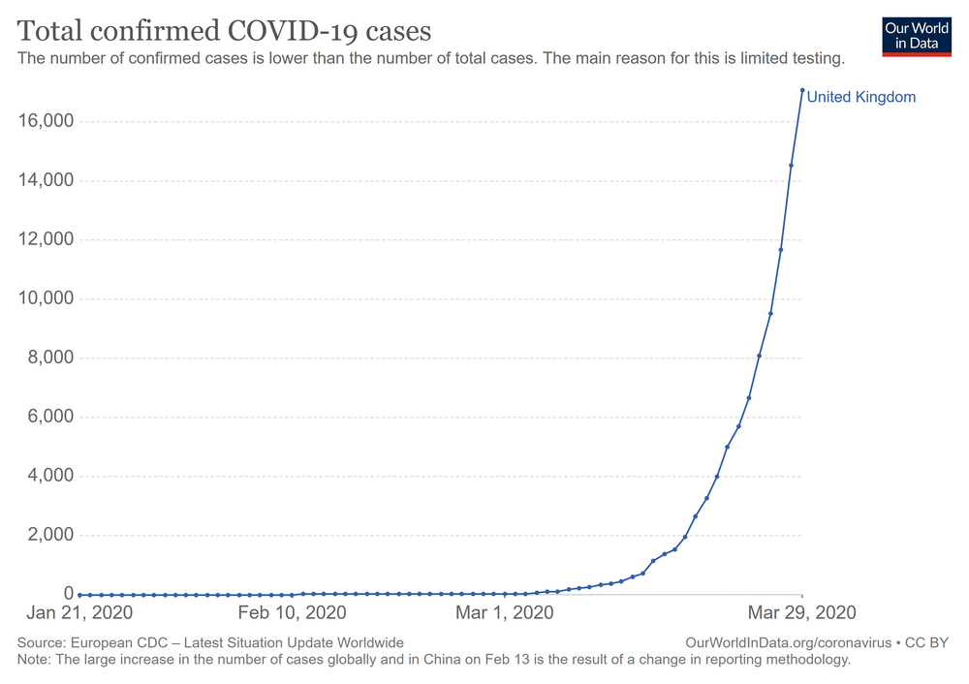
Exponential
Exponential are often seen in a time-series plot, as seen on the right.

Slide 20
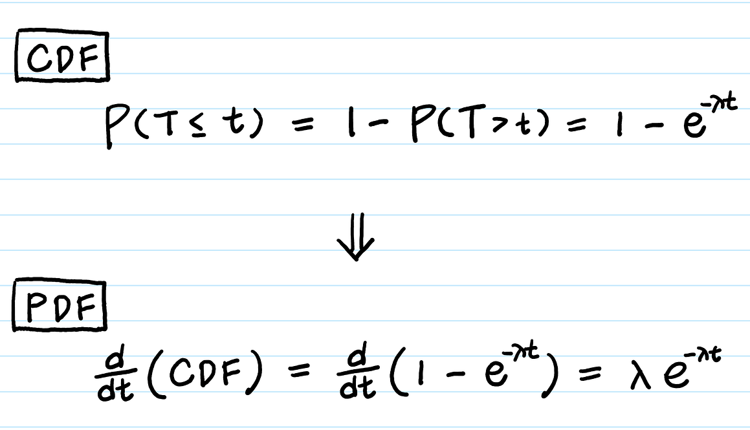
Exponential
Exponential distributions have this formula.
They are defined by a parameter lambda.
  A rate – events per unit of time.
  E(x) = 1 / lambda
    Mean = 1 / lambda
    Lambda = 1 / mean
Exponential + lambda = distribution.
Note: in scipy, there’s also loc, for the asymptote.

Slide 21
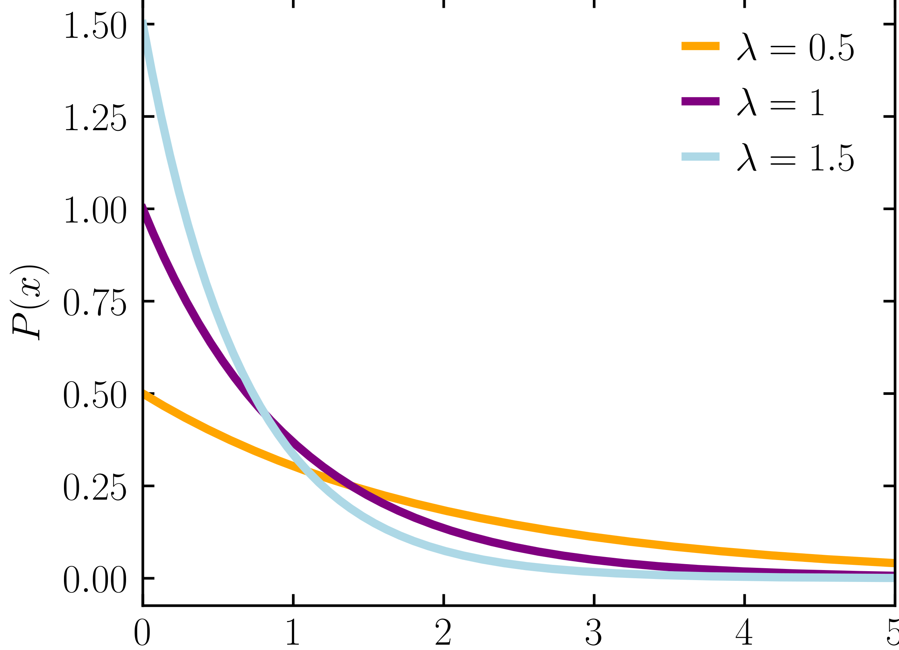
Exponential Distribution
The plot of exponential growth (normally shown over time) looks like a hockey stick.
The histogram/pmf/pdf function is the “opposite”:
  Lots of small values. (The flat, early part).
  A few large values. (The “climbing” part).

Slide 22
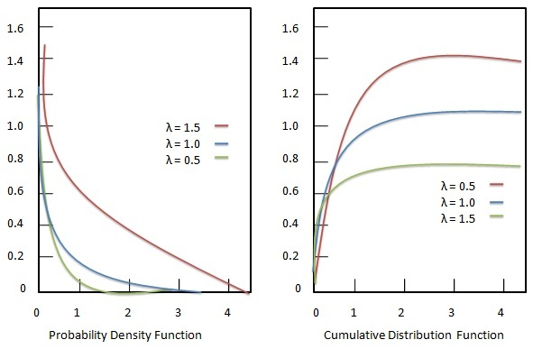
CDF your Exponents
Exponential distributions tend to be easier to match with a CDF.
  Tends to have tones of small values, a trickle of much larger ones.
  Especially if they are very steep or sparse.
It is a good idea to check the cdf if pdf isn’t obvious.

Slide 23
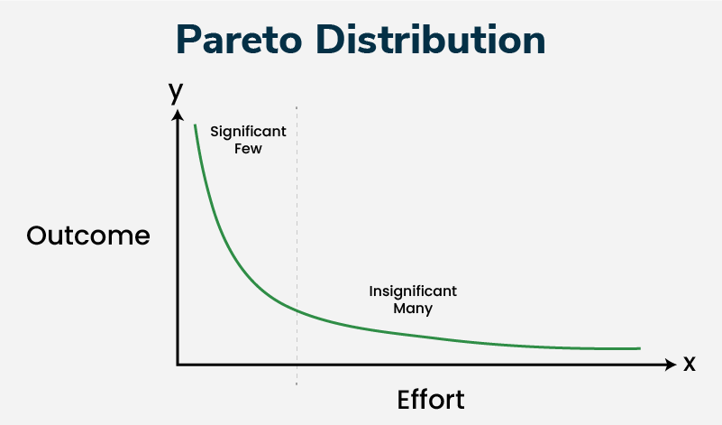
Other Distributions - Pareto
Pareto was an Italian economist from way back.
Created the 80/20 rule or Pareto Principle – 80% of the results come from 20% of the inputs.
  Original – 80% land belongs to 20% of people.
  Wealth – 80% of wealth belongs to 20% of people.
  Customers – 80% of revenue comes from 20% of customers.
The 80/20 split varies, but the idea applies in many situations:
  Microsoft – 80% errors from 20% bugs.
  Heavist <10% drinkers drink >90% of hard liquor.

Slide 24
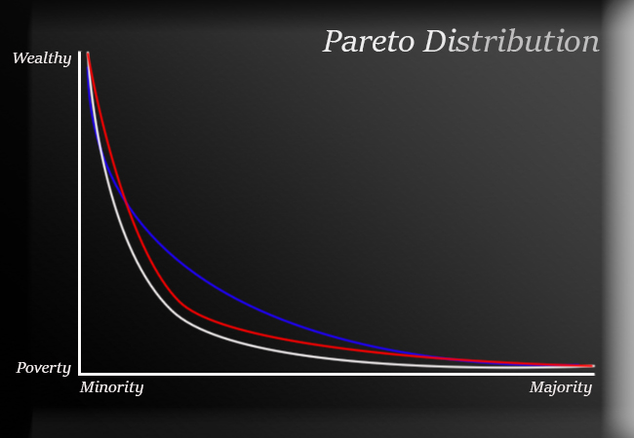

Slide 25
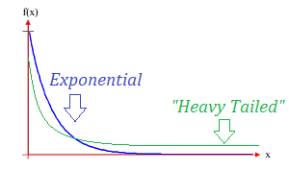
How do we Tell
You may notice some distributions are close to each other.
  Exponential can look similar to pareto.
How do we know which one is correct?
  We don’t!
We want the model that most closely matches the real-world data.
  If we can’t tell, they are likely close enough that they’ll perform similarly.
  We may be able to perform analytical tests.
  Domain knowledge or other similar data may help inform us.

Slide 26
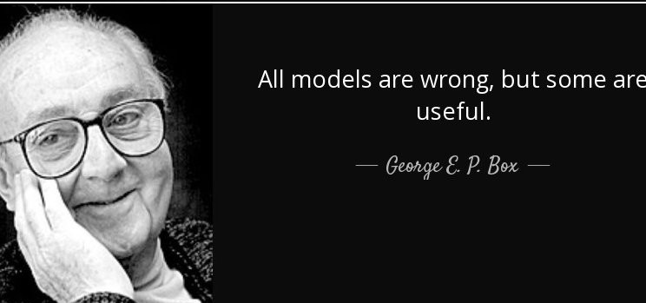
Why Bother? Great Expectations!
All models are wrong, some are useful.
Models give a simplified picture of complex and noisy real-world scenarios.
Model assumptions fill gaps in knowledge.
If a model fits something, we can use it to do calculations and draw inference.
Ex. We can try to “fit” a model to explain the spread of COVID.
  We understand flu spread and can measure the reproduction rate of covid to estimate.

Slide 27
Testing Distributions
The main way that we identify distributions is by sight.
We can also use some statistical tests to measure it.
  Details are irrelevant, basically ”how far are real values from perfect distribution”.
There’s a normality test in scipy.
  It is a hypothesis test – how likely is it that we can reject the null hypothesis of “the data is normal”.
There’s also a normality plot, where we can check visually.
This is ultimately always a judgement call, there’s no yes/no metric.

Slide 28
Preview: Hypothesis Testing
Hypothesis tests are common in things like medical trials.
  The treatment group lives X years longer, is that real?
We can frame a hypothesis test as “how likely to occur was the effect we saw in the data, just through natural variation”?
  If the treatment group lived one month longer, might be luck. 10 years, likely real.
  P=.05 is a 5% chance of the effect happening randomly.
The analytical distribution is the baseline expectation.
  If we select random variables following that baseline, how many times will it match the effect.
  For distribution tests, how frequently could data from this analytical distribution look like the empirical data.

Slide 29
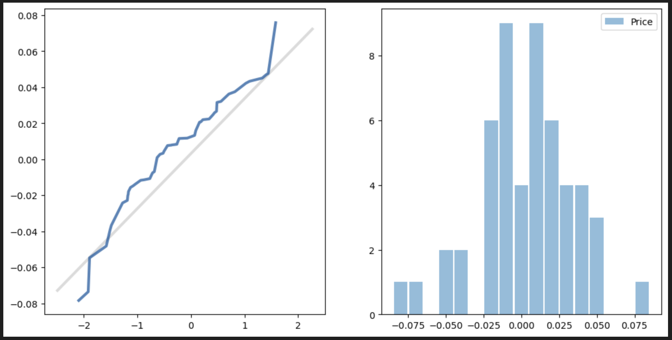
Normality Plot
Thinkstats has a normal probability plot.
It plots:
  X: a theoretical normal distribution.
  Y: the empirical data. (Blue)
We can check that the two lines are close.
  Higher: the empirical data has is higher here.
  Lower: the empirical data is lower here.

Slide 30
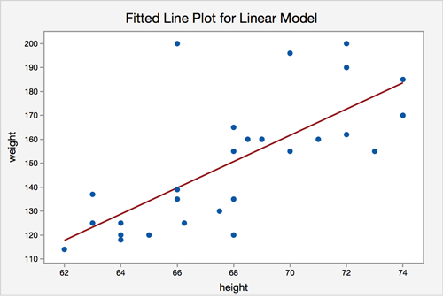
Simple Example – Use model to Predict
If someone is 67 inches tall, how much do they weigh?
Blue dots are the empirical data.
Red line is model (best fit).
We don’t have empirical data on the weight of a 67 inch person.
We do have a model that gives us an estimate, based on the empirical data.
We introduce uncertainty here.

Slide 31
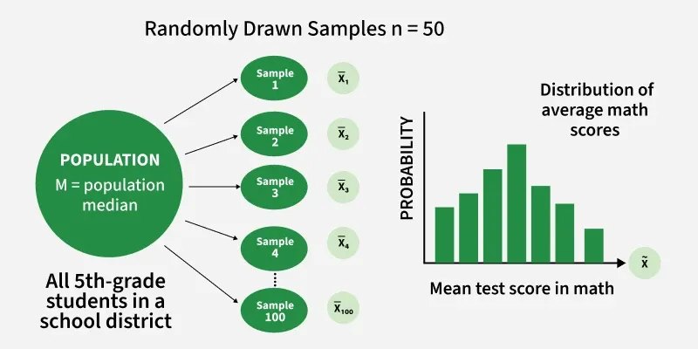
Sampling and Representation
Our data, and its stats, comes from a sample.
The population has lots of data.
Our sample is a small subset.
Our sample is representative if the distribution of the sample matches the distribution of the population.
We ‘generate’ an analytical distribution based on the sample’s characteristics.
  This inserts uncertainty.

Slide 32
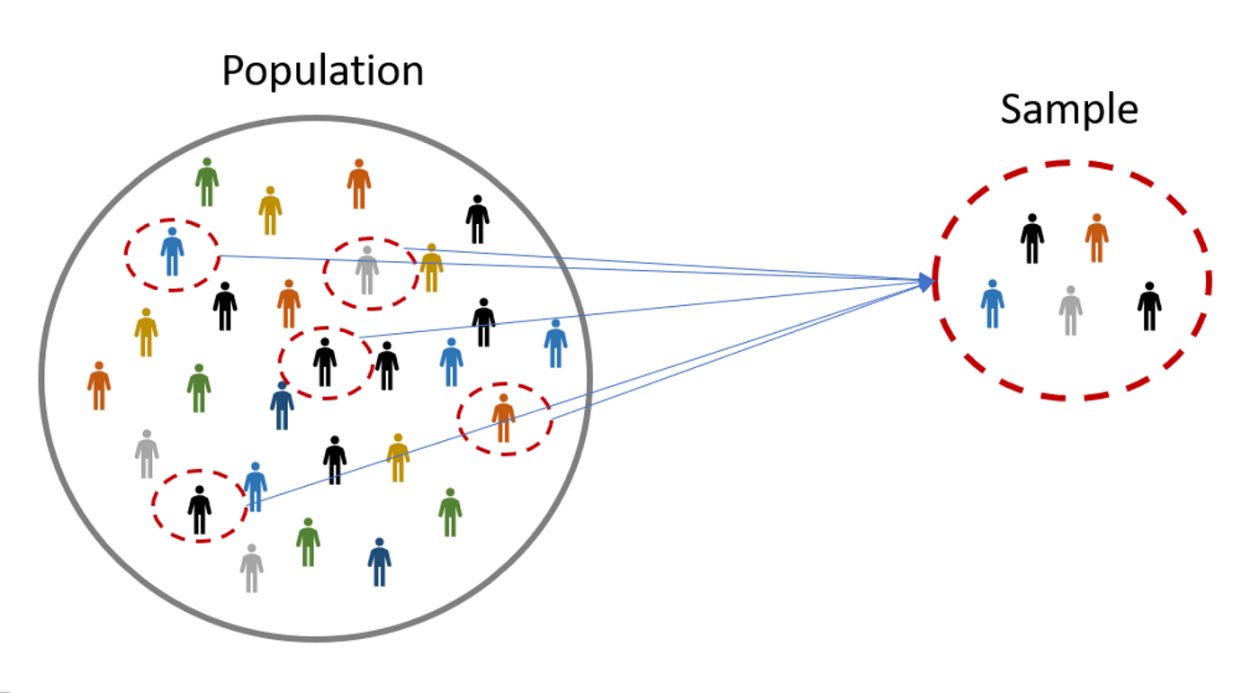
Samples May Vary
If we have a large enough sample from a consistent population, it should be stable.
If those things aren’t true, we can get variance from sample to sample.
  E.g. we are polling 100 people on their height in a university of 40,000 people.
  More samples of 100 probably vary somewhat from each other.
  This is despite them being from the same population.

Slide 33
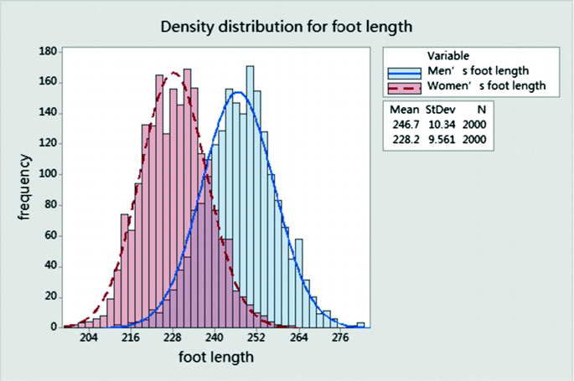
Estimation - Sampling and Randomness
Once we ‘establish’ a distribution, we can sample from it.
Sample is N random values, following that distribution.
  Density is the probability of an item of that value.
Simple example – Nike making shoes of different sizes:
  Capture an empirical sample of shoe sizes.
  Observe that empirical distribution is normal-ish, calculate mean and standard deviation.
  Create an analytical distribution with those params.
  Generate [expected sales] random variables, count number in each size, profit.

Slide 34
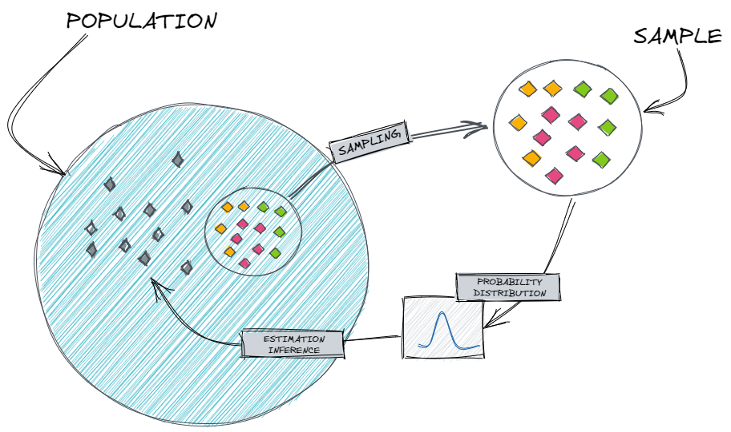

Slide 35

Transformations
While data often matches common distributions, sometimes it doesn’t.
We can help make analysis easier by transforming the data, so it fits better.
  I.e. do some mathematical operation on the dataset.
  Do the stats stuff with the transformed dataset.
  Convert between model and reality with that transformation.
Stupidly simple example – we are analyzing temperatures and we can’t use negatives.
  Do a transformation – add 100 to every temperature value.
  Do whatever analysis with the +100 data.
  To translate to real temperatures, -100.

Slide 36
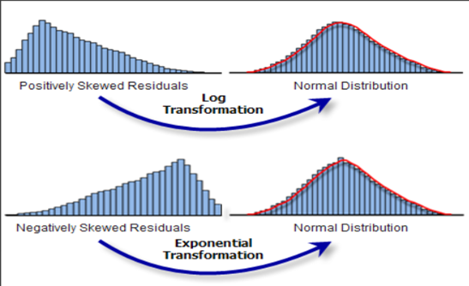
Stats Transformations
In stats, there are a few common transformations.
  Often to make data normal.
Skewed data is often transformed with log/exponent.
Exponential data can be made linear with logarithms.
There are a few others, but it could be anything.
  As long as the operation is undoable.

Slide 37
Logs and Exponents
Log and exponent operations are opposites.
  X = b^{c}
  Log_{b}(x) = c
Common to use as transformations.
  Exponential growth on a log scale is a line.
  Can make data normal for analysis.
The transformed data is easier to resolve.
  Projection for Mar 17 is easier than exp graph.

Slide 38
SciPy
SciPy is a library that we use for mathy stuff.
Here, we’ll use analytical distributions from scipy.
The documentation kind of sucks, but our needs are limited.
Most common usage:
  Generate statistics from empirical data.
  Use those stats to create analytical distribution and create random data from it.

Slide 39
Using Scipy Distributions
We need to:
  Match (visually) our data to a distribution pattern.
  Identify the key statistics the distribution needs. Normal = mean, std.
  Create an analytical distribution object that matches empirical data.
We can also auto-fit the distribution to the data.
  Match data to a distribution pattern.
  Call whateverDistribution.fit(x) to let scipy estimate the variables.
We primarily use this to generate expected values following the distribution.
  I.e. get N random values, generated from a distribution following empirical.

Slide 40
Analytical Models and Inference
Analytical models are a key foundation of inferential statistics and machine learning.
  The model provides us with a set of expectations.
  The empirical data provides us with the parameters shaping those expectations.
Generalization in statistics also relies on analytical models.
  The parameters come from a small subset, where ‘all’ is impractical.
  The model projects those expectations to an entire population.
We aren’t assured that an analytical distribution will fit our data, but they commonly do.
  ML allows us to be more flexible in making complex models for prediction.
  ’Old school’ stats is limited to things we can eyeball/calculate by hand.

