Slide 1
Housekeeping
Today:
Real Machine Mother F*cking Learning! (020 and maybe 021)
Linear least squares -> linear regression.
Intro to sklearn regression (and statsmodels regression).
The processes using the sklearn stuff carry through the ML stuff.
Linear regression error calculations (depending on time).
Much of the stuff we’ll do over the next couple of weeks is the foundation for ML.
If the sklearn stuff especially doesn’t make sense, please ask. We use it non-stop.

Slide 2
Other Logistics…
I’ll get the other assignments marked this weekend.
The assignment that was just assigned has a half that is on regression.
We’ll cover that part next week.
The actual question is quite easy, once you’ve seen it, it isn’t hard and doesn’t take long.
We can set a date for that exam +1 week from when we cover regression.
Likely next Thursday + 1 week.

Slide 3
Linear Least Squares, Regression, and More Fun Stuff!!! Part 1.

Slide 4
Linear Regression and Predictive Models
Most people have done linear regression before – it is making a line of best fit.
Result – y = m*x + b line.
M = slope, b = y intercept.
This process is also a simple predictive model – we provide X and get a prediction for Y.
If we are in a situation where we know X, the model translates that to an expected Y.
Get the thing we need from the thing we have.
The “regression calculation” uses the training data to “learn” how to generate Y from X.
That’s the machine learning bit.
We can make many types of models that do this, the only difference is the internal how.

Slide 5
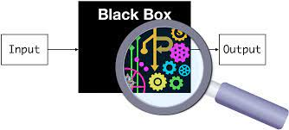
Models
Models are a mathematical simplification of some real thing.
E.g. a Poisson distribution is a model of goals in hockey games.
In predictive analytics models translate inputs to output(s).
E.g. a model can model a “loan decision” – details in, approval out.
This model is a simplification of reality, “will this person pay their loan”.
ML models simplify a decision/estimate – will buy, temperature, stock levels…
We can make many different models that can do this, quality varies...
They all do the same thing, but work differently internally.
Regression, neural networks, SVMs, trees, can all make the ‘same’ model.
We build the model using old (training) data, then use it – 2 step.
We ‘train’ the model, by doing the math to figure out the params (m, b).

Slide 6
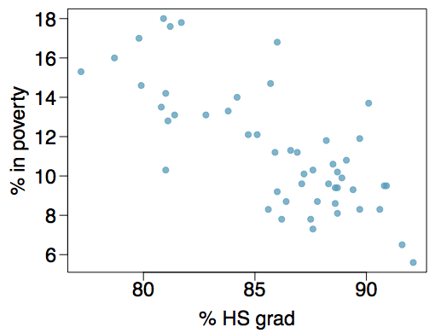
Poverty vs. HS graduate rate
The scatterplot below shows the relationship between HS graduate rate in all 50 US states and DC and the percent of residents who live below the poverty line (income below $23,050 for a family of 4 in 2012).
We have 1 input (x) – HS grad.
We have 1 output (y) - % in poverty.
This real relationship is complex, this model is a simplified version.

Slide 7
Poverty vs. HS graduate rate
Response variable? (Y, output)
% in poverty
Explanatory variable? (X, input)
% HS grad
Relationship?
linear, negative, moderately strong

Slide 8
Poverty vs. HS graduate rate
We could draw a line of best fit… but how do we know exactly where it goes?
Best fit line is a model of the relationship of HS graduation to poverty.
The “more like” the data the model is, the better it will be. How do we judge ”more like”?
We need a process to ‘learn’ slope and intercept (the two things that make the model).
i.e. y=mx+b is a model, just need m and b.

Slide 9
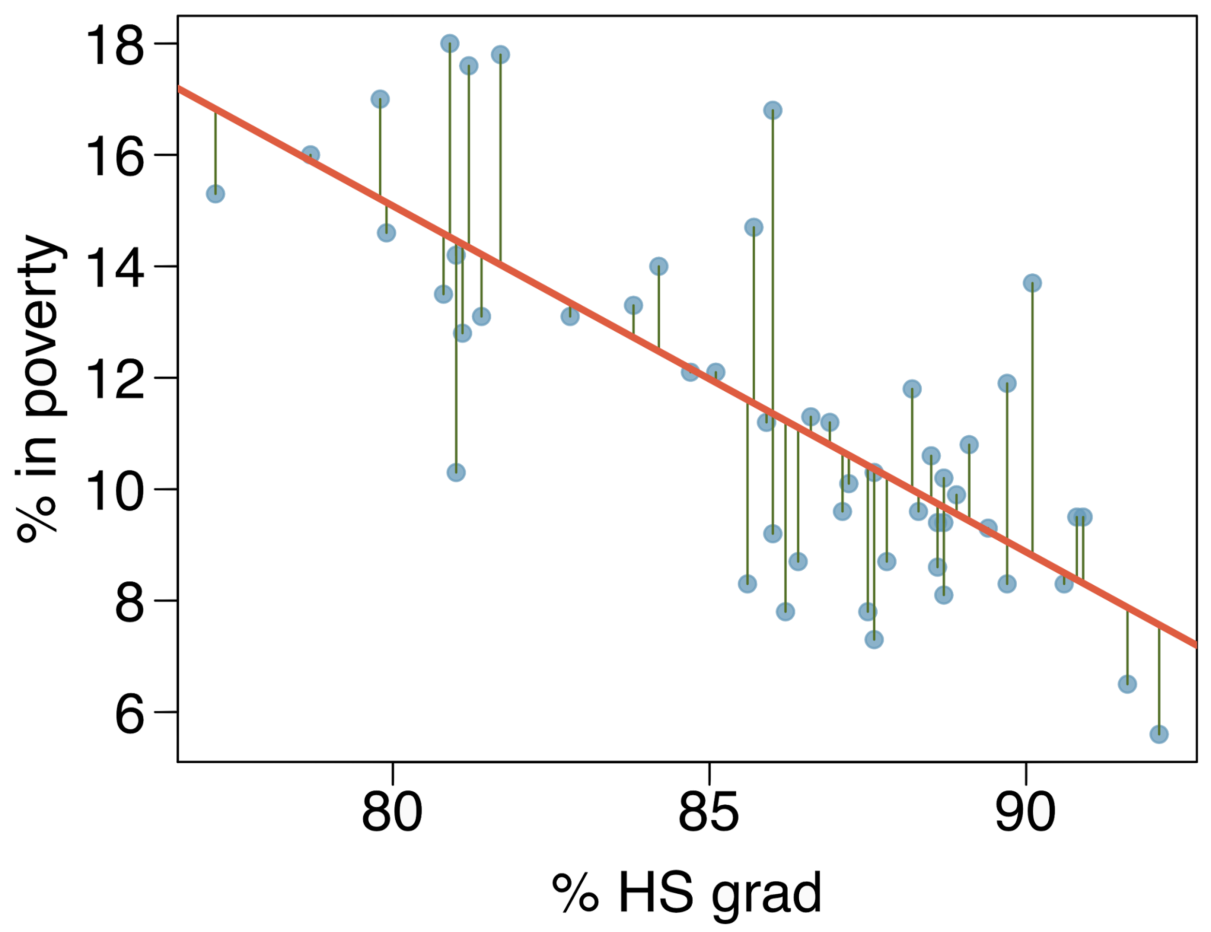
Residuals
Residuals are the leftovers from the model fit.
Data = Fit + Residual
Larger residuals means the model differs from the data.
Residuals can be totaled then compared.
We can also phrase it as the variance in y that isn’t explained by the model.
Model explains part of why Y values are what they are.
Residuals is the amount of why that the model doesn’t capture.

Slide 10
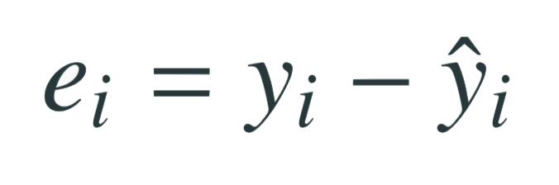
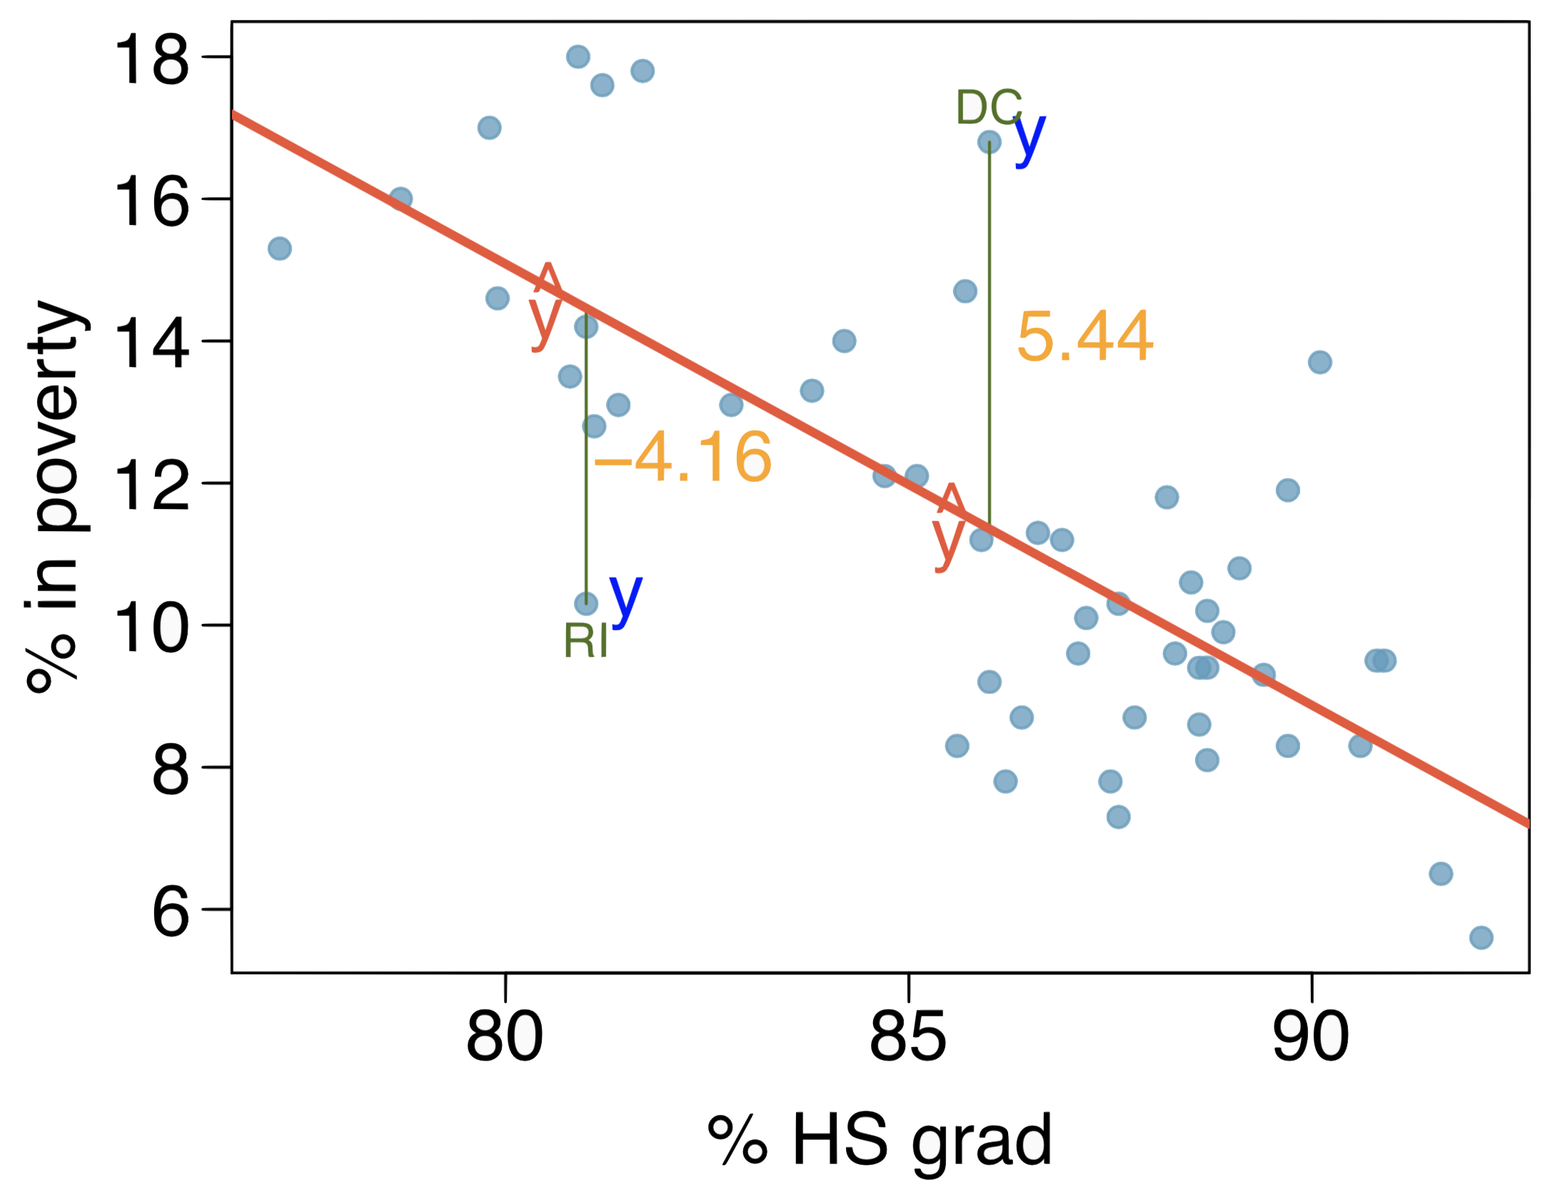
Residuals (cont.)
Residual is the difference between the observed (y_{i}) and predicted ŷ_{i}.
% living in poverty in DC is 5.44% more than predicted.
% living in poverty in RI is 4.16% less than predicted.

Slide 11
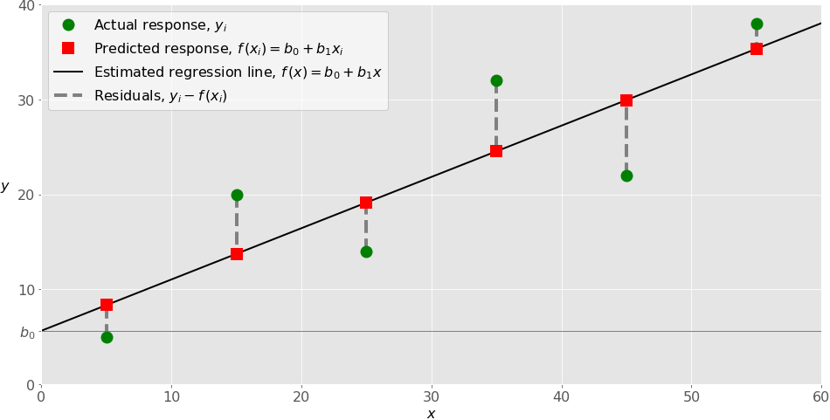

Slide 12
Linear Least Squares
The line can be defined by the intercept and slope.
We generate a line that minimizes the square of the residuals.
Why?
Small differences matter less than big ones.
Squaring deals with negatives.
Computationally efficient. (Mattered more in the past)
Is (potentially) a good estimator for slope and intercept.

Slide 13
How to find the minimum of the residuals squared?
This is the “learning” part of machine learning.
This step is the main thing that differs between other models – the math changes.
Any process that gets m and b will work!
We can use:
LeastSquares from thinkplot.
StatsModels function.
Scipy functions.
Probably many other packages.
Model (best fit line) is defined by the slope and intercept.
Add any X value to those two and you can predict Y.
The training process finds the ”best” calculation to do so.

Slide 14
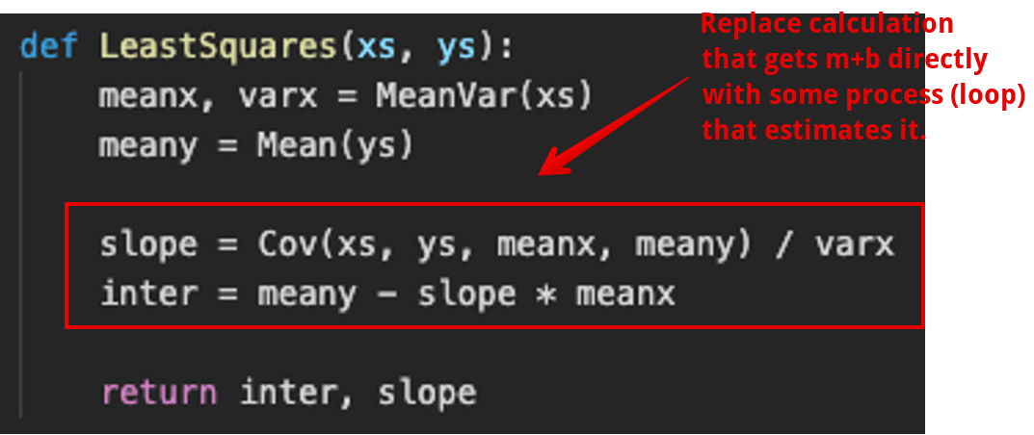
Note for Context
The step of calculating the slope and intercept in LLS is the learning part.
Other types of models have different learning parts, with the same in/out.
Linear regression is the only model* we see where we can calculate an answer.
All others we need to estimate the best answer, and that takes time.
KEY – the m and b ‘are’ the parameters.
Model produces y from x(s).
Y=mx+b does this with m and b.
The values of m and b control prediction.
In MOST models we care about, learning isn’t one step like this.
LLS can produce the optimal model in one calculation, for simple data.
Other model types or other data needs more steps – iteration.
Make a model (guess coef.), calculate error, revise, calculate, revise….
This looks like learning, it takes a long time.
We never know the perfect answer (like LLS gives) only our best guess.

Slide 15

Poverty vs. HS graduate rate
The linear model for predicting poverty from high school graduation rate in the US is:
The "hat" is used to signify that this is an estimate.
Predictions are always estimates, not assertions.
Our model ‘learned’ m and b in the training (LLS) step.
It is an estimate because this isn’t a definitive calculation to calculate the value of poverty – it is a prediction of what we expect the rate of poverty to be, given a value for HSgrad.

Slide 16
That’s a model!
Once ‘trained’ (calculation of slope and intercept) the y=mx+b is a model.
Insert any input (x value) we get a predicted output (y value).
This is one model that can predict Y given X.
There are infinite number of ways to make a model that does the same thing.
This way used a linear regression via a formula.
Later we’ll see linear regression via iteration.
We could use the same data, and different math (this changes), and get some other model.
The only* part that changes is the training/calculation step.
Same inputs, same outputs, different calculation to go from A->B.
How do we know if the one we made is good?

Slide 17
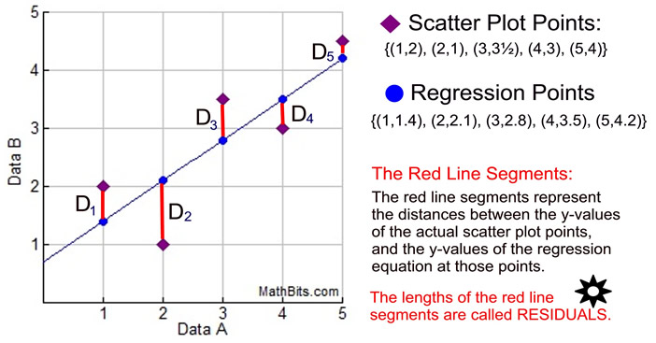
Remember the Residual…
Residuals are difference between an empirical value and the model’s predicted value.
The size of residuals tells us the ‘fit’ of the model.
Model is good fit when residuals are small.
I.E. the model follows the data patterns.
Model is bad fit if residuals are large.
Model diverges from empirical patterns.
We normally use fit as a term to discuss.

Slide 18
Residual analysis
The residuals are also helpful to us in a few ways.
They can be tallied into error metrics – RMSE, R2…
We can graph the residuals along with X to examine.
We want this pattern of residuals to not have any patterns in it – to be randomly spread out.
Why????????
Think of what’s different if there’s a pattern in the residuals vs random.

Slide 19
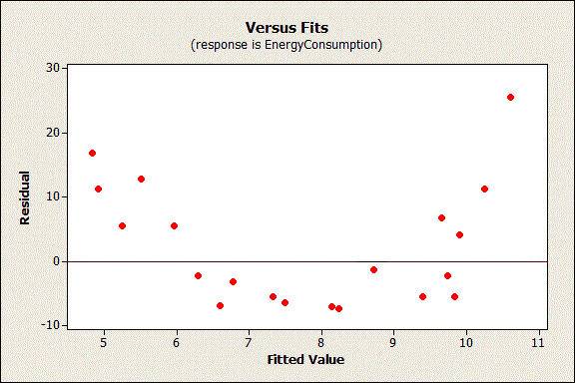
Why Random?
If there’s a pattern in the residuals it tells us that there’s some relationship here that isn’t captured in our actual model.
Middle predictions too high, ends are too low.
Residuals should be:
Uncorrelated with a variable.
Uncorrelated with each other.
We shouldn’t be able to predict residuals.
That pattern belongs in the model!!!!!
Models can be limited in fit – e.g. linear here.

Slide 20
Doing Regression - Other Packages
Using LLS calculations is ok for one x, but impractical in reality.
Regression is performed by existing packages, such as StatsModels, Scipy, and Scikitlearn.
The book uses StatsModels when multiple regression starts.
They all ultimately do the same thing.
We’ll use both StatsModels (only a little) and Scikitlearn (a lot):
Statsmodels provide more stats data in the output, so we will use that sometimes.
The scikitlearn is much more relevant experience for ML stuff.
You need to be good with sklearn no matter what, if you’re going to not learn anything, the details of statsmodels is the choice to make. We just use it for some details.

Slide 21
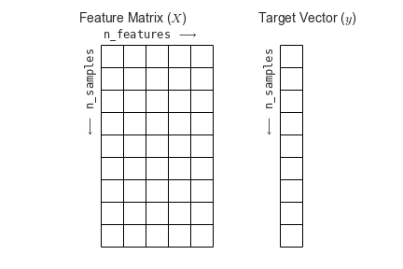
Shapes and Arrays
One thing we need to pay attention to a bit more is the data structure and the shape.
Most things we’ve used take anything ‘iterable’ or anything that is list-like.
Often (but not always) in machine learning we need arrays, usually of a certain shape.
Some tangible differences are:
Use np.array() to create arrays of the data – usually one array for x(s), one for y.
Ensure the arrays are “vertical”, print it and/or use .shape to look.
.reshape(width, height) can reshape the arrays to what we need.
Note: a 2D array that is 1 column wide and a 1D array are two different things…

Slide 22
Processing Data
As we start to do real machine learning, we’ll need to manage data in specific shapes.
This is generally not too hard (libraries try to make it easy), but is critical.
Ultimately, we’ll need to provide data to a model in specific shapes.
Our job is basically just to steer data into the ML algorithm and get the results.
We’ll semi frequently need to manipulate those shapes as we process data.
With different data types (time series, image, text…) we need to construct the shapes.
For some things this can be fairly complex, but we start simple.
Start to consciously think about dimensions and shape of data as we use it.
In sklearn, most things we use can process array, df, series, list, etc…
It’ll usually work ok (with sample data) unless you do something weird (usually).

Slide 23
Conclusion
We can train our models to predict Y, given X.
Models always predict an output given an input, the how can vary widely.
In this case, the model is a simple algebra equation, y=mx+b.
The model is a simplification of reality – will someone pay, will customer come, will it rain…
Our steps are the same no matter model type we use (LR, NN, Tree…), internal math differs.
The residuals give us information on how good our model is.
Big misses, bad model. Small misses, good model.
We can compare different types of models to choose the most accurate.
Accuracy and reliability of the predictions…. Next time.
Models made differently can be compared and evaluated.

