Slide 1
Housekeeping
More logistic regression:
Review of basics and gradient descent.
Classification cost, error, and evaluation.
Scaling numerical features.
Imbalanced learning (less important).
The theory/exercise balance for some of these concepts is skewed:
The concept is requires a lot of me rambling, with some background math.
Using said concept is fairly easy in code, but there are exceptions/variations regularly.
Get practice - load data, explore, clean, model, evaluate is constant.
Most people need practice beyond, “I can use this” – what to do, order, connecting steps together, solving issues in data, understanding impacts of changs… all require practice.

Slide 2
I’m supposed to Give You a Test Next Week!
On the stuff since the last one.
Mainly inferential stats and the regression leading into the ML stuff.
I’ll finalize it and make an outline this weekend.
We’ll cutoff after some stuff next Monday – simple probability (more complex stuff excluded).
Some multiple choice, short answer, and a little code.

Slide 3
Ravel – Why???
Sometimes you get an error that has a big explanation then says, “…use Ravel()”.
Ravel flattens data 2D->1D here.
This contradicts the “always reshape” thing I normally say.
If you look in sklearn docs, some require 1D, some take either.
I stick by the ”always reshape” (even though it isn’t the ‘correct’ answer):
It will make the prep stuff the same for every scenario.
With neural networks, you can stick with the same process.
If you need to change, that ravel message will warn you.
Ultimately, the correct way is to look up the needed shape for model’s fit() and do that.
The “always reshape” rule is a shortcut that saves thinking.

Slide 4
Classification and Imbalanced Data

Slide 5
Classification Review
Classification is predicting if observations fall into one group or another.
For now, we’ll do only two groups – True/False.
E.g. will this person be a customer? Is this MRI cancer? Will this company go bankrupt?
Linear regression was possible to calculate directly – linear least squares.
Classification, using logistic regression, isn’t something where we can calculate the model from the data.
We need to use an iterative process to “train” the model.
Need – classification concept, use of LogReg, output, concept of GD, evaluating/metrics, cost.
Nice to know – details of math, internal processes. If you’re going to do more ML, details matter more.
I’ll rip through a review quickly, please interrupt if we should drill down more on anything.

Slide 6
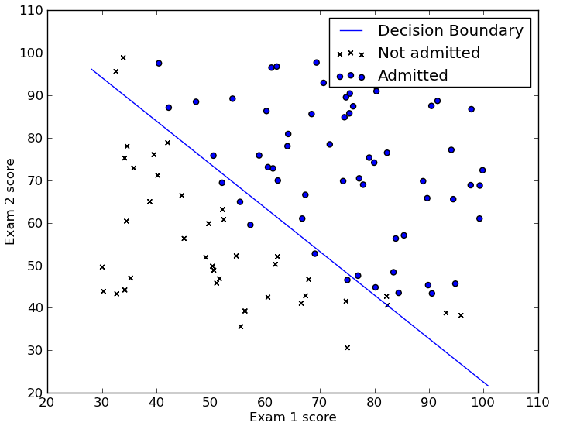
Classification and Logistic Regression
Logistic regression (and all classifiers) aim to split the data into two (or more) groups, called classes.
E.g. customer/not-customer, True/False, 1/0
We can visualize this with a dataset with 2 features.
E.g. Predict admission from two test scores.
The model here is the line, rather than being a best fit like a regression, it acts to separate class A from class B.
Logistic regression is a linear model, so we can only make a line to classify the data.
The line is our decision boundary.

Slide 7
Finding the Line – Descend that Gradient
In linear regression the “least squares” calculates m and b directly.
Our line (the model) that divides the two classes was generated by the gradient descent process we mentioned:
Make a prediction for the model’s values (2 slopes and intercept in this one).
Check the error with those values.
Use some calculus to attribute the errors to the original terms (y = m1*x1 + m2*x2 +…)
Adjust each term to get a bit less error.
When the error hits the lowest point, whatever the slope and intercept is at that point is the values we need for the model. Y = m1*x1 + m2*x2 + b
Just like linear regression, these values are all we need for a model (with more math).
Note: the error here is not accuracy of predictions, it is the distance between prediction percentage and reality.

Slide 8
Training Process
This inability to calculate an answer directly is common to most ML algorithms.
We instead need to let a model “train” or learn the answer bit by bit.
This is what happens during the “fit()” call.
The model is initialized as something that works, but poorly.
Each round the accuracy is improved a bit.
Eventually we have the best version we can get (or hit a limit).

Slide 9
Animation with Linear Regression

Slide 12
Cost/Loss
The key factor in doing the gradient descent is the error, or the cost.
The term loss is also common, technically loss means one run, cost is aggregate.
Loss and cost are commonly interchanged, and it doesn’t really matter in most cases.
The cost function calculates error, which tells the algorithm that it needs to adjust.
For regression problems, the cost is generally the MSE.
For classification problems, we don’t use the accuracy, we have a separate cost.
Accuracy is the end result, for users to look at.
Cost is measured based on the “closeness” of the model to the correct answer.
Allows for a much better fitted model.

Slide 13
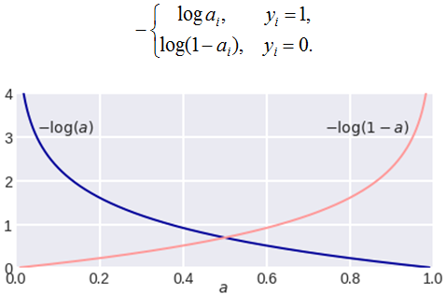
Cost Functions
Cost functions are the functions that calculate the… cost.
There are many different cost functions.
Binary (two class) classification usually uses Log-Loss, or Binary Cross Entropy.
Log-Loss basics:
Distance of the prediction of probability to the real answer. On a 0 to 1 scale.
Model predicts the probability of a 1, loss is distance to 0 if the real answer is 0, and distance to 1 if the real answer is 1.
Model learns to minimize the “distance” to correct.

Slide 14
More on Costs
Cost functions ca be defined to be almost anything.
Need* to be differentiable – i.e. we can calculate the derivative.
In practice most are easily differentiable, for speed. Hence few absolute value.
E.g. a “Price is Right” model predicting if you should bet might have a different cost for ”too low” (not high enough) vs ”too high” (instant loss) in its cost calculations.
The cost is (normally, in classification) an internal metric to the algorithm.
The model is made by minimizing the cost.
The cost isn’t really a ”user facing” metric that we’d look at when using the model.
We normally look at an accuracy-based metric to judge a model – that’s separate.
In regression, closeness and final error are the same (MSE), here they differ.

Slide 15
Gradient Descent
This gradient descent process is one that is very common, not just for logistic regression.
When we can’t directly calculate the “answers” like we can in linear regression, we do something like this – repeated guess and test as we progress towards the answer.
The starting coefficient values don’t really matter for the end result.
Different algorithms have different methods (sometimes controllable by an argument) that generate a starting point of values (slopes and an intercept).
The starting guess is intended to reduce the rounds needed to find the answer.
This is mainly relevant for efficiency – when processing large amounts of data, saving rounds of calculation can really add up. Neural networks can have trillions+ calculations, savings matter.

Slide 16
Gradient Descent in Practice
In real usage, gradient descent is everywhere.
As long as the cost can be calculated (and differentiated), and we have weights to adjust.
Neural networks do lots of gradient descent, that’s why they take a long time to train.
Rather than a handful of weights, they can have hundreds of billions.
Many other algorithms (like SVM) use gradient descent at some stage.
Most linear regression models use gradient descent rather than direct calculation.
There are gradient descent “adjustments” that can help make better models.
We’ll look at this early next semester, while doing GD, add some tweaks.
Reduce overfitting, improve speed, select features.

Slide 17
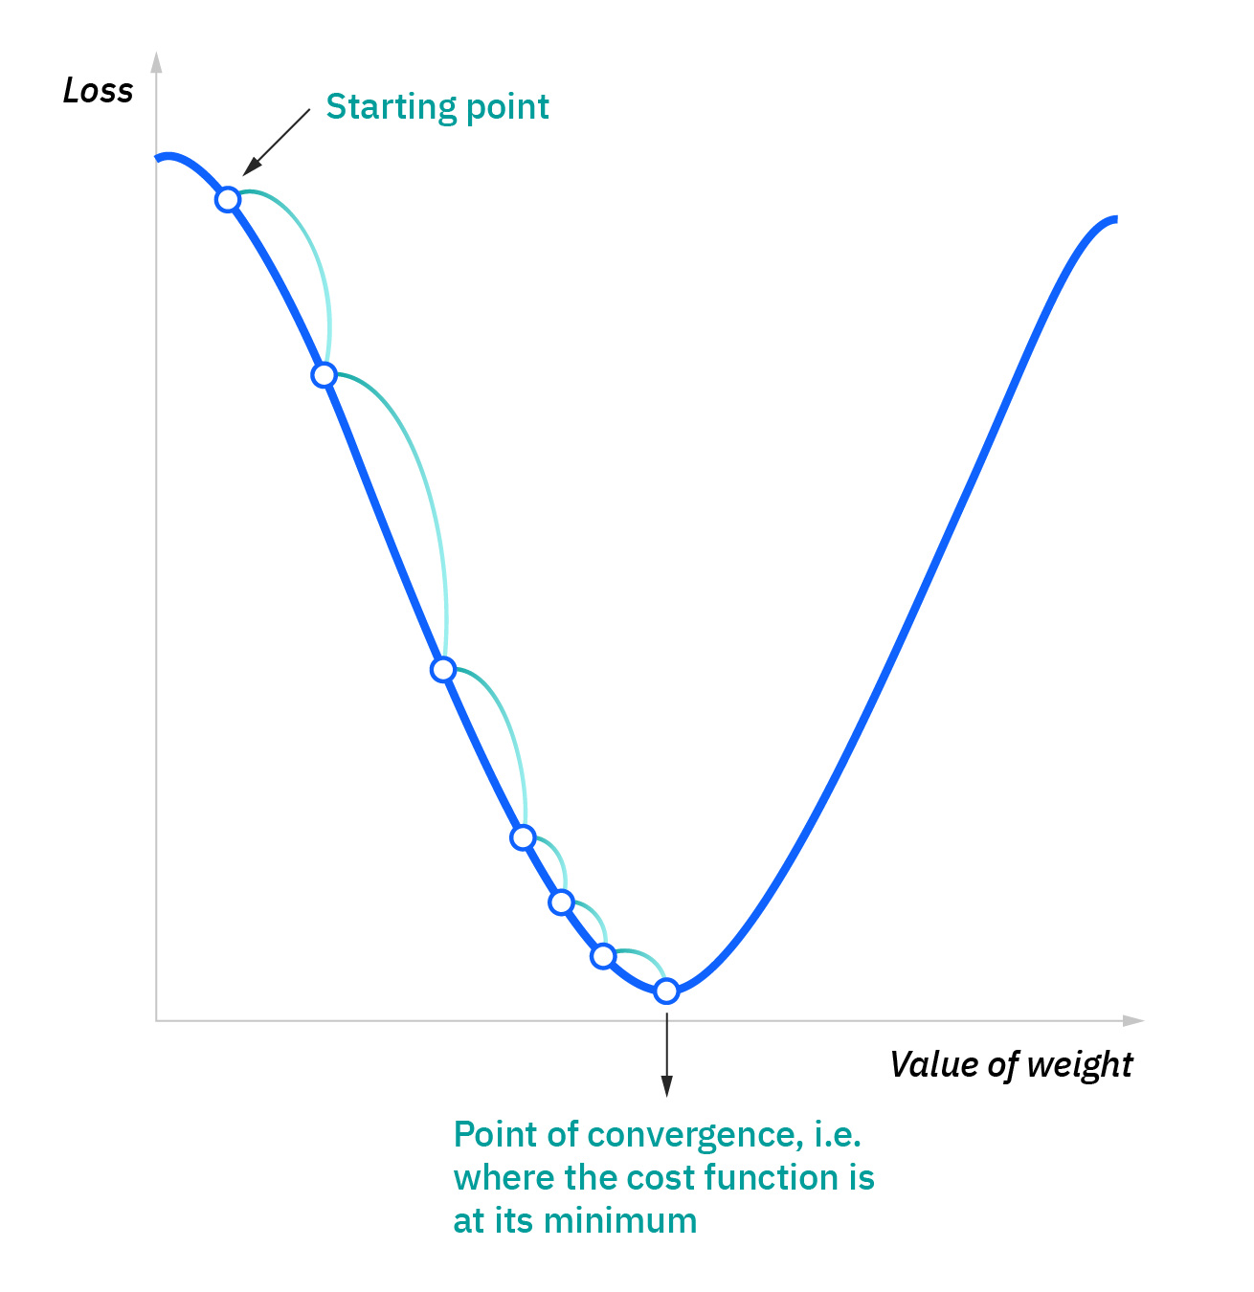

Slide 18
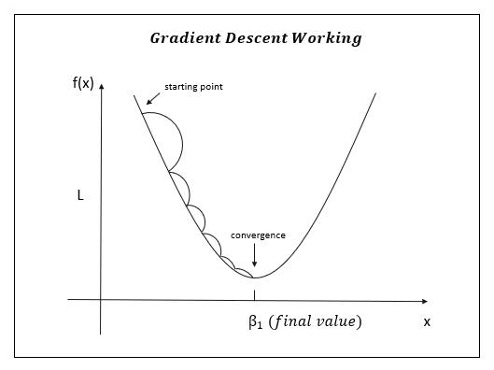

Slide 19
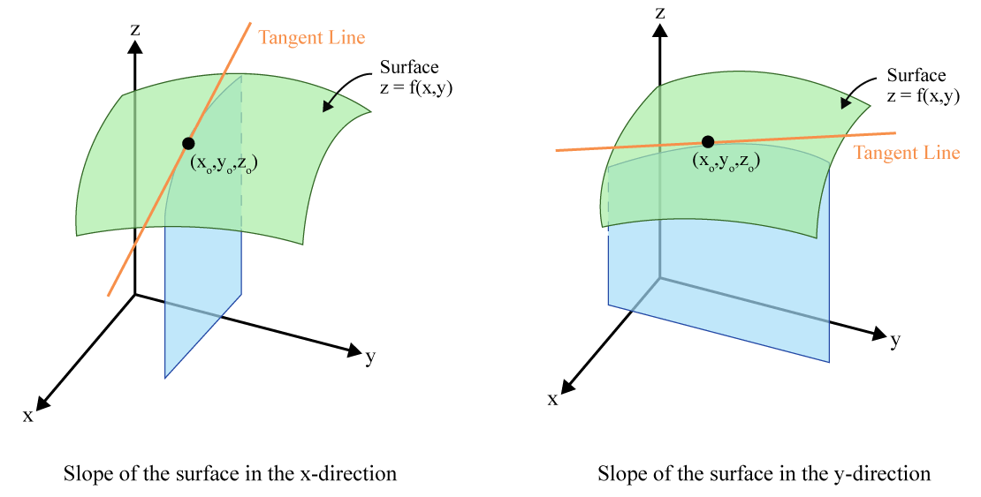

Slide 20
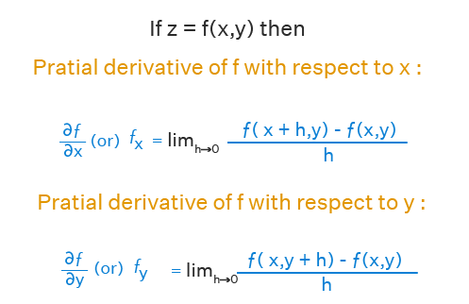
Ignore Calcs if Gibberish
When there is more than one X value (feature).
The slope of each weight is calculated on its own.
Each slope is the derivative with respect to X_{i}
I.e. direction to change that X to lower cost.
“Chain Rule” is the tool in math.
This effectively “attributes” the error to each X.
Total cost is split amongst X according to results.
Each is adjusted proportionately to lower error.
The model can learn each X separately to fit better to the data. (More X, more capacity).

Slide 21
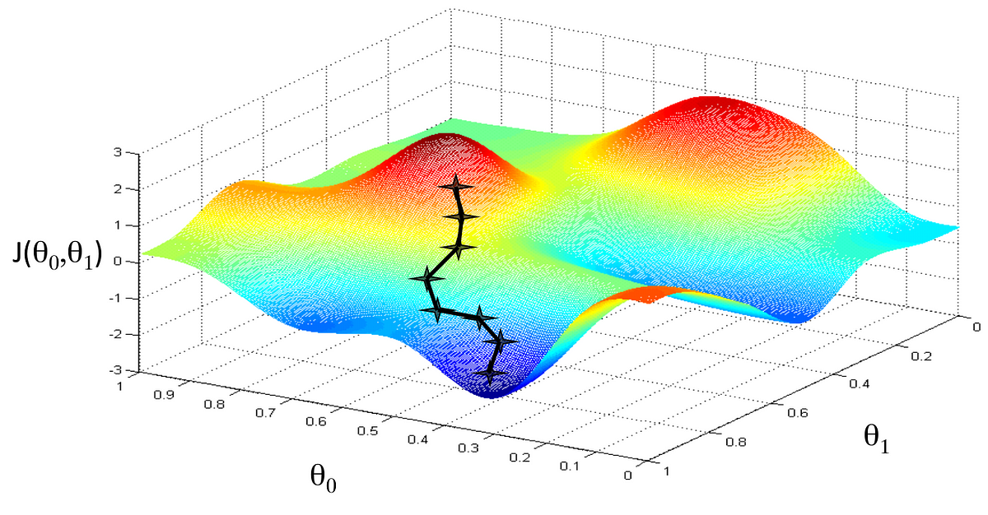

Slide 22
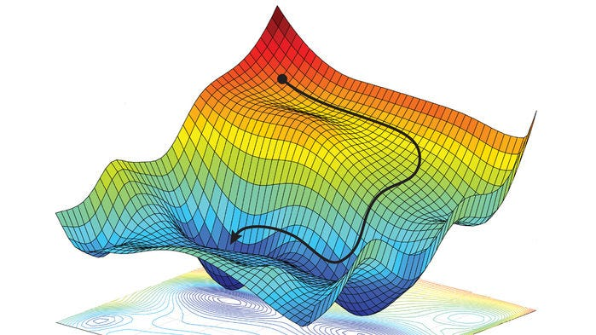

Slide 23
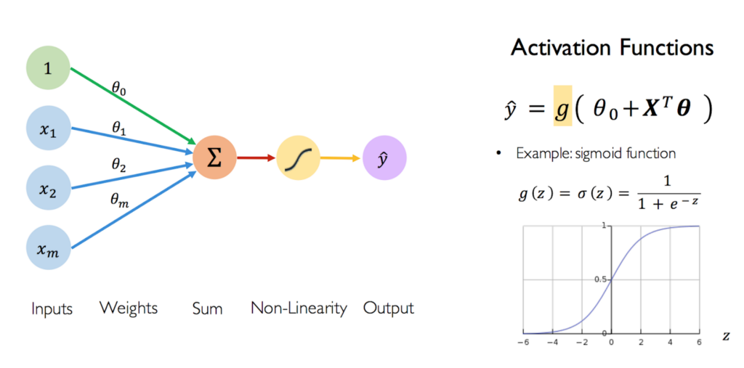

Slide 24
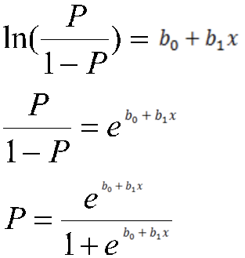
Gradient Descent Results
Eventually we have a model.
The model is just like a linear regression, we only need the weights (coefficients) to generate a model.
The gradient descent calculates each weight for us, incrementally.
The model doesn’t predict an answer, it predicts the log-odds. We can then use the sigmoid to translate to probability, and a cutoff to generate an actual answer.
We don’t calculate an answer, we wait until the “wrongness” of our current guess can’t be reduced.

Slide 25
Classification and Regression
If prediction group membership – A/B, T/F, yes/no, it is a classification problem
If predicting a raw value, it is a regression problem.
This is not related to the feature set (only target).
Features can (generally) be numerical/categorical for any model.
Most types of predictive models have versions for either.
Internal math is mostly the same, cost and final prediction differ.

Slide 26
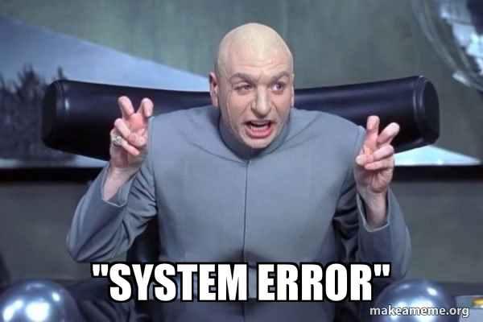
Errors

Slide 27
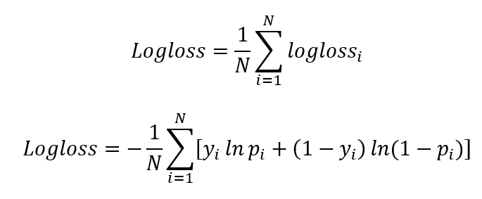
Model Accuracy
The cost (log loss) is an internal measure for the model. The accuracy is final performance.
Log loss ‘teaches’ the model as it is trained. Accuracy evaluates the end result.
The cost doesn’t directly tell us accuracy of the final model.
In regression cost and “user facing” accuracy (SSE/MSE/RMSE) are the same.
In classification, the accuracy and cost answer different questions (close vs correct).
There are several different measures for classification accuracy.
The most basic is accuracy - #correct / #total N.
Several other accuracy measures can be useful or needed.
Accuracy can be examined by looking at a confusion matrix and its derivatives.

Slide 28
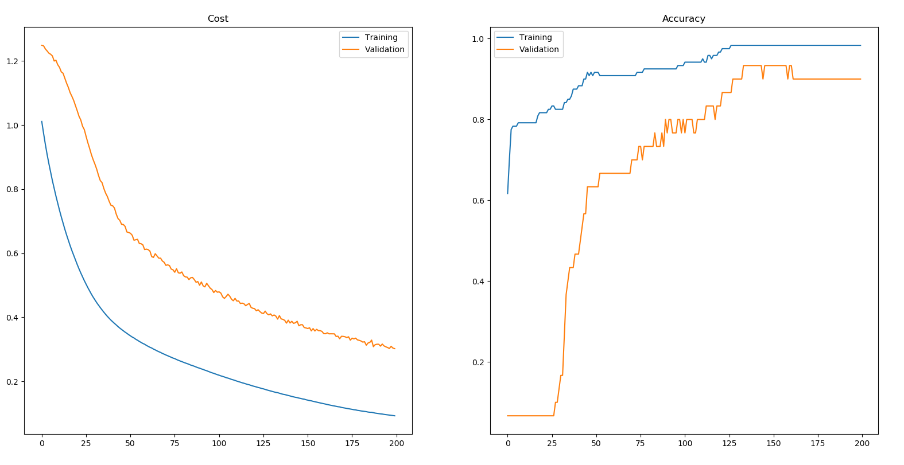

Slide 29
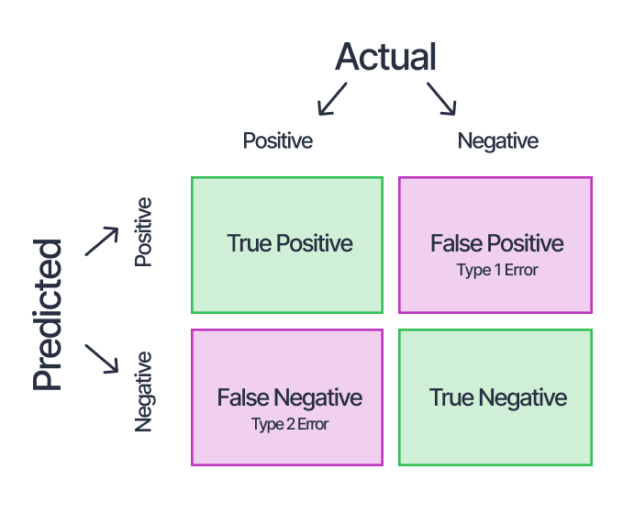
Confusion Matrix
A confusion matrix shows the “types” of right and wrong predictions from the model.
We can have two types of errors:
Type 1: Predicting 1 when it is really 0.
Type 2: Predicting 0 when it is really 1.
These might not have the same real-world impact.
E.g. detecting credit card fraud… we could miss all fraud and have 99.9+% accuracy.
Confusion matrix allows us to spot balance.
Note – layouts and orientations vary sometimes.

Slide 30
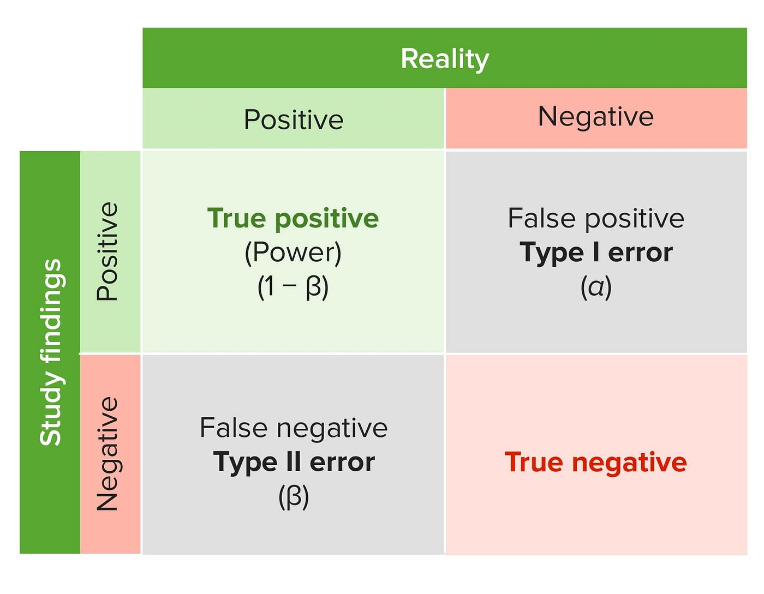

Slide 31
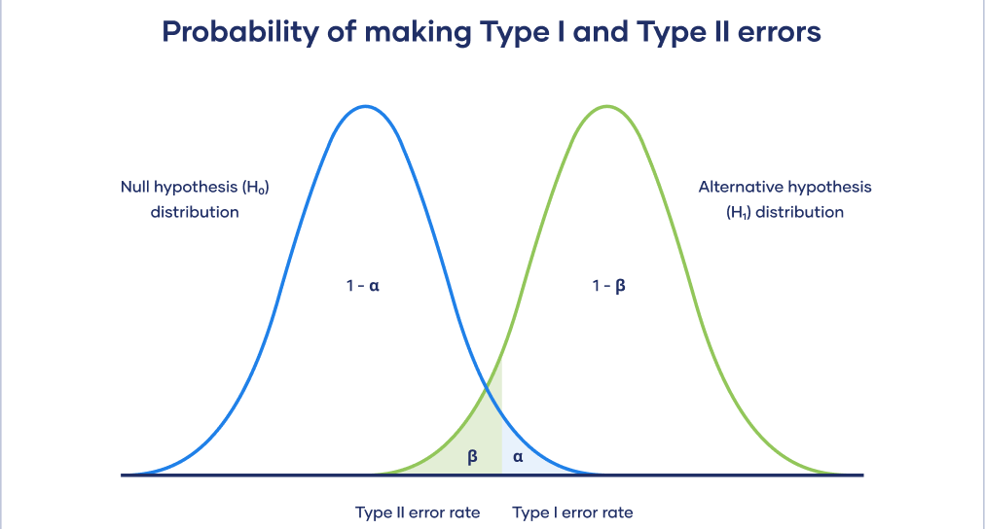
In stats Language…

Slide 32
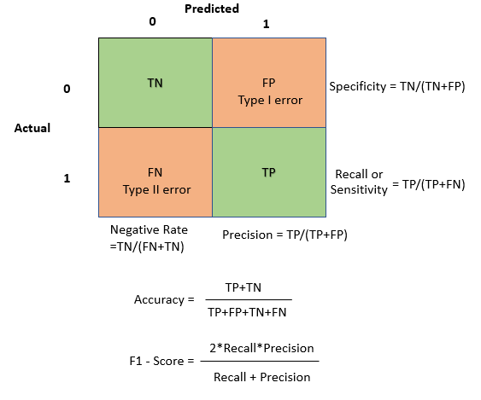
Derived Accuracies
We can use the results in a confusion matrix to calculate other error metrics.
Precision – what share of predicted 1s are right?
Where we don’t want T1 errors. FP > FN.
Targeted ads, spam detection, etc…
Recall – what share of actual1s did I predict?
Where we don’t want T2 errors. FN > FP.
Cancer prediction, safety thresholds, etc…
F1 – “Harmonic Mean” - derived to strike a balance.
Will perform poorly if either of the above is bad.

Slide 33
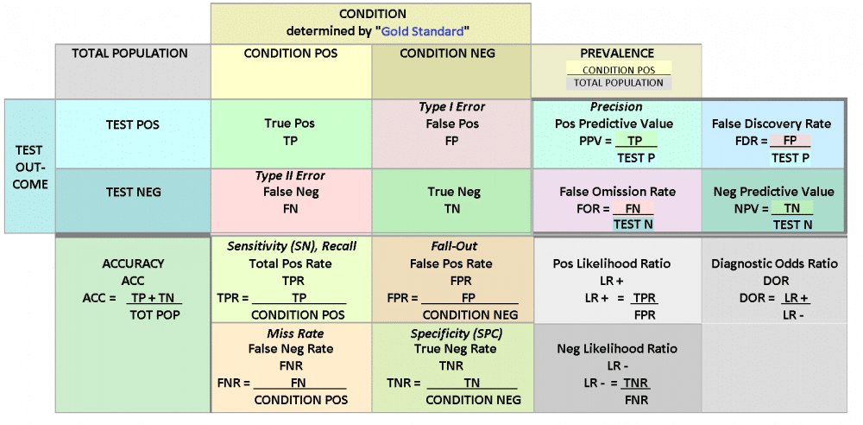

Slide 34
Errors Interlude
The accuracy is the main error metric that we (as users) care about.
In reality, the ‘right’ choice is determined by the specifics of the actual problem.
Precision and recall are important when there is a difference in outcome impacts.
Recall if we want to avoid false negatives.
Precision if we want to avoid false positives.
F1 if there’s some balance between the two.
Other metrics are overweighted to measure aspect that may matter as much or more.
You can detect credit card fraud with 99%+ accuracy by always predicting false.

Slide 35
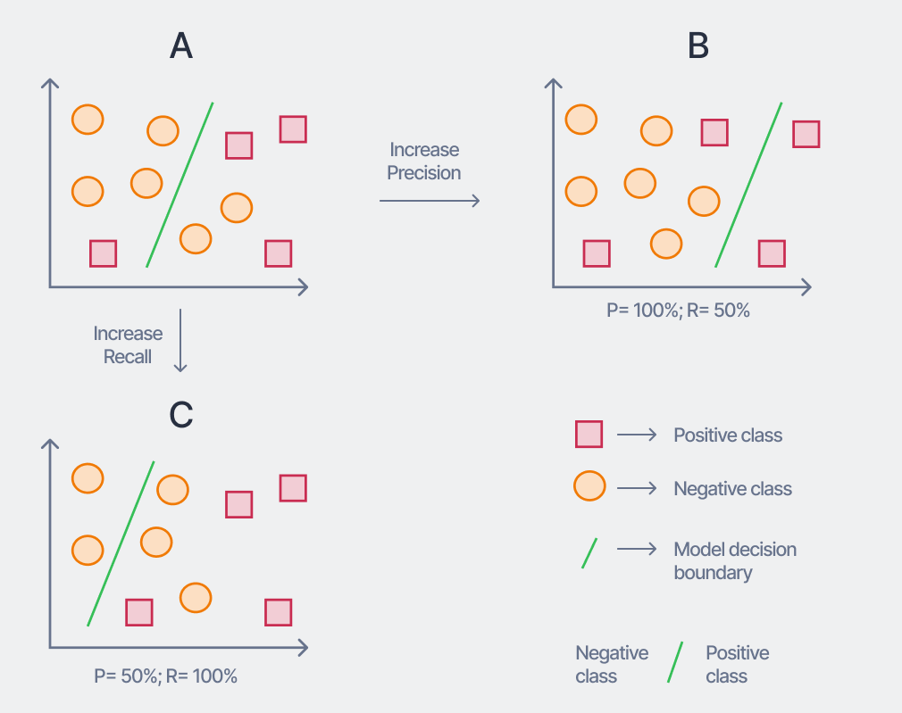
Recall-Precision Tradeoff
In most cases, we want errors to be mostly ‘balanced’.
Getting all/no of either type indicates some unexplained pattern.
Like with variance and R2.
If we get only one type of error, the model has a systemic miss – a pattern that we should capture in the model’s predictions, not its error.
Change something about the model to capture this pattern.

Slide 36
Accuracy Plotting
As with EDA, we can understand our classification model’s performance either:
Numerically, with accuracy or some other metric.
Graphically, with a ROC plot.

Slide 37
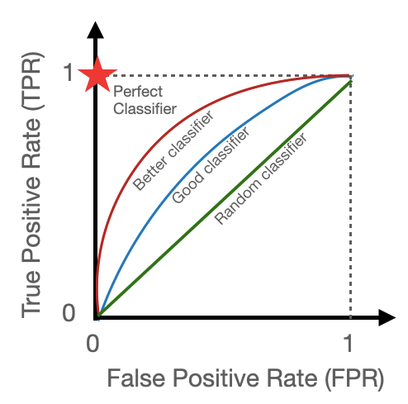
ROC and AUC
This plot is called a Receiver Operating Characteristics curve, or ROC.
True positives vs false positives.
Can think of it as a race between TP and FP.
Going up before right means TP are “got” before FP.
Going right before up means FP are “got” before TP.
Ratio of TP found vs FP found from model.
Higher and left means an overall better model.
AUC - area under the curve: [0,1].

Slide 38
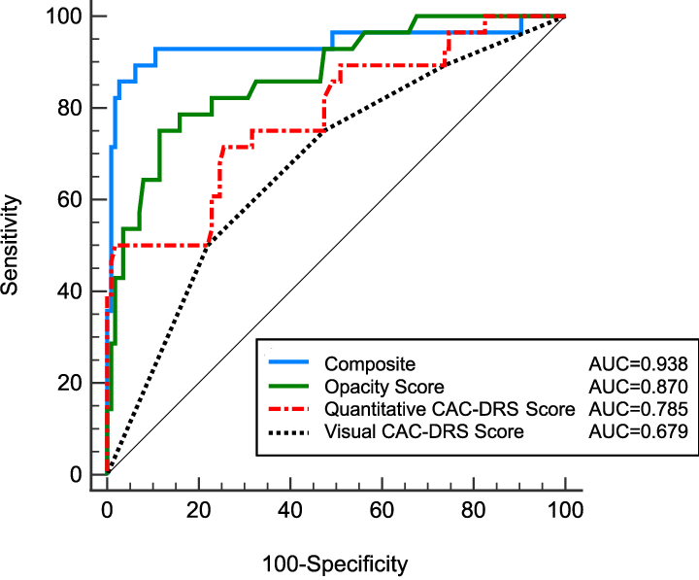
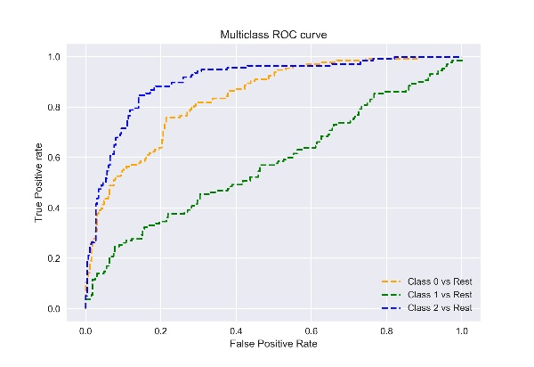
Real Examples

Slide 39
Using Different Metrics
All of these can be calculated with a score()-like sklearn function.
The main error metric to look at will depend on the scenario.
In low consequence things, raw accuracy is likely fine.
If there are serious costs to a false negative/positive, an alternative is likely important.
Performance will vary depending on model choice and model tuning.
Different models are well suited to different data, so performance may swing.
There are options called hyperparameters that we can set to “control” the process of creating the model, which impact performance.
We’ll do model tuning early next semester.
We can default to looking at error, then change if the confusion matrix shows issues.

Slide 40
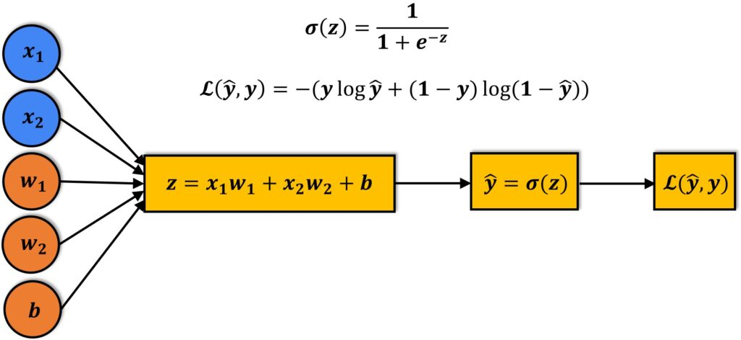
Remember the Regression
When doing a regression, the prediction is determined by:
The X values for each feature.
Each coefficient/weight/slope for the scaling of contribution of features.
The intercept, which shifts the entire model’s predictions up or down.
Consider a loan approval model:
X1 = Net worth.
X2 = Age.

Slide 41
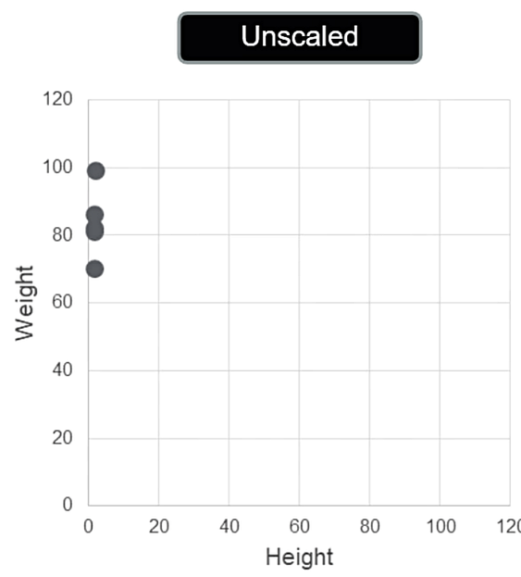
Unscaled Variables
Unscaled variables lead to relationships like this.
It would be hard to determine a regression line.
It is hard for the algorithm to learn it as well.
*This only has one X, but we can’t draw it with more.

Slide 42
Don’t Get Scared, Don’t Get Pale, Deal With the Scale!
If the values of inputs differ greatly, each term needs an extremely small/large coefficient.
The sum of all terms, the Y prediction is what it is.
All x*m terms need to add up to it (with intercept).
This isn’t theoretically wrong, but it is a problem in practice.
Huge or tiny coefficients makes it hard for gradient decent to converge, find minimum.
Rember, we are adjusting each coefficient up or down a touch each GD step.
Distances are massive in one dimension, tiny in another.
It can be hard for the algorithm to “reach the bottom” before running out of steps.
Can potentially even hit limits of float variable size.

Slide 43
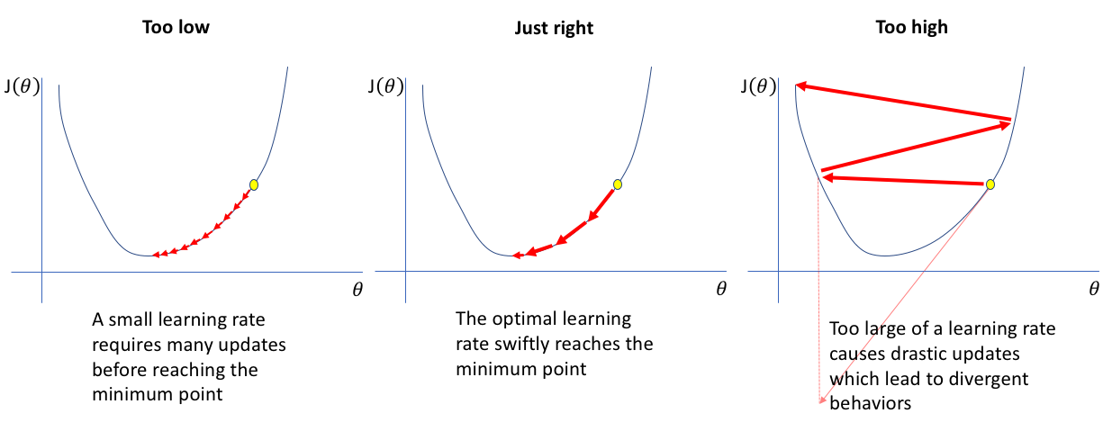

Slide 44
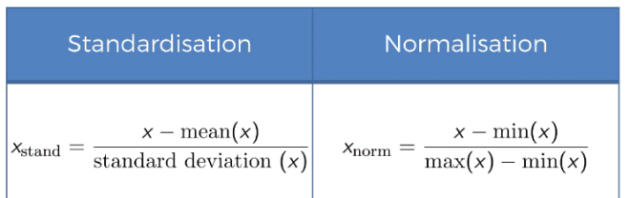
Common Transformation – Feature Scaling
There is one transformation that we almost always want to do – feature scaling.
Feature scaling takes our input features and puts them on the same scale, or range.
There are two common options:
Standardization – each feature is set to a mean of 0, and std of 1.
Normalization – each feature is shifted to be between 0 and 1.

Slide 45
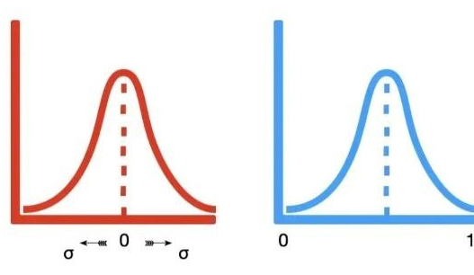
Results
The results of data scaling is that all of the features are on the same scale, either:
Centered at 0 with standardization. Or
Boxed between 0 and 1 with normalization.
This means that the actual x values going into the y-mx+b equation are on the same scale, so if one was really large, that impact is negated.
Models will generally perform better:
Accuracy can and often does improve.
The speed of a model finding a solution gets far better (important later on).
We almost always want to do some scaling.

Slide 46
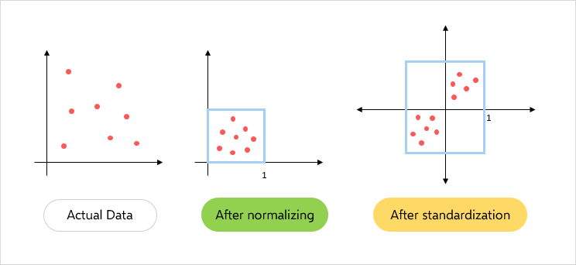

Slide 47
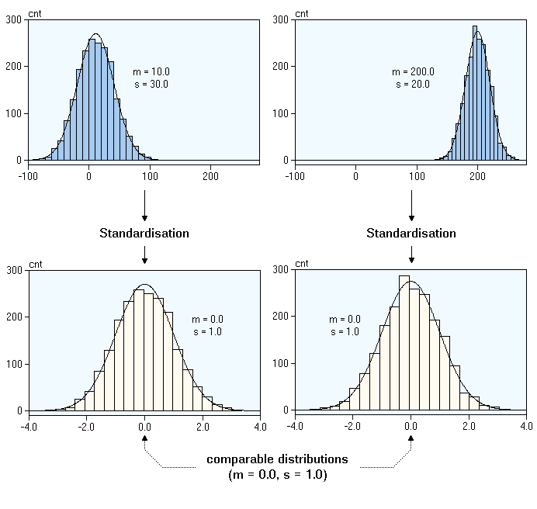
Data Example
The two features pictured here are obviously different in their original range.
After standardization, they are similar.
This lets our model consider the impact of all features in a comparable way.

Slide 48
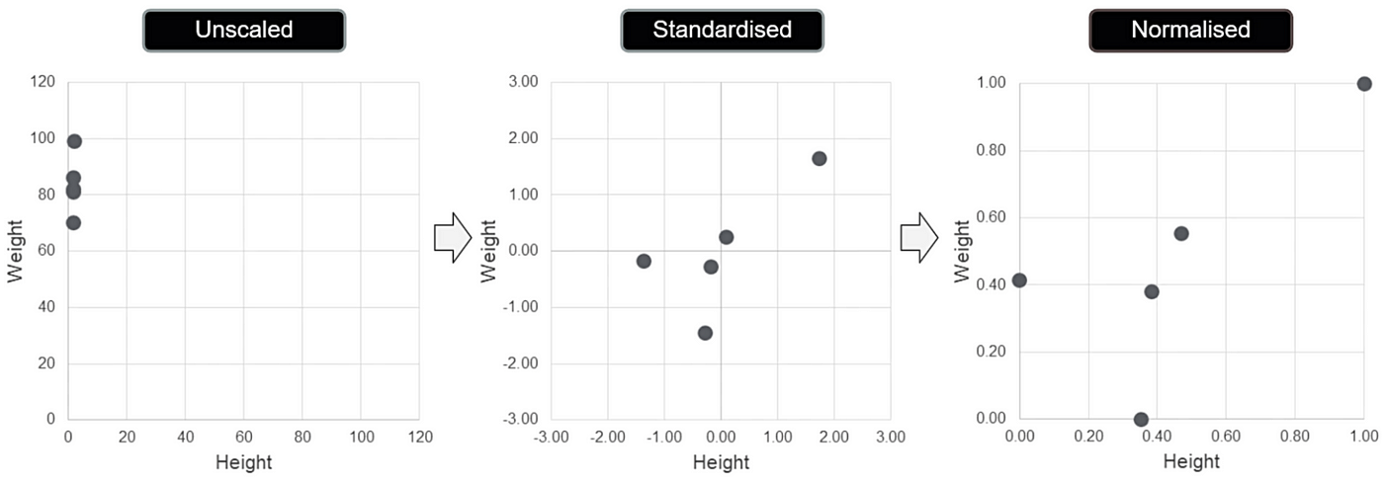
Comparison

Slide 51
Why Scale
Again, why would we do this?
The model has a hard time converging, or finding an answer.

Slide 52
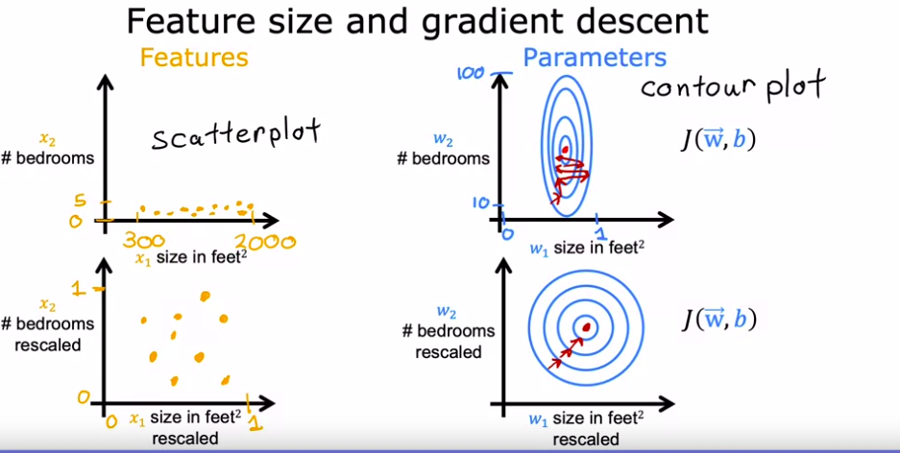

Slide 53
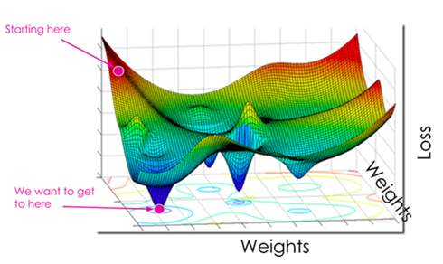
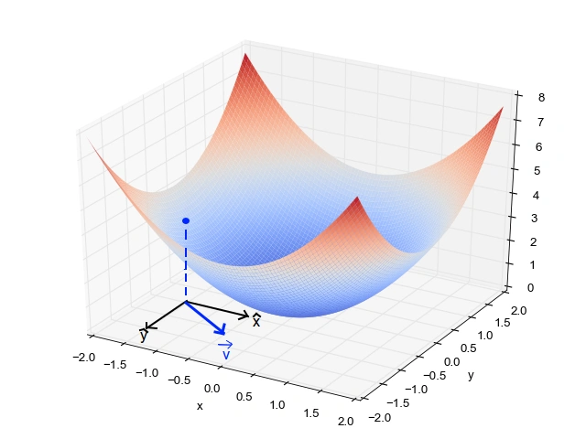
Better Descending
I couldn’t find a great picture.
The GD algorithm is trying to find the lowest point, in many dimensions.
The shape can be complex – this is hard.
If data is scaled, the shape is more ”bowl like”.
If data has different scales, some axes are compressed/stretched.
Algorithm is worse at working towards the bottom.

Slide 54
Don’t Leak while you Scale!
Technically, we should perform the scaling after train-test split.
We split the data to isolate train and test data.
Fit the scaler on the training data.
Apply the scaler to training and test data.
This avoids data leakage – we don’t want the model to ever see training data.
Good practice in general as it helps with objective metrics.
Scores of complete model are on new, never seen data.
Rough analog, LLMs can basically ‘learn’ the benchmarks they’re evaluated on.
In practice this doesn’t really make a big impact 99.99% of the time.

Slide 55
Feature Scaling Usage
We generally use feature scaling all the time, there aren’t really any downsides.
Which one do we use?
There is no “true” answer, we test and observe the performance.
If the data is roughly normal to start with, standardization may be better.
The steps in code are simple.
Make a scaler object, using the sklearn module.
Fit the scaler to the training X data, so it learns what the new scale should be.
Transform the test data, so it is on the correct scale.
Once this is done, nothing else changes. (Note: no need to scale y, generally*).

Slide 56
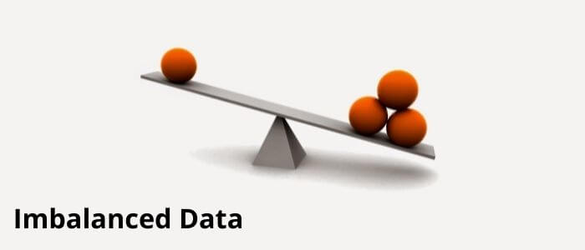

Slide 57
But First
The idea of imbalanced learning matters, but…
It is pretty simple.
These basic techniques

Slide 58
Imbalanced Data
On common issue with classification is that it is possible to have radically different number of samples in each of the classes.
E.g. credit card fraud – most things are not fraud.
Imbalance can present an issue, as our models want to be as accurate as possible.
If you predict False for every credit card transaction, you’ll miss all the fraud, but you’ll score north of 99.5% accuracy. Frauds can be disregarded in pursuit of accuracy.
Each gradient descent loop looks to make the predictions more accurate, if the data is imbalanced, we can be “pulled” in that direction. The majority class “dominates”.
In a credit card example, we may get lots of false negatives. Many frauds are missed.
One method to combat this is to look at other error metrics like recall, precision, and F1...

Slide 59
Algorithms are Greedy
The algorithm training the model is greedy, it tries to minimize cost.
The cost is just a aggregation of each individual miss.
The total cost metric doesn’t really care how that error is distributed.
A cc fraud model that always predicts 0 will have 99.9%+ loss of 0. A few loss of 1.
A cc fraud model that works, may have many losses of .1, .2, .3 that add up.
The second one could have perfect accuracy, but still maybe more loss.
Imbalanced learning techniques aim to ensure performance across all classes is kept.

Slide 60
Really Imbalanced Consideration
These simple techniques are old, can work, and are pretty simple.
Modern ML often uses different approaches.
Neural networks can often handle imbalanced data given enough data.
Can preset bias – what share to expect in each class.
Data generation is also common in some domains.
Tweaks can also be implemented in the algorithm.
Weighting can be applied, so minority classes “matter more”.
Different costs can be applied, to better account for minority class.
Imblearn has some ensemble (combination of models… later) that are setup for this.

Slide 61
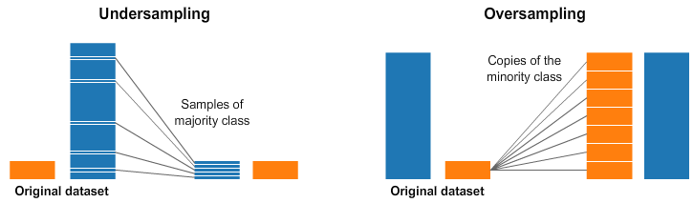
Data Resampling
Another thing we can do is manipulate the data, to make it less imbalanced.
We change the training dataset to be less “true to life” but to be better at “training a model”.
Analogous to if you studied for a diploma exam by looking at test prep material rather than the class material. You aren’t studying the “real” stuff, but you are using something that will prepare you better for what you care about – test performance. Or test data performance.
There are two basic approaches to this:
Undersampling – reducing the amount of the majority class.
Oversampling – increasing the amount of the minority class.

Slide 62
Fake your Data
The imbalanced techniques here may seem odd.
We are knowingly changing the data to be less ‘accurate’.
This type of thing is fairly common:
Transformations we’ve seen before.
Scaling variable values.
Creating fake training values or even records.
Remember, our goal with a dataset is to provide something to let a model learn.
This can be our original data, it could also be some variation.
The goal isn’t to make the ‘most accurate dataset’ it is to give the model what it needs.

Slide 63
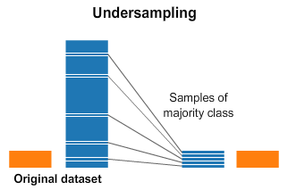
Undersampling
An undersample takes only some sample of the majority class, so there is more balance.
Most simple way is to just randomly select X records from the majority class.
Other algorithms use smarts to determine which to remove.
Tomek pairs, in the code example, removes some of the majority records that are “closest” to the decision boundary.

Slide 64

Oversampling
Oversampling is to reproduce the minority class records multiple times to improve the balance.
Most simple way is to just include the minority data multiple times.
i.e. random oversampling with replacement.
Smarter algorithms can generate “similar” data based on what is in the minority class.
SMOTE in the code example, creates interpolated (between) data records from the original.

Slide 65
Imbalanced Learning
We have a package that can handle most of the imbalanced stuff for us – imblearn.
This package provides functions that can do the resampling, that are in the same format as the sklearn stuff:
Using them is easy, as they perform like things we are used to.
We can incorporate them into things like pipelines, to make it easy.
Imblearn has lots of resampling algorithms that we can try.
Some are combined – eg. Oversample to generate new data, then under sample to “clean” it.
You likely don’t have imblearn installed.
Try running a code cell with “!pip install imblearn” and it will install it. (if you have pip)
“!conda install imblearn” (and “!conda install pip”) should do it if you don’t.

Slide 66
Process and Results
Having a more balanced dataset may help build better models.
Effects are not very predictable in most cases, must try and see results.
When oversampling we are inventing new data, that can introduce error.
When undersampling data we are removing data, that can remove information.
When dealing with imbalanced data, we can include this in our prep steps:
E.g. clean data, remove outliers, select features, encode categorical, resample data, rescale data, etc….
We are focusing on the end result here – we are going to see if changing the dataset gives us a better model.

