Slide 1
Logistics
Today (beginnings of data pipelines):
More regression stuff.
R2 and variance explained review/revisit.
Multiple regression and multicollinearity in practice.
Categorical features.
Train-test splits in data.
Assignment should be fully doable with this stuff.
Key concepts will carry through almost forever:
Reading, exploring, and cleaning our data.
Now start to build that prep stuff into a more formal series, a pipeline.
Doing whatever we need to do to get data model ready.

Slide 2
Categorical data and Encoding

Slide 3
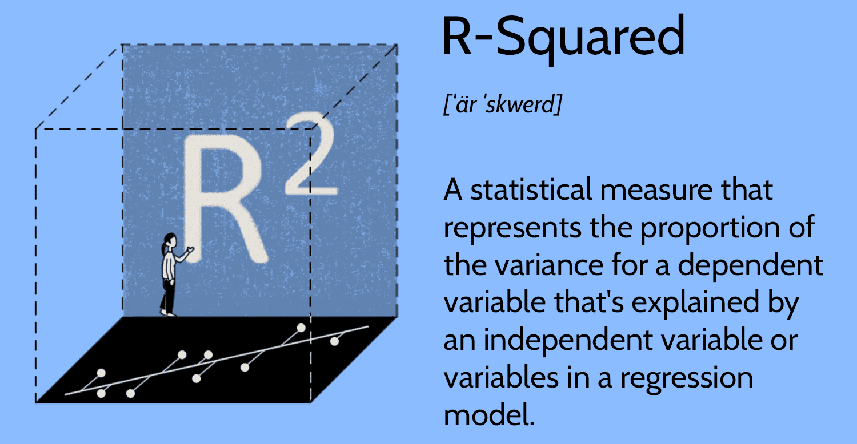
First, Variance – Explain it!
Recall our new friend, r-squared.
R2 is used to score models for their fit.
Value between 0 and 1 – percentage scale.
Comparable across models on the same terms.
Inversely related to MSE value.
R squared is:
The square of the correlation.
The percent of variance in Y that can be explained by X…
If we know X, how much about what the Y value should be do we know?

Slide 4
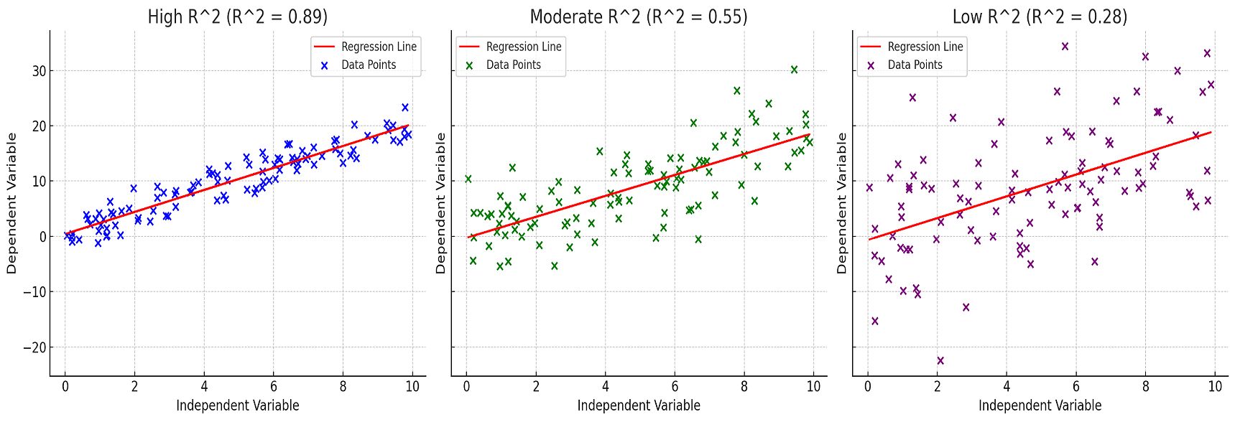
Make it Fit!

Slide 5





What iF we don’t know X?

Slide 6
If there’s no X
Without X, our best ‘explanation’ of the Y values is the mean.
This is the best model we can have to predict Y (without X).
This is also the baseline, the worst possible predictive model that we can make.
If there’s no X, we have variance that is unexplained.
The amount that each Y varies from said mean. The ss-total aka the variance.
A model without X still makes predictions, those predictions are the mean for all Y (no X to change the prediction), and the distance from y to prediction is the unexplained variance.
This amount of variance is what the R2 is ‘explaining’.
We can’t get any better than predicting the mean without X.
When we add X, how much of that unexplained variation do we now know?

Slide 7
Linear Regression Formulas
Y = m*x + b
One X value.
Prediction changes with different inputs of X.
Y = m*0 + b
= b
No X values, only Y.
Constant, flat line prediction – prediction can’t change because there’s no variable.
Y = b is a flat line at b.

Slide 8






When WE add X, Amount of Unexplained Variance Decreases
Take One Point
New Unexplained Variance
Original Unexplained Variance
Variance We Can Now Explain

Slide 9
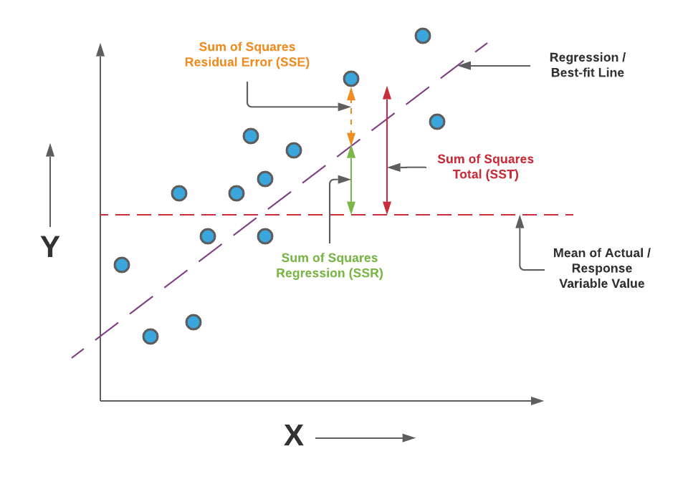
R-Squared is the percent that we Capture
Adding X, the model is now better at ‘explaining’ Y’s position.
Model can now change prediction based on X.
The X-less model has lots of variance.
Residuals between Y and mean-model is big. SS-total.
The X-inclusive model reduces that variance.
Residuals w/ Y and regression-model is smaller. SS-error.
Percent we’ve shrunk that residual becomes the R2.
R2=1 means we’ve explained everything, the pred is the real value. How close are we to that? SS-regression.
Better model ‘explains away’ more of that orig. residual.

Slide 10
Variance, Explained!
There’s a certain amount of variance in the data.
Y values literally vary from the mean. We have no explanation.
Model aims to ‘explain’ variance, i.e. tell us the exact value of Y.
Without any other data (e.g. X) the best model is just mean of Y – this has unexp. Var. SS-total.
Also the worst possible model we could make, a naïve version.
The r2 tells us the amount of the original unexp. Var we explain.
The ss-total is the starting amount of error (mean model).
The ss-regression is how much of that error gets erased.
The ss-error is the still unexplained variance.

Slide 11
So…
The residuals can be measured and tallied into MSE/RMSE.
Direct metric of error – how large are the average residuals(-ish).
The residuals also generate the R2, but with more arithmetic.
The naïve (no X value) model is taken as the baseline, with large residuals.
The new model with X is better, with smaller residuals.
The amount of the original residuals we’ve explained, or removed, is ~R2.
This is an indirect measure of error, but still residual based.
R2 is usually used as a default score for regression.
Informally describes ‘fit’ – how well model matches data.

Slide 12
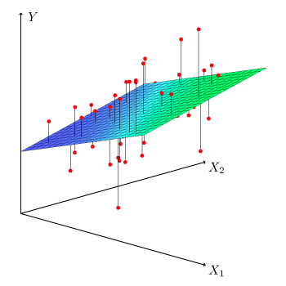
Multiple Regression and R2
Multiple regression, with more than one X, works the same way.
We have a target – Y.
We have multiple inputs – X1, X2, X3….
The concept works the same way, it’s just hard to visualize.
Model is y = x1*m1+x2*m2+….b.
Coefficients are weightings of input contributions*.
The error calculations are the same, only Y is involved.
Error looks at Y versus predicted Y, so math is identical no matter size.
The X values are generally called features or the feature set.

Slide 13
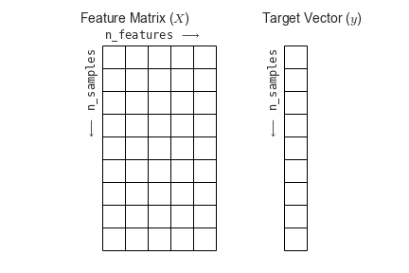
SkLearn Models
In practice, we don’t need the visualization or the coefficients directly.
Feature width + 1 dimension visual.
Each feature is one term in calculation.
We prepare data in the correct format and feed to algorithm.
This ultimately needs* to be in this structure:
2D array of features N rows tall.
1D vector of targets N rows tall.

Slide 14
Let’s Multiple Regress

Slide 15
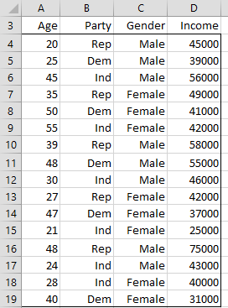
Let’s Predict Income….
X values are Age, Party, and Gender.
How do we do math with Party or Gender?
Prediction is y = m1*x1+m2*x2….
Each term is coef*x_value.
We need a number for the regression.
We have a word.
WTF??????????????

Slide 16
Feature Set Issues
The data has two parts:
Target – income.
Feature set – inputs (party, gender, age).
The two categorical features can’t be used in a regression as-is.
Using categorical data in predictive models (almost) always requires prep work.
Must make the words into numbers so we can math them.
More formally, we must encode the values.
Represent our original data with a numeric value that we can math on.

Slide 17
Encoding
Encoding is the transformation of categorical features to numeric features.
Almost* always necessary as part of the preparation process.
The concept is simple.
Identify each unique value in a categorical column.
Replace that value with a number.
This allows models to consider categorical inputs.
Sex, job type, product, etc…
Categorical data is often really important.
Note: binary is already 1/0.

Slide 18
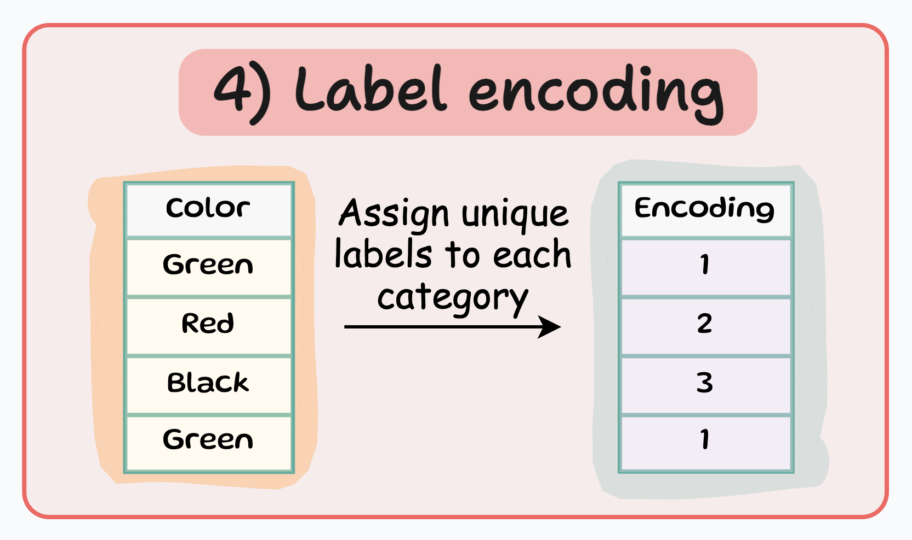
Label Encoding
The simplest method of encoding is label encoding.
Take each unique value, assign a number.
Usually 1, 2, 3…

Slide 19
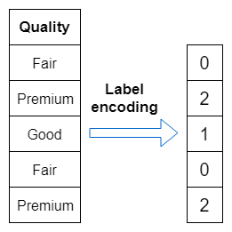
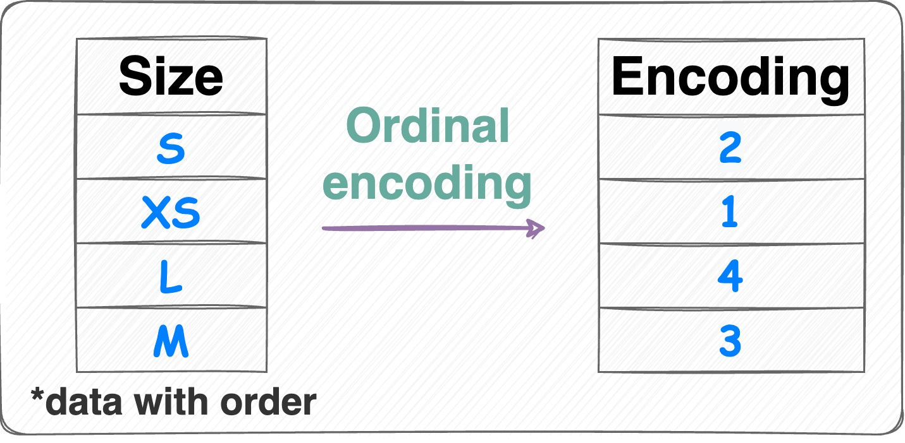
Ordinal Data
Label encoding works well with ordinal data. Recall types of categorical:
Ordinal – implied order in the categorical values.
Nominal – no implied order.
If we have something like a Likert scale, the meaning is captured in label encoding.
A larger number indicates a ‘larger’ value.
Sometimes this is called ‘ordinal encoding’ because the labels are assigned in order. Same idea.

Slide 20
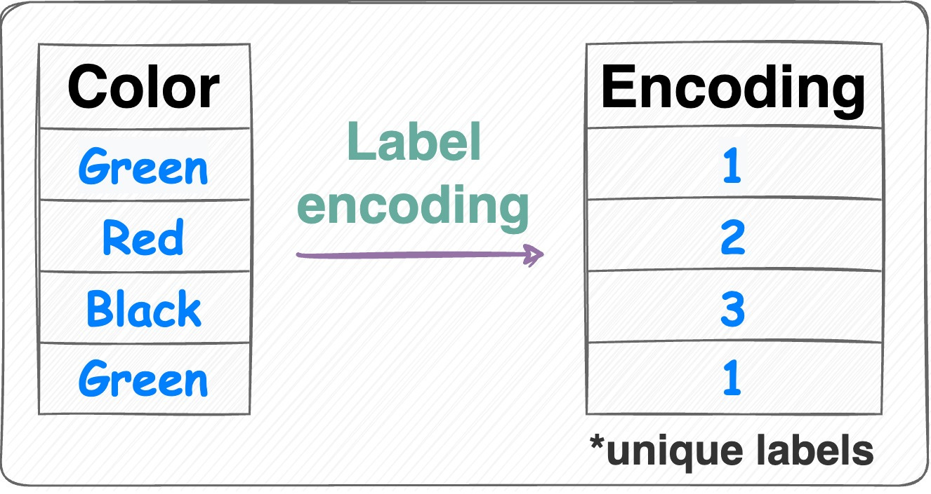
Ordinal Issues
If data has some implied order, label encoding works well.
If data has no implied order, this can introduce meaning.
3 is larger than 1, the model understands numbers.
This relationship is maintained in the model.
We are introducing a ‘ranking’ that doesn’t exist.
The model will take the 3 as 3 – it doesn’t know anything other than the fact it is a number.
We don’t want 3 to be treated as 3 times 1, just different.

Slide 21
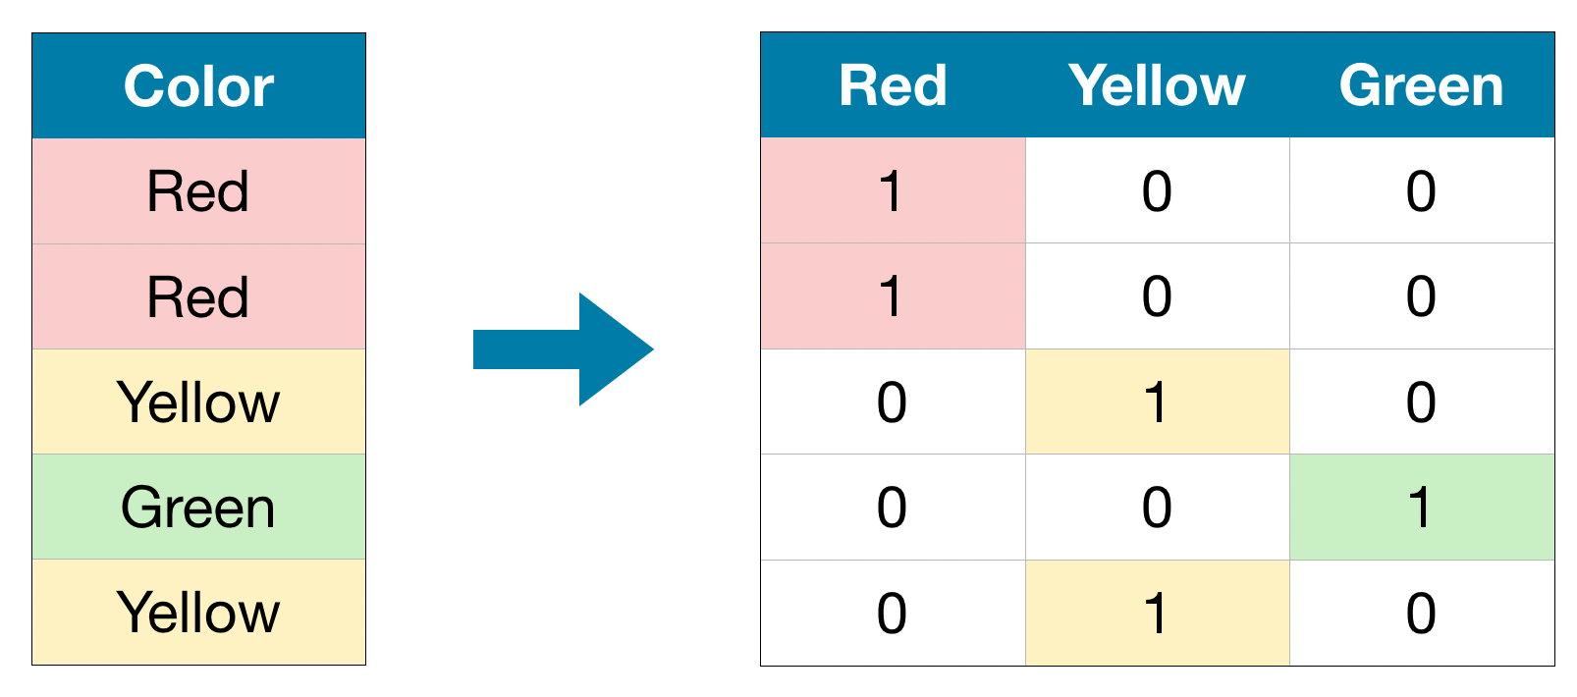
One-Hot Encoding
One-hot encoding is a different approach to encode data.
Rather than transforming the data in the column, the columns used are transformed.
Each value in the feature gets its own column.
Each row gets a 1 in the value it had, a 0 in the others.
No relationship/order is implied in meaning.
Default way to encode categorical.

Slide 22
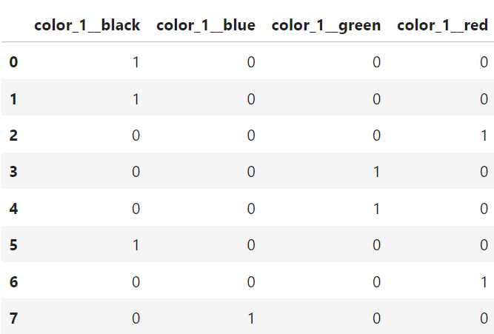
Encoding in Practice
In practice, we can call functions to do this for us.
Get_dummies in pandas.
A step in a sklearn data pipeline.
We generally do this after most other processing.
The data afterwards is much less readable by humans.
Data becomes much wider.
Only categorical columns need this processing.
We don’t deal with data in this format, but the model does.

Slide 23
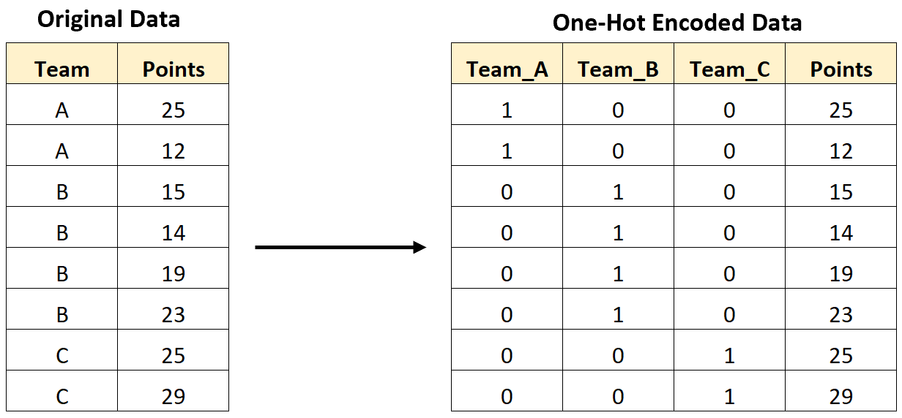
One-Hot Concerns
One-hot encoding is common and works well in most cases.
I can’t think of one-hot ever ‘breaking’ things, may be suboptimal.
Main issue, number of values per column.
Each value, in each categorical feature, means a new column.
If columns have many possible values, dataset becomes huge.
E.g. ‘city’ or text that is free entry (job titles – CSR, C.S.R, Cust. Serv. Rep…).
Trim columns like this first, or use things like ‘other’.
For reasons that will be clear in January, this can cause issues.
~ We lack enough example to learn something this complex.
Data should be taller than it is wide, ideally by a lot.

Slide 24
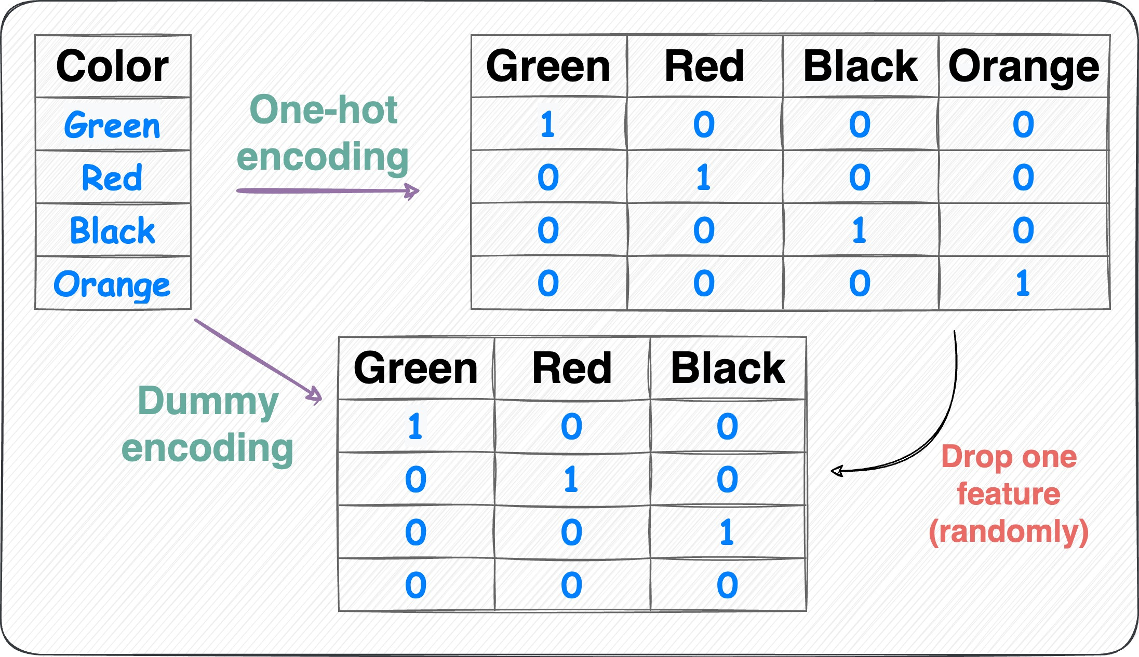
Drop it Like its (one-) Hot
Before using one-hot data we usually drop one column.
Small diff., but only need n-1 cols to encode n values.
If there’s a 1 in Green, it is green.
If there is a 1 in Red, it is red.
If there is a 1 in Black it is black.
If there is a 1 in Orange, it is orange.
1 in Orange = 0s in all other columns.
0s in all other columns has same meaning without Orange col.
Which column is dropped doesn’t matter.

Slide 25
Evaluating Models
This will become clearer in its importance post-regression.
When making predictive models we usually make a few and compare.
Different features, different data prep, different model types…
How are the error metrics we compare calculated?
We calculate residuals between model and each Y value.
What problem does this cause?
The model can ‘cheat’ - it learns from what it is being tested on.
We normally make the model on some data, evaluate on other.

Slide 26
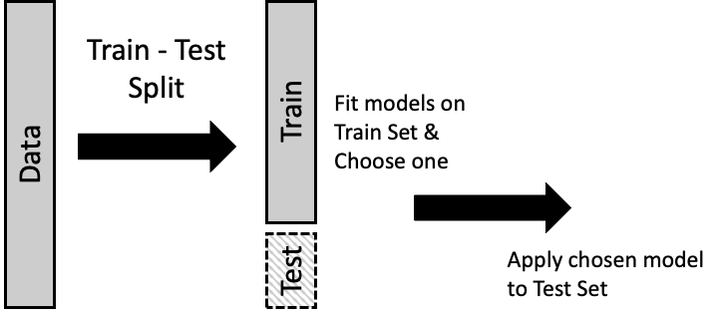
Do the Splits
In practice, we split our data and use one portion for each.
~80% - use to train (create) the model. This is what is used to calculate coefficients.
~20% - save this, calculate the model’s accuracy on this.
Makes the test more objective.
In reality, how does it do on new data?
Simulates seeing new data.

Slide 27
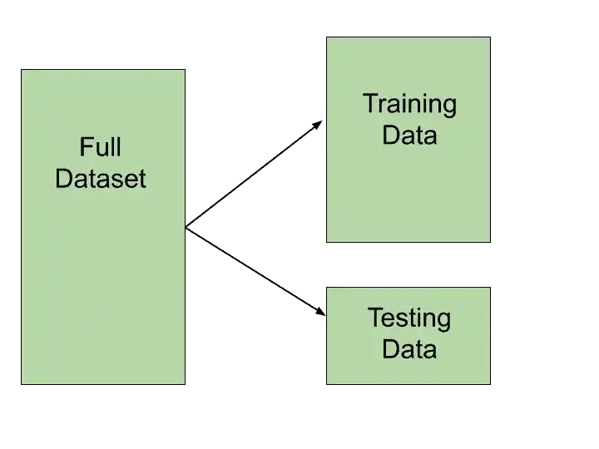
Train-Test Split
In practice, we usually use a train-test split function to do this.
Randomly subsets the data.
We provide data and amount to reserve for testing, function returns:
Test data (X and Y).
Training data (X and Y).
Use the training data, as normal, to create the model.
Once the model is made, use the test data to score and calculate error.
Percentage withheld for testing shrinks as data grows.
If this makes sense, you can skip 022, we’ll revisit it in January, there’s a few variations.

Slide 29
Prep Yo’ Data
Feature sets containing numerical and categorical data are called mixed.
Categoric features are useful but must be transformed to numbers.
Encoding performs this for us.
Label/ordinal keeps implied order/ranking.
One-hot is most common, and doesn’t insert ranking.
Different encodings rarely make a massive difference, but it does matter.
Ideally data should model reality as accurately as possible, so we aim to do that.
Dropping one of the one-hot columns is common.
Generally, comes at/near end of prep – we usually have several steps to do…
We split the data – some is used to build model, remainder is held to test.

