Slide 1
Housekeeping
Trees:
Review of basics and step-by-step example.
Restricting a tree’s growth – hyperparameters and regularization with CCP.
(Probably, dep. On time) intro to column transformers and using pipelines with mixed data.
(Depending on time) bias/variance tradeoff and over/underfitting.
Next time – grid search (this will be enough to do most of the 1st asn, part 2).

Slide 2
Review the Trees!

Slide 3
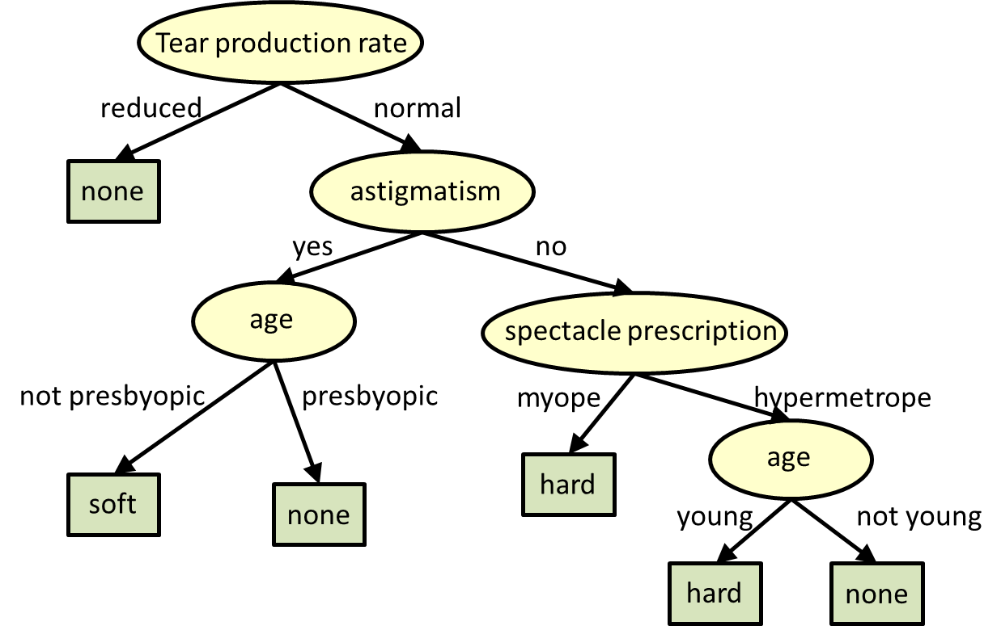
Trees
Trees are a type of machine learning model.
Can do classification or regression (later).
Every* ml model will do the same thing, differently.
They are quite different from regression models – non-linear, not a formula, etc…
Decision trees are constructed by discrimination:
Which feature will cause the result to be pure?
Measured by entropy or gini.

Slide 4
Making a Tree
The tree model is constructed (in classification) by attempting to split the data into two ‘more pure’ groups at each node, flowing down from the root.
I.e. we want each child to be as pure (only one thing) as possible.
The purity level is measured by one of two similar metrics – gini or entropy.
The tree will generally keep fitting until it is 100% accurate on the training data.
E.g. if there’s a node with 10 T and 1 F, the tree will want to split that impure group.
Trees tend to overfit – adapt the predictions too much to the training data.

Slide 5
Example
Suppose you’re me, you have a class of students, and want to predict who will pass.
We have lots of data – seating, hw completion, reading, attendance, clothing, laptop, etc…
If we want to make a tree:
The tree will use the useful things (reading, hw, attendance, etc…) to divide the data at each node.
It will keep going until accurately classifying everything.
Suppose we have a node that all does hw, attends class, does readings – 4 pass, one fail.
They are the same on the early decisions, based on important stuff like studying.
The algorithm will look at any features usable to split them to get to 100% - laptop, hair color, etc…
The rules in HP restrict the ability of a model to do this excessive adaptation!

Slide 6







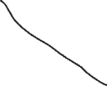



This is the overfit.
The model is fitted ‘well’ – adapted to the data, using the ‘important parts’.
The model still ‘wants’ to adapt more, and starts looking at ‘junk’.
In this node, the items are the same in the important features, but we still have a split. To get to 100%, the model will look at less important variables and pick one to split to 100% (all 4 read, all do HW, what can be used…)
With a new class, those less important things aren’t likely to hold true as predictors, so with new student’s our model will fail.

Slide 7
Important bits
The early decisions are more important to the outcome than the later ones.
By definition, these are the most important in separating the data.
In layman’s terms, we want to decide based on what matters, not trivial stuff.
The tree algorithm will capture and report these feature importances.
How important was each variable to the model’s predictions.
Can be unstable, for the same reasons as a tree in general.
We’ll do more on feature selection in a few weeks, but this is one factor we can use in choosing what data to keep.
The feature importance here isn’t global or definitive, it’s just what this model used.

Slide 8
Let’s Make a Tree!
We can make part of a decision tree manually.
We want to predict if someone has COVID.
We have some training data.
We’ll build a model, or part of it.

Slide 9
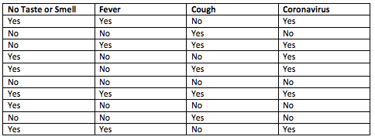


Data

Slide 10
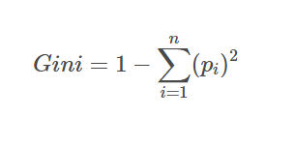
First Split – Root Node
To determine the root node we need to:
Split the data using each feature, measure the resulting purity of the child nodes.
Choose the one that is most pure (we’ll use Gini).
Step 1 – check is feature for a possible spit, compare their ginis.

Slide 11
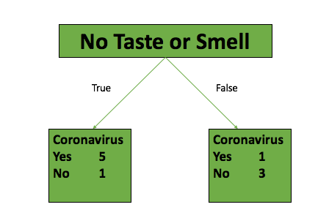
Feature 1
True:
Gini Impurity = 1 — (5/(5+1))^2 — (1/(5+1))^2 = .277
False:
Gini Impurity = 1 — (1/(3+1))^2 — (3/(3+1))^2 = .375
Since these leaf nodes represent a different number of patients (True = 6, False = 4), we have to get the weighted average of the leaf node impurities.
Weighted Average Gini Impurity = (6/10)*.277 + (4/10)*.375 = .3162

Slide 12
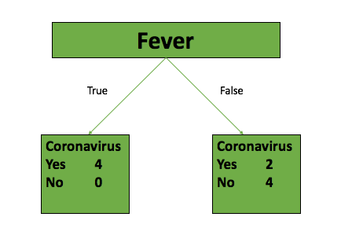
Feature 2
True:
Gini Impurity = 1 — (4/(4+0))^2 — (0/(4+0))^2 = 0
False:
Gini Impurity = 1 — (2/(4+2))^2 — (4/(4+2))^2 = .444
Weighted Average Gini Impurity = (4/10)*0 + (6/10) *.444 = .2664

Slide 13
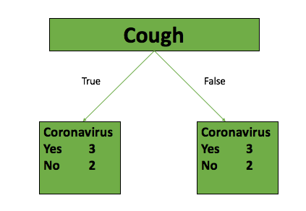
Feature 3
True:
Gini Impurity = 1 — (3/(3+2))2 — (2/(3+2))2 = .48
False:
Gini Impurity = 1 — (3/(3+2))2 — (2/(3+2))2 = .48
Weighted Average Gini Impurity = .48

Slide 14
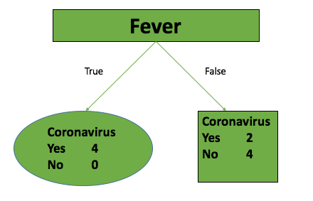
Root Node Decision
The lowest Gini is using Fever to split.
Fever is the root.
This results in the ‘most pure’ subsets.
If the tree is allowed to grow, we’d:
Repeat the same process from the right node.
Using those 6 records, what is the best split?
Repeat until 100% or a limit is hit.
Note: features can be reused for decisions.
If we used entropy, only the calculation is different.

Slide 15
Instability in Building
One of the characteristics of a tree is that it can be unstable.
Different models can be very different due to random variations in data setup.
We can see that with this example:
If the train/test split is slightly different, we might have a different root.
I.e. if two features results in similar gini/ent, then a slight shift in what is in the training data might make one or the other be chosen.
This will make the entire tree totally different.
The larger the dataset gets, the more this random instability can change things.
The model will be more stable.
The change may be more dramatic.

Slide 16
What if the Features are Continuous?
With these binary features, the decision is pretty simple – True vs False.
If a feature is numeric, there needs to be some cut-point set.
I.e. income < or > $50,000 – how is that $50,000 decided on?
Different tree making algorithms have different methods of deciding the best point.
Balance of speed and accuracy.
Generally done by some version of sorting and testing midpoints between values.
We don’t really care about the details here too much.
This can be computationally intense, so it’s the type of thing that has many optimizations.
This is the type of stuff grad students try to make ‘elegant’ in the nerdiest ways.

Slide 17
Making your Tree
This process is what the algorithm is doing to make the model.
The process keeps repeating until it hits some limit:
The overfitting is literally the model ‘asking too many questions’ or ‘digging too deep’.
We usually need some limit set by hyperparameters to make a balanced model.
Allow the tree to try to be accurate – it naturally tries to be perfect.
Set limits like depth, minimum values before splitting, # of leafs, to constrain that growth.
End result – model needs to make a decision on the ‘most important X things’.
Prevents less important (therefore less likely to be common) things from making decisions.
Forces the model to focus on the features that matter most in making decisions.
I.e. if the important things didn’t separate items, don’t use less important things to do it.

