Slide 1
Error, Bias, Variance

Slide 2
Trees be Fittin’
As we saw with trees, they want to be perfect and will overfit to remove error.
If we have non-linear data, we may also see a linear regression be underfit.
Balancing these two things is what we need to do to get a good model.
Allow the model to learn as much as possible from the data.
Use tools to stop it from learning too much.

Slide 3
Error in predictive modeling
Bias Error (Didn’t learn enough from training data):
Error due to assumptions made in the modelling process.
Generally results in underfitting.
E.g. assuming a linear relationship.
Variance Error (Learned too much from training data):
Error due to variations in the training data.
Generally results in overfitting.
E.g. different training sets for trees generate very different models.
Irreducible Error:
Error that we can’t fix through modeling, it in inherent in the data.
May be able to fix it by cleaning data (removing outliers, correcting missing data, etc…)

Slide 4
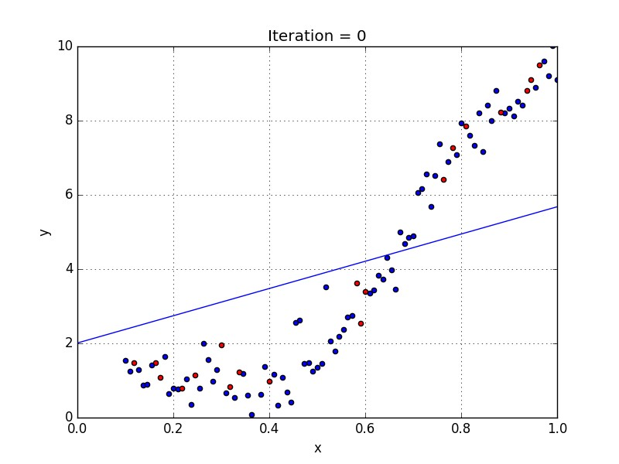
Bias Error – Model Assumes Linear Model is Underfitted

Slide 5
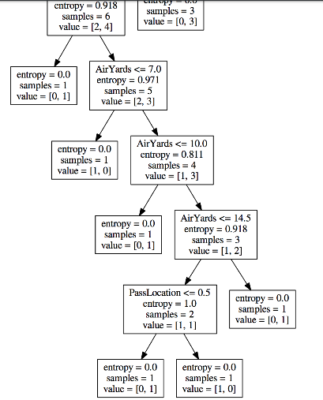
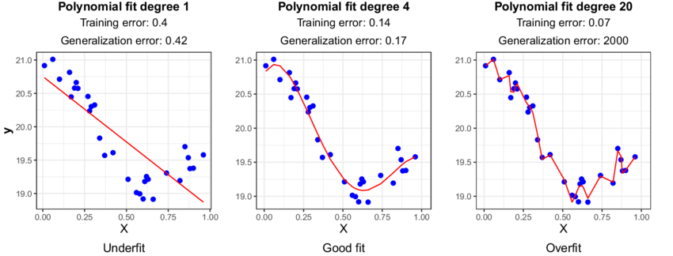
Variance Error – Tree that is Overfitted

Slide 6
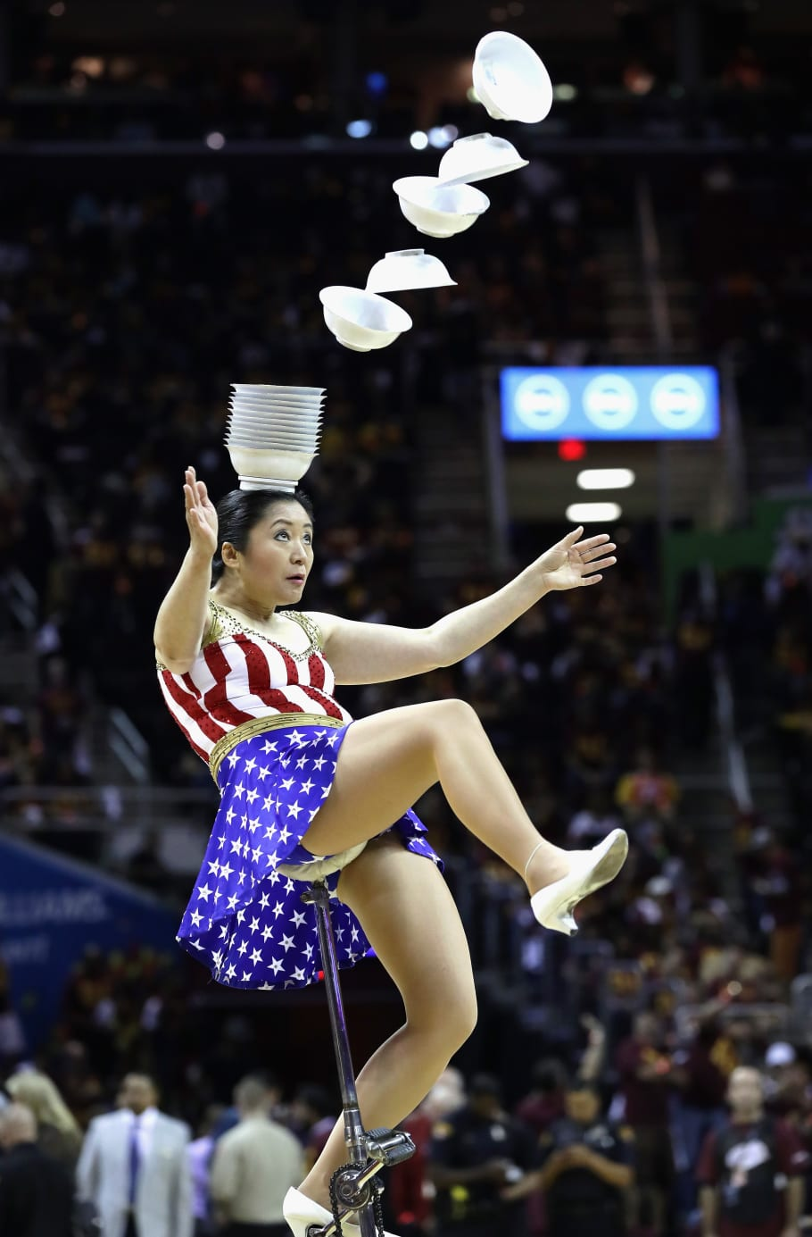
Balancing Act
A good model requires a balance between Bias and Variance.
If we have too much bias our model won’t be adequately tailored to the data.
Simple models have high bias.
A (stock) linear regression will have more bias – it can’t adapt that well to the ‘twists’ in the data since it isn’t able to ‘bend’.
If we have too much variance, the specific training sample data would impact the model’s predictions too much, and it may be wrong with different data.
Complex models (can) have high variance – that’s also it’s capacity to learn.

Slide 7
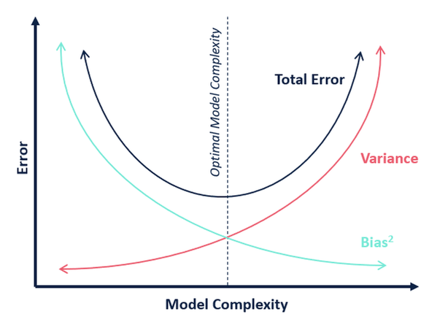
Bias Variance Tradeoff

Slide 8
How?
We have several approaches to make sure models fit, we’ll look at them all semester:
Model selection – the better a model fits the data to start, the better we’ll be.
Hyperparameter tuning – change the settings/rules for the model training.
Regularization – change loss to limit overfitting.
Feature selection – choosing which features to use.
Other stuff – more stuff later with other models, especially neural networks.
There generally isn’t a perfect solution, we need to do some educated guess and test.

Slide 9
Finding the balance
ML algorithms are generally “greedy” – they’ll try to get as accurate as possible.
E.g. a tree, without any limits, will try to make a model that perfectly fits training data.
Our goal is a model that is both accurate and generalizable - How?
Cross validation.
Hyperparameter values with grid searching.
Early stopping (big in neural networks).
Regularization. (E.g. tree pruning and regularization in linear regression)
The training and testing scores can reveal some info.
Training scores that get very accurate are an indication of overfitting.
Testing scores that drop substantially (relatively) from training are another.

