Slide 1
Housekeeping
Gridsearch and model tuning (Intro to ML.. In chapter 5):
Grid search for hp tuning.
Cross validation.
If we have time, forest and ensemble models (we should be able to):
“Ensembles of Decision Trees” in chapter 2, but just bagging – we’ll do boosting later.
Pretty easy idea – let me know honestly how you guys feel with pace of concepts.
Assignment 1 and making a tree-based model.
You can do it now.
You may want to use a forest (maybe next time), but that switch is easy in your pipeline.

Slide 2
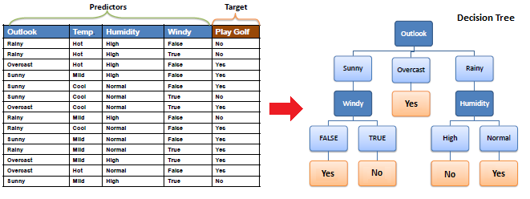
Tree Review
Remember trees - created by playing plinko with the data:
At each node, choose whichever feature can split data the best.
Gini/entropy measure of purity.
Repeat splitting whatever data is in that node until perfect or a limit is hit.

Slide 3
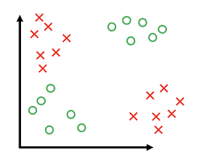
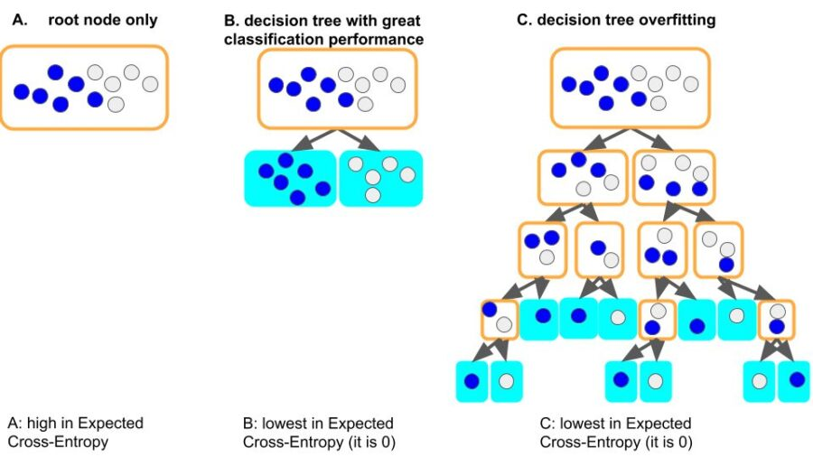
Trees
Not inherently linear, like regression models.
Can better capture non-linear relationships.
Simple and comprehensible by a human, able to be displayed visually.
Quick to predict (can be slow to train).
Very strong tendency to be high variance in error:
Will always overfit, to perfection if possible, if we don’t limit growth.
We need to use HPs or regularization to prevent the model from learning too much.
E.g. both trees here have the same purity (gini/ent.) score.

Slide 4
Tuning the Tree
To make a tree model that work well (not overfitted) we need to tune it.
Hyperparameters:
Settings for the model training process, such as max depth, min items in a leaf, criterion, etc…
We can set limits to (mainly) constrain growth, then the tree must optimize within that.
Regularization (Cost Complexity Pruning):
Regularization is the concept of adding a penalty to the growth of a model.
In order to overfit the data, the model must grow, so this combats that.
Requires each split to improve overall purity by at least some (adjustable by hp) amount.
Done after the tree is made, but is seamless to us.

Slide 5
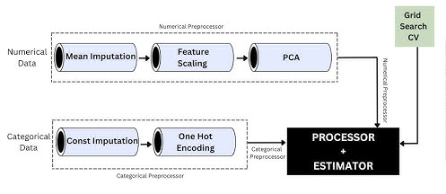
Shove a Column Transformer up Your Pipe
Column transformers are another pipeline item.
CTs are basically a pipeline with branching:
We can treat a CT like any other transformer object in connecting them.
Inside a CT we can specify different paths (pipelines), and which features go down them.
The output of the CT is just like a pipeline, it’ll recombine the data for us.
Mainly needed for mixed data types (cat/num).
All pipe-ish things can be combined in any way.
They accept/output an array(-like) dataset.

Slide 6
So we should be able to…
At this point, with some refreshment of last year, you should feel ok to:
Load, explore, and clean data prior to use.
Do train-test split and format data for training.
Decide on classification/regression model, set target and features.
Create a pipeline to process the data (now with CT branching and mixed data).
Impute, scale, encode should be usable and make sense.
Make models with different hyperparameters and evaluate accuracy metrics.
Tune a model to get better performance.

Slide 7
Grids and Pipes

Slide 8
Hyperparameters
We looked at using hyperparameters to make accurate models.
Each algorithm has different hyperparameters.
Hyperparameters are variables set ahead of time that control the training process.
We can’t evaluate optimal HP ahead of time, we need to set them and see the results.
Trial and error!

Slide 9
Tuning a model
When we make a model, we need to make it to see how good it is.
With hyperparameters we often don’t really have a good idea what to pick.
However, making a bunch of trials and comparing the results is boring.
Programmers are lazy!
Loops work, but they are repetitive and annoying to do.
We can automate this, test several trials, and just pick the best result.
Repeat the exact same training and evaluation process.
On each repetition, try a different selection of hyperparameters.

Slide 10
Grid Search
We could loop through different combinations of HPs and collect scores.
Complex and clumsy – multiple nested loops.
Sklearn provides a simplification – GridSearchCV.
Grid search takes a list of HP values we want to try, checks every combination, and returns the best model.
Same result of looping through each value.
Also a randomized version – for when we have no idea what HP values may work.
CV = cross validation….

Slide 11
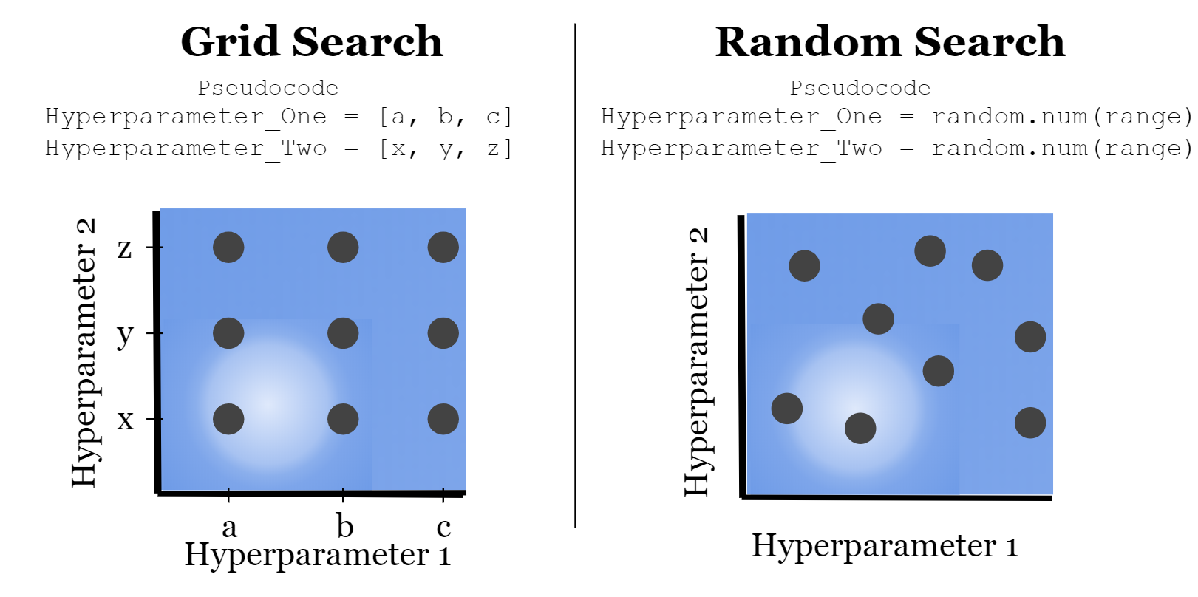

Slide 12
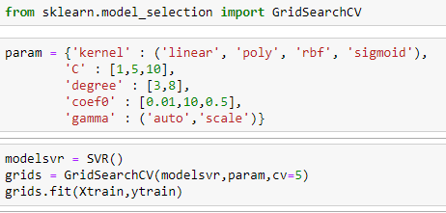
Hyperparameters
The grid search takes in a list of values to try for each parameter you want to change.
A model is made for each combination of parameters that you provide.
Can become a time issue with large sets.
Every model has different possible HP choices.
The GSCV object works just like a pipe in code.
Results in the best performing model of those tried.
We can specify a scoring metric, or take default.

Slide 13
Grid Usage
The grid search will automate the trials that we’d have to do manually.
We get the best model of all possibilities.
We are still limited by providing a non-massive good set of options, which isn’t always clear.
There are other approaches to this automated testing process that can be smarter.
Some things have large numbers of possible options, or wide ranges for numerical HPs.
We generally don’t know exactly what a good set of things to try is.
For numerical values, dialing into an exact value is even more challenging.
Randomized search will try random values – good if we have no real idea.
Halving grid search in sklearn uses a smarter approach to find good combinations.
We can get information out of the GSCV after training by grabbing its attributes.

Slide 14
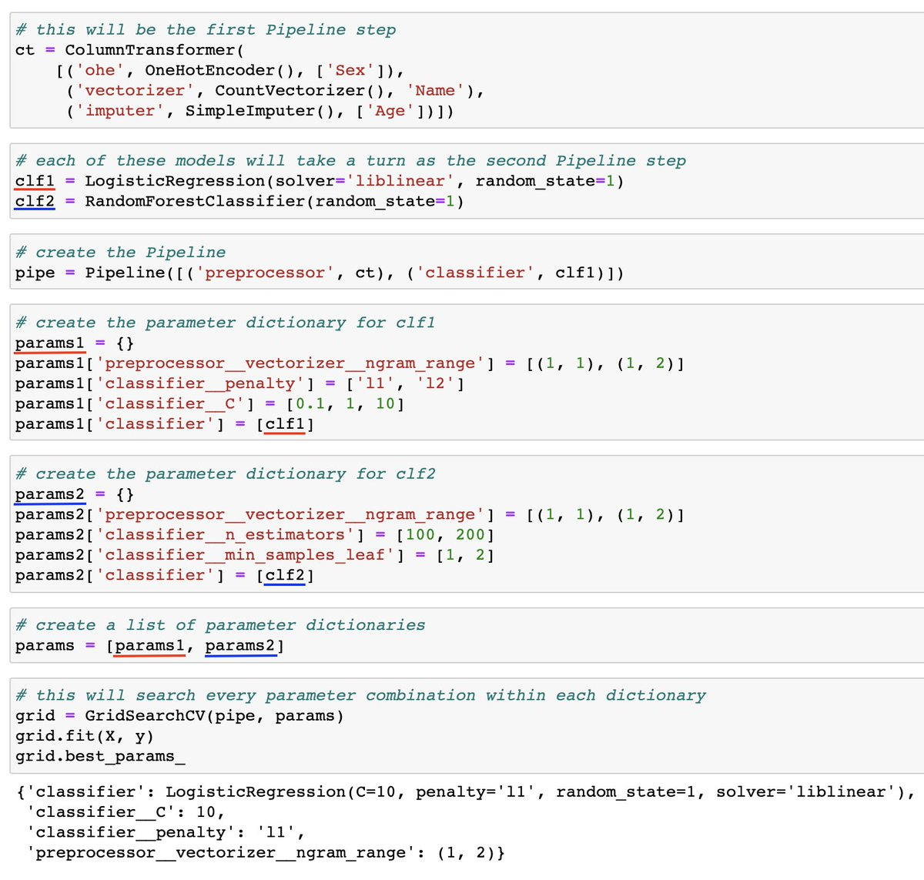
Grids and Pipes
This example is a (too) complex one.
Important:
We can refer to items by name.
Each ‘layer’ is separated by a double underscore.
We can access any hyperparameter this way.
This can be any # of layers deep, each layer just adds a double underscore.
We can also tell the grid search to use different error metrics – f1, recall, etc…

Slide 15
Measuring Results
The grid search will build each model that you specify and capture the results.
The results are tabulated from the test data.
We have several trials of each model, to ensure accuracy…

Slide 16
Train-Test Split
We are used to splitting data when building models:
Training data (~70%) used to create the predictive model.
Testing data (~30%) used to evaluate the accuracy of the model.
This split allows us to accurately assess the accuracy on “new” data.
The split amounts can change, generally bigger data = smaller test data split.
Problem – random splits in the data can lead to variance in results:
Think of drastically different trees we get when data is split differently.

Slide 17
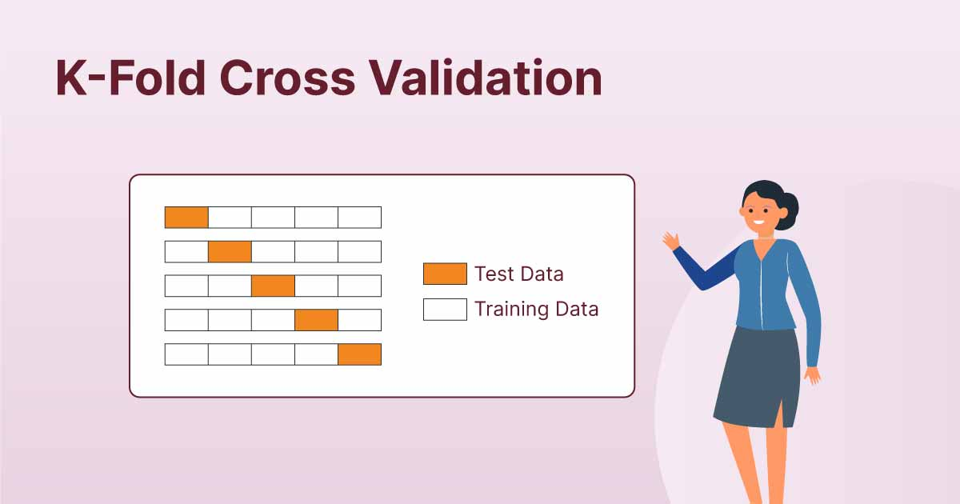

Slide 18
Cross Validation
Cross validation addresses this problem by repeating the split concept repeatedly.
K-fold Cross Validation:
Randomly split the data into K subsets.
Use k-1 set for training data.
Use the other set for testing data.
Repeat for all K subsets.
Average results together.
Mitigates variation from data randomly in one set or the other.
K of 5 to 10 is typical (for smaller sets – as data grows, this can be limited by time).

Slide 19
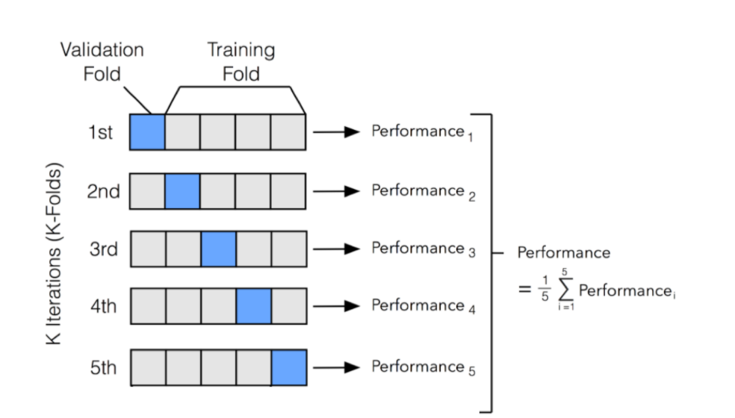

Slide 20
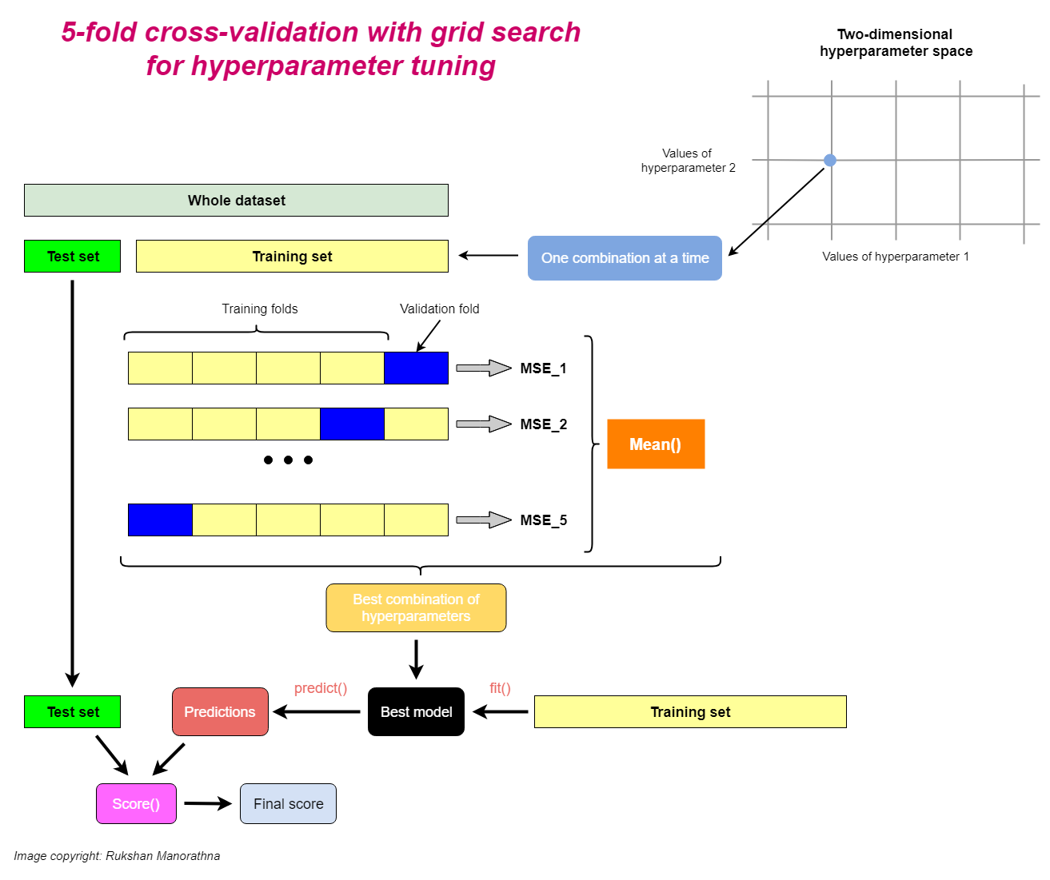

Slide 21
Grid Search CV
Grid Search CV combines these two into one simple call.
Test every HP combination.
Use cross validation to calculate scores.
Identify best model.
In place of one “normal” score we get the cross-validated score, and best HP combo.
Need to specify choices for HP in the grid.
Also a random version, that randomly chooses HP.
This will give us an easy way to get the best model, within the range we define.
This may take a long time, so we still need to be kind of selective.

Slide 22
In Practice…
Grid search can be used to easily choose a good set of HP for your model.
Setup a grid of potential choices for HP:
This isn’t generally something we can know ahead of time, need to guess and test.
If we have the data and/or this is important, use explicit test set.
Allow grid search to test and generate the best model.
Use this model for actual predictions.
Concerns:
Time - larger data, more CV rounds lead to better results, but can be slow.
Bad choices for the grid can lead to poor results. (“Smart” grid algorithms can help this).

Slide 23
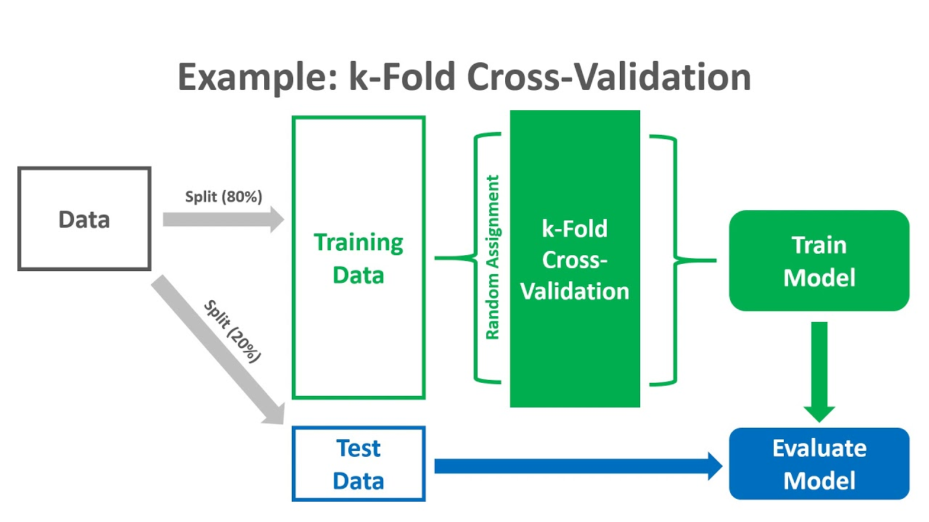

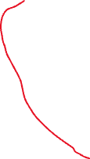
Explicit test set is ‘correct’ way to do things, but we can skip it for less critical things (especially with small data).

