Slide 1
Today
EDForests and Ensemble Models
Gridsearch, cross validation, and forests.
If time, regression trees.

Slide 2
The Forest and the Trees

Slide 3

Trees
Trees allowed us to make predictions that are transparent and simple.
Trees suffered in their lack of stability and tendency to overfit.
What’s better than a tree?
A forest!!!!

Slide 4
Ensemble Models
Ensemble learning models are just combinations of more than one model.
Ensemble models can be split into two big types - bagging and boosting.
Bagging:
Creating different models in parallel.
E.g. a forest is a bunch of parallel trees.
Boosting:
Using results of one model to improve later ones.
We’ll look at this later in the course.

Slide 5
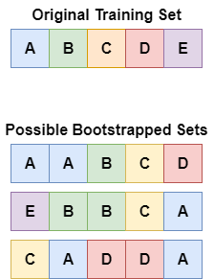
Pull yourself up by the Bootstraps
Bagging starts with creating ‘bootstrapped’ data sets.
Each dataset is the same size as the original.
Each set selects random items from the dataset WITH replacement.
Each dataset may have 0 or more copies of each training row.
Each dataset is built from the same ‘stuff’ as the original, but the balance is different.
“can encourage the individuals of an ensemble to explore features that may otherwise not be considered”
Can also limit a selection of features in each dataset.
I.e. select a random subset of features for each training set.

Slide 6
Forests
Forests are an ensemble of multiple trees. (Default is 100).
Each tree is created from a random bootstrapped selection of data.
Each tree makes its own predictions on the test data.
The predictions are voted (or averaged, for regression) to create a final result.
Result:
The random variation in tree results due to splits is neutralized.
Less variance in results.
Individual overfitted trees will be “outvoted” for final results tabulation.

Slide 7
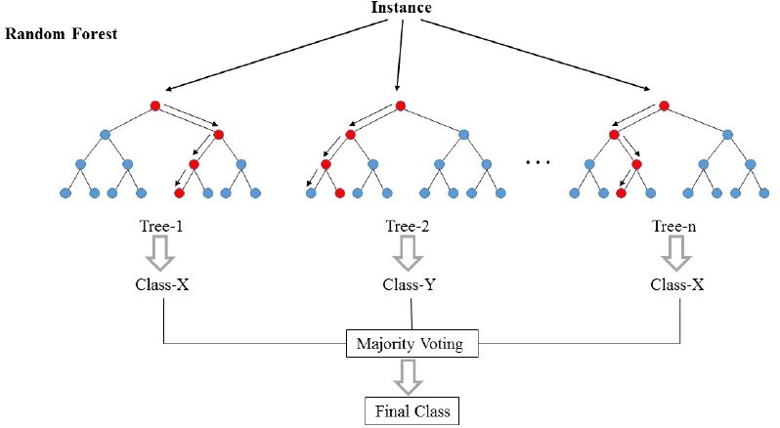

Slide 8
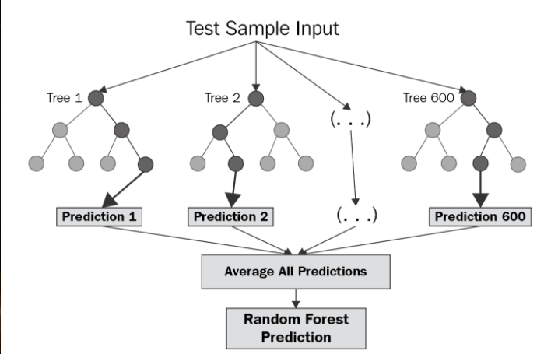

Slide 9
Forests Against Overfitting
Forest model are more resilient to overfitting than individual trees.
Trees tend to overfit by splitting nodes by less important features to get slightly better.
By definition, it is looking at the less important stuff to separate similar records.
Forests give each model a slightly different training data set.
Only some models will be able to overfit (in any particular way) since they don’t all have the data.
The final result is a vote of all the models.
Even if some trees overfit, that can be overcome as those will ‘loose the vote’ of all trees.
Only ‘trends’ in the data that exist in many of the models will persist.
We’re using the instability of the tree for us – each tree is different, but the ‘overlap’ persists in the model.

Slide 10
Forests
Can be both accurate and simple.
Not really explainable in the same way that trees are though.
Combining multiple models with a specific weakness can mitigate that weakness.
Trees often overfit if they are accurate.
Multiple trees from different training sets fights this.
Boosted (adaboost, xgboost) tree models are very accurate.

Slide 11
Don’t Boost it!
Ensembles have another type – boosting ensembles.
Boosting works in sequence - one model feeds the next, each improves slightly.
Based on weak learners – small simple models that each aren’t that good.
We’ll worry about boosted models at the end of the sklearn stuff.
These models are the ‘best’ for most non-NN things.

Slide 12
Forests
Can be both accurate and simple.
Combining multiple models with a specific weakness can mitigate that weakness.
Trees often overfit if they are accurate.
Multiple trees from different training sets fights this – it must learn, but some data is missing.
Large ensembles can have a time or space concern, they aren’t that fast.
Highly parallelized code and many cores can accelerate this in places.
Boosted (adaboost, xgboost) tree models that we will talk about later on are very accurate.

