Slide 2
Trees

Slide 3
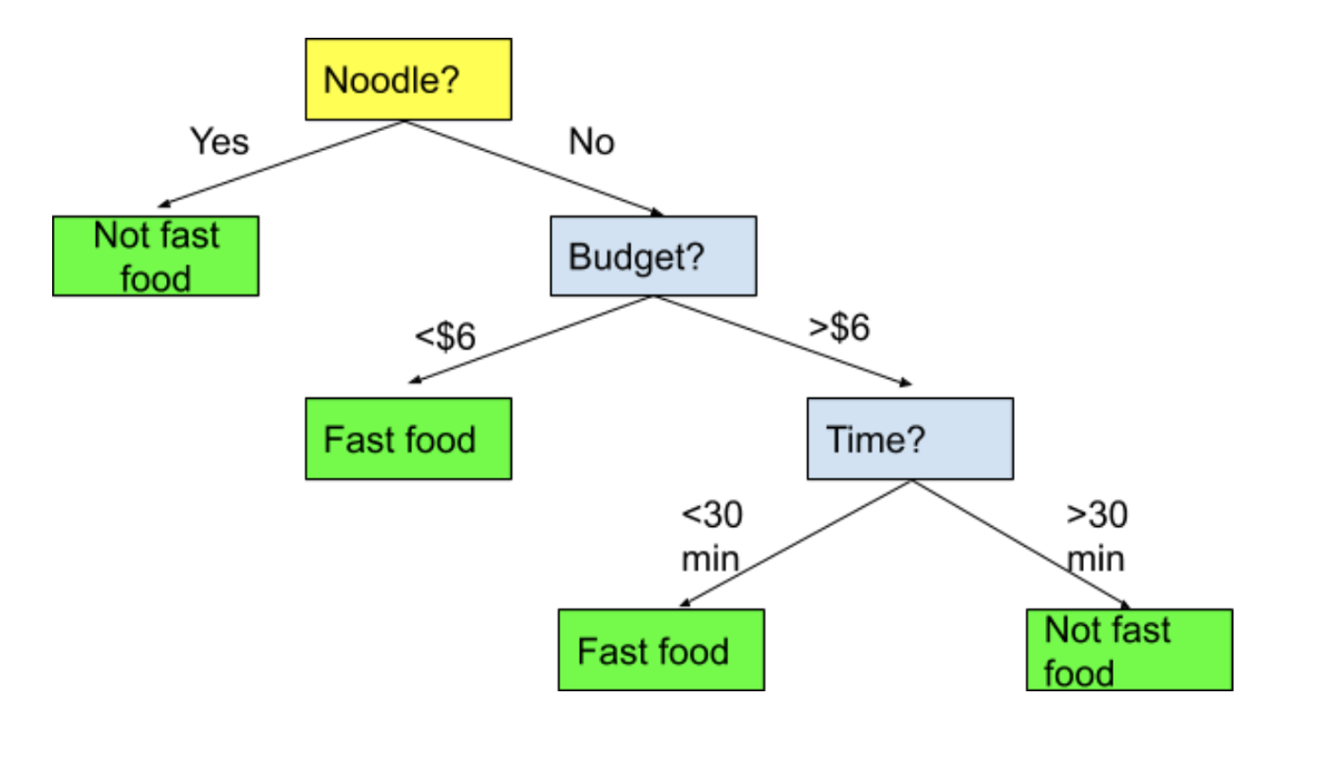
Trees
Trees are one of the simplest to understand models in machine learning.
A tree is just a series of if statements, until a decision is reached.
Once the tree is made, making a prediction is dead simple, just follow the tree and make decisions.
We’ll look at classification trees first, regression are similar once we understand classification.

Slide 4
See the Forest for the Trees
A tree is a fundamentally different type of model from a regression based one.
There’s no equation like y=mx+b to make a prediction.
There’s no linear relationship, as seen in that equation.
The process of creating the model is quite different from gradient descent.
The end result is interchangeable.
All models predict Target given Features.
The only thing that changes is how it learns to do so.

Slide 5
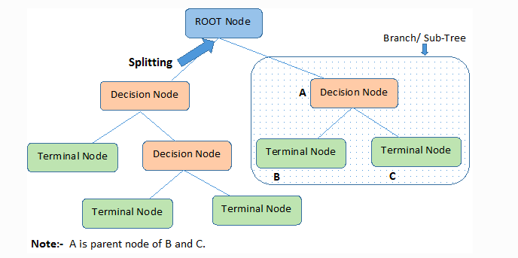
Tree Parts
The parts of a tree are simple and tree like:
Node– each point.
Decision – node where a split is made.
Terminal/leaf – node where a value is determined.
Brach/Sub-Tree – a segment of a larger tree.
Depth – how many layers the tree has.
Samples – number of items in that node.

Slide 6
Building the Tree
The decisions and the cutoffs are created by looking at the features for the criteria that will do the “best job of deciding” – or that will split the group most sharply.
For example:
You are classifying people as horse jockeys or basketball players.
You know their height and hair color.
Height does a better job of splitting the records.
Those >6ft are almost all bball playters.
Those <6ft are almost all jockeys.
Your choice would be to divide the data based on height.
The algorithm finds the decisions that maximize this separation.

Slide 7
Criteria
The criteria for how good the separation can be defined by different metrics.
Gini.
Entropy.
The math behind each is different, the idea is the same.
There is rarely a substantial difference between the two.
Gini is the default.

Slide 8
Scenario
If we have 4 red gumballs and 0 blue gumballs, that group of 4 is 100% pure.
If we have 2 red and 2 blue, that group is 100% impure.
If we have 3 red and 1 blue, that group is either 75% or 81% pure, if we use Gini or Entropy respectively.
As with most post-COVID political movements, trees want to discriminate.

Slide 9
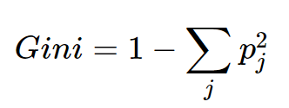
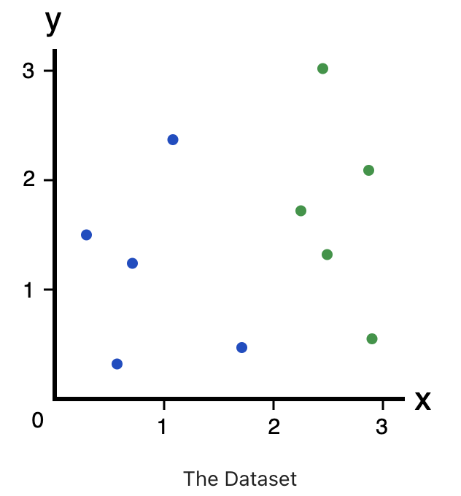
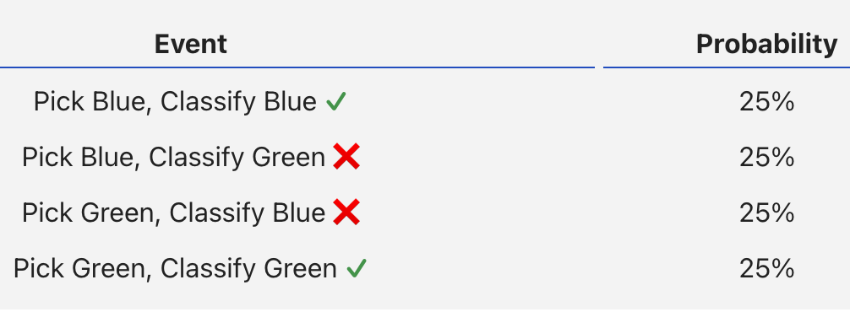
Gini
Gini measures how often a randomly chosen element from the set would be incorrectly labeled.

Slide 10
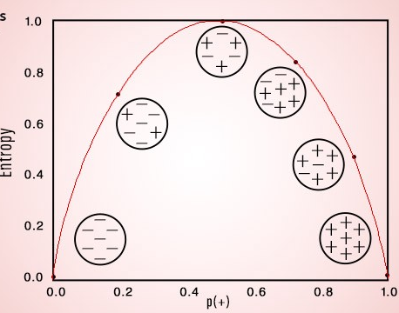
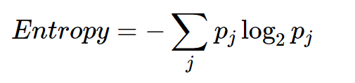
Entropy
Entropy is similar to Gini – a measure of impurity.
Created to convey the idea of information – the lower the entropy the more “information” it conveys.

Slide 11
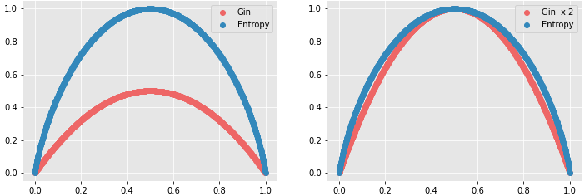
Splitting Decision
The algorithm looks for the decision that maximizes information gain or purity.
Gain = Gini/ENT before the split – Gini/ENT after the split
The split is the one that makes the tree more pure after.
Maximize discrimination with the division.
The series of the decisions makes the tree sequence of decisions.
In practice Gini and Entropy will usually give close to the same results

Slide 12
Woody Goodness
Tree benefits:
Simple, understandable, and mirrors human decision making.
Handles non-linear relationships.
Non-parametric – there is no assumption of what the data is, such as normal.
Explainable – we can follow the exact logic of the decisions.
Data prep is minimal – no need to encode or scale data.
Generally computationally efficient with large datasets when making decisions.
Can be acceptable in scenarios (finance, insurance, etc…) where a black box model isn’t.
You can show how a decision is made in human language.

Slide 13
Barky Badness
Trees have some disadvantages:
Non-robust – small changes in training data can generate wildly different trees.
I.e. a small difference in train-test split can yield different split points, which can then lead to a very different tree. Even if the end results perform almost identically.
What might we try that could mitigate this?
Prone to overfitting (though we can combat that when we code them).
Training with large datasets can be time consuming, especially when attempting to limit overfitting.

Slide 14
Improving Models

Slide 15
Making Better Trees - Hyperparameters
Hyperparameters are basically the settings that the algorithm uses while making a model.
Each algorithm has a different family of hyperparameters.
We can create different models with different HPs.
These models may perform very differently.
Tree hyperparameters can help us tailor our tree models:
Maximum number of levels in the tree.
Gini vs entropy for splits.
Minimum number of samples in a node to allow it to split.
Maximum total number of leaves.

Slide 16
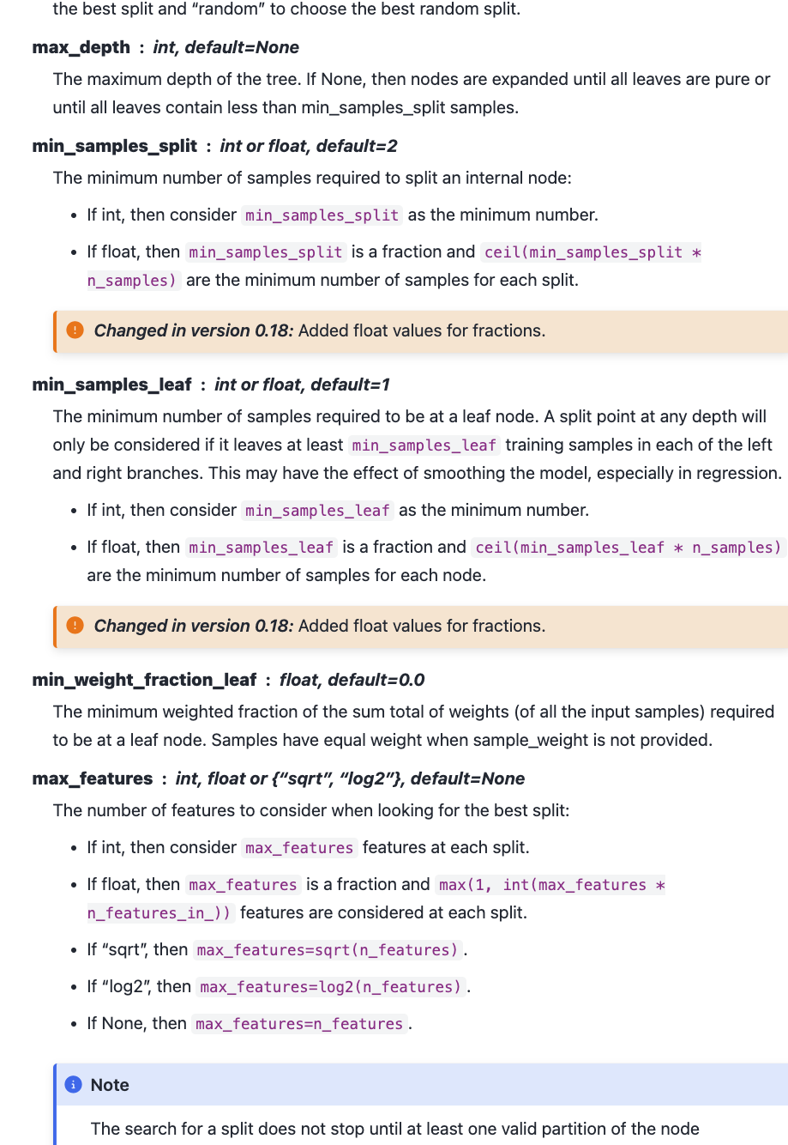
HP Options
Every model has different hyperparameters.
For a tree, they mainly relate to limits on growth:
Max number of levels.
Minimum items in a leaf to allow a split.
Maximum number of features to use.

Slide 17
So Many Parameters!
Parameters are the things that the model learns internally while training.
In a tree – split criteria.
In other models – weights, values, centers, etc… (This will make more sense later)
Hyperparameters are the things the model is told from the developer.
The rules on how the training process can run.
Settings for how it does its job.
Creating a model will require [model type + HP choices].
We often want to compare different HP sets against each other.
Soon we’ll look at tools to automate testing and comparing HP settings.
Can use HP settings to mitigate over/under fitting in a model.

Slide 18
Tuning the Model
We want our model to:
Learn the data well, so it can make accurate predictions.
Not become overly customized to the specifics, so it can make good predictions on new data.
We want to balance overfitting and underfitting.
Trees can tend to overfit if we don’t constrain their growth.
E.g. if a node has a T and F, just split so each node is perfect.
We want to let our tree fit to data, but limit how far it can go.
The model can get to near 100% in training, we want to constrain that growth.
The most common thing we’ll do with tuning is limiting overfitting.

Slide 19
Regularization
Another concept that can combat overfitting is regularization.
Regularization modifies the loss (or equiv) function to penalize growth of the model:
Normally more accuracy means less loss, so the model wants to overfit.
Regularization changes the loss to a combination of [loss + penalty]
The penalty is a value that gets bigger the mode the model ‘grows’ (or adapts).
Learning reduces error, but increases the penalty.
The model can only get more complex, or grow, if the increase in accuracy ‘outweighs’ the penalty of that growth.
The strength of regularization allows us to control the amount of learning.

Slide 20
Cost Complexity Pruning
Cost complexity pruning is a way to reduce the complexity of a tree after it is made.
CCP finds the leaves that are least beneficial.
The complexity parameter is used to define the cost-complexity measure, Rα(T) of a given tree (or branch of a tree) T:
Rα(T)=R(T)+α|T|
Where |T| is the number of terminal nodes in T and
R(T) is traditionally defined as the total misclassification rate of the terminal nodes.
Parts of the tree that were least helpful are pruned.
Acts to limit tree size like hyperparameter limits, but dynamically based on the tree.

Slide 21

Be More Alpha
In the CCP equation Rα(T)=R(T)+α|T| the alpha-t is a penalty.
The larger the number of terminal nodes gets, the larger the penalty.
The larger alpha gets, the larger the penalty.
Effectively removes things that have many terminal leaves.
Larger trees will generate larger penalties in branches.
Tends to limit overfitting, as it stops large branches from being developed.
Adding a penalty to “size” is a common strategy.
If a split is going to happen, it needs to “overcome” the penalty incurred by increasing the number of terminal nodes ( |T| increases ).
R(T) needs to decrease, or more accuracy, to overcome alpha-T increase.

Slide 22
Use some Trees
Trees are one of the most approachable model types to understand:
We can visualize the entire process and walk through decisions in English.
Trees tend to be greedy, so we need ways to limit the overfitting.
Tuning the settings of hyperparameters and regularization.
Tree creation algorithms seek purity – each node is uniform.
Trees do the same thing as regression, but in a totally different mathematical way.
Linear models assume a linear relationship, trees are non-parametric.
Different data may work better with one or the other (or some other type).
Many of the best non neural network models use some trees in different ways…

Slide 23
General Notes
Sklearn has gotten much better in the recent version in handling dataframes natively.
Many/most of the examples have a step to convert to array before the model part.
I.e. do prep stuff with data in dataframe, convert to array, feed to pipeline/model/gridsearch.
You can avoid this more easily now and sklearn will (more often) handle it ok.
I generally like the conversion step when learning, it’s a clear delineation.
All the prep work is done on the dataframe, we make the conversion when done.
The array conversion doesn’t really change anything in functionality.
The results are the same, and the process is only different in that one or two lines.
The algorithm does a conversion internally and just obscures it from you.
When we do neural networks we’ll need to do that conversion (often) again.

Slide 24
EDA and Classes

Slide 25
EDA and Classes – DataFrame Class Object
Methods:
Head
Info
Attributes:
Data
Columns
Size

Slide 26
Using a Class - Dataframe
When we create a DF we instantiate, or create an object of, that class.
Df = pd.read_csv(“some_data.csv”)
That object, df, has all the stuff in the previous image – the data, attributes, and functions.
Df.columns:
Give me the value of that attribute.
Df.head():
Run this function on the object

Slide 27
We can Make A Class – for EDA
We can try to make our own class, to help with EDA, what should it contain?
Attributes:
A dataframe. (An object in an object).
Some other helpful stuff? E.g. a list of categorical variables.
Functions:
Generate histograms.
Print EDA stuff.
Use:
Create an “EDA” object by loading the dataframe we are using.
Call the “give me EDA” function to get it all spit out for us.
We can reuse this by creating an EDA object for each df, then we can just call the EDA function.
Note: We can also extend classes – or basically make a “dataframe+” adding what we want. We’ll do this later for transformations.

Slide 28
EDA and Classes – DataFrame Class Object
Methods:
Make_EDA
Attributes:
Dataframe

