Slide 1
Housekeeping

Slide 2
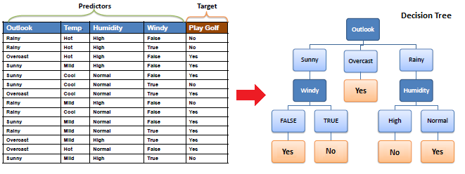
Tree Review
Remember the tree.
Created by playing plinko with the data:
At each node, choose whichever feature can split data the best.
Gini/entropy measure of purity.
Generally need to limit growth to stop overfit.
Test different HPs…

Slide 3
Grids and Pipes

Slide 4
Hyperparameters
We looked at using hyperparameters to make accurate models.
Each algorithm has different hyperparameters.
Hyperparameters are variables set ahead of time that control the training process.
We can’t evaluate optimal HP ahead of time, we need to set them and see the results.
Trial and error!

Slide 5
Tuning a model
When we make a model, we need to make it to see how good it is.
With hyperparameters we often don’t really have a good idea what to pick.
However, making a bunch of trials and comparing the results is boring.
Programmers are lazy!
Loops work, but they are repetitive and annoying to do.
We can automate this, test several trials, and just pick the best result.
Repeat the exact same training and evaluation process.
On each repetition, try a different selection of hyperparameters.

Slide 6
Grid Search
We could loop through different combinations of HPs and collect scores.
Complex and clumsy – multiple nested loops.
Sklearn provides a simplification – GridSearchCV.
Grid search takes a list of HP values we want to try, checks every combination, and returns the best model.
Same result of looping through each value.
Also a randomized version – for when we have no idea what HP values may work.
CV = cross validation….

Slide 7
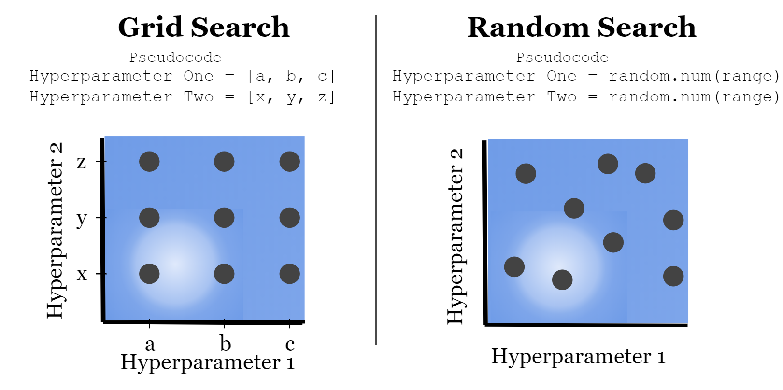

Slide 8
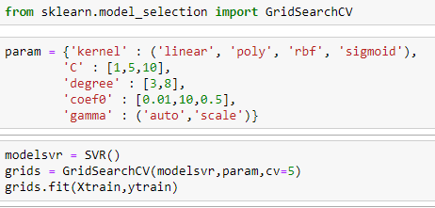
Hyperparameters
The grid search takes in a list of values to try for each parameter you want to change.
A model is made for each combination of parameters that you provide.
Can become a time issue with large sets.
Every model has different possible HP choices.
The GSCV object works just like a pipe in code.
Results in the best performing model of those tried.
We can specify a scoring metric, or take default.

Slide 9
Grid Usage
The grid search will automate the trials that we’d have to do manually.
We get the best model of all possibilities.
We are still limited by providing a non-massive good set of options, which isn’t always clear.
There are other approaches to this automated testing process that can be smarter.
Some things have large numbers of possible options, or wide ranges for numerical HPs.
We generally don’t know exactly what a good set of things to try is.
For numerical values, dialing into an exact value is even more challenging.
Randomized search will try random values – good if we have no real idea.
Halving grid search in sklearn uses a smarter approach to find good combinations.
We can get information out of the GSCV after training by grabbing its attributes.

Slide 10
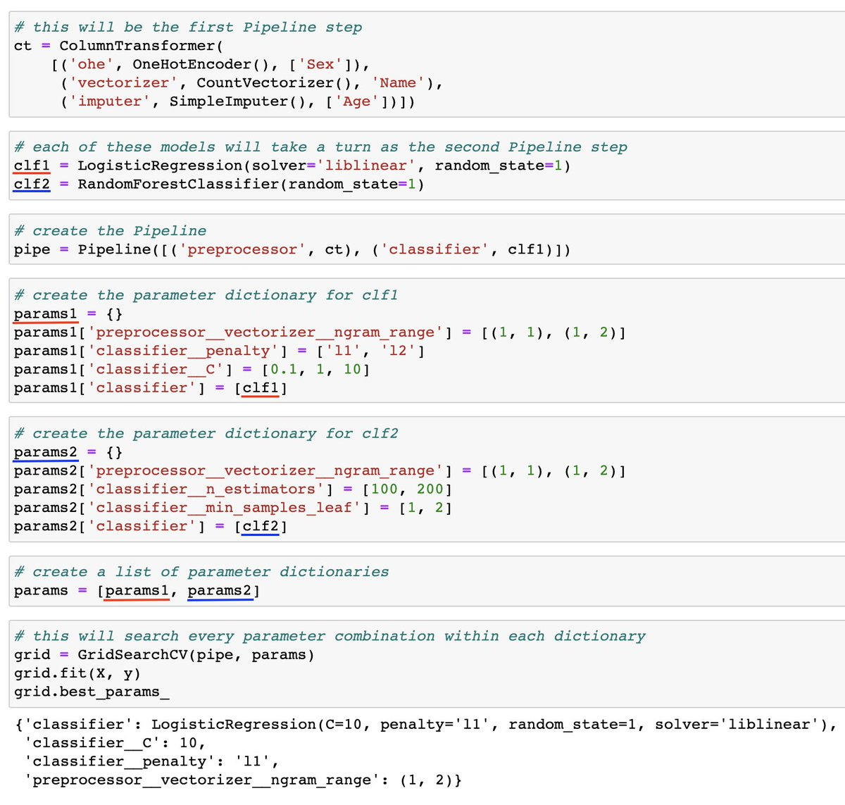
Grids and Pipes
This example is a (too) complex one.
Important:
We can refer to items by name.
Each ‘layer’ is separated by a double underscore.
We can access any hyperparameter this way.
This can be any # of layers deep, each layer just adds a double underscore.
We can also tell the grid search to use different error metrics – f1, recall, etc…

Slide 11
Measuring Results
The grid search will build each model that you specify and capture the results.
The results are tabulated from the test data.

Slide 12
Train-Test Split
We are used to splitting data when building models:
Training data (~70%) used to create the predictive model.
Testing data (~30%) used to evaluate the accuracy of the model.
This split allows us to accurately assess the accuracy on “new” data.
Problem – random splits in the data can lead to variance in results:
Think of drastically different trees we get when data is split differently.
The split amounts can change, generally bigger data = smaller test data split.

Slide 13
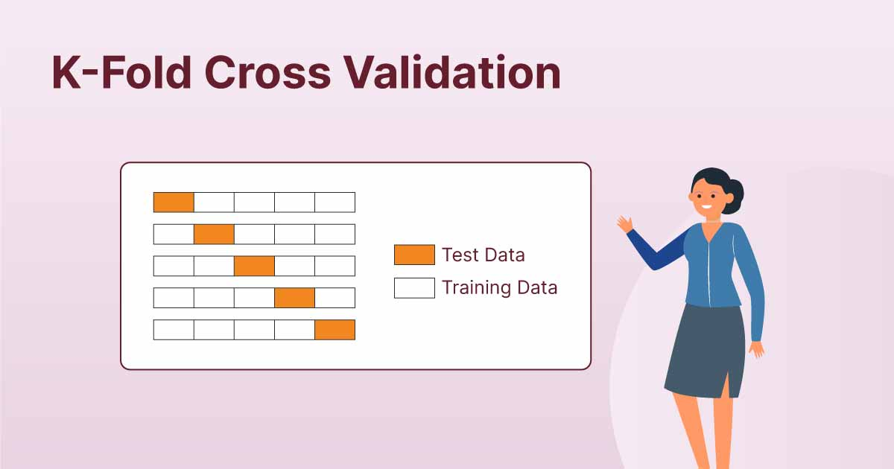

Slide 14
Cross Validation
Cross validation addresses this problem by repeating the split concept repeatedly.
K-fold Cross Validation:
Randomly split the data into K subsets.
Use k-1 set for training data.
Use the other set for testing data.
Repeat for all K subsets.
Average results together.
Mitigates variation from data randomly in one set or the other.
K of 5 to 10 is typical.

Slide 15
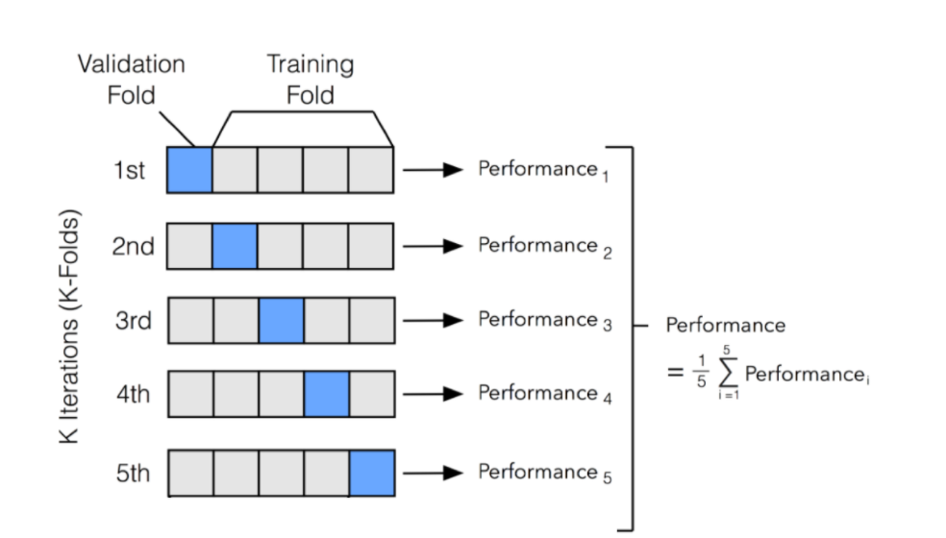

Slide 16
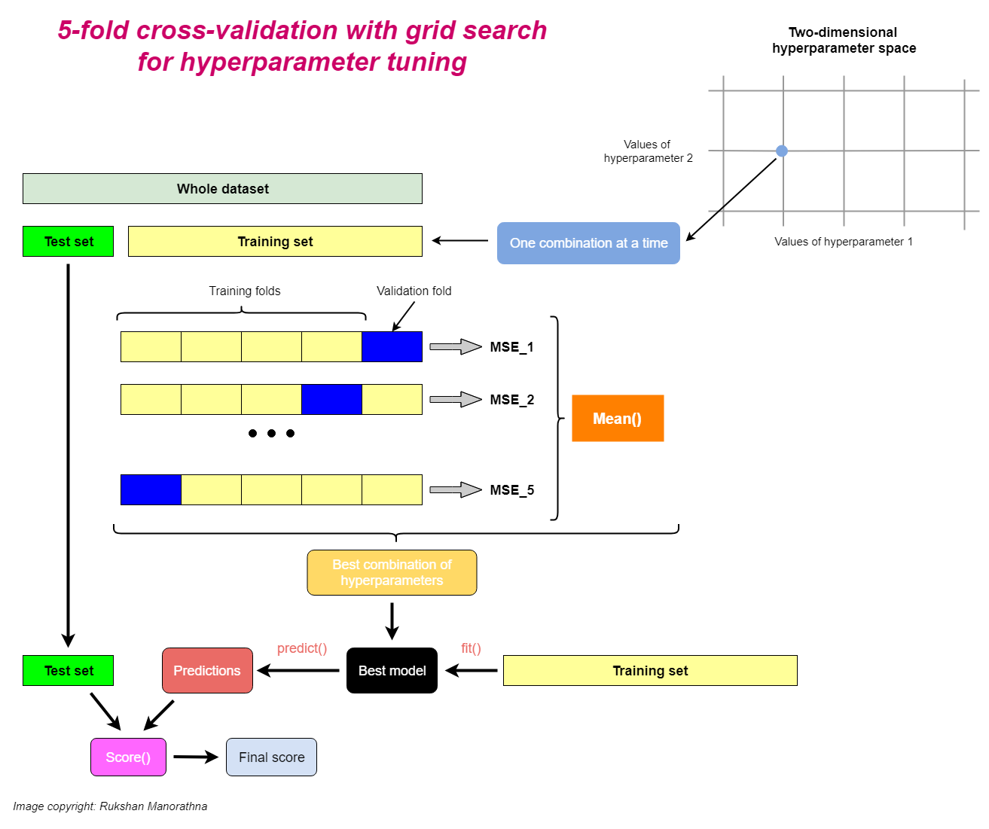

Slide 17
Grid Search CV
Grid Search CV combines these two into one simple call.
Test every HP combination.
Use cross validation to calculate scores.
Identify best model.
In place of one “normal” score we get the cross-validated score, and best HP combo.
Need to specify choices for HP in the grid.
Also a random version, that randomly chooses HP.
This will give us an easy way to get the best model, within the range we define.
This may take a long time, so we still need to be kind of selective.

Slide 18
In Practice…
Grid search can be used to easily choose a good set of HP for your model.
Setup a grid of potential choices for HP:
This isn’t generally something we can know ahead of time, need to guess and test.
If we have the data and/or this is important, use explicit test set.
Allow grid search to test and generate the best model.
Use this model for actual predictions.
Concerns:
Time - larger data, more CV rounds lead to better results, but can be slow.
Bad choices for the grid can lead to poor results. (“Smart” grid algorithms can help this).

Slide 19
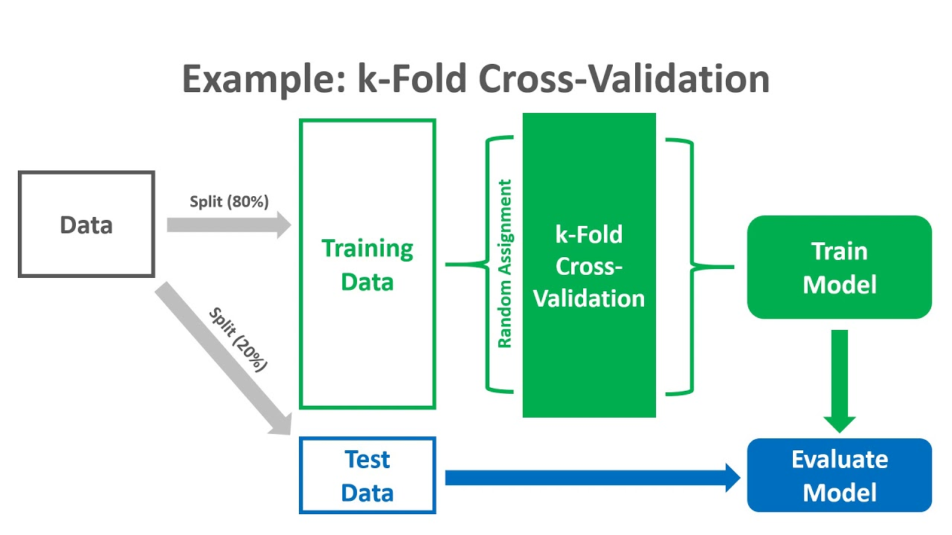
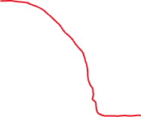
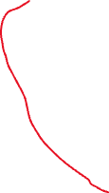
Explicit test set is ‘correct’ way to do things, but we can skip it for less critical things (especially with small data).

