Slide 1
Housekeeping
Today:
Real Machine Mother F*cking Learning! (020 and maybe 021)
Linear least squares -> linear regression.
Intro to sklearn regression (and statsmodels regression).
The processes using the sklearn stuff carry through the ML stuff.
Linear regression error calculations (depending on time).

Slide 2
Linear Least Squares, Regression, and More Fun Stuff!!! Part 1.

Slide 3
Linear Regression and Predictive Models
We have done linear regression before – it is making a line of best fit.
Result – y = m*x + b line.
M = slope, b = y intercept.
This process is also a simple predictive model – we provide X and get a prediction for Y.
The “regression calculation” uses the training data to “learn” how to generate Y from X.
That’s the machine learning bit.
The process of creating a regression is almost the same as other models, we’ll do later.

Slide 4
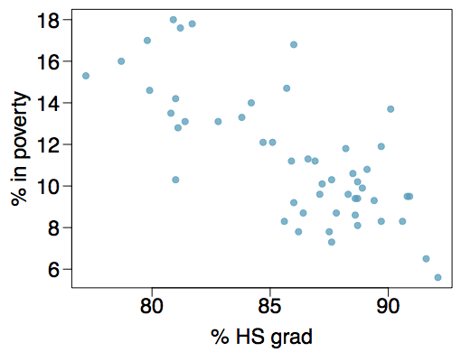
Poverty vs. HS graduate rate
The scatterplot below shows the relationship between HS graduate rate in all 50 US states and DC and the percent of residents who live below the poverty line (income below $23,050 for a family of 4 in 2012).

Slide 5
Poverty vs. HS graduate rate
The scatterplot below shows the relationship between HS graduate rate in all 50 US states and DC and the percent of residents who live below the poverty line (income below $23,050 for a family of 4 in 2012).
Response variable?
% in poverty
Explanatory variable?
% HS grad
Relationship?
linear, negative, moderately strong

Slide 6
Poverty vs. HS graduate rate
We could draw a line of best fit… but how do we know exactly where it goes?

Slide 7
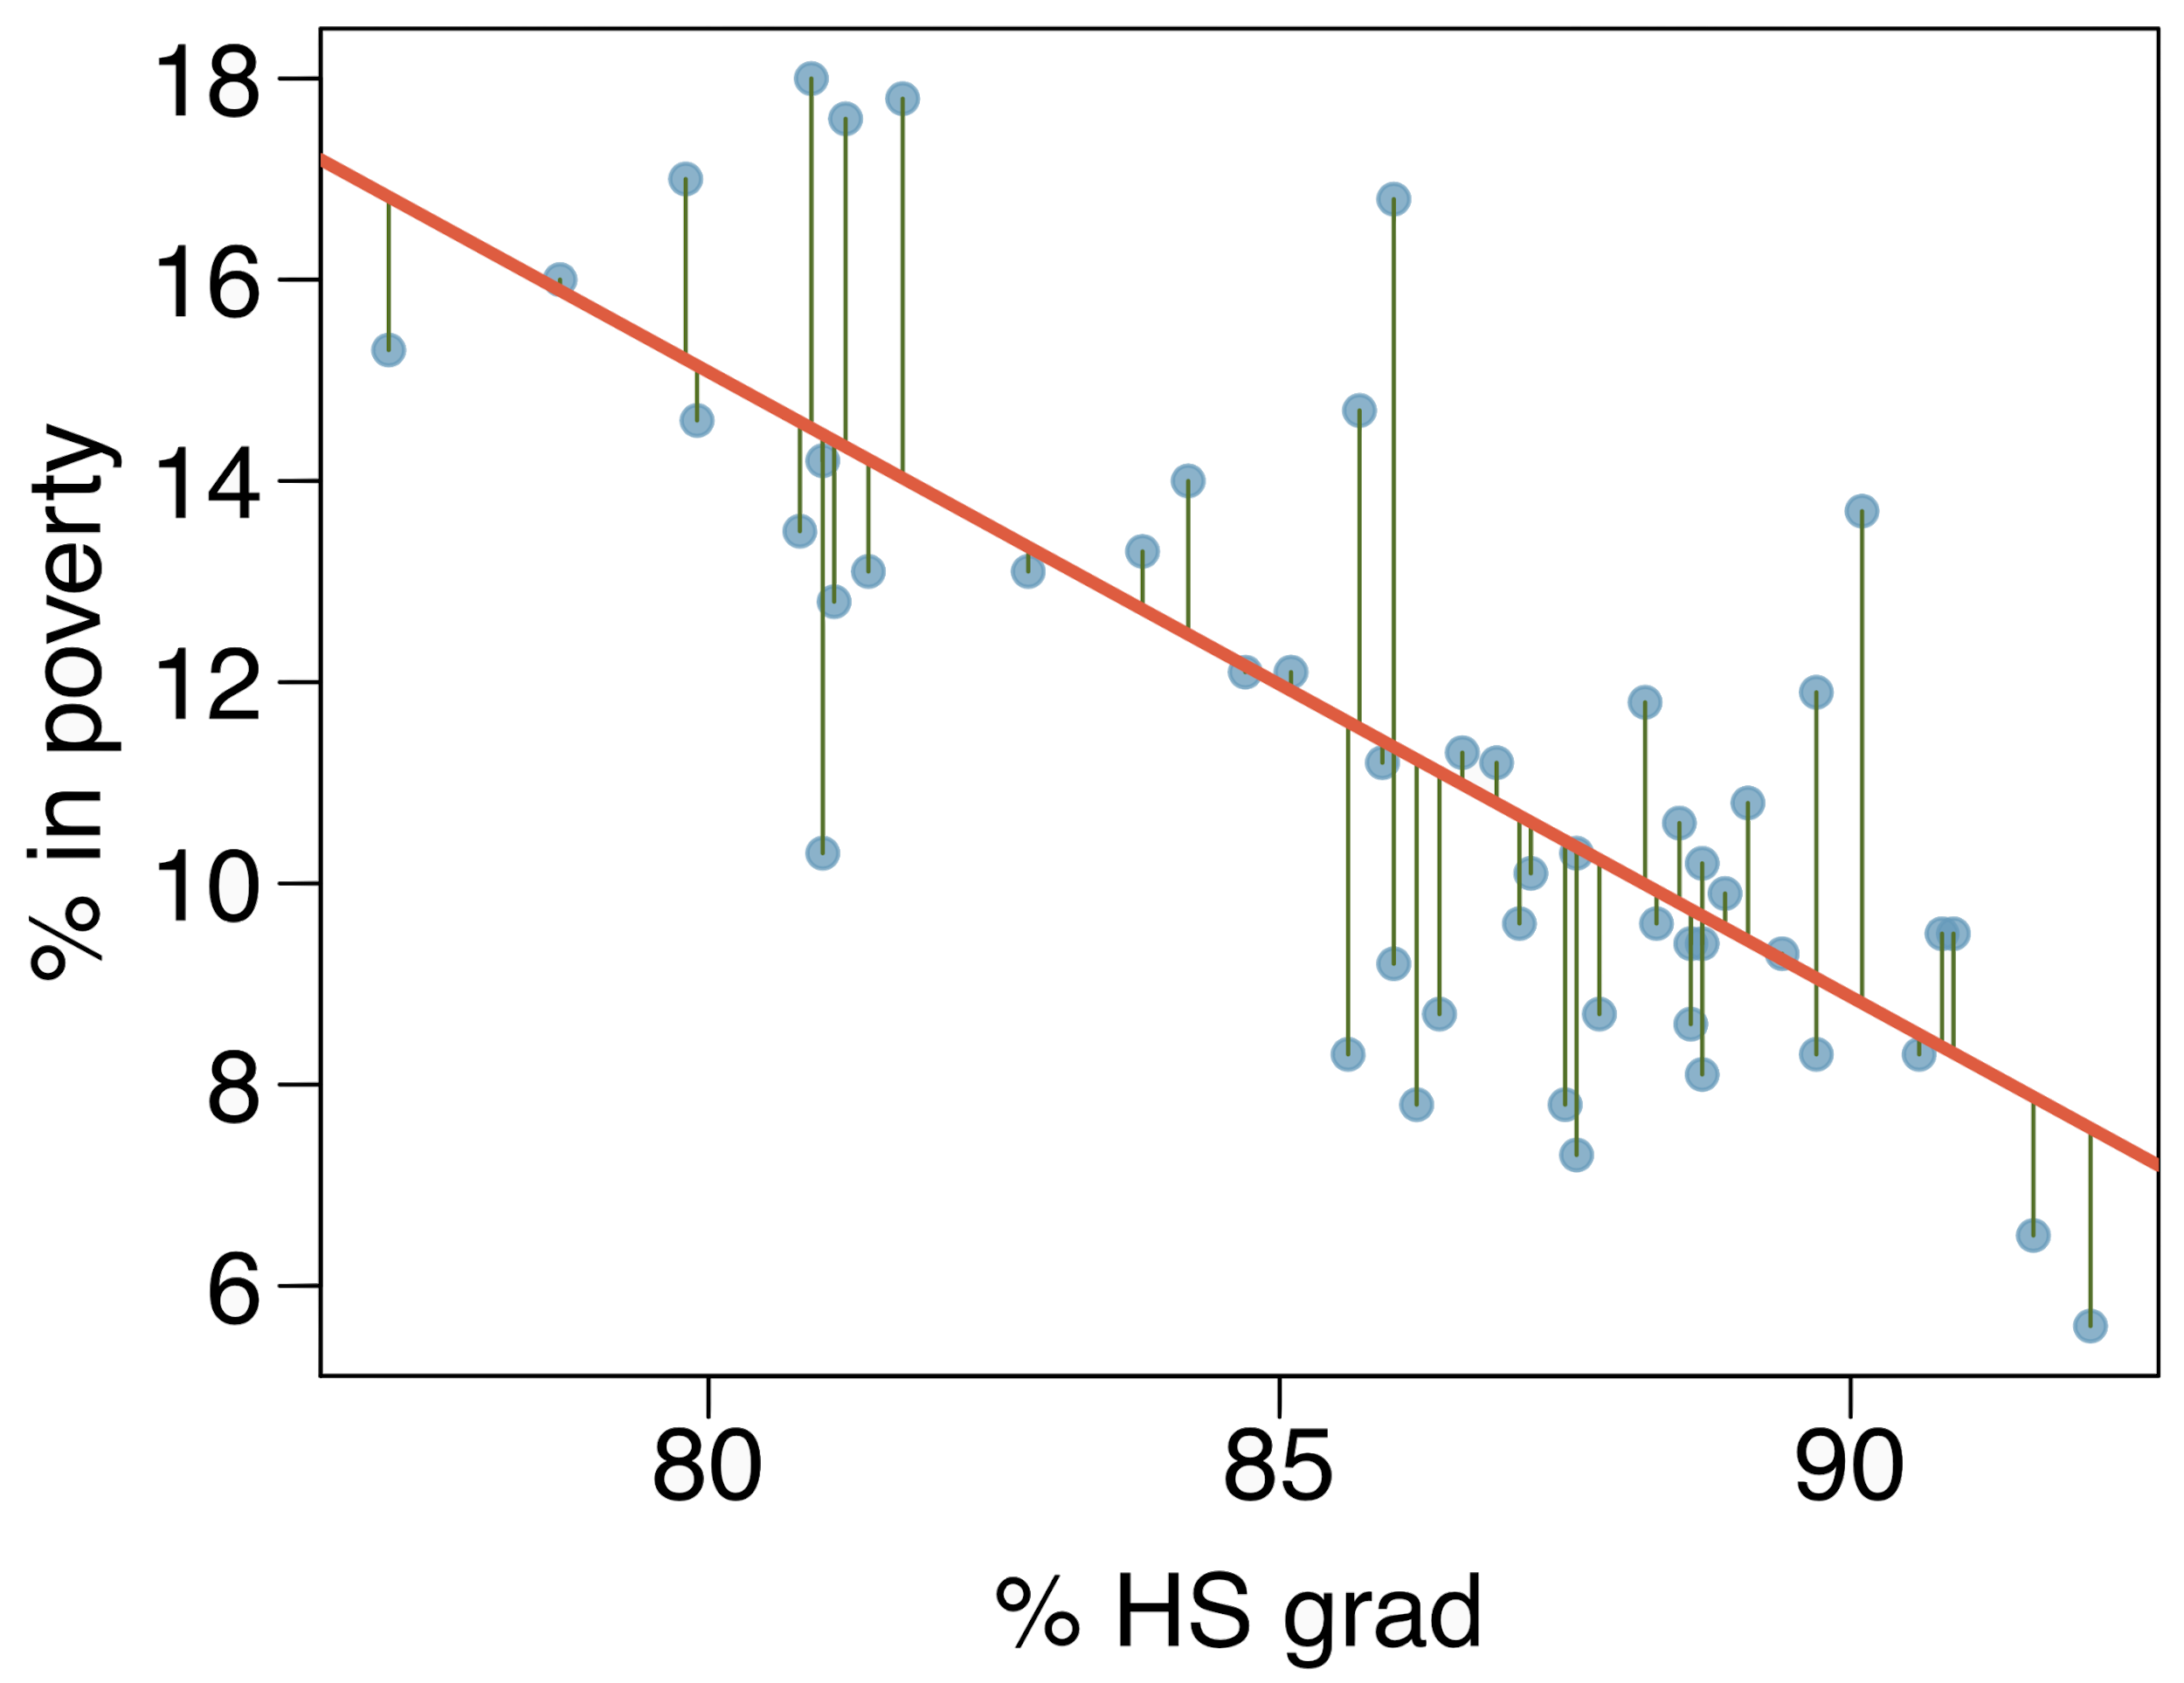
Residuals
Residuals are the leftovers from the model fit:
Data = Fit + Residual

Slide 8
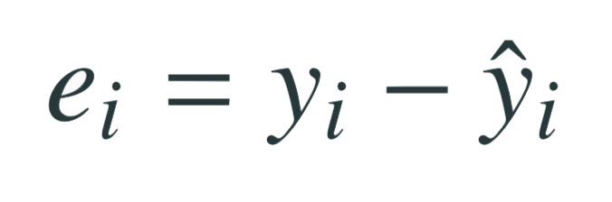
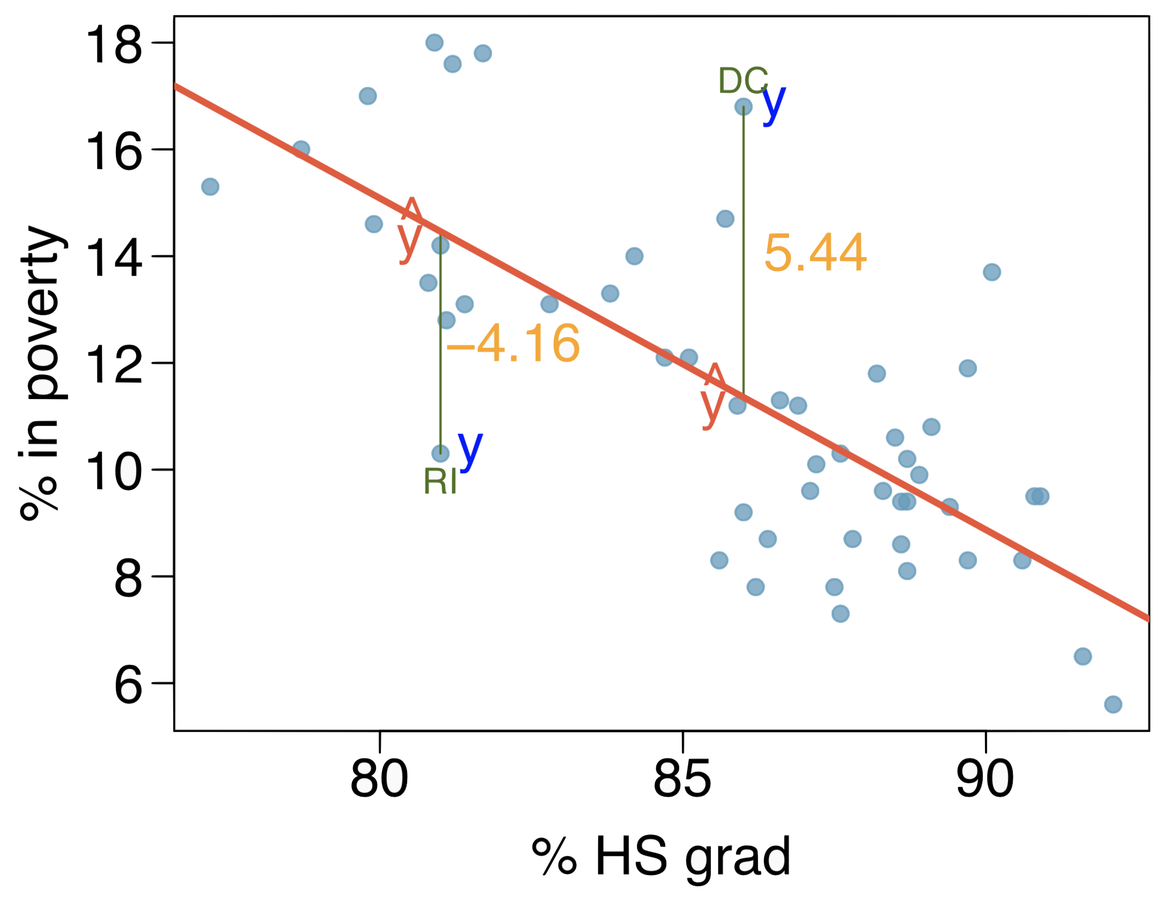
Residuals (cont.)
Residual is the difference between the observed (y_{i}) and predicted ŷ_{i}.
% living in poverty in DC is 5.44% more than predicted.
% living in poverty in RI is 4.16% less than predicted.

Slide 9
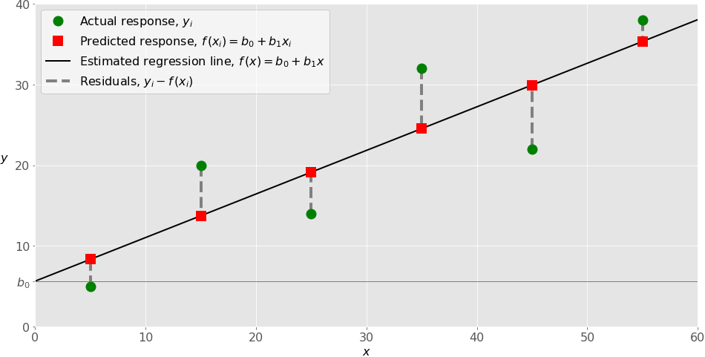

Slide 10
Linear Least Squares
The line can be defined by the intercept and slope.
We generate a line that minimizes the square of the residuals.
Why?
Small differences matter less than big ones.
Squaring deals with negatives.
Computationally efficient. (Mattered more in the past)
Is (potentially) a good estimator for slope and intercept.

Slide 11
How to find the minimum of the residuals squared?
This is the “learning” part of machine learning.
This step is the main thing that differs between other models – the math changes.
We can use:
LeastSquares from thinkplot.
StatsModels function.
Scipy functions.
Probably many other packages.
The model (best fit line) is defined by the slope and intercept.
Add any X value to those two and you can predict Y.
The training process finds the ”best” calculation to do so.

Slide 12
Key Parts of Machine Learning
We can pick apart the key items here – the details change, but these parts are there:
Algorithm – the thing that makes the model, linear least squares.
Training data – the old data that we have the ‘answer’ for:
Target – the answer, or thing to predict.
Feature(s) – the other variables, what we use to predict.
“The Model” – the equation y=mx+b, or just the parameters (m,b) needed to predict y.
We feed the data to the algorithm, it generates a model.
We can take new examples (features only) and predict the target.
We can use different algorithms, features, settings, etc… to get an accurate model.

Slide 13

Poverty vs. HS graduate rate
The linear model for predicting poverty from high school graduation rate in the US is
The "hat" is used to signify that this is an estimate.
It is an estimate because this isn’t a definitive calculation to calculate the value of poverty – it is a prediction of what we expect the rate of poverty to be, given a value for HSgrad.

Slide 14
Residual analysis
The generated residuals are also helpful to us in a few ways.
We can graph the residuals along with X to examine.
We want this pattern of residuals to not have any patterns in it – to be basically randomly spread out.
Why?

Slide 15
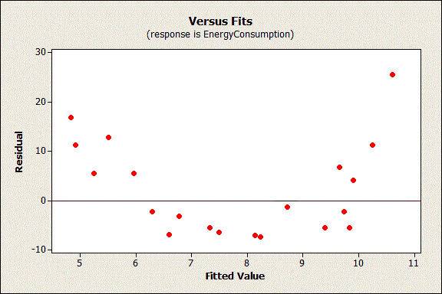
Why Random?
If there’s a pattern in the residuals it tells us that there’s some relationship here that isn’t captured in our actual model.
Middle predictions too high, ends are too low.
This pattern should be in the model!
Residuals should be:
Uncorrelated with a variable.
Uncorrelated with each other.
We shouldn’t be able to predict residuals.
Here, the model doesn’t ‘capture’ the curve.

Slide 16
Other Packages
Linear regression is performed by many existing packages, such as StatsModels, Scipy, and Scikitlearn.
The book uses StatsModels when multiple regression starts.
Which you use mostly doesn’t matter, it is a personal choice.
We’ll use both StatsModels and Scikitlearn:
Statsmodels provide more stats data in the output, so we will use that sometimes.
The scikitlearn is probably more relevant experience for ML stuff.
I think going forward I might replace some of the statsmodels examples in future workbooks with sklearn one. The interface is easier, and it is more relevant to ML.

Slide 17
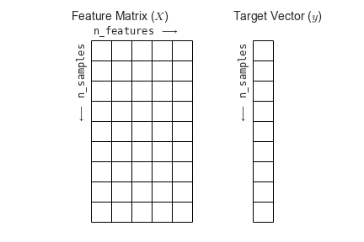
Shapes and Arrays
One thing we need to pay attention to a bit more is the data structure and the shape.
Most things we’ve used take anything ‘iterable’ or anything that is list-like.
Often (but not always) in machine learning we need arrays, usually of a certain shape.
Some tangible differences are:
Use np.array() to create arrays of the data – usually one array for x(s), one for y.
Ensure the arrays are “vertical”, print it and/or use .shape to look.
.reshape(width, height) can reshape the arrays to what we need.

Slide 18
Classification
The same logic applies when doing classifications – logistic regression.
When picturing a logistic regression, the line (decision boundary) separates classes.
One side is 1, the other is 0.
Logistic regression doesn’t have a closed form solution like LLS.
We must use some other process to get the parameters.
We can use the process of gradient descent to find the answer.
Guess the parameters, check amount of error, adjust, repeat.

Slide 19
Cost and Lost
In linear regression, the MSE is (normally) the loss function.
The function that calculates the amount of error in the model’s predictions.
In logistic regression, our accuracy is correct/incorrect, not closeness.
In the process of training the model, a different ‘accuracy’ metric is used – loss.
This is roughly equivalent to MSE – being closer to correct means less error.
E.g. if a model predicts 1/0 if someone is a customer, it internal prediction may be .9. If they are a customer, that means that prediction has a loss of .1.
This allows a model to learn – get increasingly better. Yes/no would not work well.
The gradient descent process finds the low point of loss, or where we have the least error.

Slide 20
Gradient Descent Basics
The detailed math of gradient descent can get a bit messy, but the idea is easy.
We require one concept from calculus – a derivative.
Derivatives in calculus are the slope at that point of a curve.
A curve has a derivative of 0 at a turn – a low or high point.
The sign of the derivative tells us which direction we must move.
In GD, the algorithm takes the derivative with respect to each x value.
This calculates (kind of) the amount of error that ‘belongs to’ that term (m*x).
We get an adjustment to make for each parameter.

Slide 21
Gradient descent Process
Guess a value for parameters (ms and b).
Calculate the loss.
Take the derivative to determine if each m needs to go up or down.
Adjust m proportional with the learning rate.
Calculate the loss.
Stop when the loss stops getting better.

Slide 22
Gradiently Descend Everything
The process of gradient descent is used all over the place in machine learning.
Neural networks use gradient descent to train, that’s what takes so long with billions of parameters.
As long as there is a loss function, we can do the process.
Most (or virtually all) linear regression will use gradient descent instead of LLS or similar.
This process works everywhere, closed form solutions only exist in certain situations.
Allows us to modify the loss function, so we can adjust what ‘good’ means.
Adjust loss to compensate for problems, like overfitting…

Slide 23
Over and Underfitting
We want a model that is well fitted to the data.
An overfitted model is ’too tailored’ to the specific training data, and may not generalize well to new data.
An underfitted model has not learned enough from the data, and makes predictions that are too ‘default’.
Trees will generally overfit:
If a node has impurities, a tree will want to split to make those groups pure.
Our trees will normally get to 100% on training data if we let them.
A model that is perfectly tuned to one set of examples rarely works that well with new ones.

Slide 24
Conclusion
We can train our models to predict Y, given X.
In this case, the model is a simple algebra equation.
This is a simple version of all the more complex ML work to come later.
The residuals give us information on how good our model is.
Accuracy and reliability of the predictions…. Next time.

