Slide 1
Grids and Pipes

Slide 2
Hyperparameters
We looked at using hyperparameters to make accurate models.
Each algorithm has different hyperparameters.
Hyperparameters are variables set ahead of time that control the training process.
We can’t evaluate optimal HP ahead of time, we need to set them and see the results.
Trial and error!

Slide 3
Tuning a model
When we make a model, we need to make it to see how good it is.
With hyperparameters we often don’t really have a good idea what to pick.
However, making a bunch of trials and comparing the results is boring.
Programmers are lazy!
Loops work, but they are repetitive and annoying to do.
We can automate this, test several trials, and just pick the best result.
Repeat the exact same training and evaluation process.
On each repetition, try a different selection of hyperparameters.

Slide 4
Grid Search
We could loop through different combinations of HPs and collect scores.
Complex and clumsy – multiple nested loops.
Sklearn provides a simplification – GridSearchCV.
Grid search takes a list of HP values we want to try, checks every combination, and returns the best model.
Same result of looping through each value.
Also a randomized version – for when we have no idea what HP values may work.
CV = cross validation….

Slide 5
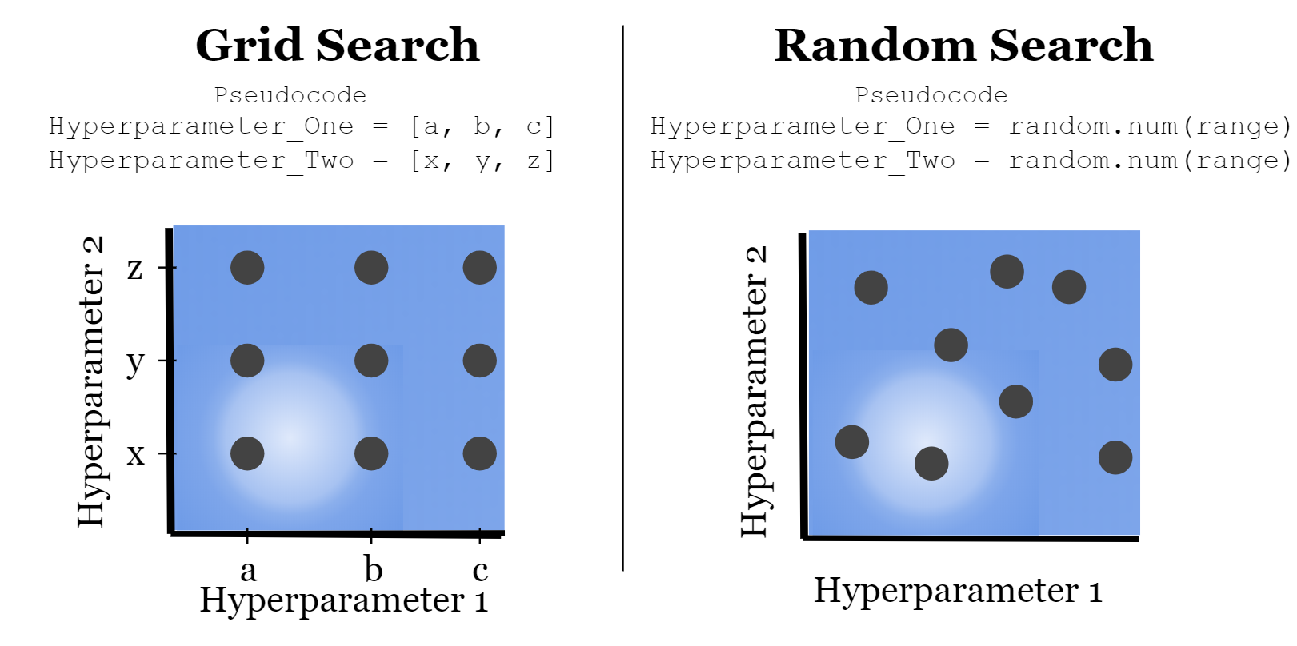

Slide 6
Measuring Results
The grid search will build each model that you specify and capture the results.
The results are tabulated from the test data.

Slide 7
Train-Test Split
We are used to splitting data when building models:
Training data (~70%) used to create the predictive model.
Testing data (~30%) used to evaluate the accuracy of the model.
This split allows us to accurately assess the accuracy on “new” data.
Problem – random splits in the data can lead to variance in results:
Think of drastically different trees we get when data is split differently.
The split amounts can change, generally bigger data = smaller test split.

Slide 8
Cross Validation
Cross validation addresses this problem by repeating the split concept repeatedly.
K-fold Cross Validation:
Randomly split the data into K subsets.
Use k-1 set for training data.
Use the other set for testing data.
Repeat for all K subsets.
Average results together.
Mitigates variation from data randomly in one set or the other.
K of 5 to 10 is typical.

Slide 9
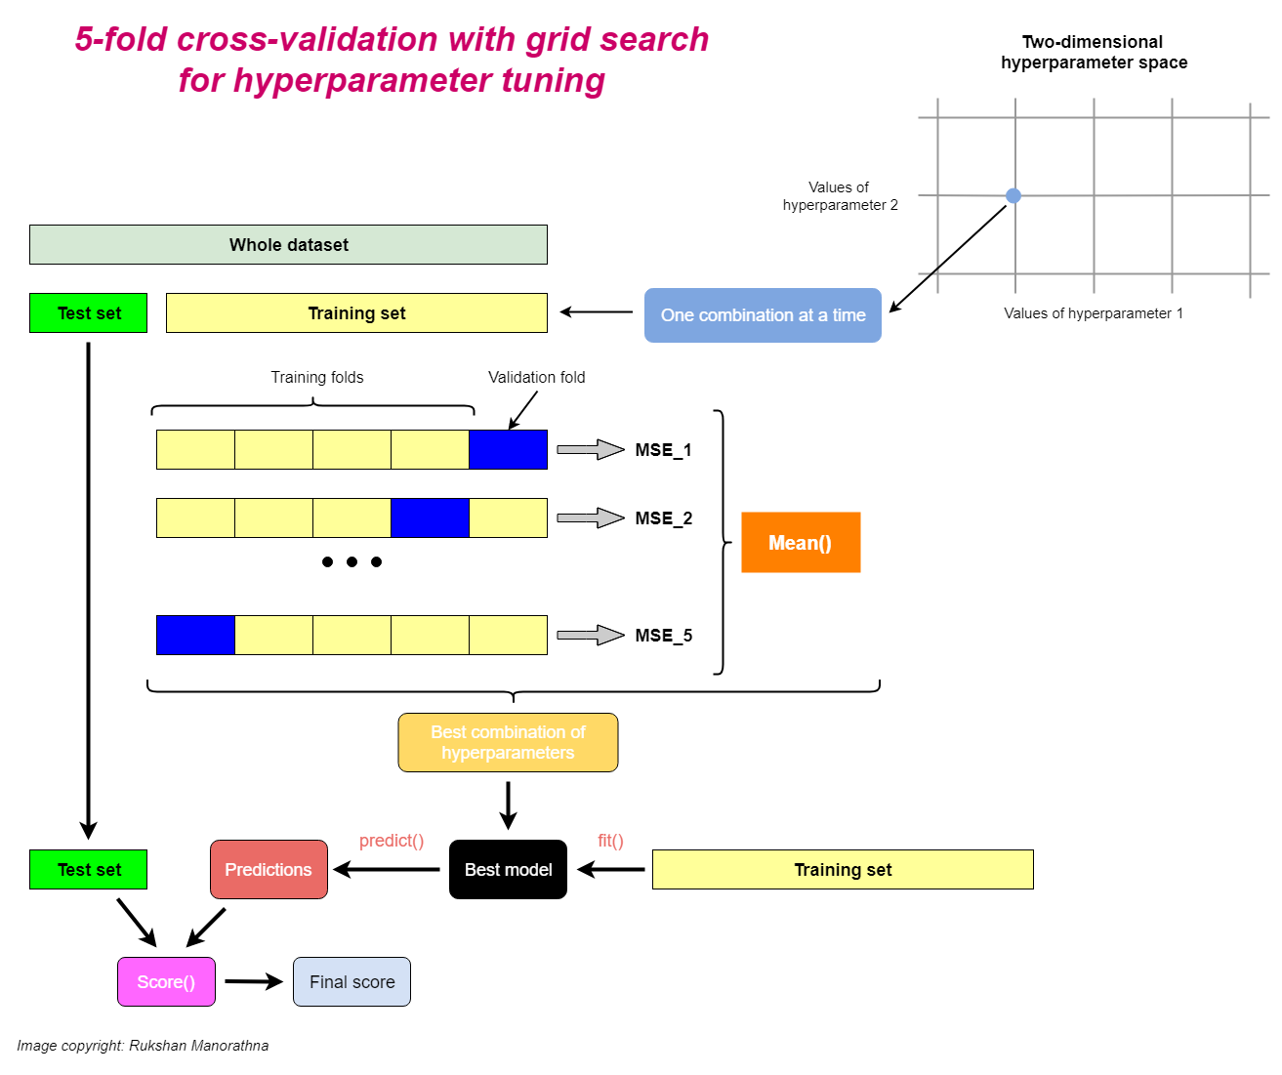

Slide 10
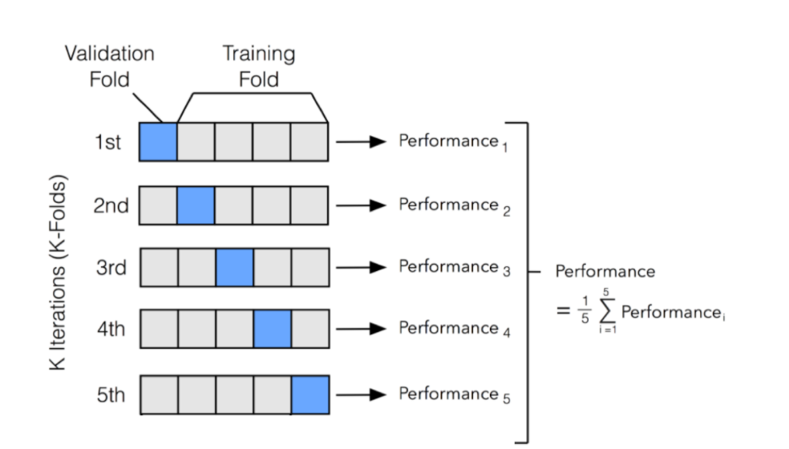

Slide 11
Grid Search CV
Grid Search CV combines these two into one simple call.
Test every HP combination.
Use cross validation to calculate scores.
Identify best model.
In place of one “normal” score we get the cross-validated score, and best HP combo.
Need to specify choices for HP in the grid.
Also a random version, that randomly chooses HP.
This will give us an easy way to get the best model, within the range we define.
This may take a long time, so we still need to be kind of selective.

