Slide 1
Linear Regression with non-Linear Data and Regularization

Slide 2
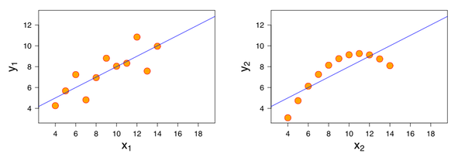
Linear and non-Linear
Linear models are excellent….
… If there’s a linear relationship in the data.
For non-linear relationships, linear regressions can struggle – they can’t ‘capture’ curves.
We first saw this with Anscombe’s Quartet:

Slide 3
Basis Function
We can adapt linear regression to non-linear relationships by using a basis function.
Basis functions are a transformation that changes the x to a function of x.
If we have a basis function: 𝜙_{𝑗}()
Each x value then becomes: 𝜙_{𝑗}(𝑥_{𝑖})
Similar to something like a log-transformation in stats – we can transform the data, make it more normal (or linear), then use things that work with the transformed form.

Slide 4
Polynomial Functions
Maybe the most common example is a polynomial function.
We can replace each x in a linear regression with a polynomial function of x^{n}.
y=b+m₁x+m₂x²+m₃x³…..
This is still a linear model, but one of polynomial functions.
The linear part refers to the coefficients never interact.
In sklearn, this is done with the PolynomialFeature transformation.
We can add it in a pipe.
Note: This increases complexity of the model – more dimensions are generated!
E.g. linear regression is in 1D on the example, after basis it is in 2D.

Slide 5
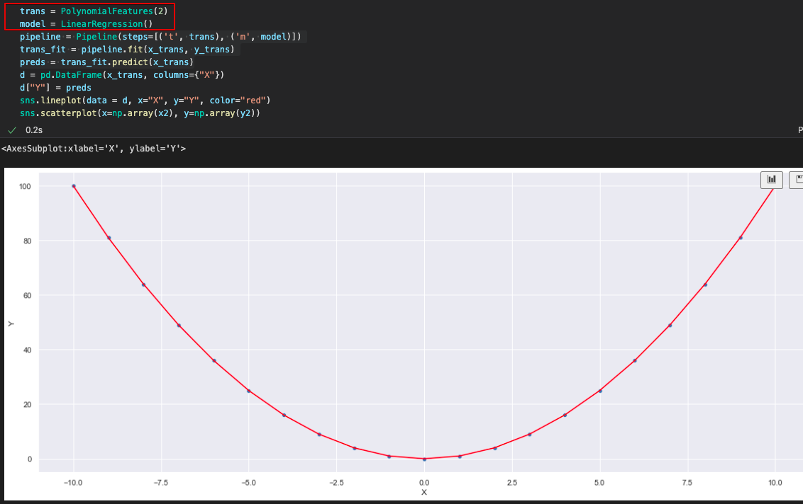

Result of Polynomial Feature Transformation

Slide 6
Basis Success
What a victory! We can model a non-linear relationship with a linear regression.
More flexible and applicable simple models.
Basis functions aren’t only polynomial, it could be anything:
Gaussian – example in 5.06 PDSH
Rectified Linear Units (Relu) – will come up again in neural networks.
Radial - revisit in SVM and clustering.
Why?
Really useful in applying linear regression to any random scenario. (Good for old math)
Helps classification with “weird” borders (~1.5 - 2 weeks from now). Linear seperability.

Slide 7
Errors in Modelling
Bias Error:
Error due to assumptions made in the modelling process.
Generally results in underfitting.
E.g. assuming a linear relationship.
Variance Error:
Error due to variations in the training data.
Generally results in overfitting.
E.g. different training sets for trees generate very different models.
Irreducible Error:
Error that we can’t fix through modeling, it in inherent in the data.
May be able to fix it by cleaning data (removing outliers, correcting missing data, etc…)

Slide 8
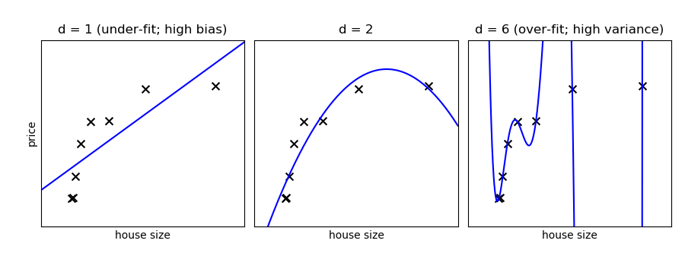

Slide 9
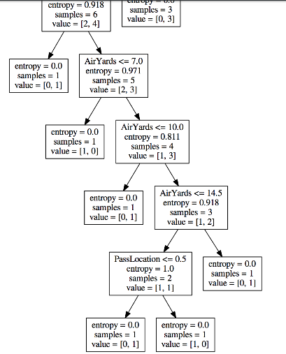
Variance Error – Tree that is Overfitted

Slide 10
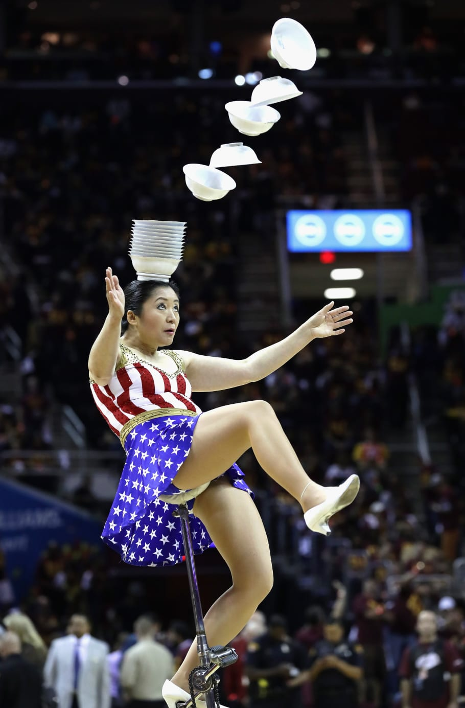
Balancing Act
A good model requires a balance between Bias and Variance.
If we have too much bias our model won’t be adequately tailored to the data.
Simple models have high bias.
If we have too much variance, the specific training sample data would impact the model’s predictions too much, and it may be wrong with different data.
Complex models have high variance.

Slide 11
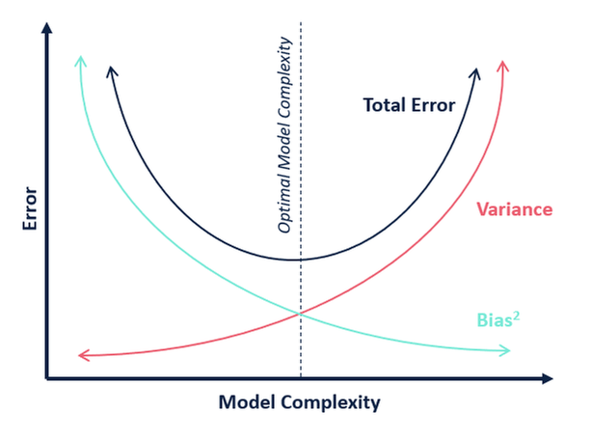
Bias Variance Tradeoff

Slide 12
Finding the balance
ML algorithms are generally “greedy” – they’ll try to get as accurate as possible.
E.g. a tree, without any limits, will try to make a model that perfectly fits training data.
Our goal is a model that is both accurate and generalizable.
We want this accuracy, but limit it to try to achieve the sweet spot.
How?
Cross validation.
Hyperparameter values with grid searching.
Early stopping (big in neural networks).
Regularization. (E.g. tree pruning and regularization in linear regression)…

Slide 13
Regression Coefficients
The regression process, closed form or gradient descent, finds coefficients.
E.g. y = m1*x1 + m2*x2 +…. B
The process determines those m values, and the b.
The algorithm finds these coefficients by determining what set of them minimizes the squared residuals.
Our new friend the cost function!

Slide 14
Regularization
Regularization modifies a model by changing the cost function.
A ”penalty term” is added to the cost function.
Now the regression algorithm isn’t minimizing the residual squared error, it is minimizing the new cost.
Regularization types:
L2 – Ridge. Adds a penalty based on the square of the coefficients.
L1 - Lasso. Adds a penalty based on the absolute value of the coefficients.
ElasticNet – a combination of the two.
This incentivizes smaller coefficients, lowering overfitting.
Large coefficients are unlikely to generalize well.

Slide 15
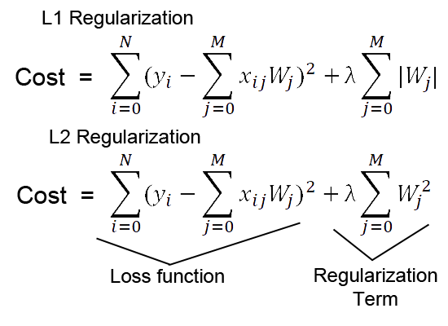
Cost Functions
The regularization term is the last bit.
The alpha value controls the amount of regularization, as a hyperparameter.
Elastic net is just some proportional (the ratio is an HP) blend of the two.

Slide 16
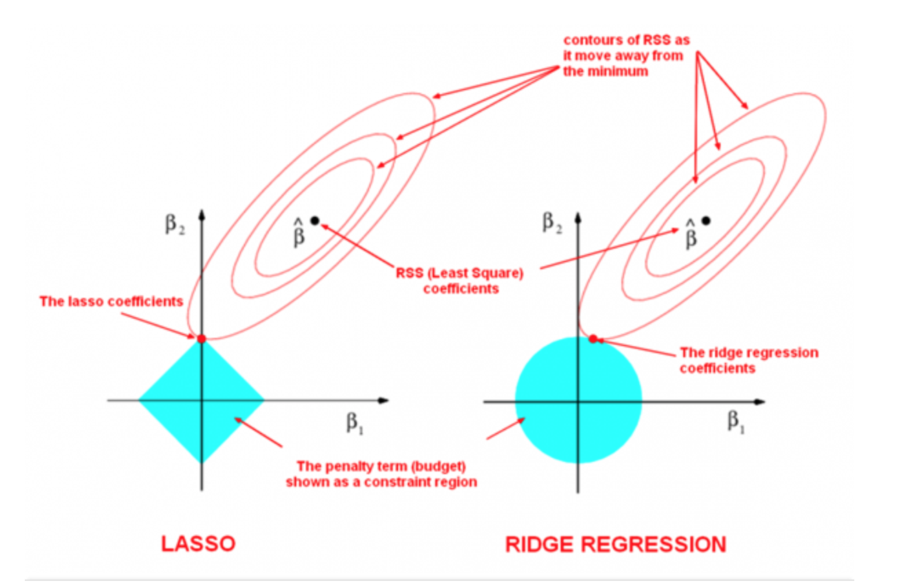
Result – not optimal solution, compromised Solution

Slide 17
Impact
Models are limited from becoming over fitted, as it is “hard” for coefficients to grow.
Very large coefficients are likely to be overfitted.
Difference:
L1:
Reduces coefficients to 0 – good for feature selecting.
No closed form solution - estimation like gradient descent needed.
More robust to outliers.
L2:
More computationally efficient.

Slide 18
Implementation
Ridge, Lasso, and ElasticNet are all sklearn packages that do their names.
Other cost-function based things may use regularization in the background:
SGD has a penalty hyperparameter that imposes regularization.
Other linear models (e.g. SVM) do the same.
Neural networks often use a regularization penalty.

