Slide 1
Housekeeping
Project stuff – ask away if you have any questions.
Today:
Text generation with LSTMs.
Text padding.
Bidirectional LSTM layers.
Temperature.

Slide 2
Text Generation

Slide 3
LSTM
LSTM models are excellent in dealing with temporal relationships in data.
The recurrence allows the model to maintain a ‘memory’ of what came before.
LSTM models are good because they are able to do several things:
Maintain a long-term memory.
Maintain a short-term memory.
Combine these with new data to make predictions.
Be selective about updating the memories with new data.
Each of the LSTM units has several gates to process all of this.

Slide 4
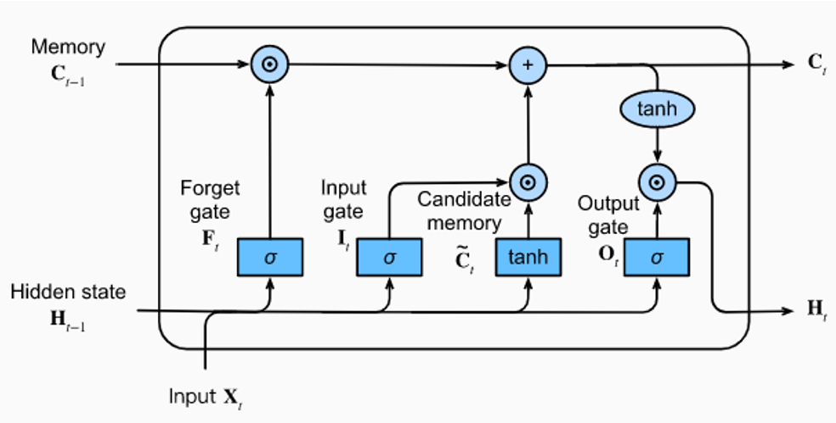

Slide 5
Predicting Text
Text is one of the things that has temporal relationships in the data.
The order of words matter, as does what came earlier in the sequence.
We can use a model to predict the next word, or set of words.
Input – previous tokens.
Output – next token(s).
A piece of text is a weird time-series of words.
We can make a model that predicts the next word, then the next, etc…
Eventually, we’ll basically have Siri.

Slide 6
Forget predicting, what about Generating Text?
We can apply these LSTM models to predict the next word.
We can then tell it to generate that word!
ChatGPT, watch out!
We just need to setup the data properly:
The input is the previous set of words.
The output is the next word.

Slide 7
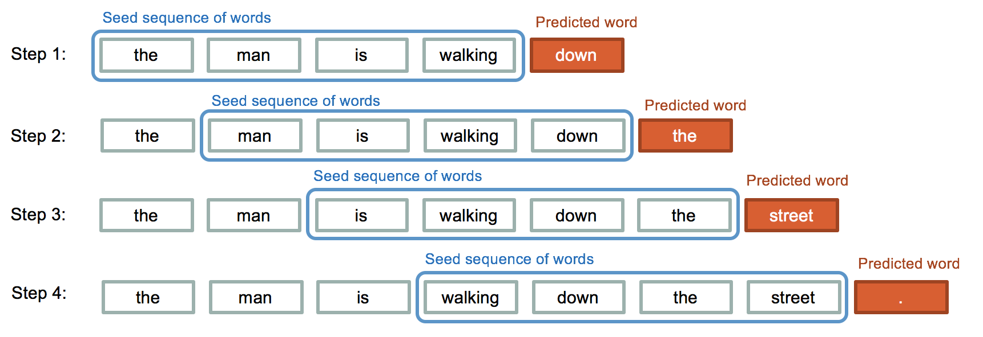

Slide 8
Data Configuration
Our data again needs to be processed and reshaped.
We need to strip and tokenize the data. (This changes with ‘good’ models as they predict things like commas).
We need to shape the data.
X – previous M tokens.
T – next N tokens.
We need to pad the data, or make every record the same length.
Models need fixed size data, but sentences are any length.
We add blanks to either end to standardize the length.

Slide 9
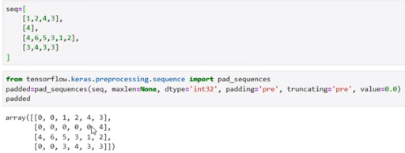
Padding
Padding makes each tokenized text record into a set length.
Padding adds 0s either at the end or at the beginning of the text to fill it.
For generation, we want to pad at the beginning, as we want the ‘next’ item.

Slide 10
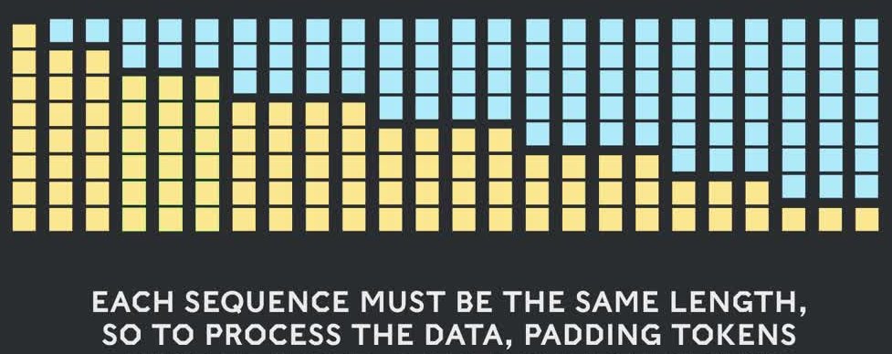
Post Padding
After padding, we have a usable dataset.
Each X value will be a fixed number of tokens before the current word.
The target is the next token, we can train.

Slide 11
Language Model Notes
This is very simple processing for text, for a simple model.
In larger models, the data preparation is different.
Construction of the datasets is potentially a lot of work.
Specific applications like chatbots may need to restructure data into prompt-response.
Other models are commonly used to help process the massive amount of data.
The dataset is massive, and may only have one or two epochs.
Large/smart models also have an assortment of things done to make them faster and better – reinforcement, specialized ‘sub-models’ (mixture of experts), etc…

Slide 12
Training a Text Generator
Training the model is the same, once the data is setup.
We need to ‘wrap’ some generation logic around it.
Predict the next word, add it to the input, then that’s the input for predicting the next…
The prediction is a token value, so we need to make it a word.
We can make a couple of simple functions to do this with our model.
When generating text, we need to provide some prompt that is the original X data.
We can tune the temperature…

Slide 13
Temperature
The temperature injects randomness into the predictions.
Models always try to predict the correct answer, if possible.
This usually makes sense, but for speech it really doesn’t.
A novelist isn’t trying to always choose the optimum word, or it would get repetitive.
Temperature inserts random variation of the prediction.
Instead of just taking the most likely next token as the prediction, we will randomly select a token that is ‘in that area’.
The ‘correct’ next word is most likely, but we’ll vary our selection of similar words.
This makes generated text sound more normal, as it will vary word choice more.

Slide 14
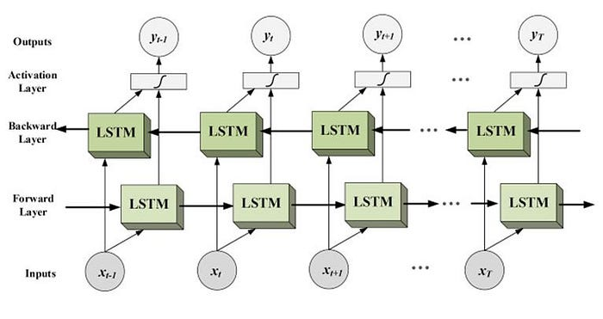
Lastly, Let’s Go Bi
We can also add LSTM layers that are bidirectional.
This is common in sentiment analysis, but transformers have largely surpassed this there as well.
These layers feed the data through the LSTM units in both directions.
This can allow the model to get context from before as well as after the word.
I.e. if a word in the future helps give context to something earlier.
“Server can you bring me this dish” vs. “He crashed the server” – meaning of ‘sever’ is better captured.
By processing it in reverse, model can capture relationships bef/aft.

Slide 15
conclusion
LSTM text generation works well, but transformers have surpassed it.
Transformers are better able to track what matters and what doesn’t in context.
Most of the other mechanics, like dealing with data, are similar.
We can train a simple, though awful, text generation model.
Actual generative models require lots of training – time and data – ours will be bad.
I heard a podcast where an ex-Open AI guy said the next generation would cost $1billion+ to train.
I already trained the sample model, for at least 800 epochs, so this isn’t starting fresh.
There’s an example in the workbooks of both downloading and fine tuning a transformer model, and making one from scratch in the repository.

