Slide 2
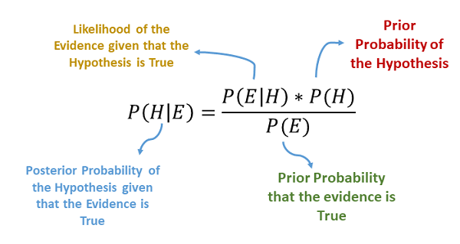
Bayes Theorem
Recall Bayes and his theorem.

Slide 3
So Naïve…
Naïve Bayes is a type of classification algorithm based on Bayes.
The naïve part comes from the assumption that the features are independent.
This likely isn’t true, but it keeps things simple and works.
Types of Naive Bayes Classifiers:
Multinomial: Feature vectors represent the frequencies with which certain events have been generated by a multinomial distribution. For example, the count how often each word occurs in the document. This is the event model typically used for document classification.
Bernoulli: Like the multinomial model, this model is popular for document classification tasks, where binary term occurrence(i.e. a word occurs in a document or not) features are used rather than term frequencies(i.e. frequency of a word in the document).
Gaussian: It is used in classification and it assumes that features follow a normal distribution.

Slide 4

Smoothing
One issue that Bayes has is if there is a term that is in the test set, but not in the train.
This will have a probability of 0.
This is called the Zero Frequency Problem.
Smoothing, specifically Laplace Smoothing, combats this.
A small corrective term, a pseudo-count is added to the probability estimates.
This term is alpha, defined as a hyperparameter.

Slide 6
NLP Feature Sets
When using vectorizers to generate feature sets from text, we can get a large set:
By ‘default’, we get one feature per word in the corpus.
If using n>=2 grams, this can explode.
Very large (wide) feature sets can present problems.
More features leads to more likelihood of overfitting (like in asn 1, or large tree examples).
If we are going to get a good fit with many features, we will need lots of training data.
It gets slow if the data is very large.
We can use some techniques to reduce the size to help us fit a model.
Previously we expanded dimensions to allow for better fit by making the problem more complex.
This makes the problem more simple, while hopefully keeping most of the ‘value’ in the data.

Slide 7
Dimension Reduction
Some caps can be placed on size during vectorization:
Limit max features.
This isn’t really a sophisticated method.
There has to be a better way!
Goal – create a smaller feature set that keeps as much valuable info as possible.

Slide 8
Truncated SVD and LSA
LSA is latent semantic analysis. LSA attempts to:
Extract meaning from large amounts of text.
LSA follows a couple of assumptions:
Meaning of Sentences or Documents is a sum of the meaning of all words occurring in it. Overall, the meaning of a certain word is an average across all the documents it occurs in.
semantic associations between words are present not explicitly, but only latently in the large sample of language.
Latent Semantic Analysis (LSA) comprises of certain mathematical operation to get insight on a document. This algorithm forms the basis of Topic Modeling. The core idea is to take a matrix of what we have — documents and terms — and decompose it into a separate document-topic matrix and a topic-term matrix.

Slide 9
Truncated SVD – Singular Value Decomposition
Truncated SVD is the mathematical mechanics used for LSA.
We won’t worry about the math with this one much, we’ll look at a similar technique later (PCA) where we can look at the math more closely.
We can generate a dataset that captures the meaning of the text.
We can then use LSA to simplify that dataset to a smaller one that we’ll use to predict.
We replace the original features with new features, calculated from the original.
Ideally each feature ‘captures more meaning’ than the original features, meaning we can do more with less.

Slide 10
LSA Results
The output of the LSA process is that we get features that measure ‘topics’.
Each topic is extracted automatically by the algo, we don’t predefine them.
We’ll tend to see similar words grouped into the same topics.
E.g. if we are doing sentiment on some reviews, a topic may contain, “pool”, “hot tub”, “splash”, etc,.. As they all convey similar meanings in the text.
Note that it figures the meaning from what it sees, it doesn’t have a preexisting definition that X words are similar.

Slide 11
Slight Detour – Remember R2?
One of the key metrics we use in regression is the coefficient of determination – R2.
R2 tells us the proportion of variance in the target that is explained by our model.
i.e. an R2 of .8 for predicting lifespan means that our model accounts for 80% of the value of the target, while stuff not captured by our model is the other 20%.
When we do dimensional reduction, we can think of it like R2. (Conceptually, not literally).
Our original M features (as a whole) capture K% of the meaning of the document.
After reduction, we have <M features, but hopefully capture ~K of the meaning.
Each of our features captures more useful data, while we discard the non-useful parts.
We want the key info (var. of target), contained in as few features as possible.

Slide 12
NLP in Practice
NLP is an area that is very quickly developing.
More data makes a big difference!
Language has subtleties, massive datasets allow those subtleties to become patterns.
Preprocessing choices can make massive differences:
Stemming, lemmatization, stop words, and n-gram size all vary widely depending on context.
E.g. the word “lit” has a different lemma on Twitter, in a college English dept, or for wildfires.

Slide 13
Embeddings

Slide 14
More advanced NLP
Many NLP tools are used in concert with neural networks.
We’ll revisit some later on towards the end.
NNs “suit” the challenge of extracting patterns from large datasets.

