Slide 1
Housekeeping
Boosting review.
Step by step walk through of a boost.
Today – intro to neural networks.
Neural network parts, structure, and basic theory.
Look at neural network made by hand.
By next week or week after you’d benefit from accelerated tensorflow.
One month from roughly the start of next week or so will likely do you fine. (Final due Apr 16)
If you have an nVidia graphics card, you can likely run it locally.
For most people, the Google Colab subscription that’s ~$15 a month is likely best.
If you have an Apple Silicon Mac, you can accelerate, but may be too slow for large examples.

Slide 2
Neural Networks Basics

Slide 3
Neural Network Intro Steps
Look at theory of how they work (lots of stuff, which we’ll revisit as we go)
Overview of the math, but no calculations.
Deeper examination of gradient descent process through layers.
Hopefully – reasonable comprehension of what a NN is doing in training.
Examine sample neural network made from scratch.
Later (Next time + 2 or 3 classes):
Using libraries for creating neural network models.
Tuning accurate models.
Then:
Specific applications (e.g. images) and tools/functionality.

Slide 4
What is a neural Network?
In terms of usage, a neural network is just another family of predictive algorithms.
We can use neural networks to classify, predict, and forecast.
Neural networks are based on a conception of how a brain works:
The conception didn’t end up being particularly brain like, but it still works well.
Neural networks are made of a bunch of “neurons”.
Neurons have connections with each other.
Neurons take some inputs, do some math, and output some value.
The most direct analogue is a logistic regression, with multiple steps (layers).

Slide 5
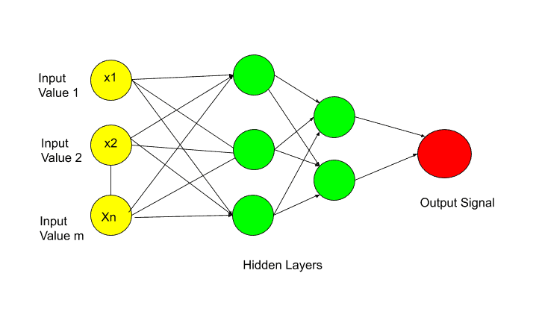

Slide 6
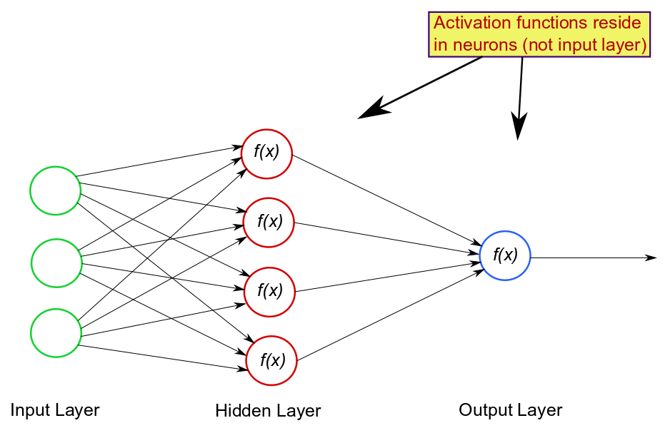

Slide 7
Goal Today
Neural networks are a pretty big idea, so you probably won’t memorize each detail now.
Today we’ll mainly walk through the details of what happens inside a NN.
Understanding this is good for knowing how/why things work, and making better decisions.
This isn’t strictly needed to just use the models. (Though moreso than sklearn stuff.)
We don’t need the math, but understanding the operations helps.
Try to see if you can trace through one execution mentally.

Slide 8
Why a Neural Network?
Neural networks, as a concept, are old – dating back to the 1940s.
Neural networks have exploded in popularity and usage over the past few years.
Libraries have gotten easier to use.
Datasets have gotten larger and cheaper.
Processing power (specifically GPUs and derivatives) has gotten better and cheaper.
Neural networks tend to excel with data that is unstructured and large.
Many/most interesting problems fall into this!
Image and speech problems have been revolutionized by modern neural networks.
Neural networks can capture complex relationships in data, if we provide enough.
The last ~10 years have given us data and processors to take advantage of this.

Slide 9
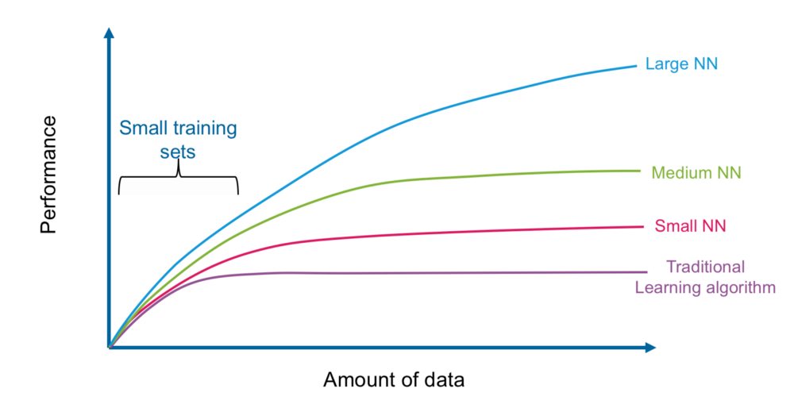

Slide 10
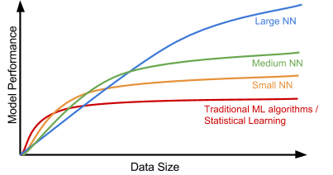

Slide 11
Neural Network Components
A neural network is made up of multiple layers of neurons, which are then connected.
Neurons – each neuron takes in inputs, does a calculation, and produces an output.
Layers – each layer is one ‘step’ in the calculation process.
Inside this framework, there are a few important parts:
Weights – modifies the contribution for an input value. The m in y = m*x + b
Bias – shifts the entire function. The b in y = m*x +b
Activation function – translates the linear output of a neuron. The sigmoid in log reg.
Inputs/output – the same as we are used to.
The NN’s capacity to learn is roughly the total number of params/weights. (Maybe 100B +)

Slide 12
Layers and Construction
The structure of the layers and how they are connected can be flexible.
We’ll only look at ones called “fully connected”:
Each layer connects to the next.
We have one input and one output.
Things flow from one layer to the next, sequentially.
We can do almost any predicting with this, it isn’t much of a limitation.
Models with more complex structure are used for other scenarios:
E.g. if you have multiple inputs/outputs.
Looking at sequence/order for things like time series or text (RNNs).

Slide 13
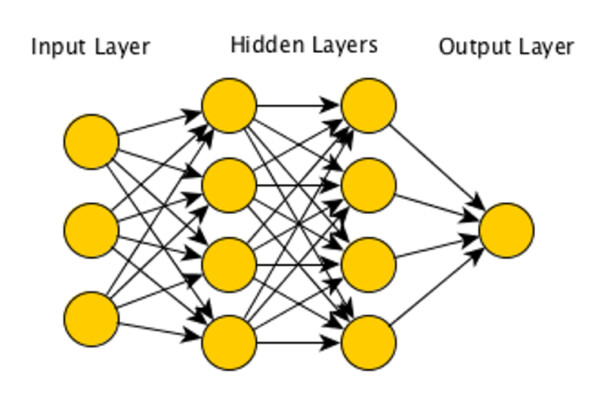
X1
X2
Y
X3

Slide 14
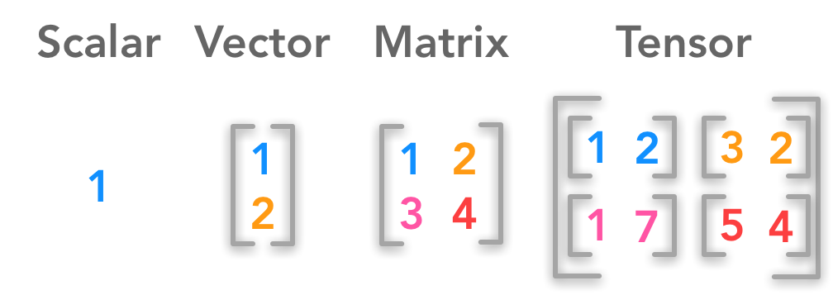
Tensors
Neural networks require us to pay a little more detail to the shape of data.
We can and will abstract some of this out later on with the Keras package.
NN are dependent on multidimensional arrays, called tensors. Tensors are largely interchangeable with np arrays.
We will need to make data into arrays in almost all cases before using it in neural networks, dataframes are out.
Internal calculations frequently use tensor math. We don’t need all the details, but we do need to understand some of it.

Slide 15
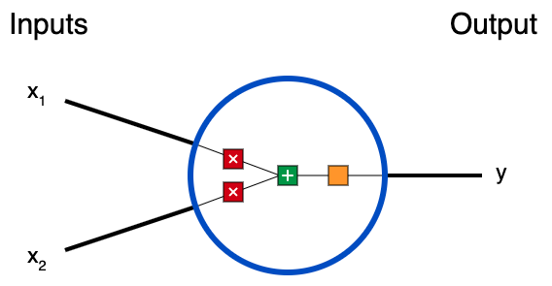



Structure of a neural Network: Neuron
3 things happen in each neuron:
First, each input is multiplied by a weight.
Next, all the weighted inputs are added together with a bias b.
Finally, the sum is passed through an activation function (e.g. sigmoid).
This process is called “forward propagation”.

Slide 16
Single Neuron Example
We can manually perform an execution of our NN, assume:
x1, x2 = 2,3
Weights = 0,1
Bias = 4
Multiply by weights (also a dot product: x· w):
x1 * w1 = 2 * 0 = 0
X2 * w2 = 3 * 1 = 3
Add bias:
0 + 3 + 4 = 7
Produce final output with activation function (sigmoid):
1/(1+e^-x) = 1/(1+e^-7) = .999
Loss here is 1-.999 or .001

Slide 17
Put the Parts Together
The tensors, inputs, weights, and activation for the structure of the network.
Each layer:
Takes in the set of inputs. (Just like any model).
Multiplies each by it’s weight., in bulk with a dot product (Like a regression).
Adds the bias. (Like a regression).
Goes through an activation function. (Like a sigmoid in a regression).
Acts as an input to the next layer, which repeats the process <- This is new.
Each layer of the network is roughly like a logistic regression.
Multiple layers can each adapt the model to fit the data differently.

Slide 18
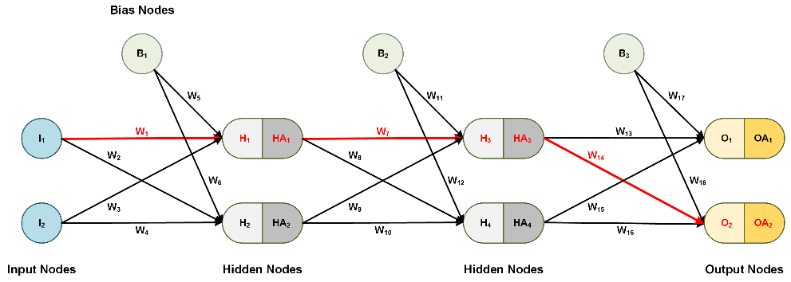
Neural Network Structure
Each node takes in inputs (x values) of the outputs of each node previously.

Slide 19
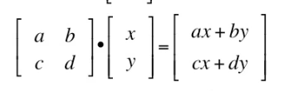
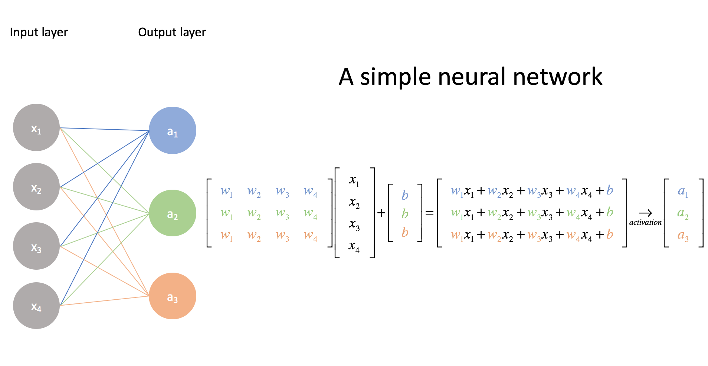
Implementation - Dot Product
One common operation is a dot product - multiplies items at same position of two sequences.
Think – the python zip command, but with multiplication.
We can use a dot product in bulk to multiply each x by each weight in a neural network.
We can end up with billions of these weights and features, so lots of matrix math is needed.
This is faster than looping or other solutions – these operations are optimized.

Slide 21
Loss Functions
Like with gradient descent, we need to define a loss function for our model.
There are many options.
Most common:
Regression – MSE or RMSE.
Binary Classification – binary cross entropy.
Multiple Classification – categorical cross entropy.
The loss functions work exactly how we are used to previously.
Recall – we calculate loss from final predictions/probability for each prediction.
We use this one loss to adjust all of the weights in every layer.

Slide 22
Neural Network Structure: Layers
As we can see in the diagrams, a neural network is made up of layers.
Each layer represents one “step” of the processing.
A set of linear transformations, followed by processing through the activation function.
Every network has an input layer and an output layer:
Input layer’s input shape is sized to the number of features in the feature set.
Output layer output shape is sized to the # of outputs. 1 for regression, # classes for classification.
There can be an arbitrary number of hidden layers in between the two.
“Deep Learning” networks have many, over 3, potentially 100s.
The main layer we’ll use is Dense – meaning that each neuron in a layer is connected to each neuron in the next.

Slide 23
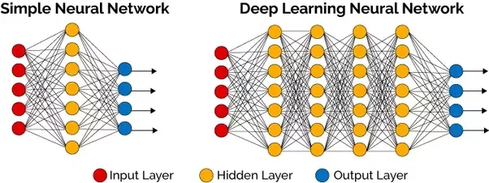

Slide 24
Neural Network Structure: Layers
Each layer does “a thing”. Most layers perform one set of the neuron calculations above.
Middle layers are called “hidden layers”.
There are other layers that can do other stuff as well:
E.g. normalization, regularization, flattening, etc…
We generally aren’t referring to these when talking about the NN’s calculation execution.
The number of layers and the number of neurons in each layer are configurable.
The number of neurons a NN has is it’s capacity. Larger capacity networks can model more complex relationships.
Number of neurons is the width, number of layers is the depth.
“Proper” size of a network is an open question. We’ll look at some guidelines later.
For the moment, try hidden 2-4 layers, each with the same # of neurons as features.

Slide 25
Key Layers
While a neural network can have any number of layers, two are standard and required.
Input layer – takes in the original data, so it accommodates the number of features in the data.
Note: prep steps like encoding or imputing may be done before or with other layers.
For later - the input can accept data that is in 2 or more dimensions.
Output layer – produces the final output our prediction needs (rules-of-thumb):
Regression – linear or no activation function. 1 output neuron.
Classification – sigmoid activation function. 1 output neuron.
Multiclass Classification – softmax activation function. N-classes output neuron.
Multilabel – sigmoid activation function. 1 output neuron per class.
Translates the current value of the output into an actual prediction. (Equivalent to sigmoid in log reg)

Slide 27
Learning Layers
This is easier to picture with image classification, but each layer “sees” the data differently.
Each layer gets a different transformation of the data.
Layers learn from the representation it sees, and weights are updated to minimize error.
Each layer is learning what representation of the data helps at that point.
The layers are dependent of those before them, so they are adapting to those changes too.
We can think of these layers as generating new features for the next layer to predict.
The final layer predicts from features it sees, made from features the prior layer sees, etc…
This ability to adapt, and adapt to the adaptations, makes neural networks very good at complex tasks like images, video, genetics, sound, etc…
In general, networks with many layers tend to perform best in most task. This varies widely.

Slide 28
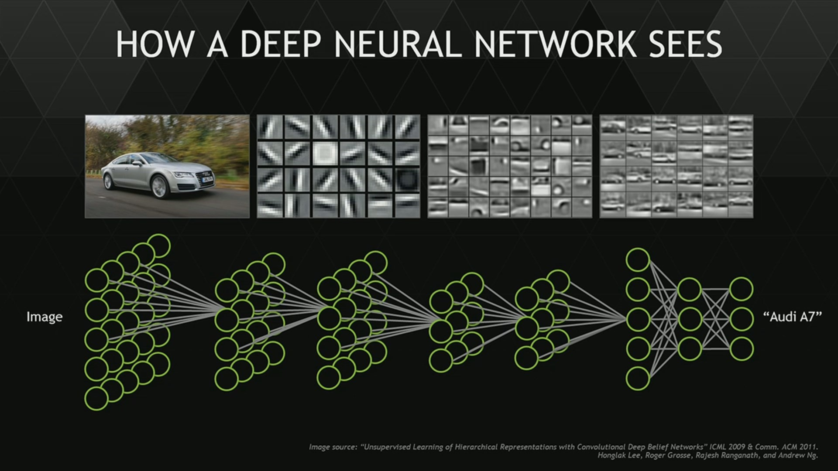

Slide 29
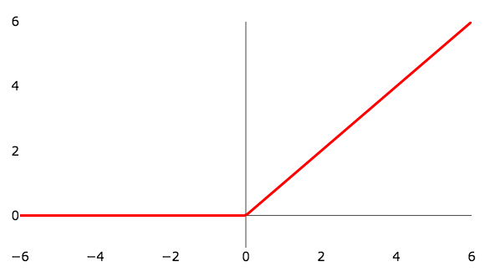
Activation Function
Each layer calculates the linear combination, then runs it through an activation function.
We can think of the activation function as the sigmoid, though we’ll usually use others.
This activation function determines in the neuron “fires”:
Easiest to visualize is the ReLU function pictured in the top right.
This allows the network to learn complex, non-linear patterns.
A network with no activation functions would be reducible to a linear equation.
Each neuron calculation sums the weights*inputs, + bias then the output is determined by that value run through the activation function.
Introduces non-linearity, otherwise the NN would be a big linear equation.

Slide 30
Internal Activations
The activation functions inside the hidden layers can vary.
ReLU or one of it’s cousins is our normal default.
These are tunable, though we normally use common ones for type of task.
Each activation function causes the transformation of that layer to differ.
Has the effect of having different layers “learn different aspects” of data.
Easier to visualize later, when we are using images.
With larger models, we can have networks that can learn in great detail.
(Very roughly) analogous to gradient boosting – each step “targets” one aspect of understanding the data.

Slide 31
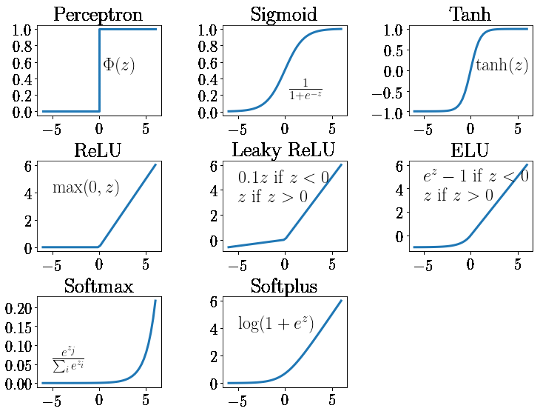

Slide 32
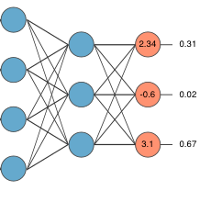
Output Activation
One different scenario we need to pay attention to is the activation on the output.
This is analogous to using the sigmoid to do a logistic regression.
If the problem is a regression, we don’t need one (linear). We want raw values.
If the problem is a classification, we need one to produce class estimates:
Multiclass – Softmax activation, one output neuron per class. (pictured)
Binary – Sigmoid, one output neuron. (Or a 2 class version of above).
Multilabel – Sigmoid activation, one output neuron per class.

Slide 33
Neural Network Execution
Now we have the main pieces of a neural network, we can look at the execution.
Training a neural network has two parts – forward propagation and backward propagation.
Forward propagation:
start at the input, do all calculations to make a prediction.
This is what we walked through with one neuron above.
At the end, calculate loss – the error of our prediction.
Backward propagation:
Work backwards from the error to the input layer.
This is just like gradient descent, in a logistic regression but with more steps.

Slide 34
NN Execution: Backwards Propagation
Backwards propagation takes the error from the prediction and translates it to errors in the weights and biases.
We start the FP with a set of inputs, weights, and biases.
To minimize error we need to adjust weights and biases.
BP uses derivatives to translate the error w.r.t. y from our prediction, to gradients of error w.r.t. each weight and bias.
The weights and biases are then adjusted with these gradients and gradient descent.
This process repeats through each layer. Error w.r.t. output -> error w.r.t. inputs.

Slide 35
Partial derivatives
The key mathematical concept in making backpropagation work is the partial derivative.
Partial derivatives are gradients where there is more than 1 independent value.
A derivative “with respect to” something means that thing can change, other parts are fixed.
A.k.a. how much does this change as the w.r.t. part changes.
We get the gradient of each “term” (weight*feature) – the feature is fixed. This is the adjustment.
For our backpropagation.
End up with the error of a prediction.
Take the partial derivative of the error w.r.t. each of the inputs. Repeat back each layer.
Adjust each weight/bias ”down” the gradient – our partial derivative tells us direction.

Slide 36
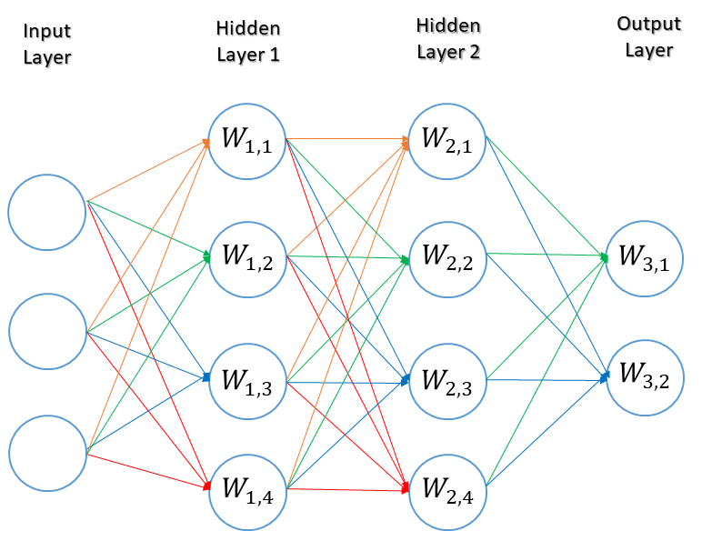
Back Propagate Error – One Batch Example
At the output, we get loss.
Partial derivatives ‘allocate’ that error to layer 2.
Adjust L2 weights as in GD.
This loss is the loss for the outputs of layer 1.
Partial derivatives ‘allocate’ that error to layer 1.
Adjust L1 weights as in GD.
This loss is now the loss for input layer.
Partial derivatives ‘allocate’ that error to input.
Adjust input weights as in GD.

Slide 37
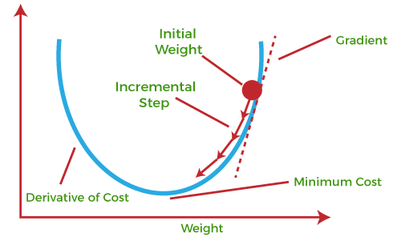
Gradient Descent Recap
The gradient is the derivative of the cost function.
We adjust the weight to try to minimize that cost.
The gradient (slope) gives us direction to adjust (pos/neg tells us).

Slide 38
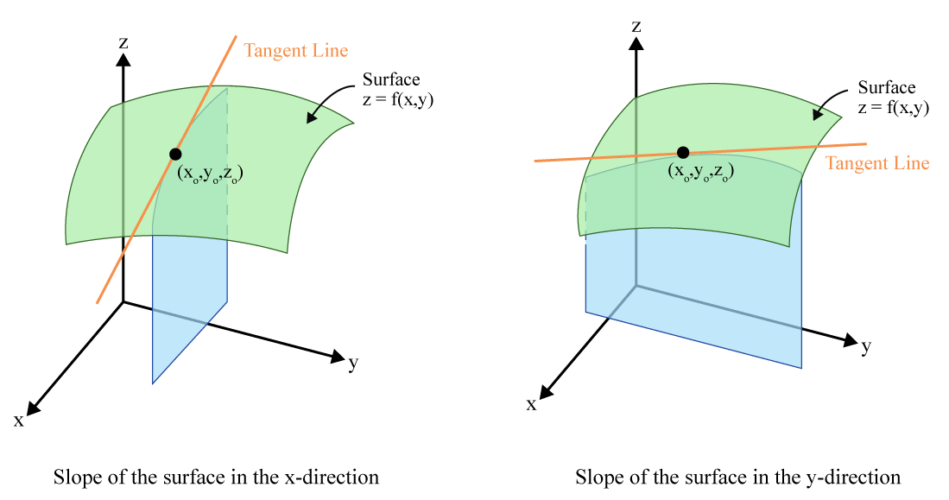

Slide 39
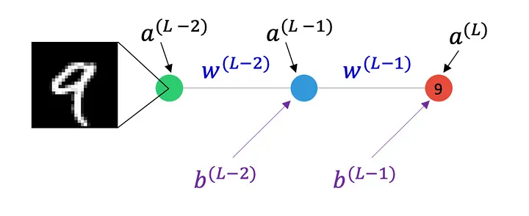
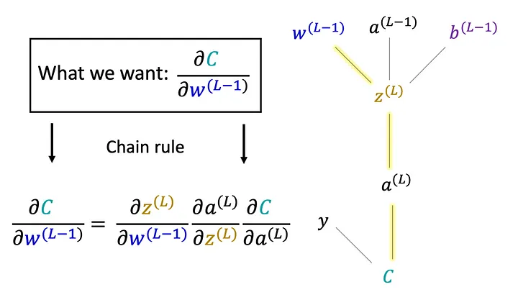
Backwards Propagation
Backwards propagation is also some linear algebra, with derivatives.
We take the “derivative of error w.r.t. each weight and bias”.
A.k.a. how much does this error change for a change in the weight?
Each layer of weights is adjusted in reverse.
The chain rule is the tool that makes this “easy”.

Slide 40
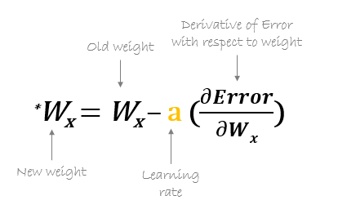
Weight Updates
Once the error is attributed through the back propagation, everything is updated for the next run.
The learning rate scales the change.
‘Smarter’ learning rates are common here, since efficiency is more important.
The next forward pass generates a new error.
The bias is the same – derivative of error w.r.t. bias.

Slide 41
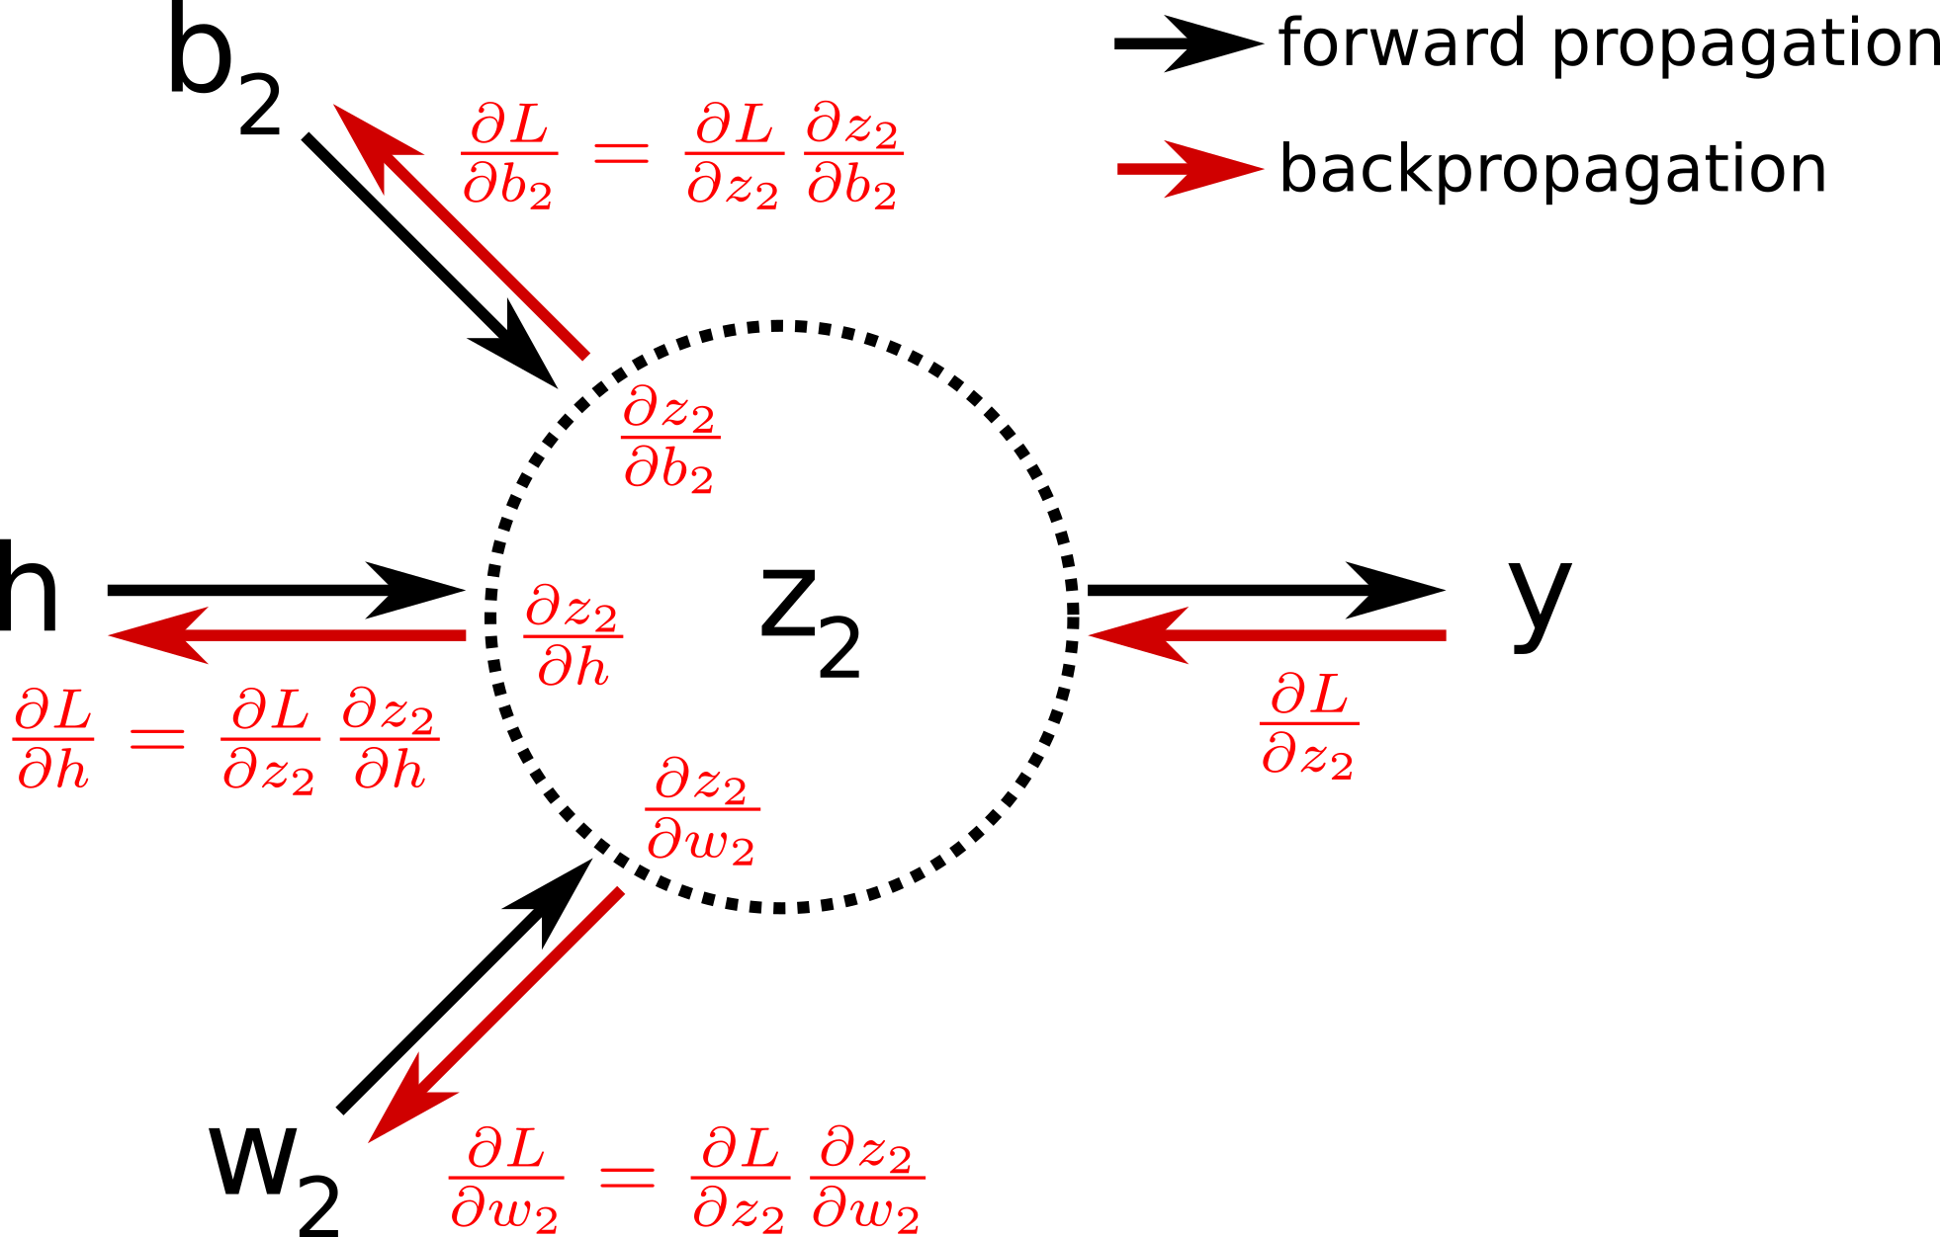
h – feature.
W – weight.
B – bias.
L – error.
Z2 – activation function

Slide 42
Neural Network Process
Forward propagation:
Use the inputs, weights, and activation function to generate a prediction.
Loss calculation:
Evaluate the error of that prediction with the loss function.
Backwards propagation:
Use the error and the derivatives of the function to figure out how to adjust the weights.
Repeat until final prediction error flattens, or limit is reached.
We often stop the training of neural networks when they reach peak accuracy.
This process allows large networks to become very well fitted to complex patterns if given enough data.

Slide 44
Logistic Regression -> Neural Network
We can look at logistic regression as a framework for a neural network.
Think of an image, like the digits we used for classification:
Each pixel is a feature/input. The x values in a NN.
The classification outcome is the output.
The slopes (m) are the weights.
The sigmoid is the activation function.
The linear calculation is the calculation of weights and inputs.
The error is the loss function in the NN.
The gradient descent to find the optimal solution is the backpropagation in the NN.

Slide 45
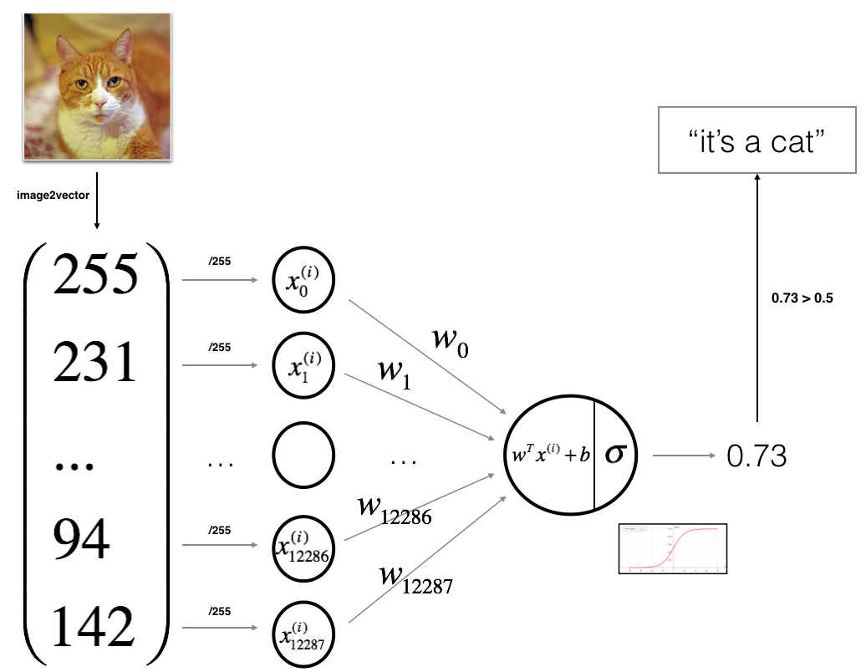
Backpropagation:
The error is “.27”
Use chain rule to attribute error to each weight and bias. (dError/dẟ)
Adjust vars. weighted by LR.
Start another pass.

Slide 46
Usage of Neural Networks
In general usage, we don’t need to pay too much attention to the inner workings to use.
We can focus on the setup of layers, as well as HP/options:
Width/depth, activation, regularization, loss, other tunable things…
The details of architecture matter a bit more if doing something specialized:
Overall speed of calculating matters more, so making GD efficient is a big thing. (loss/opt.)
Performance with different activation functions or similar may vary.
Sometimes parts of a NN can become ‘deactivated’ and stop helping.
We’ll look at some of these details when tuning, but for ‘normal’ use it is kind of OOS.
We can tune for accuracy in a grid search-ish way, but finding the best architecture requires more.

Slide 47
Conclusion
To make sense of how a neural network functions, it is good to look at the detail a little.
In practice we’ll use libraries (Keras/Tensorflow) to make it easier.
Key points that we need to be comfortable with:
Data shape to feed the network.
Layers and neurons – size and function, not math.
Output, errors, and loss.
Neural networks tend to rely more on allowing more training loops (epochs) than any other model type to fit to the data well.
The amount of “fitting” with large models is very high, and that takes time.
We end up with very large matrices of weights (~layer 1 size * layer 2 size * # layers)

