Slide 1
Housekeeping
Cancelled assignment 3:
Some people did it, which wasn’t my intent.
If you want to hand it in, I’ll take ¾ for the scores to calculate the assignment mark bucket.
It isn’t something that you need, explicitly, to know deeply for the other parts.
To this point:
Can do basically any regression/classification/clustering problem we encounter.
Pipeline stuff for prep, stats stuff for exploration, model selection grid for model, results.
Today:
Time series #2 – ARIMA and FB Prophet.
Thursday – boosting ensembles and that’s pretty much it for normal models.

Slide 2
Test Stuff
Good job overall.
Small notes:
The kernel transformation and the kernel trick are separate. The transformation makes things work, the ‘trick’ allows it with less math.
Forests are generally not really interpretable.
Dimensionality will continue to be important as we move to NN stuff.

Slide 3
Time Series Forecasting

Slide 4
Time Series Data
Time-series data is data that progresses over time.
E.g. gas prices, stock prices, temperature, etc…
The basis of predictions, or forecasts, is by looking at patterns in the data.
Time-series data has a few parts that our forecasts try to separate:
Trend – are we going up or down as time progresses.
Seasonality – do we have regular waves, such as seasonal sales.
Cyclicality – do we have larger waves, spanning several seasons.
Irregularity – how much variation is there that doesn’t fit into the above.
The models generally try to decompose each of these, measure each, and recombine them to create projections.

Slide 5
Note on Time series-ing…
There are two basic ways that we can approach processing time series data:
Manually.
Automatically.
We’ll cover the basics of the manual bits.
The more I cover this, the less critical I think that getting into those details is.

Slide 6
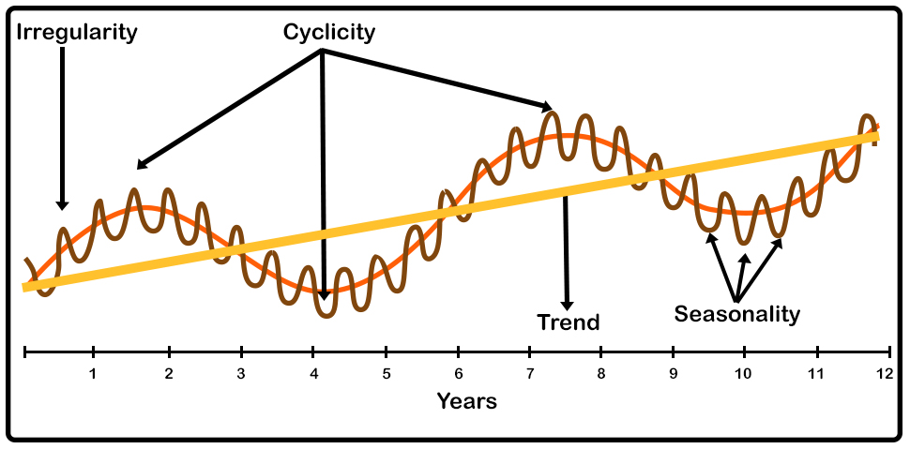

Slide 7
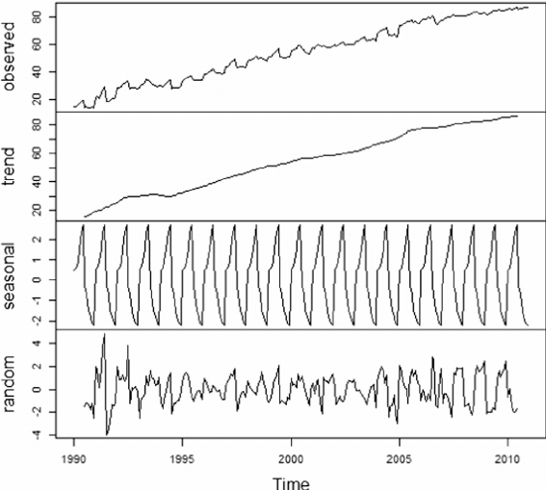
Time Series Components
The basic idea is that if we can extract each component of the time series’ variation, our model can more easily project each.
Example plots:
Trend – linear increase.
Seasonality – predictable waves.
Random – “other” variation.
Note: different models may capture slightly different components.

Slide 8
Exponential Smoothing
Exponential smoothing is one of the simplest forms of time series forecasts.
Weighted averaging with a smoothing term.
Can also incorporate:
Trends – are we moving up or down over time.
Cyclicality – are there seasonal patterns.
Trends and seasonality can be either Additive or Multiplicative:
If every December we sell 10,000 more apartments than we do in November, the seasonality is additive in nature. However, if we sell 10% more apartments in the summer months than we do in the winter months the seasonality is multiplicative in nature.

Slide 9
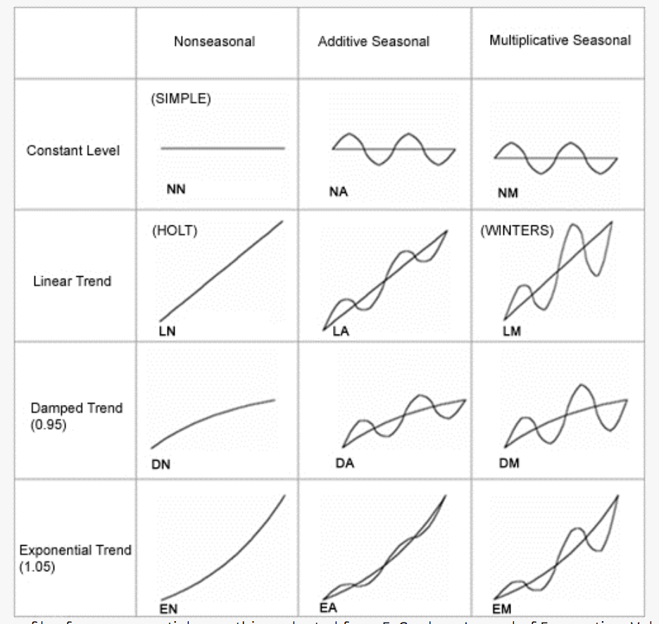

Slide 10
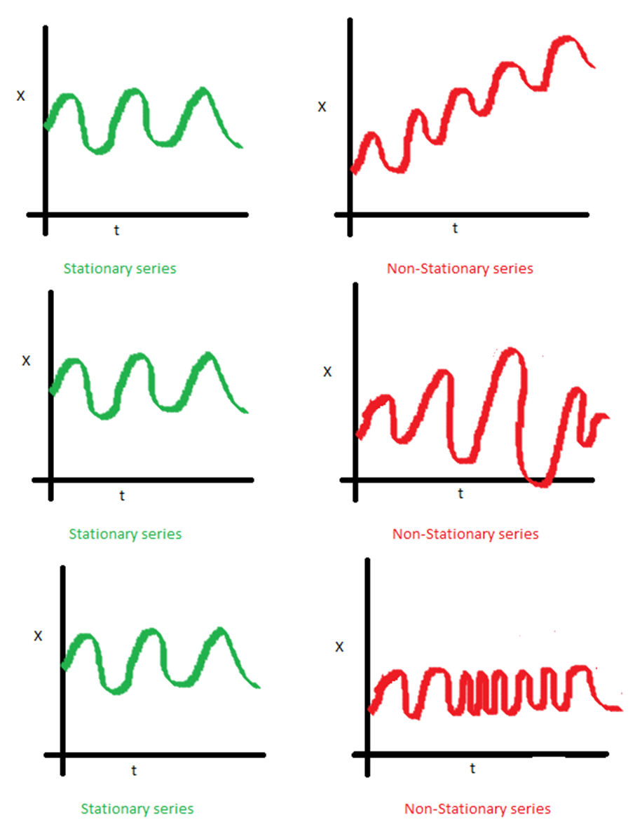
Stationary
A time series being stationary means that its major stats (mean, std) are not changing over time.
We can transform data to make it stationary:
Differencing.
difference(T) = observation(T) – observation(T-1)
.diff() in code.
Other transformations (e.g. log). We won’t cover this stuff in detail.
We generally need to make a time series stationary, or provide arguments for it to be made stationary.
Similar idea to a kernel or basis function.

Slide 11
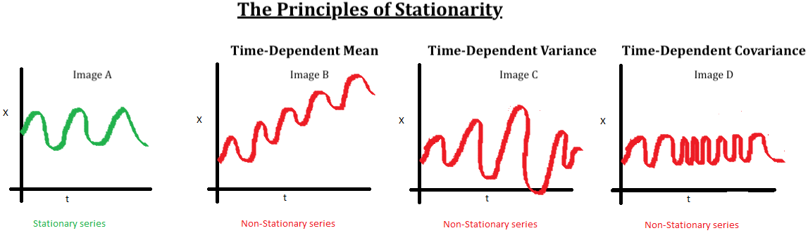
Stationary stats
The stationary bit is/was more significant in older “stats” models.
The stationary transformations work like bias/kernel to adapt model to non-fitting data.
If we can define some operation to make the data predictable, its easy to predict.
This is the “linearly separable” of time series – we can use simple models, if they fit.

Slide 12
ARIMA
ARIMA is a common time series model, it has 3 parts:
AR (p) – Autoregressive. Regresses on its own prior or lagged values. In other words, it predicts future values based on past values.
I (d) – Integrated. Observes the difference between static data values and previous values. The goal is to achieve stationary data that is not subject to seasonality.
MA (q) – Moving Average. A moving average.
Uses differencing to become stationary – removes seasonality.
Doing this part manually is for context, we have tools to do it for us that we’ll leverage.
We don’t need to know how to do this process in depth, we’ll use the library tools.

Slide 13
Creating ARIMA
Manually doing an ARIMA model requires we figure out the d,p,q parameters first.
D term - Augmented Dickey Fuller test.
Hypothesis test for “is this thing stationary”.
P < .05 for significance test is normal cutoff.
P and Q Terms from autocorrelation and partial autocorrelation graphs.
Next page…
If in doubt, default to lower values first.

Slide 14
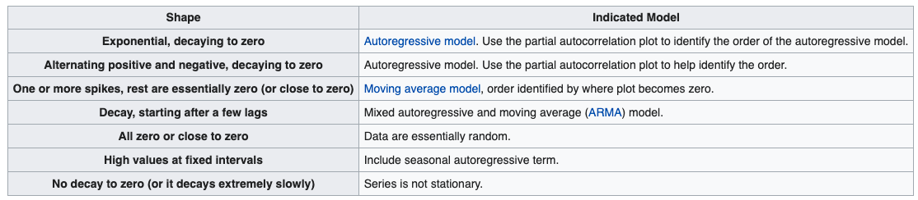
Guidelines on What to Use…

Slide 15
P and Q
Determining the p and q values is kind of vague.
These terms act with the d param like kernel/basis functions to do a stationary transformation.
We make guesses based off of what we can see in a couple of plots:
ACF – residual autocorrelation.
PACF – residual partial autocorrelation.
Note – there’s more detail that goes into selecting these things that is largely out of scope. We can make estimates and evaluate.

Slide 16
P and Q, Part 2
Rough ‘rules’ – these are condensed guidelines.
If the PACF of the differenced series displays a sharp cutoff and/or the lag-1 autocorrelation is positive--i.e., if the series appears slightly "underdifferenced"--then consider adding an AR term to the model. The lag at which the PACF cuts off is the indicated number of AR terms.
If the ACF of the differenced series displays a sharp cutoff and/or the lag-1 autocorrelation is negative--i.e., if the series appears slightly "overdifferenced"--then consider adding an MA term to the model. The lag at which the ACF cuts off is the indicated number of MA terms.
Start small, test, and revise.

Slide 17
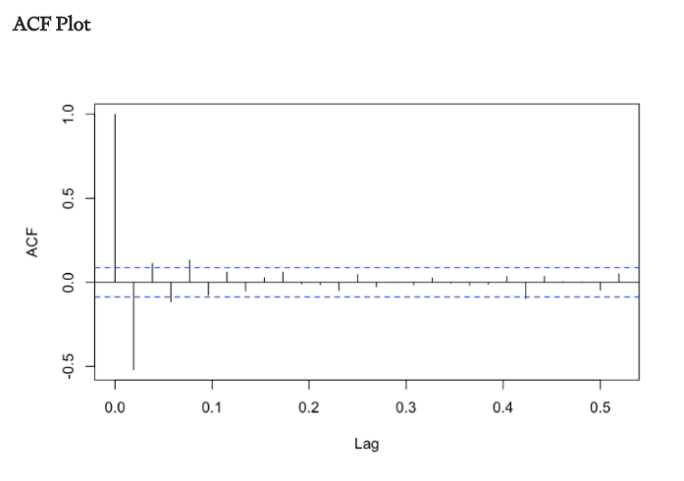
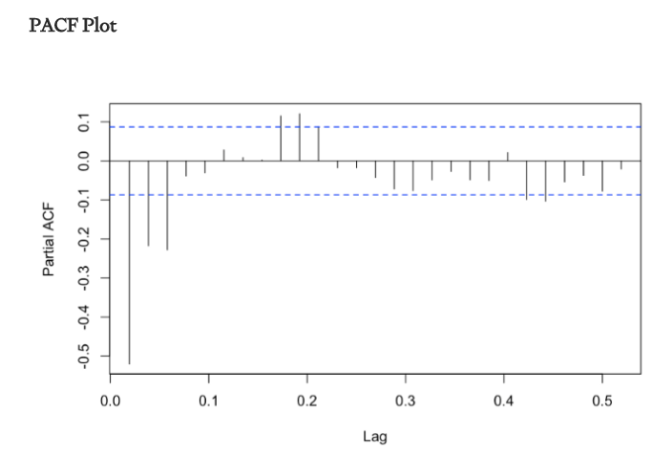
AR – 0 MA – 1

Slide 18
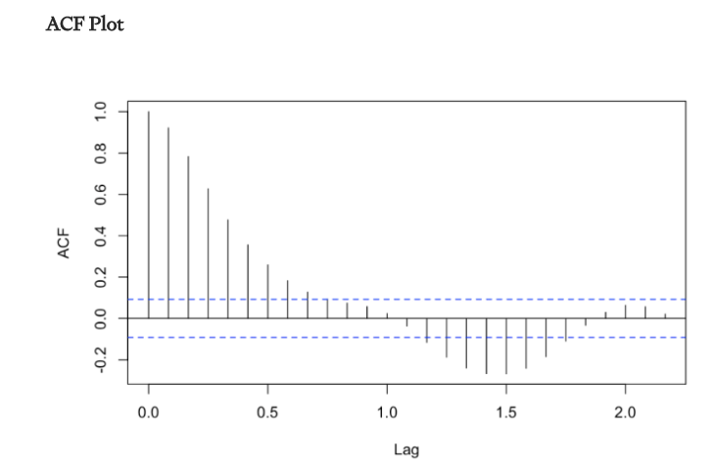
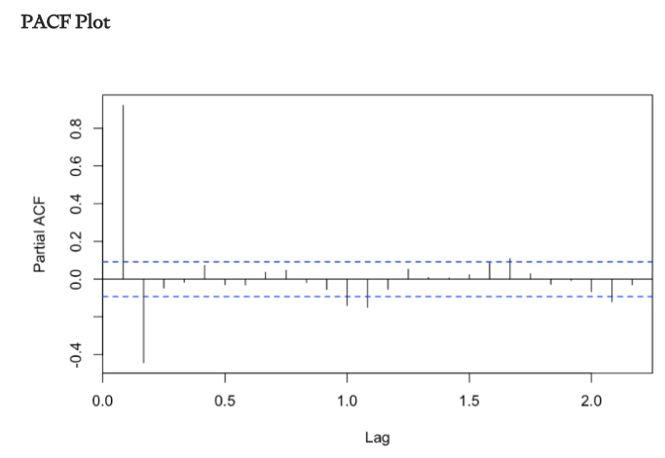
AR – 1 MA – 0

Slide 19
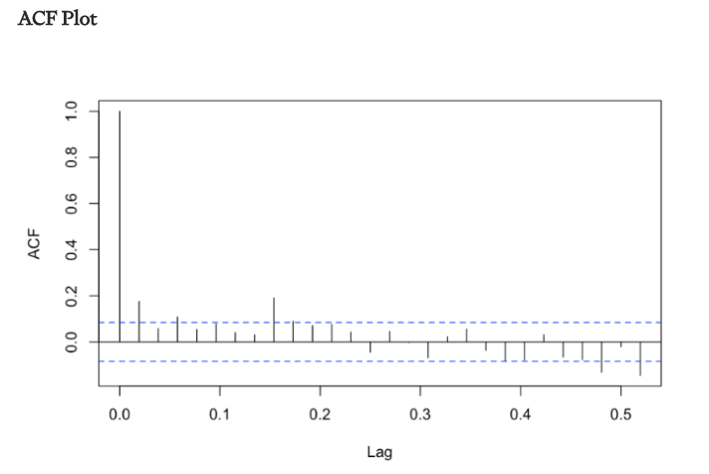
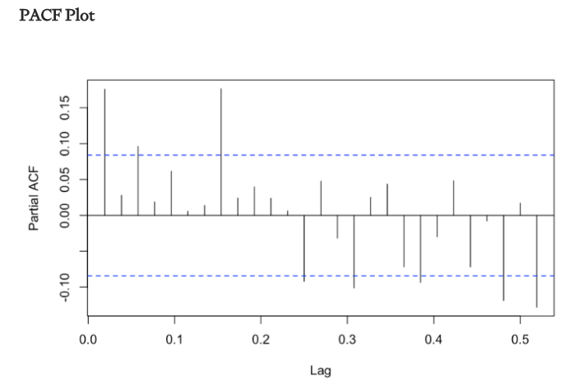
AR = 1 MA = 1

Slide 20
Implementation
Sktime is a wrapper that packages time series functionality, largely from statsmodels, into a sklearn-ish format.
Statsmodels documentation is not the best.
Statsmodels code is structured quite differently.
Allows us to do basic time series at a higher level, much more easily.
ARIMA details previously can be replaced with AutoARIMA.
Key notes:
Train-test split is now normally just the last X records are test data.

Slide 21
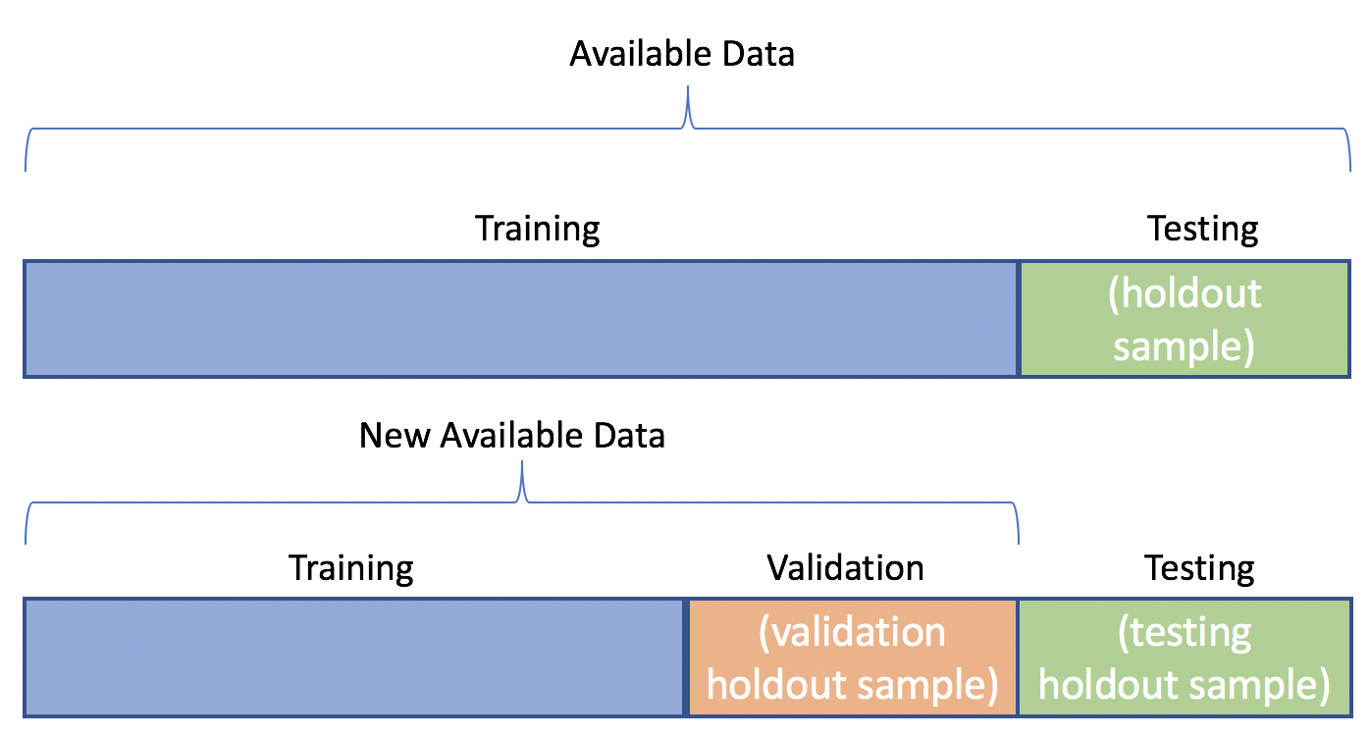
Data Splits in Time
The idea of a train-test split is different in a time series scenario.
Randomized selections don’t make sense.
The “end” is the test data, normally.

Slide 22
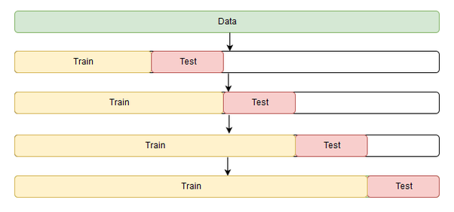
With Cross validation
With cross validation, we need to do a similar split, but moving over time.
If there’s a trend that we haven’t captured, that’ll impact things with drift here.

Slide 23
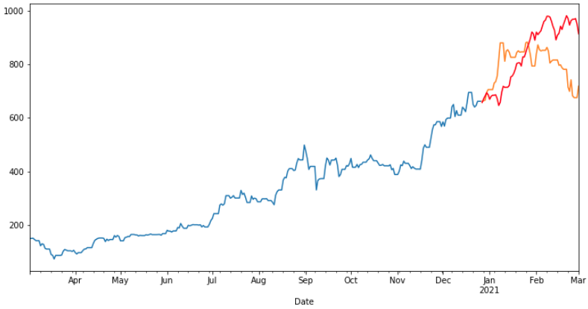

Slide 24
ARIMA-d Up
The ARIMA model type is a ‘basic’ one – a more elaborate moving average.
I.e. it is ‘pure stats’ and is an old way of making these projections.
Pros:
Simple, transparent, generally less overfitting/variance error.
Single digits of number of weights trained during fitting.
Cons:
Potentially too simple, not adaptable to variable scenarios.
Low capacity to adapt – too much bias error, especially in complex scenarios.
Note – these simpler models with more bias error may perform best, the future is hard to predict accurately. Too much ability of the model to adjust predictions may harm us.

Slide 25
Smarter Time Models
Modern models have much more capability than a simple ARIMA one.
Large numbers of weights can capture less frequent or obvious patterns.
In some cases (neural networks) models can learn things like the ARIMA patterns themselves.
Their capacity to learn is much larger - they have more weights, can learn complex patterns.
Similar to a large tree (or NN) vs a linear regression – more flexible in learning and adapting.
Rare events, ‘special’ times like holidays, longer cyclical patterns, etc…
Much of the flexibility in the tools that helped language models also help here.
These models tend to work and interact more similar to what we’re used to (or NN-style).

Slide 26
Facebook Prophet
Facebook Prophet is a library that is well setup to handle common time-series problems:
Handles events such as holidays, including custom lists.
Can be set to anticipate change points, e.g. product launches.
Provides useful things like plotting and cross validation.
Can handle additional regressors.
We can use a Prophet model much like the above models, with slightly different syntax.
There are several other libraries that handle time-series data similarly.
Modern implementations are based on recurrent neural networks (RNNs) or transformer based neural networks.
Neural networks well suited to sequential data. Seen with language models.

Slide 27
Prophet Models
The prophet library makes many of the time series things we may need, easier.
Dealing with statationality without a bunch of transformations.
Accommodating common date-related stuff:
Days, weeks, months, weekends, etc..
Handling common real-life concerns:
Events, holidays, etc….
Can incorporate additional predictors – expand dimensionality.

Slide 28
Additional Regressors
Much like a classification or regression we can have multiple features.
With a time-series we can add more regressors (using Prophet).
The regressors must exist for the data that we’re predicting.
E.g. if we are using the barometric pressure to predict the temp next week, we need to have that pressure value as an input.
This is the main drawback to adding regressors to time series models – we don’t know them.
We can make a forecast for those values, or construct regressors that can be known in advance (e.g. average past 3 days of barometric pressure.)
Many times, even if these regressors add more info, we don’t have a way to create a model that properly captures that info properly. Simple may be better.

Slide 29


Regressor Availability
If we want to use other factors, and predict farther into the future, we have an issue with those regressors not existing for the future period.
E.g. if predicting sales of a store, and ‘foot traffic’ is a feature, we only know that for the past.
Predictions using that in the future, must use something generated from past data.
Now
If we are using other variables to predict, we don’t have them for the future period.
Prediction Frontier

Slide 30
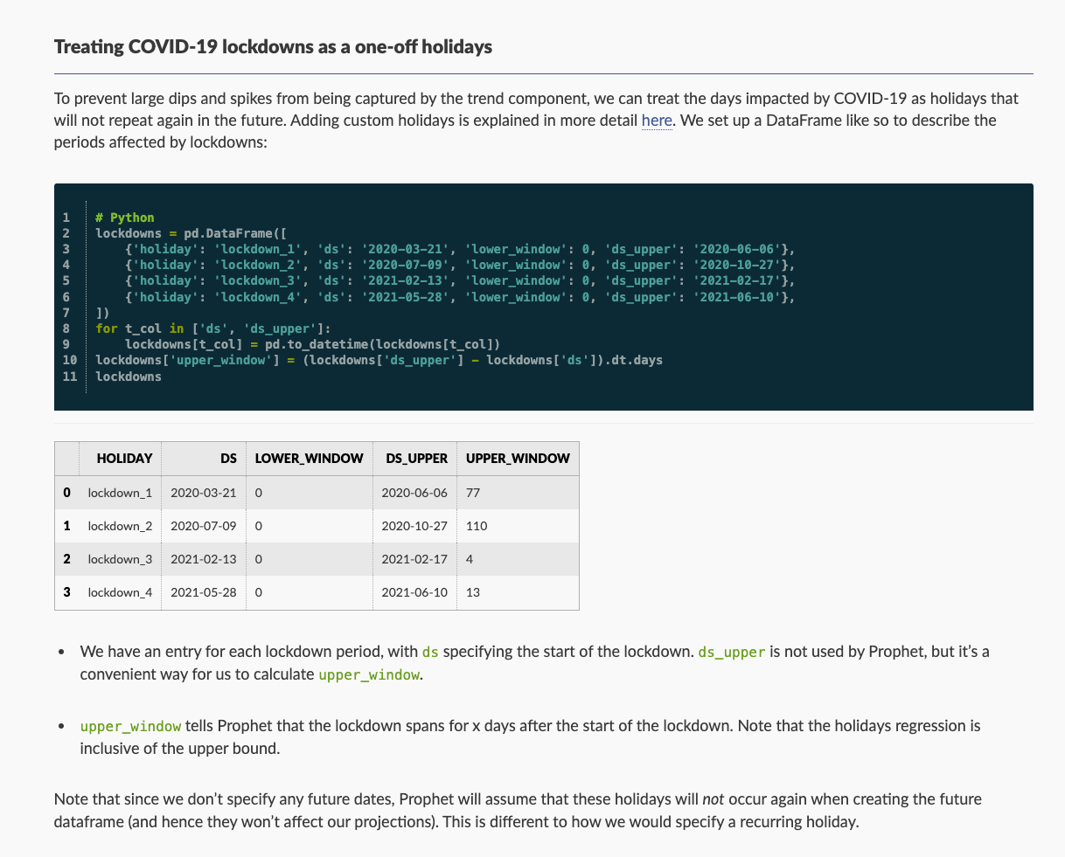
Other Considerations
Advanced models can also handle one-off events, like COVID.
The prophet API is generally setup to make this mostly pretty simple.
There are a bunch of similar options, mostly in a user-friendly setup.
Events, weekends, etc…

Slide 31
Determining a Time-Based Model to Use
The approaches with time series modelling differ greatly – averages, regression, NNs…
Data processing becomes more open ended in some ways:
Time values may be transformed many ways – binned, time since last, duration, etc…
May see more/different things done for feature construction, especially with future preds.
Framing of the problem is flexible, and requires domain and technical knowledge.
Some problems may be framed in different ways.
A CC fraud model may look at time of day, time since last purchase, or both as features.
A “crime predictor” could be a regression that predicts #crimes/day as a target, or a time series that predicts the same thing, just oriented differently.
Feature selection here tends to be much more selective than with regression/classification.

Slide 32
Time Series Conclusion
Sequential or time-series data requires a slightly different approach to predictions.
Simple models only have one value, and we attempt to make a model that captures its patterns.
Larger models require some ad-hoc dataset construction to make sense.
Time-series often requires different, and more, data prep before we can model.
Rule-of-Thumb – start with a simple model, and complexity if needed.
Time-series models are rapidly developing with language/translation and other generative models.
Any time there’s a direct dependence on “the previous record(s)”, these ideas apply.
We’ll revisit this a little with RNN/transformer models, they maintain more temporal (sequence) info.

