Slide 1
Housekeeping
Today:
Boosted ensembles (roughly pg. 90 in ItML)
Time series – we’ll wrap that stuff in with neural network time series modelling.
Things we are hopefully OK with:
Predictive model type and their use – classification, regression, clustering.
Assorted sklearn-ish data prep – pipes, cleaning data, PCA/transformations, etc…
Creating and evaluating models – HP tuning, results, comparing models, feature selection.
After today:
Neural networks.

Slide 2
Boosting Ensembles

Slide 3
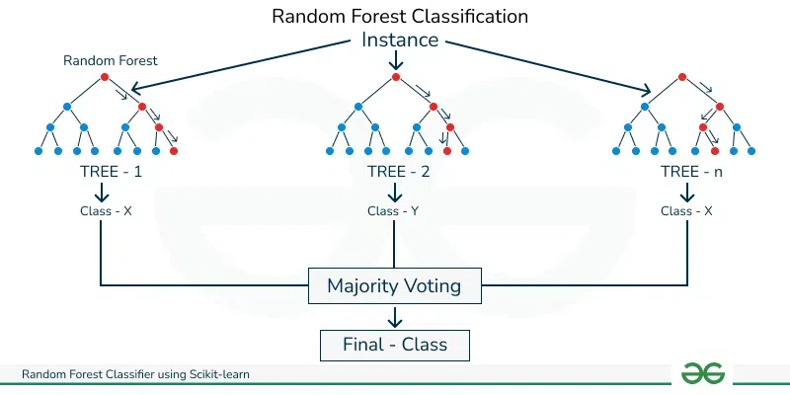
Remember Forests and Ensembles…

Slide 4
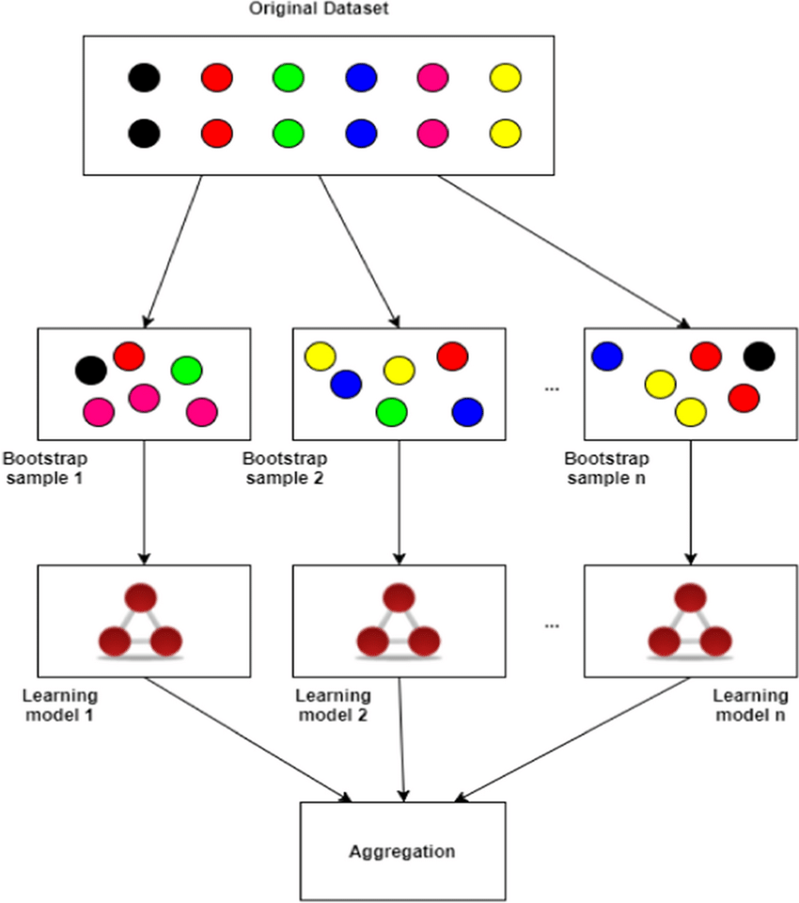
Bagging and Bootstrapping
Fights overfitting with models that are prone to be overfit, like a tree.
Trees will grow to perfection on training data without limits to their growth.
Bootstraps training datasets.
Each row of data will only be in some models.
Each feature may also only be in some models.
Combines all models to predict.

Slide 5
Bagging
Several of the same models.
All run in parallel.
Data is bootstrapped to introduce randomness.
‘Winner’ of the most models is the final answer.
Results;
Tends to be better than a tree, particularly with respect to overfitting.
Each model is independent inside of a forest.

Slide 6
Boosting vs Bagging
Remember – ensembles are models made of several models combined together.
Early in the semester we looked at some ensembles – bagging:
E.g. Random forest.
Employed many models in parallel, “averaged” their predictions to make final prediction.
Generally outperforms individual models, particularly in preventing overfitting (var error).
Each individual model runs independent of the others – can be parallelized.
Another ensemble technique is boosting:
Multiple copies of a model used.
Results of one model are used to improve the next, sequentially.
Utilizes weak learners, like 1 or 2 layer trees.

Slide 7
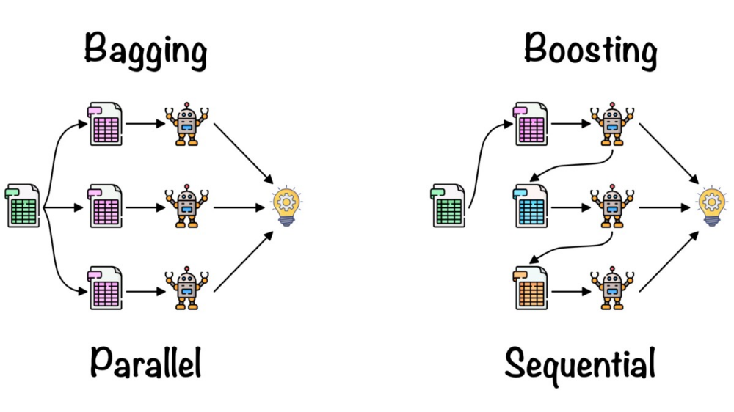

Slide 8
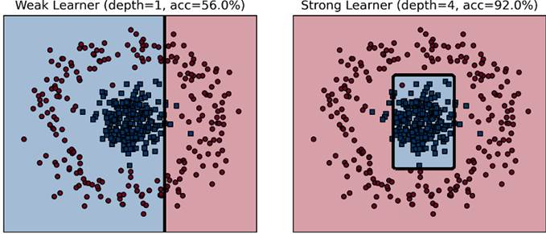

Slide 9
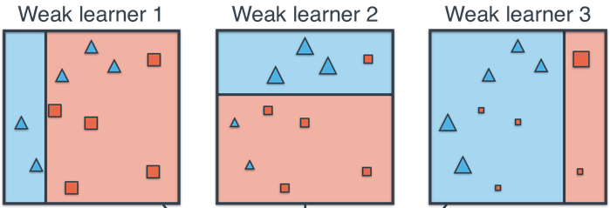
Weak vs Strong Learners
Weak learners are models that are slightly better than a guess.
Simple and fast.
Very underfitted – lots of bias error, low/no variance error.
Strong learners are models that have “high” accuracy.
Everything we’ve done has been with strong learners.
More complex, slower, and can tend to overfit.
The “goal” of machine learning – we want to predict accurately.
Boosting usually uses a simple decision tree, such as a stump (~2 levels) , as the base learner.
Other simple and small versions of SVM, regression, Bayes, etc can be used.

Slide 10
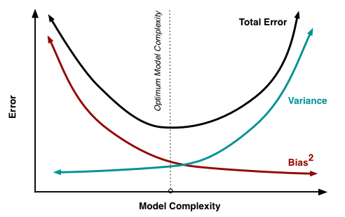
Weak benefits
They are fast.
They won’t overfit.
Think of a tree – one with only 2 levels can only make decisions based on a couple of things. It lacks the ability to adapt enough to training data to overfit.

Slide 11
From Weak to Strong
Boosting algorithms create a strong learner from many weak ones.
Each learner contributes a little, subsequent ones focus on the mistakes.
Each learner does a slightly different thing, compensating others’ weaknesses.
One model doesn’t “learn everything”, so they don’t overfit.
Boosted models:
Provide ability to capture variance with many “steps” – i.e. each model.
Prevent excessive overfitting by having simple models, and targeting current error.
New boosted models (within last 10 year or so) are very good.

Slide 12
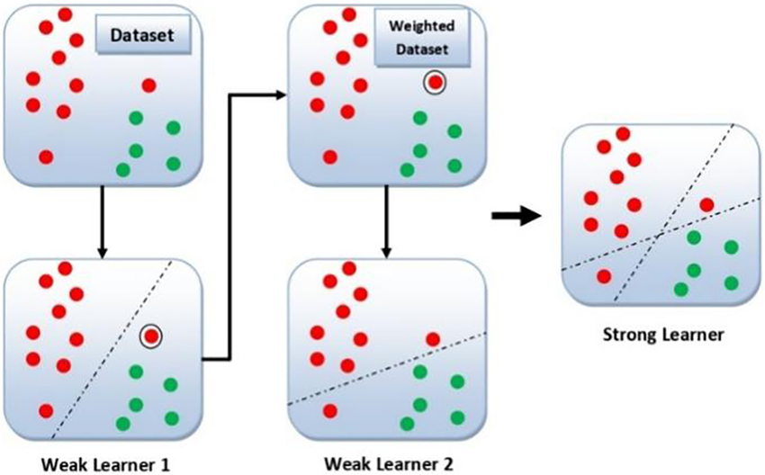

Slide 13
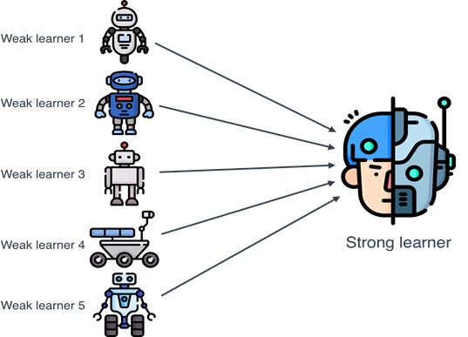

Slide 14
Boosting Ensembles
Boosting algorithms take a combination of weak learners and combine them.
Result is a strong learner.
Each step (model) of a boosted algorithm makes the current predictions marginally better.
Process is sequential – one comes after another.
Each step is ‘targeted’ to focus on the things that the model has wrong, thus far.
Some of the currently most accurate non-neural network models are ensembles.
Xgboost, lightgbm, etc…

Slide 15
Boosting Implementation
Like bagging, boosting can theoretically be used with many base estimators.
Need to be fast, and not overfit.
Trees are by far the most common estimators, and can do classification and regression.
Boosting generally reduces BOTH bias and variance.
i.e. it is better fitted to data, but less likely to be overfitted.
The base models won’t overfit, and the algorithms try to focus only on errors.
Boosting has a small risk of reducing performance, mostly on very noisy datasets.
Bagging rarely hurts performance, but tends to have less benefit than boosting.
(Roughly) noise can cause the model to try to correct the error of the “errors” (noise).

Slide 16
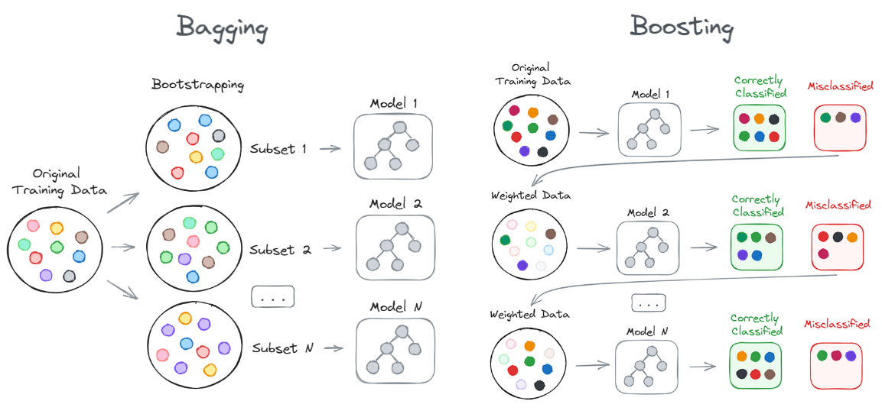

Slide 17
Boosting Models
There are many boosted models in existence, and common use.
Adaboost.
Gradient boosting.
Extreme!!!!!! Gradient boosting.

Slide 18
AdaBoost
One ensemble algorithm is Adaboost – adaptive boosting.
Adaboost works by updating sets of weights as data goes through each model:
A weighted sample of data goes through model N.
Model N gets a weight value increased if it is accurate, decreased if inaccurate.
Data that is correctly predicted gets a weight decreased, incorrect gets an increase.
Data with higher weights gets sampled more frequently.
Weights of classifiers combine for final prediction – better accuracy, more influence.
Result – Easy to predict data is dealt with quickly, harder data goes through more models; the most accurate models are more important in final prediction.

Slide 19
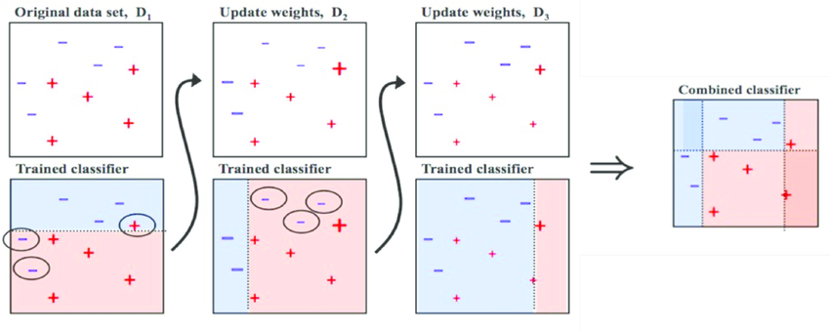

Slide 20
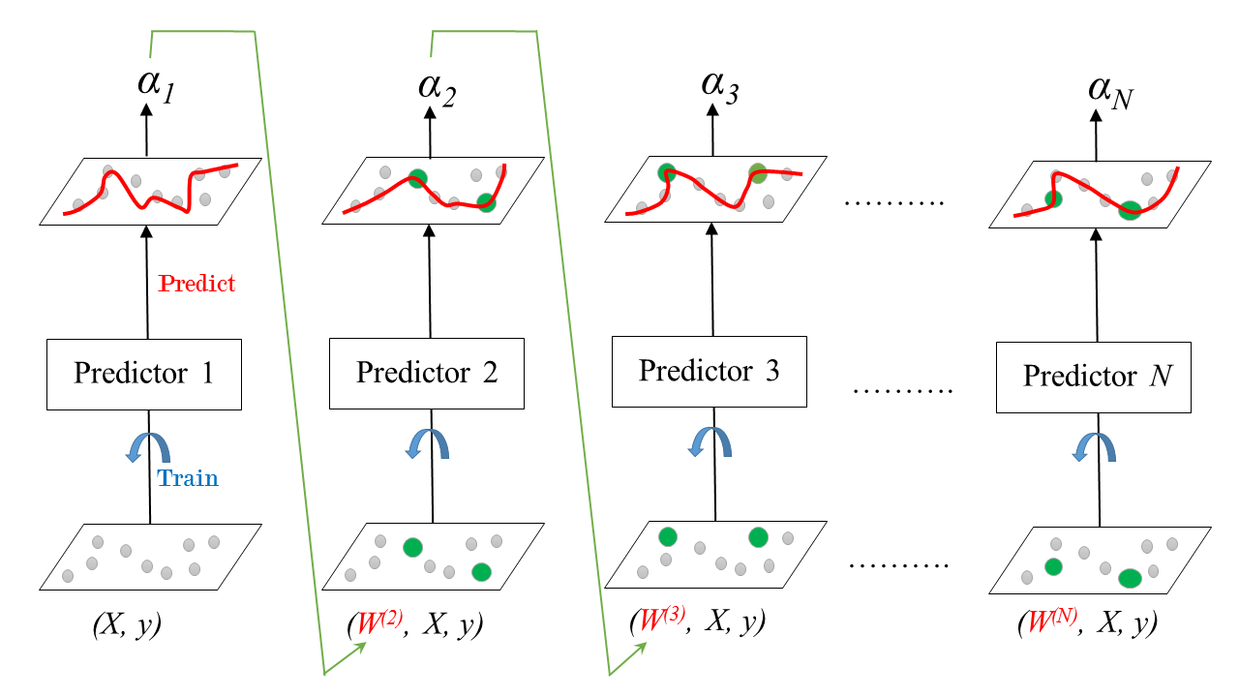

Slide 21
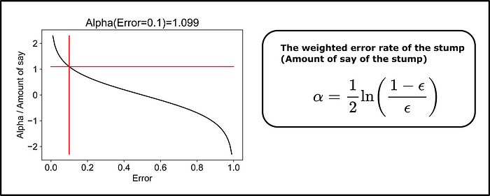
Final Adaboost Prediction
The final model is a weighted sum of all predictions.
The details of the weighting and summing aren’t something we need to examine much.
The weight for the weighting is based on the amount of error.
Similar in spirit to MSE – larger errors are penalized more.
Large errors can even be discounted with negative weights.

Slide 22
Adaboosted….
The adaboost ensemble ends up:
Creating a series of models, placed in sequence.
Each model overweights whatever was incorrectly predicted before.
Each model gets a score for how well it does – more accuracy, more weight.
Predictions are generated by taking the weighted sum.

Slide 24
Gradient Boosting
Gradient boosting is an ensemble that focuses on loss (residuals) to train the models.
The algorithm’s (regression version is easier to picture) process is:
Make initial predictions (this can be a guess). Calculate residuals for each prediction.
Fit the next model to the residuals from the previous round.
Repeat until limit or cutoff is reached.
Predictions are incremented by the set of residual predictions:
y(pred) = y1 + (eta * r1) + (eta * r2) + ....... + (eta * rN)
Result – each subsequent tree “bumps’ a prediction a little closer to the true value.
Any differentiable loss function can be gradient boosted.

Slide 25
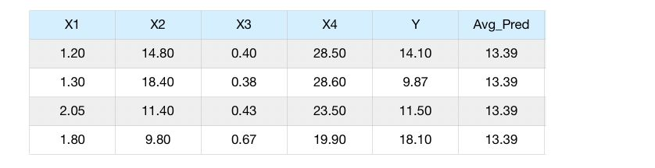
Gradient Boosting steps: Make initial Prediction (AVG Target)
Note: the starting point is the average of the target value. Like many models this would theoretically work from any starting point, it would just take longer to get there.

Slide 26
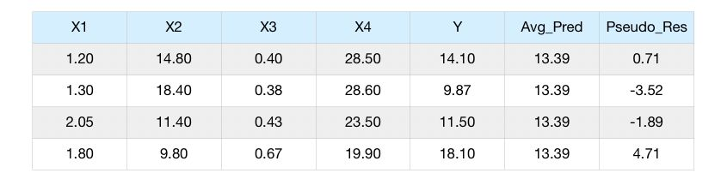
Gradient Boosting steps: Calculate Residuals

Slide 27
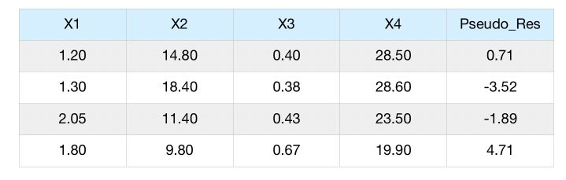
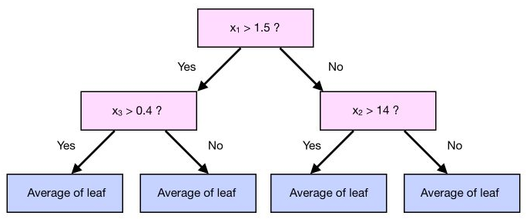
Gradient Boosting steps: Create new Model with target as residuals

Slide 28
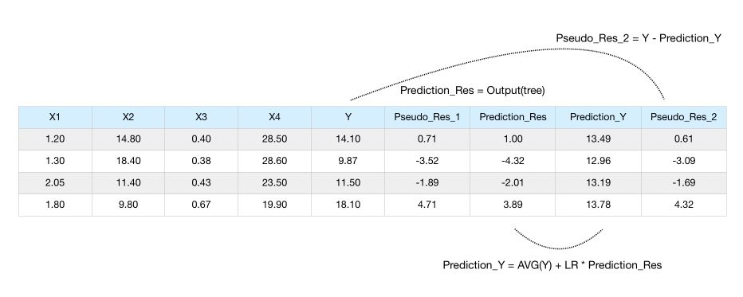
Gradient Boosting steps: Update Predictions and new Residuals
Note: LR is the learning rate, which controls the size of the jump between each model.

Slide 29
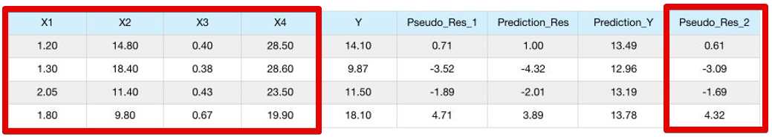
Gradient Boosting steps: Fit new model on new Residuals, repeat

Slide 30
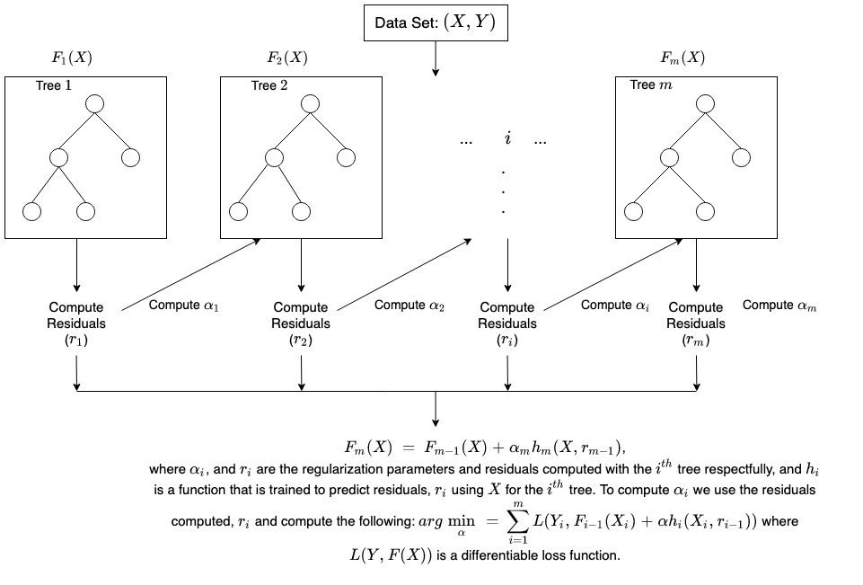

Slide 31
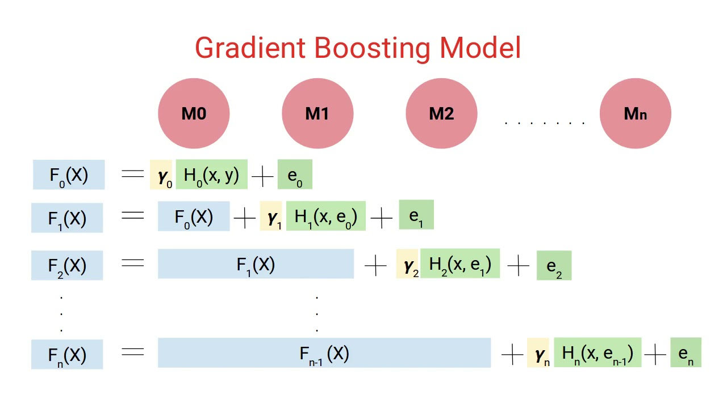

Slide 32
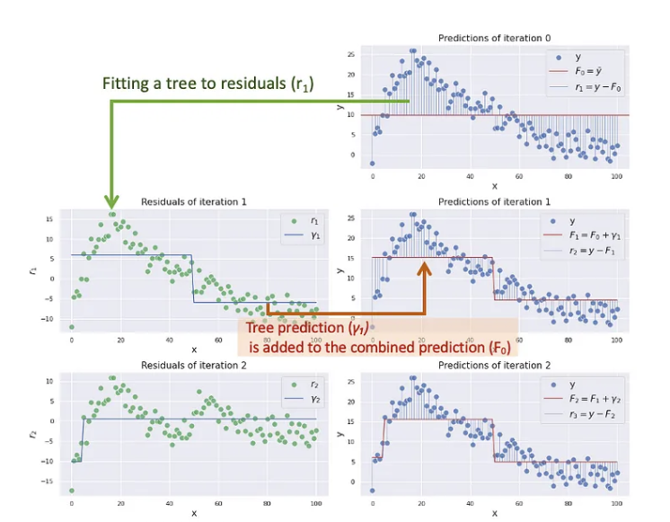
Step-By-Step
The model starts with an estimate of the mean, for all records. In this case it is 10.
The first model in the ensemble is fitted:
Assume this one is only 2 layers deep – 1 split.
Real ones are normally 3 levels, so 8 nodes.
The split is at X = 50:
If above 50, add ~5.
If below 50, subtract ~5.
Now the prediction is 10 + the adjustment.
+/- 5 depending on which side of 50 it is.
This “bumps” the model closer to the data…

Slide 33
Next Step…
Now the new residuals are calculated from the original residuals from last round.
Assume the split here is at apx. X=5.
If < 5, then subtract 10.
If >5, then add nothing.
The prediction is now 10 (the mean):
+ 5 if < 50, -5 if more than 50.
-10 if < 5, +0 if more than 5.

Slide 34
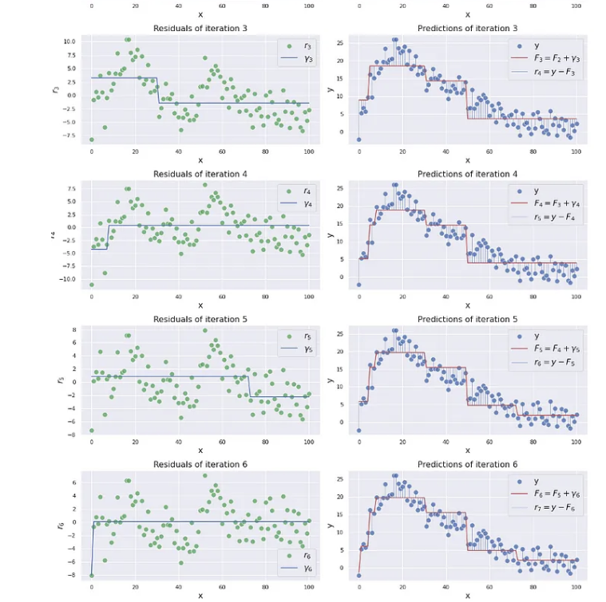
One More Step…
Measure the residuals of residuals again…
Suppose the next split is at x=30:
If < 30, +2.5
If <30, -2.5
This adjustment is chained onto the prediction.
We end up with a series of adjustments from the mean, each conditional on the X values.
The naïve prediction is just the mean.
Each model’s correction fits the data better.

Slide 35
Results
The models apply their corrections in series.
Start with mean, then adjust with each model.
Because models are based on residuals, they only act where there is a miss.
Limits overfitting as good fits are unchanged.
Allows good fits, as the model can adapt to the training data well, like any tree.
Model’s complexity comes from multiple trees instead of one large one.
Easy parts are ‘solved’ by a simple tree.
Each model corrects prior misses.

Slide 37
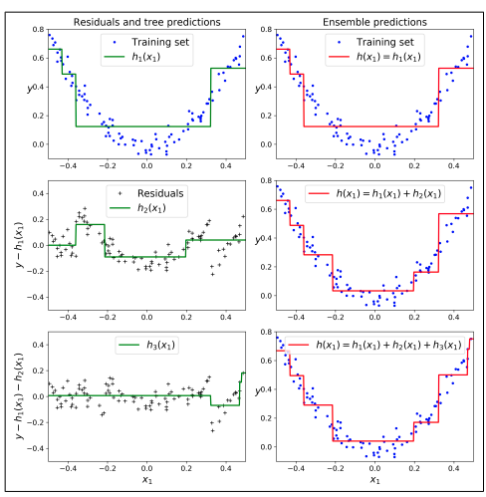

Slide 38
Gradient Boosting Magic
Gradient boosted models generally perform very well.
Each new model in the ensemble is fitted to correct whatever problems the model has at that moment, without hurting the things the ensemble does well.
This allows for:
Lots of learning by the model to happen (reduce bias error).
Not overfit, because it’s only acting on the errors (prevent the introduction of variance error).

Slide 39
Stochastic Factor
When performing gradient boosting, we can also make it stochastic.
Recall, that means we randomly select some subset of data for each update, rather than all.
The subset parameter controls this split.
A split in the 30% range is common, but this is pretty flexible.
This can speed things up a bit as data grows large.

Slide 40
XGBoost – Extreme Gradient Boosting
XGboost is one of the current “champions” of non-neural network algorithms.
LightGBM (by MS) is similar to xgboost, but often even faster. Trees get deeper.
HistGradientBoosting from sklearn is similar to LightGBM.
New – only developed in 2014. Mostly by one dude!
Applies many tricks/optimizations to gradient boosting.
Parallelized and written to optimally utilize hardware for speed.
Built in cross validation and regularization.
Handles sparse or dense data by default, as well as data that is too large for memory.
Revised methods to efficiently find internal calculations like tree split points.
Effectively – gradient boosting + all the “extra stuff” that can make algorithms faster and better.

Slide 41
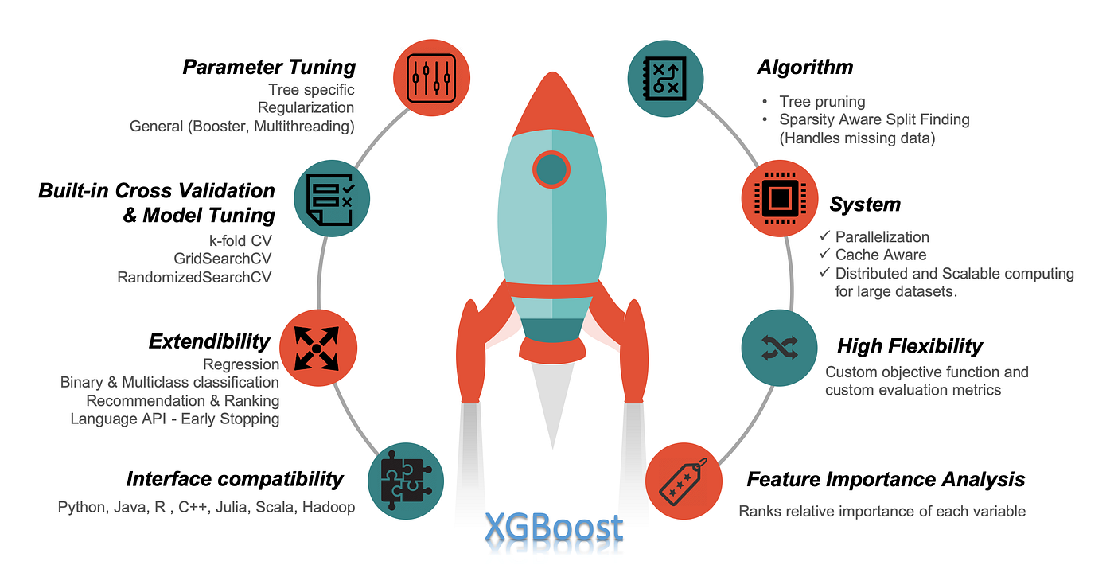

Slide 42
Xgboost Oddities
Xgboost and similar models excel over the “pure” gradient boost due to optimizations.
Exist both to better utilize hardware and make calculations faster, e.g.:
Uses “max_depth” in place of criterion (gini/entropy) for some calculations like stopping criteria.
Calculates imputation internally based on training loss.
Parts of the algorithm that can be parallelized are, aggressively.
Manages cache and memory to prevent memory related slowdowns.
Small improvements can yield massive differences, as large datasets require lots of calculations.
Faster executions allow for more experiments for optimization.

Slide 43
Other Ensembles - Stacking
Stacking is an ensemble technique that uses another model that is used to do the “blending” step for the final predictions.
I.e. rather than taking a “vote” of all the predictions like one would for a random forest classification, those predictions are the feature set of another model (e.g. log. reg.)
The stacking model is setup as:
Y = final prediction being made.
X = feature set made of each estimator’s individual prediction.
Stacking tends to increase performance on average, but it is often slow.
Generally, reduces variance.
If we have enough data, a neural network can likely learn what the stack is doing, better.

Slide 44
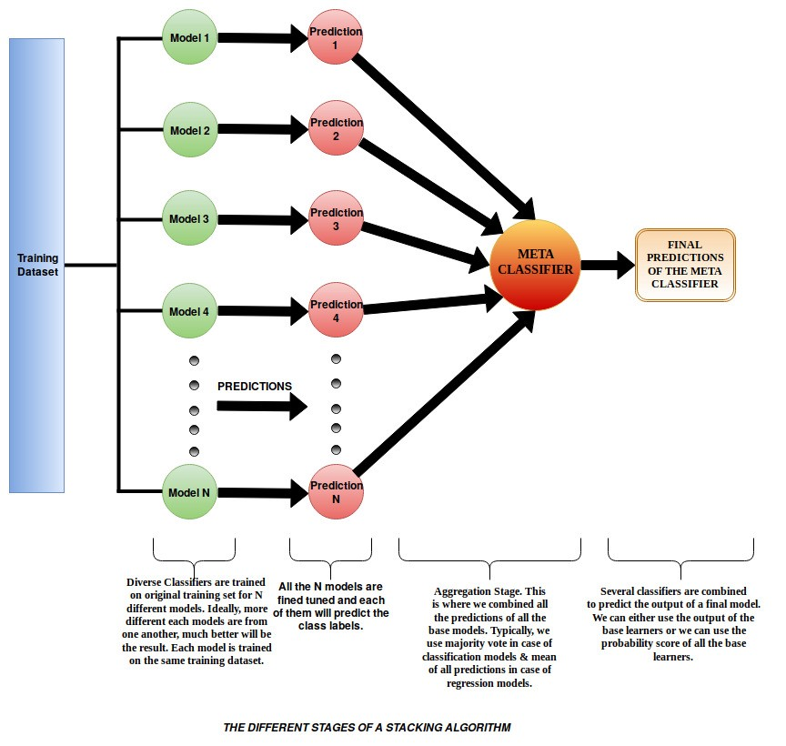

Slide 45
Boosting Conclusion
Boosting is extremely effective – boosted trees are the best overall models in many cases.
Weak learners prevent excessive overfitting.
Multiple learners and weighting allow for good fitting, and not underfitting.
XGboost (and competitors) incorporate a suite of optimizations to maximize performance.
Rule of Thumb: Smaller/structured -> xgboost/lgbm. Larger/unstructured -> neural network.
Are less parallelizable, due to sequential calculations, than other models.
Partially mitigated by xgboost/lgbm, though limits are inherent to the process.
Going forward, the concept for boosting is similar-ish in a way to neural networks.
Each model in boosting expands the capacity of the model to fit data.
Each layer in a neural network expands the capacity of the model to fit data.

