Slide 1
Today:
Text processing project.
You can tackle this after today.
Be attentive to the details – for this you need to produce a specific output.
Trial and experimentation are probably needed, and this is pretty well suited to splitting work.
Today – more text processing and NLP.
Dimension reduction and latent data with tsvd.
Embeddings.
Did you all do Bayes models in stats? Ideally making the model from scratch.

Slide 2
NLP Part 2

Slide 3
Natural Language Processing Intro
We can use text as a feature set to do predictive modelling.
X is our feature set – the text after its processing.
Y is our target – something external. E.g. positive/negative review, spam/not spam.
We end up with a ‘normal’ array of data, that we can then TTS, predict, etc…
NLP uses some specific terms:
Corpus – all the text that we are using.
Document – one ‘piece’ of text. Normally a sentence or line.
Vocabulary – all the tokens (words/terms) that is in our corpus.
Creating the feature set from the text involves some preparation.
Text is first tokenized – transformed into individual ‘terms’ (words or n-grams).

Slide 4
Vectorization
Turning the text into numbers – vectorization.
We translate the free text into a numerical representation of that text.
Simple vectorization is based on counts of words in that piece of text.
More elaborate vectorization calculates a value based on frequency (tf-idf).
Result is a set of numbers (a vector) that represents the document we started with.
Text-y data preparation tools are also involved:
Removing stop words – get rid of ‘a’, ’the’, ‘it’, etc… as they don’t really change meaning.
Stemming – chopping words down to their root. E.g. Skiing -> ski.
Lemmatization – reducing words down to their root meaning. Chuckling -> laugh.
The goal is to have a vector that “means” the same as the original text.

Slide 5
“meaning” of Text
When used for prediction, the meaning of the vector determines model quality.
We need to generate a vector that accurately captures the underlying meaning in text.
In larger scenarios this is called creating embeddings.
Take in some free text.
Evaluate the meaning of that text, using some complex model.
Return a set of values that ‘capture the meaning’ in n-dimensional space.
“Real” models can have an embedding space that is 1000s or more dimensions.
The ‘meaning’ of a word is its position in 1000-dimensional space.
The distance between words shows their similarity in meaning.

Slide 6
Dimensionality and Embeddings
The meaning captured with real embedding processes are more sophisticated.
Use massive amounts of text to learn meaning from seeing tokens over and over.
The larger and more complex the embedding space, the higher the celling.
The amount of data needed to generate it also increases.
For smarter NLP-ish models, we want to represent the meaning of docs as accurately as possible.
Counting occurrences of terms captures some meaning, but it is rudimentary.
We can use other processing tools to extract meaning from the text, and use the values on those “meaning” metrics as our feature set.
Note: this isn’t dealing with generating text, that requires models that capture sequence.

Slide 7
Dealing With dimensions

Slide 8
Dimension Reduction
Feature sets for text can get massive! Probably excessively so:
# of features is often > # of rows -> trends towards overfitting.
Common sense – only a subset of words really define meaning – we can kill some.
Processing time can grow to be unreasonable.
Some caps can be placed on size during vectorization:
Limit max features.
There has to be a better way!

Slide 9
Truncated SVD and LSA
LSA is latent semantic analysis. LSA attempts to:
Extract meaning from large amounts of text, using more advanced frequency calculations.
LSA follows a couple of assumptions:
Meaning of Sentences or Documents is a sum of the meaning of all words occurring in it. Overall, the meaning of a certain word is an average across all the documents it occurs in.
Semantic associations between words are present not explicitly, but only latently in the large sample of language.
Latent Semantic Analysis (LSA) comprises of certain mathematical operation to get insight on a document. This algorithm forms the basis of Topic Modeling. The core idea is to take a matrix of what we have — documents and terms — and decompose it into a separate document-topic matrix and a topic-term matrix.

Slide 10
What’s Going on…
The process does some linear algebra calculations to generate the topics and strengths.
The details of the math aren’t really super relevant for us here.
We’ll look at PCA soon, which does a similar thing.
PCA has math that is more clear and easy to understand.
We want the key info (var. of target), contained in as few features as possible.
The ‘ideal’ scenario is one feature with an R2 of 1, how close can we get?

Slide 11
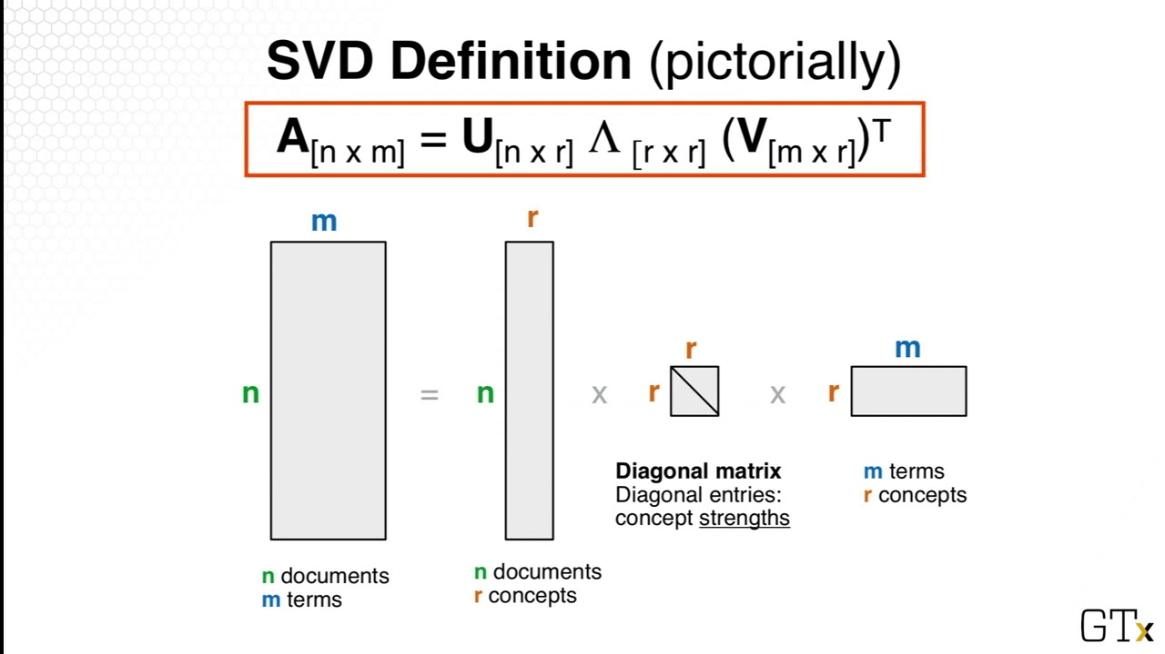
Truncated SVD – Singular Value Decomposition
Truncated SVD is the mathematical mechanics used for LSA.
SVD breaks the original data into 3:
Documents x concepts.
Strength of concepts.
Concepts x terms.
Concepts are represented as patterns of words that usually appear together in documents. For example “leash”, “treat”, and “obey” might usually appear in documents about dog training.

Slide 12
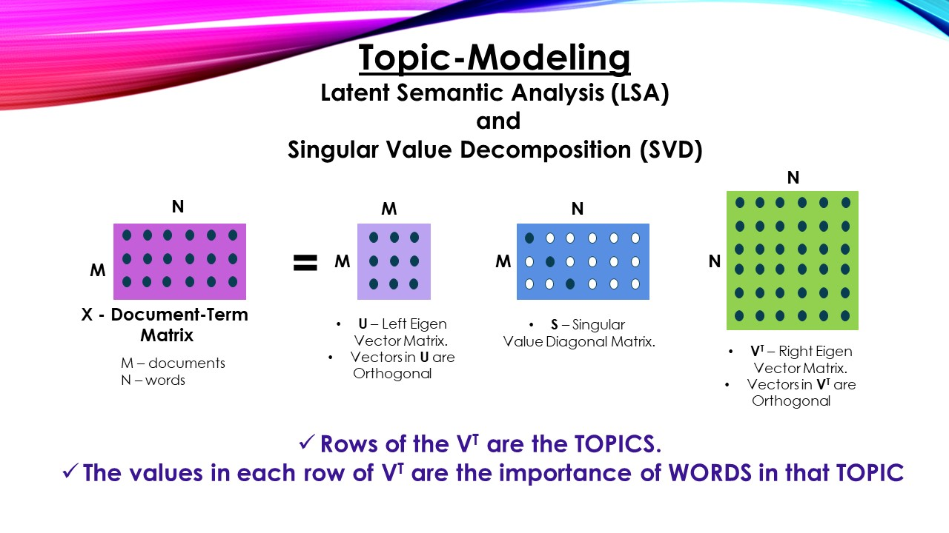

Slide 13
Truncated SVD - Results
SVD aims to capture the maximum meaning with the minimum amount of data.
Only the strongest concepts are kept.
Feature set can be massively reduced.
We don’t know a good number of components going in – we need to tune it.
Prediction accuracy is usually “close”, but with a far smaller feature set.
Accuracy won’t (likely) increase – you are tossing data.
Can’t reliably separate different meanings of one word.
Similar to how PCA reconstructs features into more meaningful components.

Slide 14
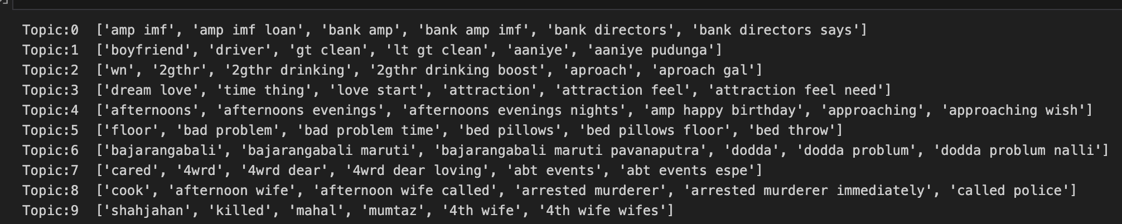
TSVD Results
This is an example of the ‘topics’ detected from tsvd.
The topics are internally similar, as far as the model is concerned.
These topics aren’t defined from outside, the process learns them. (More data impacts this a lot).
The process has no understanding of meaning here, it’s just math.
1 is bank-y things, 3 is love, 8 is a future Netflix documentary. More data, better results.
For meaning predictions – knowing the topic is likely better than the exact token.
Inconsistency in meaning will require more data or worsen results. E.g. bad can be bad or good.

Slide 15
Slight Detour – Remember R2?
One of the key metrics we use in regression is the coefficient of determination – R2.
R2 tells us the proportion of variance in the target that is explained by our model.
i.e. an R2 of .8 for predicting lifespan means that our model accounts for 80% of the value of the target, while stuff not captured by our model is the other 20%.
When we do dimensional reduction, we can think of it like R2. (Conceptually, not literally).
Our original M features (as a whole) capture K% of the meaning of the document.
After reduction, we have <M features, but hopefully capture ~K of the meaning.
Each of our features captures more useful data, while we discard the non-useful parts.
Kind of (even more conceptually) like multicollinearity – capture meaning in fewer features.

Slide 16
Numbers from Words
Every tool aims to generate some numeric representation of the text – needed for model.
Count vectorization does it with simple arithmetic.
TF-IDF does it with some algebra.
Truncated SVD does it with some linear algebra.
Other tools do it with predictive models.
Generally, we call the result of the models' embeddings (others do too, but term is less common):
This embedding space is multi-dimensional – each term is represented by K numbers.
The larger K gets, the more accurate our representation can be, given we have the data.

Slide 17
Embedding Generating Tools

Slide 18
Word2Vec and Alternate encodings
There are lots of other NLP libraries out there that take different approaches to dealing with text.
One library we can use is Word2Vec, originally developed by Google.
Word2Vec transforms words into vector representations using a neural network.
Word2Vec looks at words and their surroundings in sentences (documents) to generate the encoding.
Each word gets a vector of values that encodes it, not just one number.

Slide 19
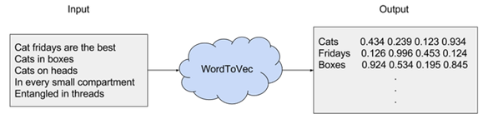
Embeddings
Each word is defined by a 100/200/2000/big number dimension vector of values.
Those dimensions are learned when the model is trained.
Each word is “placed” in that N-dim space, and it “sits” in an area of similar words.
Large embeddings basically plot tokens in large D, the distance to other tokens is the similarity.
E.g. Man, dude, guy, brochacho, will all have similar values in nearly all dimensions.
The ones where they differ will (very roughly) measure things like formality. (This is rough, not pre-def.)

Slide 20
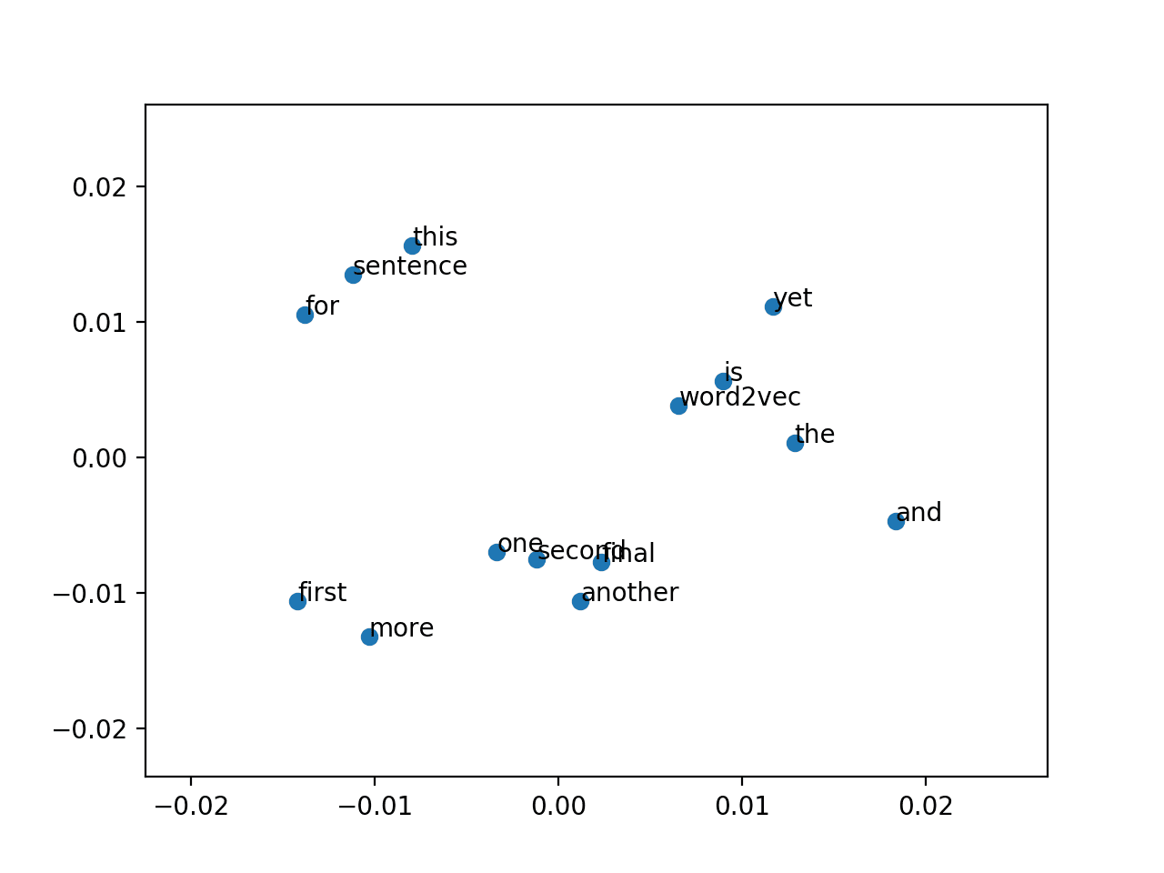
This, but in 5000 Dimensions

Slide 21
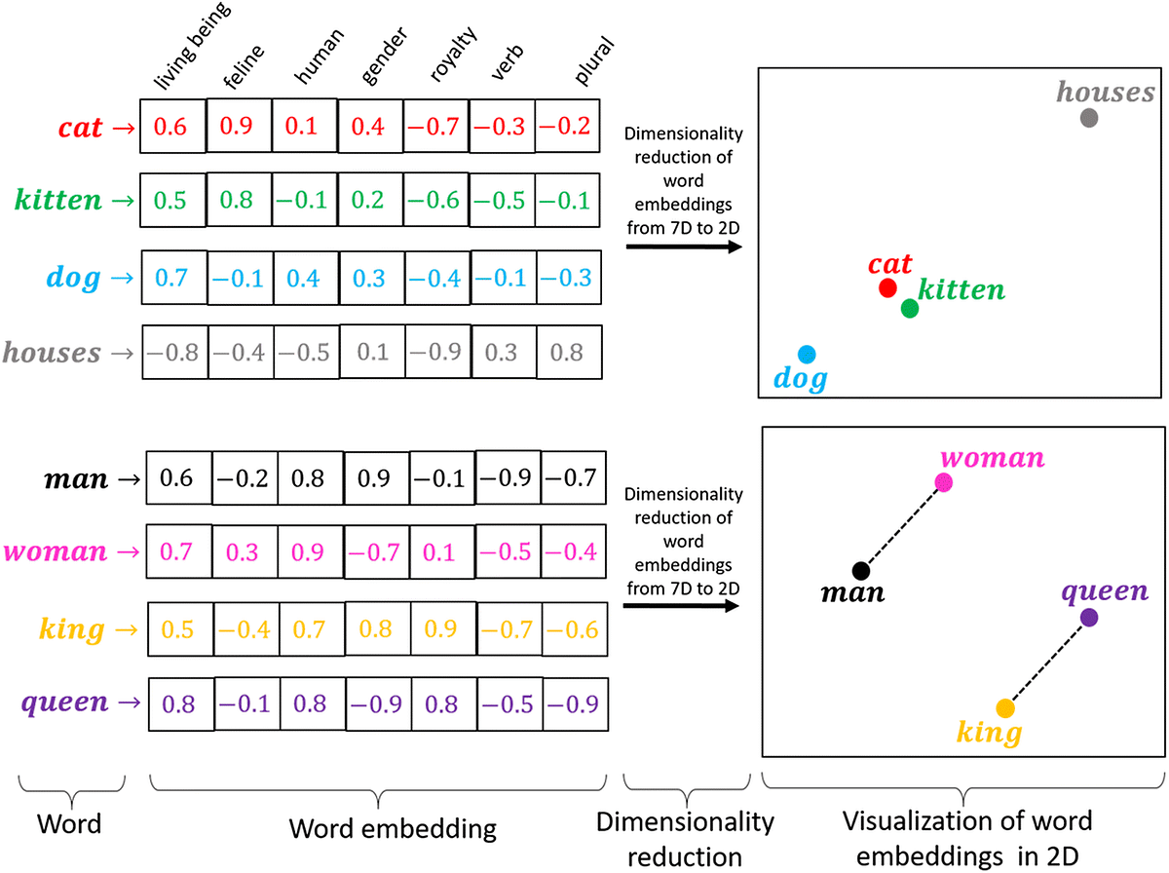
Embeddings Visualized
Each token is represented in K dimensions.
Larger k, more complex representation.
Data needs scale rapidly.
Those dimensions aren’t predefined as they are here, that’s what the embedding system learns.
They aren’t human dims, they’re machine dims.
The accuracy of this embedding determines how well the model handles the meaning of each word.
LLMs are in the thousands.

Slide 22
Embedding Systems
Tools that create embeddings such as word2vec are critical in NLP models.
Models only use and predict numbers, no matter the complexity.
The embedding is what defines the text -> numbers relationship.
The better the embedding is (the closer its representations matches the ‘real’ meaning), the more accurate (with respect to actual use, not model statistics) the results will be.
Real tools use massive text sets to learn word meaning / embedding space.
Larger dimensionality can yield better results, but requires more data/time.
Key – the model learns the dimensions to use, they aren’t defined going in.
E.g. there’s no “plural” axis, or “masculine” axis – the model learns the dimensions needed and they don’t need to correspond to the metrics that we’d use to “measure” a word.

Slide 23
SkipGram and CBOW
These are two different methods to generate embeddings for our tokens.
Skipgram – predicts context given a word.
I.e. output is a set of similar words. It then uses these to map value.
Continuous Bag of Words – predicts probability over vocabulary given words.

Slide 25
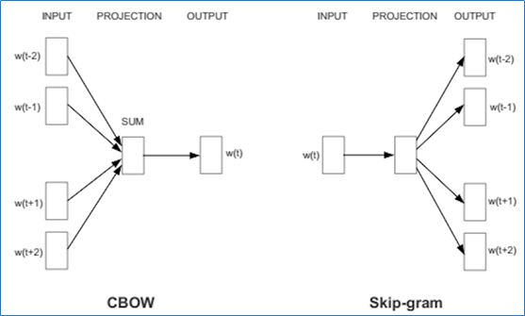
Word2Vec uses Sequence to create Embeddings

Slide 26
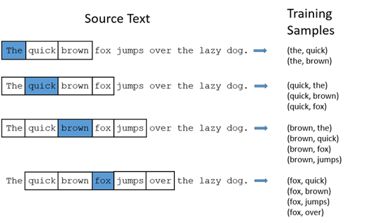
Temporal Awareness
Text isn’t just a bag-o-words, order matters.
”Dumps like a truck” and “likes dump trucks” are verry different.
NLP can benefit from learning from order.
Word2Vec can use the sequence order.
In NN, we’ll look at order more explicitly.
The order will (hopefully) help generate better embeddings by capturing meaning.

Slide 27
Differences
Skip Gram
Often better with low frequency words and maintains sequence information.
Can be computationally slow and perform worse with non-diverse datasets.
Better for semantic relationships (meaning) and text generation.
CBOW
Faster and often better where words are frequent and order is less important.
Often worse with low-frequency words and loses order.
Common in classification and recommendations – ‘vibes’ over details.
How well the embedding matches the text meaning and use will determine performance.

Slide 28
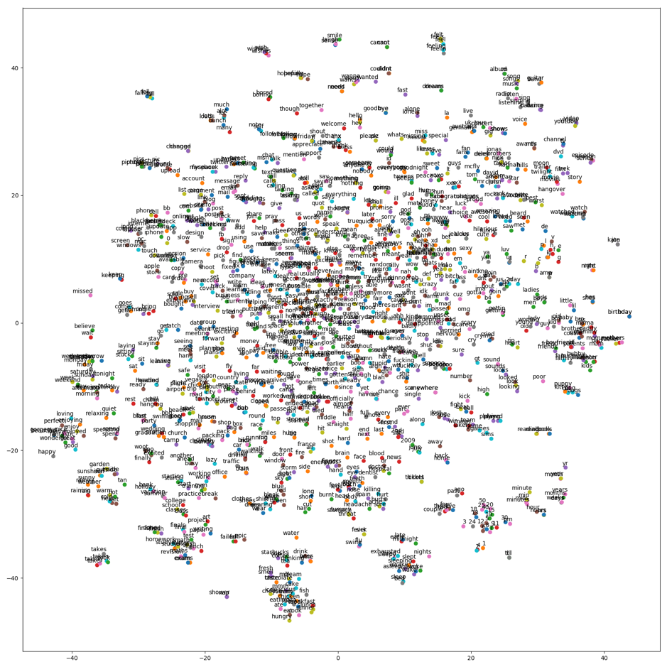

Slide 29
Big Note
We will use embeddings, but we have to collapse them to 1 dimension.
Each feature needs 1 value, not 200 values.
This is a simplification for our simple models that must have 1D data.
In neural network models we don’t do this, we can keep 2D data.
Feature x embedding dimensions.
The process doesn’t really change all that much, the we can just use the embedding as is.
This loses the ‘magic’ of fancy embedding, so we can expect much better results with this approach only if we use a bigger model to take advantage of them.

Slide 30
Using Embeddings
For us, for now, we’ll collapse the embedding values down.
Later, with neural networks, we’ll look at how we can use them sans collapse.
Our models can only handle a 2D grid of data.
Overall, any representation could work.
In our examples, we’ll collapse multi-D embeddings down to 1 D.
We could keep the multiple dimensions, and have a 3D dataset (later).
We could do any other flattening – we’d have to test to see what works well.

Slide 31
NLP in Practice
NLP is an area that is very quickly developing.
More data makes a big difference!
Language has subtleties, massive datasets allow those subtleties to become patterns.
The #1 determinant of future language models will probably be access to human written text.
Preprocessing choices can make massive differences:
Stemming, lemmatization, stop words, and n-gram size all vary widely depending on context.
The embedding space quality matters as much or more than the predictor.
Like images, we must represent text as numbers – how well we do this is critical.
This is a source of irreducible error for the predictive model.
E.g. the word “lit” has a different lemma on Twitter, in a college English dept, or for wildfires.

Slide 32
More advanced NLP
Many NLP tools are used in concert with neural networks.
We’ll revisit some later on towards the end.
NNs are well suited to the challenge of extracting patterns from large datasets.
Complex relationships, huge data, large models.
Recurrent neural networks and transformers (March) are model types that are good at NLP.
Good at capturing sequence of tokens – important for actual language.
These tools enable text generation – predict the next word, and generate it.
I.e. what value (in N-dim) should the next word have? Choose a word that is embedded close to that ‘correct’ word.
Precursor to the types of models that are used for modern text generation, transformers.

Slide 33
NLP Conclusion, Part 2
Text is a very complex thing – we can express the same thing in many ways, and different things in similar ways.
Performance of our models is very context dependent:
Different parts of text matter depending on the goal (e.g. generation vs classification).
There are several moving parts – cleaning, processing, embedding, model….
In general:
For classification/regression – simplify the problem as much as is reasonable/works.
Meaning matters, text detail doesn’t. We want to limit variance errors.
For generation/advanced stuff – complex model, embedding, large data.
The relationships are complex, so we need a large model to be able to capture it.
Data needs can explode – need to be able to disambiguate all uses of each token.

