Slide 1
Housekeeping
Today – NLP with RNNs part 1, classification. (Pull for updates).
Padding and sequences.
Using embeddings to their fullest.
Next (and last!) project starting repository is up.
You need to classify some images, in a few different ways.
Make a presentation (in workbook, not literally) that demonstrates that you know how to do this and are good at it.
Next class (lstm text generation) will be a cutoff for the test in 1.5 weeks.
Do you all need anything specific for the project stuff?

Slide 2
NLP with Neural Networks
Classification

Slide 3
Overview
Neural networks work well with natural language.
Language is unstructured, very highly dimensional, and has complex relationships.
Today – classification with NLP.
Next time – generation with NLP (which isn’t as different as we’d think).

Slide 4

Remember RNNs?
Recurrent neural networks handle temporal relationships.
They can capture the impact of prior time steps on future predictions.
These models perform better on sequenced data.
Something that is repeated over many time steps.
Stock quotes, price forecasts, language, etc…
Benefit from maintaining a ‘memory’.
Tracks the earlier stuff so the model can make predictions from data + memory.

Slide 5
RNN Implementation
There are several RNN implementations.
Simple RNNs maintain a state, that is passed forward each step.
This can lead to issues over long time periods.
E.g. how much do initial words in a long sentence impact the next word.
Backpropagation goes over time, and gradients can vanish (or explode).
Model isn’t able to accurately learn from far past time steps.
Solution – long short term memory models with two states.
Cell state tracks long term information, hidden state tracks short term info.
Series of gates combine data and keep/remove based on relevance (w/ linear algebra).

Slide 6
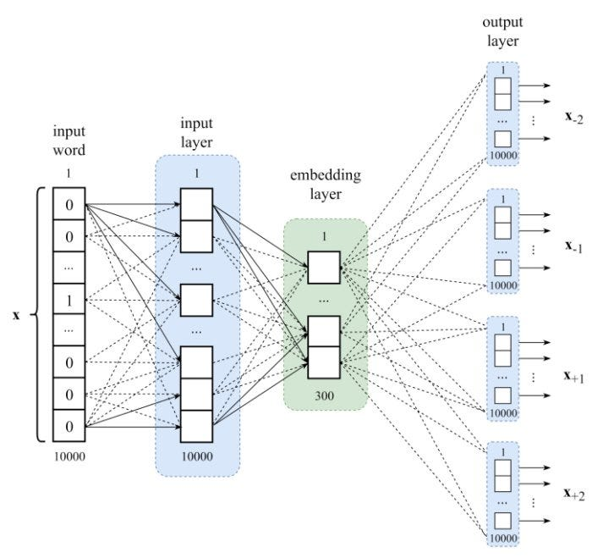
Remember NLP
Natural language processing uses natural text as features.
Can do sentiment, classification, text generation, etc…
Depends on vectorization – represent text with numbers.
Simple versions are count based like frequency or tf-idf.
In neural networks we use embeddings.
Represent each token with a N-dimensional number.
High dimension space and lots of text give a good representation.

Slide 7
Data in NLP
With neural network models we don’t need 1D input data.
Those solutions work, but they lose lots of data.
Using high-dimensional embedding captures value better.
Each record is # tokens * embedding dimension.
The temporal abilities of the model help with the time factor.
Overall, neural networks classify like ‘regular’ ones, except:
The model can understand the sequencing of stuff.
The data provides a right representation of the meaning of words (tokens).
The model and data structure capture “what matters” better than before.

Slide 8
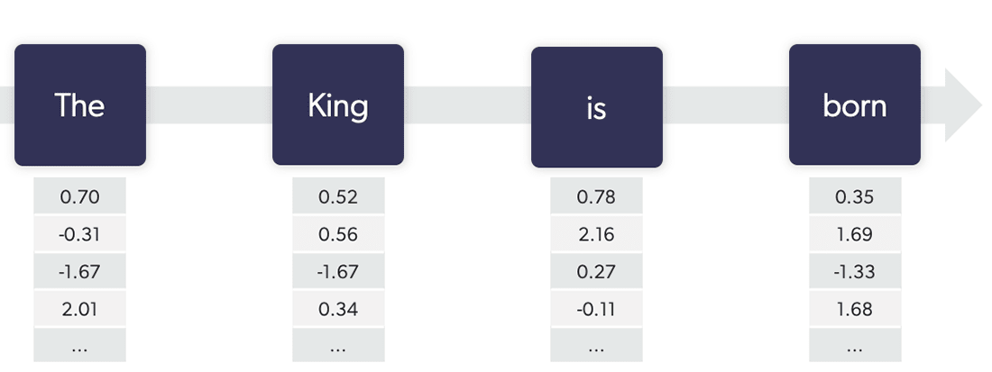
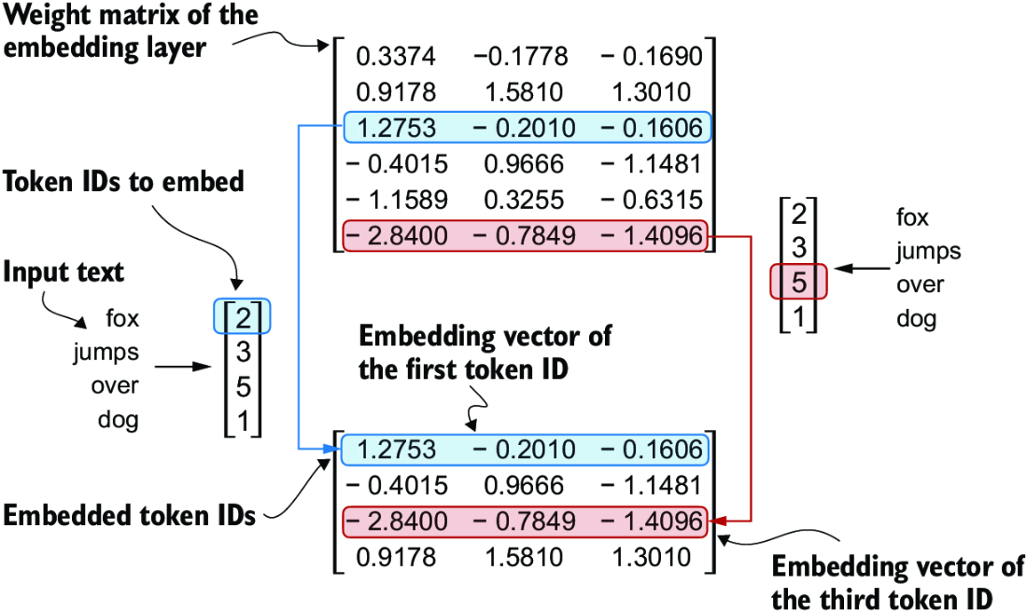
Embeddings
Recall the embeddings we looked at with word2vec.
Represent each token with K dimensions.
With statistical models we had to collapse the embedding down to 1D.
Our neural networks can handle the data as-is.
Can capture a richer modeling of meaning of text.

Slide 9
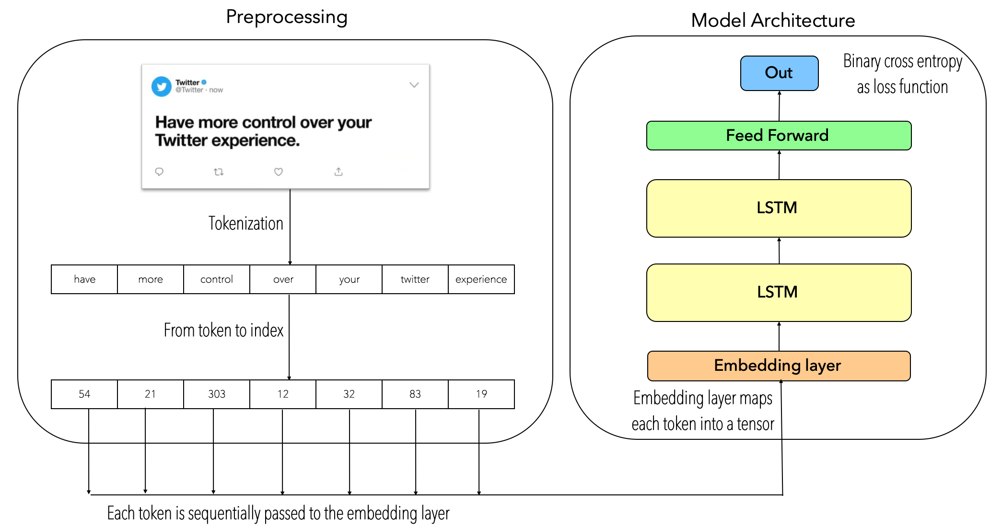
Embedding Layers
Performing the embedding is easy.
Can use from_pretrained() to use existing embedding spaces.
Add embedding layer as/near first layer.
Feed it sequences of tokens.
Outputs embedded values.
Num_tokens * emb_dimension.
We just need to have series of tokens.
No need to manage embedding dims.

Slide 10
Embedding Smarts
Having good embedding values is critical to performance.

Slide 11
LSTM Hope!
This dataset structure and model should hopefully be better for text predictions.
Each token is represented in a “smarter” way – our representation gets more of the true meaning of that token.
The features sent to the dense layers come from this sequential “reading”.
The LSTM’s memories should help with understanding.
Cell state should (hopefully) capture things earlier in a sentence that matter.
That state isn’t “overridden” with new stuff, like a plain RNN.
Our input to the model can just be a sequence of tokens.
Embedding layer will translate it to vector of meaning, this will be passed forward.

Slide 12
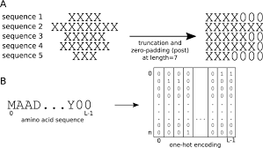
Padding
To allow documents of different lengths to be used in the same model we can pad.
This makes our data a nice cube shape. (rows * tokens * dims).
Padding is inserting a special character/0s to fill the dead space.
Can do it manually, it is just a loop.
Padding can be at start or end (or other, but we’ll ignore).
Padding at the start is used when generating data.
Pieces of text are random lengths, so we need to use something like this to handle all of our data.

Slide 13
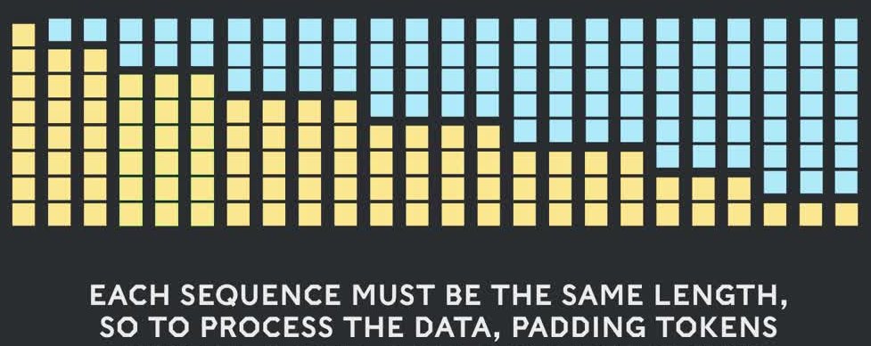
Post Padding
After padding, we have a usable dataset.
Each X value will be a fixed number of tokens before the current word.
The target is the next token, we can train.

Slide 14
Sequences
PyTorch also offers a more elaborate way to manage different length inputs – sequences.
Sequences can manage different lengths, without padding.
Saves processing time, we don’t need to worry about the padded part.
PyTorch provides padded and packed sequences to:
Keep batching efficient.
Ensure RNN/LSTM models only process real tokens.
Common workflow: pad → pack → model.

Slide 15
Creating Sequences
Packed sequences remove padded elements before computation
Created using pack_padded_sequence()
To pack the sequences, we need:
Actual sequence lengths.
Sequences are sorted by length or the enforce_sorted is False.
Allows for model to not deal with useless padding data.
Helps convergence in many cases.

Slide 16
Collate
Collate functions can be used to provide a batch, in some different way.
The dataloader is provided the function, and calls it to get data.
This function can do anything.
Ours will take the data and create the sequences.
Our collate will allow padding to be to max length of batch.
When the dataloader wants data, it’ll get a padded sequence, instead of a tensor.

Slide 17
NLP Classifications
Our LSTM model will perform similarly to CNN models when doing classification.
The recurrent layers will transform the sequence to features.
The dense layers will transform these to a prediction.
Remember, given these features, we can predict anything we set as target.
Bidirectional is more likely to be helpful here.

Slide 18
Multi-Label Classifications
Our predictions are determined by the output shape and the values we put there.
One thing we can do is multi-label classifications.
Predict membership of several classes, irrespective of each other.
E.g. is this person a runner, cyclist, swimmer, skier, etc…
Setup:
Each class gets its own output neuron.
Each uses a sigmoid individually (no softmax) to determine membership.
Each prediction is like a separate binary classification.

Slide 19
Vectorization Matters
How we generate embeddings matters depending on what we are doing.
Classification or sentiment models need only the meaningful words.
Generative text models need to capture and “understand” punctuation.
Generating embeddings for either task has different goals.
The embedding representation is roughly like data quality for tabular data.
We need to capture the features important for our prediction.
Quality of the representation matters as much or more than modelling.
There are many tokenizers/vectorizers/embedding models, results may vary.

Slide 20
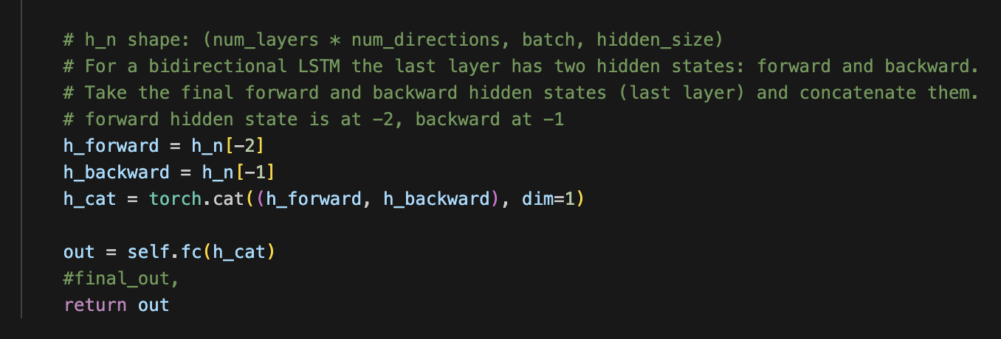
I went Bi, Wrong!
In the last lesson I said that pytorch will auto-combine the forward and backward direction.
I read this in a text.
That doesn’t seem to be true, I messed that up.
We want to combine the hidden state from the last forward and backward layer.

Slide 21
Other Text-y Uses of Models
NLP uses with neural networks have exploded over the last few years.
These concepts apply, but some details differ with modern commercial models.
Modern transformer models have a more elaborate, larger method of tracking relevance.
Translation.
Chatbots.
Document review.
Classification – is this document relevant to this lawsuit?
Marketing – mass review/twitter/comment processing for sentiment and trends.

Slide 22
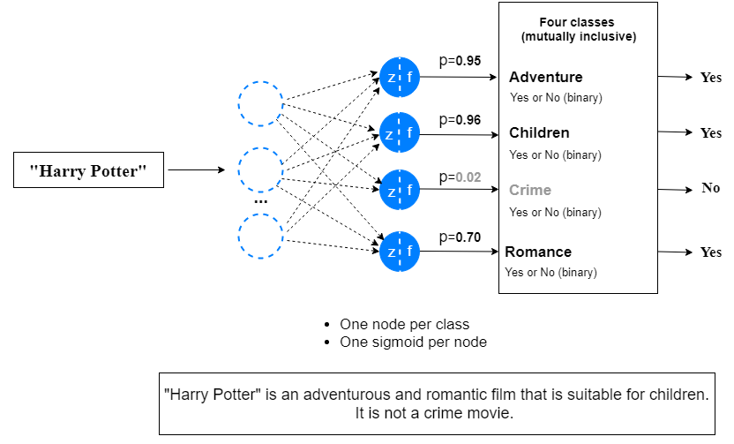
Multi-Label Classifications
We can set our models up to do multilabel classification easily.
Classification where record can be in 0 or more classes.
Setup:
Neuron per class.
Individual sigmoid activation.

Slide 23
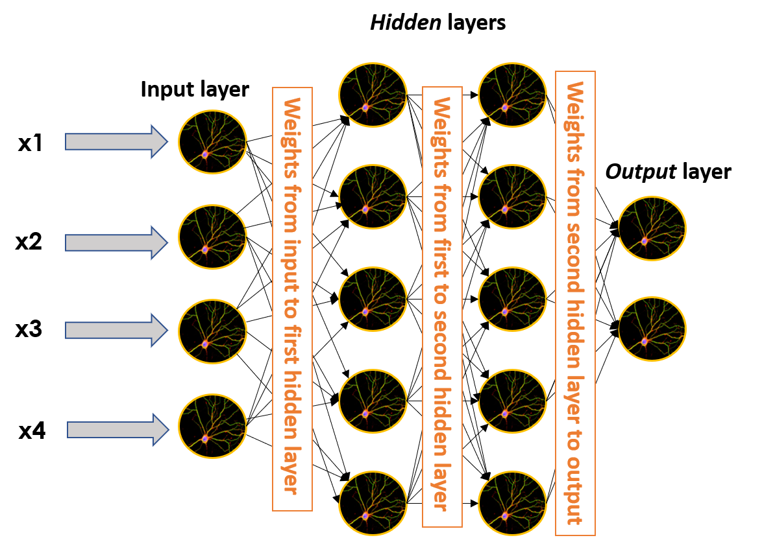
Neuro (Network) Plasticity
Basic example of how neural networks can predict anything.
Need to provide target and predictors.
Those could be basically anything (but do features have info?).
Models with 1+ hidden layers are universal approximators.
Model can theoretically replicate any function*.
Middle layers figure out how to make outputs from inputs.
With enough data/time/capacity learns well.
Capped by predictive info in the features, we don’t have it all.
Given preceding text, can you predict the next word (token).
Based on these pixel values, what is this image?

Slide 24
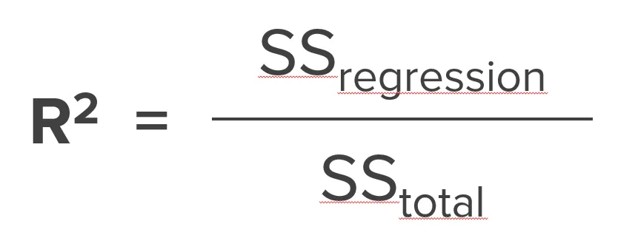
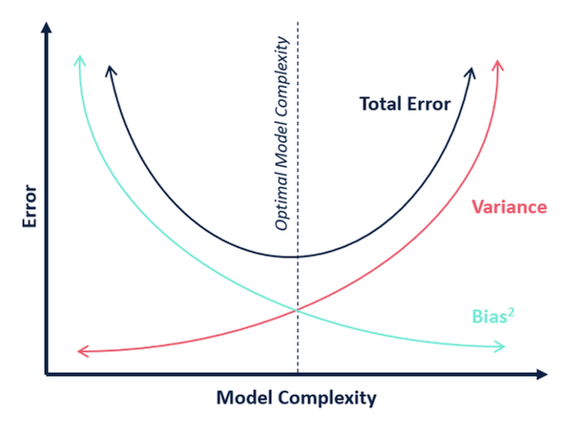
The R-Squared of Life
A perfect model drops bias and variance error to zero.
We will still have errors though.
Irreducible error still exists, we can’t model it away.
Can only make predictions given some (incomplete) inputs.
Those inputs don’t have all the info needed.
Real life scenarios make this more clear.
The irreducible error in inherent to the problem.
Inputs of previous text don’t give 100% info on next word.
Credit history doesn’t give 100% info on bankruptcy risk.
There are things that change outputs that aren’t in inputs.

Slide 25
LSTMs and NLP
LSTM models were good performers at text generation and similar, before transformers.
Given a sequence of tokens, what is the next token?
Transformer models are (much) smarter at tracking relevance (e.g. this word is important to the words that come later).
There’s not that strict of a separation of model types sometimes.
You can predict text stuff with CNNs and image stuff with RNNs.
Layers can also be mix and matched inside models – resnet image models have recurrent bits.

Slide 26
Conclusion
Classifications with NLP data is pretty simple once we handle the data.
Standardize lengths.
Pad the data, or use packed sequences to save processing time.
Generate vector representation with the embedding layer.
Create a normal LSTM model to capture text features and feed to dense layers.

