Slide 1
Tensorboard and Logistics

Slide 2
Housekeeping
Logistics and monitoring of training (there’s a revised workbook #25 for this).
More callback details.
Keras tuner.
Tensorboard.
Saving model progress.
Likely more transfer learning, depending on time/pace (#26).
Using models trained elsewhere.
Fine tuning models.

Slide 3
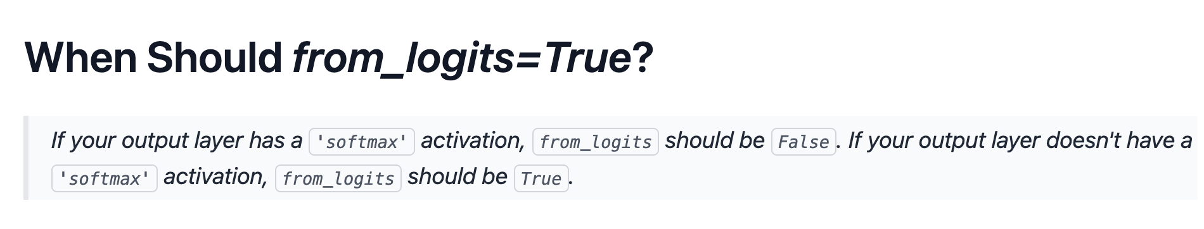
From Logits…
I saw a more succinct way to describe the logits thing:
This doesn’t matter all that much theoretically.
If softmax is there, it’ll normalize the probabilities out of 1.
If softmax isn’t there, the logits are non-normalized.
The loss calculation is different – that’s the parameter’s effect.

Slide 4
Managing Training
Training neural network models can take a long time and involve lots of resources.
Large models (GPT scale) can train for weeks on tens of thousands of GPUs.
One person probably doesn’t want to sit there and make sure it runs.
If someone pulls the plug, we don’t want to start over.
There are remote monitoring tools to help:
”Real” model training will happen on servers/clusters elsewhere.
We can interact through a web page instead of the computer itself.
We can start training, leave it be, and monitor it via a webpage.

Slide 5
Training Data and Disks

Slide 6
Generators
What happens if the size of the data is larger than memory?
Generators are another variety of datasets that we can use.
Generators “generate” data when demanded, automatically.
The easiest way to understand them is reading from disk:
We pass the generator instead of the data itself to a function.
Every time data is needed, the generator reads some part off of the hard drive and provides it.
To the model/fit, the generator is just the data. To the system, it only demands the resources needed for that ‘bit’ of work to happen.

Slide 7
Generator Madness
Since a generator provides data on-demand, we can add transformations, if needed.
The generator can provide variations of data each time it is asked.
Generators can do whatever we define to produce the data.
Usually read from disk.
We can also add some fun stuff…

Slide 8
Dataset Differences
Most useful neural networks are trained on large amounts of data.
The larger the data, the more the capabilities of neural networks become useful.
These datasets are not as easy to manage as a dataframe with small amounts.
Data will often exceed the memory of the computer or GPU.
“Swapping” (using a HD as ‘extra’ memory, like Windows does) is impractical here.
If we exceed the memory of the system, we are done.
We can create special purpose datasets that are smarter for neural networks.
Able to manage data that is larger than the available memory.
Able to manage some of the preparation work on their own to help efficiency.

Slide 9
Tensorflow Datasets
Tensorflow datasets are a container that hold data for TF models.
For our purposes, these will replace a dataframe.
The TF datasets are generally made by ‘aiming at’ data, not by ‘giving them’ data.
For images, we will point it at the directory on disk.
For other stuff, like text, video, databases, we’d use an equivalent.
The datasets are “smart” in some ways.
They can manage some work to maximize resource utilization.
Can build things like batch size into the data.
We generally need to get data ‘out’ of one to look at it – plot, calculate, etc…

Slide 10
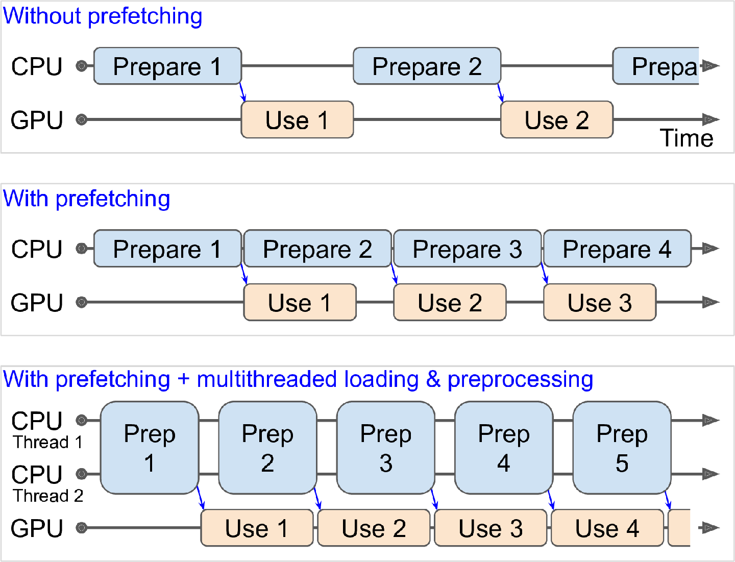
Goal – GPU and CPU are both Busy

Slide 11
Datasets in Tensorflow
When dealing with larger data, or non-tabular data we normally use a dataset.
For small data, it isn’t really critical or important.
We can make a tensorflow dataset from array/df data, there just isn’t really a need.
The dataset can be constructed by:
Aiming it at the source (usually a folder, for us).
Setting the parameters that belong to the dataset (if needed, these are performance related).
We can configure the pipeline to be efficient – load and process at once.
These datasets and pipelines are more customized than the sklearn.
In sklearn things are in memory, so most of these things aren’t considerations.

Slide 12
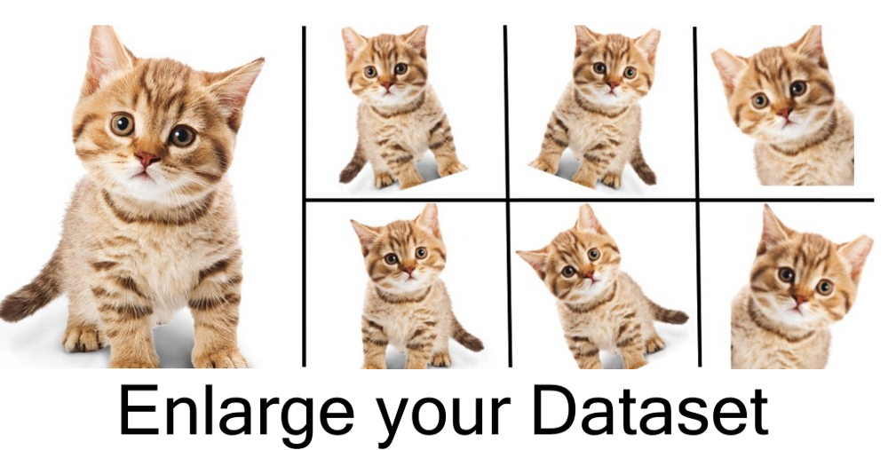
Data Augmentation
Recall the #1 rule of better predictions – get more data.
Images make it easy to generate more data for training.
Flip images.
Shift a window to parts of an image.
Easy to do when constructing a dataset.

Slide 13
Data Augmentation
Data augmentation is the creation of synthetic training data.
This sounds insane, but works more often that you’d think.
Data augmentation is actually simpler and easier with images, in most cases.
We generally want to do some variety of image recognition.
The things we want to recognize can ‘move around’ in an image, and the data is still good.
When using data augmentation for image data, it allows us to increase data size, without actually collecting and maintaining large datasets.
We can instead create generators – things that make data for the model, on demand.
These generators can apply data augmentation on the fly to make variations of images.

Slide 14
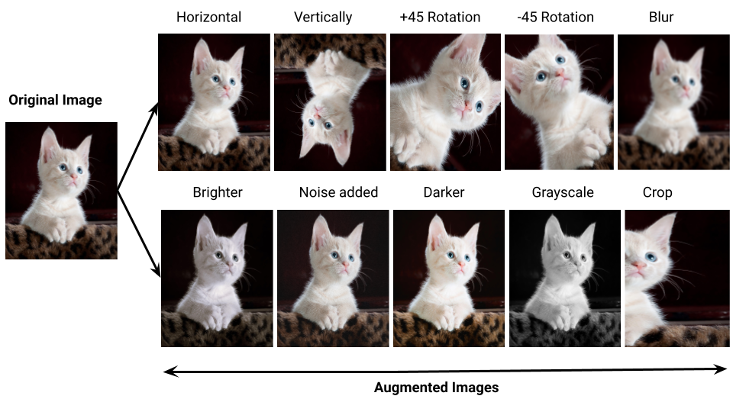

Slide 15
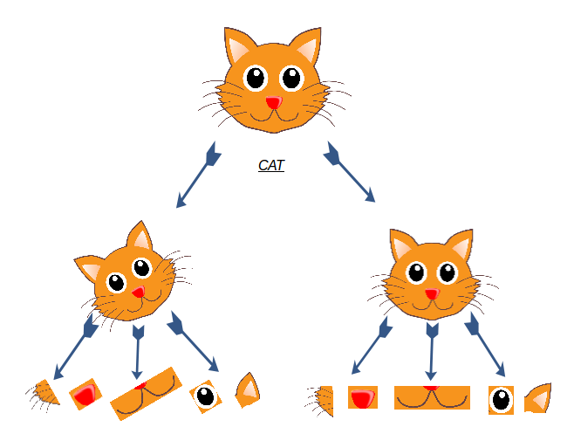

Slide 16
Monitoring and Managing Training

Slide 17
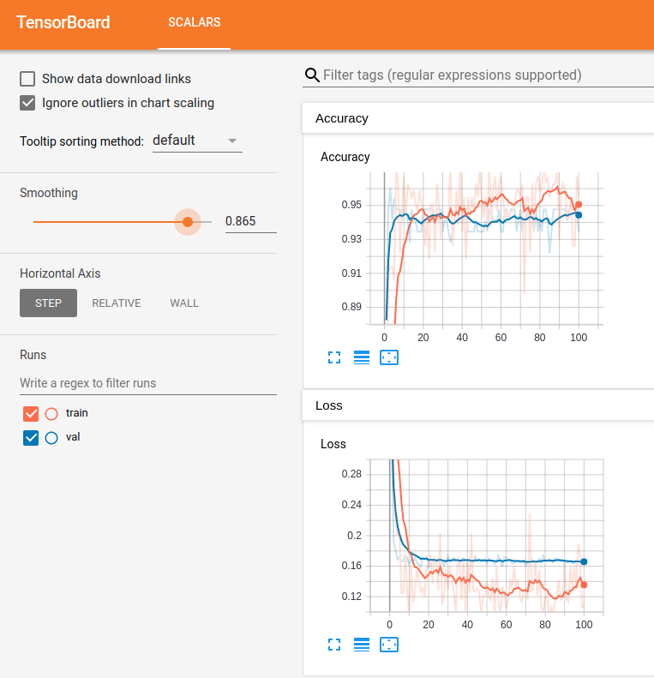
Tensorboard Monitoring
We are used to using several tools to monitor network results.
Epoch by epoch text printouts.
Plotting of loss from history.
Tensorboard is a tool from Keras that makes this process nicer.
We can use Tensorboard to get a “modern” dashboard to monitor training results.
In ‘real’ applications, we’d run tensorboard on the server, and connect to it via the web from anywhere.
You can try locally, it will tell you port when starting.

Slide 18
Tensorboard
Tensorboard can show lots of stuff and is largely customizable.
There are lots of examples of how to put things into it online.
We’ll use it for the basic monitoring mostly.
Key usage:
Start training on the server you’re using.
Launch tensorboard to monitor it.
Connect to the web page remotely while the server works.
Works mainly by monitoring log files.
We set a log file directory to monitor, and write logs there via callbacks.

Slide 19
Using Tensorboard
Tensorboard can do a lot of things and is very flexible.
Almost anything that you can write to a log can be sent to TB.
We can create custom callbacks that log whatever we care about.
Note: the tensorboard stuff is a little simpler/cleaner when we have one model only.
There’s a Boolean switch HPARAMS that controls which gets tensorboarded in the workbook

Slide 20
Tuning

Slide 21
Keras Tuner
Keras Tuner is a framework for tuning optimal neural networks.
Analagous-ish to a grid search in sklearn.
We can setup a search for the optimal hyperparameters and structure of a model:
Hyperparameters like the activation function or optimizer.
Structure like number of neurons, number of layers, or optional layers (e.g. dropout).
The idea is the same as a grid search optimization.

Slide 22
Keras Tuner Tools
The Keras tuner process is a little more involved than a gridsearch.
Model builder function:
We create a model building function that returns a compiled model.
This function has options built into it to create different models.
HP objects:
The tuner is based on a family of “hp” objects.
These function like a grid-searched value – we specify the type of choice and the options.
The object automatically changes options when we run a search.

Slide 23
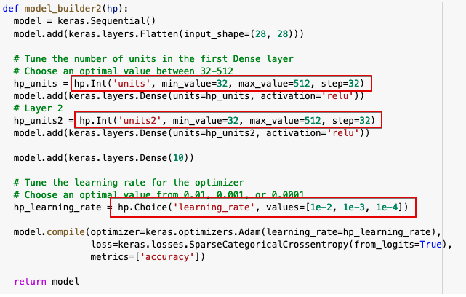
Hypermodel
The building function is a hypermodel.
The hp.STUFF items will automatically swap values when the search is done, and the function will return different models.
This one will try:
Different # of neurons in the two layers.
Different learning rates.
Anything that returns a model will work.
Adding varying layers (in workbook).
Complex conditions – e.g. really wide vs. really deep.

Slide 24
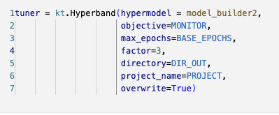
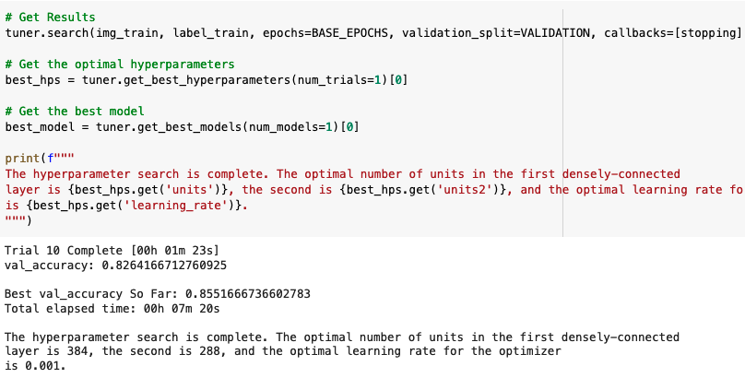
Running a Search
To find the best model configuration we define a “tuner”.
This is similar to a gridsearch object.
We set the tuner to have a hypermodel, along with options.
We replace “fit” with “search” and then get the results.
We have different search options:
Random – randomly pick a set of HP options for each model.
Bayesian – “smart” targeting of best combinations.
Hyperband – uses early stopping to identify the best HPs.
Works like a grid search with a cool output.

Slide 25
Making a Winner
After searching is done, we generally want to train a new model with:
All the data.
The optimal options that we just found.
The search process can take forever if the search space is too large.
We want to narrow the options prior to starting.
The Bayesian or Hyperband options will help a more efficient search.
We can still incorporate early stopping in the search.

Slide 26
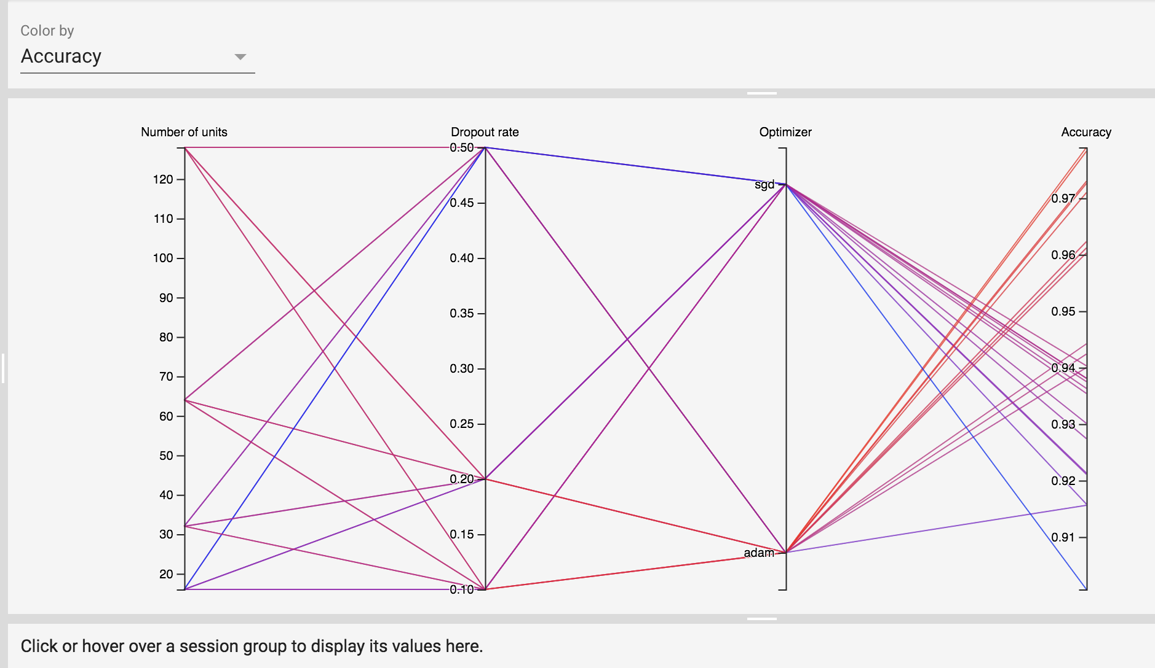
Tuning in Tensorboard
In Tensorboard we can use the HPARAMS section to check performance.
Visualizes the different executions through the HP choice in that model.
WE can see that ‘adam’ is best here.
Lower dropouts look better.
Units is not really clear.

Slide 27
Logging

Slide 28
Checkpoints
Another thing we can do with long training processes is to set checkpoints.
Checkpoints record the weights at specified points.
Usually as a callback each epoch.
Write the weights only if the current performance is the best we’ve seen.
We can load the saved weights and pickup training there.
If the process is interrupted, we don’t loose everything.
Note – on colab the environment is temporary, lasting data would be written elsewhere.
It will be fine for trying it now, but what you write won’t be permanent for eternity.
Google drive is an option, accessing it can be slightly annoying, we won’t do this.
On your machine, they’d be as permanent as anything.

Slide 29
Writing and Reading Checkpoints
We looked at saving models previously.
Saving weights can be far (orders of magnitude) smaller than saving a model.
To restore a model from weights we have to:
Create a model with the same structure – layers and # of neurons.
Load the weights into that model.
Things like the optimizer settings are not kept.
We can use this to predict, or we can train more starting with current weights.
The new training process already has better-than-starting weights.
We should progress from roughly the last epoch (with some variation).

Slide 30
Callback Mechanics
Most common things are doable with premade callbacks.
We can also create our own.
Generally triggered on some action like ‘on epoch end’.
We can put whatever we want or need in here.

Slide 31
Tuning CNN Models

Slide 32
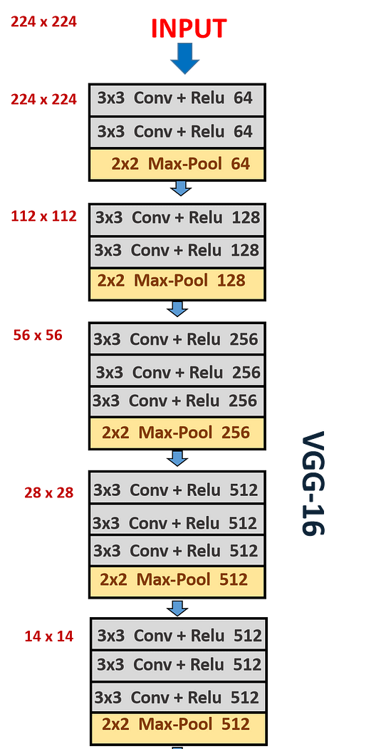
CNN Structure Notes
In general, the number of filters increases as we add layers.
The initial layers start with a higher definition (width vs. height).
Lower layers have a lower definition, due to the pooling layers.
The number of filters typically increases to continue capturing information through layers.
(Roughly, not literally) each layer ‘breaks’ a high-definition image into more lower definition images.

Slide 33
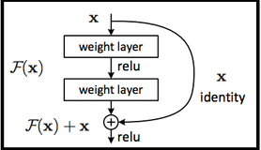
Complex Image Models
More advanced image recognition models can have more complex architectures.
Some are built to allow ‘skipping’ of layers, like the ResNet ones.
Data can be passed around some layers.
Allows the model to learn which ‘level’ of representation matters, and use that.
I.e. if a representation at some Conv level is good, it can be passed forward directly.
Other models also employ the other techniques in more ways.
E.g. different strides, padding, or pooling. These can be more useful as these models can better blend what the less common options find, with what the more common ones do.
Good, complex models are slow to train, and are generally based on extensions of what has worked previously. Catching up to large image/language/etc… models is near impossible.

Slide 34
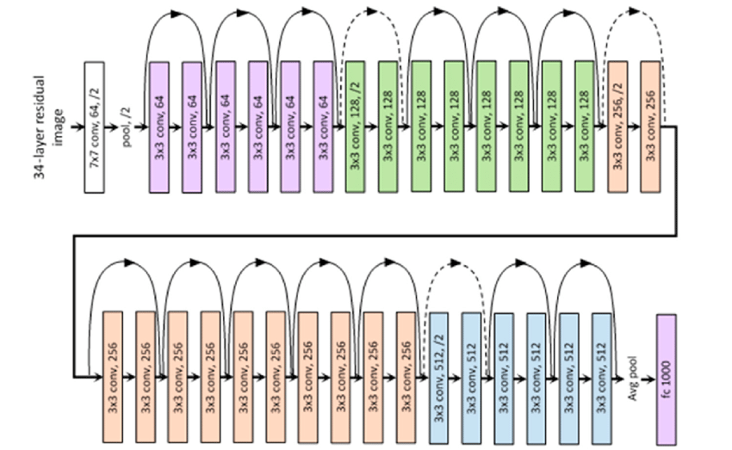

Slide 35
How and Why?
This mitigates vanishing/exploding gradients if the model is quite deep.
The concept of “holding some data from earlier, and combining it with new” is seen elsewhere.
RNN networks, that are the basis of NN time series and text models use it.
Transformer models like ChatGPT et.al. also do it, but differently.
Attempts to keep what matters as data is processed, and selectively drop what doesn’t.
‘What matters’ doesn’t necessarily happen only after the last layer, it can be uncovered at multiple points in the network. If the model finds something useful, it is ideal to just hand onto that data.

Slide 36
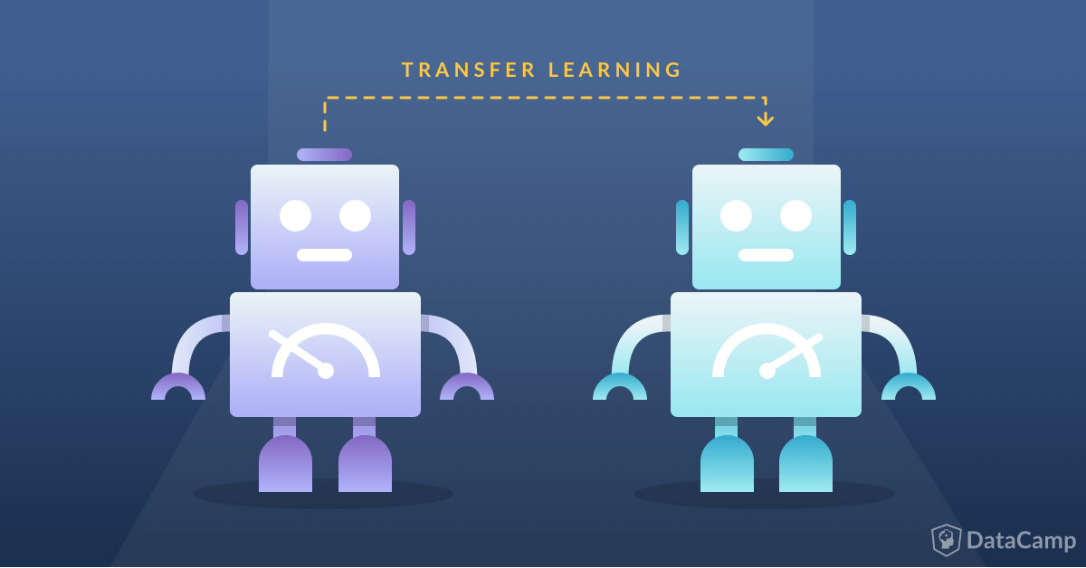
Transfer Learning

Slide 37
Changing a Model
We’ll look at this more later, but we can change/repurpose a model.
The CNN parts do feature extraction.
I.e. the output of the CNN layers is a set of features that ‘describes’ the image.
The dense part does the classification.
I.e. the dense layers take in those features and make a prediction.
What if we…. Kept the smart, trained, vision stuff, and fed it into our own classifier?
This is called transfer learning, and it is common, especially now with large models.
We can use the CNN part trained on massive data, and use what it “sees” in our model.

Slide 38
Intro to Transfers
Neural networks have some pronounced strengths and weaknesses.
Long time to train, big data needs, slow trial time…
Very accurate, good with unstructured data, adaptable…
Many neural network applications (image recognition, NLP stuff) have similar parts.
Seeing edges in an image is the same no matter what that image is.
We can split the model to use the convolutional part and add our own end:
The convolutional layers are trained on massive data, they extract image features from images.
The classifier makes classifications from those features, we add our own.
Transfer learning allows us to repurpose the power of pretrained models.

Slide 39
Loading External Models
Similar to how we can load weights from previous sessions, we can load entire models.
Many models that were trained on huge datasets are available to us.
Image models are most prevalent for this.
Ultimately, we can take pretrained models and tailor them to our use.
A process called transfer learning.
The initial bits of a CNN (the convolutional part) are fairly generic.
Extracting useful parts of an image – edges, contrast, shapes, etc…
The final bits of a CNN (the dense classifying part) is unique.
Given these features the conv. model found, assign a label prediction for class.
Transfer learning combines the two parts!

Slide 40
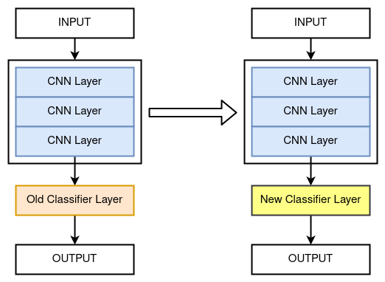

Slide 41
Using outside Models
“Which products will sell” is a prediction that is highly dependent on the specifics.
“What is that object in the picture” has many parts that are shared.
“Seeing” is a very transferable skill that the convolutional layers learn.
Breaking images into features that are useful for predicting benefits from data.
A model that was trained on lots of random images is probably better than a custom model trained on a little bit of targeted data (i.e. what we’d have).
We can take the “seeing” part and combine it with our specific “classifying” part.
The model learns to see “stuff” on massive datasets, then uses that to predict our data.
In most cases, this will probably be better than anything we can do.
Unless you have a huge cloud budget, or lots of GPUs and someone else paying the electric bill.

Slide 42
Using Transfer Learning
We can partially train the Frankenstein model to our new data.
The original convolutional layers are (for now) frozen, their weights are static.
The weights in our new layers get trained to predict our classes from the original model’s features.
The end result is ready to predict for us!

Slide 43
Conclusion
Using neural networks often involves larger scale tools, as the problems are larger.
Managing resources becomes a more primary concern:
A model can get very accurate, but likely needs time to do so.
Allowing for trials to be automated lets us do way more productive work.

