Slide 1
Housekeeping
Project – detect some images.
After this, the mechanics of doing the assignment should be covered.
Today:
More transfer learning – some examples of different variations.
Other examples of tensorboard, logging, etc…

Slide 2
AI is having a Moment…
I used to use an example in 3320 of the US military using large-scale AI to find targets.
Do a sweep of mass data collection – cell phones, demographic data, etc…
Identify which of those people are “terror likely”, then drone them.
The US military denied this and said all strikes are human decision based.
Raises the question of how people are being connected – which features matter.
Data is collected over a large population, so most is stuff you can get in bulk.
Terrorists, generally, hide their terrorist activities to the public.
If the target is “already labeled terrorist” and the features are “things about this population”, I’d bet that things like phone location and family/school/workplace connections weight heavily.
I’d really suspect that everyone killed is labeled as a “1” for the next training loop…

Slide 3
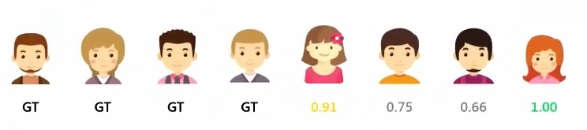
Enter “The Gospel”, “Lavender”, and “Where’s Daddy”?
Since the bombing in Gaza started, Israel’s use of AI in targeting has emerged.
https://www.972mag.com/lavender-ai-israeli-army-gaza/
Several systems are used to identify who and where should be bombed.
… examples of the “hundreds and thousands” of features that can increase an individual’s rating, such as being in a Whatsapp group with a known militant, changing cell phone every few months, and changing addresses frequently.”
The Lavender software analyzes information … of the 2.3 million residents of the Gaza Strip through … mass surveillance, then assesses and ranks the likelihood that each person is active in the military wing of Hamas or PIJ.
Reporting says that targets were identified at a fast rate, with near 0 human oversight.

Slide 4
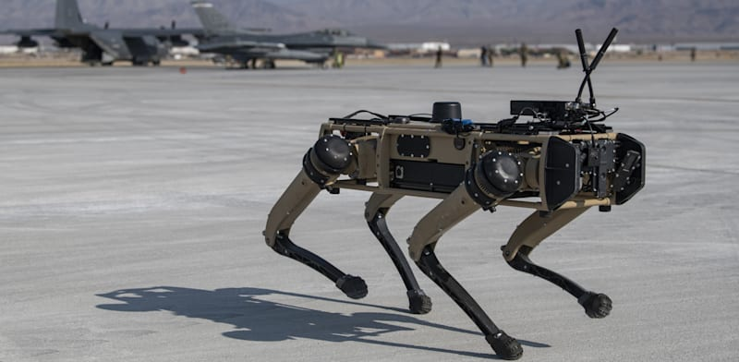
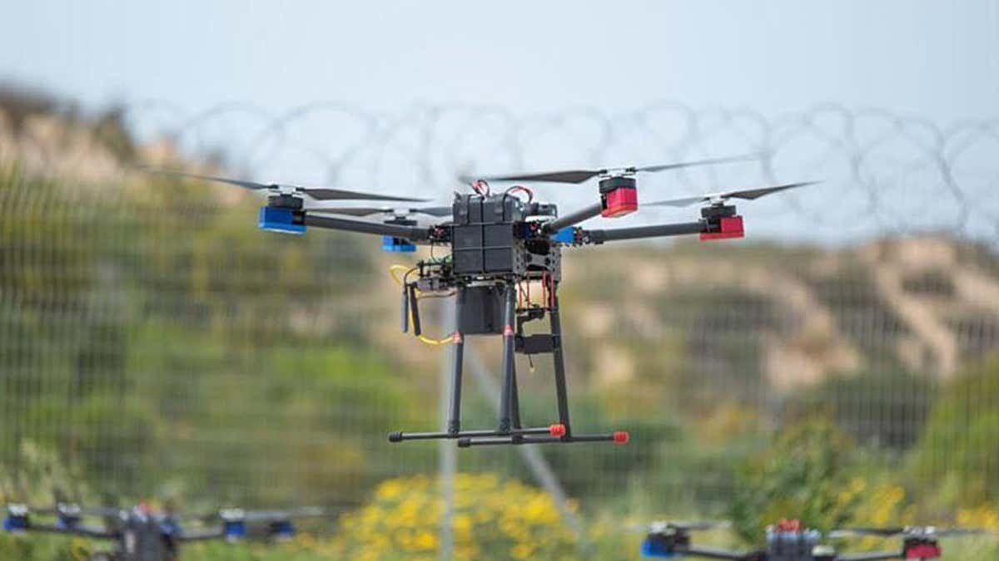
There’s also Robots…
AI control also extends to an assortment of robots.
These things may be human controlled now, but companies advertise that they can do everything autonomously.
Track people, enter building, lay in wait, kill – all via AI.
Regular consumer drones/robots can do all this now except for the “boom” part, so it is realistic.

Slide 5
And additional “AI is Going to do…”
Musk and crew have said they’ll use AI for find waste and excess employees.
There are no details on exactly how the AI is doing anything.

Slide 6
This will Likely be a problem…
Automated death robots seem somewhat concerning.
The bar to do all of this is also often quite low, so it won’t just be governments.
Details are rarely, if ever, public, but I’d guess that the important factors are tenuous.
Collecting metrics on if someone is “doing terrorism” is probably slow and hard.
A slightly earlier article said that targets identified went from 50/yr to 100/day.
Collecting location, phone, internet, etc… records is easy and fast.
Given tones of detailed data from ‘civilian’ sources, that’s probably what the models will learn.
Any false positives here are very bad, but I’d bet that most aren’t tracked as such.
If you ‘validate’ a bombing by confirming a prediction was correct, you get more people like that bombed.
I played HS basketball with a dude who immolated a person – we had very similar patterns of activity in-season…

Slide 7
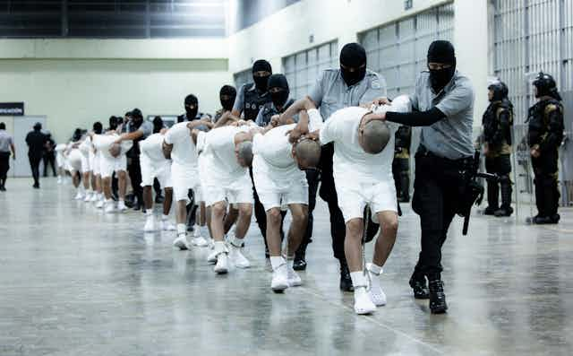
Watch out for Foucault’s Boomerang
Right now these things are being used as elements in war.
The other people are ‘bad’ so using better tools to kill them is good, or at least not questioned.
This will very likely boomerang on us, if it hasn’t already.
Those in charge don’t need to actively decide on anything, the AI just found a threat, and you don’t want to ignore an urgent threat…

Slide 8
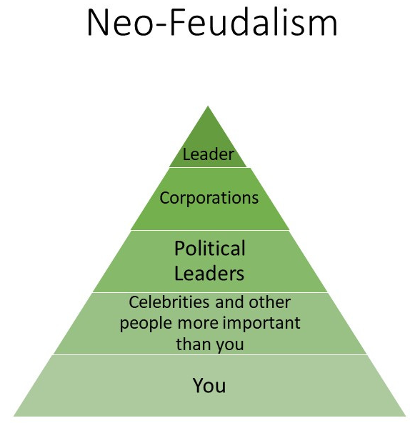
Technofeudalism
There’s a fundamental view of the tech oligarchs that society – democracy, normal people, social services, basic empathy is killing humanity and the brilliant must be unchained.
Having a world directed by some narcissistic, racist, sexist, eugenicist, anti-social weirdos who think every issue is solvable by their unique and solitary brilliance will be bad.
They are “pushing humanity forward” so any stopping them from doing what they dream is ”anti-human” in their minds - e.g. limiting AI development is worse than genocide.
Helping people is stealing resources from progress. Democracy lets ‘normal’ people constrain the natural geniuses from progressing. Cooperation is a risk to the weak.
Giving rights to everyone holds society back from letting the geniuses save us.
End goal here is feudalism – a chosen class with all authority, the rest submitting to their betters. See anything Technofeudalism, Curtis Yarvin, or Network State related.

Slide 9
Transfer Learning

Slide 10
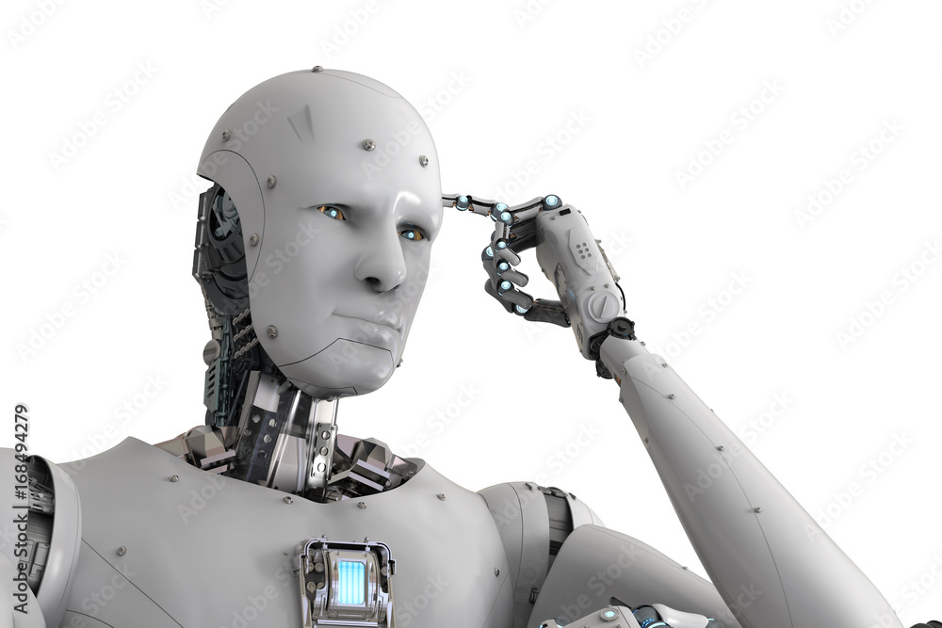
Model Training
As we’ve seen, training models can be time consuming.
For something like image recognition or language processing the dataset of stuff is immense.
Training state of the art models isn’t possible without serious resources.
Most people, including us, don’t have that.
What to do?

Slide 11
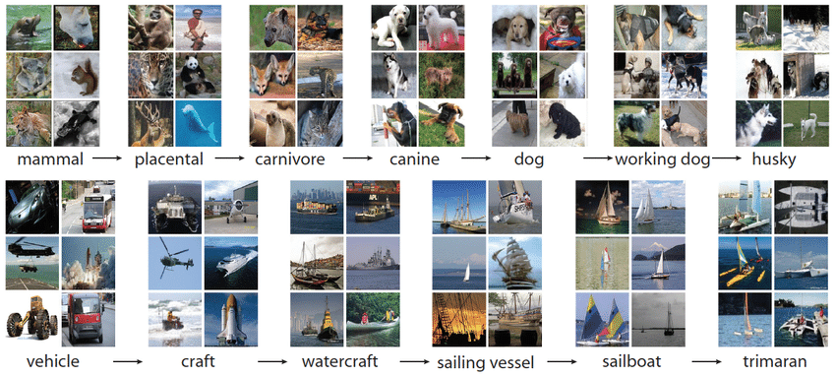
Big Data - Imagenet

Slide 12
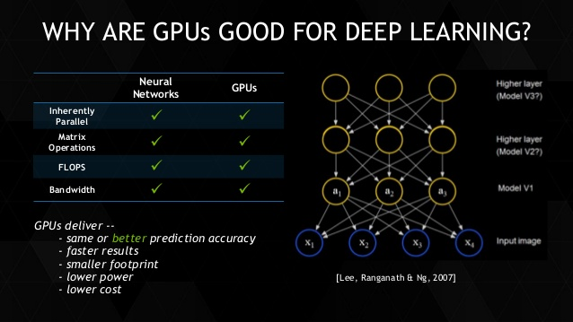
Big Processors

Slide 13
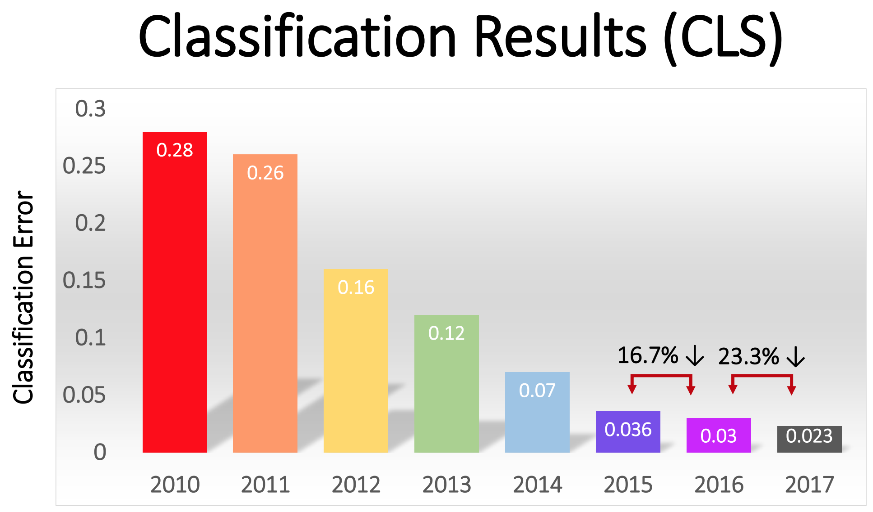

Slide 14
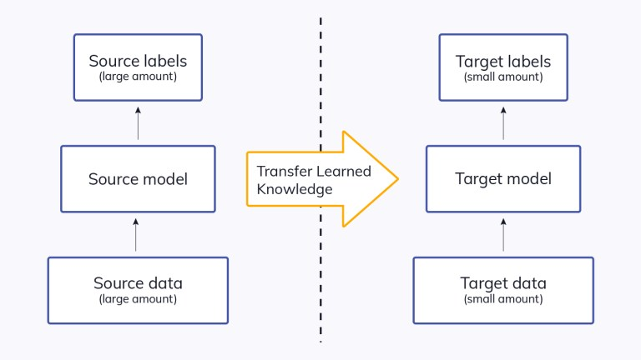
Transfer the Learning
Enter transfer learning!
We can use the training of other models and borrow those models for our applications.
Idea – many tasks are very similar, if a model is good at one thing, it will probably be good at something similar.
In the real world – I could ski before I could waterski. The idea of carving on an edge, balancing, weight transfer all help learning to water ski.

Slide 15
Pretrained Image Models
Image recognition models are trained on large datasets like ImageNet, which has over 1000 classes.
Massive dataset + large model + fast processor = accurate model.
“Seeing” objects is what the model is trained to do.
We can repurpose it to use those skills for other types of objects.
Keras packages many pretrained models that we can download and use.
The pretrained model’s abilities to extract features are well developed through training.
We aim to combine that feature detection with our specific challenge.

Slide 16
When does it work (or not)?
To no one’s surprise, the more similar the datasets, the better the transfer.
Common use cases are image recognition and language.
Natural Language Processing:
Language structure, word meanings, etc... are all very generalizable to other problems.
Word2Vec was a transfer learning application.
Image Processing:
Multiple pretrained models in tensorflow.
Datasets and complexity make training a model like this at home impractical.
Allows us to leverage similar scenarios to learn more quickly – like real life!

Slide 17
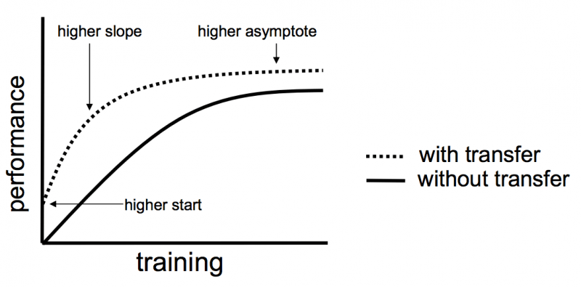

Slide 18
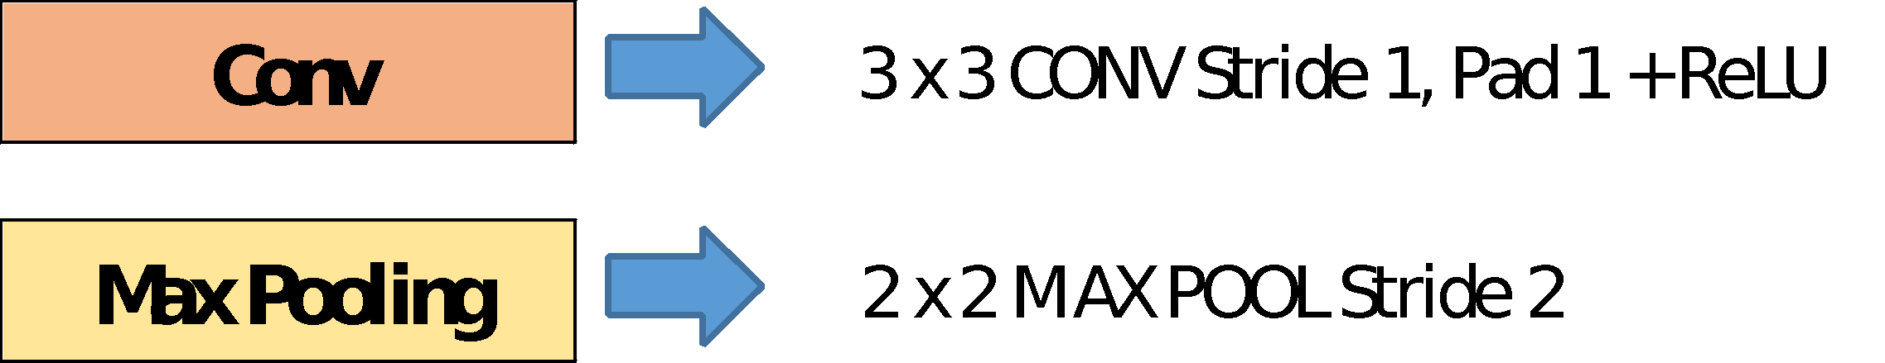
VGG16
VGG 16 patterned the general form of the models we typically use.
Contains 16 (“real”) layers.
Larger models, with 100s of layers, have surpassed in accuracy.
Trained on the very large Imagenet database.

Slide 19
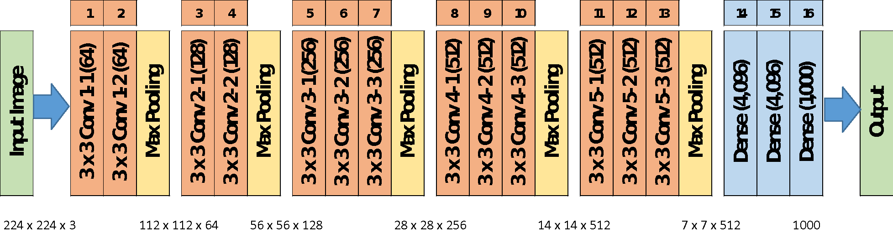
VGG16

Slide 20
Implementing Transfer Learning
Using transfer learning is relatively simple:
Load the pretrained model.
Remove the classification layer.
Download the pretrained weights for the model.
Set the layers to not be trained.
Adapt data, if needed, in preprocessing.
Attach our own classification layers.
Output layer + preceding dense layers.
Train on our data.
Only the added layers learn in training.
Optional – unlock and retrain to fine tune.
Gently adjust the model to more closely match our data.

Slide 21
Implementing Transfer Learning
Load pretrained model:
There are many well trained image recognition models that are shared, vgg is one.
When loading it we need to ensure we load the old weights.
We remove the “top” and set the model to not update its weights.
Add our own classifier:
The imagenet data is classified into ~1000 classes.
Our data has 5 classes.
After the trained model does the feature extraction, we want to classify those features into one of 5 classes.
This part does get trained – it learns how to use VGG’s features to make classifications.

Slide 22
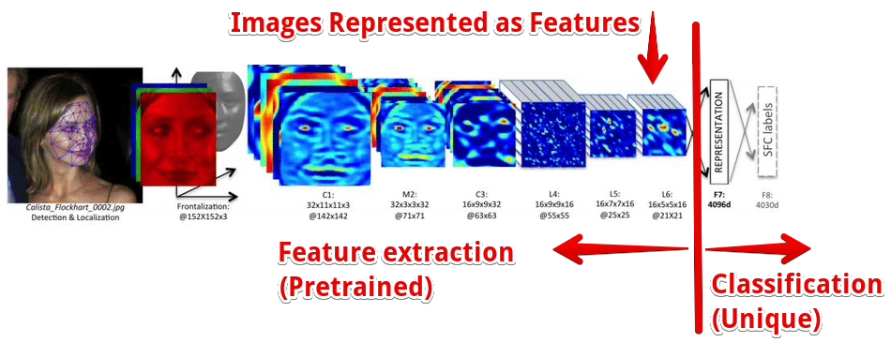

Slide 23
Fine Tuning
The fine-tuning step needs a bit more exploration.
When we initially use our transfer model we end up with:
Convolutional layers that are trained on the pretrained data.
Classification layers that have trained on our data.
Fine tuning updates the entire model to fit our data better:
Unlock the entire model, so it all learns in training.
Set the learning rate extremely low.
Retrain on all the data.
Result is that the entire model is slightly adjusted through some small training.

Slide 24
More Retraining
In addition to just removing the output bits, we can allow for retraining of other layers of the network.
This removes some of the existing training, making the model adapt more to our data.
If our dataset is more different from the original, this may help.
I.e. use the pretrained layers to extract image features at a higher level.
Train layers ourselves to bend the model towards our data.
We are removing some of the pretrained intelligence:
If our training set is small, we might end up behind where we started.

Slide 25
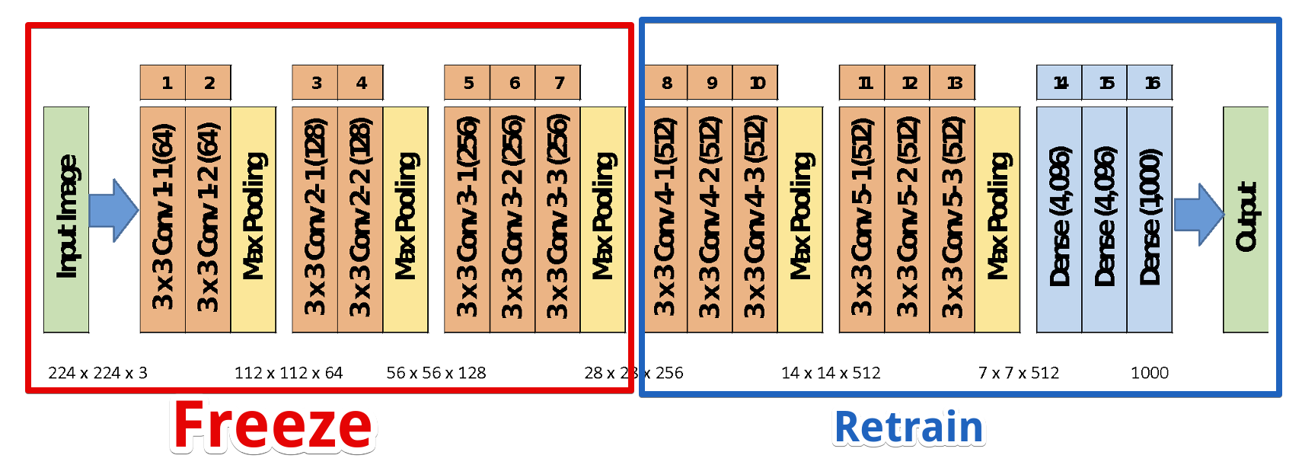
E.g. Freeze Part, retrain Part

Slide 26
Practical Applications
Transfer learning can help in many real-world scenarios.
Many problems are similar – image recognition, text processing.
Other problems are very large – self driving car.
I’d personally legislate that automakers must open-source their models and training data.
In either of these scenarios, being able to build on the learning of other models can both speed and improve performance.

Slide 27
NLP - Word2Vec
Word2Vec is an example of transferred learning.
Takes in some unstructured data, returns a feature set for a model.
Other NLP models such as Glove do similar things.
Utilizes pretrained models on massive amounts of text.
Google’s News dataset has over 100 billion words.
Language is pretty repetitive, so models can learn on massive sets of training data.
This super smart model can help us by applying that knowledge:
Better understanding of language, so better vectorization.
Ability to evaluate sentiment or similarity based on large dataset of training.

Slide 28
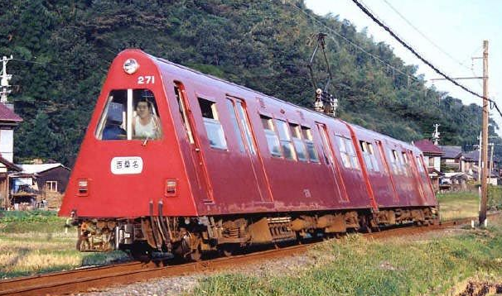
Image recognition
Image recognition is a massive application of transfer learning.
Images are large, so the processing required for accurate models is massive.
There is a large amount of transferability of skill.
E.g. you can recognize a dog you’ve never seen before as a dog.
You can recognize a weird train car as a train, and as a method of transport.
The CNN models used in images act to extract features, then predict based on those features.
Inherently splitable.
Kreas pretrained models: https://keras.io/api/applications/

Slide 29
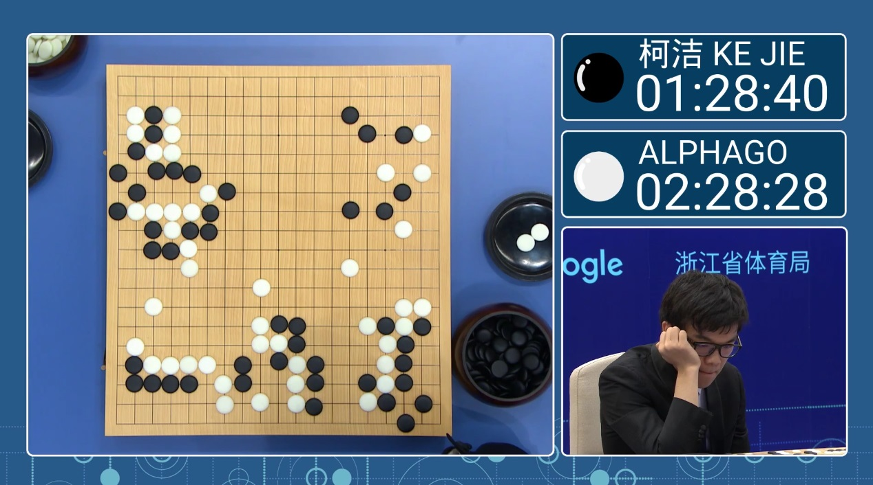
Gaming
A classic and old way to train game AI is to have it play itself.
Early machine learning was an IBM guy training a checkers machine.
One application of transfer learning is video gaming.
Watch AlphaGo: https://www.youtube.com/watch?v=WXuK6gekU1Y
The learning from one game can be applied to others.
Researchers are teaching AI system to learn games, based on other games:
https://www.wired.co.uk/article/deepmind-atari-learning-sequential-memory-ewc
"Previously, DQN had to learn how to play each game individually," the paper says. "Whereas augmenting the DQN agent with EWC allows it to learn many games in sequence without suffering from catastrophic forgetting."

Slide 30
Modern Transfer Learning
In the last couple of years, the focus on repurposing models is expanding.
Training a new model that is as good as an LLM or image model is impossible.
The data needs are not realistic for consumers.
The amount of training GPU power would cost millions.
Creating one large model can cost 10s of millions, or more.
The number of ways that we can adapt trained models has been expanding.
Large models have very high capacity, so they can learn lots of different stuff.
Here are some tuning/tweaking approaches that can tailor premade models.

Slide 31
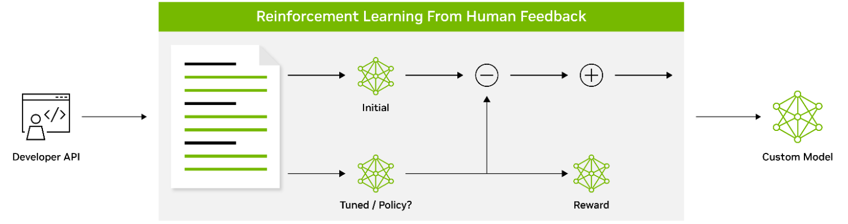
Reinforcement
Especially for generative models, we can use reinforcement.
Reinforcement learning is the domain of making models that learn in response to ‘grading’.
If the result is good, the model gets a ‘reward’, if not, a ‘penalty’.
This feedback is used by the model to tune its weights.
Often seen with humans or AI as the decider – generate 2 sentences, human picks best.
Motion models often incorporate this – hitting things is bad, middle of lane is good.

Slide 32
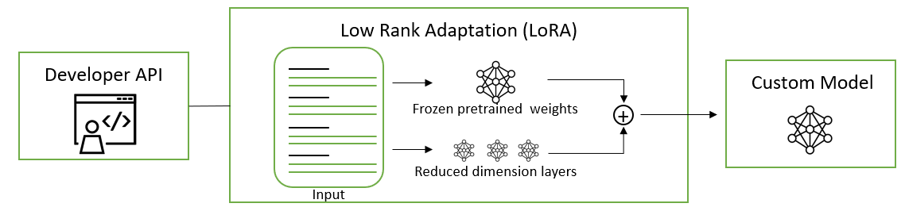
Parameter Efficient Fine Tuning (PEFT)
PEFT is a strategy to lock most weights, and only allow some to update.
If the important stuff updates, the model will learn.
The less is updated, the quicker it will go.
There are several strategies, which are mathematically different.
Generally involves adding/changing something to limit training to certain areas.
This is commonly seen with people reusing LLMs from places like HuggingFace.

Slide 33
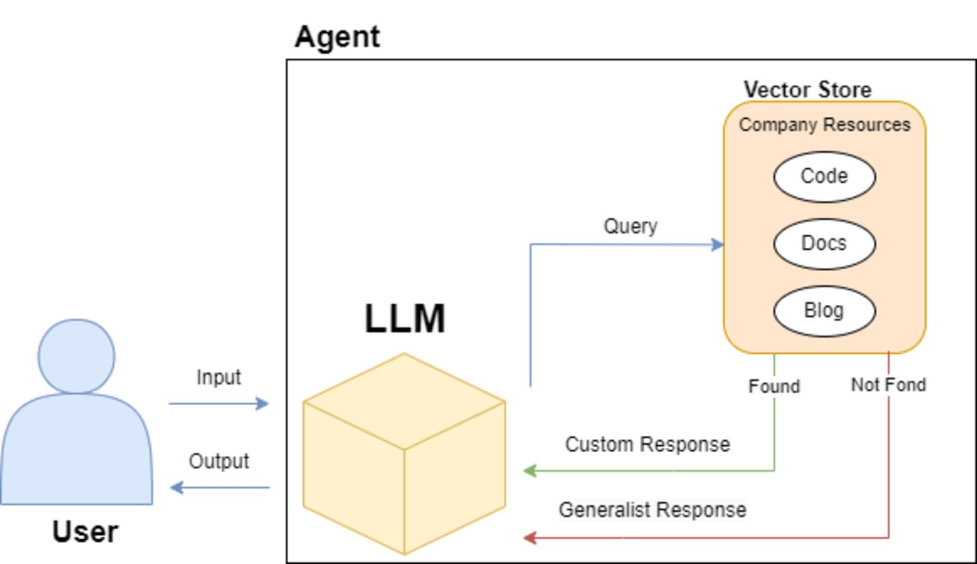
AGENTS
Agents wrap a trained model (usually an LLM) in a structure for a specific domain.
The ‘wrapper’ do anything:
Provide context like RAG.
Translate inputs or outputs.
Augment queries, etc…
Search custom information first.
From the outside, it is ‘custom’.
The speaker guy referenced this (probs).
The vector database stores the embedding values of items.

Slide 34
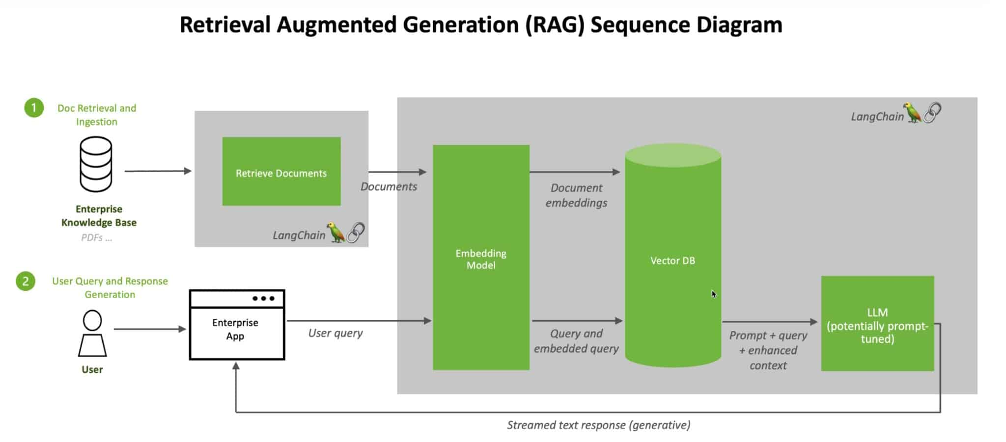
Language Models
Retrieval-Augmented Generation (RAG) can be used to tailor language models.
Provide a scenario-specific context to a trained model for that prediction.
Kind of like “answer this, given this body of knowledge”.
This isn’t retraining, but kind of similar – the question is preseeded with context.

Slide 35
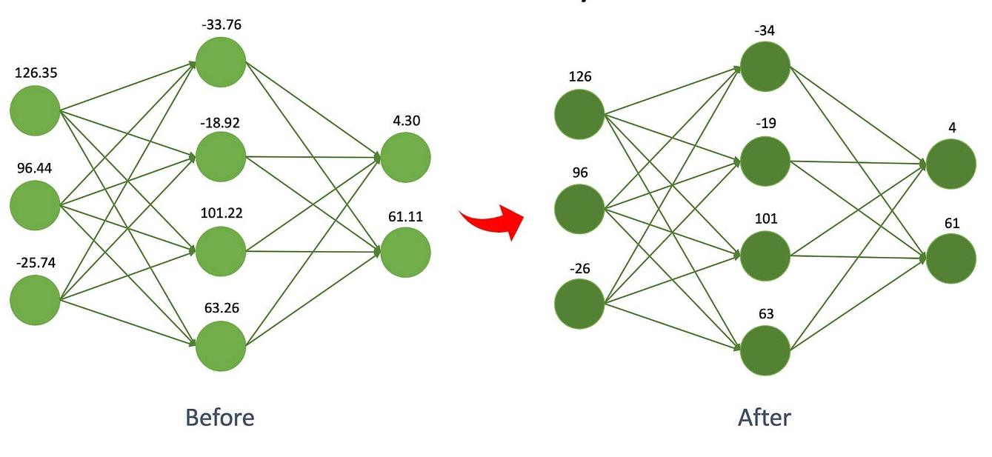
Quantization
Quantization is reducing the precision of the numbers in the model.
There are lots of very long numbers, they need to be calculated regularly.
If these numbers get smaller (in size, not value), those calculations are quicker.
Large models are usually ‘quantized’ if being released to the public, so they work on normal GPUs.
Quality can be kept high, while size drops.
More quantizing, worse model.
Smaller models are trainable on more systems.

Slide 36
Tuning models for Fun and Profit
Adjusting/customizing/tuning existing models will be a very important thing.
The best models are simply unmatchable without a large budget – this may increase.
In the future, assembling data that isn’t AI generated, at scale, may be very hard.
I’d suspect that people who learn how to smartly retrain models will be a large career.
In many/most cases the limitation is the amount of GPU/RAM/time we can have.
Every one of these tailoring choices is a large compromise.
Amount/quality of our data, GPU/RAM, time, budget, current model performance, # trials…
People are constantly working on this all over, so it changes quickly.
Things are being developed both based on theory, and empirical observation.
Changes all through the pipeline data->embedding->model->model internals are happening.

Slide 37
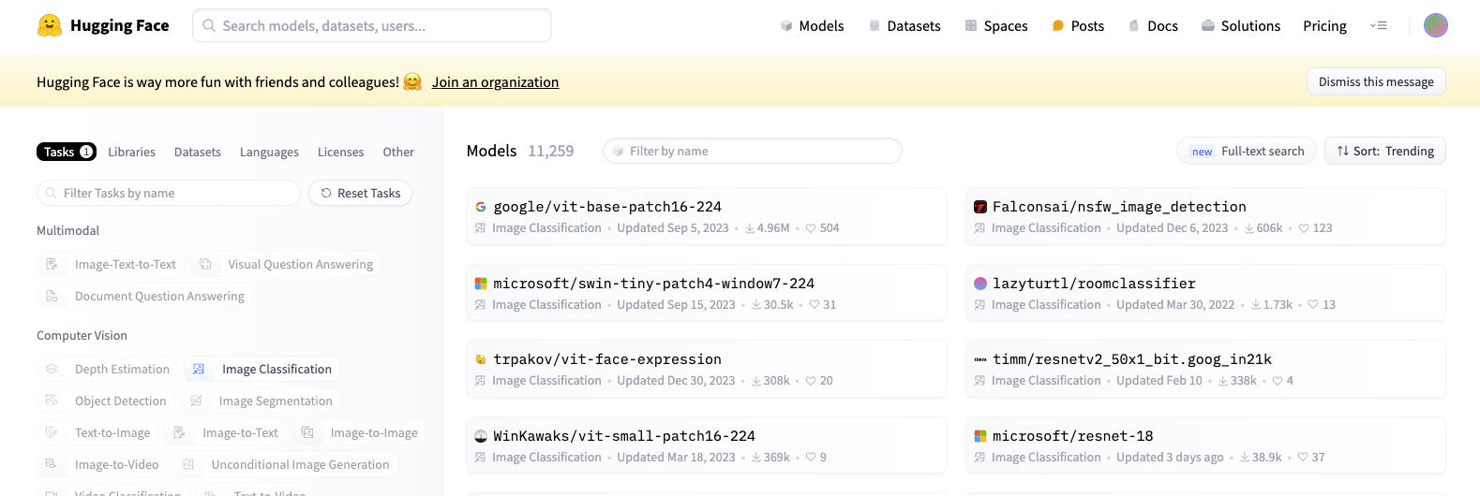
Some stuff is still Public…
Much of the stuff that we use in data science was created for free.
This will probably change, but a decent amount of stuff still is on sites like HuggingFace.
You can download assorted near state-of-the-art models and use/tune them now.
If this makes you super excited, learning some PyTorch is a good summer project.

