Slide 1
Housekeeping
Today:
Regression trees (in the decision tree parts of ch 2 of text, there’s not lots on regression specifically)
Depending on time, possibly stochastic gradient descent.
Probably not, this is a natural split point. If you guys demand it and threaten me if we don’t do gradient descent, then we will.
Assignment submission note:
I can get your submission from GitHub (assuming you clicked the classroom link).
I extended the due date a bit – if you need some practice, use this time; if not, get it done. As you do…
In Brightspace, please submit your github username in the assignment, when I get that, I’ll mark it.

Slide 2
Practice, In General
For the most part, the sklearn tools are interchangeable.
This makes it easy to practice if you need more than the built-in ones:
Pretty much any other dataset can be used – make a model, include whatever you’re unsure of in the pipeline, see the results.
One caveat is data with specific characteristics – imbalanced data, explicitly non-linear, etc…
Sklearn make datasets – module with methods to make data, including specific types.
Seaborn and sklearn both have built in datasets, just google for an example of loading.
I recommend starting basic if you’re stuck – can I make a model, then expand slowly.
E.g. a multi-path pipeline (cat/num) may be complex, we can test one half of features, then add…
If you’re unsure past this (like you need some specific example), please ask.

Slide 3
Regression Trees

Slide 4
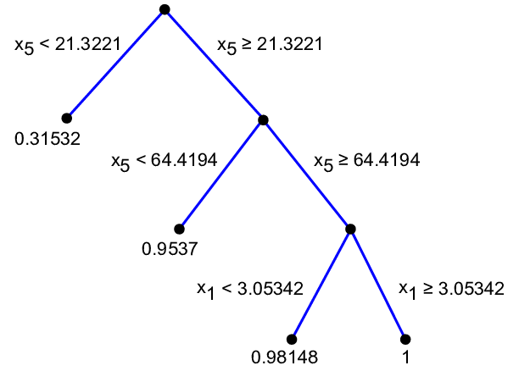
Trees
Thus far we’ve only looked at classification trees.
We can use a tree to do regression as well.
Practical usage is not really any different in sklearn.
Interchangeable with other regression models.
The logic of how a tree works remains the same, some details change.
Note: the features for class/reg trees can always be anything, type is referring to the target only.

Slide 5
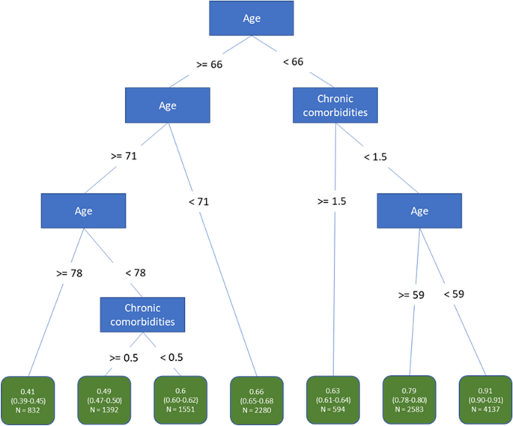
Tree Changes
The ‘purity’ (entropy/gini) of each split becomes the mean squared error.
Instead of finding a split to maximize purity, it looks for one to minimize MSE.
The predication of each leaf node is a value, not a class.
In classification trees, the majority class in a leaf is its value.
In regression trees, the mean of the records in it is its value.

Slide 6

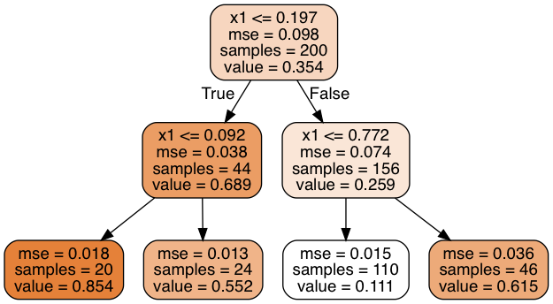
Deciding Splits
The split decision in a classification tree is based on the purity of the resulting nodes.
I.e. the goal is to split all True values from all False values.
The feature and split point (if numeric) are whatever does the best job of discriminating.
The split decision in a regression tree is based on the MSE of the result.
The algorithm will split the data so the MSE of the two nodes is minimized.
Model still looks for ‘sameness’ but distance based instead of T/F value of same.
Note: the concept of having an algorithm work to minimize/maximize something, and allowing that something (cost) to change, is common in machine learning.

Slide 7
Leaf Node Predictions
Just like a classification tree, the regression tree predicts based on the value of the final leaf node.
In a classification tree it is the predominant class of that node.
In a regression tree it is the mean of the values in that node.

Slide 8
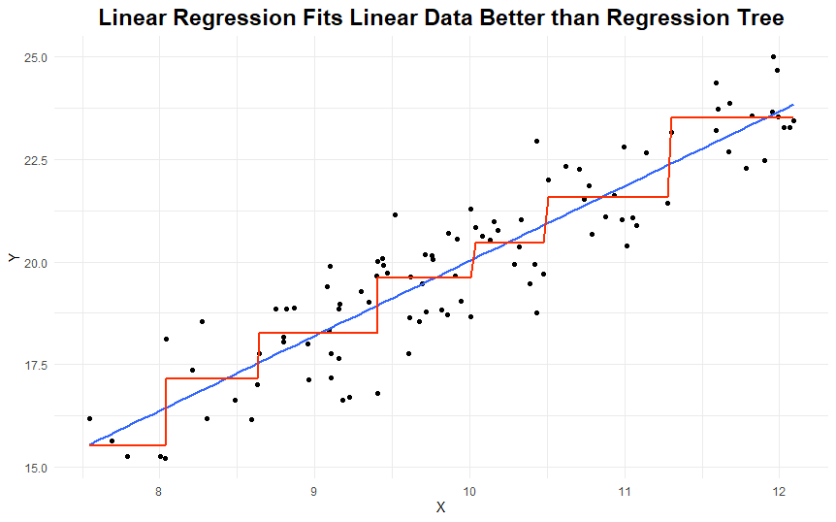
Regression Tree results
The predictions of a regression tree are different from a linear regression – they are discreet.
A linear regression’s predictions are continuous.
Each ‘step’ of the line is one leaf node.
Regression trees are limited by this:
They can’t extrapolate beyond data they see.
Only good over a limited range of inputs.
The number of possible predictions is constrained.
Regression trees can adapt to any relationship “shape”, not just linear.
# leafs = # of steps in a graph.

Slide 9
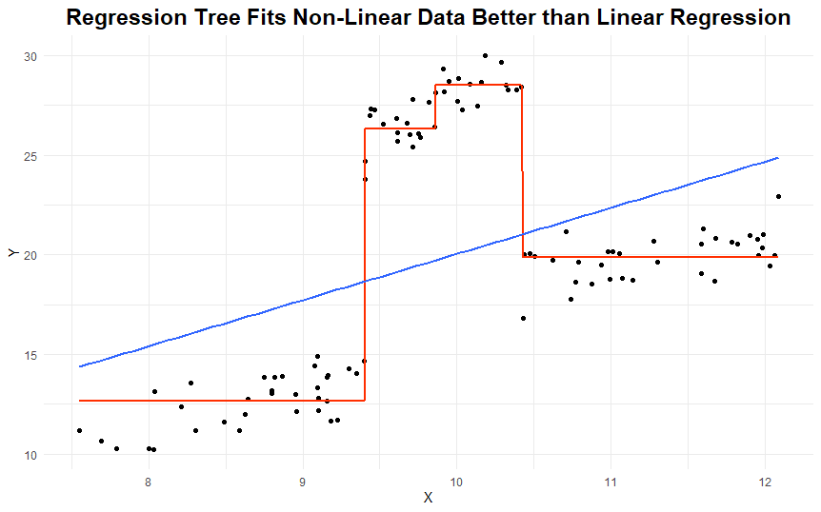
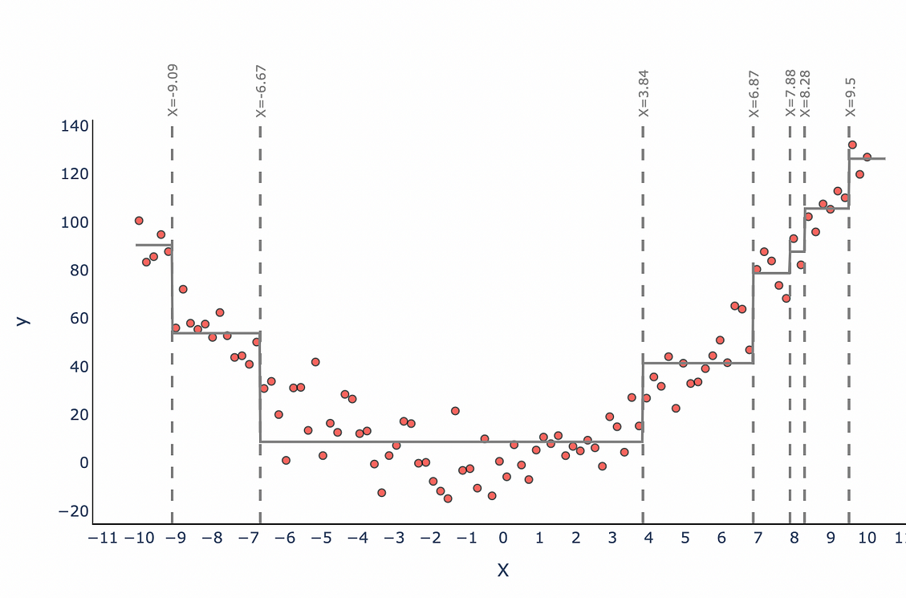
Non-Linear Relationships

Slide 10
Go Back to Extrapolation – Keep Going…
The inability to extrapolate is one of the stat-y things we can notice in EDA.
The properties of the data are going to impact the performance of models.
We can only make predictions that are the mean of previous target results.
Scenario 1 - Predicting student performance in school.
The range of the target is 0 to 100 (or 0-4 GPA), we have records all over that range.
Scenario 2 – Predicting total sales in dollars of a new car we developed.
The range of the target is 0 to unknown. Our training data likely doesn’t blanket the range.
Training data likely previous models, competitor cars, etc…
If our car is a huge hit, we can’t predict “off the charts” results – linear regression could.
These types of things can help guide model choice, are often subtle to notice.

Slide 11
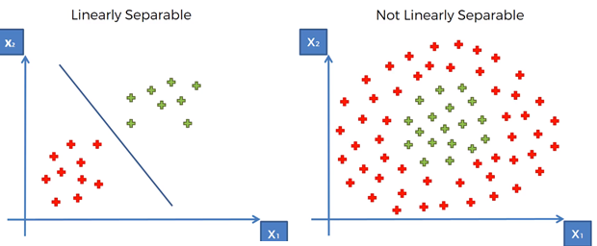
Another example
We’ll explore this more when we hit SVM’s, but data-model matching (kind of) matters.
Trees can adapt to data on the right, but can’t project to data outside its inputs.
Data exploration/stats knowledge can initially guide this, then performance can finish it.

Slide 12
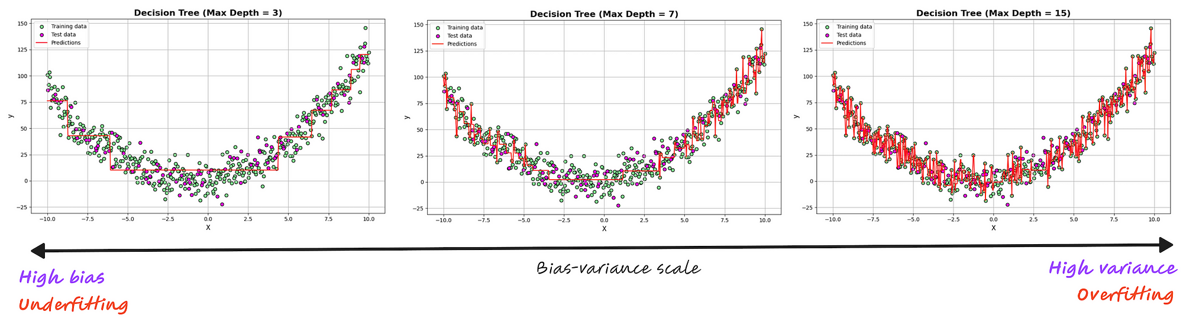
Regression Tree Fits
Like a classification tree, regression trees will overfit without limits.
For regression, that can mean one node per output value (i.e. the model gets MSE near 0)
Anti-overfitting things like HP limits, pruning, or forests are maybe more important here.

Slide 13
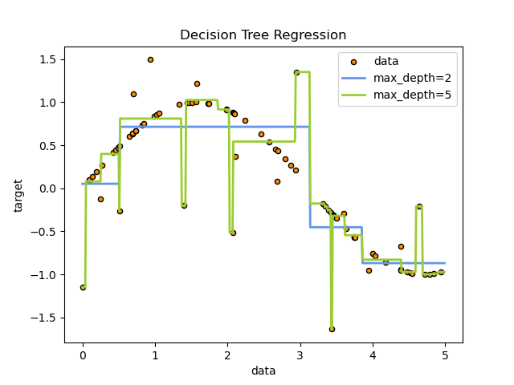
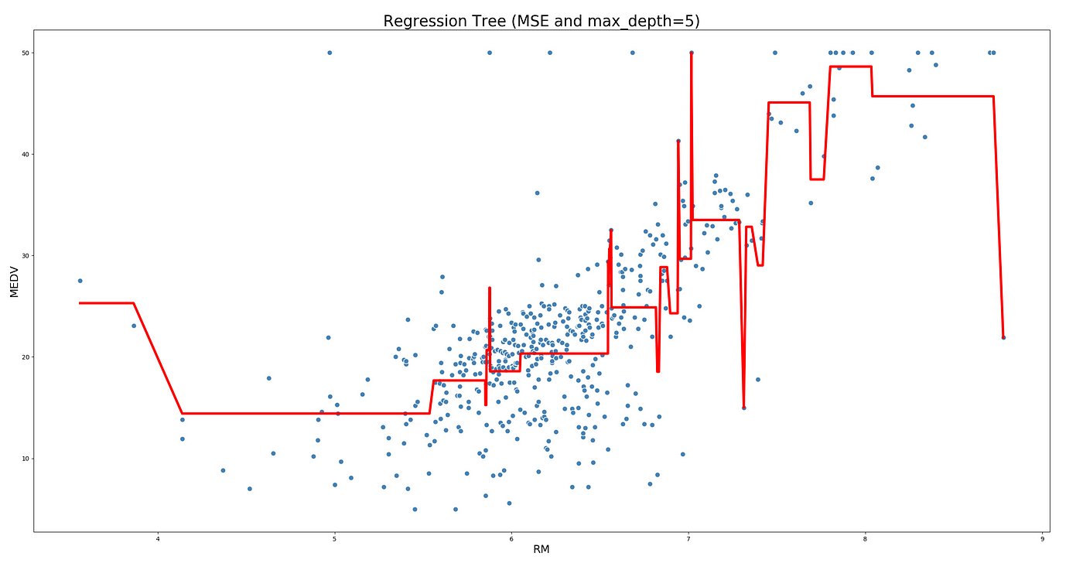
Overfits – Extreme ‘Jumps’

Slide 14
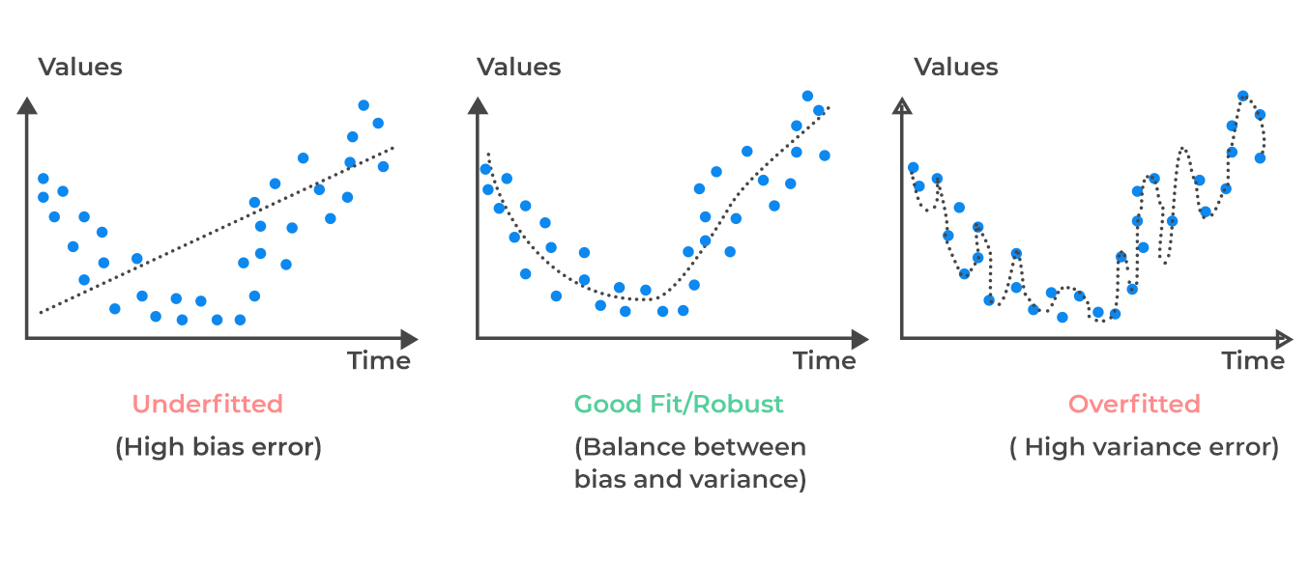
Fit Errors in Regression Trees
Reg. trees can make over/underfits explicit.
Underfit (bias error):
Model can’t learn enough, is too gen.
Model can’t split nodes to red. error where it could.
Overfit (variance error):
Model learned too much, isn’t generalizable.
Model could split too much to avoid error.
Wide swings in predictions with small input diffs.
Underfit models treat odd values like exceptions, overfit models treat them like mandates.

Slide 15
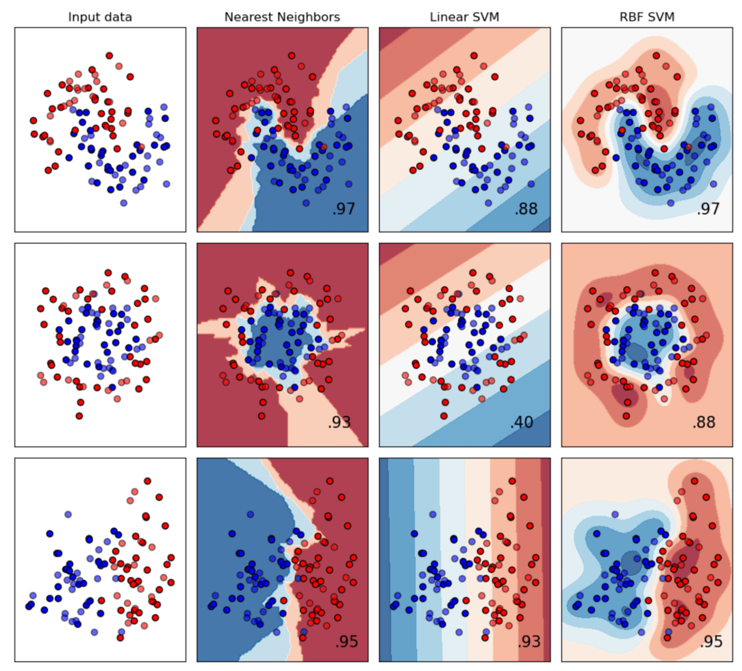
Spot Check - Visualizations
In machine learning we often do visualizations and talk about things in 2D/3D, like here.
The 2D is usually a simplification to represent aspects of the data:
Taking only a couple of the dimensions from the original data.
Using some technique to map the data to lower dimensions for display.
The concepts are the same, but this simplification lets us see it in terms we understand.
Separability – the ability of a classifier to divide A and B – literally a line dividing points.
Relationships (particularly linear) – when we plot things, is it linear in 2D.
Loss plots – moistly for later on.
This language/display is common – we are representing high dimension data in 2D.
If it doesn’t make sense, please interrupt/ask.

Slide 16
Tuning a Regression Tree
Tuning a regression tree for better performance is the same as a classification tree.
Hyperparameters:
Like a classification tree, most are settings to restrict growth.
The error is usually MSE, but can be changed to others like absolute value.
Still use a grid search to hunt for optimal values.
Pruning:
Pruning works in the same way as with classification, only the metrics change.

Slide 17
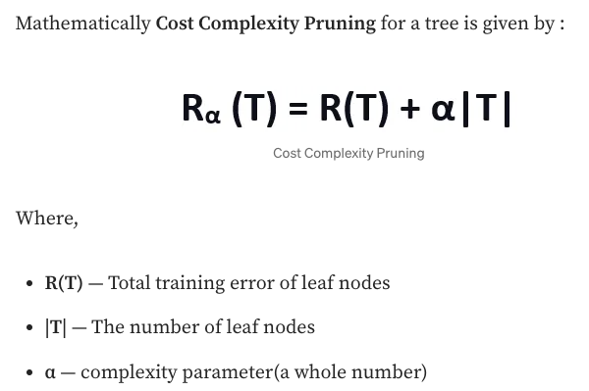
Cost Complexity Pruning
When looking at classification trees we saw pruning.
Pruning is a form of regularization – a technique to reduce variance in a model.
Regularization adds a ‘penalty’ term to the cost.
Instead of minimizing cost, minimize cost + penalty.
The penalty here is a ([HP constant] * [# leaf nodes]).
Acts to increase the cost as the tree grows larger.
For the tree to grow, the cost needs to shrink enough:
In a normal tree, any improvement will make a split.
With pruning, improvements need to exceed the penalty.

Slide 18
Pruning in Practice
Suppose:
A node has an MSE of 4 right now.
Splitting will yield a weighted average MSE of 3.5.
This split only happen if the penalty term is < .5 – if not, the improvement is too small to be worth it.
Pruning limits overfitting in a similar way to other techniques, by limiting growth of the model.
We don’t really know ahead of time which option (depth, split HPs, pruning) will be best.
A grid search testing different options will probably be the best.
Incentivizes a model that is both correct and small.
Both growing (adding complexity to the model) and being wrong will negatively impact the cost.
Algorithm doesn’t look for the most accurate tree, it looks for the one with the least loss, as defined here.

Slide 19
Regression Trees
Regression tree strengths and weaknesses are similar to classification trees:
Strengths: adapt to any relationship, able to be very accurate, explainable, fast.
Weaknesses: overfitting by default, improvements limit interpretability, limited output values.
If the output domain is limited, relationships in data are non-linear, and interpretability is important, reg trees are a strong option.
In most other cases, some other model will likely win out.
Trees are more common in classification.
Regression trees are also commonly used in gradient boosting models that are top class.
The concepts of model size, fitting, HP tuning, regularization, and cost carry over to other models.
The concepts of a penalty, regularization, and measuring the overall ‘cost’ will be big later.

Slide 20
Trees!
Trees are a commonly used machine learning model:
Supervised learning, can do classification and regression.
Able to handle non-linear relationships well – very adaptable to complex relationships.
Able to be transparent, clear, and explained – good where a black box is disallowed.
Trees tend to overfit if not limited – will keep improving to 100% training accuracy.
Hyperparameter tuning and grid searches in a pipeline – test multiple options for best.
Regularization (ccp) – limiting growth by penalizing a larger model as well as an inaccurate one.
Ensembles – combine multiple trees to mitigate their weaknesses. Bootstrapping and bagging.
Future models will combine trees in series for similar reasons.
Other model types do the same thing, but they’re harder to ‘see’ the inner workings.

