Slide 1
Housekeeping
Probability, conditional probability, and (potentially) Bayes.
  Please be honest about what makes sense, we’ll see how far we can get.
  Largely example based, the core theory of probability is pretty simple.
For test things, conditional probability is fair game, after that is off.
We’ll finish the topic next Monday, the last class.
  We’ll cover the actual sklearn model then.
  We (probably) won’t get to deriving it, that’s worth a read through (w.b.32).

Slide 2
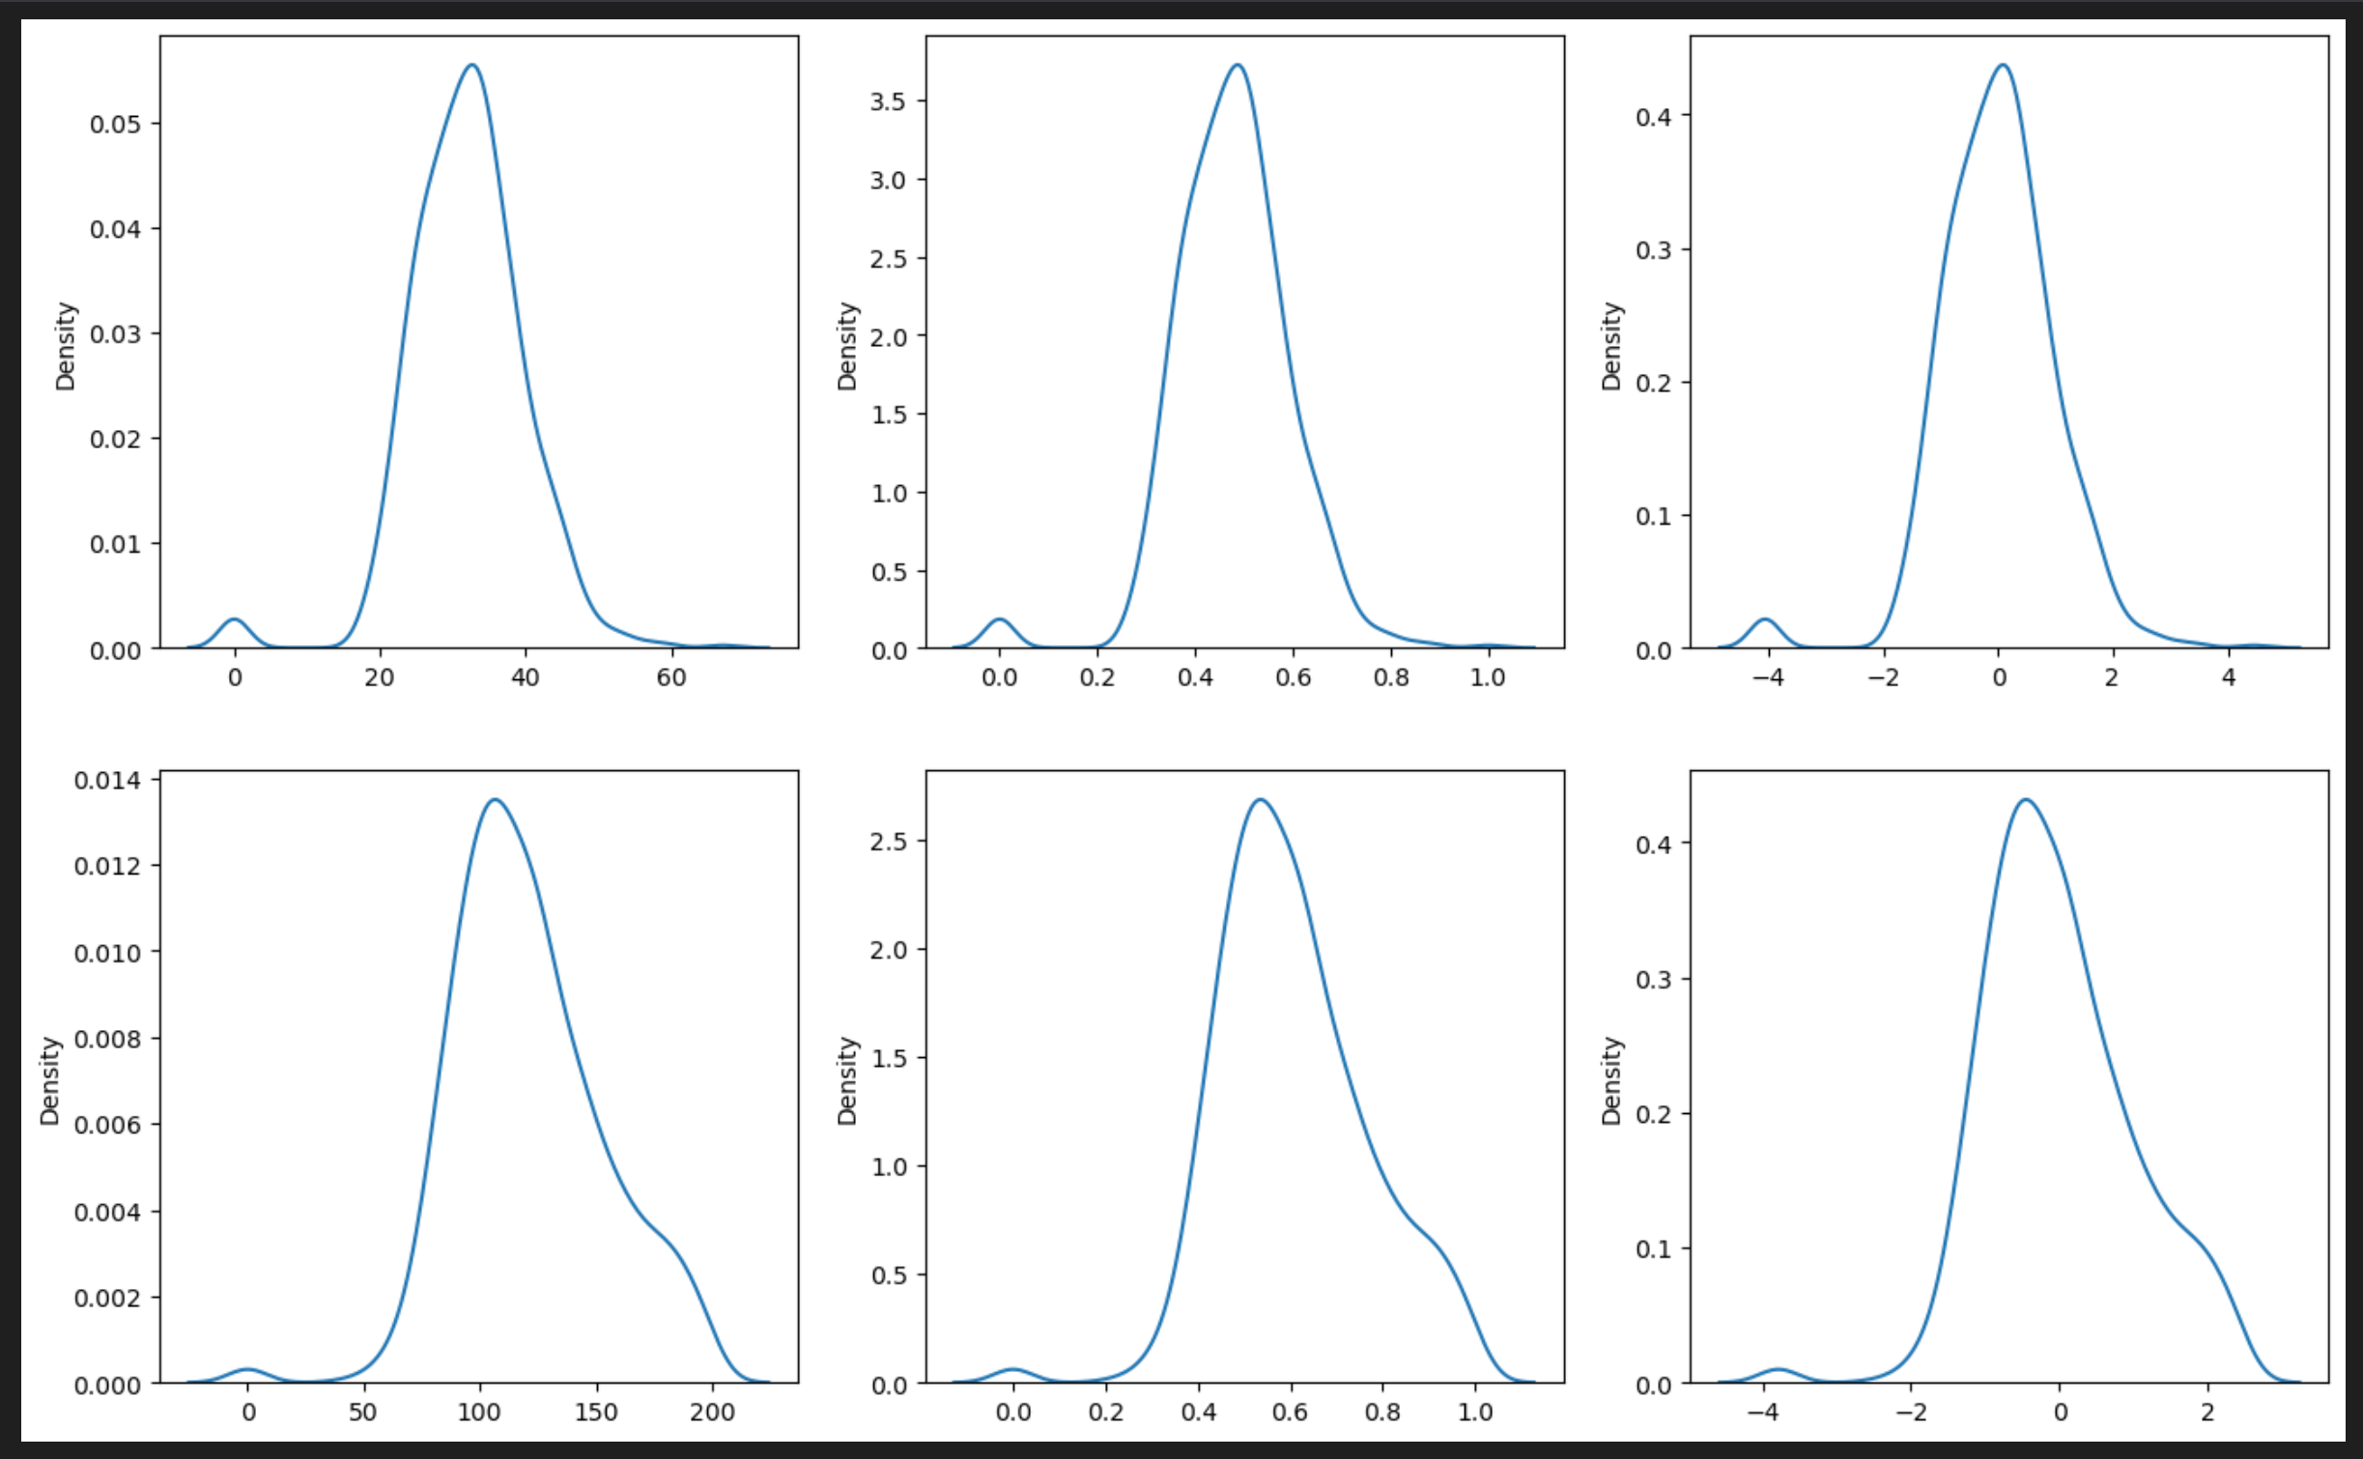
Why Are densities so Weird?

Slide 3
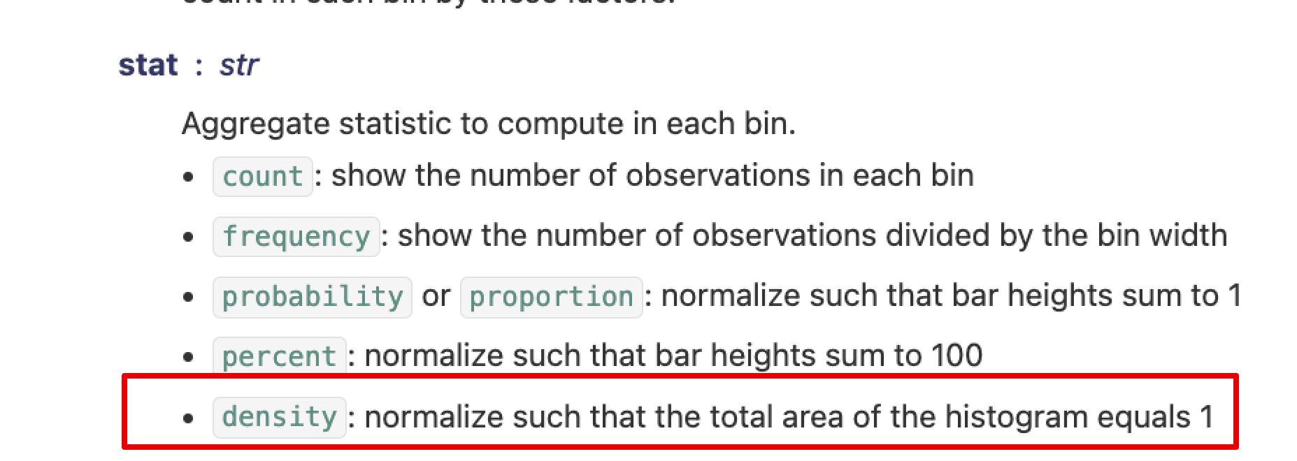
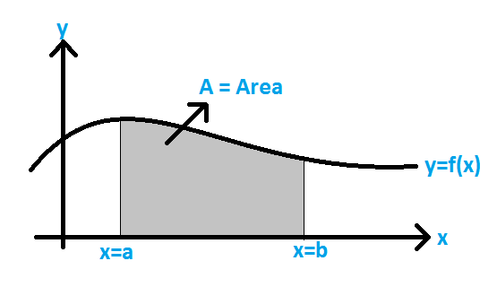
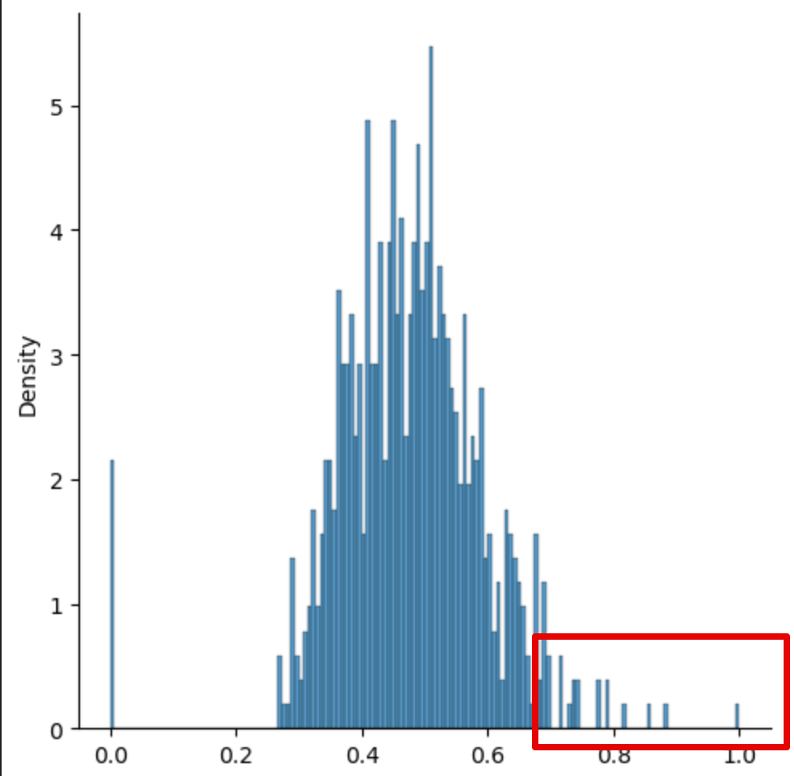
What’s the Density… Really…?
Density means the total area under curve is 1.
  If we have a continuous dataset, this works, but…
The area is the integral, not a count.
  Works over an area, not a point (like a bin w/ discreet).
  Sparse discreet data can make this weird.
  We don’t get a ‘rectangle’ we get stalagmites.
With discreet data there’s estimating going on.
  There is a smoothing parameter that can help.
Fundamentally a mismatch data/visual tool.

Slide 4
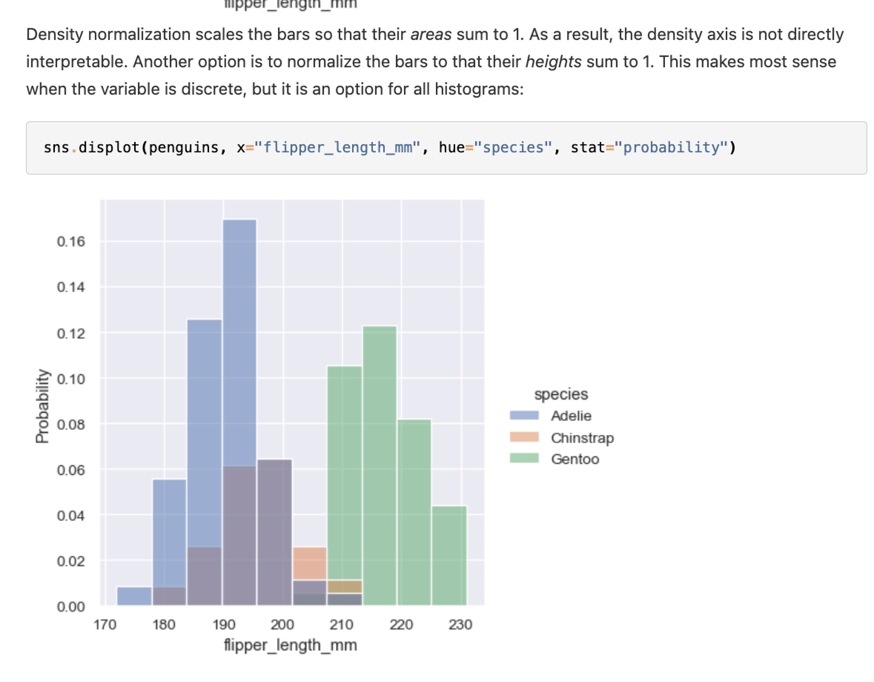
Discreetness
With discreet data, those y values can be odd.
  ’Area’ is not the most meaningful concept.
  Discreet data is ‘meant’ for a histogram.
Change to ‘probability’ to get something more readable.
  Height of bars sums to 1.
In practice this isn’t really an issue often.
  Only if you need to read Y value from KDE.
  Pattern, comparisons, etc.. Still work fine.
  Bigger and smoother data lessens impact.
Seaborn has a “visualizing distributions” page.

Slide 5
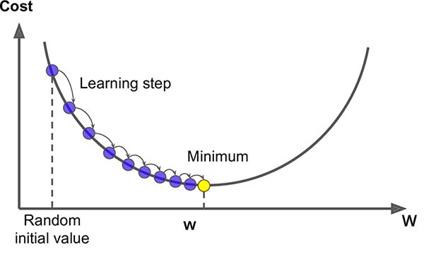
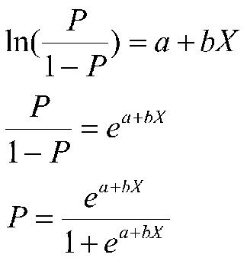
Review - Gradient Descent and Logistic Regression
Last week we looked at classification using logistic regression.
  Instead of predicting a value we predict T/F, a class membership.
Still a linear calculation, but the details differ – need to predict probability not value.
  Uses a regression to the logit to get (something convertible to) probabilities.
  Sigmoid calculation converts any logit to a probability.
The slope and intercepts can’t be calculated directly here like with LLS.
  Need an alternative way to find best coef – gradient descent.
  Guess some coefficients, calculate cost, adjust coef (using gradient), repeat until done.
  This process is very common, coefficients can rarely be directly calculated.

Slide 6
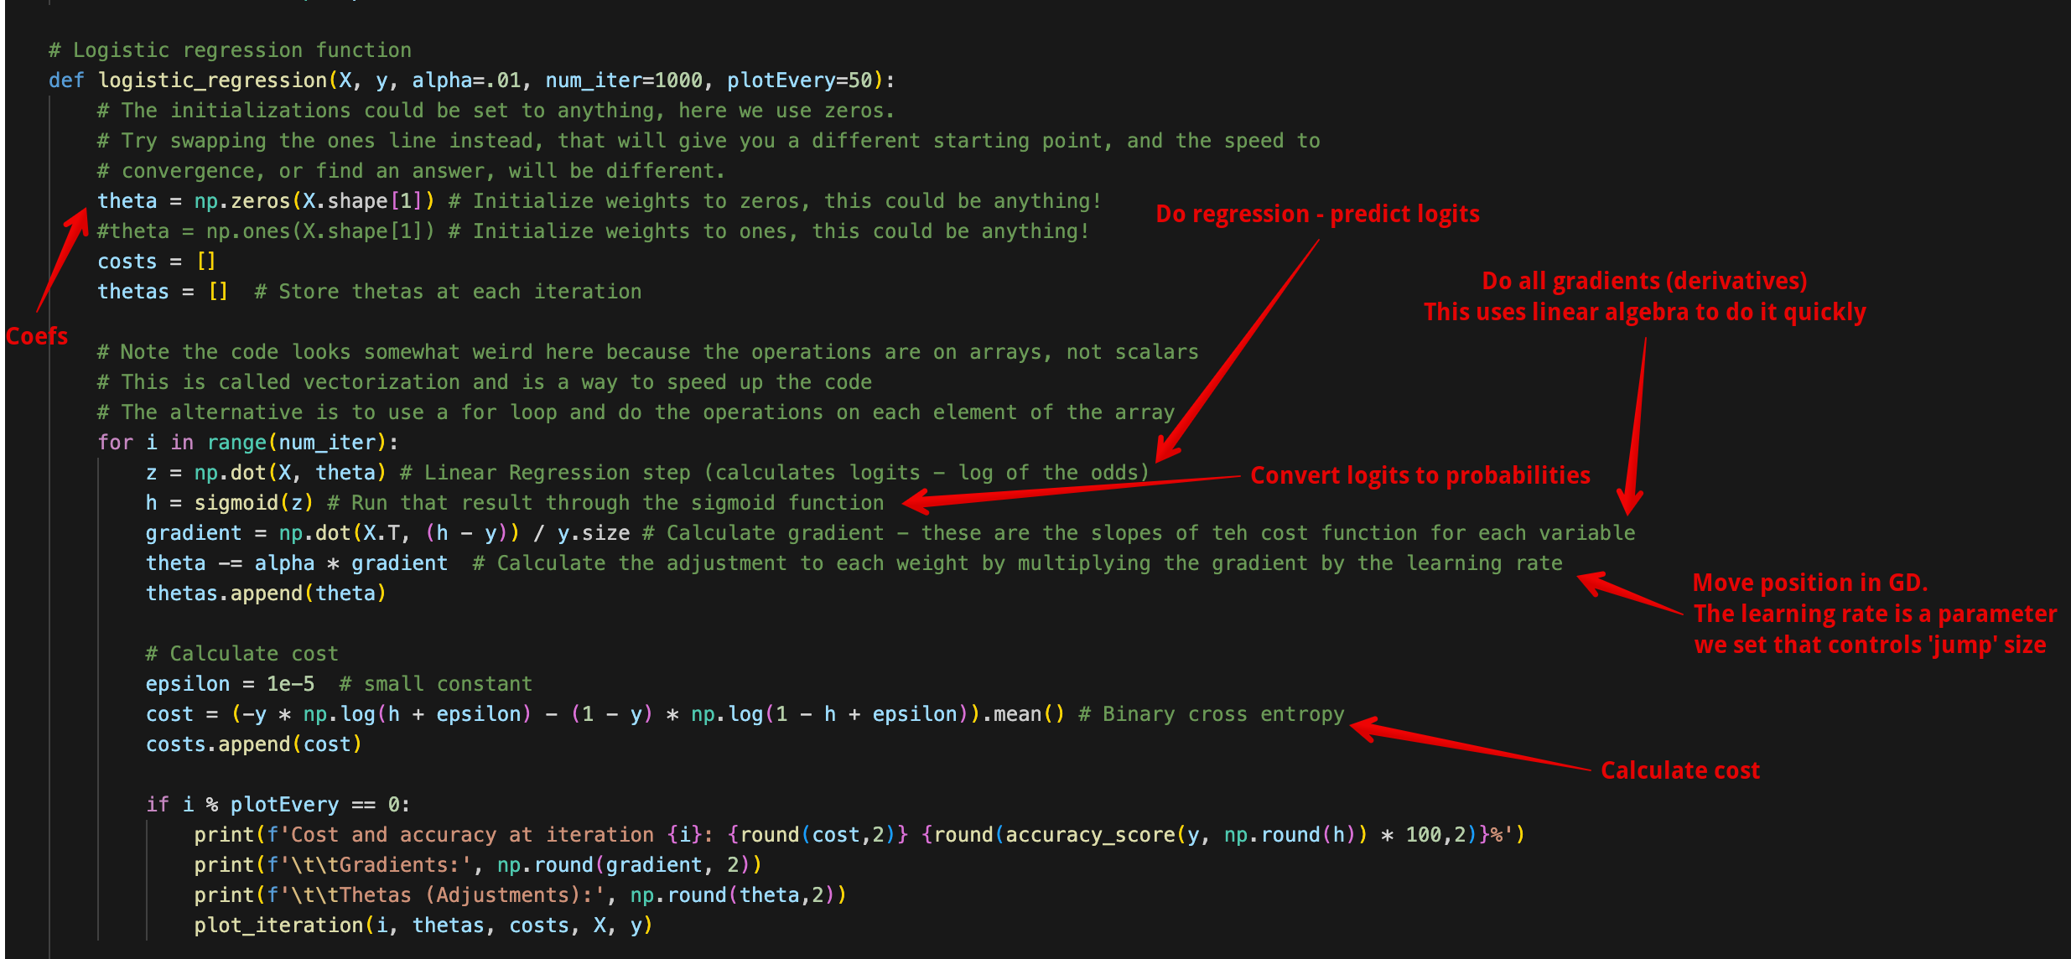
At bottom of Logistic Regression Code

Slide 7
Naïve Bayes

Slide 8
Probability – Remember it!
Recall the idea of probability.
  P(A) – what is the likelihood that A will happen.
Probability comes up directly in several inferential things:
  Monte carlo simulation and hypothesis testing.
  Odds and logit for gradient descent and logistic regression.
We can understand all* of the stats we’ve done from the perspective of probability.
  We track what happens in data.
  These happenings can be converted into probabilities.
  Bayesian statistics explains the ideas we’ve covered, but looking at probability.
Log. Reg. Classification models predict the probability something will happen!

Slide 9
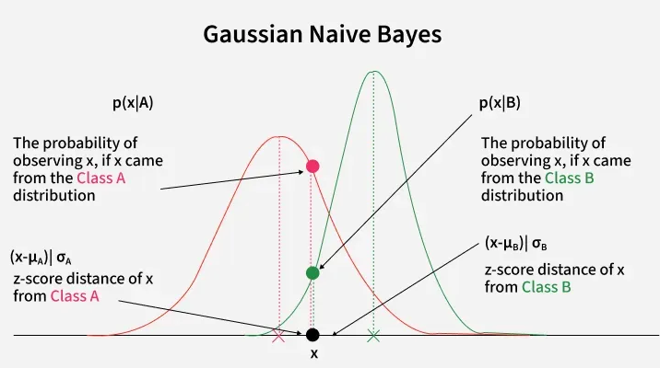
Note on Features
In this stuff we’ll use totally categorical data.
  Classification of categorical target.
  Features are all categorical.
We can use numeric features, but we won’t now.
  Practically, this is very easy to do, follows most sklearn conventions.
  Several model types just make more sense to explain with one or the other.
This is one where the model assumes normal distribution of features.
  Probability calculations are similar to hypothesis test probabilities.
  The closer the features are to normal, the better the results.

Slide 10
Conditional Probability
Using probabilities for prediction relies on conditional probabilities.
  Given this fact, what is the probability.
  E.g. if you have high blood pressure, what is the likelihood of a stroke.
We can express conditional probabilities like this:
  P(A | B) – probability of A, given that B is true.
In datasets, this conditional probability could be calculated for any combo. E.g.
  P( stroke | high blood pressure)
  P( stroke | high BMI)
  P( stroke | high BMI and high blood pressure)

Slide 11
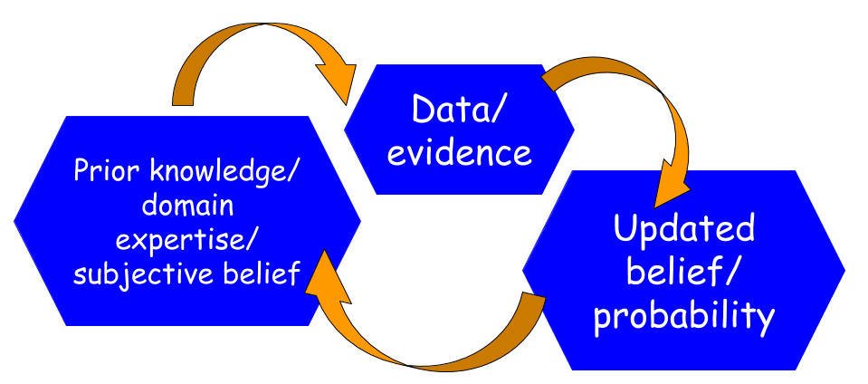
Updates
We can think of the probability as conditional, and progress through ‘learning’ things.
  Pretend you learn each feature one-by-one and change the estimate each time.
We start with a baseline – what is the probability?
  As we ‘learn’ each feature, the probability becomes conditional on that. P( Y | X1)…
These ‘updates’ make our prediction more accurate as we learn each one.
  Each adds another X to the prediction.
  If that X is useful, we’ve ‘learned more’.
We can label them prior and posterior.

Slide 12
Check the Code
Look to code for an example of some updating…

Slide 13
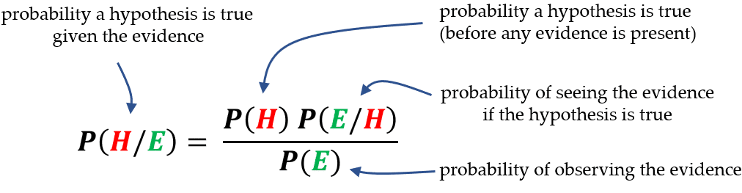
Back to Bayes
Recall Bayes’ Theorem on conditional probability.
Bayes’ allows us to update the probability of something happening as we gain information.
  Think – Bayes’ tables from stats.

Slide 14
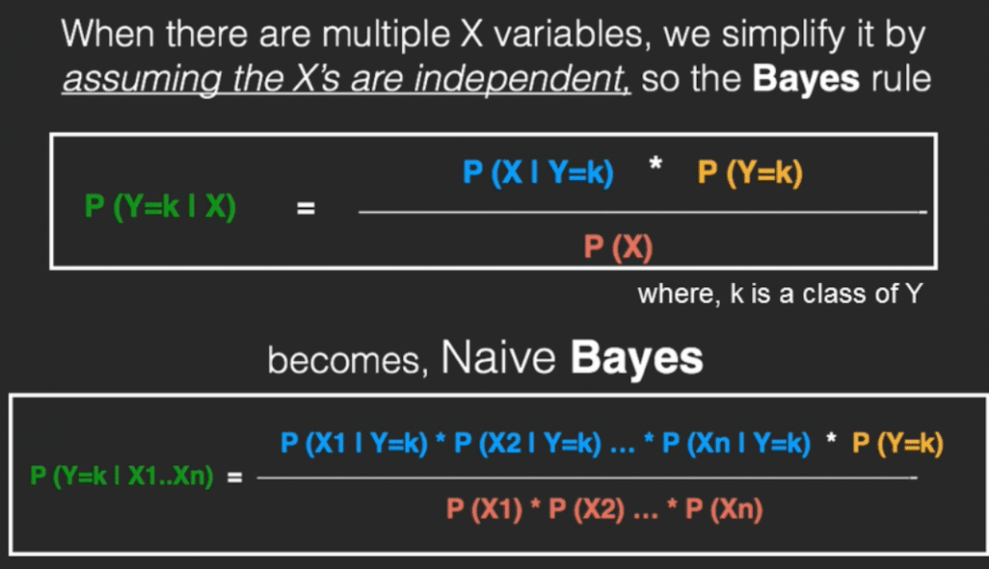
Naïve Bayes
Naïve bayes is an algorithm that is built on the Bayes’ Theorem calculation.
  Naïve – each feature is treated as independent.
  Bayes – uses Bayes’ Theorem.
Classifier is a “Big Bayes’ Theorem” where each feature is another term.

Slide 15
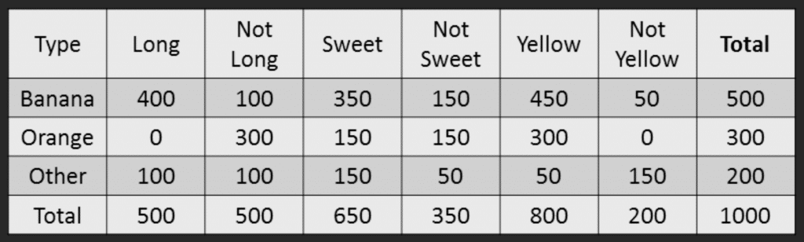
Example by Hand
A fruit is Long, Sweet, and Yellow – what fruit is it?
Below is our training data.

Slide 16
Naïve Bayes Process
Calculate prior probabilities:
  P (Banana) = .5
  P (Orange) = .3
  P (Other) = .2
Compute denominator:
  P (Long) = .5
  P (Sweet) = .65
  P (Yellow) = .8
  P(L)*P(S)*P(Y) = .26
  This is needed for the full calculation, but doesn’t matter in the prediction.

Slide 17
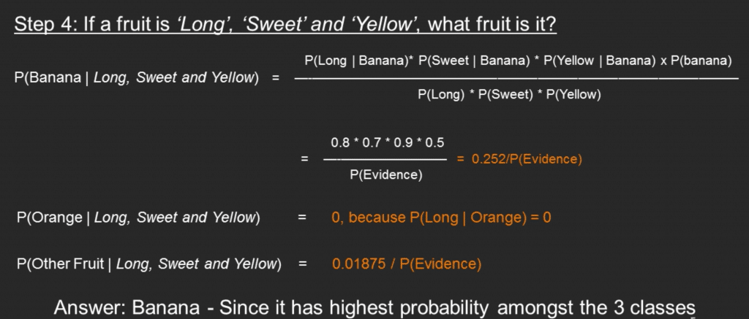
Naïve Bayes Process 2
Calculate numerator:
  P (Long | Banana) = .8
  P (Sweet | Banana) = .7
  P (Yellow | Banana) = .9
  P (Banana) = .5
  Product = .252
Classify – Calculate probability for all potential classes.
  P (Banana | Long, Sweet, Yellow) = .252/.26
  P (Orange | Long, Sweet, Yellow) = 0 (There are no long oranges)
  P (Other | Long, Sweet, Yellow) = .01875/.26

Slide 18
Naïve Bayes
Those final probabilities could be normalized to get the probability on a percentage scale.
  As we did with the Bayesian tables in stats.
As a classifier, Bayes is:
  Interpretable – we can illustrate how predictions are made.
  Simple – the math is just what we did by hand.
  Fast – due to the simplicity, training and predicting are usually fast.
However, Bayes is also:
  Limited – the independence assumption is often untrue. Making its applications limited.
  Probability estimates aren’t reliable, even if classifier is accurate.

Slide 19
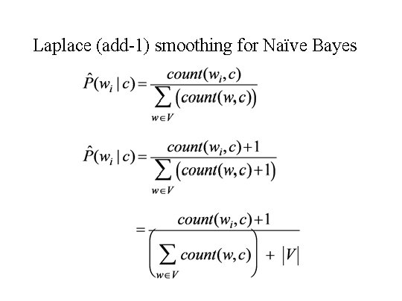
Smoothing
One issue Bayes can have is if there is an example to predict that was not in the training data.
  E.g. what if a fruit is green?
  This introduces a divide by 0, which is impossible.
Laplace smoothing is the solution:
  Add 1 (or another value) to the observations.
  Built into any implementation, usually as a parameter.

Slide 20
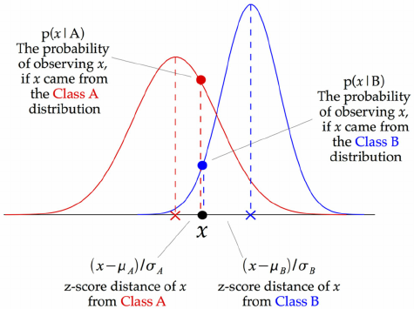
Flexible Bayes
By default, Bayes only works with categorical features.
When dealing with numerical features we need to adapt the algorithm.
Gaussian Bayes does so by replacing the probability calculation with a probability calculation based on a gaussian distribution.
  These probabilities replace the probabilities in Bayes and everything else works in the same way.

Slide 21
Naïve Bayes Conclusion
Bayes is one of the more simple classifiers that we can create.
Bayes regression exists, but is not super common.
Bayes is often used in things like spam detection, the speed helps here.
When Bayes works well for a dataset, it can be very good, but if it doesn’t there is limited ability to tune it to be better.

