Slide 1
Keep The House
Today – Recurrent Neural Networks (ch5).
  Recurrence
  Long-short term memory models.
  Time-series like datasets.
  Bidirectional layers.
There’s a test next time, yay!
Generative models next week, then school’s out forever!

Slide 2
Recurrent Neural Networks

Slide 3
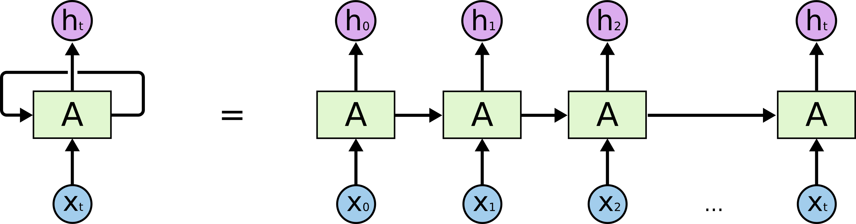
RNN Basics
In looking at a CNN we saw a neural network that can deal with spatial relationships.
RNNs can handle temporal relationships – looking through time.
Time-series and text are well suited to this structure of model.

Slide 4
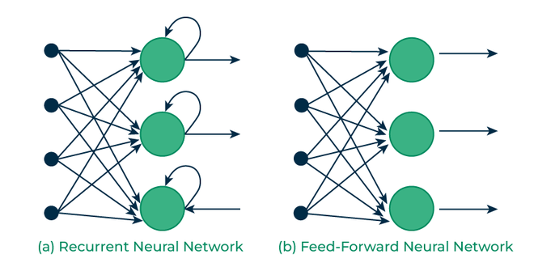
Big Difference – ‘Looping’
RNN models have some looping in their structure.
Allows the model to ‘know’ something about previous records.
Regular models are 1 at a time.
We often refer to this as memory.

Slide 5
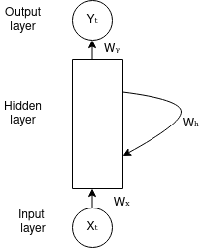
Recurrent Neural Networks
RNNs are able to ”save” some information from earlier steps.
There are several different varieties of RNN models. (Which we’ll mostly ignore).
RNNs maintain a memory by keeping the output of one step as part of the input to another.
  This allows things at different time steps to be considered at once.
  A ‘regular’ model would have each time step as independent rows.

Slide 6
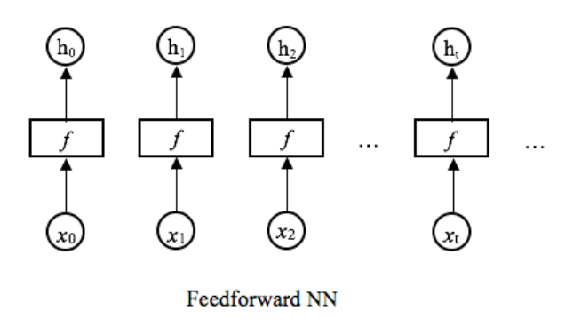
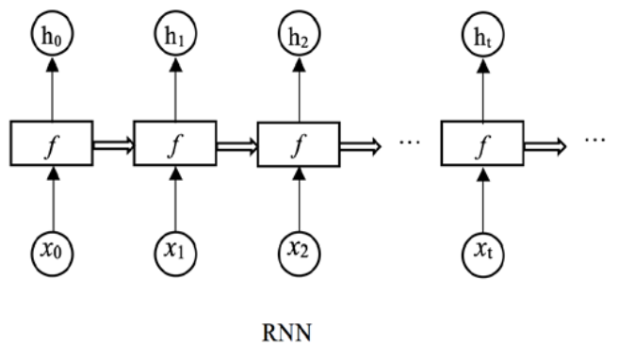
RNN Depiction
We can picture this by contrasting to a regular (feed forward) network.
In a normal network, each prediction is independent.
In a RNN, each informs the next.
  If dealing with time series data, this makes sense.
We have the concept of ‘state’.
  The model has an understanding of current status.
  Predictions aren’t just made based on the current record.

Slide 7
RNN Implementation

Slide 8
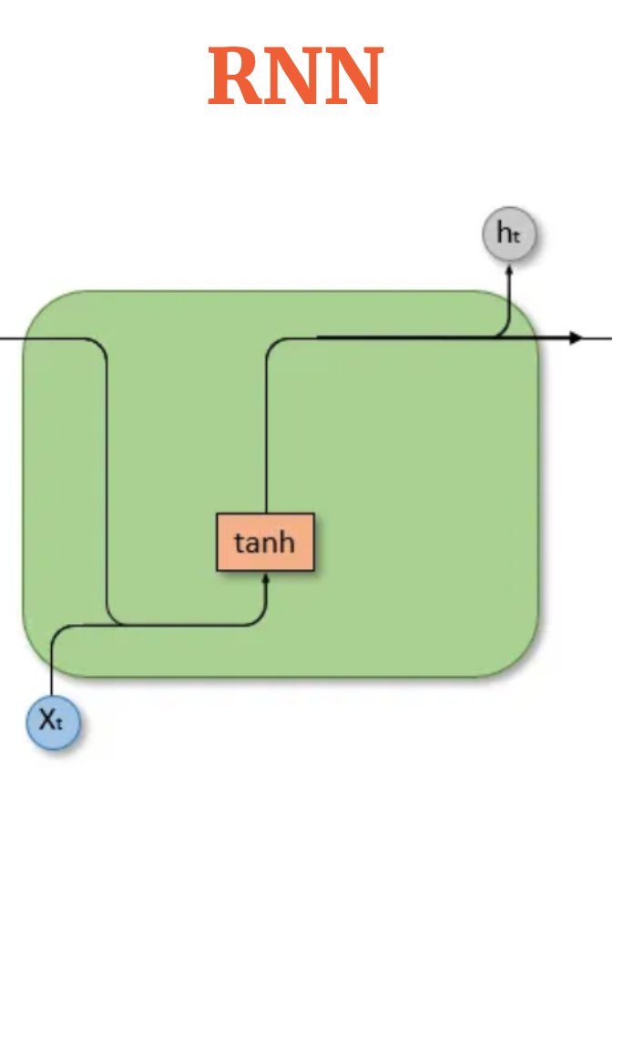
RNN Basic Structure
The basic idea of an RNN is that there is some sort of State that holds memory.
  The network can have information from earlier held in its state.
  The new record can bring in its features (as normal).
  The model can use both to make a prediction.
We refer to this as a ‘unit’ in a RNN layer.
  Roughly equivalent to a neuron, though more complex and we have fewer.
The top line is the state, that is what is passed on from before.
The bottom line is the feature set for this record.
Each prediction is based on “X + memory of previous predictions”.

Slide 9
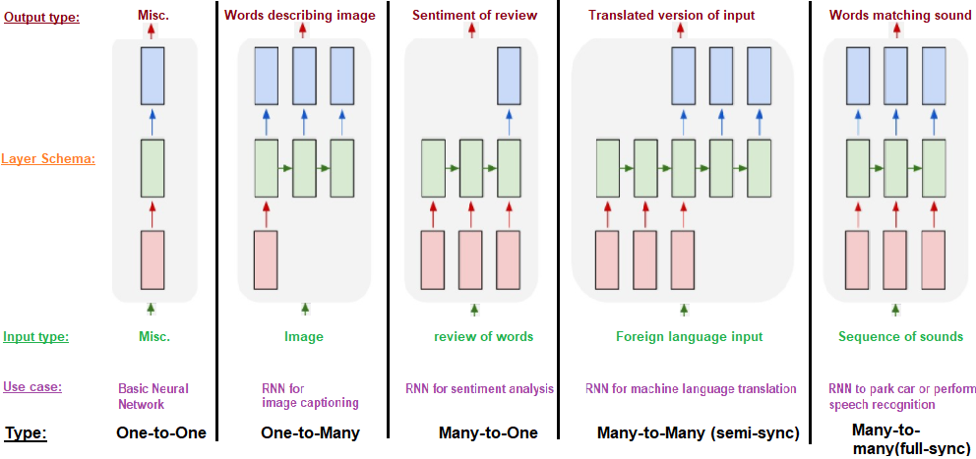
Applications
The ability to keep state allows for RNNs to excel any time we have a sequence.
We can have arbitrary number of input and output lengths.

Slide 11
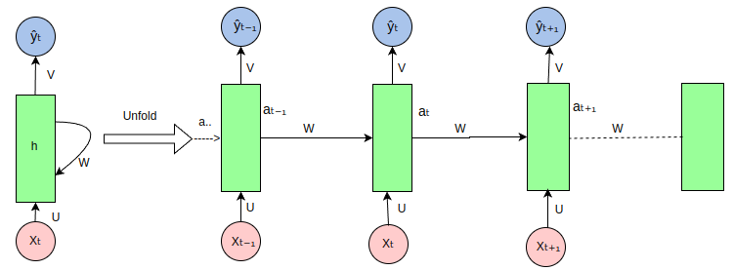

Slide 12
Rnn Basic Concepts
RNN models keep a memory of past action.
These predictions combine with a record to make a new prediction.
This means RNN models make predictions based on now and ‘the past’.
  Often better suited for anything sequential – time series, audio, NLP…
Note: transformer based models (another NN structure) have surpassed RNNs for most text stuff. ChatGPT et al are transformers. We’ll see a bit of it next week.

Slide 13
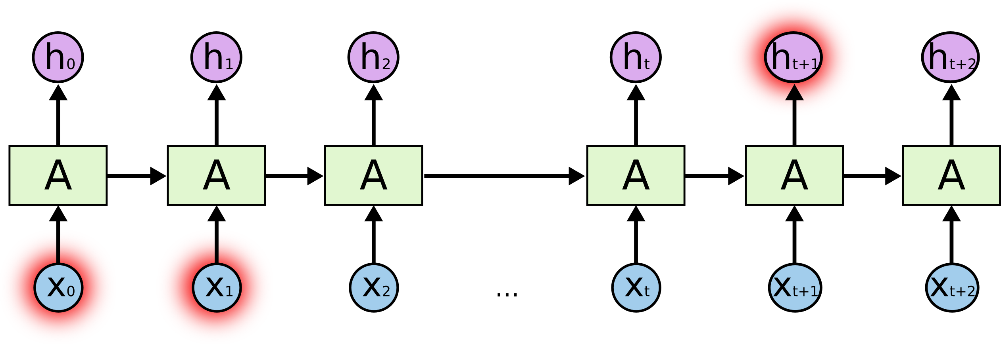
Mo’ Gradients, Mo’ Problems
RNNs can run into issues with the gradients getting too large or too small.
  Exploding or vanishing gradients.
Vanishing gradients commonly occur with deeper models.
The longer the memory, the more risk of vanishing.
  How much of an impact can the memory of 20 steps ago be?
As gradients get extremely small, learning updates stop.
Solution – Long Short-Term Memory

Slide 14
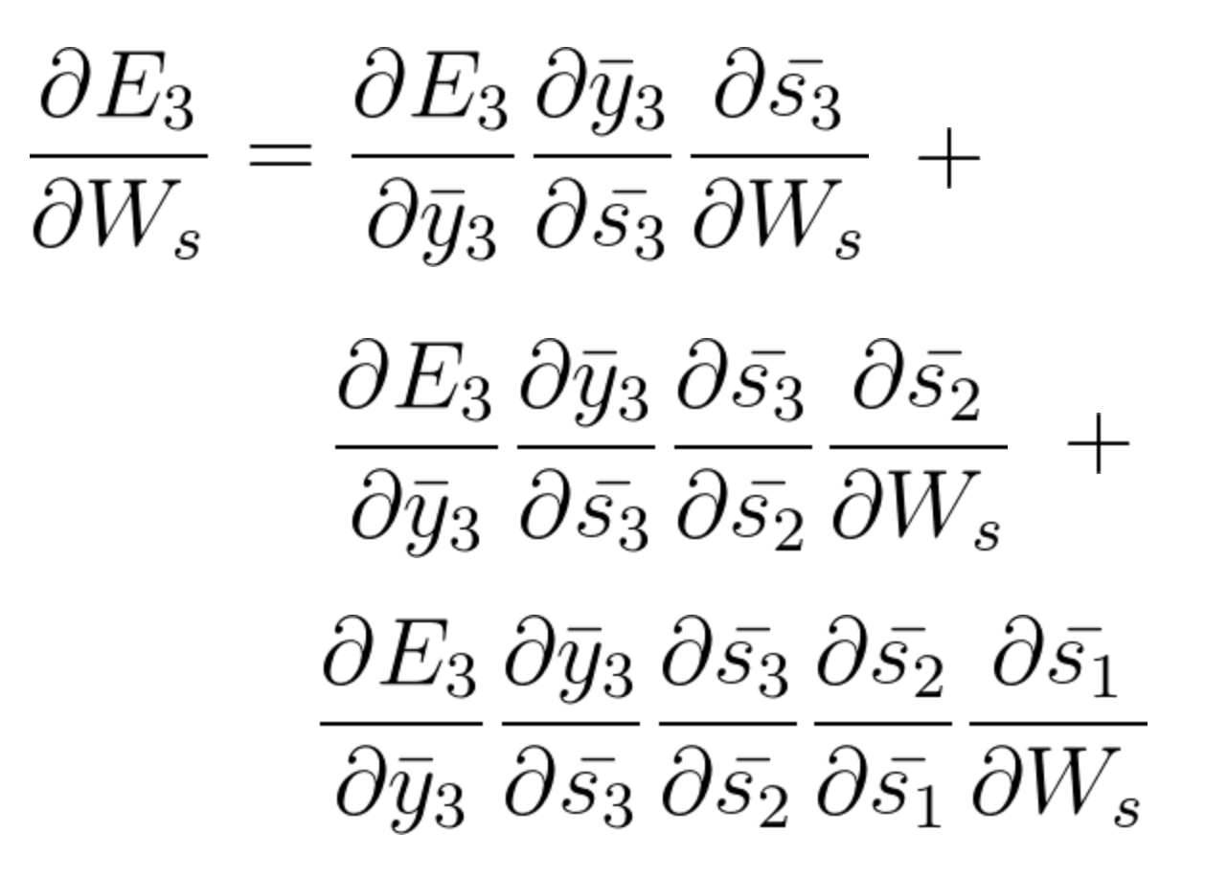
Training a RNN and Issues
RNNs are trained using an algorithm called BPTT – back propagation through time.
  Mathematically this is the same as ‘normal’, but with transformations on the model structure.
Image shows gradient calculations at step 3.
  Adjustment for this step depends on steps 1 and 2.
  As steps grow, this equation grows, and values can get minute.
  We lose the gradient, or indication of how to adjust weight.

Slide 15

Enter Long-Short Term Memory…

Slide 16
Long Short-Term Memory
LSTM models are a commonly used type of RNN.
LSTMs can avoid/mitigate the gradient issues.
LSTMs retain a bunch of data – their long memory.
  “Look back” period of N previous records.
At a basic level, the output of an LSTM at a particular point in time is dependent on three things:
  The current long-term memory of the network — known as the cell state.
  The output at the previous point in time — known as the previous hidden state.
  The input data at the current time step.
https://towardsdatascience.com/illustrated-guide-to-lstms-and-gru-s-a-step-by-step-explanation-44e9eb85bf21

Slide 17
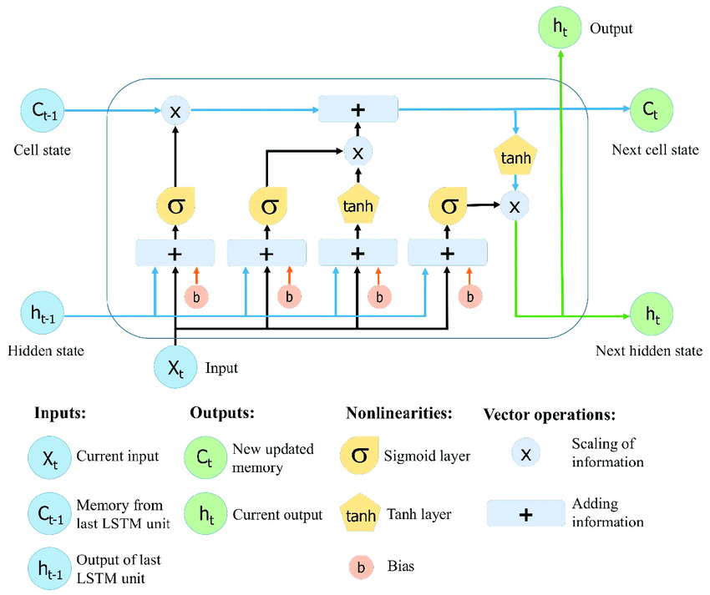
It’s simpler than it looks…
The activation functions are referred to as ‘gates’.
  Each gate ‘decides’ what to keep and what to discard.
The node (roughly):
  Takes in X, hidden, and cell states.
  Weighs what parts to keep/ditch.
  Creates a prediction.
  Passes pred and state forward.

Slide 18
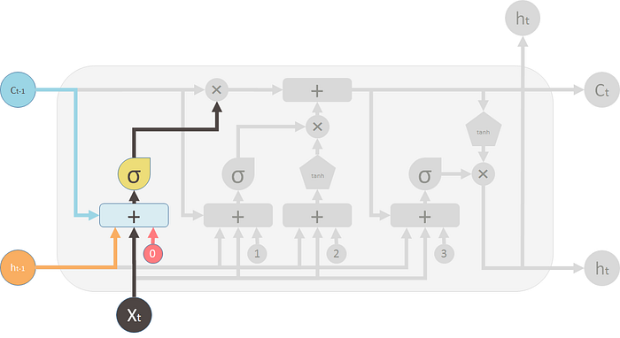
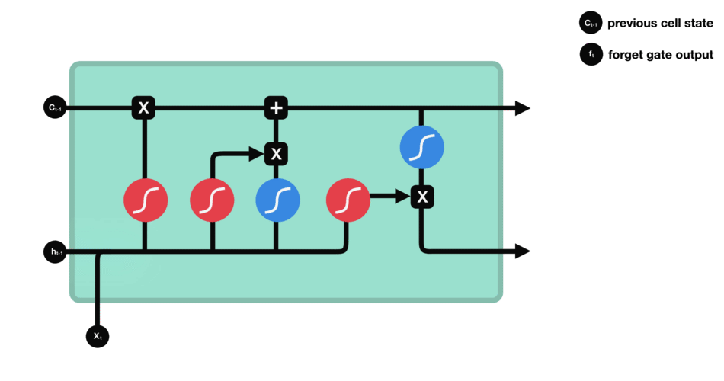
Forget Gate
The forget gate decides what information should be thrown away or kept.
Information from the previous hidden state and information from the current input is passed through the sigmoid function.
Values come out between 0 and 1. The closer to 0 means to forget, and the closer to 1 means to keep.

Slide 19
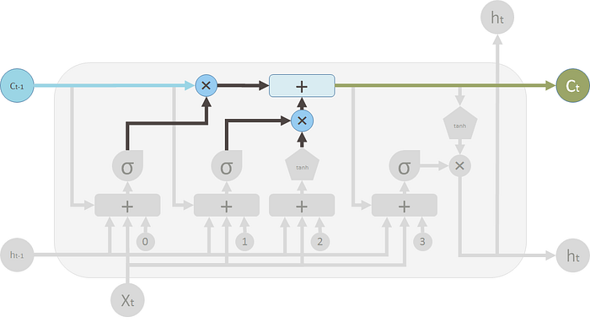
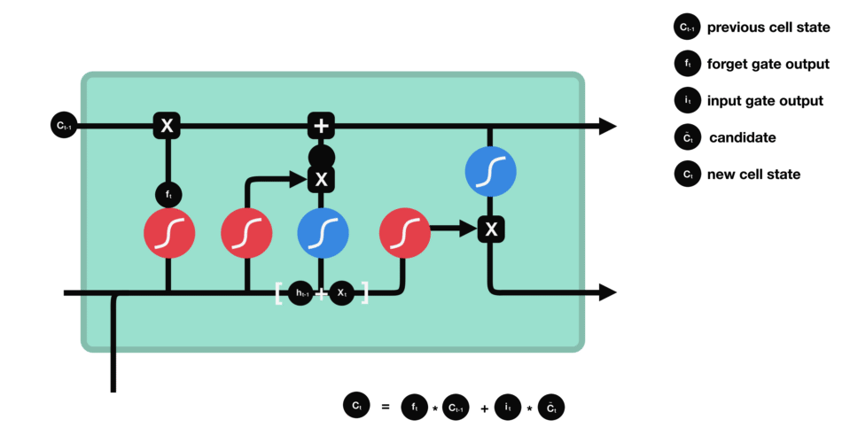
Cell State
The forget and input results are combined to generate a current state.

Slide 20
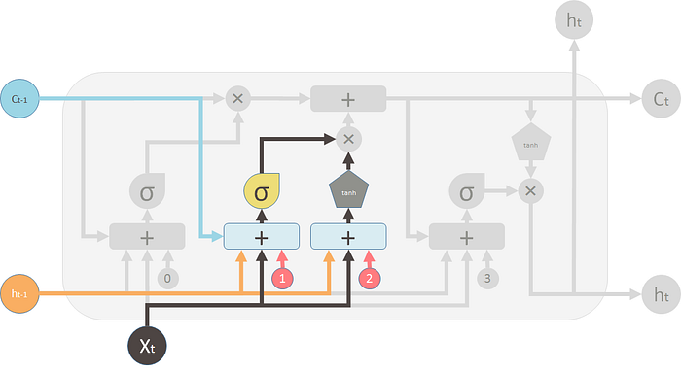
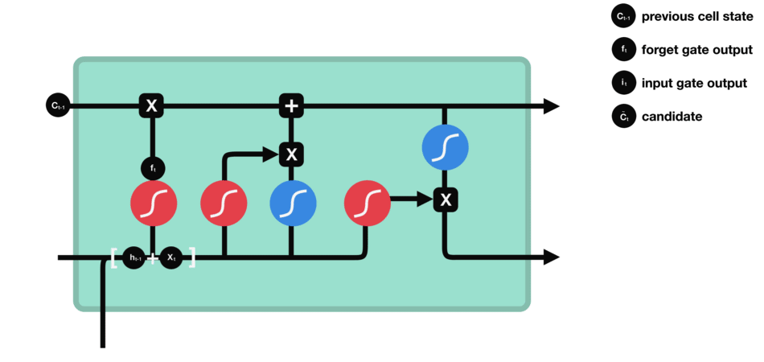
Input Gate
To update the cell state, we have the input gate.
We pass the previous hidden state and current input into a sigmoid function.
  Decides which values will be updated by transforming the values to be between 0 and 1.
Also pass the hidden state and current input into the tanh function to squish values between -1 and 1 to help regulate the network.
Multiply the tanh output with the sigmoid output. The sigmoid output will decide which information is important to keep from the tanh output.

Slide 21
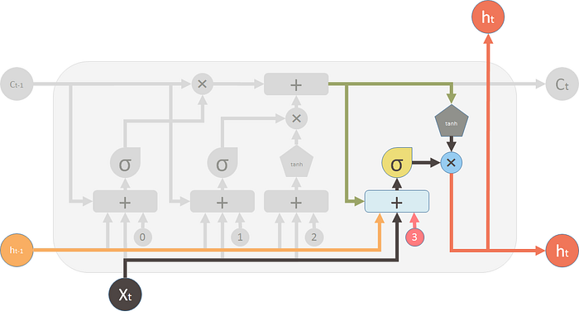
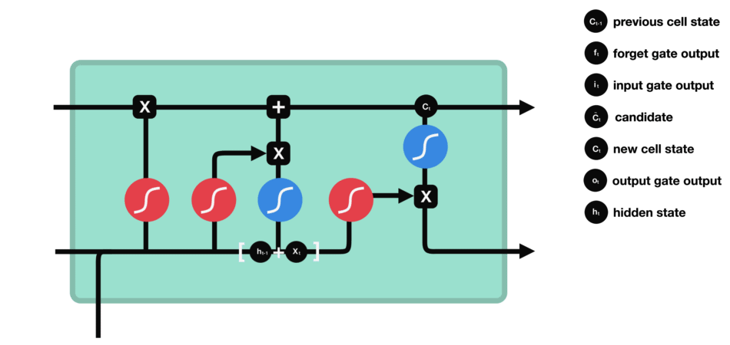
Output Gate
Output gate decides what the next hidden state should be.
Pass the previous hidden state and the current input into a sigmoid function.
Pass the newly modified cell state to the tanh function.
Multiply the tanh output with the sigmoid output to decide what information the hidden state should carry.
The output is the hidden state.

Slide 22
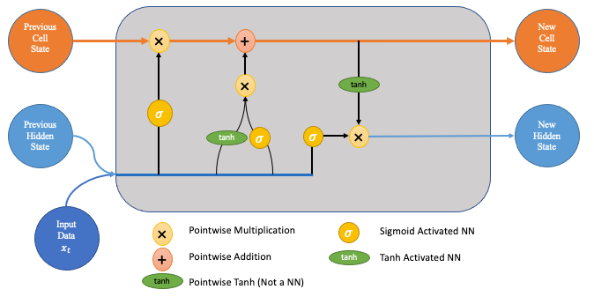
State it Clearly
The LSTM units have two different lanes for state – cell and hidden.
  The hidden state acts as a short-term memory – more impacted by recent events.
  The cell state acts as long-term memory – more able to hold things from earlier.
The cell state flows from itself, and new stuff is only added after passing a gate.
The hidden state flows from the last prediction and the new input.

Slide 23
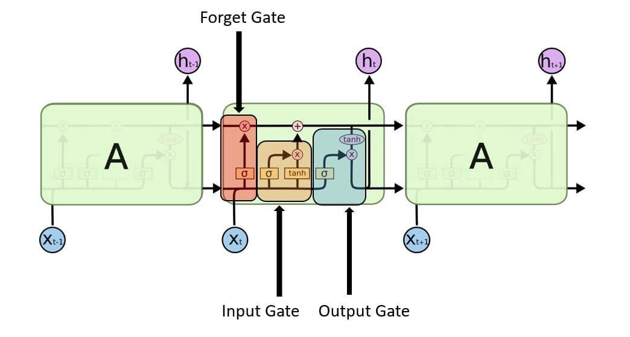
Data flows through, in order…

Slide 24
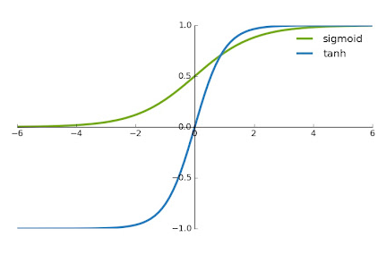
Training and Activation
LSTM models us 2 activations – sigmoid and tanh.
Sigmoid is bounded [0,1] – keep/forget here.
Tanh is bounded [-1,1] – emphasize/deemphasize.
  Tanh has a steeper gradient, it helps to not vanish.
As the weights are set in training, they learn this.
  What to keep in each subset of data/states.
  What to ditch.
  These can differ because of the ‘multiple memories’.

Slide 25
LSTM in Parts
The LSTM layers use this design to better deal with sequential data.
The state (top) part of the model remembers information from previously.
  The forget/memory gates try to keep the important stuff in the memory.
The output provides a prediction, as normal.
Each of those predictions depends on two things:
  The new data in this record - this is exactly what we are used to.
  The data from the state, what the model remembers – this is the new part.
The ‘features’ extracted in the top layers are made by combining info from different steps.
  Just as the ‘features’ extracted in a CNN are made by combining different pixels.

Slide 26
LSTM In Effect
LSTM can “hold” information from the past.
During training, the model keeps things that are useful and forgets things less useful.
  Important previous information is held.
  Temporal awareness!
LSTMs are very good at many scenarios:
  Time series applications.
  Speech and NLP applications – e.g. translation, Google’s phone answer AI, chatbots.
  Generative models (think GMM) – creating text from a model.
Transformers have often surpassed these in practice – better able to manage state over time.

Slide 27
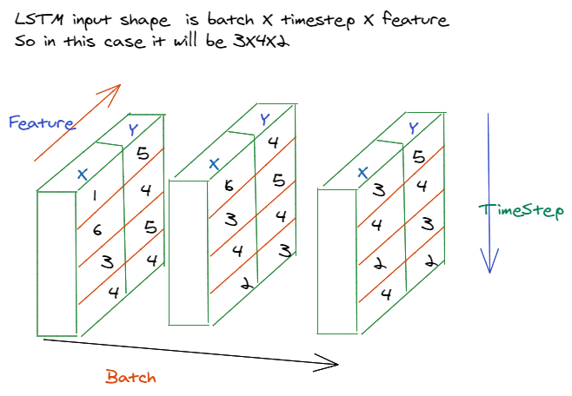

Slide 28
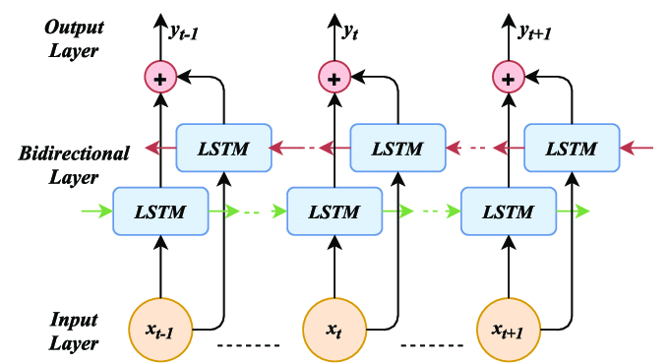
Let’s Go Bi
There are LSTM variations like bidirectional.
Bidirectional models have a ‘backwards’ layer.
  Data is fed through here in reverse.
Helps capture longer dependencies.
For/back are merged with some math (option).
Can help performance in many cases.
  Can be much slower.
  Data requirements increase.

Slide 29
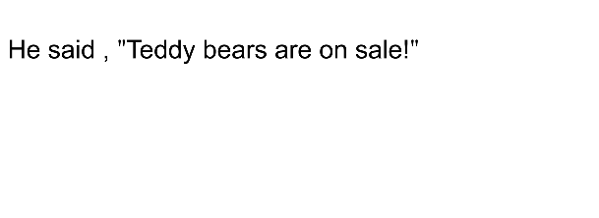
Recall Word2Vec…
In the top example, the model has no idea what happens after Teddy.
In the bottom example, the backwards part of the model sees Roosevelt, so it can capture that relationship.
Parts of speech are often not one word after another.
Can understand the sequence in both directions.
“If I know this thing is coming, what do I expect to see before it” vs. ”If I know what happened before, what do I expect next.”

Slide 30
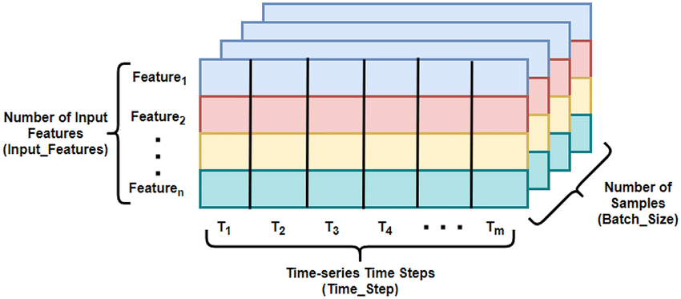
Building LSTM Data

Slide 31
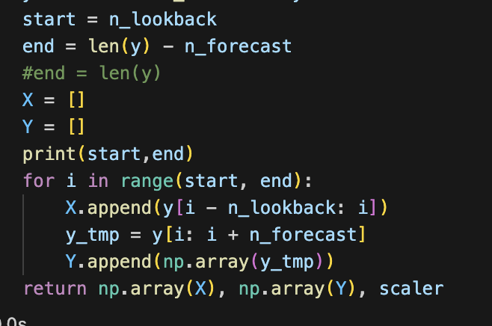
LSTM Data
Using an LSTM model requires that we deal with some complex shapes in our data.
  Using “normal models”, each instance is one row of data.
  In an LSTM, each instance contains several past features and several future inputs.
The shape of the data going into the model will generally be:
  X data - (Batch_size, length_of_lookback, number_of_features).
  Y data – number of predictions ahead.
For most data, we’ll need to construct a dataset to look like this.
  We’ll probably need a function to take our data, loop through the rows, and assemble all values from different rows into multi-dimensional data for us.
This can be a bit annoying and easy to make a mistake on – be careful.

Slide 32
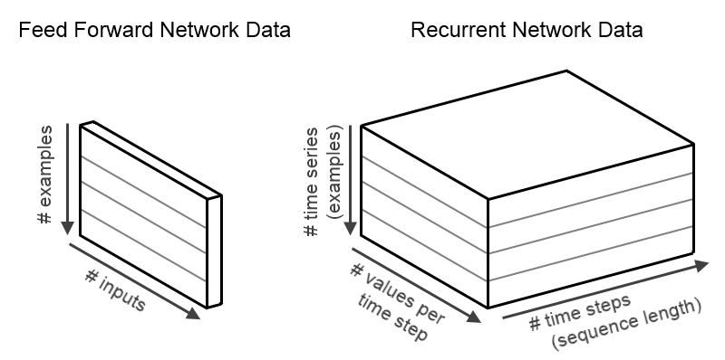

Slide 33
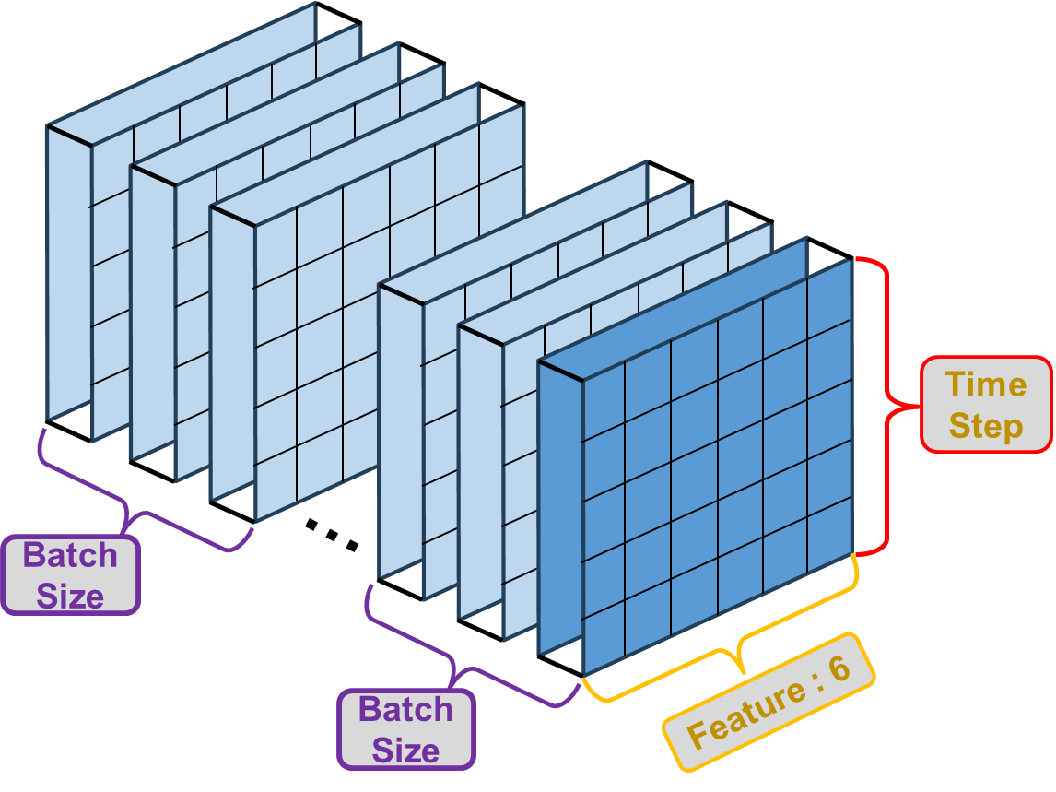

Slide 34
Time Series Data
Data usually needs to be reshaped to be useful.
The shape of our output can differ here.
  One node is the next prediction – the next day/week/year etc…
  We can create a multiple node output for several predictions at once.
I’d generally recommend deciding the data size and making a function to construct it from your data – if you have changes, set things like #records to be parameters.
  Keep it as a separate goal form the modelling bits, and check it independently.
Note: there are functions to create datasets from time data in tf/keras, the examples mostly do it by hand so we can see the details. This is easy to make a mistake on.

Slide 35
LSTM in Keras
LSTM (or RNN) layers can be added just like any other layer.
  The nodes param is roughly like the filters in a CNN model – layers have many.
When there’s more than one LSTM layer, we need to enable ‘return_sequences’.
The output layer normally has one node per prediction, no activation.
Making multiple predictions into the future is one place where custom loss is useful.
  Could weight the value of errors for the next prediction vs the one 10 instances later.
  Differing considerations could make accuracy at different time steps matter more.
LSTM layers are often/usually paired with a dropout (and/or regular regularization).
  We can add it as a parameter to the layer directly.

Slide 36
Tuning LSTM Models
Like other models, we generally want to have a larger model for a larger problem.
  Estimate - Units = samples in training data / ((# input neurons + # output neurons) * alpha)
  Unstructured problems are more likely to benefit from more layers, each with fewer units.
  Structured problems (sales or stock prices) may benefit from fewer, larger layers.
Hyperparameter tuning is back on the menu, boys!
  LSTM models can be determined via the Keras Tuner – layers, units, drop, other options…
  Bayesian or Hyperband may help with time, as might sampling (smartly) the data.
  LSTM models often employ a dropout for regularization, it performs well.
  Large numbers of epochs are often helpful, possibly with small batches (~8-96).
    Think – update model every day vs every 100 days.

Slide 37
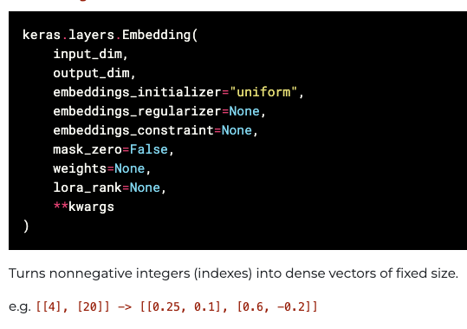
Text Notes
RNN based models are often used for text/NLP problems.
We need to generate embeddings to represent the value of the tokens.
  Recall – count, tf-idf, and their tsvd outputs are ‘simple’ ways to represent tokens.
  Word2Vec generated embeddings for tokens – multi-dimensional vectors to convey meaning.
In neural networks we can use an embedding layer to do it for us.
  If in the model, this would be done on GPU (this is what the examples do).
  You could also map it as part of the pipeline to get it on CPU.
  This could be a slow step if data is big – real NLP embedding spaces are massive and vocabs are larger.
In general, NN will perform well with massive data and large embedding spaces – NNs win with complexity.

Slide 38
Being BI is in… if it Performs better
Bidirectional LSTM layers feed the previous sequence bot forwards and backwards.
Common in NLP applications.

Slide 39
Generative Models
LSTMs can be used to generate things, like text.
Text generation is simpler than it sounds at first glance.
  Train a model to be able to predict the next word (or token) from text.
  Generate text by taking in the previous text, and predict the next word.
  The ‘previous text’ + ‘predicted word’ is then the source for the next prediction.
We can treat it as 1 word tokens, large LLMs may have different splits – it varies.
  E.g. predict a root word, then the correct suffix: run to running or runner.
  2+ grams for thinks like ‘downhill skiing’ and ‘oven glove’.

Slide 40
Got the Right Temperature
Generative models usually utilize a parameter called temperature.
Temperature basically introduces randomness to a prediction.
  A model will default to try to predict the correct (most likely) next token.
  People don’t really speak like that, especially if writing one piece of prose.
  Normal sounding text will use synonyms an alternate terms to avoid sounding robotic.
Temperature makes the actual prediction probabilistic.
  The ‘correct’ answer is most likely, but we are choosing from all likely predictions.
  Sometimes we want to return a word that is not optimal, but reasonably likely.
  The higher the temperature is, the more likely we are to choose an imperfect option.
  Multiple implementations of this idea can exist.

Slide 41
Conclusion
Sequential problems are common – prices of anything traded, weather, “life stuff”, etc…
Highlight an example of real-world challenge for analysts – defining the type of solution.
  Classification/regression are relatively simple in their structure, or they can be.
  We have a target to predict, features we can use, and we can make a model to predict y from X.
  Sequential models bring ambiguity to the forefront more – how far in advance can we predict? Should we use any other features? Can we use our predictions to feed other predictions?
Many time series (esp. long term) problems inherently involve ‘features’ we (likely) don’t have.
  Commodity prices, climate trends, or product sales are often highly impacted by things like laws, regulations, or decisions from other actors that are hard or impossible to capture in data.
  Large and complex models can ‘learn around’ this, but with limits. ‘More data’ often not as useful.

