Slide 1
Data 3950 – Machine Learning
Note: We’ll start classes at :05 to give people a sec to login and get setup.

Slide 2
Overview
Introduction and logistics.
Course overview.
ML review of stuff from stats.
Part 1 of assignment #1.

Slide 3
Instructor
Akeem Semper
Contact: asemper@nait.ca
Education:
B.Sc. Computer Science
B.Ed. Secondary Math/Physics
MBA
Relevant background: Mainly in reporting analytics.

Slide 4
Overview
Broad coverage of major machine learning techniques – 2m ‘classical’ models, 1m neural networks.
Focus on being able to apply the techniques in code.
Touch on, but not deeply interrogate, the mathematical backing.
Survey impacts and uses of different technologies.
For each ”chunk”, we’ll aim to cover:
An algorithm (or two).
A type of data.
Some tools/library/processes.
Goals by the end of the course:
For simple/repeated problems, you can solve them by building models.
For more complex/novel problems, you have an idea what to start investigating.

Slide 5
Grading
Quizzes: 15%
Assignments: 50%
Projects: 35%

Slide 6
Quizzes
The quizzes will be relatively minor, not full midterms.
The focus is primarily on doing, so we’ll focus on making stuff.
Open book.
Quiz 1:
Machine learning concepts.
Quiz 2:
Neural network/deep learning concepts.
Business societal impacts (depending on timing)

Slide 7
Assignments
Assessed on:
Accuracy.
Coding.
Specific measures of the topics we’re covering.
Assignment topics:
Simple classification and pipelines.
Regression and data cleaning.
Unsupervised learning and generative models.
Basic neural networks.

Slide 8
Projects
Groups of 2 - 3.
Larger and more complex.
Topics:
Natural language processing and text classification.
Image recognition with neural networks.

Slide 9
Progression

Slide 10
Resources
(Almost) Everything is free!
Three textbooks are on Brightspace:
Introduction to Machine Learning – full textbook on pre-NN machine learning.
Python Data Science Handbook – short summary on pre-NN machine learning.
Deep Learning with Python – full textbook on neural networks (we’ll only cover part).
Tools:
GitHub, Anaconda, VS Code – the same infrastructure as last semester.
Colab (or other GPU) for the final ~month. Colab will cost about $14 for a month.

Slide 11
Tips and Rules
Very “learn-by-doing” topic – trying things is far more important than listening/reading.
Due dates – extensions generally aren’t fair, if something’s unfair, I’ll change for everyone.
I think the pacing is pretty reasonable, but we’ll see.
Bring relevant examples, if they occur:
E.g. if the project class requires you do some specific thing, let me know so I can make examples that are relevant to that. We’ll do geographic stuff because of this later.
Experiment – try to change things and see what happens!
Read, don’t memorize.
If you get used to reading documentation, and applying that, you’ll be able to code anything.

Slide 12
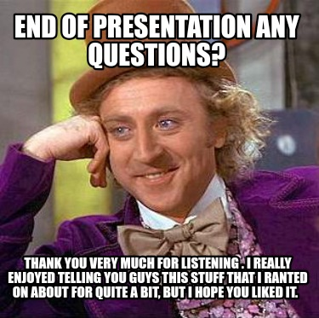
Questions

Slide 13
WHAT’S MACHINE LEARNING?

Slide 15
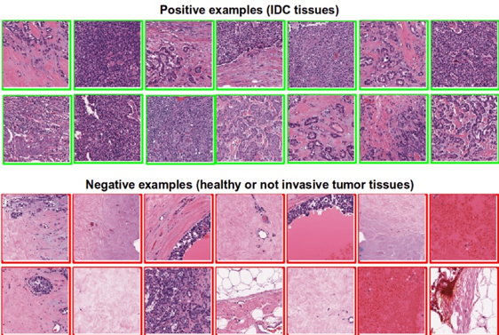
Is this Cancer?

Slide 16
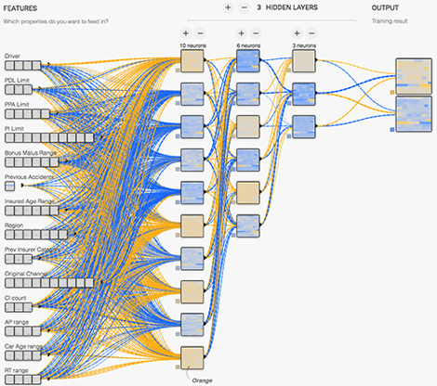
How Risky is this driver?

Slide 17
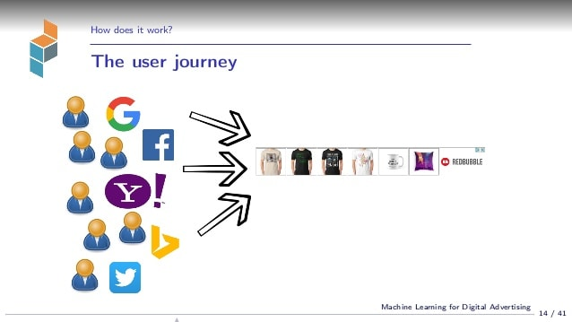
Who’s Going to Buy My Product?

Slide 18
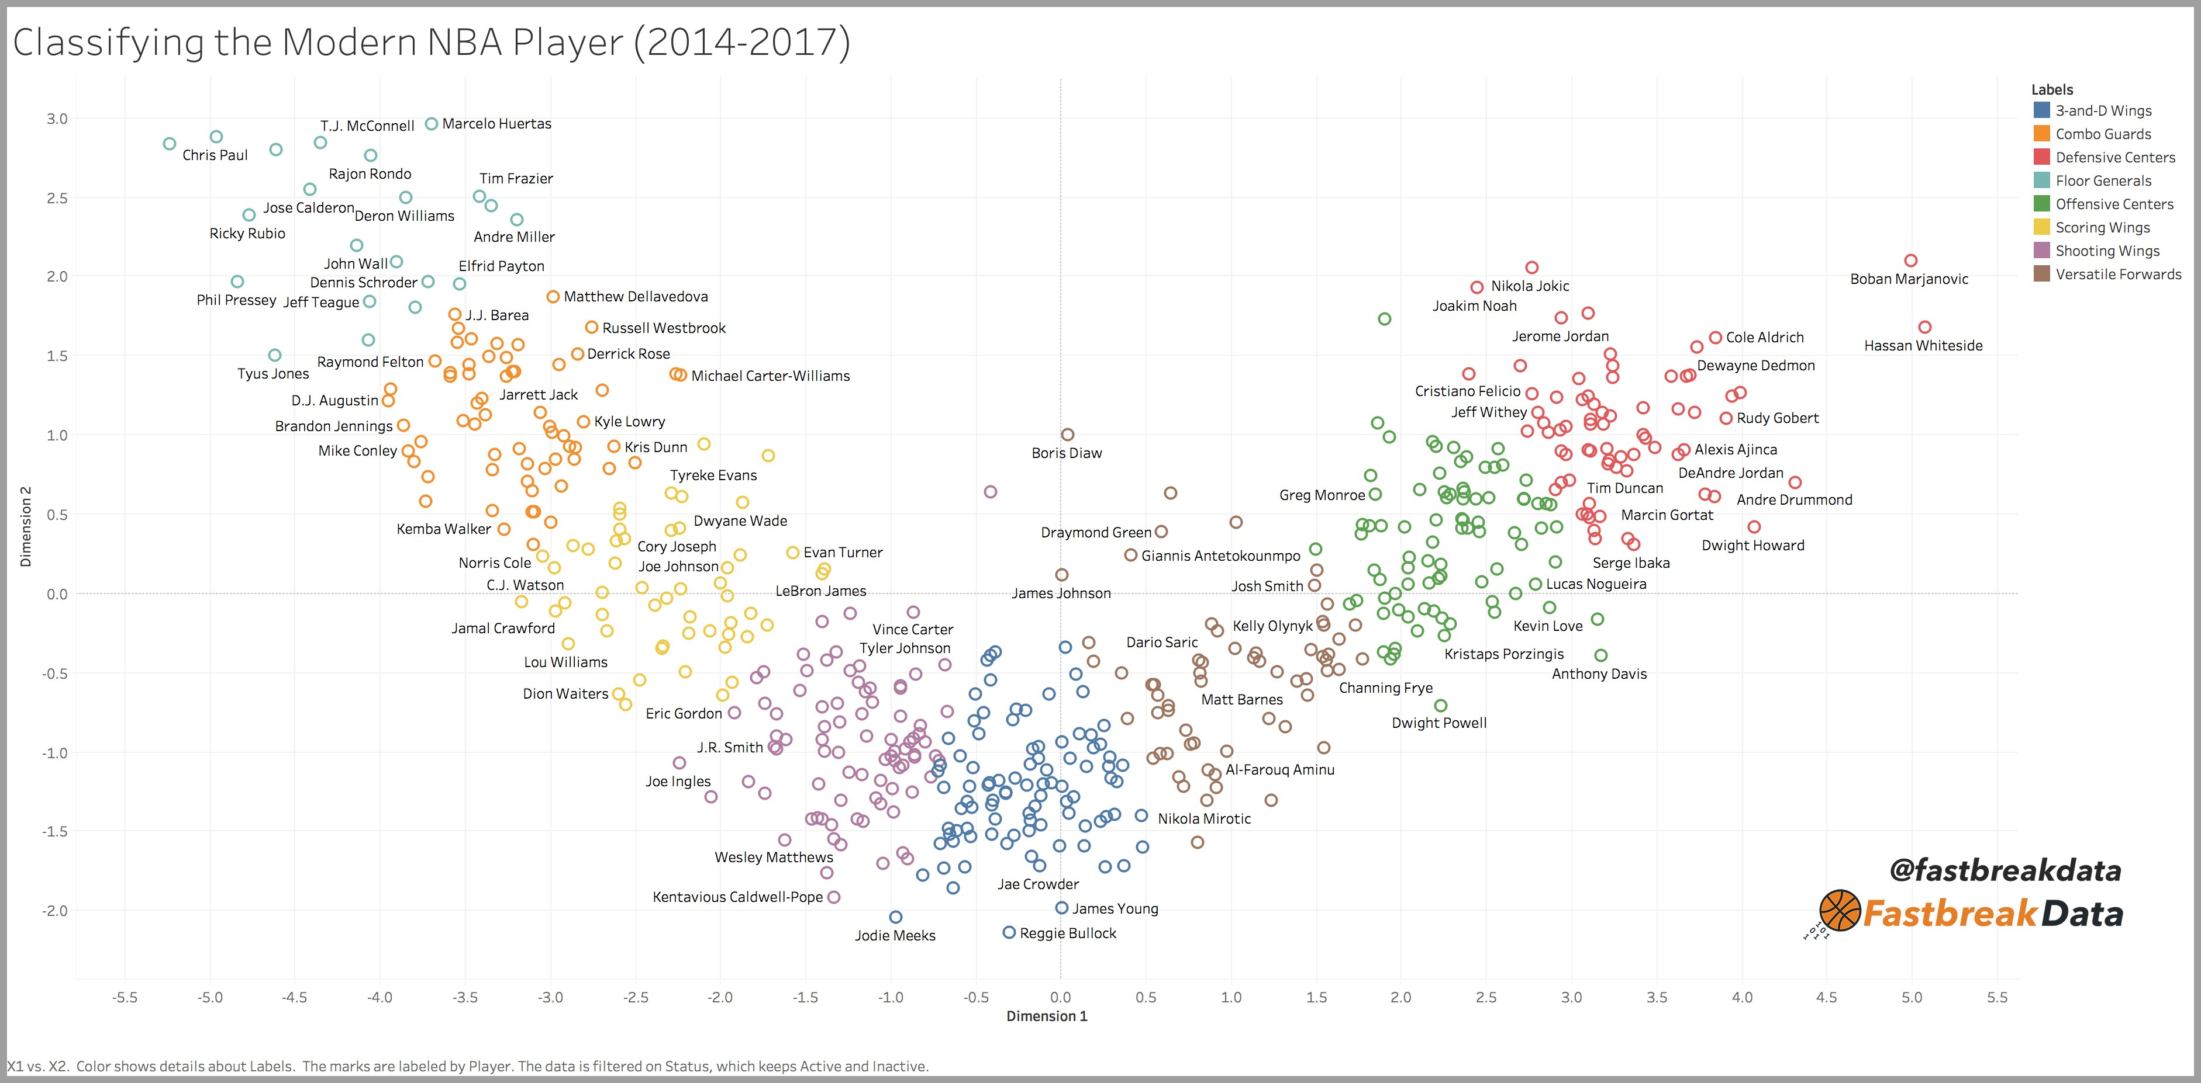
Is this Player Going to Excel in the NBA?

Slide 19
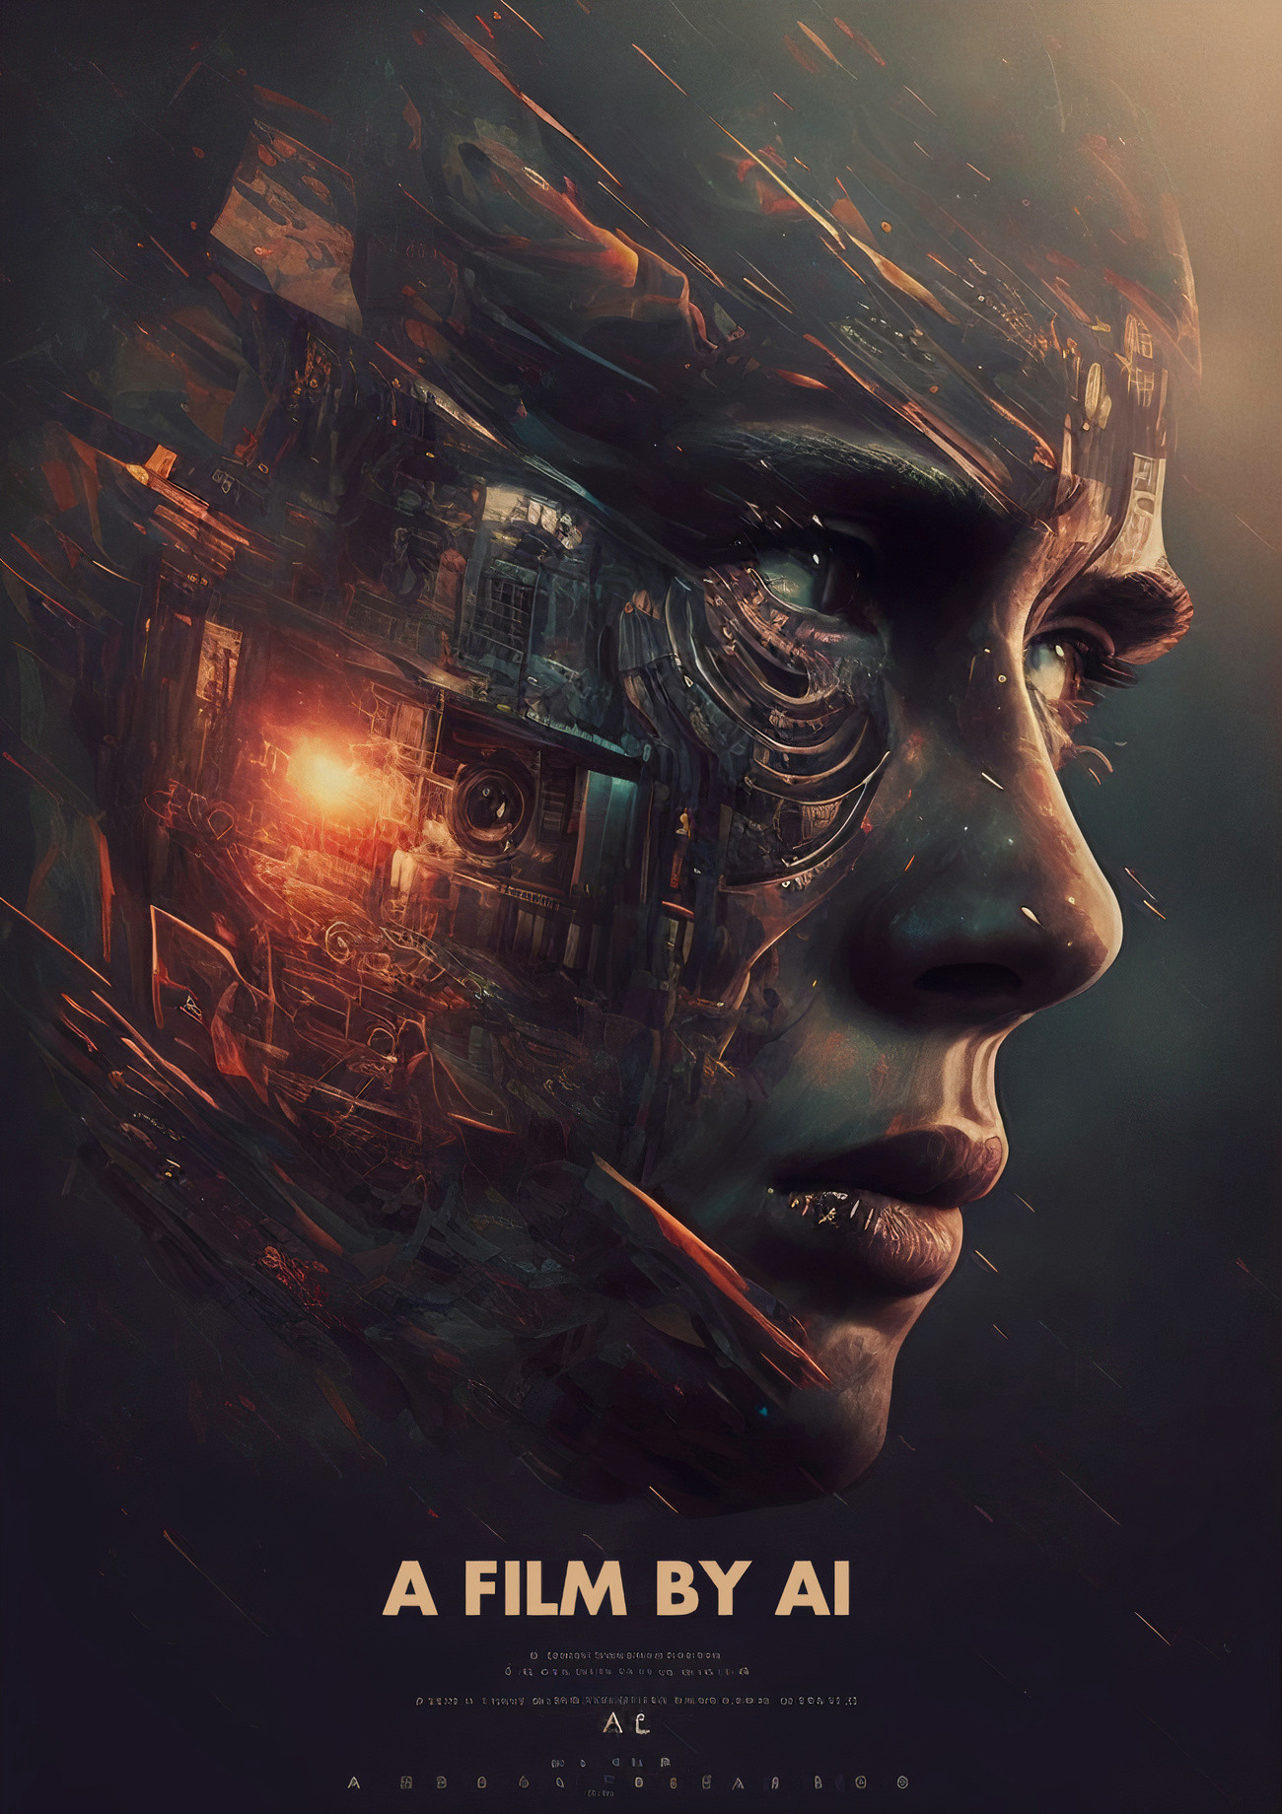
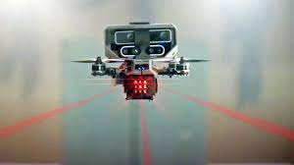
It can also allow people to destroy the concept of human creativity or create an army of AI powered killing machines.

Slide 20
MACHINE LEARNING BASICS
Computerized information systems allow us to capture massive amounts of data.
Machine learning is using computers to detect patterns and use those patterns to make predictions.
Basically – if we have a lot of old examples, the computer can become really good at learning patterns and making predictions.

Slide 21
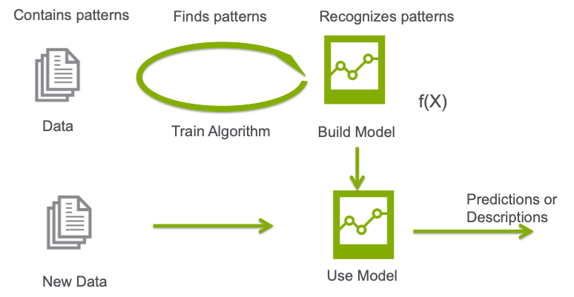
What’s the Key?
We don’t tell the computer how to make predictions.
We give the computer old examples, it figures out how to make predictions itself.

Slide 22
Old Concepts, New Applications
That idea isn’t new:
How do you predict if a restaurant will be good?
If a job is worth applying for?
If someone will date you?
The scale, breadth, speed, and accuracy are new.
More data and smarter models means that more subtle patters can be found.
We can apply this almost anywhere that we have data.

Slide 23


Slide 24
What’s this Deep Learning Bit?
Deep Learning uses neural networks – one type of algorithm of machine learning.
The DL algorithm can be replaced with linear regression, trees, or any other algorithm and the concepts are the same.
(Virtually??) All of the cool AI things are based on deep learning models.
Image recognition.
Large language models.
Image and video generation.
Deep learning models can be very powerful, but need lots of data.

Slide 25
The ML Process is Simple
The machine learning process will always involve a few basic steps:
1 – Collect data on what we care about.
2 – ‘Clean’ that data up.
3 – Give the data to the algorithm to learn.
4 – Evaluate and revise if needed.
5 – Let the model generated from the algorithm make new predictions.
Our work here is generally in stages 2 to 4.
There are many different models that will work, we need to try to find a good one.

Slide 26
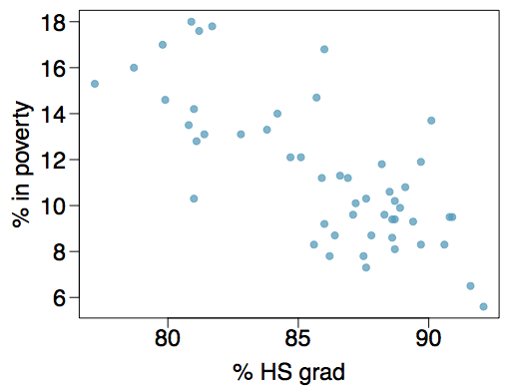
Review – Regression and Gradient Descent

