Slide 1
Embeddings in NLP – finish looking at the last bit.
SVD – there’s a detailed step-by-step thing in the repository docs folder.
Principle Component Analysis.
Dimensional reduction.
Some math background.
Using it.

Slide 2
PCA and Dimensionality Reduction

Slide 3
Truncated SVD Review and PCA
In processing text we looked at Truncated SVD.
TSVD took high dimension features (from text) and transformed it to a much lower dimension feature set.
Truncated SVD is one algorithm for dimensional reduction.
PCA – Principal component analysis is another dimensionality reduction method that is very common in general predictive modelling.

Slide 4
Unsupervised vs Supervised
PCA (and SVD) are both examples of Unsupervised Learning.
Classification and regression are examples of Supervised Learning.
Supervised learning has labeled training data, unsupervised does not.
Unsupervised learning classes:
Dimensional reduction (SVD and PCA).
Clustering (next class)
Association (e.g. market basket, such as Target’s pregnancy scoring)
Unsupervised learning generally looks to discover the underlying structure in data.

Slide 5
PCA is Simple
It’s art time, control your excitement.

Slide 6
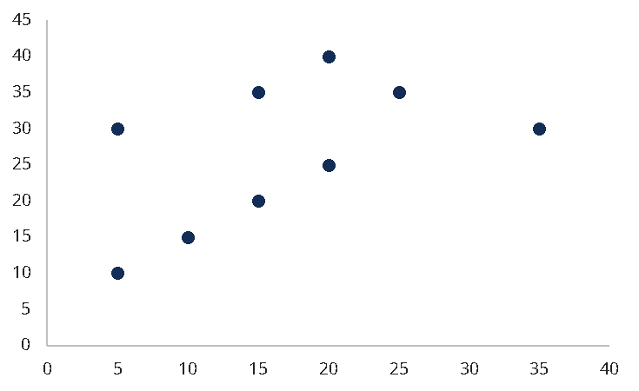
X₂
X₁

Slide 7
X₂
X₁

Slide 8
X₂
PC₁
PC₂
X₁

Slide 9
Principal Component Analysis
PCA is a general method of dimensional reduction.
Data is broken down into “principal components”, and only the most influential are kept.
Principal components are linear combinations of original variables.
The components are uncorrelated with each other.
The first ”few” components contain most of the information.
Components are orthogonal to each other.

Slide 10
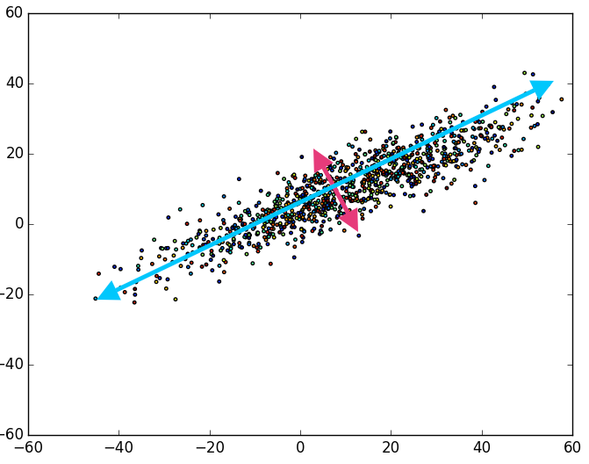
PCA Example
The points here have 2 features – X and Y.
There are two principal components – Blue and Pink.
Each is a combination of X and Y.
The blue component contains most of the variability in the data.
The pink contains much less.
The two represent the same thing as X and Y, but ”puts” more info in Blue than X.
These components are called Eigenvectors.

Slide 11
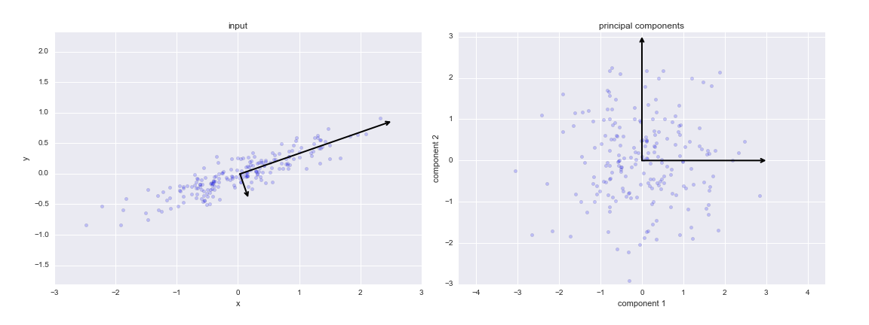
PCA Transformation
We can plot data on an axis of its components.

Slide 12
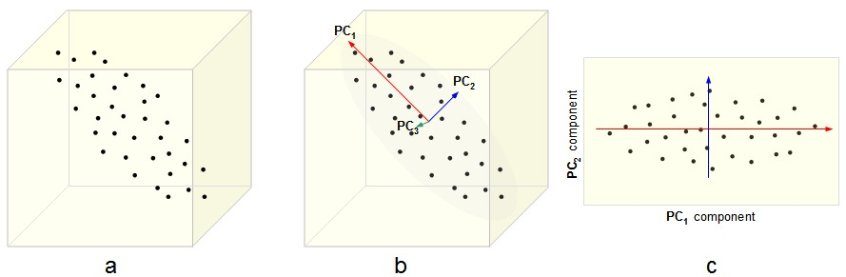
In 3D

Slide 13
What’s the Math Doing?
We can look at the math for PCA, it is relatively straightforward.
If your linear algebra skills are up to snuff, you can do small ones by hand, but not needed.
Our PCA function gives us the end result, after the last step of math-ing.

Slide 14
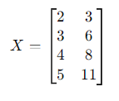
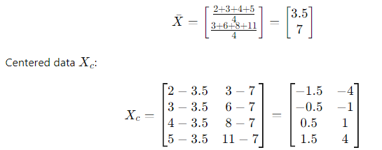
Dataset
Suppose this is our data – 2 features, 4 records.
The first step is to center the data.
Note – outliers and scaling are needed for good PCA results.

Slide 15
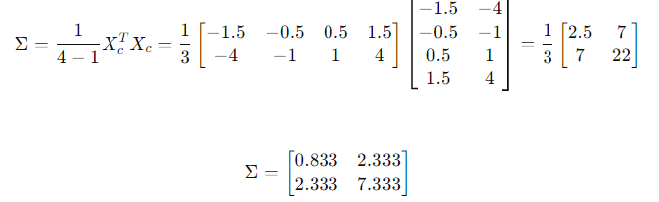
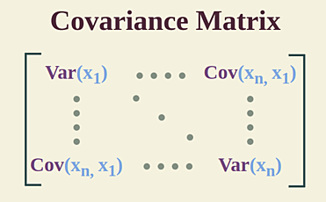
Compute Covariance Matrix
From the centered data, the covariance matrix can be computed.
The covariance measures the correlation between features.
The variance is on the spine.

Slide 16
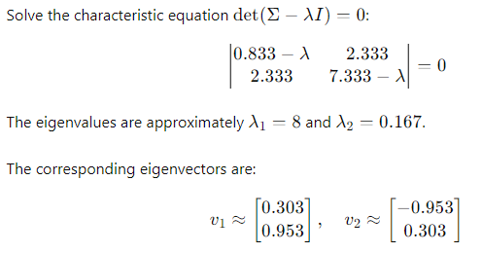
Calculate the Eigenvalues and Vectors
The covariance matrix can be used to calculate the eigenvalues and eigenvectors through a process called Eigenvalue Decomposition.
The magnitude of the e.v. tell us the PC rank.
The vectors define the projection.
We matrix-multiply the data by the eigenvectors we use, that results in the final dataset.
Values in vector are the weightings of features.
*I’m 95% sure from linear algebra class that it is also a point combined with origin that defines the plane. I couldn’t find a definitive yes in text though.

Slide 17
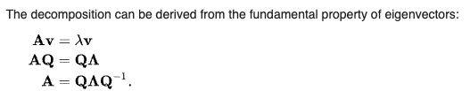
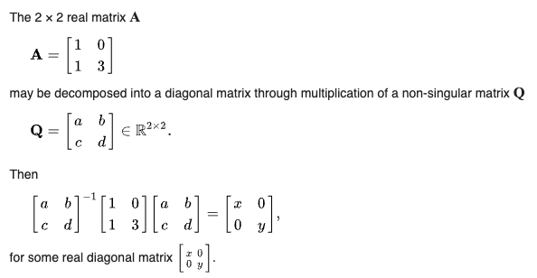
While We were Decomposing…
The ‘characteristic equation’ from the previous slide is derived in a larger operation.
Earlier in that derivation, we can see the idea of PCA as the matrix is diagonalized.
What this means is that the covariance matrix can be set so all non-spine values are 0.
If covariance is 0, they’re orthogonal. (Like an axis!).
All variance is captured in one of the values.
This eventually simplifies to the characteristic eq.
We insert data there, and save this math stuff.

Slide 18
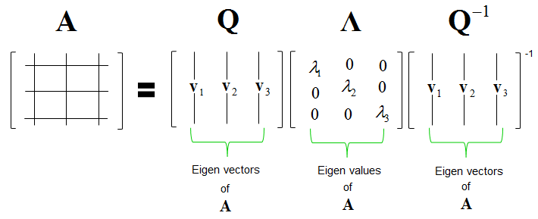
In Pictures…
We have a rule that allows us to solve this if we have a matrix of data.
The other stuff are different variations of this formula at different points.

Slide 19
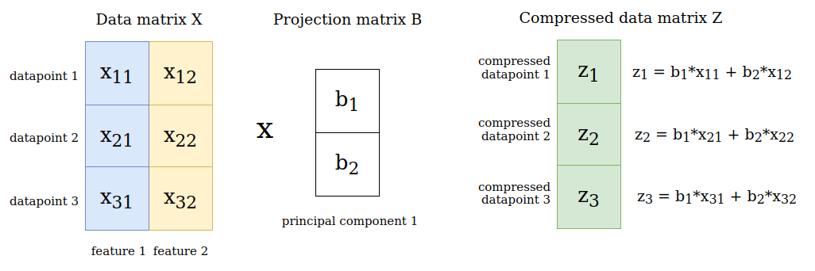
Once Acquired…
Once we have the eigens, producing the final dataset is simple.
Determine how many components to keep.
Project into that many dimensions – this is all linear algebra, so pretty quick to calculate.

Slide 20
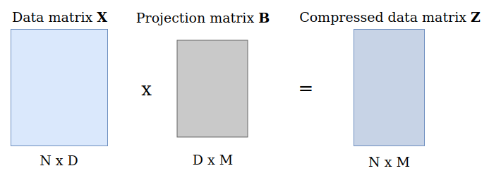

Slide 21
Animated and Interactive
Check: https://setosa.io/ev/principal-component-analysis/

Slide 22
PCA and Variance
PCA frequently refers to variance.
Each feature “explains” some amount of the variance in a target.
The more a target varies with a feature, the more that feature explains it.
Think of correlation.
The total amount of information in the dataset is spread amongst all features.
PCA takes the components that explain most of the variance, and ditches those that explain only a small amount.
We redefine features->PCs, all the information is still spread over all, but now less equally.
Result – we can find most of the info on our target, with fewer inputs to a model.

Slide 23
PCA and Feature selection
PCA reduces dimensionality, just like feature selection.
PCA isn’t feature selection:
Feature selection removes features.
PCA removes components that are created from a mixture of those features.
With PCA the features themselves aren’t removed.
In general:
Feature selection is still good, especially if there are features that are minimally helpful.
PCA is most useful when the dimensionality is very high.
One, the other, or both may be useful - it depends on the scenario.

Slide 24
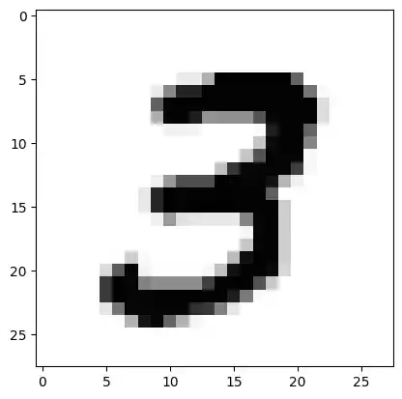
PCA vs Feature Selection
We can look at an image for a more clear example.
If we feature select, we lose a pixel (1 feature).
This might not be too bad here, some pixels around the edge probably don’t matter much.
Lose all of one specific part of the data.
If we PCA, we lose a component.
This component is constructed of some information in each pixel.
Some matter more, so the least useful component ‘has’ less info.
Lose a ‘little off the top’ from all parts of the data.

Slide 25
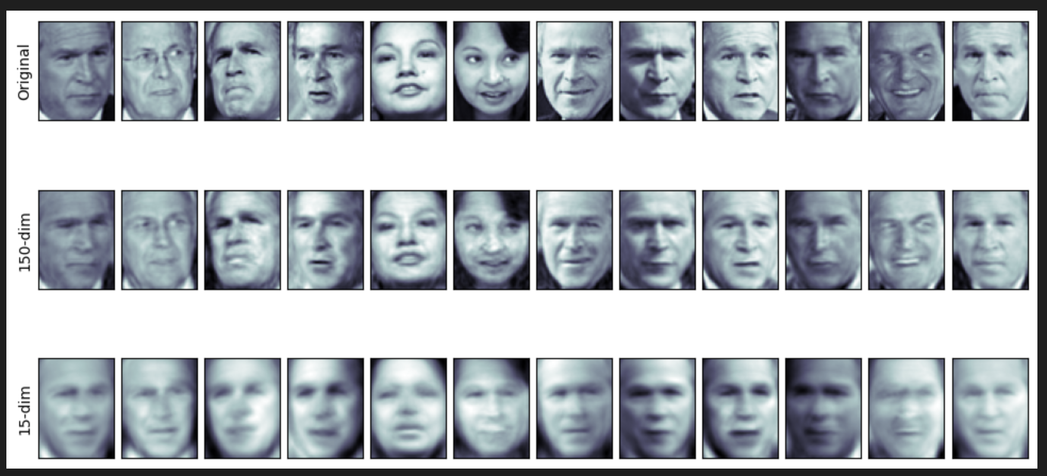
PCA Impacts
This shows images PCA’d at:
~3000 features.
150 features.
15 features.
We keep most valuable info, while cutting most size.
The info losses are spread across all features.
Each pc is made of all feats.

Slide 26
PCA Conclusion
PCA is quite common, especially when there are a lot of features.
PCA can also serve to help with noise reduction – large feature sets, high irreducible error – picks the important bits of value out, and shrinks the dataset.
PCA does not work (logically – it’ll still run) with categorical variables.
There’s a rough equivalent called MCA (multiple correspondence analysis - oos).
PCA needs scaling and outlier filtering to be reliable.
PCA is/has been used for lower power devices – e.g. image recognition on a rasp. pi.

