Slide 1
Housekeeping
Today – tuning, tensorboard, raytune.
  First – outline of tensorboard and raytune tools.
  Next – common tuning options.
  Finally – try to log some of those tuning options with tensorboard or automate with R.T.
There’s a new, simple, neural network assignment up.

Slide 2
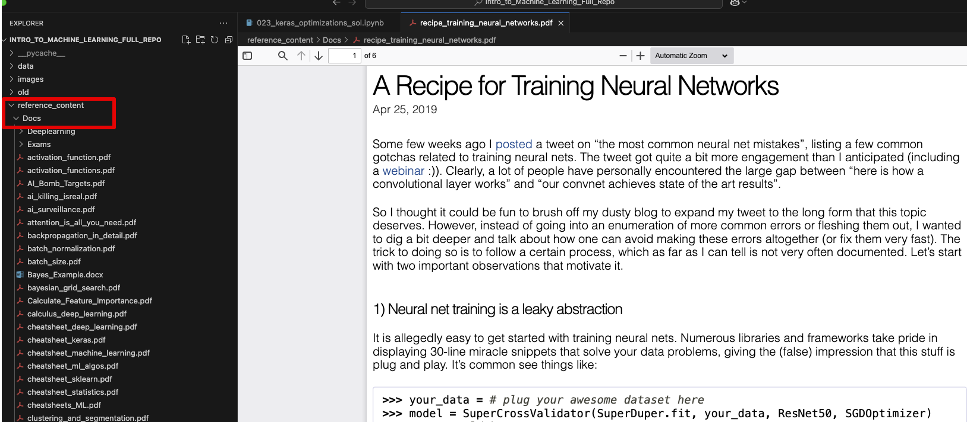

Slide 3
Project (Other Class) Stuff
If you are still doing real estate, think about large scale feature construction.
You can make many features from latitude and longitude that may matter.
  I’d make a lot of them, since you have a lot of data, and let the model sort it out.
Directly calculable via spatial joins and spatial files you can find online (Google mapping/spatial/gis):
  Distance from almost anything – roads, schools, water, commerce, neighbors, etc.
  Stats – density, comparison to neighbors, trends, crime, construction, census data (wealth, education, etc.)
Calculable with potentially free services online – time to get places, real estate stuff, sun.
Possible with large scale scraping – real estate data, all kinds of other stuff.
I’d try to cast as wide a net as possible and get almost anything I could automate as a start.

Slide 4
Cluster Assignment - Results
The basic steps needed are:
  Cluster the original data to break the numbers into similar groups. (k-means, other…)
  Manually add a label – each group is similar, but we don’t know what it is a group of.
  Now you have labeled groups of digit images.
  Train 10 (or more) GMMs, one that ‘knows’ each number from the data used to train it.
  When asked for a printout, ask the right GMMs for a digit each, assemble.
Overall, the images tend to be OK at best, some improvements:
  Number of clusters can be >10, to capture different digit variations. GMMs can as well.
  Some cleaning/processing (PCA, feature selection, etc..) may help, requires much tuning.

Slide 5
Cluster Assignment
Common issues:
  Assorted mix-ups applying labels to clusters.
  Training GMM timing/location.
Adding labeling:
  This feels weird to lots of people, but it isn’t really all that rare. (LLMs and gen models).
  The clusters are able to be ‘pure’ on their own, but we need to add the label info ourselves.
  This could be supplemented by other models – e.g. manually label enough, then use classifier.

Slide 6
Neural Network tuning and Optimization

Slide 7
But First – Get Board
Tensorboard is a tool we can use to monitor training.

Slide 8
Neural Network Configuration
We’ve seen that neural networks offer a large amount of flexibility in their configuration.
How do we determine the optimal structure?
Generally, the true answer is to grid search it.
  Neural networks are very flexible, and can ‘learn around’ lots of changes.
We can use some guidelines to get started in a reasonable and smart way.
  Problem types (image class, NLP, etc…) have architectures that work well, and most things (except innovations) are based on what worked before.
This is largely getting used to pytorch and making adjustments there.
  Play around with some models, get used to syntax, try some different models.
More of our focus is now on speed – the faster we converge, the more we can test.

Slide 9
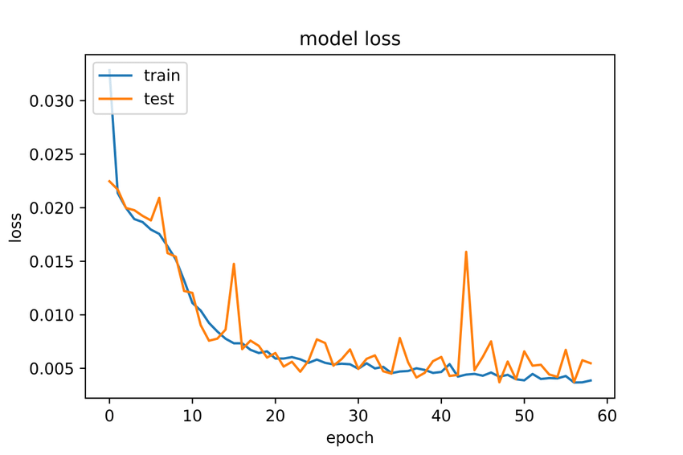
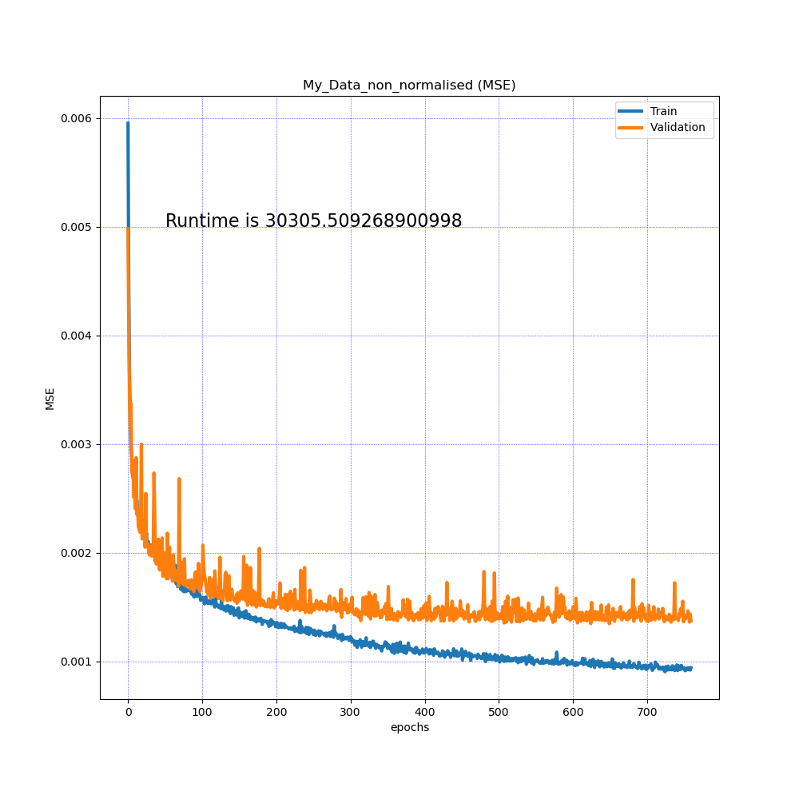
Converging Loss Plots
Our main tool for monitoring training is the loss plot.
We are looking for, ideally, where the validation loss flattens, or minimizes and starts to increase again.
  The more stable, the more reliable, but it won’t always get this smooth.
These show an accurate small and large model – small is more jumpy.
  Error scale on Y are very small on both.
Training loss seems to be flattening as well – convergence.
  The ball has found the low point of the gradient curve.
  It may bump around a little, but we’ve found the bottom of loss.
The smaller the gap, the less overfitting – small and stable is ideal.

Slide 10
Tensor

Slide 11
Network Size
The first thing to look at is the network size, or capacity.
The more neurons a network had, the higher the capacity.
In general, larger networks need larger amounts of data, to find more complex relationships.
We can examine the two metrics of size:
  Neurons per layer (width)
  Number of layers (depth)

Slide 12
Width vs Depth
When we make a neural network, should we favor width or depth?
In theory one hidden layer can approximate any function.
  Universal approximation theorem – one layer can in principle learn anything.
In general, depth is preferred more often. Why?
  Wider networks are more prone to overfitting.
  Deep networks can find representations of data with each transformation (see in CNNs next)
  We can apply regularization or normalization between layers to counter overfitting.
  We can make models with more complex structure – layer types and connections.
  Deep networks can kind of feature select as less significant features are minimized.
  Data with complex relationships (’natural’ stuff) tends to do well with deep models.

Slide 13

Deep Learning
For modern usage most/all of the “cool things” that AI can do is due to deep networks.
Reasons:
  Layers can extract different representations of data. (More on this next time).
  Opportunities to regularize.
  Less overfit prone than wide models.
Practical evidence is that deep models are generally better.

Slide 14
Example: ImageNet
Imagenet is a dataset developed in the late 2000s to help computer vision.
  Thought – better dataset leads to better models.
Nested set of 3.2 million (initially) to over 13 million (now) images with labels.
  Labeled largely through Mechanical Turk service.
  Hierarchical labels – e.g. a chair is a type of furniture, a dog is an animal.
Became benchmark of image recognition accuracy.
From ~2012-2013 to ~2015-2016 networks got deeper and losses fell.
  In addition to use of CNN architecture – next time.
  Improved GPU speed and utilization drove success.
  Why GPU? The multidimensional tensor operations are similar calculations to 3D space.

Slide 15
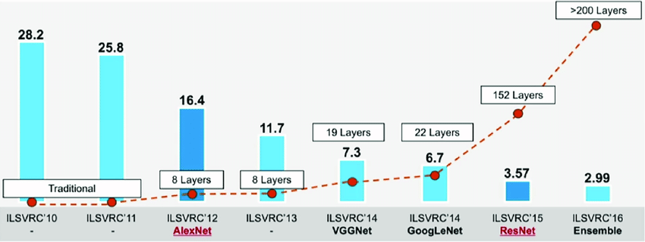

Slide 16
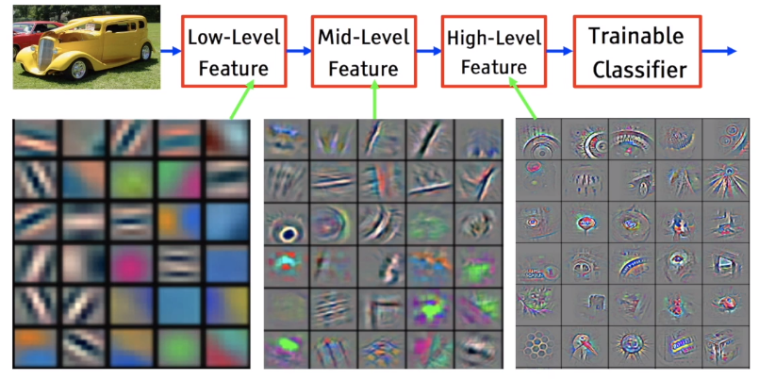

Slide 17
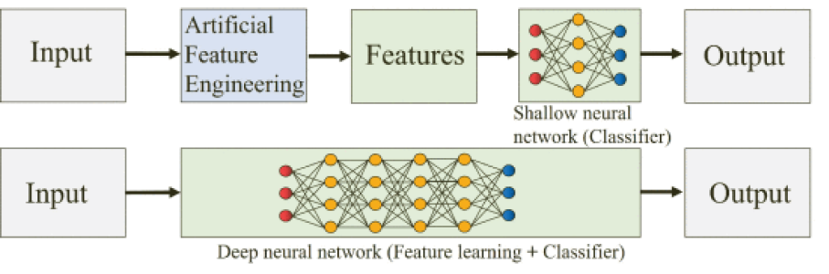
Neural Nets as Feature Constructors (extractors)
We can also think of a deep neural network split into two pieces:
  The final layer to do the classification (or regression), normally called the ‘classifier’.
  The initial layers to construct the best features that allow the classifier to be accurate.
Final layer is a logistic regression, other layers are a smart feature constructor.

Slide 18
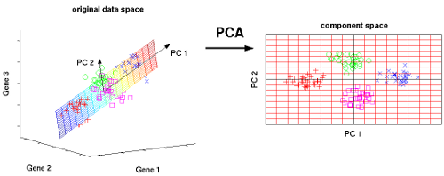
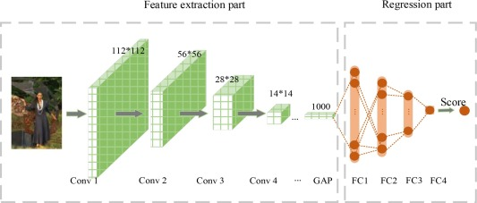
NN Feature Construction Vs Pca
We can also picture this compared to PCA.
PCA does a simple linear transformation on features to generate new features that are better predictors.
  PCA is a specific calc – it does what it does.
NN layers do a non-linear transformation on features to get new features that are better predictors.
  NN training is smart, it’ll adapt each batch based on the results – the potential is far higher.

Slide 19
So how big do I make it?
Big enough to be capable of overfitting – don’t obsess too much on details unless bored.
See more specific guidelines in workbook.
  Start with 1 to 3 layers the same size as the input (or ~512-768 if input is big).
  Add layers to overfit that are about the same size.
  Try with layer size “funneled” down layer by layer.
  Add regularization and normalization to cut overfitting.
  Prune network back in size, if still overfitting.
A real answer is grid search, this should get us close enough to start with.
If doing something big, base it off something that works and adjust as best you can.

Slide 20
Data
Improving and increasing the data size is the best possible optimization.
Scaling numerical data can often have large impacts:
  Ensure outliers are handled and data is scaled.
If practical, increase data size – real or by augmentation (later).
If we have high dimension categories, that can lead to very sparse data:
  Many high dimension categories will add lots of features to the data once encoded.
  This will make lots of sparse data – many features with nearly zero information.
  This isn’t wrong but may lead to poor and slow results, especially without many records.
  Consider feature engineering (‘other’ group, consolidation, selection) these first.

Slide 21
Epochs and Batches
Each epoch is an execution of one fp/bp through all of the data.
  Easiest method is to set early stopping and let the computer figure it out.
  Really big models might only have one epoch through the data total.
Batches are how many records to process before updating weights.
  Just like regular gradient descent – higher is more stable, smaller more erratic.
  Limited at the top end by memory capacity.
  Large vs small is still a matter of debate and varies by data.
  Recently, smaller batches (as small as 2 -32) seems to offer better generalizable models.
  Big batches may process far faster – better HW utilization and fewer weight updates.
    Think – weight matrix per layer is input_size * output_size. 512 * 512 = ~250k updates

Slide 22
Optimizer
The optimizer is the algorithm used for gradient descent.
The internal details aren’t super important for us, at least for now.
Adam is the most common and is a good choice for most scenarios:
  Converges efficiently – manages different rates for each gradient.
  Computation and memory efficient.
  Adapts separate learning rates for each parameter using moving averages of several moments.
  Tends to not be too negatively impacted by parameters or different data – defaults work well.
The actual best performer depends on model complexity, data, and the shape of the gradient curve.
There’s several variants similar-ish to Adam, simpler SGD may perform better on ‘simple’ NN.

Slide 23
Optimizer
In a logistic regression the ‘descent’ part of g.d. is pretty simple.
In a 20 million dimension plane, it is much less simple.
We are (potentially) in a real time crunch, processing can be measured in weeks.
We need something that is efficient, even if every process will result in the same answer.
Not converging fast enough to be usable is a real concern with NN.

Slide 24
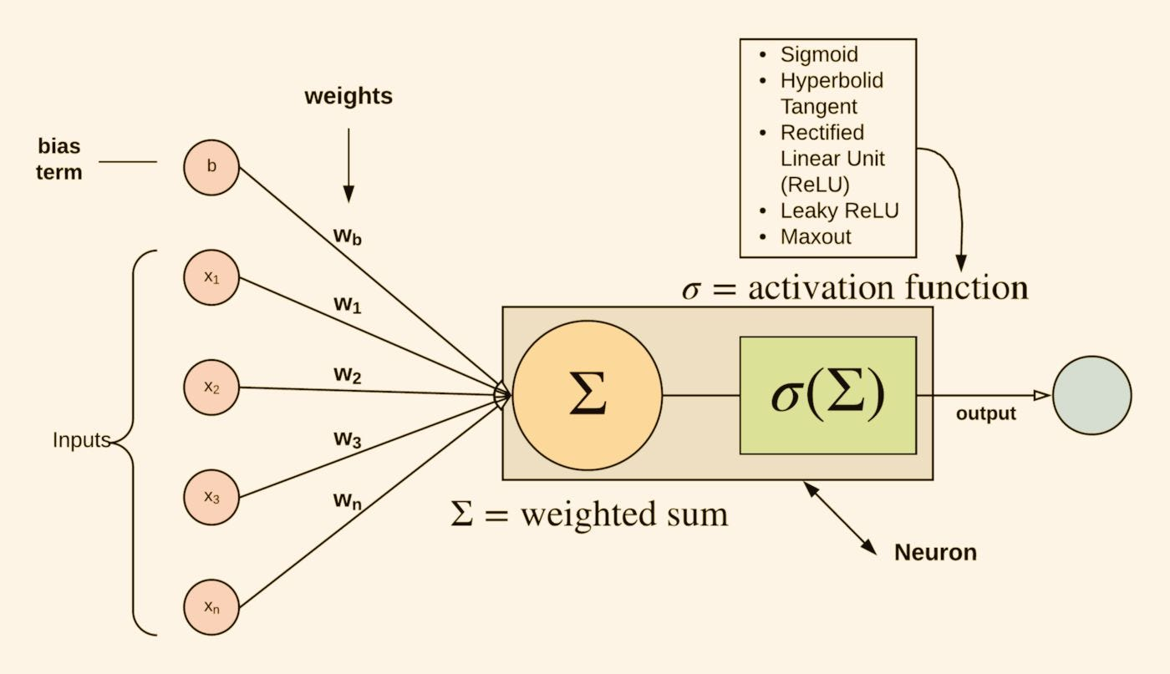
Activation Functions

Slide 25
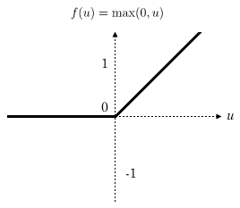
Activation Functions (Hidden Layers)
Activation functions “squish” the linear combination in a neuron into an output.
Typically use defaults/variants per layer/model type.
They provide non-linearity that neural networks need.
  No activation function = giant, complex, linear regression.
ReLU – Rectified Linear Unit has been our default.
  Efficient computations, converges quickly in most cases.
  Acts as a trigger – suppresses negative inputs, passes positive.

Slide 26
Activation Issues

Slide 27
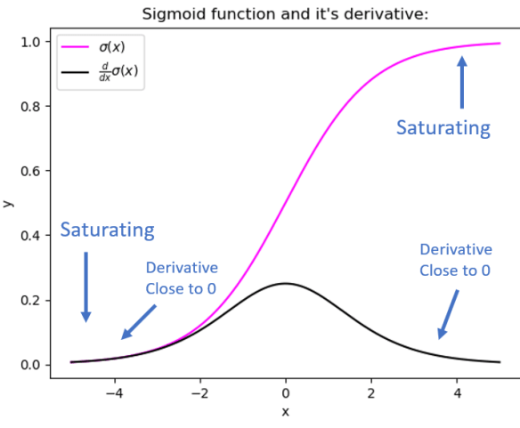
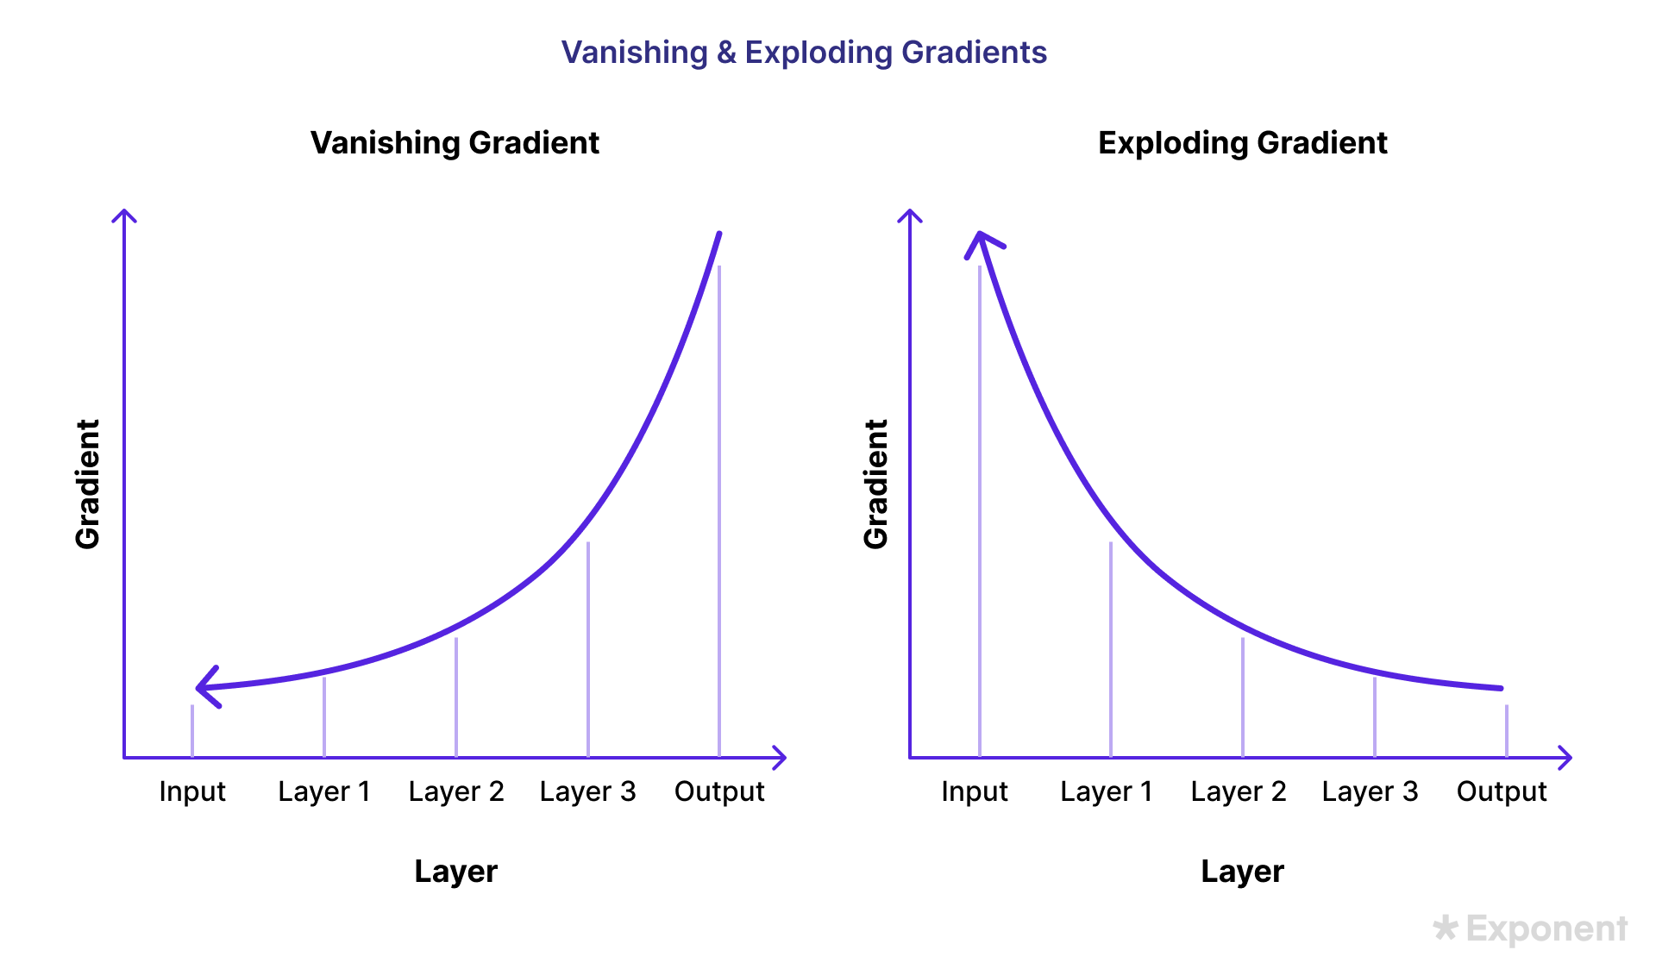
Vanishing Gradients
Recall – gradient descent attributes error to different weights using the gradient (slope of the cost cure w.r.t. that weight).
Recall some neural network training facts:
  They have many weights.
  Propagate loss back through all layers, and there can be many.
  Often train over many rounds, and get very accurate.
We can encounter a problem that small changes to small numbers from small error split many ways yields tiny values.
  The gradient can “vanish” if it is too small for the GD to work.
  This can lead to ‘dead’ models, that can’t keep learning.
Exploding gradient is opposite, more common with tanh and deep networks – things grow multiplicatively.

Slide 28
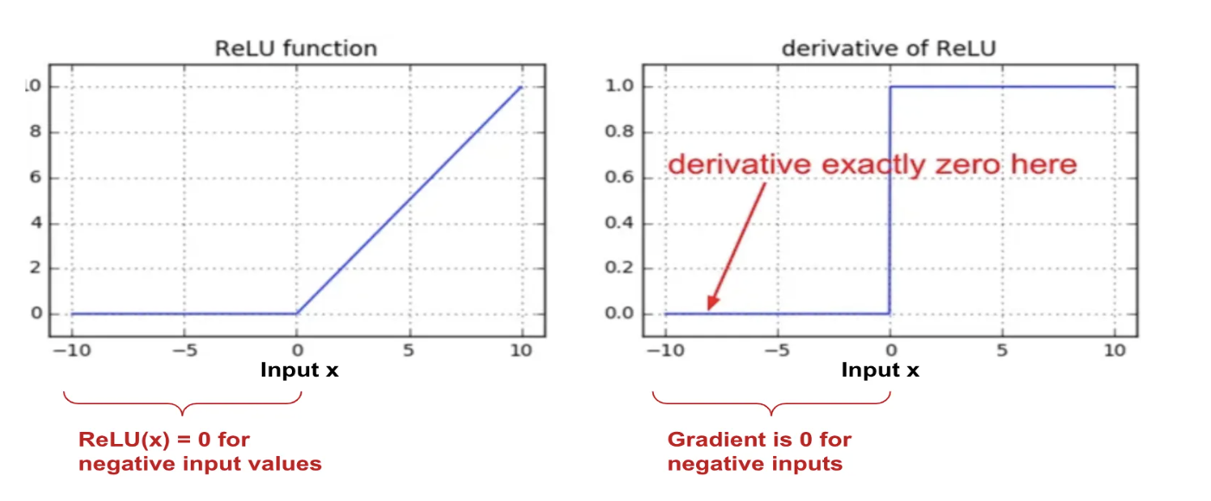
Dying relu - Weight Updates
Relu can suffer from ‘dying relu’.
It is less prone to this than others, that’s a strength.
Negative inputs yield 0 gradient
0 times anything is always 0.
If this happens for all inputs, the neuron may ‘die’, or become unable to ever ‘escape’.

Slide 29
Keeping Gradients Graded
These issues would be seen in loss as the model stopping learning.
  This definitely isn’t the only reason!
There are several things that can combat this problem.
  Activation functions – the sigmoid gradients can flatten more than others, tanh can explode, relu can die.
  Batch normalization.
    Recenter each batch, to prevent being stuck in saturated areas.

Slide 30
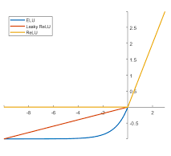
Activation Functions – Relu Variations
To address those issues with ReLU, alternatives were created:
  Notably – Leaky ReLU and ELU (exponential linear).
Each removes that 0-value range of the derivative.
  Removes the Dying ReLU issue, so gradients don’t vanish as much.
  Can help speed training, or even allow convergence at all.
ReLU or a variation on it are our defaults, and normally good.
If using ReLU – reducing LR can also combat the dying issue.
Note – this isn’t the most likely thing to be a massive issue, the case specific defaults tend to perform well most of the type.

Slide 31
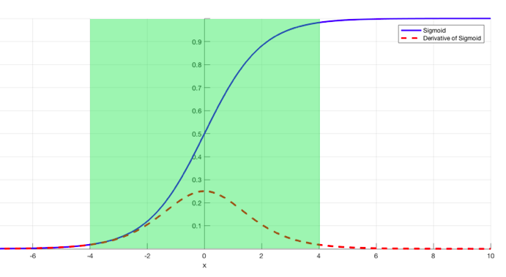
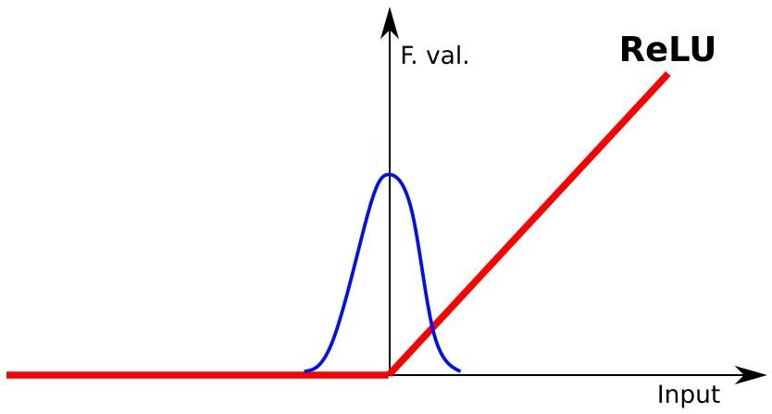
Batch Normalization
Another gradient maintaining technique is batch normalization.
Batch normalization will shift the distribution back to “the middle”, where gradients exist.
  “Flat” gradients may vanish – near 0/1 with sigmoid.
  In relu, may die and go negative where there’s no gradient.
Usually applied after dense layer, but can vary.
Can often allow higher learning rates to work.
Note: we should normalize normally still.

Slide 32
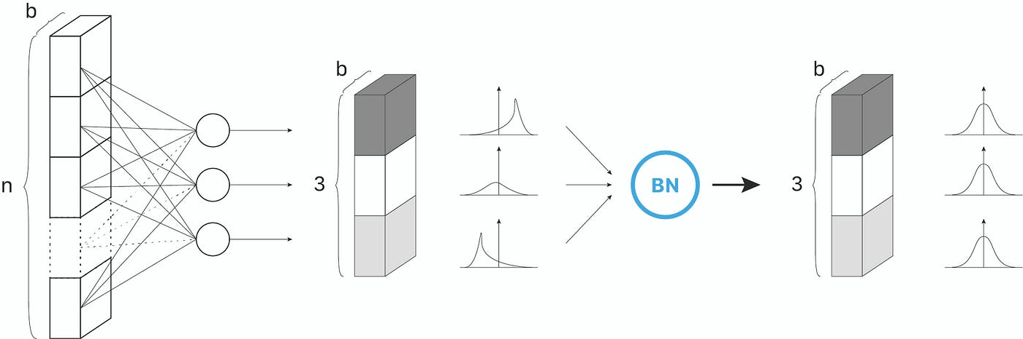

Slide 33
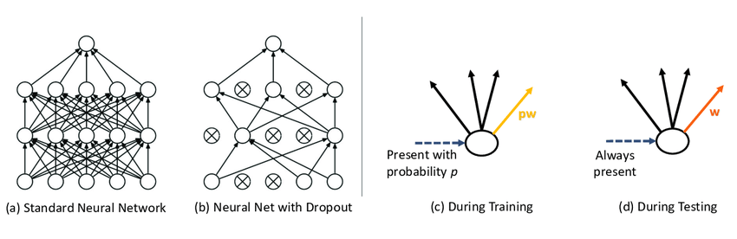
Refresher - regularization
We frequently/typically use some regularization in our models.
  Semi-standard as neural networks are large and flexible, and this constrains overfit.
  L1/L2 – works just as in regression, can be applied in layer as a hyperparameter.
  Dropout – removes some percentage of neurons randomly each batch of training, forcing learning to occur on the remainder. Applied as a layer, typically round 20—40% to start.

Slide 34
Initialization
Initialization controls how the weight and bias values start.
Can be controlled via a parameter for each layer:
  Weight initialization is by default is “glorot_uniform” – a variety of random.
  Bias initialization defaults to 0.
  We can preset the output layer with the log of the expectation (for logit).
This can help the model train – both in speed and potential for convergence.
Imbalanced data – the data has a “bias” to start with.
  Set bias on output layer to the bias in the data.
  Network doesn’t need to learn the massive shift in bias.
  Faster convergence and more accuracy.

Slide 35
Neural Networks are Flexible
This isn’t near all of the things that we can change in a neural network.
The flexibility in their learning as they grow means that a wide range of models that are ‘good enough’ will converge on a good solution.
  E.g. the image competition has models with widely different structures fighting for fractions of a percentage of accuracy in a task.
Mirror something that is known to work, unless experimenting (which is good).
Make reasonable choices, add some excess, regularization, and early stopping, let train.
  Adjust from here based on what you see.
Finding the perfect configuration as we did with a grid becomes time impractical quickly.

Slide 36
Other Tuning - Optimization
There are a huge number of things that can be changed to tune a neural network model.
We are focusing mainly on the ‘structure’ type of things.
  Network size, layers, type, hyperparameters, regularizing (and similar) layers like normalization.
We are not really focusing on the optimization part - loss/gradient descent specific things.
  Learning rates, momentum, optimizers.
  This matters, but is more theoretical in theory, and scenario dependent in practice.
  Optimization is critical as problems get larger – converging quickly, or at all, can be hard.
For our usage, we can mainly try different learning rates, if needed.

Slide 37
Tuning From A Loss Plot
The loss plot is our main, but not only, tool to help tune a model.
None of these things are definitive, but there are things that happen often that we can look at first for a possible solution.
In neural networks, we must weigh against computation time – defaults are usually fast.
Some general things:
  Make sure that data is scaled.
  More complex relationships perform better with more layers.
  The more data you have, the larger a model you’ll be able to train well.
  Unless there’s a time constraint, let things go for lots of epochs and use early stopping.

Slide 38
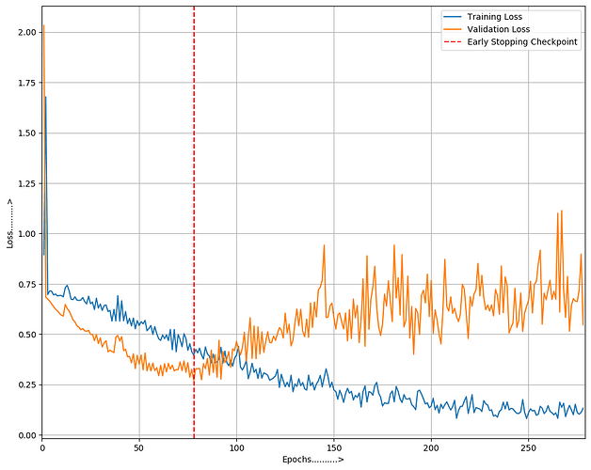
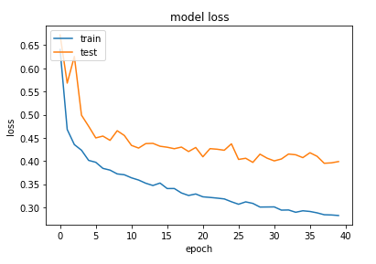
Training and Validation Diverge
Probably the most common issue is overfitting.
  Training gets really accurate, validation is far behind.
  Validation hits a low point, then gets worse as training improves.
Learns everything in training, generalizes poorly.
  Reduce model capacity.
  Add regularization.
  Add dropout layers.
  Early stopping – careful with tolerance settings.
  Learning rate (or lr stuff) change – may be stuck in local minima.
Pattern’s quite normal – gap btwn curves is potential improvement.

Slide 39
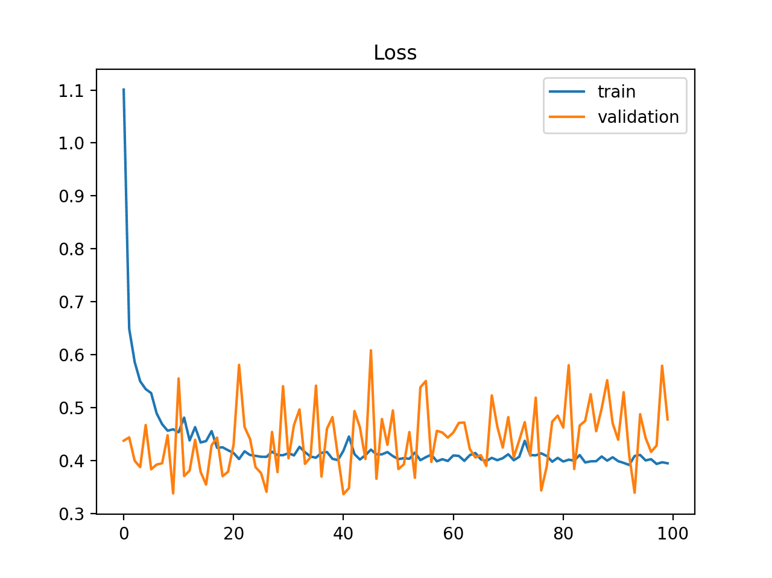
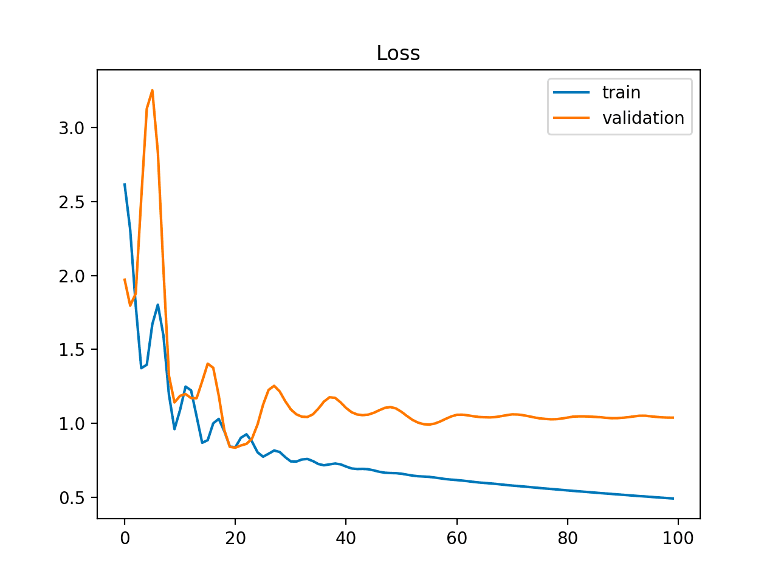
Unstable Plots
Unstable results can have several causes.
Model’s accuracy swings wildly between tests.
  Data processing – outliers, scaling.
  Data size – overall and validation set size.
  Is the data representative, and are train/test splits balanced*.
  Increase batch size.
  Learning rate things – may be ‘jumping around’ instead of converging.
  Initialization (potentially bottom picture).
This can be hard to stop in small data sets – don’t worry too much.
Some instability can happen, if it flattens then it’s probably ok.
  Be aware of scale – if loss difference is small, you might just be zoomed.

Slide 40
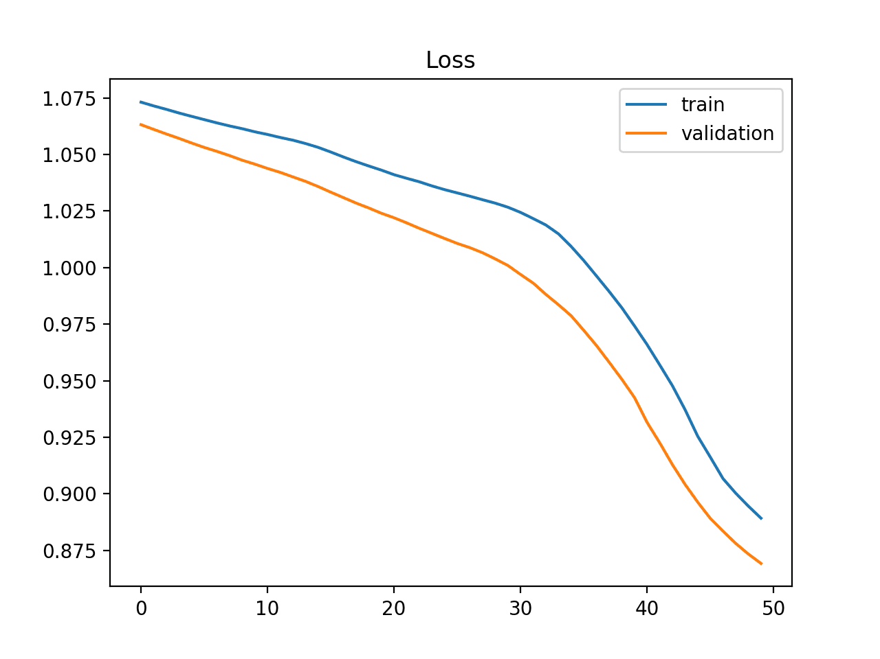
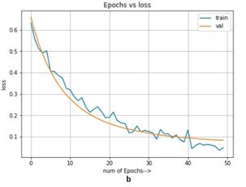
Close/Inverted lines or still Falling
Plots still improving are still learning - underfit.
  Train/val performance is similar/inverted
  Still improving at the end of training
The model could learn more, may be underfit:
  More capacity and more training, higher LR if improvement stays.
  Reduce regularization strength if it is high.
  Easy speed-up (if needed) – bigger batches.
  *The absolute loss in the bottom one is too low to be a great example, picture that shape, with more loss.

Slide 41
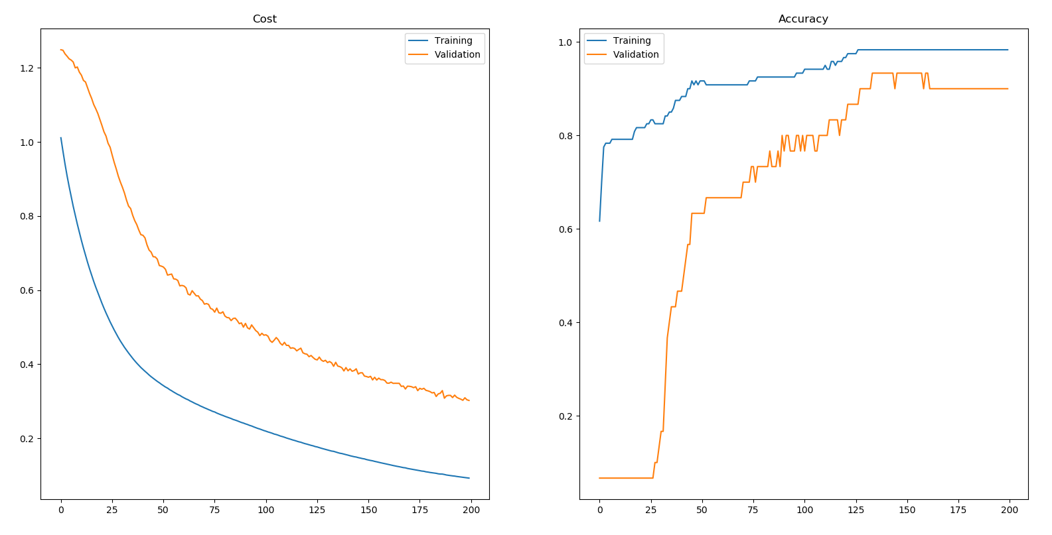
Loss Plot Tuning
We always generate loss plots and they’re the starting point for tuning.
The patterns and suggestions aren’t definitive – things are still highly variable per model.
All of these changes will impact each other, so they’re hard to predict if done in concert.
You want to do this on the loss plot – not accuracy plot.
  Remember 51%/49% and 99%/1% confidence have the same accuracy score.

Slide 42
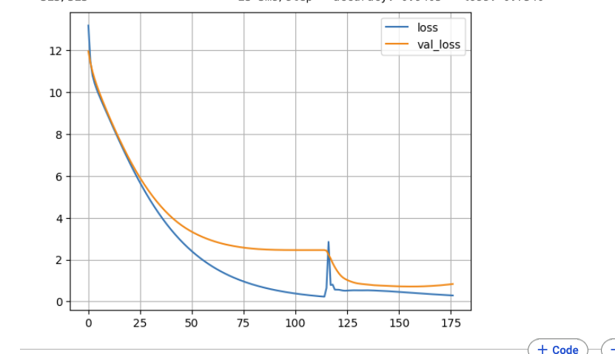
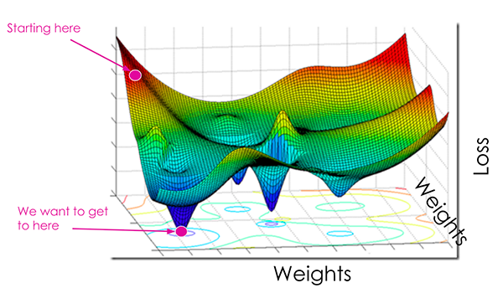
Example – Training is Unpredictable
The training of these models can be unpredictable, especially with complex ones.
  There are many variables that impact the model.
  There’s randomness.
I got one execution that looked like that.
  Validation accuracy went from 93% to 23% to 93%.
The loss curve is not convex and simple.
  Sometimes the results wander quite a lot.
  This is where having the optimizer stuff right shows.

Slide 43
Pruning
Neural networks can get very large!
Like a tree, a trained network may contain parts that aren’t super critical in making predictions.
  As an example, think of “dying relu” neurons.
Pruning can trim a network back by making it more sparse.
Can potentially improve generalization – just as tree pruning does.
Allows networks to be used for prediction with fewer computations.
  Predictions on a computer: one forward propagation, relatively simple.
  Predictions on a phone/raspberry pi/Roomba/drone, can be challenging.
  Pruned models require less processing and less memory, can be used on more devices.

Slide 44
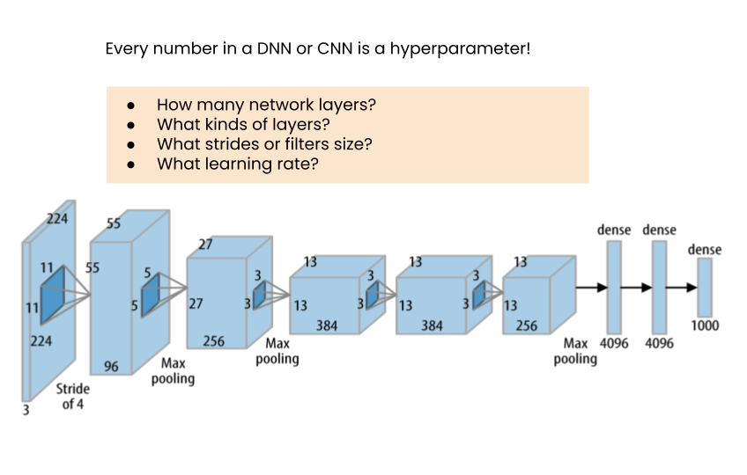
RayTune
Hyperparameter tuning is more involved than a grid search.
  The concept is the same, the tools are different.
RayTune allows us to setup gridsearch-y tuning.
  We can control basically anything if we want.
RayTune also allows for distributed tuning.
  Train models on several systems.
  This adds some complexity, unfortunately.
The idea is relatively simple, implementation may not be.
Provides tensorboard logs by default.

Slide 45
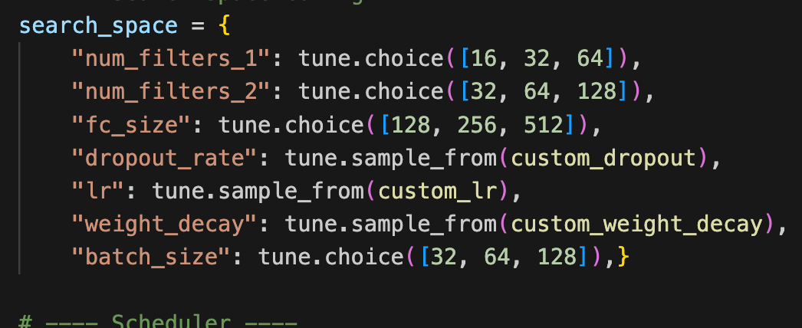
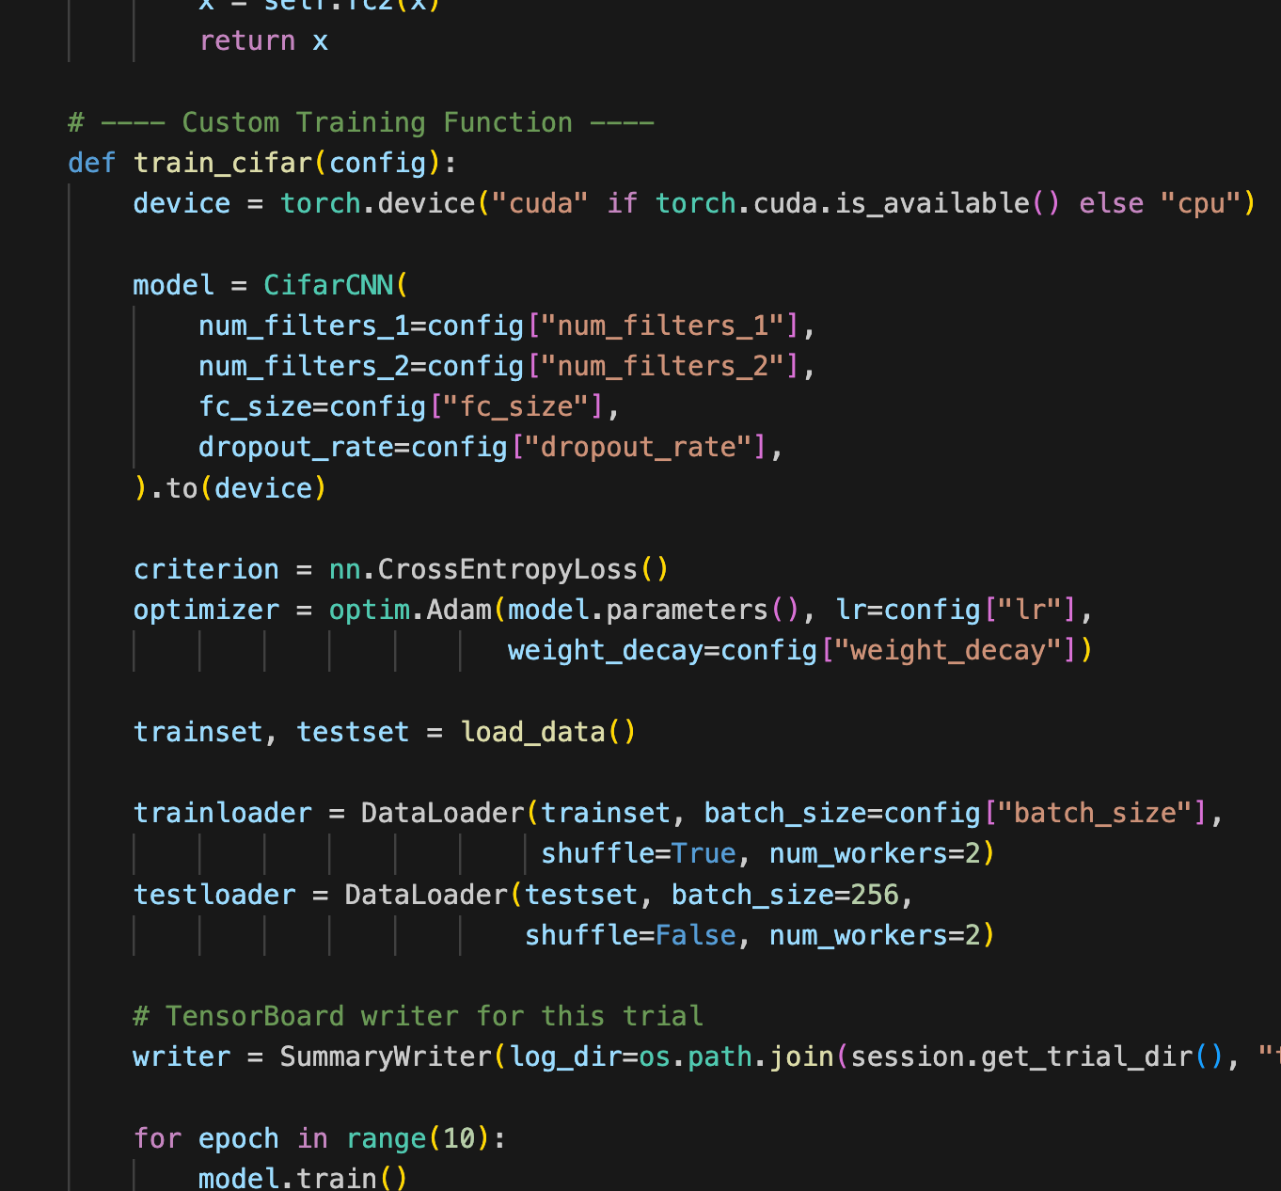
RayTune Setup
We setup a ‘tunable’, usually* a loop.
  This loop ‘does’ all the model stuff – create, dataloaders, optimizer, etc…
  The all-in-a-loop thing allows for dist. training.
We add variables and a gridsearch-y space.
  E.g. config - num_filters, dropout_rate, fc_size.
  Each run selects a value from the search space provided.
  Select from list, number within range, random, etc…
Can add schedulers to manage the training – e.g. cutoff bad trials early. There’s lots more, we only use a bit.

Slide 46
Using Raytune
Using raytune is kind of annoying at first, the capability adds some complexity.
  Memory management and serializable errors are easy to make*.
  There’s several ways to do things.
  Need to allow everything to be split to different systems makes it more complex.
The time demands are often large, so make the search space as smart as possible.
  Ensure GPU if on colab, not automatically enabled.
Don’t tell anyone I said this, but the infrastructure code around raytune is a good LLM use.
  Along with crawling file systems, regular expressions, and UI things you rarely need.
  You still want to define the model, search space, and datasets at a minimum.
  The stuff around tuner, scheduler, etc... Isn’t insanely complex, but it is finicky.
  If you understand the concept, and can adjust code, that stuff is AI-OK™

Slide 47
Conclusion
There are many variables in making a good neural network model.
  Size – we need to make the model big enough to learn the data.
  Structure – different model structures may perform better (we’ll see this next, more).
  Regularization – L1/L2, dropout, batch normalization.
  Training Parameters – learning rate, optimizer, etc…
For us, we can settle on getting close, then letting things train.
  Real model tuning like this becomes impractical at a larger scale, we don’t need to obsess.
  There’s not one solution for what model will work.
  We’ll later use some other tools to do grid-searches and monitor training.
This is less deterministic than we’d like, we generally just need to get ‘in the ballpark’.

Slide 48
Housekeeping
Today (roughly chapter 4):
  Tensorflow and keras part 2.
  Making and basic tuning of models - callbacks, results, evaluation.
  Some things that we can change in tuning a model.
  Using a loss plot to tune the model.
  Assignment on neural network regression should be doable after this – it isn’t too complex.
  Please read recipe_tuning_neural_networks.pdf in docs folder, it’s a version of this.
Next time(s):
  Images in 2+ dimensions in neural networks – CNNs.
  Processing image data in a smart way – managing out of memory data and smarter datasets.

Slide 50
Project (Other Class) Stuff
If you are still doing real estate, think about large scale feature construction.
You can make many features from latitude and longitude that may matter.
  I’d make a lot of them, since you have a lot of data, and let the model sort it out.
Directly calculable via spatial joins and spatial files you can find online (Google mapping/spatial/gis):
  Distance from almost anything – roads, schools, water, commerce, neighbors, etc.
  Stats – density, comparison to neighbors, trends, crime, construction, census data (wealth, education, etc.)
Calculable with potentially free services online – time to get places, real estate stuff, sun.
Possible with large scale scraping – real estate data, all kinds of other stuff.
I’d try to cast as wide a net as possible and get almost anything I could automate as a start.

Slide 51
Cluster Assignment - Results
The basic steps needed are:
  Cluster the original data to break the numbers into similar groups. (k-means, other…)
  Manually add a label – each group is similar, but we don’t know what it is a group of.
  Now you have labeled groups of digit images.
  Train 10 (or more) GMMs, one that ‘knows’ each number from the data used to train it.
  When asked for a printout, ask the right GMMs for a digit each, assemble.
Overall, the images tend to be OK at best, some improvements:
  Number of clusters can be >10, to capture different digit variations. GMMs can as well.
  Some cleaning/processing (PCA, feature selection, etc..) may help, requires much tuning.

Slide 52
Cluster Assignment
Common issues:
  Assorted mix-ups applying labels to clusters.
  Training GMM timing/location.
Adding labeling:
  This feels weird to lots of people, but it isn’t really all that rare. (LLMs and gen models).
  The clusters are able to be ‘pure’ on their own, but we need to add the label info ourselves.
  This could be supplemented by other models – e.g. manually label enough, then use classifier.

Slide 53
Tensorflow and Keras Optimizations

Slide 54
Neural Network Configuration
We’ve seen that neural networks offer a large amount of flexibility in their configuration.
How do we determine the optimal structure?
Generally, the true answer is to grid search it.
We can use some guidelines to get started in a reasonable and smart way.
  Problem types (image class, NLP, etc…) have architectures that work well, and most things (except innovations) are based on what worked before.
This is largely getting used to keras and making adjustments there.
  Play around with some models, get used to syntax, try some different models.

Slide 55
Converging Loss Plots
Our main tool for monitoring training is the loss plot.
We are looking for, ideally, where the validation loss flattens, or minimizes and starts to increase again.
  The more stable, the more reliable, but it won’t always get this smooth.
These show an accurate small and large model – small is more jumpy.
  Error scale on Y are very small on both.
Training loss seems to be flattening as well – convergence.
  The ball has found the low point of the gradient curve.
  It may bump around a little, but we’ve found the bottom of loss.
The smaller the gap, the less overfitting – small and stable is ideal.

Slide 56
Network Size
The first thing to look at is the network size, or capacity.
The more neurons a network had, the higher the capacity.
In general, larger networks need larger amounts of data, to find more complex relationships.
We can examine the two metrics of size:
  Neurons per layer (width)
  Number of layers (depth)

Slide 57
Width vs Depth
When we make a neural network, should we favor width or depth?
In theory one hidden layer can approximate any function.
  Universal approximation theorem – one layer can in principle learn anything.
In general, depth is preferred more often. Why?
  Wider networks are more prone to overfitting.
  Deep networks can find representations of data with each transformation (see in CNNs next)
  We can apply regularization or normalization between layers to counter overfitting.
  We can make models with more complex structure – layer types and connections.
  Deep networks can kind of feature select as less significant features are minimized.
  Data with complex relationships (’natural’ stuff) tends to do well with deep models.

Slide 58
Deep Learning
For modern usage most/all of the “cool things” that AI can do is due to deep networks.
Reasons:
  Layers can extract different representations of data. (More on this next time).
  Opportunities to regularize.
  Less overfit prone than wide models.
Practical evidence is that deep models are generally better.

Slide 59
Example: ImageNet
Imagenet is a dataset developed in the late 2000s to help computer vision.
  Thought – better dataset leads to better models.
Nested set of 3.2 million (initially) to over 13 million (now) images with labels.
  Labeled largely through Mechanical Turk service.
  Hierarchical labels – e.g. a chair is a type of furniture, a dog is an animal.
Became benchmark of image recognition accuracy.
From ~2012-2013 to ~2015-2016 networks got deeper and losses fell.
  In addition to use of CNN architecture – next time.
  Improved GPU speed and utilization drove success.
  Why GPU? The multidimensional tensor operations are similar calculations to 3D space.

Slide 62
Neural Nets as Feature Constructors (extractors)
We can also think of a deep neural network split into two pieces:
  The final layer to do the classification (or regression), normally called the ‘classifier’.
  The initial layers to construct the best features that allow the classifier to be accurate.
Final layer is a logistic regression, other layers are a smart feature constructor.

Slide 63
NN Feature Construction Vs Pca
We can also picture this compared to PCA.
PCA does a simple linear transformation on features to generate new features that are better predictors.
  PCA is a specific calc – it does what it does.
NN layers do a non-linear transformation on features to get new features that are better predictors.
  NN training is smart, it’ll adapt each batch based on the results – the potential is far higher.

Slide 64
So how big do I make it?
Big enough to be capable of overfitting – don’t obsess too much on details unless bored.
See more specific guidelines in workbook.
  Start with 1 to 3 layers the same size as the input (or ~512-768 if input is big).
  Add layers to overfit that are about the same size.
  Try with layer size “funneled” down layer by layer.
  Add regularization and normalization to cut overfitting.
  Prune network back in size, if still overfitting.
A real answer is grid search, this should get us close enough to start with.
If doing something big, base it off something that works and adjust as best you can.

Slide 65
Data
Improving and increasing the data size is the best possible optimization.
Scaling can often have large impacts:
  Ensure outliers are handled and data is scaled.
If practical, increase data size – real or by augmentation (later).
If we have high dimension categories, that can lead to very sparse data:
  Many high dimension categories will add lots of features to the data once encoded.
  This will make lots of sparse data – many features with nearly zero information.
  This isn’t wrong but may lead to poor and slow results, especially without many records.
  Consider feature engineering (‘other’ group, consolidation, selection) these first.

Slide 66
Epochs and Batches
Each epoch is an execution of one fp/bp through all of the data.
  Easiest method is to set early stopping and let the computer figure it out.
  Really big models might only have one epoch through the data total.
Batches are how many records to process before updating weights.
  Just like regular gradient descent – higher is more stable, smaller more erratic.
  Limited at the top end by memory capacity.
  Large vs small is still a matter of debate and varies by data.
  Recently, smaller batches (as small as 2 -32) seems to offer better generalizable models.
  Big batches may process far faster – better HW utilization and fewer weight updates.
    Think – weight matrix per layer is input_size * output_size. 512 * 512 = ~250k updates

Slide 67
Optimizer
The optimizer is the algorithm used for gradient descent.
The internal details aren’t super important for us, at least for now.
Adam is the most common and is a good choice for most scenarios:
  Converges efficiently – manages different rates for each gradient.
  Computation and memory efficient.
  Adapts separate learning rates for each parameter using moving averages of several moments.
  Tends to not be too negatively impacted by parameters or different data – defaults work well.
The actual best performer depends on model complexity, data, and the shape of the gradient curve.
There’s several variants similar-ish to Adam, simpler SGD may perform better on ‘simple’ NN.

Slide 68
Activation Functions

Slide 69
Activation Functions (Hidden Layers)
Activation functions “squish” the linear combination in a neuron into an output.
Assign per layer in a a parameter in keras.
Typically use defaults/variants per layer/model type.
They provide non-linearity that neural networks need.
  No activation function = giant, complex, linear regression.
ReLU – Rectified Linear Unit has been our default.
  Efficient computations, converges quickly in most cases.
  Acts as a trigger – suppresses negative inputs, passes positive.

Slide 70
Vanishing Gradients
Recall – gradient descent attributes error to different weights using the gradient (slope of the cost cure w.r.t. that weight).
Recall some neural network training facts:
  They have many weights.
  Propagate loss back through all layers, and there can be many.
  Often train over many rounds, and get very accurate.
We can encounter a problem that small changes to small numbers from small error split many ways yields tiny values.
  The gradient can “vanish” if it is too small for the GD to work.
  This can lead to ‘dead’ models, that can’t keep learning.
Exploding gradient is opposite, more common with tanh and deep networks – things grow multiplicatively.

Slide 71
Dying relu - Weight Updates
Relu can suffer from ‘dying relu’.
It is less prone to this than others, that’s a strength.
Negative inputs yield 0 gradient
0 times anything is always 0.
If this happens for all inputs, the neuron may ‘die’, or become unable to ever ‘escape’.

Slide 72
Keeping Gradients Graded
These issues would be seen in loss as the model stopping learning.
  This definitely isn’t the only reason!
There are several things that can combat this problem.
  Activation functions – the sigmoid gradients can flatten more than others, tanh can explode, relu can die.
  Batch normalization.

Slide 73
Activation Functions – Relu Variations
To address those issues with ReLU, alternatives were created:
  Notably – Leaky ReLU and ELU (exponential linear).
Each removes that 0-value range of the derivative.
  Removes the Dying ReLU issue, so gradients don’t vanish as much.
  Can help speed training, or even allow convergence at all.
ReLU or a variation on it are our defaults, and normally good.
If using ReLU – reducing LR can also combat the dying issue.
Note – this isn’t the most likely thing to be a massive issue, the case specific defaults tend to perform well most of the type.

Slide 74
Batch Normalization
Another gradient maintaining technique is batch normalization.
Batch normalization will shift the distribution back to “the middle”, where gradients exist.
  “Flat” gradients may vanish – near 0/1 with sigmoid.
  In relu, may die and go negative where there’s no gradient.
Usually applied after dense layer, but can vary.
Can often allow higher learning rates to work.
Note: we should normalize normally still.

Slide 76
Initialization
Initialization controls how the weight and bias values start.
Can be controlled via a parameter for each layer:
  Weight initialization is by default is “glorot_uniform” – a variety of random.
  Bias initialization defaults to 0.
  We can preset the output layer with the log of the expectation (for logit).
This can help the model train – both in speed and potential for convergence.
Imbalanced data – the data has a “bias” to start with.
  Set bias on output layer to the bias in the data.
  Network doesn’t need to learn the massive shift in bias.
  Faster convergence and more accuracy.

Slide 77
Refresher - regularization
We typically use some regularization in our models.
  Semi-standard as neural networks are large and flexible, and this constrains overfit.
  L1/L2 – works just as in regression, can be applied in layer as a hyperparameter.
  Dropout – removes some percentage of neurons randomly each batch of training, forcing learning to occur on the remainder. Applied as a layer, typically round 20—40% to start.

Slide 78
Neural Networks are Flexible
This isn’t near all of the things that we can change in a neural network.
The flexibility in their learning as they grow means that a wide range of models that are ‘good enough’ will converge on a good solution.
  E.g. the image competition has models with widely different structures fighting for fractions of a percentage of accuracy in a task.
Mirror something that is known to work, unless experimenting (which is good).
Make reasonable choices, add some excess, regularization, and early stopping, let train.
  Adjust from here based on what you see.
Finding the perfect configuration as we did with a grid becomes time impractical quickly.

Slide 79
Other Tuning - Optimization
There are a huge number of things that can be changed to tune a neural network model.
We are focusing mainly on the ‘structure’ type of things.
  Network size, layers, type, hyperparameters, regularizing (and similar) layers like normalization.
We are not really focusing on the optimization part - loss/gradient descent specific things.
  Learning rates, momentum, optimizers.
  This matters, but is more theoretical in theory, and scenario dependent in practice.
  Optimization is critical as problems get larger – converging quickly, or at all, can be hard.
For our usage, we can mainly try different learning rates, if needed.

Slide 80
Tuning From A Loss Plot
The loss plot is our main, but not only, tool to help tune a model.
None of these things are definitive, but there are things that happen often that we can look at first for a possible solution.
In neural networks, we must weigh against computation time – defaults are usually fast.
Some general things:
  Make sure that data is scaled.
  More complex relationships perform better with more layers.
  The more data you have, the larger a model you’ll be able to train well.
  Unless there’s a time constraint, let things go for lots of epochs and use early stopping.

Slide 81
Training and Validation Diverge
Probably the most common issue is overfitting.
  Training gets really accurate, validation is far behind.
  Validation hits a low point, then gets worse as training improves.
Learns everything in training, generalizes poorly.
  Reduce model capacity.
  Add regularization.
  Add dropout layers.
  Early stopping – careful with tolerance settings.
  Learning rate (or lr stuff) change – may be stuck in local minima.
Pattern’s quite normal – gap btwn curves is potential improvement.

Slide 82
Unstable Plots
Unstable results can have several causes.
Model’s accuracy swings wildly between tests.
  Data processing – outliers, scaling.
  Data size – overall and validation set size.
  Is the data representative, and are train/test splits balanced*.
  Increase batch size.
  Learning rate things – may be ‘jumping around’ instead of converging.
  Initialization (potentially bottom picture).
This can be hard to stop in small data sets – don’t worry too much.
Some instability can happen, if it flattens then it’s probably ok.
  Be aware of scale – if loss difference is small, you might just be zoomed.

Slide 83
Close/Inverted lines or still Falling
Plots still improving are still learning - underfit.
  Train/val performance is similar/inverted
  Still improving at the end of training
The model could learn more, may be underfit:
  More capacity and more training, higher LR if improvement stays.
  Reduce regularization strength if it is high.
  Easy speed-up (if needed) – bigger batches.
  *The absolute loss in the bottom one is too low to be a great example, picture that shape, with more loss.

Slide 84
Loss Plot Tuning
We always generate loss plots and they’re the starting point for tuning.
The patterns and suggestions aren’t definitive – things are still highly variable per model.
All of these changes will impact each other, so they’re hard to predict.
You want to do this on the loss plot – not accuracy plot.
  Remember 51%/49% and 99%/1% confidence have the same accuracy score.

Slide 85
Example – Training is Unpredictable
The training of these models can be unpredictable, especially with complex ones.
  There are many variables that impact the model.
  There’s randomness.
I got one execution that looked like that.
  Validation accuracy went from 93% to 23% to 93%.
The loss curve is not convex and simple.
  Sometimes the results wander quite a lot.
  This is where having the optimizer stuff right shows.

Slide 86
Pruning
Neural networks can get very large!
Like a tree, a trained network may contain parts that aren’t super critical in making predictions.
  As an example, think of “dying relu” neurons.
Pruning can trim a network back by making it more sparse.
Can potentially improve generalization – just as tree pruning does.
Allows networks to be used for prediction with fewer computations.
  Predictions on a computer: one forward propagation, relatively simple.
  Predictions on a phone/raspberry pi/Roomba/drone, can be challenging.
  Pruned models require less processing and less memory, can be used on more devices.

Slide 87
Conclusion
There are many variables in making a good neural network model.
  Size – we need to make the model big enough to learn the data.
  Structure – different model structures may perform better (we’ll see this next, more).
  Regularization – L1/L2, dropout, batch normalization.
  Training Parameters – learning rate, optimizer, etc…
For us, we can settle on getting close, then letting things train.
  Real model tuning like this becomes impractical at a larger scale, we don’t need to obsess.
  There’s not one solution for what model will work.
  We’ll later use some other tools to do grid-searches and monitor training with Tensorboard.

