Slide 1
Detour - Imputation
Generally, models can’t handle missing data – they’ll fail.
If we have missing data, we need to do something with it:
Delete it.
Impute it – fill in a placeholder value for the missing spot.
Doing either of these is both a simple requirement and potentially complex decision.
We need to do something to make it work, and doing imputation/deletion is simple.
We need some real knowledge, including domain knowledge, to do it well.
We are leaning more towards the former – we need imputation but don’t dig into it.

Slide 2
Impute or Delete
The first decision is to choose to remove data if we have missing values, or impute them.
This is situation dependent – the real-world impact of the values matters.
We can also analyze the data to help make better decisions.

Slide 3
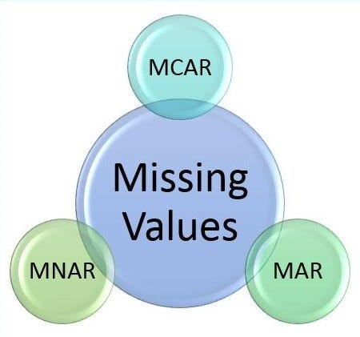
Why is Data missing?
Data can be missing for several reasons.
Missing at Random:
Things missing are partially dependent on other values in the data.
Missing Completely at Random:
This is totally random missing values.
Missing not at Random:
Things missing are depending on their values in the data.

Slide 4
Missing Completely at Random
This is the simplest – an assumption that missing data is randomly distributed.
There is no connection between the values in data and if it is missing.
This is the best candidate for deletion:
The randomness means that losing some data doesn’t impact results.
The only real concern is sample size – in large datasets deletion is easier.
If we shrink a large dataset by 10% (or more) or something, nothing really changes in the model.
If a column is missing a lot of data, we may be better of deleting that column.
This varies depending on the exact data, and what is missing.
Rule of thumb, if it is about 20% or so, start considering – though more missing values than you’d think might be ok in terms of results.

Slide 5
Missing at Random
Missing at random is the default assumption – missing data has some relation with the other values in the data.
“The missingness can be explained by variables on which you have full information”.
Suppose we have census data and the income field is missing from many:
Whether or not the income is missing doesn’t depend on the income value.
Whether or not the income is missing can depend on other values – age, location, etc…
This is a good candidate for imputation:
The imputed value of the mean (or similar) won’t convey a pattern to the data. (no relation.)
The other values, potentially, can help ‘smart’ imputation be accurate.

Slide 6
Missing Not at Random
The worst case – missing values depend on their value.
E.g. high income people may tend to fill out the field on the census, low income don’t.
Overweight people may be less likely to fill out weight in a health survey.
It can also depend on variables outside our dataset or other values as well.
If we just imputed a mean, that would skew the distribution, and that’s bad.
The imputed value has different distributions in the missing vs present sets.
‘Good’ imputation can use more elaborate methods (e.g. estimate proper distribution of the values to be imputed) than we will look at.

Slide 7
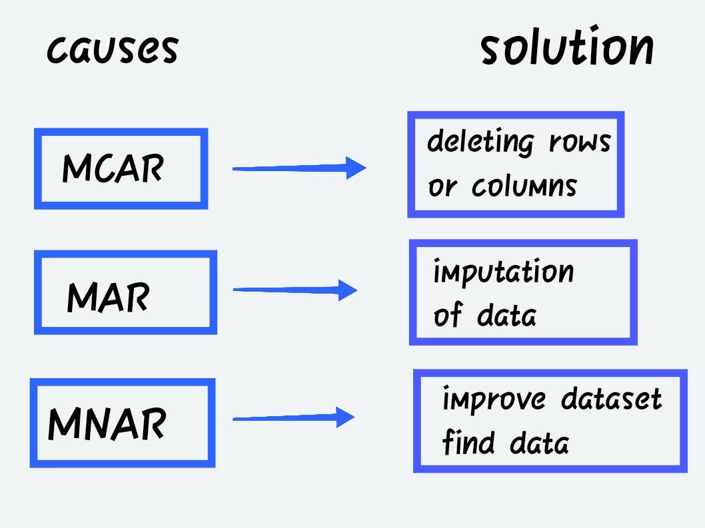
Rules of Thumb
This requires specific knowledge to do ‘right’.
Medicine has lots of analysis on missing data from medical studies.
High consequence, hard to get more data, expensive, low-ish samples to start.
Avoid skewing data for things like life exp.
For us, we need to make reasonable choices.
One generally must happen.
It’s not really a critical thing for us.

Slide 8
Impute This
Imputation is something we need and use all the time, but it is more complex in reality.
Good imputation requires some more elaborate analysis, unless it is simple.
Any solution - imputing or deleting – can introduce bias into the data.
Ideally we want to minimize that bias (i.e. don’t change the data patterns):
If deleting data, we want to ensure that we aren’t deleting data from one part of the dist.
For imputing data, we want to ensure that the data we insert matches the dist.
There is no perfect answer – everything is a patch.
At a high level, the ML models pick up on patterns in data. Imputation generates fake data, but if done well, won’t impact that pattern – so the model learns the same thing.

Slide 9
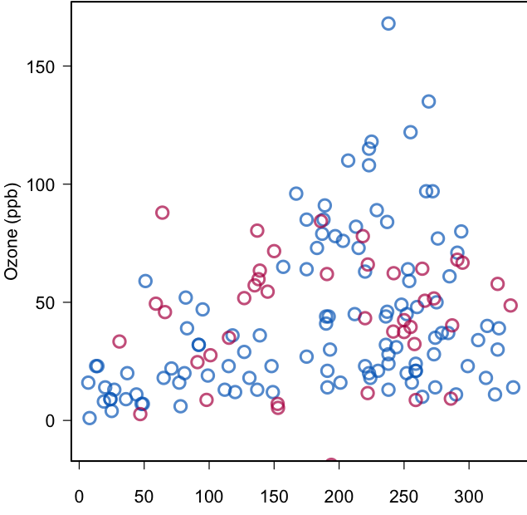
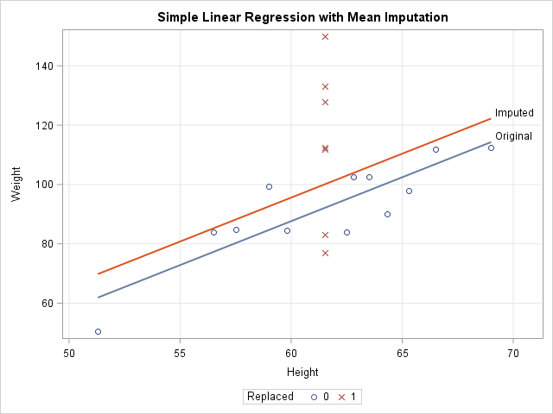
Example – Linear Regression
This has simple mean imputation on height.
Inserting the imputed height introduces some bias.
The average weight of the imputed data is higher than the observed.
Those heavy players are likely taller in reality.
The model shifts due to bias.
The upper picture is better – no change in pattern of the data.

Slide 10
Housekeeping – BiG Time ML Stuff!
Regularization in linear models (ch2, ~pg51):
Basis functions and bias/variance fit review.
Residual plots and analysis.
Types and theory of regularization.
Variable selection with regularization.
Checkpoint – manipulating data and pipelines.
Next time we’ll use some 2D data – images.
It isn’t really hard, but it is a bit easier to get confused with data, shapes, etc…
If this feels hard or confusing, please ask and we can try to figure it out.
You guys are all comfortable with one-hot encoding, right?

Slide 11
A thing Happened!
There’s been new news on machine learning in the past week or so.
Existing large models are basically mega-corp only due to needed resources.
10s of thousands of GPUs, each costing 10s of thousands of dollars, to train.
Companies are literally looking at nuclear reactors to power the data centers.
Costs can be in the hundreds of millions, next-gen models may cost billions to train.
Only Google, FB, MS invested OpenAI can really do this, no one else has the resources.
A Chinese company Deepseek released a new model that is supposedly much more efficient on HW and training time than competitors like ChatGPT.
This was apparently a side project of some hedge fund guys? They had spare GPU time.

Slide 12
This Could be Really Big!
The DeepSeek people made the training process more efficient, keeping performance.
A bunch of optimizations – lower precision values, multi-token predictions (later).
Mixture of Experts – basically a combination of smaller specialized models vs one massive.
Other optimizations to maximize utilization and minimize moving data.
This stuff already exists, so it might also have some private stuff or a weird combo.
Much more achievable on consumer grade hardware, or lower end enterprise.
If these techniques work well in general, we should see smaller (universities, hobbyists, small companies) orgs able to develop models that are more competitive with the large players.
~$5 million vs ~$100 million training costs for similar performance. (Rumored)
China is under US export restrictions stopping them from getting state of the art GPUs.

Slide 13
Changes May be Underfoot
This may potentially cause serious changes in the industry soon.
NVDA lost $600 billion in one day of trading.
Facebook is said to be readying “multiple war rooms” (which sounds appropriately stupid) to figure out the details of how it works.
GPU market might change drastically – NVDA was really juicing their monopoly position.
The GPUs needed for this are nVidia only, expensive, and limited – the company controlled this.
The ability to run inference (generate data) on smaller devices may be huge. (Reading needed)
Smarter Siri-like AI models able to run offline. On-device things like self driving cars may be better.
For data sensitive clients, this may matter a lot – a bank won’t provide their data to OAI for customized models, creating a large custom one from scratch is too expensive, this may bridge.

Slide 14
Farther Out
Adapting something like this to image/video models could be even more impactful.
Could reduce massive video needs ‘down to’ the current expensive GPU specs.
Training image/video (or 4k) models is even more intensive than text, so benefits may be greater.
Could help speed development in things like self driving cars.
Will probably spur a bunch of grad students and smart AI researchers to expand on what the deepseek people found, expand it, ‘test it’, adapt it, and document it for us normal folk.
People will try similar things in all type of scenarios and see what works.
HW demands are still huge for cutting edge things, but universities, companies, gov’ts have that.
Current LLMs train for 1 or 2 epochs, could these techniques make multiple epochs practical?

Slide 15


Geopolitical Fun!
Thankfully, this is happening at a time of global tranquility, where rational leaders will carefully consider the impacts and act in the good of humanity.
Said leaders would also never resort to protectionist tactics like tariffs.
Some tech bros genuinely think their AI is the most important thing to humanity.
It is massive to Taiwan and China/US interest there for chip making.
AI investments have been massive – under certain assumptions.
Biggest wins and easy to monopolize – barrier to entry is massive.
These massive investments look less awesome now. How much?
DS has kind of commoditized the pricing of LLMs now.
Lower entry barriers means mass competitors vs a handful.

Slide 16
Linear Regression with non-Linear Data and Regularization

Slide 17
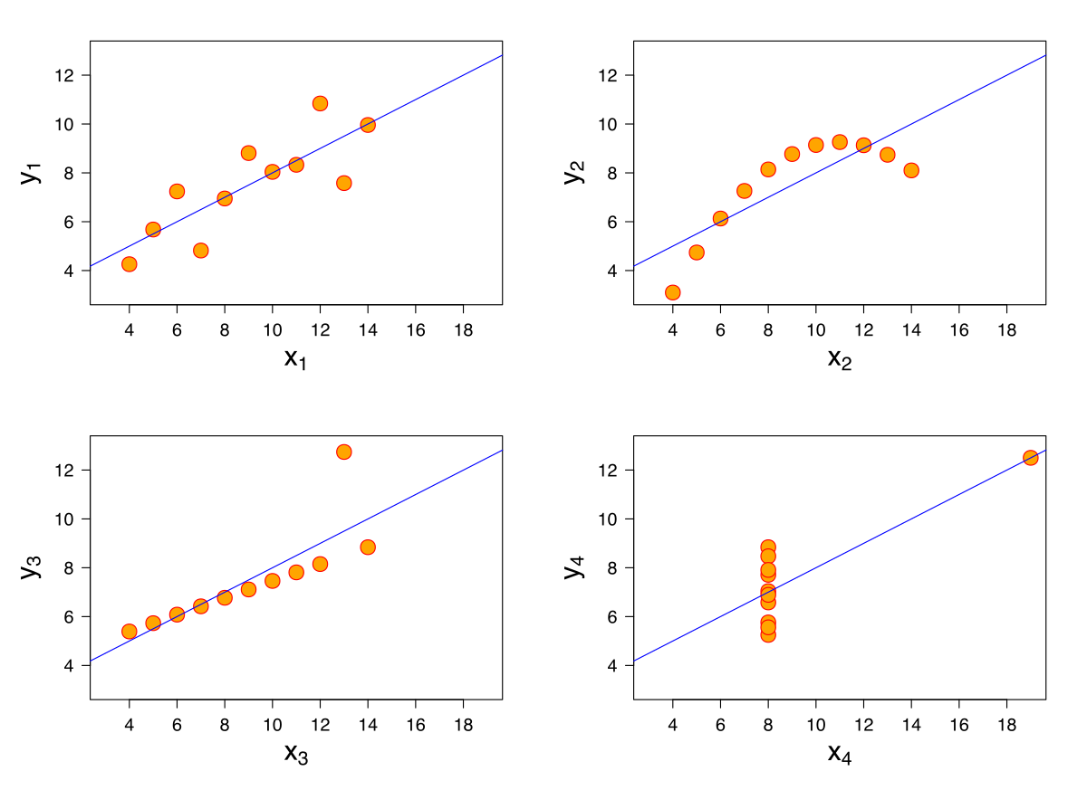
Linear and non-Linear
Linear models are excellent….
… If there’s a linear relationship in the data.
For non-linear relationships, linear regressions can struggle – they can’t ‘capture’ curves.
Linear models can’t learn non-linear relationships (trees can).
We first saw this with Anscombe’s Quartet.
Same regression, r2, mean, variance.
Only one would yield good predictions.

Slide 18
We need a Hero - Basis Function
We can adapt linear regression to non-linear relationships by using a basis function.
Basis functions are a transformation that changes the x to a function of x.
If we have a basis function: 𝜙_{𝑗}()
Each x value then becomes: 𝜙_{𝑗}(𝑥_{𝑖})
This function could be anything, the closer it captures the pattern in data, the better.
Similar to something like a log-transformation in stats – we can transform the data, make it more normal (or linear), then use things that work with the transformed form.

Slide 19
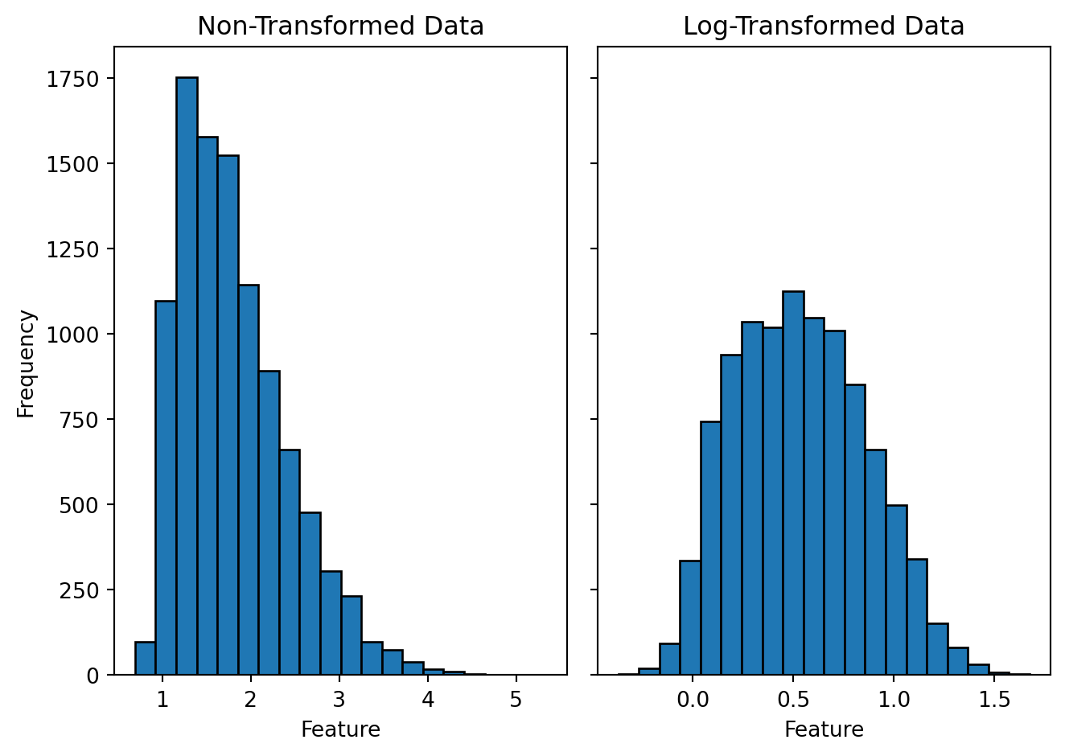
Recall – Stats Transformations
Recall in stats where we frequently do things like log-transformations.
E.g. income or wage analysis. Generalizations.
Data that fits a certain pattern allows for tools that assume that pattern to function better.
Log: we can do parametric tests (e.g. t-test) or improve model (e.g. regression target).
Basis: we can use a parametric model (linear models assume linear data) on non-linear data.
Residual plots can show this sometimes.

Slide 20
Polynomial Functions
Maybe the most common example is a polynomial function.
We can replace each x in a linear regression with a polynomial function of x^{n}.
y=b+m₁x+m₂x²+m₃x³…..
This is still a linear model, but one of polynomial functions.
The linear part refers to the coefficients never interact.
In sklearn, this is done with the PolynomialFeature transformation.
We can add it in a pipe.
Note: This increases complexity of the model – more dimensions are generated!
E.g. linear regression is in 1D on the example, after basis it is in 2D.

Slide 21
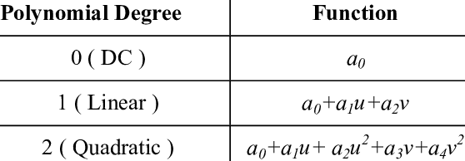
Model Growth
As with a tree, the larger the model, the more complex a relationship it can adapt.
The larger the degree, the more parameters are added.
Linear models are simple – X+1 parameters.
After basis transformation, data is larger, so X is larger.
Dimensions are expanded.
Model becomes larger.
We can’t fit the linear model well in X dimensions, but we might be able to in X^n dimensions…
More parameters -> more learning -> more complex.

Slide 22
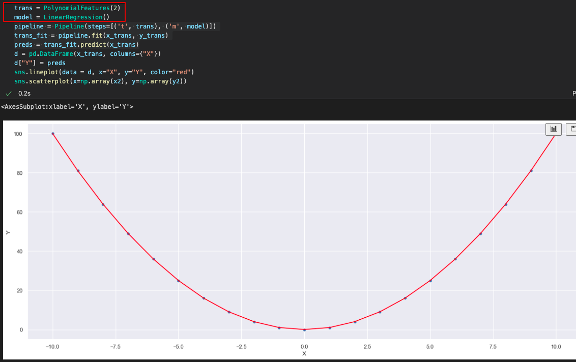

Result of Polynomial Feature Transformation

Slide 23
Basis Success
What a victory! We can model a non-linear relationship with a linear regression.
More flexible and applicable simple models – a linear model can learn non-linear things.
The transformation allows the data to fit the constraints of the model’s function.
Basis functions aren’t only polynomial, it could be anything:
Gaussian – example in 5.06 PDSH
Rectified Linear Units (Relu) – will come up again in neural networks.
Radial - revisit in SVM and clustering.
Why?
Really useful in applying linear regression to any random scenario. (Good for old math)
Helps classification with “weird” borders (~1.5 - 2 weeks from now). Linear seperability.

Slide 24
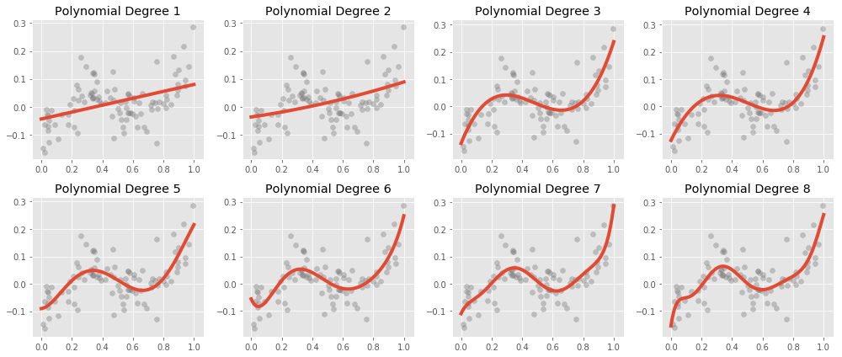
Basis and Regression
Models using basis functions are more complex – the ceiling of what they can learn is higher.
The data needs are also higher.
Data will have an ‘adequate’ complexity.
Non-linear curves can be modeled with linear models.
This was more critical pre fast computers and other models.
Linear model + non-linear-ness is good…

Slide 25
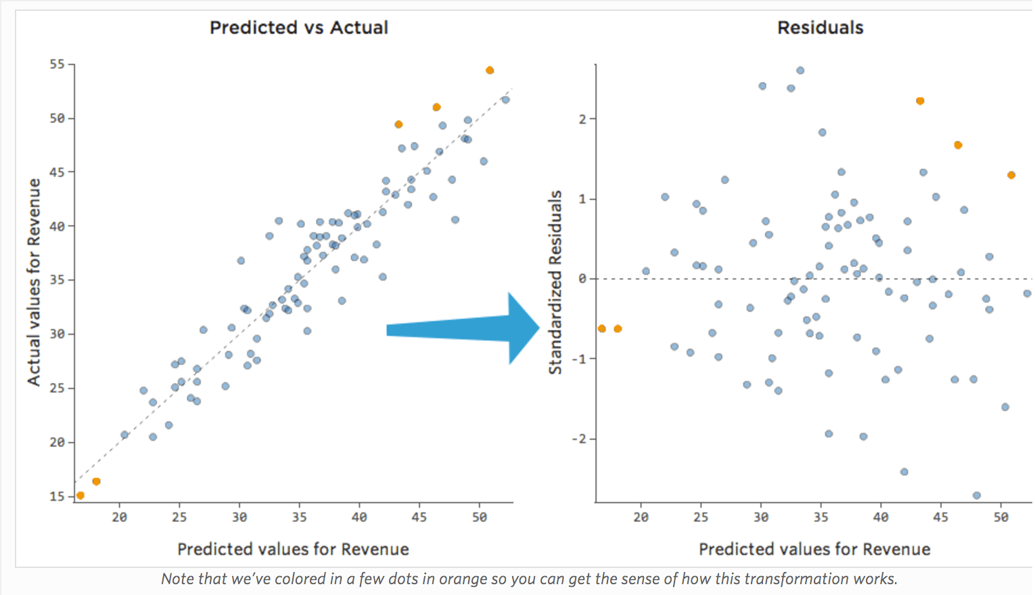
Improving Models with Residuals

Slide 26
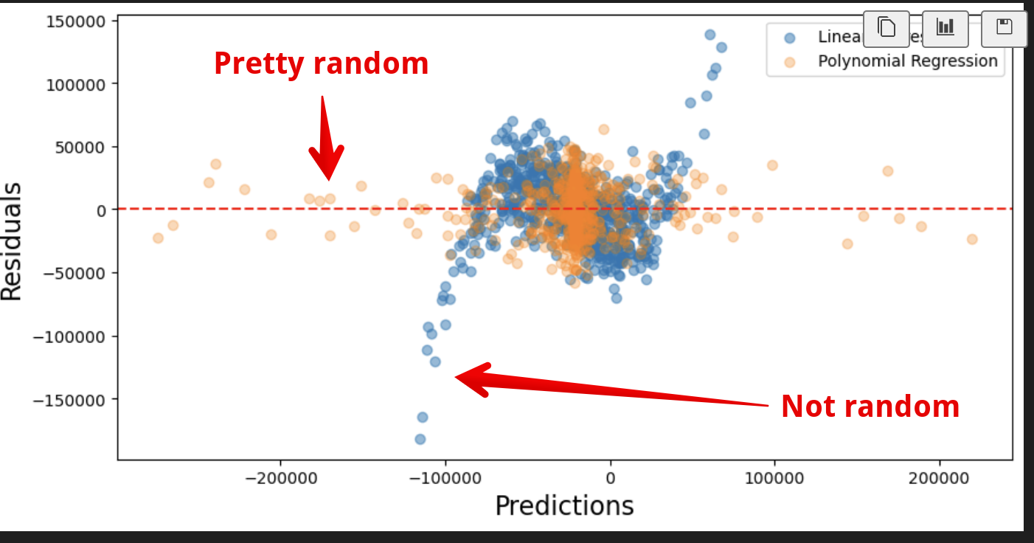
Residual Plots
We can capture some of these missed relationships in residual plots.
Patterns in residuals are patterns missed by the model.
Might not be easy to eyeball fit as we can here – need to test (in SVM…).
We want random residuals.
No correlation between Y and Error.
Basis ‘captures’ this pattern in model.
Still have error, but not systemic error

Slide 27
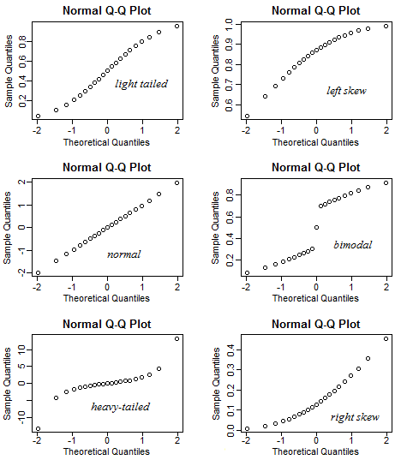
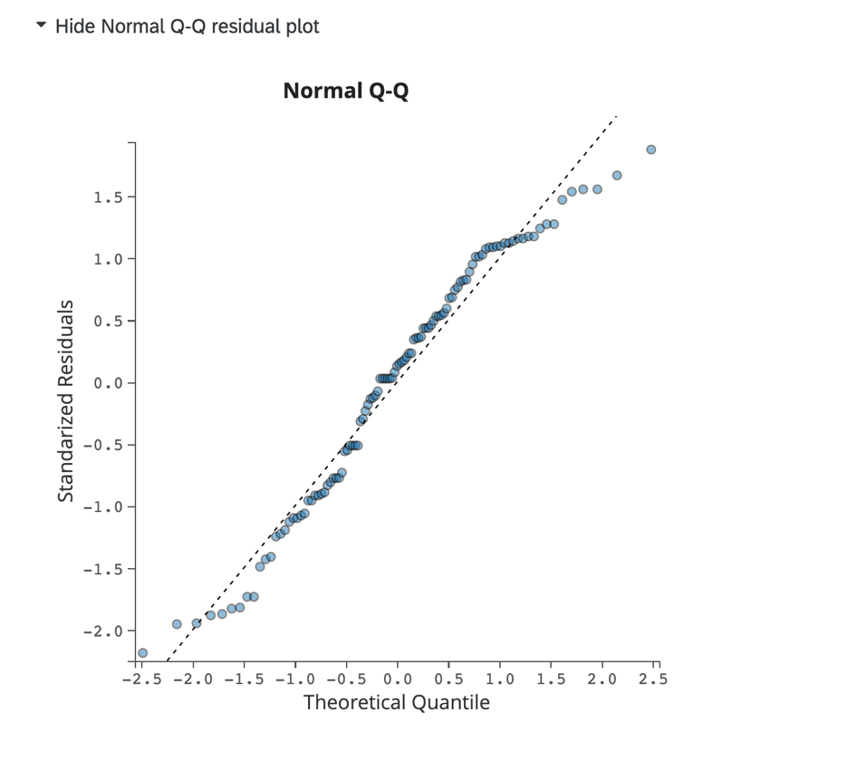
Q-Q Plots
For the stats-ier among us, the Q-Q plot show this.

Slide 28
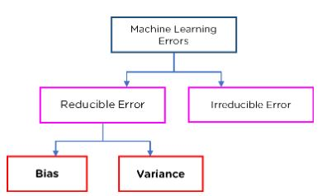
Error Types in ML

Slide 29
Errors in Modelling
Bias Error:
Error due to assumptions made in the modelling process.
Generally results in underfitting.
E.g. assuming a linear relationship.
Variance Error:
Error due to variations in the training data.
Generally results in overfitting.
E.g. different training sets for trees generate very different models.
Irreducible Error:
Error that we can’t fix through modeling, it in inherent in the data.
May be able to fix it by cleaning data (removing outliers, correcting missing data, etc…)

Slide 30
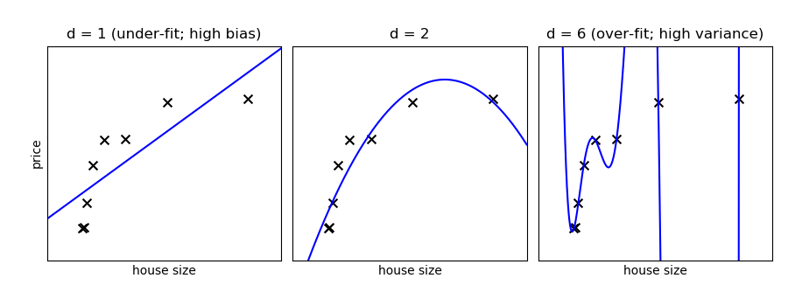

Slide 31
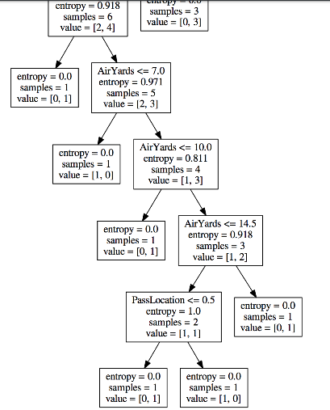
Variance Error – Tree that is Overfitted

Slide 32
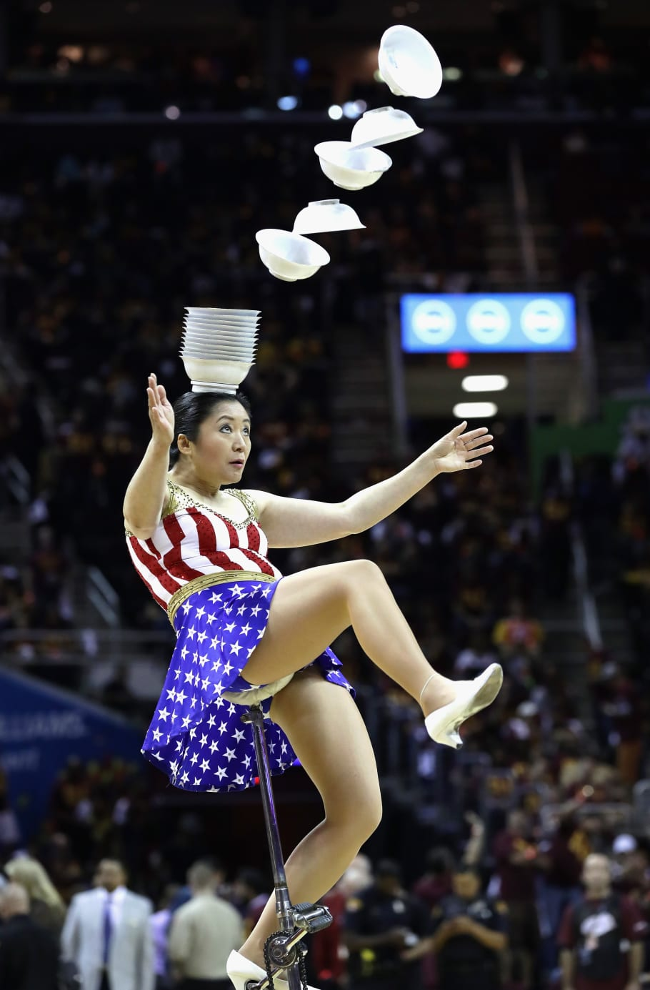
Balancing Act
A good model requires a balance between Bias and Variance.
Variance comes from model ‘growth’ or adaptation (change) to data.
Too much bias and our model won’t be adequately tailored to the data.
Simple models have high bias. (Small tree)
Too much variance, the specific training sample data would impact the model’s predictions too much, and it may be wrong with different data.
Complex models have high variance. (Large trees)
Polynomial basis allows us to make a linear model capable of overfitting more – normally it’d have bias error from lack of learning.

Slide 33
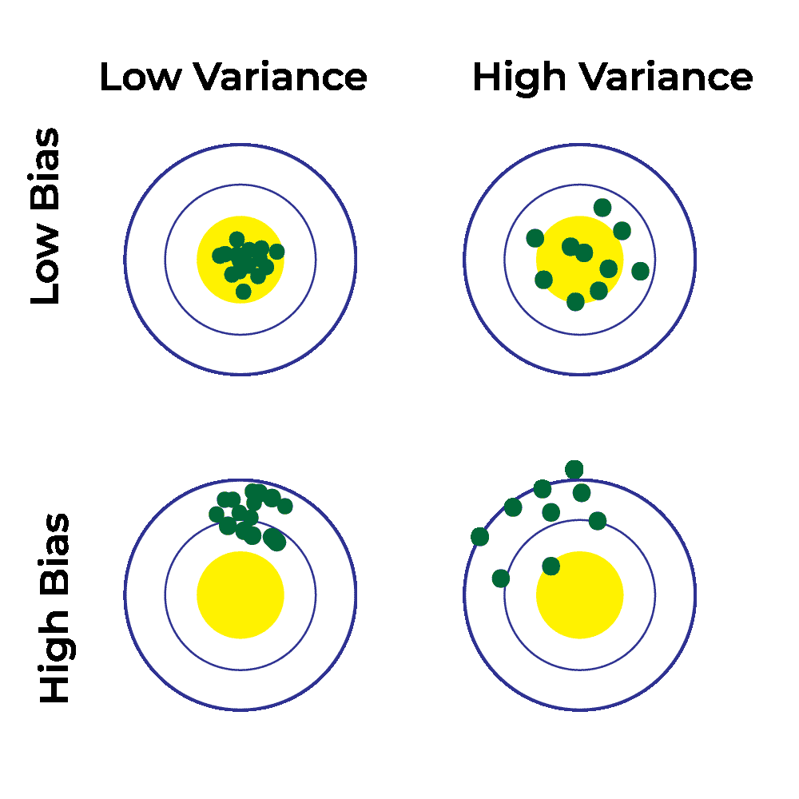
Getting the balance
We need a model that is large enough to learn the patterns in the data.
Not enough parameters, the model can’t capture patterns.
Too many parameters, likely to overfit the data.
I use these explanations to keep it straight:
Bias – the model is too biased towards its preconceptions, so it doesn’t learn from data. (Reacts too little to training data).
Variance – the model is too reactive to the data it sees, so its answers vary too much towards the training data. (Reacts too much to training data).

Slide 34
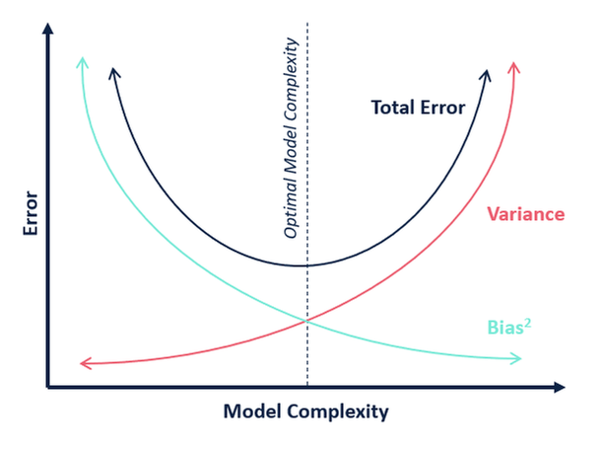
Bias Variance Tradeoff

Slide 35
Finding the balance
ML algorithms are generally “greedy” – they’ll try to get as accurate as possible.
E.g. a tree, without any limits, will try to make a model that perfectly fits training data.
Our goal is a model that is both accurate and generalizable.
We want this accuracy, but limit it to try to achieve the sweet spot.
How?
Cross validation.
Hyperparameter values with grid searching.
Early stopping (big in neural networks).
Regularization. (E.g. tree pruning and regularization in linear regression)…

Slide 36

Regularization

Slide 37
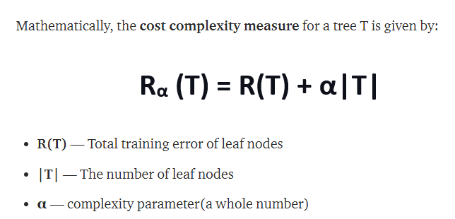
Tree Regularization - CCP Alpha Pruning
We saw regularization with trees – CCP Alpha pruning.
This worked by adding a penalty to the calculation of if the tree should split a node.
The “error” increases as the model grows. (The penalty part of the error).
A tree is better by being smaller, or more accurate.
Any growth must be ‘justified’ by overcoming the penalty for making the model larger.
The tree wants to grow, regularization constrains that growth.

Slide 38
Recall - Regression Coefficients
The regression process, closed form or gradient descent, finds coefficients.
E.g. y = m1*x1 + m2*x2 +…. B
The process determines those m values, and the b.
The larger a coefficient is, the more impact that term has in the prediction.
The algorithm finds these coefficients by determining what set of them minimizes the squared residuals.
Our new friend the cost function!
Gradient descent looks for the best set of coefficients it can find.
The coefficients are the parameters – the thing that changes to ‘hold’ the learning.

Slide 39
Regularization
Regularization modifies a model by changing the cost function.
A ”penalty term” is added to the cost function.
Now the regression algorithm isn’t minimizing the residual squared error, it is minimizing the new cost – error + penalty.
Regularization types:
L2 – Ridge. Adds a penalty based on the square of the coefficients.
L1 - Lasso. Adds a penalty based on the absolute value of the coefficients.
ElasticNet – a HP controlled ration combination of the two.
This incentivizes smaller coefficients, lowering overfitting.
Large coefficients are unlikely to generalize well.

Slide 40
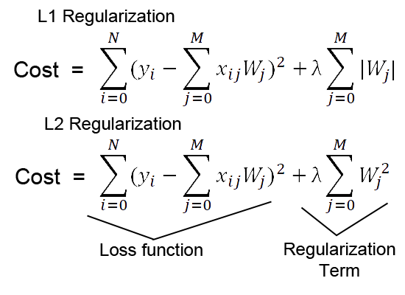
Cost Functions
The regularization term is the last bit.
The alpha value controls the amount of regularization, as a hyperparameter.
Elastic net is just some proportional (the ratio is an HP) blend of the two.
Algorithm minimizes the entire formula.
I.e. the w (param value) that gives the lowest total error.

Slide 41
Cost and Loss
The cost function is what the model is optimizing to.
We generally use MSE and log-loss, but could be almost anything.
Cost is often referred to as loss (and a loss function).
The two are pretty much interchange in common usage, but technically different:
Loss is one example – i.e. there’s this much loss in one prediction.
Cost is the entire dataset – there’s this much loss in all predictions.
Some books, and especially the internet, will use them interchangeably – that’s fine.

Slide 42
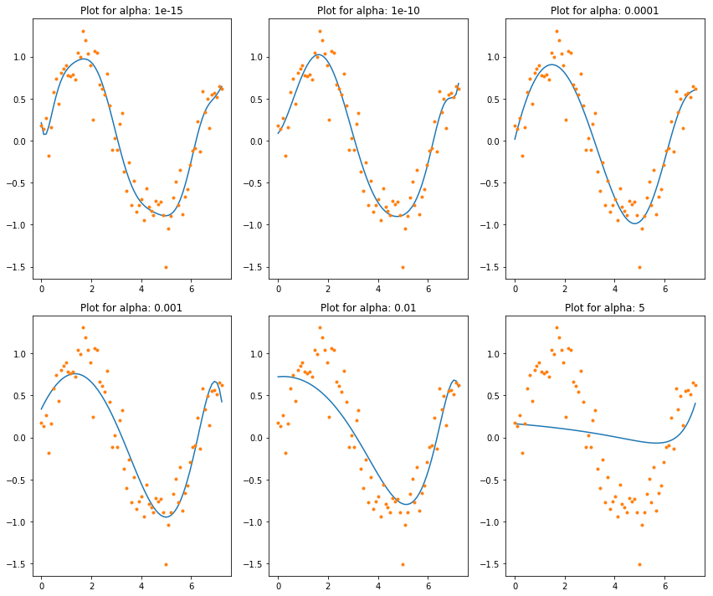
More Regularization = Less Learning

Slide 43
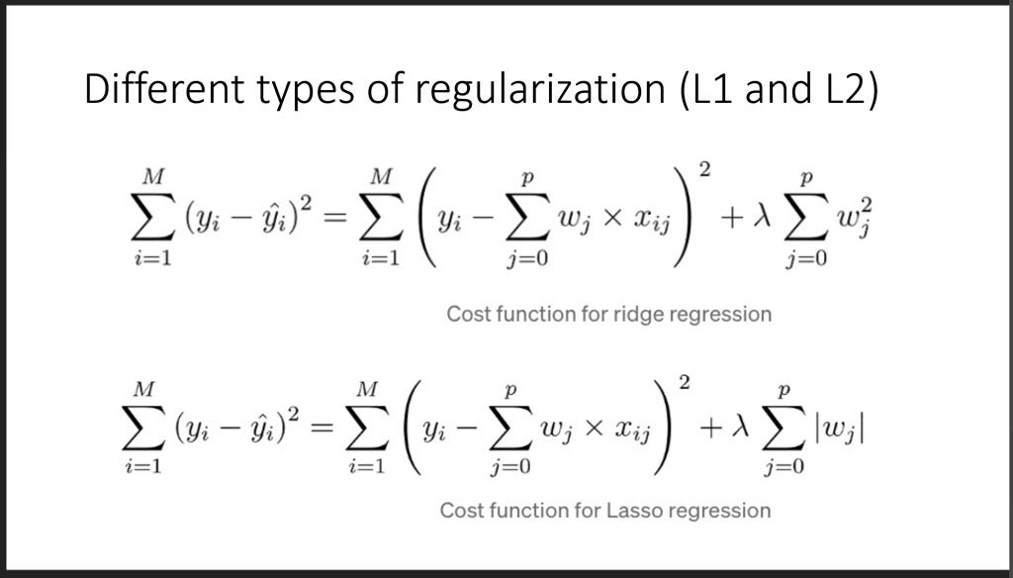
Loss and you!
This cost function is key to machine learning.
The cost function defines the ‘goodness’ of a model.
The algorithm tries to maximize that metric of goodness.
In a tree the cost was the entropy or gini – the algorithm tries to minimize.
In a linear regression the cost is (usually) MSE – the algorithm tries to minimize.
In a regularized model, the processes stay the same, but the cost function changes.
The optimization is for the lowest ‘total cost’ – i.e. cost + penalty.
This buffers the model adapting to the data – it directly slows learning (and overfitting).
Like in a tree – growth must decrease MSE more than it increases penalty.

Slide 44
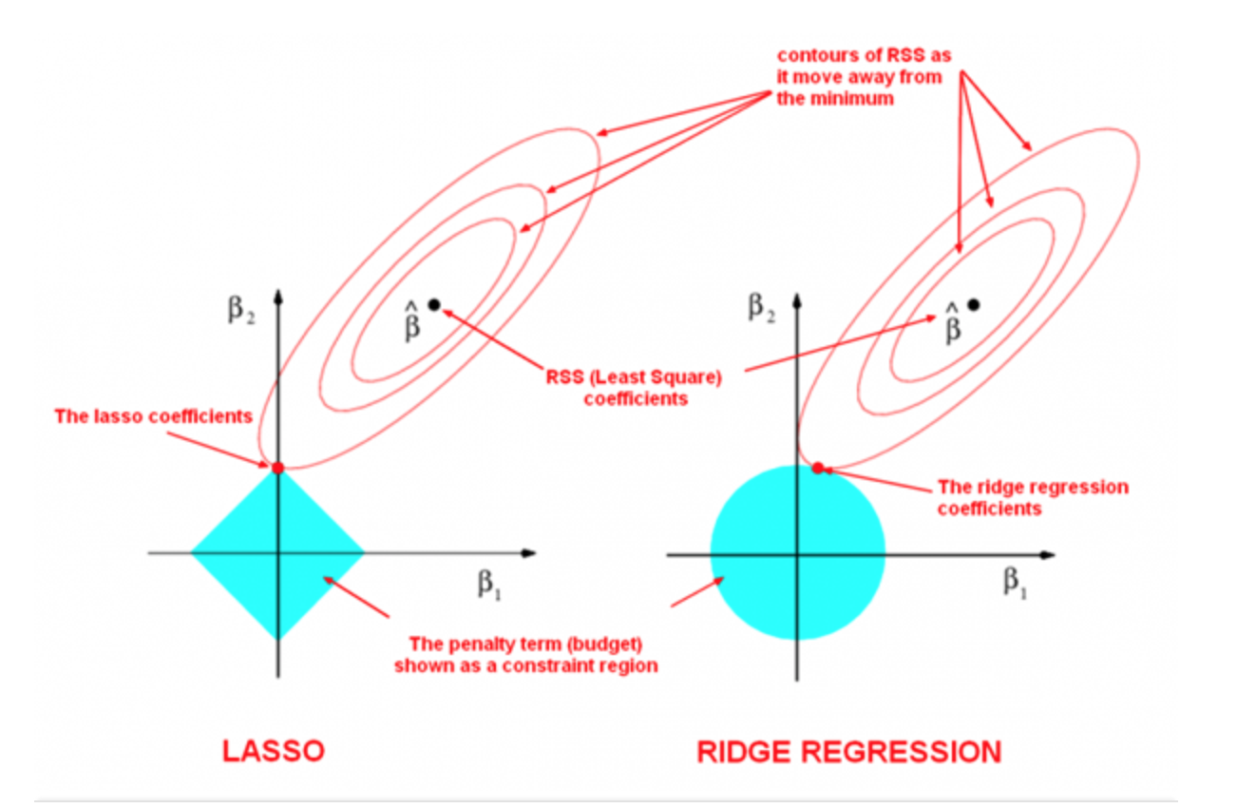
Result – not optimal solution, compromised Solution
There are two parameters in model.
The optimal MSE values are the dot.
The optimal penalty values are 0.
The algorithm increments both to be ‘worse’ (farther from optimal).
Where they meet is the solution – a value that satisfies each part.
Best overall solution.

Slide 45
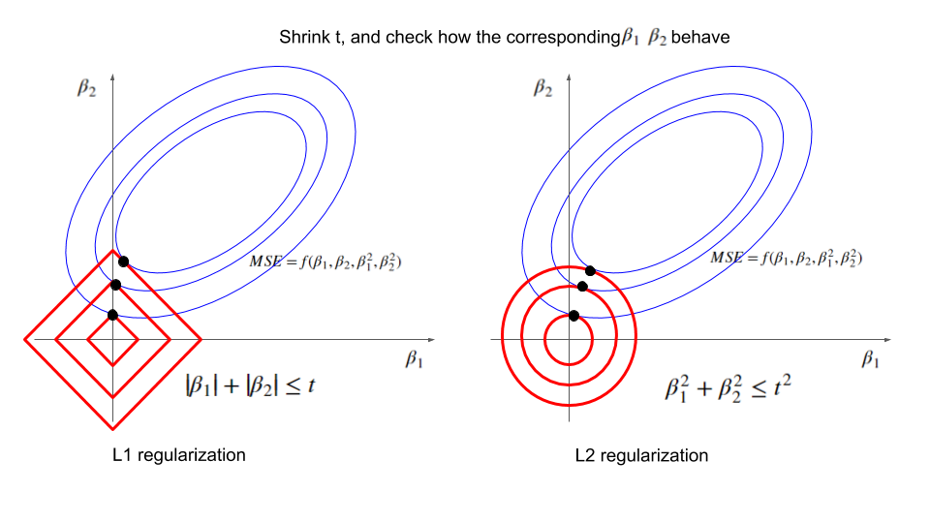
Why Variable Selection
L1 tends to reduce coefficients to 0.
This effectively selects that variable out.
If we optimize, the solution for L1 is more likely to be on the axis.
Smallest penalty = tangent of curves.
Mathematical property of the curves.
Can be used directly, or as info to select variables otherwise.

Slide 46
Get Lost in the Cost
Cost functions are (mostly) interchangeable with each other:
Regression is usually MSE, classification is usually cross-entropy, but it can vary.
As long as it measures error and is differentiable (for math), it can work.
The gradient descent process to find optimal solutions can take (almost) anything.
Similarly, the penalty can also be anything, as long as the math works.

Slide 47
Impact
Models are limited from becoming over fitted, as it is “hard” for coefficients to grow.
Very large coefficients are likely to be overfitted and exert excess influence on predictions.
We can make regression models larger and more capable, then limit overfit.
L1 Lasso:
Reduces coefficients to 0 – good for feature selecting. Could compare with tree importance…
Math is worse – the derivative isn’t differentiable everywhere, so calcs are slower.
More robust to outliers if they are not filtered out.
L2 Ridge:
More common, is sometimes a default in other models.
More computationally efficient (large reason for the commonness) due to math speed.

Slide 48
Implementation
Ridge, Lasso, and ElasticNet are all sklearn packages that do their names.
Other cost-function based things may use regularization in the background:
SGD has a penalty hyperparameter that imposes regularization.
Other linear models (e.g. SVM) do the same.
Neural networks often use a regularization penalty.
Regularization is one of the most common tools used to fit models.
Limiting the overfitting of a potentially very adaptive model is most common need.
L2 is mathematically quick, is seamless, little/no work from developer.
Larger models are needed for more complex things, larger models also overfit – regularization is often built into those larger complex models to constrain the overfit.

