Slide 1
Housekeeping
Project stuff – ask away if you have any questions.
Today:
Text generation with LSTMs.
Text padding.
Bidirectional LSTM layers.
Temperature.

Slide 2
Text Generation

Slide 3
LSTM
LSTM models are excellent in dealing with temporal relationships in data.
The recurrence allows the model to maintain a ‘memory’ of what came before.
LSTM models are good because they are able to do several things:
Maintain a long-term memory.
Maintain a short-term memory.
Combine these with new data to make predictions.
Be selective about updating the memories with new data.
Each of the LSTM units has several gates to process all of this.

Slide 4
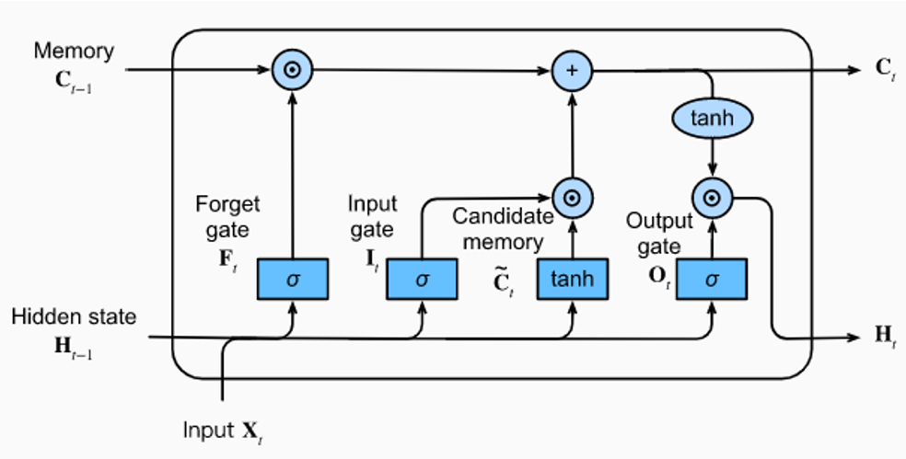

Slide 5
Notes
We’ll look at this in some level of detail:
Constructing datasets.
Padding
Shape
Etc…
In many/most applications we’d automate some of this through loaders.
It is common for us to need to define preprocessing.
E.g. provide a preprocessor to map.

Slide 6
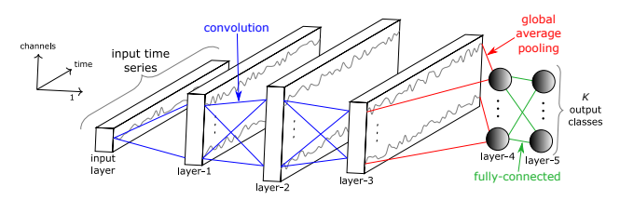
Key Idea – Here and Elsewhere
One key thing here is that anything can predict, we need to choose the best interpretation.
Any model that can calculate loss and adjust weights will ‘work’ with gradient descent.
In images, CNNs capture spatial data, and that tends to be a good feature set.
In time series (and now text), RNNs capture temporal data, that tends to work well here.
This representation is flexible – and can vary.
Some models can combine different parts to generate features.
Image models can use RNN parts, time-series can use CNN parts.
For time series in particular, the hierarchical representations seem to work well.
We basically just want the best features for the dense bit – CNN, statistical, RNN, NN, etc…

Slide 7
Predicting Text
Text is one of the things that has temporal relationships in the data.
The order of words matter, as does what came earlier in the sequence.
We can use a model to predict the next word, or set of words.
Input – previous tokens.
Output – next token(s).
A piece of text is a weird time-series of words.
We can make a model that predicts the next word, then the next, etc…
Eventually, we’ll basically have Siri.

Slide 8
Forget predicting, what about Generating Text?
We can apply these LSTM models to predict the next word.
We can then tell it to generate that word!
ChatGPT, watch out!
We just need to setup the data properly:
The input is the previous set of words.
The output is the next word.

Slide 9
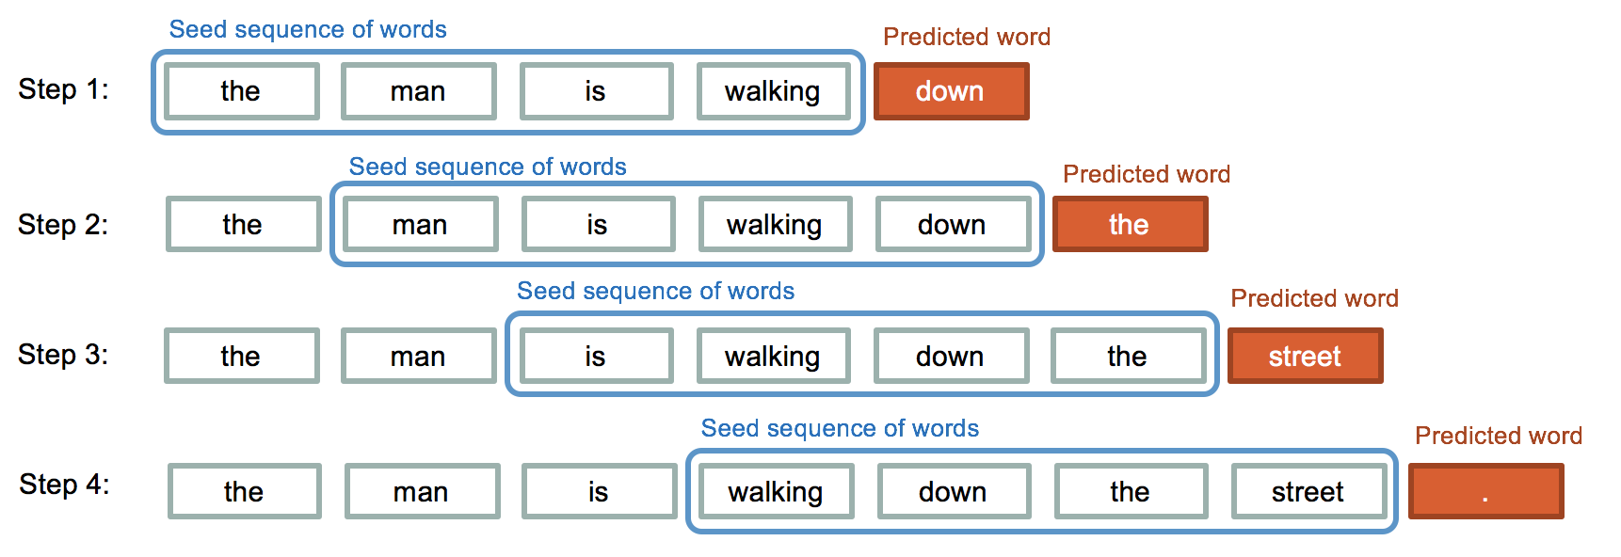

Slide 10
Data Configuration
Our data again needs to be processed and reshaped.
We need to strip and tokenize the data. (This changes with ‘good’ models as they predict things like commas).
We need to shape the data.
X – previous M tokens.
T – next N tokens.
We need to pad the data, or make every record the same length.
Models need fixed size data, but sentences are any length.
We add blanks to either end to standardize the length.

Slide 11
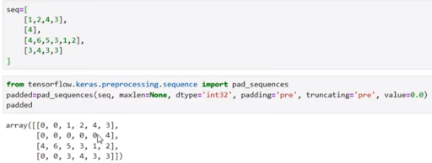
Padding
Padding makes each tokenized text record into a set length.
Padding adds 0s either at the end or at the beginning of the text to fill it.
For generation, we want to pad at the beginning, as we want the ‘next’ item.

Slide 12
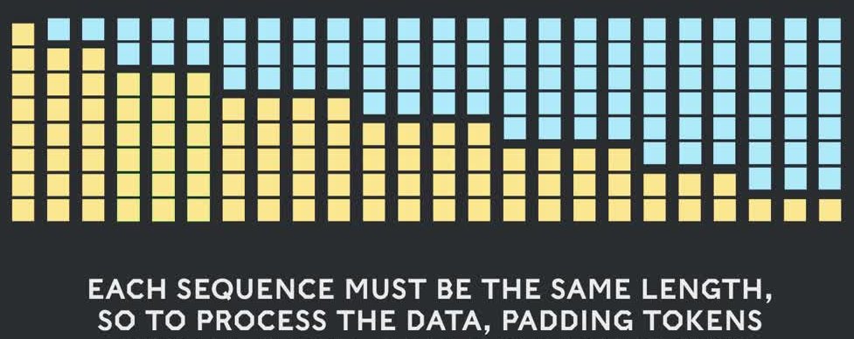
Post Padding
After padding, we have a usable dataset.
Each X value will be a fixed number of tokens before the current word.
The target is the next token, we can train.

Slide 13
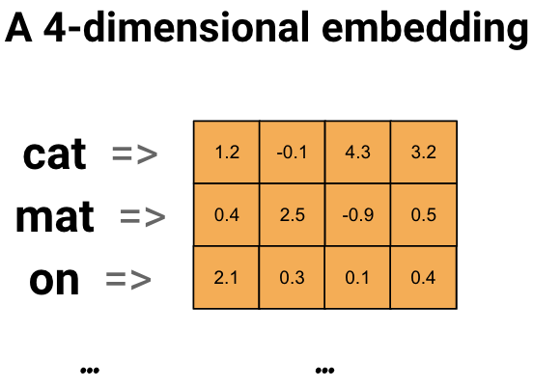
Embedding
To make things useful, we need to generate embeddings for the tokens.
This can be done in any way – we’ll use an embedding layer.
Can download and use embedding space pre-made, such as word2vec.
There are several options, they can be extended for customization.
Most important thing is the number of dimensions:
Higher dimension, better representation, slower, more data needed.
We can use ‘tens’ as a start, real LLMs can use thousands.

Slide 14
Language Model Notes
This is very simple processing for text, for a simple model.
In larger models, the data preparation is different.
Construction of the datasets is potentially a lot of work.
Specific applications like chatbots may need to restructure data into prompt-response.
Other models are commonly used to help process the massive amount of data.
The dataset is massive, and may only have one or two epochs.
Tokens are often sub-word length, as models need to handle suffix/prefix etc…
Large/smart models also have an assortment of things done to make them faster and better – reinforcement, specialized ‘sub-models’ (mixture of experts), etc…

Slide 15
Training a Text Generator
Training the model is the same, once the data is setup.
We need to ‘wrap’ some generation logic around it.
Predict the next word, add it to the input, then that’s the input for predicting the next…
The prediction is a token value, so we need to make it a word.
We can make a couple of simple functions to do this with our model.
When generating text, we need to provide some prompt that is the original X data.
We can tune the temperature…

Slide 16
Temperature
The temperature injects randomness into the predictions.
Models always try to predict the correct answer, if possible.
This usually makes sense, but for speech it really doesn’t.
A novelist isn’t trying to always choose the optimum word, or it would get repetitive.
Temperature inserts random variation of the prediction.
Instead of just taking the most likely next token as the prediction, we will randomly select a token that is ‘in that area’.
The ‘correct’ next word is most likely, but we’ll vary our selection of similar words.
This makes generated text sound more normal, as it will vary word choice more.

Slide 17
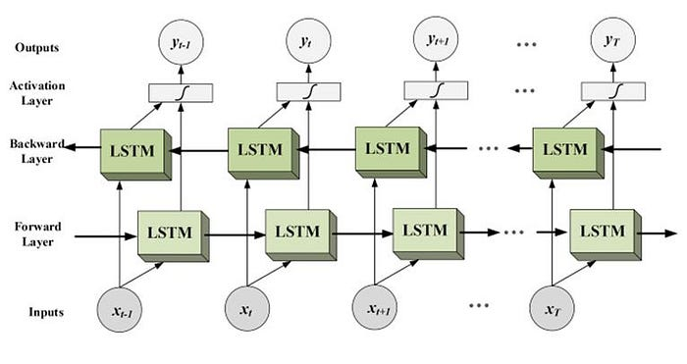
Lastly, Let’s Go Bi
We can also add LSTM layers that are bidirectional.
This is common in sentiment analysis, but transformers have largely surpassed this there as well.
These layers feed the data through the LSTM units in both directions.
This can allow the model to get context from before as well as after the word.
I.e. if a word in the future helps give context to something earlier.
“Server can you bring me this dish” vs. “He crashed the server” – meaning of ‘sever’ is better captured.
By processing it in reverse, model can capture relationships bef/aft.

Slide 18
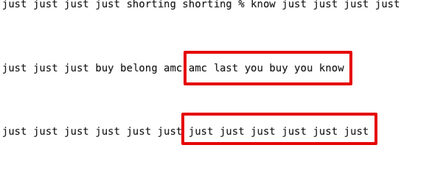
Lower your Expectations…
Lower your expectations, even lower than the normally are here.
Good text generation is hard, and we aren’t making a good attempt.
Language is diverse - need large embedding space and model to capture it.
That requires massive datasets.
Those mean it takes ages to train one – we aren’t even at a fraction of .001% of that.
E.g. this example from training – real-ish flipping to ‘junk’.
The model is ‘stuck’ and every prediction falls on ‘just’.
The model can learn its way out of this, but may take time…

Slide 19
In Real Usage…
This is the basis of generating text in most cases.
Real applications add some other tactics:
Custom prompt/response framing – e.g. a chatbot is setup so a question is an input and their response is a prediction.
Reinforcement – feedback is provided by a human for good/bad, or better response. This helps tune the model. This can also be done live, e.g. do you accept or reject a response.
Token variation – LLMs can use tokens that are smaller than a word. This helps since they need to understand sub-word things like a prefix.

Slide 20
conclusion
LSTM text generation works well, but transformers have surpassed it.
Transformers are better able to track what matters and what doesn’t in context.
Most of the other mechanics, like dealing with data, are similar.
We can train a simple, though awful, text generation model.
Actual generative models require lots of training – time and data – ours will be bad.
I heard a podcast where an ex-Open AI guy said the next generation would cost $1billion+ to train.
I already trained the sample model, for at least 800 epochs, so this isn’t starting fresh.
There’s an example in the workbooks of both downloading and fine tuning a transformer model, and making one from scratch in the repository.

