Slide 1
Housekeeping
Today – Logistic Regression and Images. (Regression in ch2)
Review of gradient descent.
Classification with linear models.
Images as data.
Representing analog data.
Feature construction basics.
Assignment #2:
Regression with data cleanup and processing.
Feature selection next time, you’ll need that as well.
Overall, this will kind of wrap up the ”make a model and use sklearn” bit, we’ll move into more complex things (natural language) in a week or so. Please ask/review if it’s shaky for you.

Slide 2
Terms
I want to be explicit about a few terms, because some things are used somewhat interchangeably.
Label, class label, class – the categorical target value of a row.
Instance, row, item, record – one row of data in the dataset.

Slide 3
Logistic Regression and Images

Slide 4
Logistic Regression – What’s New?
Regularization
Multiple Classification

Slide 5
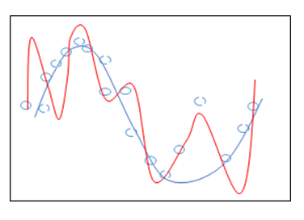
Regularization
Logistic regression is a linear model.
Recall the internal regression of logit.
Regularization penalizes growth of the model’s weights.
Regularization is often applied to linear models by default.
We can define the type with the HP: penalty
Logistic regression has L2 as default.

Slide 6
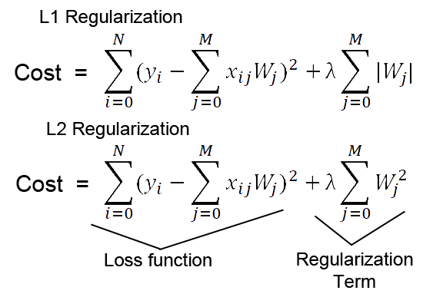
Regularized Cost penalizes Weight Size as Well as Error

Slide 7
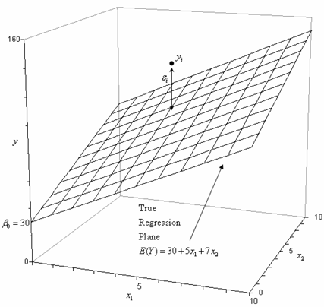
Regularization in Effect (W/ Bonus Normalization)
Recall:
In a regression, the prediction is just y=mx+b calculated.
Scaled data to have Xs that all in the range. ~0-1(or norm.)
Regularization limits the growth of the m. (Weights)
B (intercept) is purely corrective, added at the end to shift.
In regression we’d have scaling and reg. limiting [mx] terms.
I.e. the model is less “reactive” or variant in its predictions.
In large models, with many terms, this limits overfitting.
“Blunts” the impact of any one factor.
Weight determines X’s influence on Y, overweighting is penalized.

Slide 8
What about Classification…

Slide 9
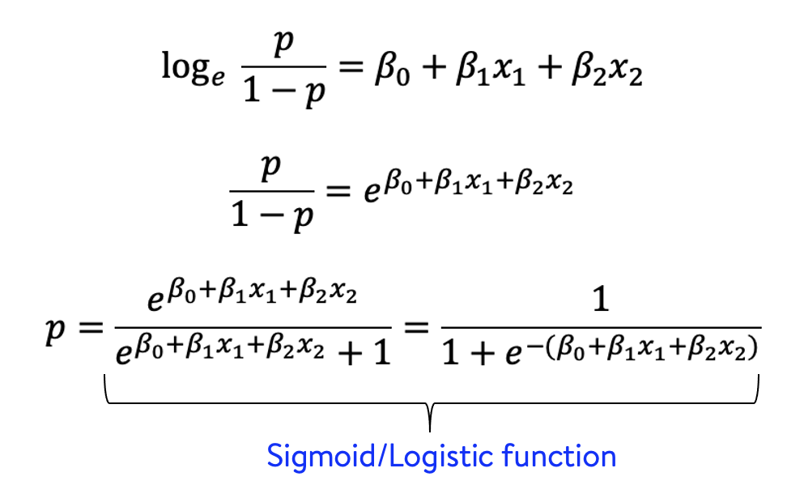
Classification and Logistic Regression
We can use a linear model to do classification as well – logistic regression.
Throw back to our old favorite, the logit!
Ratio of the log odds.
Logistic regression:
Has a linear regression inside of it – to the logit, not target.
Transforms that logit value predicted by the linear regression into a probability of the record being each possible class.

Slide 10
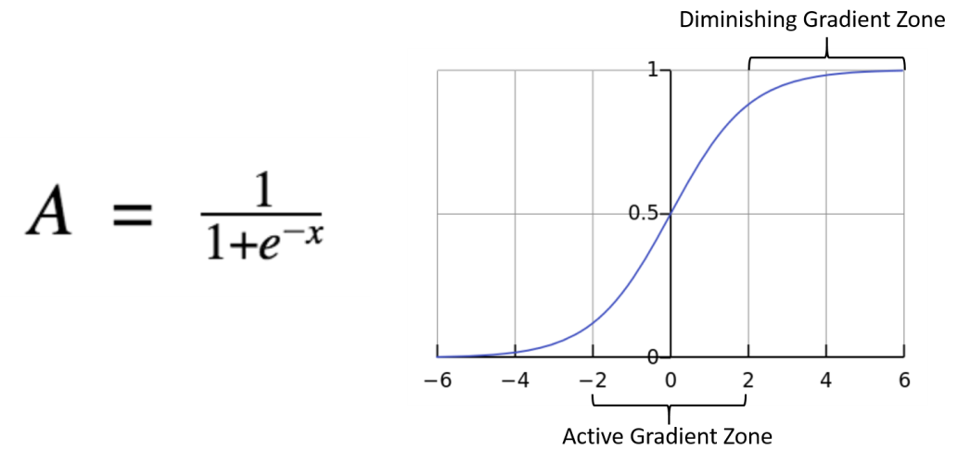
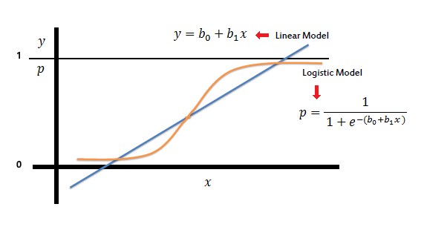
Sigmoid
The predictions of the linear model are ‘inputted’ into a sigmoid function.
The input to the sigmoid (top) is x.
We input the linear form. as x.
The output is a probability of that record being 1.
Output is constrained in [0,1]!!!
This is the probability of the pred.
If it is over .5, then T, else F.

Slide 11
Result – Probability of Classes
Our model predicts the probability of being in class 1 for each record.
1-p is the probability of being in class 0.
This probability (not the actual class prediction) is used in training.
Class prediction comes at the end, it isn’t super important to the process.
This is the y value on the sigmoid plot on the previous screen.
Input the logit as X.
Get the probability as Y.

Slide 12
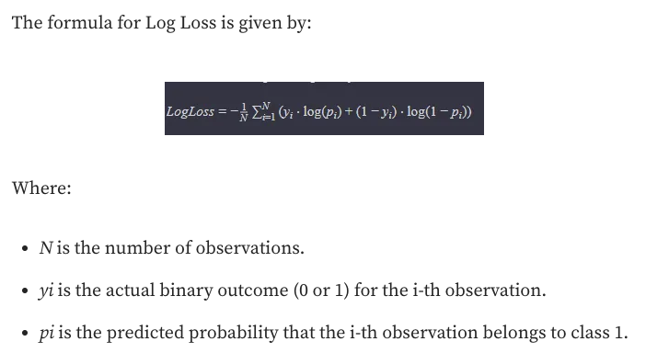
Cost
Cost function is log-loss, or binary cross entropy.
Measures the distance between true value of the record and prediction probability.
The final class prediction and right/wrong don’t matter in training, only this loss.
Gradient descent works the same, the loss calc is just different.
The key ‘binary’ bit is the y value terms:
Y is the real value, so either 1 or 0.
Half of the calculation becomes 0, depending on T/F.
Measures distance from correct answer.

Slide 13
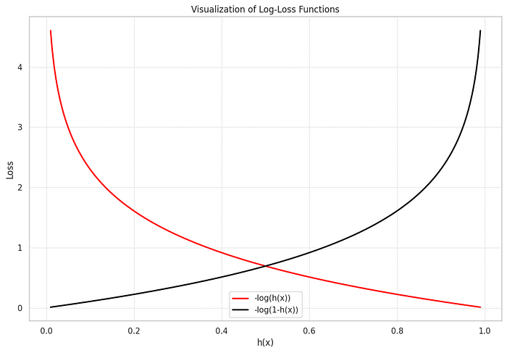
Result – Nice Curve

Slide 14
Conversion to Categorical Predictions
The ‘raw’ prediction of a logistic regression is a probability.
Probability that the predicted value is True.
The goal of what we need is a T/F prediction, not probability.
This conversion function takes the raw value and generates the actual prediction.
This prediction is irrelevant to the training – only loss mattered there.
The internal regression predicts the logit, which is then:
Converted into this probability for the internal log-loss calculations for training.

Slide 15
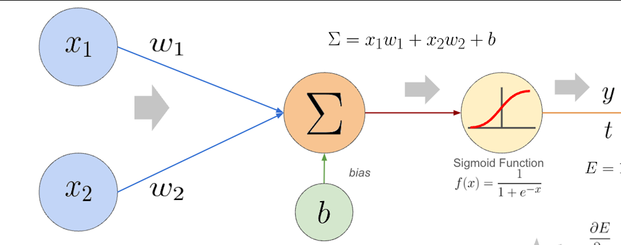
A.K.A - Activation
The result of the regression is the logit.
Before the model is done with its prediction it needs to make that logit into something useful – a probability.
To do so, we run the predicted logit ‘through’ some function (activation, later on in NN).
In a logistic regression, that function is the sigmoid.
Generate the logit.
Calculate the sigmoid with logit as the input value.
Output is a probability of that class label for each class.
We can calculate the loss using cross-entroy, and/or convert to a prediction (>.5?)

Slide 16
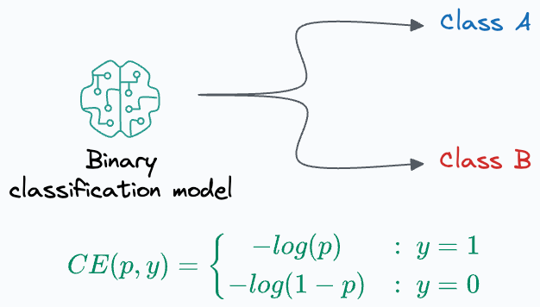
Final Outcome
The sigmoid generates a probability of True as a prediction.
The CE cost is calculated with this and the true label.
A model that is highly confident in (correct) preds is optimal.
The most probable label wins.
In binary, this is simple, they are complements. P(0) = 1-P(1).

Slide 17
What if There Are More than 2 Classes?
Classification models have defaulted to binary so far.
Classes are (or can be understood as) True and False.
Output is the probability something is true, translated into a T/F for a final prediction.
Loss function (binary cross entropy) is built on the difference from the correct answer.
Trees and Bayes can (theoretically) handle more than 2 output classes by default, linear models can’t.
We can modify these models to handle more than one class, in several ways.
One vs One – make a classifier for each pair of possible outputs.
One vs Rest – make a classifier for each class vs not that class.
This can be forced in Sklearn, but is generally invisible. SVM uses OvO, other linear use OvR, and tree or Bayes models can do multiple classes directly.

Slide 18
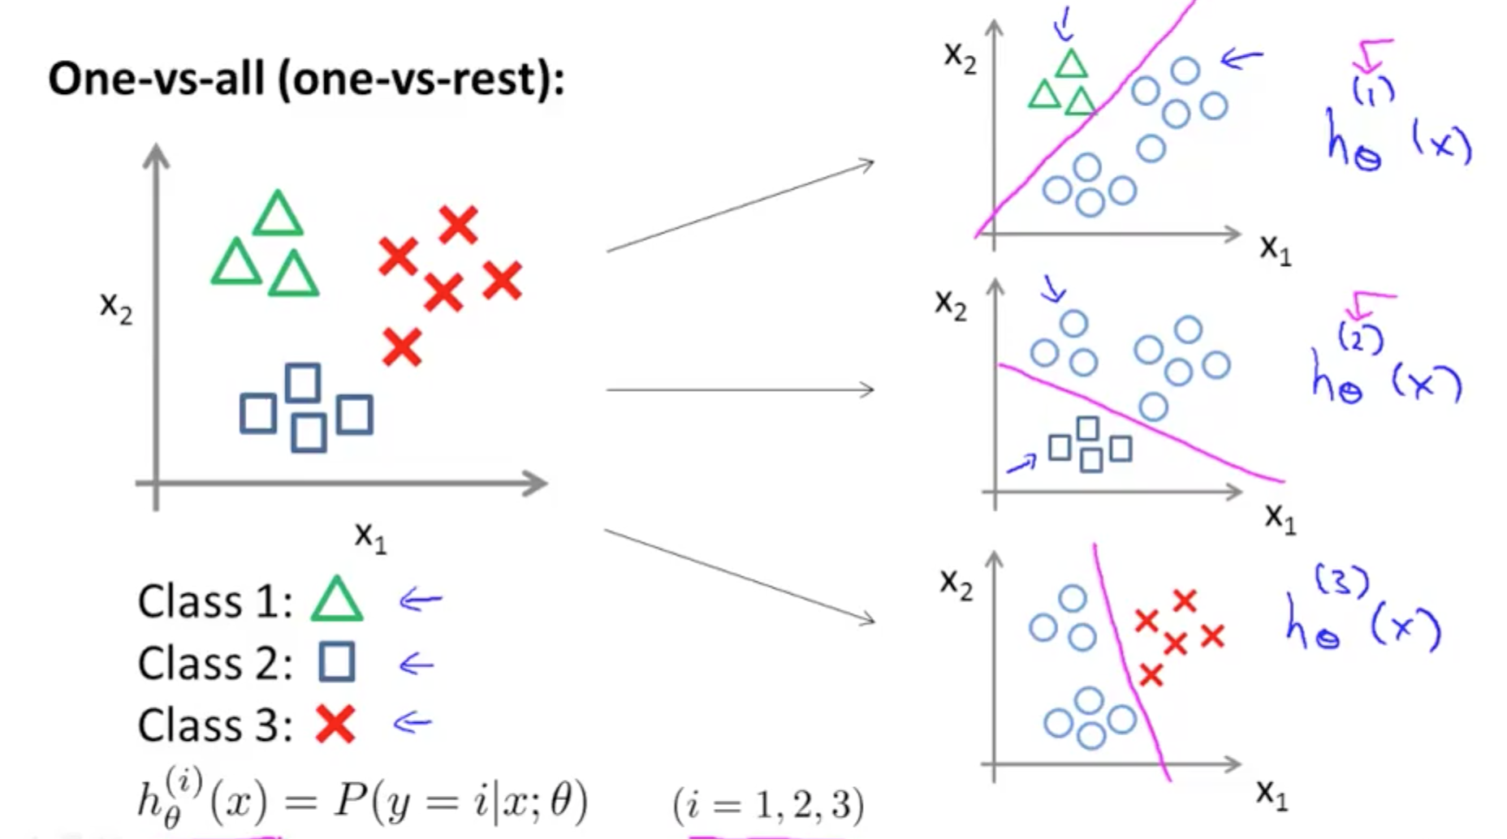
Multiple Classification
We can also predict things into multiple classes.
Sklearn does this by default by doing 1 vs rest.
Build 1 classifier per class, making a yes/no for that class.
We get the probabilities of the above prediction.

Slide 19
Adapting Regression to Multi-Classification
In binary classification we:
Generate a logit prediction through linear regression.
Use that logit and the Sigmoid function to translate logit→ probability.
I.e. the probability that this predicted label is the correct one.
We can do the same thing with multiple classes (with few changes):
Generate a logit prediction through linear regression.
Use that logit and the Softmax function to translate logit -> probability.
i.e. the probability that this predicted label is correct.
The softmax functions like the sigmoid – gives us probabilities.
As with the binary one, the most likely label is the winter.

Slide 20
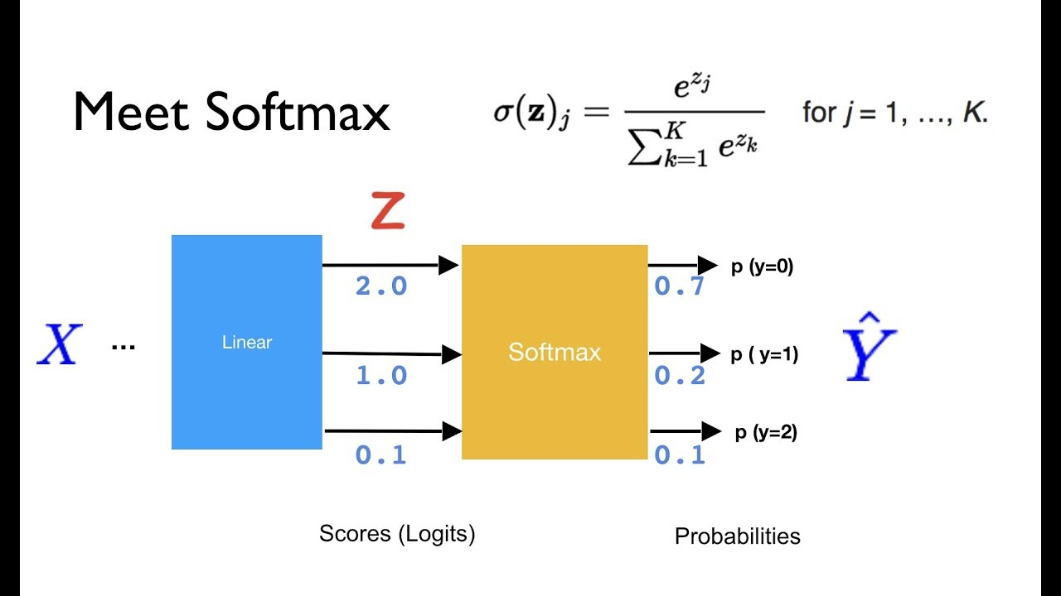
Softmax
Softmax allows us to directly predict class probabilities with one classifier.
The output of Softmax is a probability (0 to 1) that the instance is in that class.
Softmax can:
Take in the logits, or the output of the regression models internally.
Change those into probabilities per class, which is what we need!

Slide 21
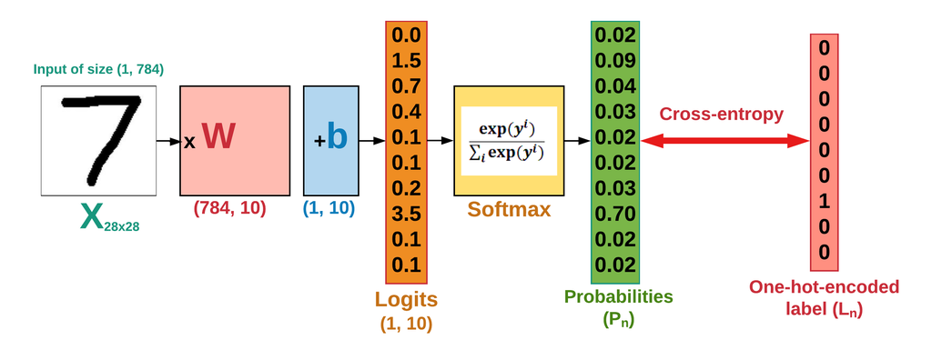
Loss – Non-Binary Cross Entropy
Cross Entropy (non-binary kind) is a common cost function for classification.
Cross entropy translates the softmax probabilities into a label, and calculates the cost.
Like binary cross entropy, this measures the “distance from” the correct prediction.

Slide 22
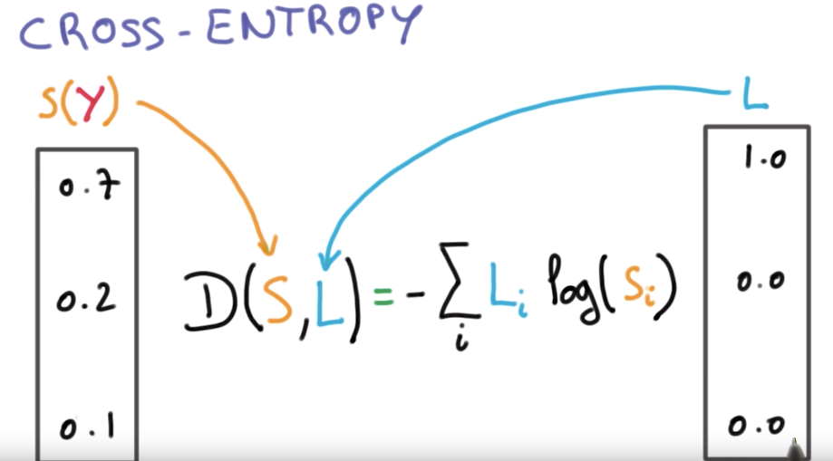

Slide 23
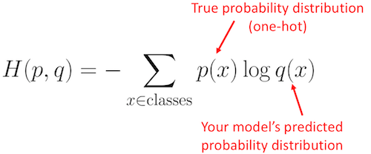
Result – Arbitrary Numbers of Classes

Slide 24
Gradient Descent and Multiclass Models
The gradient descent process is the same, the cross-entropy generates loss, the gradient is taken on the loss curve w.r.t. each feature, the weights are adjusted, and repeat…
As long as something can be structured as “loss” and ”things to adjust”, G.D. is the same.
Regularization is applied by default in sklearn.
Multiclass classification is commonly used on things like image recognition, where there are lots of potentially classes, so limiting overfitting is good.
The process is basically the same, with a few tiny changes:
There are more than two output classes, so we can’t say “P(T) = 1-P(F)”. All probs matter.
Instead of using the sigmoid, this one uses softmax. (We can split the regression and ‘act func’).
The cost is slightly changed due to multiple classes.

Slide 25

Multi-class Classification - Images

Slide 26

Images
Images are basically 2D (for now) grids of pixels.
E.g. Your 1080p screen is 1920 x 1080 pixels.
Each pixel is an integer value.
0-255 for lightness.
Images are normal data, and we can treat them like any other data.
The data of an image is a representation of the real thing (analog image). This can change.
This allows us to, pretty easily, do image recognition!

Slide 27
Image Notes
We’ll deal with images that are bitmaps (i.e. a bunch of pixels) like jpegs.
There are other image formats – each encodes the image differently in the data.
We’ll ignore other image types and formats (a bit more in NN).
In general, you can convert from one to the other if needed. (e.g. in a prep pipeline).
If we were dealing with differently encoded data, most things are the same, but the process of turning the 2D data into something ready for the model needs to change.
In other scenarios, there may be feature extraction – making features from raw data:
E.g. instead of using raw data, preprocess to detect lines, edges, faces, etc…
Simplify model – we don’t need to process a billion features, only a few that matter.

Slide 28
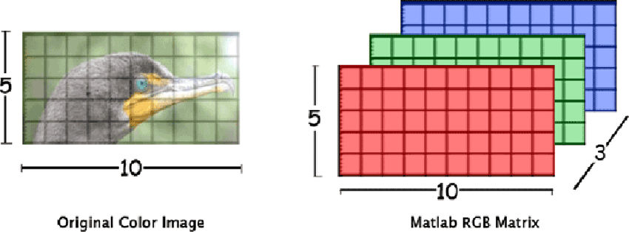
Better Images
Our images are simple – 1 color.
No depth - we only need an array with depth of 1.
More complex images add pixels and additional layers for more colors (RGB for ours).
These are tensors – multidimensional arrays.

Slide 29
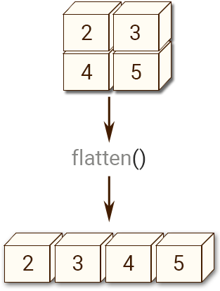
Classifying Digits
We can create a model to classify digits into 10 classes.
Our image data – we will interpret it like “normal” data:
Each digit is an image of pixels – either 64 (8x8) or 748 (28x28).
There’s only one color, so each pixel can be between 0 and 255 for “darkness”.
Our target is the label, the actual number that the pixel is.
We can flatten the 2D representation of pixels into one row, then use normal models.
Each pixel will now just be one feature, in order. (We can reshape back to get original)
We lose the spatial part of the data – our flat representation doesn’t “understand” 2D.
With images, and other things that are analog, we create a representation to use.
There are better ways to process image data that keep spatial awareness, we’ll see later.

Slide 30
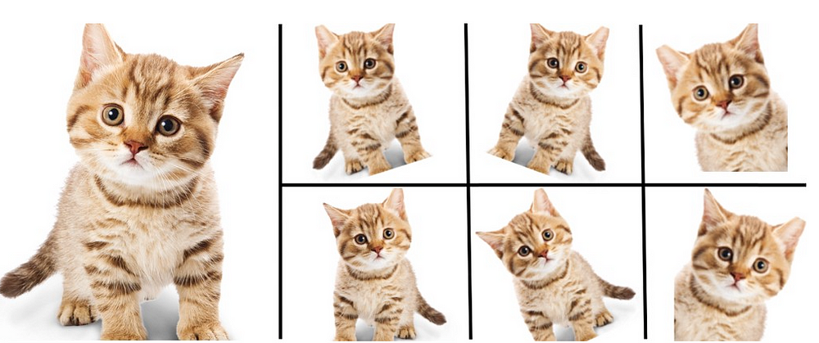
Better Image Processing (For Later on)
In our models we always need to flatten the data prior to doing anything.
I.e the data we use is a datasheet – one value per column, row per item.
In an image, that transformation causes some data loss.
We lose the info on where things are in 2D relative to each other, like the shape of a face.
E.g. a cat is a cat if it is on the right, upside down, etc… but our model only sees pixels.
A cat in the upper left corner is different from a cat in the lower right corner in data. (diff pixel)
This is a limitation in fit of this type of model to this data – irreducible error.
It will work as long as we can transform the data, but the representation (flattened pixels of the image fails in that it is unable to capture all of the important info in an image, like the spatial bit.
Other models (CNN) can capture the spatial part of the data, and are better for images.
I.e. instead of using just pixels as features, this can construct features from the 2D image.

Slide 31
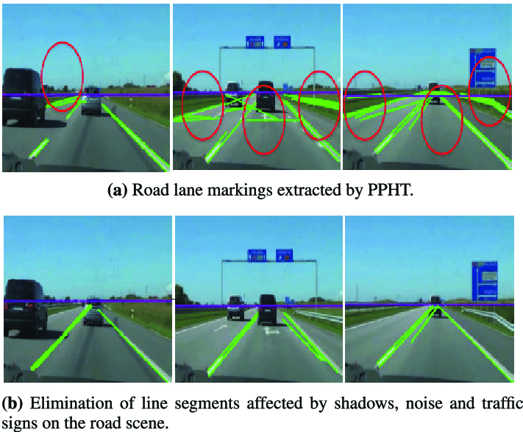
Detour - Feature Extraction and Preprocessing
Domain specific, and mostly out of our scope.
If a car needs to stay in lane, 5 1080p feeds is lots of data, all all we really need is something that represents where the lane is.
I.e. instead of using all the data, our processing will find edges, and create features of that.
Can make a smaller and more efficient model.
A large non-feature model could learn this, but processing and data needs are higher.
Domain knowledge shortcuts learning needs.

Slide 32
So… Images
So, we will treat our image data in the most simple way: pixels -> features.
This works, and requires few changes at all to work with our processes as they are.
This compromises on some of the information that is important in an image, like 2D stuff.
Other models use the same source images, but interpret it differently.
I.e. instead of pixels->features, they do some version of pixels->process->features.
None of these strategies is using the ‘true’ data (the actual visual), they all transform it.
Our goal isn’t to produce a dataset that most perfectly represents reality.
Our goal is to make a model that most accurately predicts reality.
We can (and should) manipulate the data to those ends – (outliers, transformations, feature selection, etc…) We want the pattern from the training data, not necessarily the data.

Slide 33
Data Representations
For structured data (numbers, classes, Booleans) the data values we use are pretty set.
Our models calculate numbers, so we are just converting to different numbers.
Our predictions are based on getting as close as possible to whatever the value is.
For unstructured data, that can’t really happen.
An image, sound, or paragraph doesn’t really have a ’value’ in the same sense.
We need to generate a representation of the data to use in a mathematical model.
Here, that is a simple rearranging of the pixel layout.
In more advanced image processing models, we can look at 2D ‘hunks’ (or edges, or…)
Soon, for free text, we’ll need to do something similar – generate an embedding.
Performance depends both on the model, and how good the numeric representation of reality is.

Slide 34
Images and Logistic Regression
Images can be treated like any other data – represent the image in a format that our model can accept, and let it fly.
The chosen representation will determine if we can extract value from it.
We must ensure that the shape/size of our model matches that data (post-prep).
This applies to anything, if we can represent it tabularly, we can predict it.
Logistic regression can adapt a linear model to do classification.
Instead of doing a regression to Y (target) we do a regression to the logit (loggy prob).
The result of the regression is “run through” a function to make that prediction a probability.
That function (activation) can be a sigmoid (bin) or a softmax (multi), produces ’prob of label’.
The most probable label gets chosen and assigned as our prediction.

Slide 35
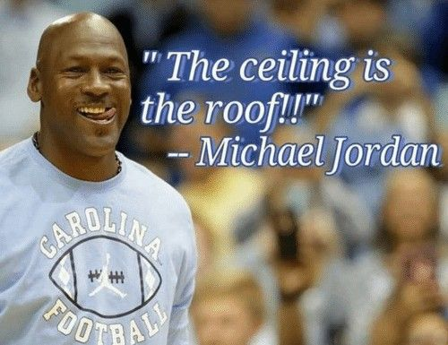
Constructing Features
Sometimes training data isn’t the data you train on.
The data we have isn’t in the format that is useful for us.
E.g. log transformations in stats, one hot encoding for us, etc…
Sometimes we need to take more drastic (and open ended) steps.
Remember – our goal is a good model, not one that is ‘true to the data’.
We need data that teaches our model the pattern of our data, irrespective if what we use is actually the data or not.

Slide 36
Example
Suppose you’re in charge of planning new Amazon warehouse locations.
The goal is to make it somewhere convenient for the customer deliveries.
You have data on all the amazon customers, including their address.
This address could (theoretically) be a feature for a model.
Transforming the address may make for a better model, what if we:
Geocoded it, making it latitude and longitude.
Calculated distance from customer-warehouse using lat/lon and used that instead.
Used a service like google maps to lookup driving distance cust-ware, and used that.
Used another model to calculate effective routes between warehouse and common custys…
UPS does this for planning delivery routes – they avoid lefts and reverse, not just shortest.

Slide 37
Another example
Suppose you’re a traffic engineer predicting # of accidents at some interchange.
Date and time of accidents or traffic may be a feature that you have.
E.g. 2025-01-30 15:00:00
The original can be used, but we can also change things:
Truncate some precision – does knowing seconds and minutes help? Maybe hour, 4h block, 6h block.
Custom binning – morning commute, day, aft commute, overnight.
Combine with sunrise/set data and make a dynamic version of that, or light/dark, etc…
Combine date with historical weather data to get precipitation info…
Depending on scenario, what makes sense might change quite a bit.
A default time may tell us less than a “is the sun in your eyes” feature for this purpose.

Slide 38
Make our Features Useful
In these types of cases the original data has info we need, but it’s not ‘pure’.
If we are smart about what we need, we can extract the valuable bit.
E.g. lanes from an image, distance from address, pant size from weight, etc…
We are consciously distorting the data, hopefully to make it better for us.
A definitive answer on “what’s best” requires testing, we are shrinking the test set.
Some things to think about trying:
Is numeric data better binned? Does the precision help? Is there noise? E.g. credit scores.
Too many choices. These become columns, can we condense or simplify with ‘other’?

Slide 39
Assignment #2 – Regression
The next assignment has lots of this type of stuff – yay for data cleaning!!!!!!
The data is messy (it’s survey data) so you need to clean it.
This could/will involve a few potential cleanup steps:
‘Basics’ – imputation, scaling, etc…
Selection (f.s. next week) – what to keep, what to remove.
Transformations – many of the features are probably more useful in different formats.
Process - you’ll need to:
Do some testing and trials to figure out what works.
Build that into a pipeline (both sklearn and informal) to do that stuff and train model.

