Slide 1
Housekeeping
Today – Discussion: who won in the NBA trade market and why is Dallas so stupid?
Support Vector Machines (chapter 2).
SVM classifiers.
Decision boundaries, hyperplane, hinge loss.
Depending on time/capacity:
Intro to NLP
Tokenization
Assignment 1 – marks up, notes.
There’s a quiz in a week, mostly short (~1 sentence answers). Overview in description.
Today in AI - the world is becoming insane, so the news is too.

Slide 2
Assignment #1 Notes
Overall good, most people did a good job.
Some people went a bit over the top and did lots, that’s good.
Pat yourselves on the back, I was a bit too lazy to put ‘good job’ in the comments.
If you did a good job and are also lazy, the EDA thing may be reused.
Train-test split doesn’t really need to be mentioned as a tuning thing.
Some people had little to no tuning of HP with a grid, but still good accuracy.
If you had more tuning that you did and deleted, ignore this.
This could just be luck, your choices worked well. We want to be a bit more systemic.

Slide 3
Assignment 1 Notes
Things I noticed….
The random state thing isn’t really for tuning, it’s for boring logistics.
Computers don’t do random, they need some starting point, a seed.
If you provide the same seed, you’ll get the same randomness over and over.
If you’re writing a textbook or something, this lets you repeat results.
Its irrelevant for actual usage, we want random.
If one seed works better, it’s a totally random coincidence.
Custom transformers (pipeline steps) – we’ll look at those soon.

Slide 4
Assignment 1 Notes
I generally try to allow smaller errors to break your way.
I tried to correct small errors, or things like file paths that are different.
It didn’t really apply here, but if some part in the middle of the process has an error, I generally try to give benefit of the doubt to the other sides.
E.g. you mess up ‘encoding’, making the process break, but I read the code and it looks like the parts before and after are good.
Please don’t actively try to take advantage of this.
If you think I messed up, let me know and make your argument. Sometimes I might miss stuff, especially in things like this where some code may be in different files.

Slide 5
Some Free Accuracy… Maybe
One thing we can do is to make a new model post testing/grid search.
We split the data (train-test or cross-validation) to get a way to evaluate models.
The test set that is not trained on allows us to estimate performance on new data.
Once we test the contenders, we can select the best model/HP/feature set….
If we want to use this model in real life (i.e. we train it, now time to actually predict), we can:
Take the settings that produced the best model.
Train a new model with all of the training data, no train-test split.
We don’t have a way to test this model, but we can assume the floor is the ‘best’ from the grid.
Will this help – maybe, it depends on amount of data, complexity, and distribution

Slide 6

What’s going on in AI…
Elon and crew are using AI to find ‘cuts’.
Given history, this seems like it won’t be good.
Think about what the target could be for whatever the model they make is predicting.
Previously he asked for people to upload medical records to twitter for his AI, and they just got access to VA (military healthcare), Medicare (old people healthcare), and Medicaid (poor people healthcare) data.
There will probably be something weird to flow out of this….

Slide 7
SVM Classification

Slide 8
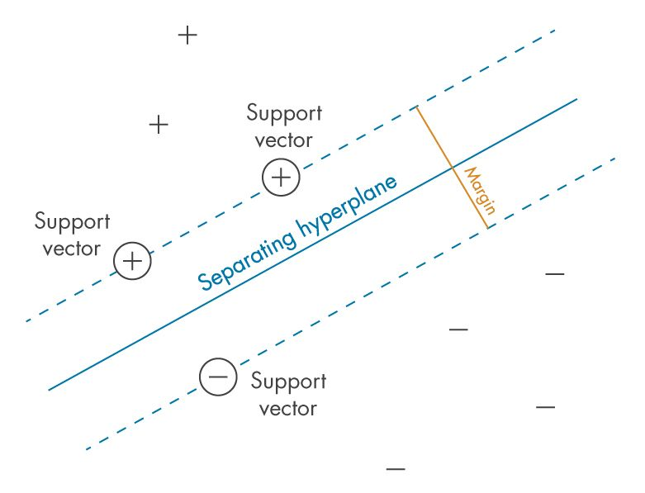
Support Vector Machines
Support vector machines are a linear-based classification model.
There’s regression versions, but those are less common.
They are based on creating a margin between the groups.
Aim to create the biggest ‘lane’ between the groups.

Slide 9
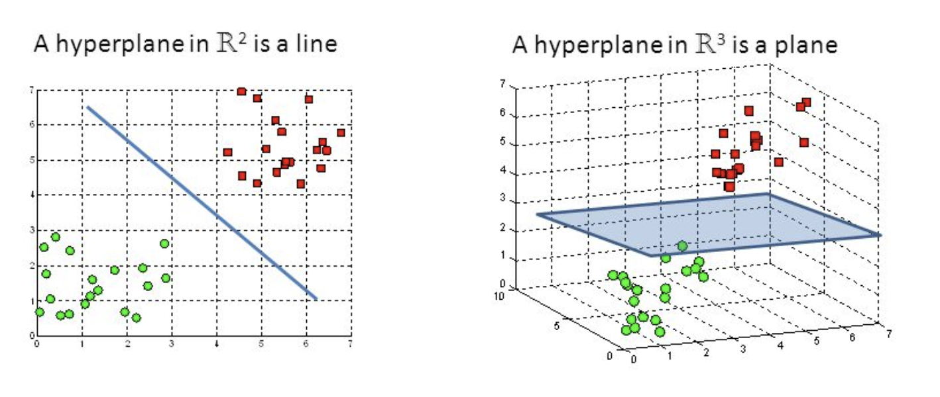
Hyperplane
The thing that does the dividing of the two sets is called the hyperplane.
This is the line in a 2D logistic regression – defined by the regression result.
The hyperplane is a plane that is 1 D less than the data.
The model looks to find this plane and use it to divide data.

Slide 10
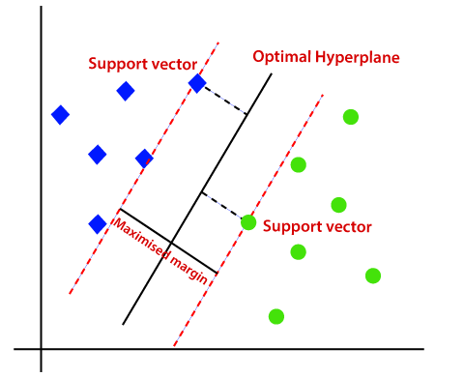
Support Vector Machines
A support vector machine is easiest to understand by picturing it.
It attempts to separate classes by drawing a division (a hyperplane) between two sets.
The points that define the separation are called the support vectors.
Everything on one side gets one label, everything on the other side gets the other.
The algorithm maximizes these margins – leading to the best possible separation.
Only the support vectors matter!

Slide 11
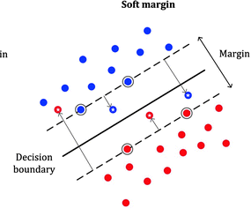
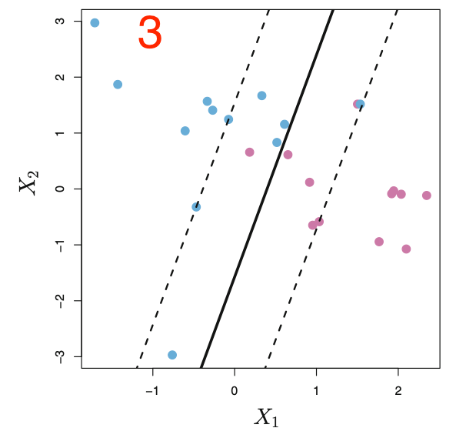
What if there’s not a Perfect lane?
Much of our data doesn’t have a perfect gap to divide on.
We can “soften” the margin or allow some misses.
This is done by hyperparameter C.
More C, more fitted, smaller margins.
Less C, less fitted, more tolerant of violations of the margin.
This allows the SVM to fit data without clear class divisions.
This is pretty common in real life, the model can fit properly despite ‘fuzzy’ borders between the classes.

Slide 12
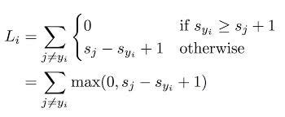
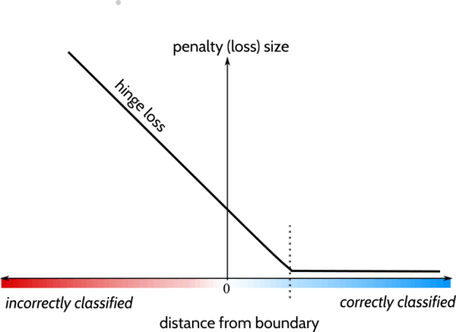
Cost and Loss
SVMs normally use a new cost function – hinge.
Hinge loss is defined as:
0, if ‘adequately’ correctly classified.
Increasing linearly while ‘close’ and wrong.
This incentivizes separation of classes.
Things that are well on the side are 0 loss.
The more wrong we are, the loss scales.
Advantages – small data and outlier resistance.
Non-differentialbe – g.d. isn’t used – quad. Prog.

Slide 13
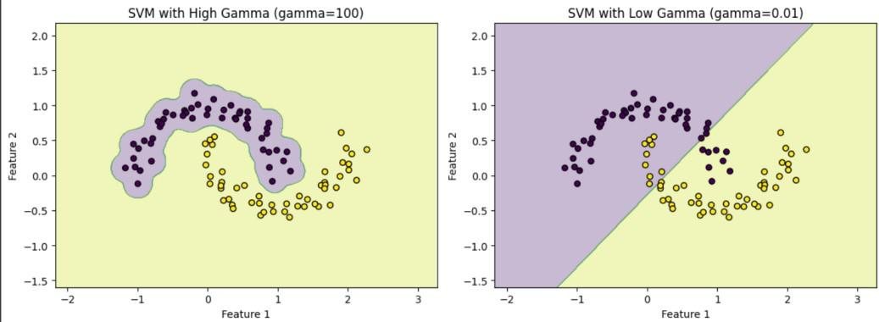
Other Key Parameter - Gamma
Gamma scales the influence of one example.
A high value means that each point only impacts a DB close to it, so the fit is tight.
A low value means that points impact works farther, so the DB isn’t as tightly fitted.
This is also roughly a dial for “amount of overfitting” allowed, that we can tune.
Works with C, for the hardness of the boundary.
If the boundaries aren’t super clean, these two will impact each other, unpredictably.
Need to grid search for a good value.
Overall, tuning an SVM is generally a grid search experience.
If the grid search is slow, SVM is likely to work well with a smaller sample of data.
We don’t do it (it’s pretty easy) but this is a good candidate for a random CV search.

Slide 14
Linear models, Non-Linear Data
As we’ve seen with trees and basis functions, non-linear data needs a non-linear model to accurately capture the patterns.
Basis functions did a transformation for linear.
Basis transformation ‘captures’ the non-linear curve so the model can fit it.
SVMs have a similar transformation tool, the kernel.

Slide 15
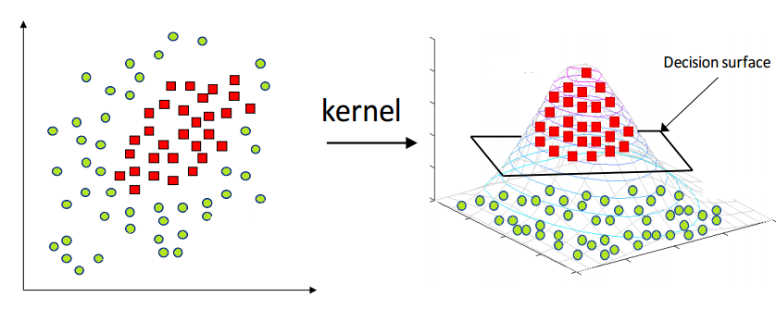
What if the split isn’t a Line?
As well, lots of data isn’t split by a nice simple line.
We can use a kernel – similar to a basis function in linear regression.
Transformation raises data to a higher degree (like a basis), and allows for different ways to draw the hyperplane.

Slide 16
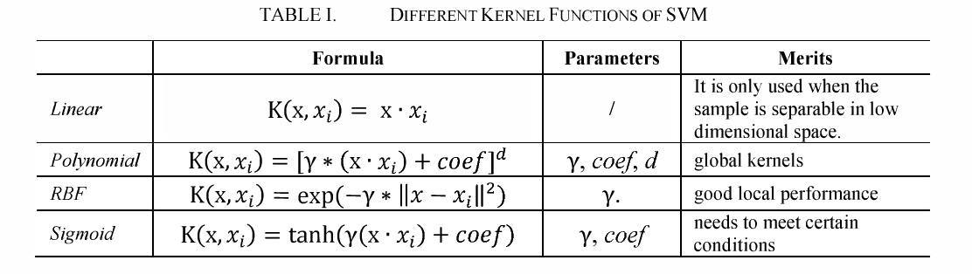
Kernel Choices
There are several kernel choices.
Generally, we need to test to know best option.
You can write your own, if you’re really into that. (You aren’t).

Slide 17
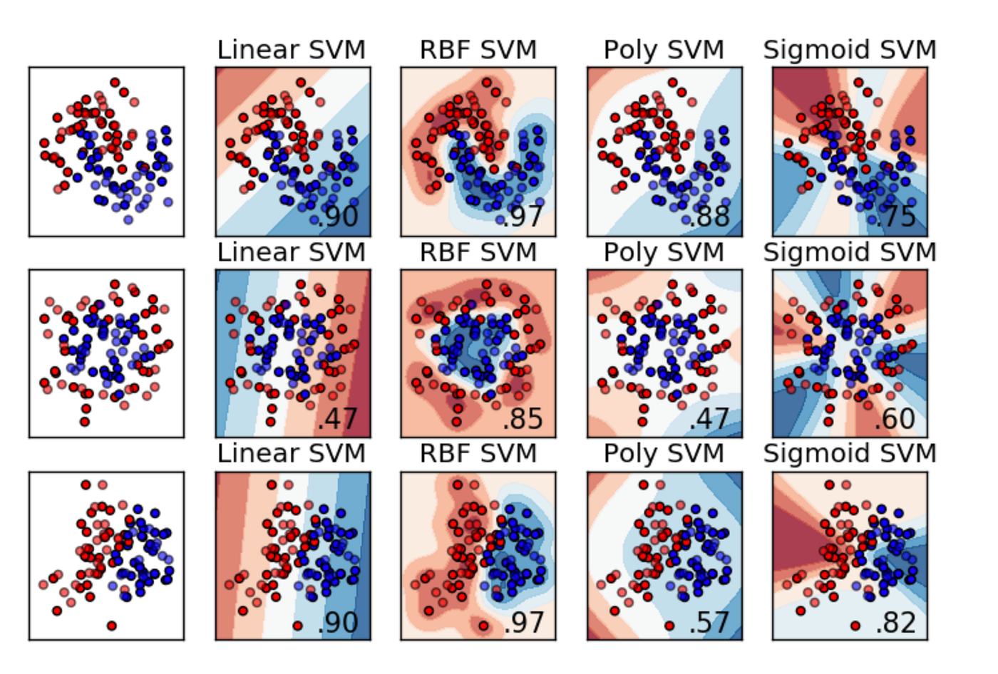
Kernel Results
Each kernel will do a different transformation.
In 2D, we can see what makes sense. In lots of D, we have to test.
Grid search makes this one pretty easy.
Results can swing wildly depending on kernel/data combo.

Slide 18
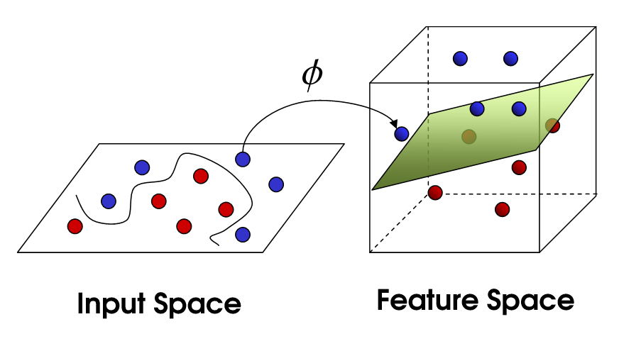
Dimensional Explosion
As with basis functions, this increase the dimensionality of the data.
The intuition is simple:
Can’t separate in 2D, make it ‘more D’, more space, we can then draw a plane to separate.
Same number of points.
There’s literally more empty space for HP.
We map the points from N-D to M-D.
This can take a minute, lots of math.

Slide 19
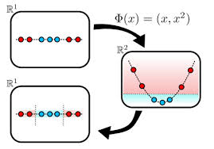
Easier to Split

Slide 20
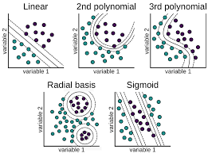
Kernels and their tricks
The mapping needs math in the raised dimension space.
This is really slow, especially if we have high-D to start.
The kernel trick is a math shortcut that does the same thing, but saves the math in many dimensional space.
We can specify the kernel as a HP:
Linear
Radial
Sigmoid
Polynomial
After kernel trick, sets may become linearly separable.

Slide 21
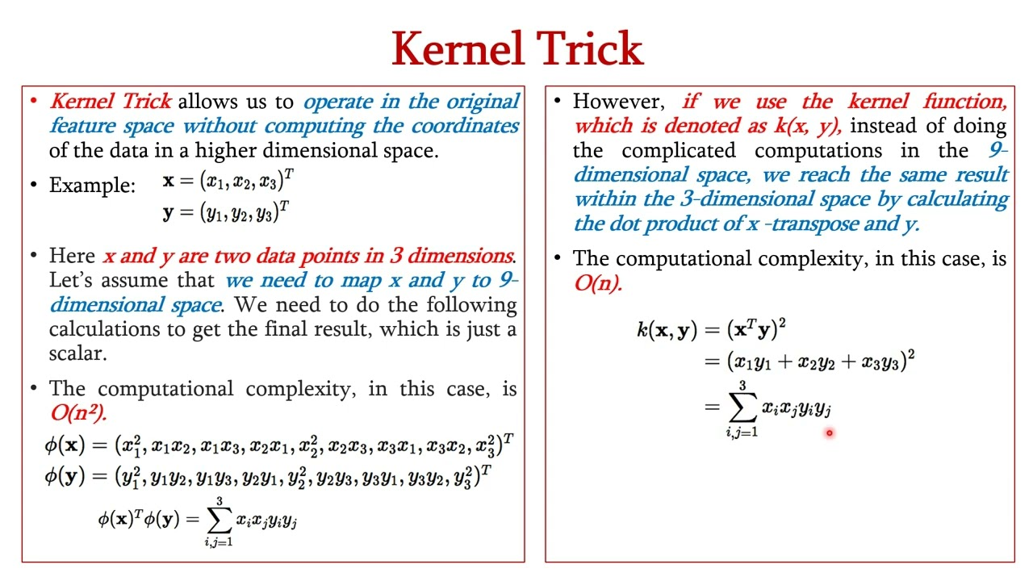
What’s happening

Slide 22
Turing Tricks…
The kernel trick is a mathematical shortcut that sidesteps the mapping math.
i.e. we can ‘make’ the data M-dimensional, without all the calculations.
This makes things run much more quickly.
Once in higher dimensions, division is typically easier.
This one is polynomial power of 2, same a basis LR.

Slide 23
Kernels are Tricky
The kernel trick saves calculations in mapping to a higher dimension space.
I.e. the kernel function needs to be applied to each record – lots of algebra.
The kernel trick is a shortcut of that mapping.
Get: data in higher dimensions.
Without: having to do all the math.
This makes this practical to use in more cases.

Slide 24
SVM Uses
Support vector machines are relatively widely used in real-life.
Often good at unstructured, high dimensional things like image or voice classification.
Marketing/sales related – spam, fraud, recommendation systems.
NLP related things like sentiment analysis.
Has been used for things like image classification at FB/Google, Siri and Google voice ast.
These may or may not still be true, but they were in ‘big’ production uses.
These applications are/may be better with NN, with lots of data. If not, SVM competes.
An SVM would tend to fit quicker with less data, then loose out as data increases.
Due to the support vector concept, as long as we have a few ‘key’ records, more don’t help.

Slide 25
Bonus Hyperparameter - Tolerance
Many algorithms have a hyperparameter for tolerance.
Tolerance controls how aggressive the stopping criteria for training is.
E.g. if the model is not improving from iteration to iteration, when can we stop.
This is common, it cuts off training when our improvements have slowed to negligible.
For this one, the higher the value, the more aggressive the algorithm is in cutting training.
Most (all???) iterative processes have something similar.
In large/slow training sessions, we can set the limit on iterations high, then let it stop when improvement stops. In neural networks this is more common.

Slide 26
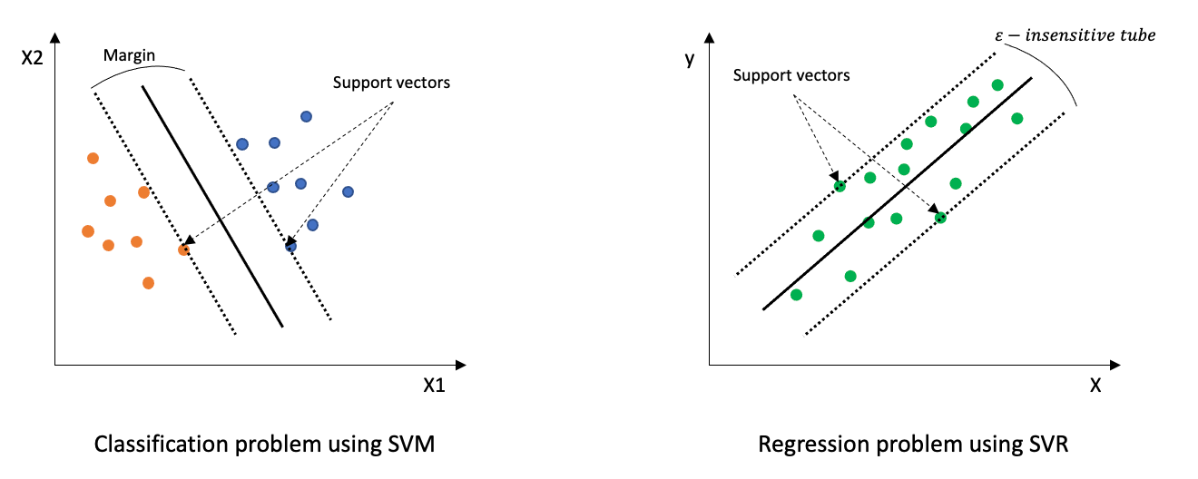
Support Vector Regression
We’ll mostly ignore this…
Support vector machines can also do regression.
The goal is basically opposite – draw a plane where things are within the decision boundaries.
The tube is basically zero loss for those records.

Slide 27
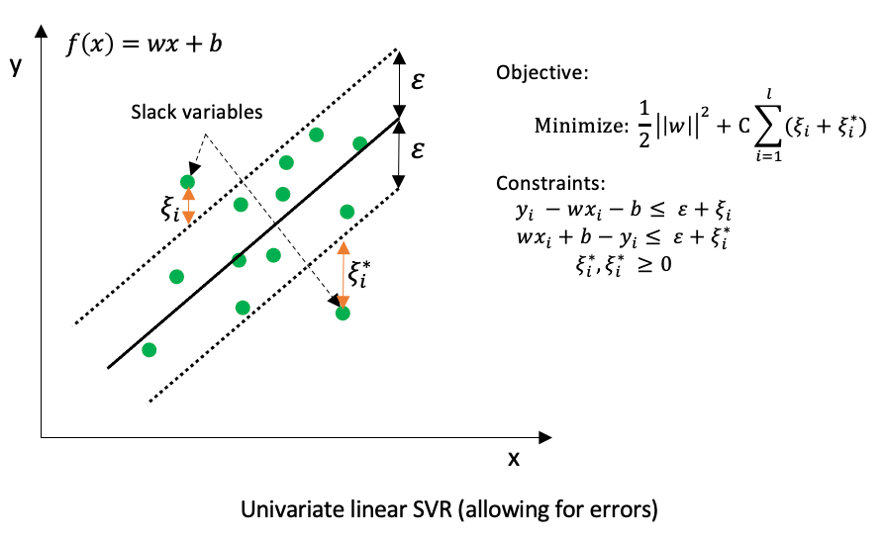
Regularization and HP Fit
C allows for things that are outside the tube.
The epsilon value is a HP.
The algorithm tries to find the plane that is ‘most close’ to the points.
~Find a tight lane where most points are in the tube.
Basically, minimize residuals.

Slide 28
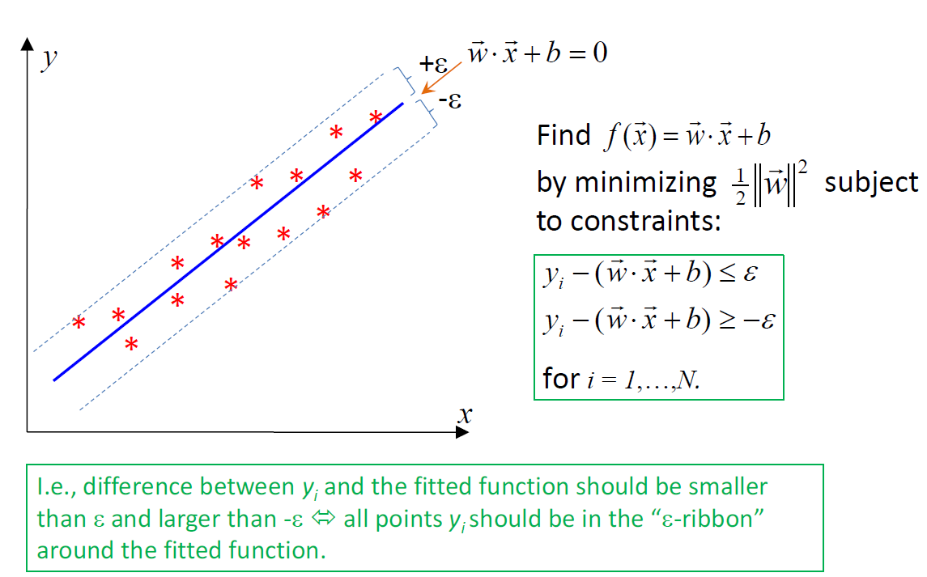

Slide 29
SVM – So Hot Right Now
Multiple classes – One vs rest, or one vs one. No softmax equivalent.
But if it’s something like “Hey, Google” vs. anything else, that’s a pretty reasonable fit.
Pros:
Can be really accurate, and pretty flexible thanks to kernel tricks.
Good (potentially) with small-ish datasets, especially those with many features like images.
Stable – only different if the support vector change (but with large N, big change is less likely)
Cons:
May be slow on large datasets.
Noise and messy data may hurt accuracy if the margins are hard to define in the data.
Correct kernel and C requires testing via a gridsearch or similar.

