Slide 1
housekeeping
Today – Intro to NLP.
Tokenization
Feature scaling – a better answer than my mumbling one.
There’s a test next time! Get all the answers right so the marking is easy please.
There’s a group project on NLP after reading week – pick groups.
Assignments -> Groups -> There’s some selection thingy here.
I accidentally deleted the groups trying to set them up, please let me know if things go weird.

Slide 2
Variable Scaling
We got a question at the end of last week on scaling, I’ll answer in a less mumble-y way.
We generally need to rescale numeric variables before modelling.
Having feature values with vastly different ranges can impact training.
Loss functions are generally based on distance, like MSE.
Wildly different distances can cause problems with convergence. (The plane with a ball illustration is compressed and stretched to extreme extends, and the gradients are off).
In linear models, each term is a weight * feature. If one feature is orders of magnitude larger, that can skew impact of features on the model output.
Some algorithms are (can be) scaling insensitive (tree), but we pretty much always rescale.

Slide 3
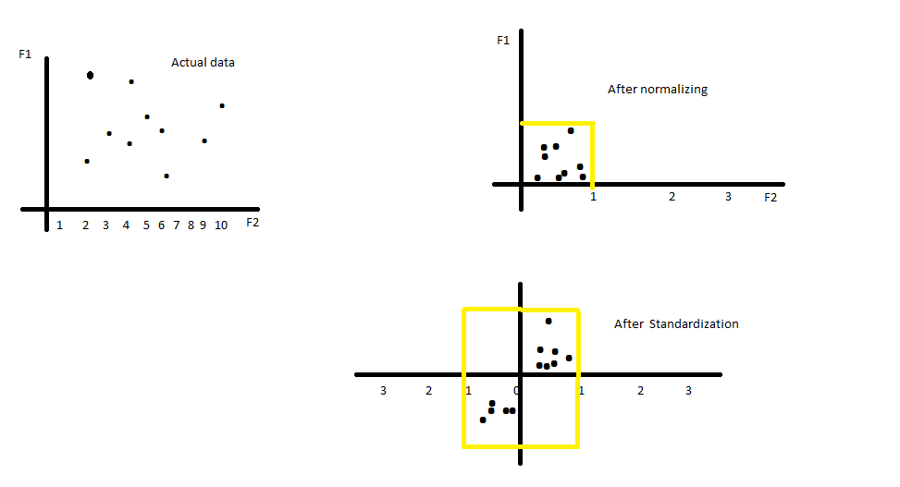
Rescaling options
Standard scaler – rescale with mean of 0 and standard deviation of 1.
Min-Max scaler – rescale with a min of 0 and max of 1 (usually).
There are a couple of other methods, but they’re less important. Same idea with all.

Slide 4
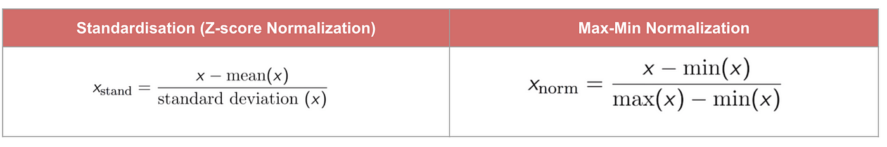
Which one to use?
The real answer for ML usage is that we need to test and observe the results.
For the most part, as datasets grow, there won’t really be massive differences.
The statistical answer is that it depends on the data and what we are using it for.
Each of the options is a transformation of the data, the impacts are different:
Standardization is based on normal distribution, so data that (roughly) follows that pattern fits.
The range in standardization isn’t bounded.
Normalization shifts the data to be within a specified range – a shift.
Normalization is also (potentially) massively impacted by outliers, since it squeezes the data.

Slide 5
Ok, so what do I use?
In general, if the data is normally distributed or we are doing something that assumes normality (like PCA, gaussian Bayes, clustering), then standardization may be better.
~ A model assumes that the data is normally distributed about the mean, that’s hard coded.
If we need outliers kept, standardization will likely be better.
We’ll do one assignment where we generate data, and the pattern that is generated is based on an assumption of normality. In this case, we’ll expect better results with standard data.
In general, if the data is not normal, normalization may be better.
Image processing always uses normalization to shift feature range to 0 to 1.
If we ‘just need to prevent disproportionate impact of features’, normalization does that.
These are very loose rules.

Slide 6
So…
I searched but couldn’t really find a more satisfying rule, it depends is the answer.
MOST of the benefit comes with either, the specific performance depends on the details.
Both techniques perform similar things, and maintain the original distribution shape.
Normalization – the range is hard bounded (usually 0 to 1).
Standardization – the range is not limited.
The bulk of the benefit comes from the shared improvements:
Equalizing scales allows the model to learn better, both in metrics and speed.
Distance based calculations (grad. Desc., MSE, etc…) will see improvements with either.
There are some cases where the difference might (really) matter, but probably not.

Slide 7
Basic Text Processing and NLP

Slide 8
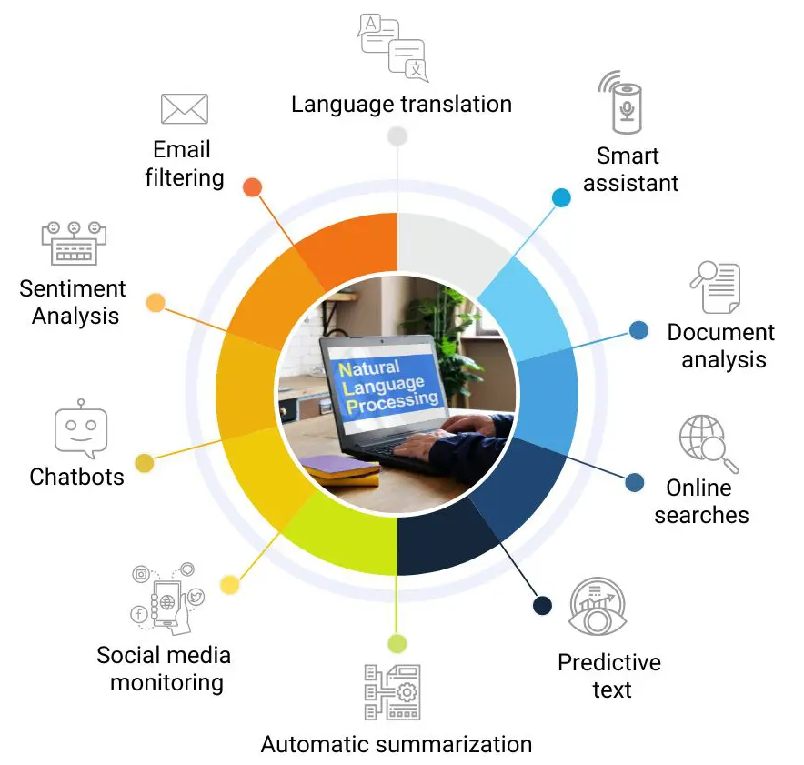
Text and Machine Learning
Many of the coolest AI and ML things that have happened recently have been in NLP.
Natural language processing.
AI assistant type things.
Siri, Alexa, Google, etc…
Generative Large Language Models.
ChatGPT, the assorted competitors.
We can use language as a data source for stuff like this, and regular ML predictions.

Slide 9
Natural Language
Natural language is text that exists in its natural, human usable, state.
Like this sentence, any word document, or pretty much any text.
The text in its original form can’t be used, but there is info in it that we can extract.
E.g. “FreeMsg Hey there darling it's been 3 week's now and no word back! I'd like some fun you up for it still? Tb ok! XxX std chgs to send, å£1.50 to rcv ”
NLP Terms:
Document - each row of text in dataset.
Corpus – entire dataset of text.
Token – a word (kind of, more later.)

Slide 10
NLP – Natural Language Processing
For computers to learn to listen and speak, we need to make text computer friendly.
NLP is a field of study and set of tools to do this.
Goal: take in free text, generate data that can be processed (for ML for us)
For example, can we filter spam messages from not spam?
The first step is to generate some representation of the text that we can process.

Slide 11
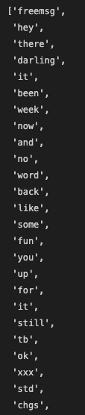
Tokenization
Tokenization is the base of simple text processing.
Tokenization transforms free text into a collection of component words.
The tokenization process usually also strips things like punctuation, converts all text to lower case, and may remove stop words. (~ Make it ‘just words’)
Stop words – stuff that isn’t useful (for us) because it doesn’t convey meaning:
E.g. it, a, an, the, etc…
Terms:
Document - each row of text in dataset.
Corpus – entire dataset of text.
Token – a word (kind of, more later.)

Slide 12
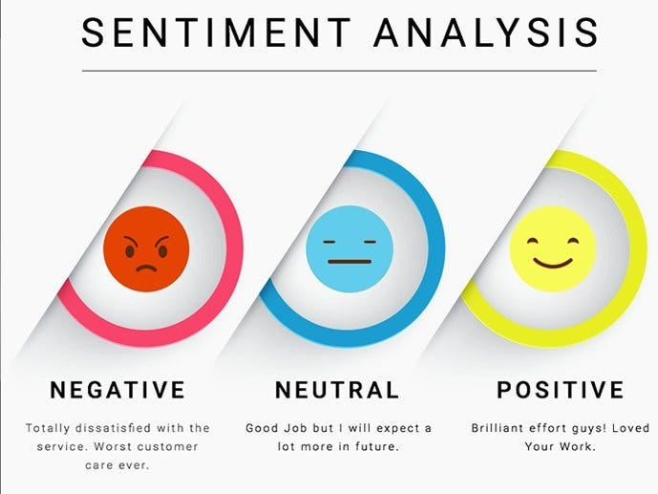
Note - For Our Examples…
As we go through text processing almost all of the focus is on the features and processing the text – we barely mention the target.
You can think of these as sentiment analysis – one of the most common NLP prediction tasks.
E.g. we have some hotel reviews and want to determine which are positive vs negative.
Other normal prediction things will be the same, except for the target.
Processed text is the feature set.
Pos/Neg type of classification is target.
Our usage has a target, LLM models predict next token*.

Slide 13
Note - Tokenization for us vs. ChatGPT
In our usage, we are stripping lots of the structure from the text.
Stop words, punctuation, etc…
Our usage is as features for predictions, so we want ‘meaning’.
The model doesn’t really need to know a sentence’s structure, just what it is saying.
Removing things like ‘a’, or commas changes the sentence, but not the meaning.
Large models like LLMs are a little different in this, they produce text – structure matters.
They need to keep that stuff in the training data as that’s part of what must be learned.
The amount of data needed skyrockets – language is way more complex when you model all the ways to say a thing vs. just the thing that is being said.
E.g. “I’m going skiing”, “Imma go skiing”, “I have to ski” vs. “I ski” – the 1st is way more complex.

Slide 14
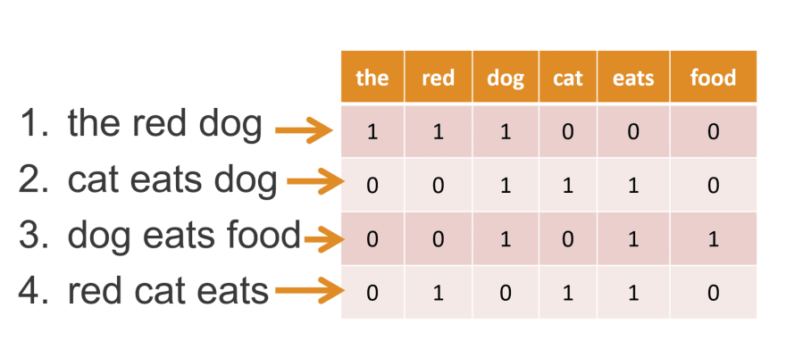
Vectorization
Vectorization is basically ”tokenization+”.
Text is tokenized, then placed into a data structure along with some “weight” of the value.
Count vectorization:
Count vectorization is the most simple vectorization.
Produces a list of words, and number of times they occur.
Results in “Bag of Words”.
Can be structured into a dataframe.
The collection of all words is the vocabulary.
This creates a feature set we can use. We need some version of this step, though the details vary.

Slide 15
Vectors to predictions
In this case, our data setup is as follows:
Records – each statement is one record.
Features – each token (~word) is one feature.
Feature values – each value is the number of occurrences.
Target – we haven’t specified it, probably something like sentiment (positive vs. negative).
This table is roughly one “X_train”.

Slide 16
TF-IDF Vectorization
Term Frequency - the number of times a word appears in a document divided by the total number of words in the document.
Inverse Document Frequency - the log of the total number of documents divided by the number of documents that contain the word.
Rather than simple count, the score is a product of TF and IDF.
Goal is to reduce weight of rare words (not frequent enough to establish a pattern) and very frequent words (so ubiquitous they don’t help discriminate).
The values we use to predict are (hopefully) a measure of what determines the meaning of a statement.

Slide 17
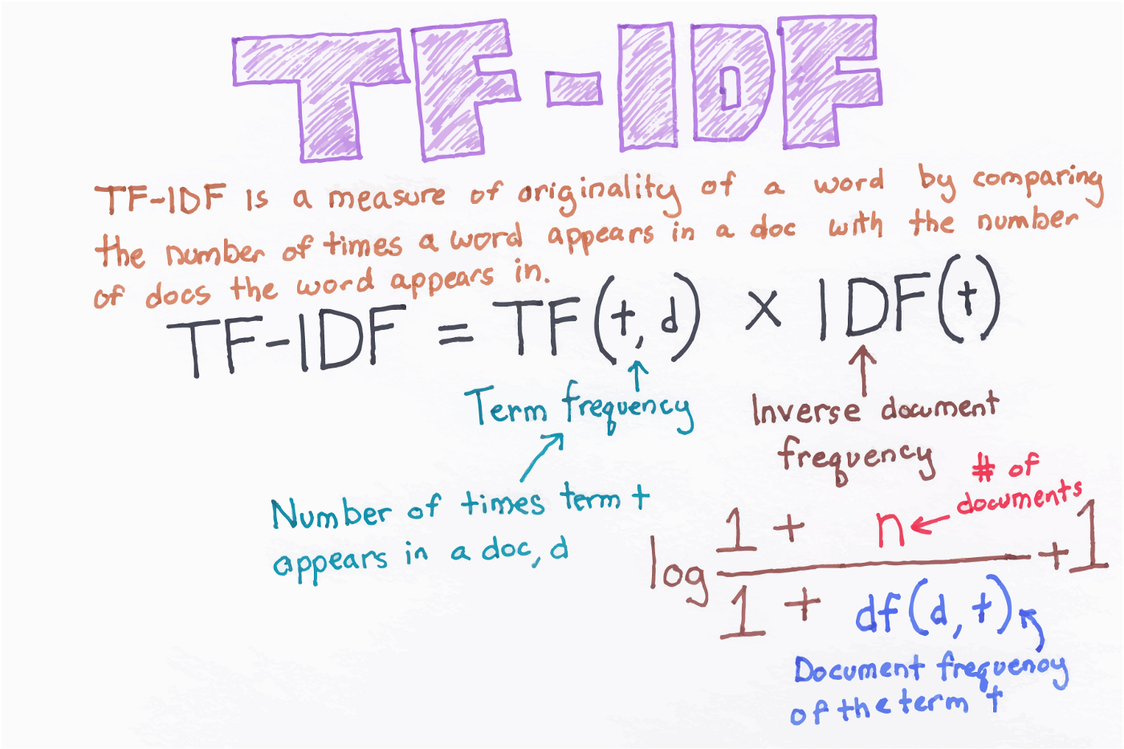

Slide 18
TF-IDF Example
Our Original Statements:
d1​: "The sky is blue.
d2​: "The sun is bright today."
d3​: "The sun in the sky is bright."
d4​: "We can see the shining sun, the bright sun."
After stopword filter:
d1​: "sky blue
d2​: "sun bright today"
d3​: "sun sky bright"
d4​: "can see shining sun bright sun"

Slide 19
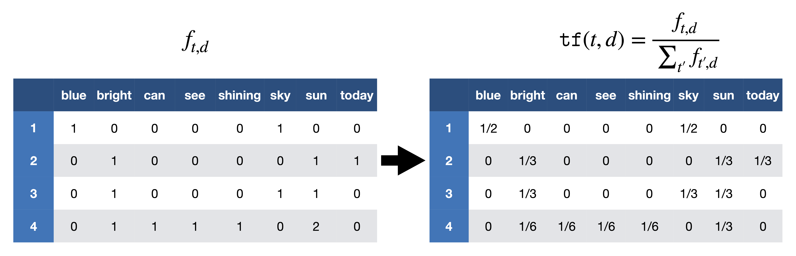
Compute TF and Normalize

Slide 20
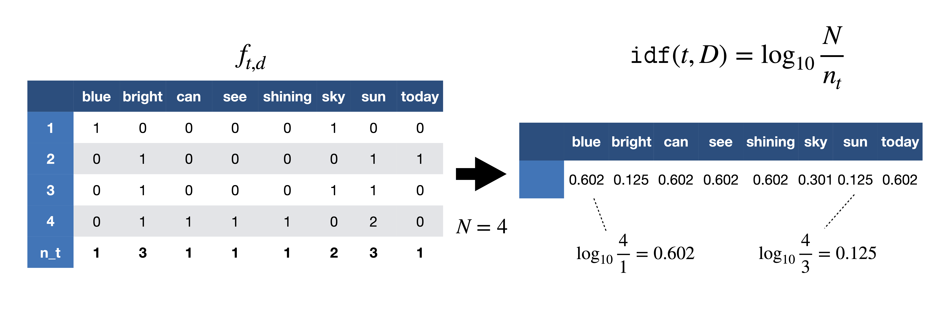
Compute IDF – Frequency of Terms

Slide 21
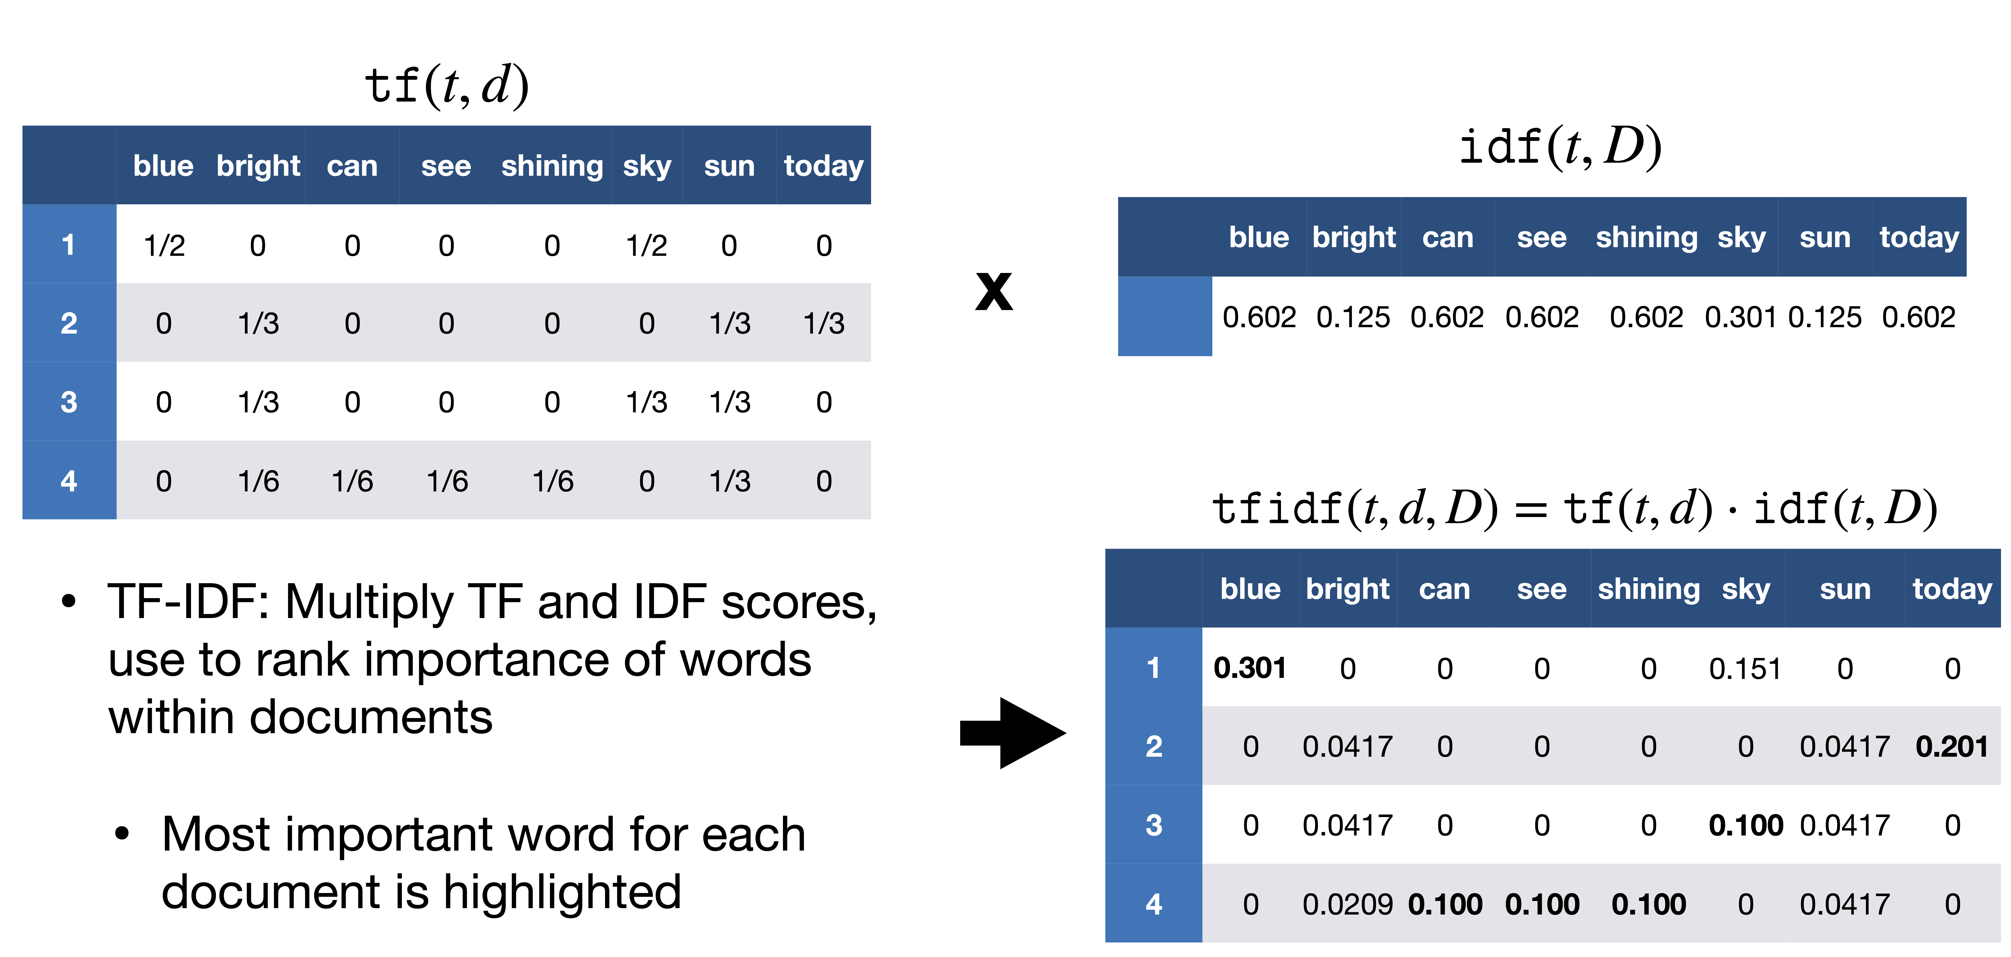
Compute TF-TDF by Multiplying

Slide 22
Result
We get a feature set that we can feed to our model.
Ideally, this is a better representation of meaning than the count.
In all cases we need some step that does this part.
Translate raw text to some numerical value we can use.
The quality of this representation matters for accuracy and can vary depending on the goal.

Slide 23
Stems and Lemms
Stemming and lemmatization both seek to trim words back to their “root”.
Stemming:
More simple, just chops word down to root by removing prefix and suffix.
E.g. “climbing” becomes “climb”.
Lemmatization:
Lemmatization simplified words to their “lemma”, the “root meaning”.
E.g. “better” becomes “good”.
Each of these can help our model understand text better:
“I went climbing” has a similar meaning to “I did a climb”.

Slide 24
Using Stemming and Lemming
Like with vectorization, both of these operations aim to capture the ‘meaning’ of the text in the representation we are using.
For many predictive tasks, the meaning is important, the language not so much.
E.g. Sentiment analysis.
Reducing the size of the vocabulary makes the feature set smaller.
The problem is inherently pretty large.
This allows for smaller models and smaller datasets to do the job.
If we were aiming to reproduce text, this simplification isn’t wanted (or less of it).

Slide 25
Ngram Range
The ngram range is basically the number of words allowed in a token.
Take the sentence: ”I like downhill skiing”:
There are 4 “1-grams”, each word.
There are 3 2-grams: “I like”, ”like downhill”, and “downhill skiing”.
There are 2 3-grams: “I like downhill” and “like downhill skiing”.
There is one 4-gram: “I like downhill skiing”.
Allowing for sizes >1 can often help the algorithm better “understand” meaning.
E.g. Suppose you make a classifier to identify if text was about downhill skiing, waterskiing, or cross-country skiing. Allowing for 2-grams better captures context.

Slide 26
Lots of Features and Sparse Matrices
A result of vectorization is usually a wide matrix, with lots of features.
This matrix is almost always very sparse.
We can limit the number of features with a parameter, or…
We can use “Dimensional Reduction” to reduce the number of features.
We’ll do this next week.
Look up Truncated Single Value Decomposition (SVD) if you’re jumping ahead.

Slide 27
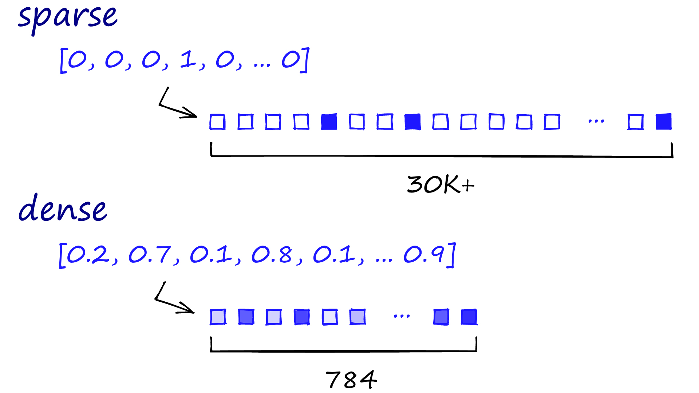
Note - Sparse Vectors – They’re Mostly Zero
Sparse vectors are mostly zero.
This can be common in high-dimension, unstructured tasks like NLP.
We (sometimes) care due to performance.
Sparse matrices can lead to problems with convergence.
Not enough slope in GD.
Big vector, big model, big data.

Slide 28
Processing Text Data for Predictions
To use our text data to make predictions, we need to do some preprocessing.
Tokenize the text into individual tokens (~words).
Remove stuff that isn’t useful like punctuation and stop words.
Stem/Lem to simplify text down to its ‘core meaning’.
Vectorize the tokens to create a numeric representation of each document (count, tf-idf).
This is now our feature set that can be used just like any other.
Representing the text in a feature set is not a determinative thing.
Depending on what we are doing, a different representation might be better or worse.
The parts of language, the level of detail, and the complexity of analysis all change.

