Slide 1
Stuff
Feature selection basics.
I’m going to ask you to read the workbook part over the next week. It’s pretty easy.
This Week (007-010) – Dimensionality of Data:
Regularization. Images and multiclass classification. Support Vector Machines.
Involve multidimensional space, videos and animations on YouTube can help visualize.
These are all important concepts, but the hands on is simple-ish.
The long text (Intro to Machine…) has chapters on each, please read. Also ask as we go.
After that – NLP and almost back on schedule-ish.
We’ll do a test after the NLP stuff, pre neural network. ~2-3ish weeks.
We’ll test on basic ML concepts, then leave the neural network stuff for hands-on.

Slide 2
Feature Selection

Slide 3
Detour – Sparse vs Dense
One thing that is mentioned regularly is a sparse or dense matrix.
Sparse matrices are mostly 0, dense matrices are not.
E.g. one hot encoded data with many classes makes a very sparse matrix.
The difference is in how they are treated (sometimes) in code.
Sparse matrices can be represented differently in storage:
Storage space can be more efficient.
Processing speed can be quicker.
We don’t really need to think about it much, it is a concern with large amounts of data.
E.g. Sklearn data needs to fit in RAM.

Slide 4
Feature Selection
Until now, we haven’t worried too much about feature selection.
Outside of things like L1 regularization built into algorithms.
We’ve seen some pretty wide (high dimension) data, with lots of features.
Just like with linear regression with p values, we can select some features to help our models.
We can build this selection into pipelines to make things slick.

Slide 5
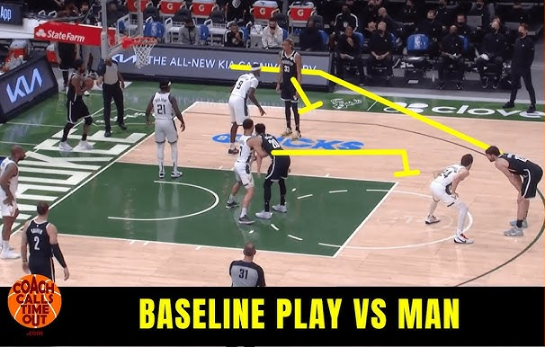
But First, Baselining
One idea that is helpful while tuning models is baselining.
Get a ‘baseline’ level of performance in ‘stock’ model.
Before trying most tuning stuff, but with cleaning.
E.g. Model with all features and default hyperparameters.
If doing tuning outside of a gridsearch, it is more useful.
Grid will just get the best, so if all searching is within there, it is still ‘good’, but doesn’t matter all that much.
E.g. different model types. (This can be in a grid search, but you need to manually make the transformer – not super hard, but somewhat annoying due to different HPs.)

Slide 6
Feature Selection Basics
In general, selecting features won’t improve a model’s overall performance very often.
Feature selection allows us to have simpler models:
Fewer features can make for less data, quicker execution, lower cost, or more transparency.
We want to include the things helpful to an accurate prediction, exclude those not.
The metric for helpful can change:
Basic statistics or inspection – does this value vary enough or is it clearly useless?
Correlation-ish measures.
Model determinations from internal measures, such as tree feature importance.
Performance of the actual model with/without.
All feature selection is basically different methods of calculating and testing this.

Slide 7
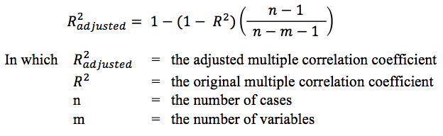
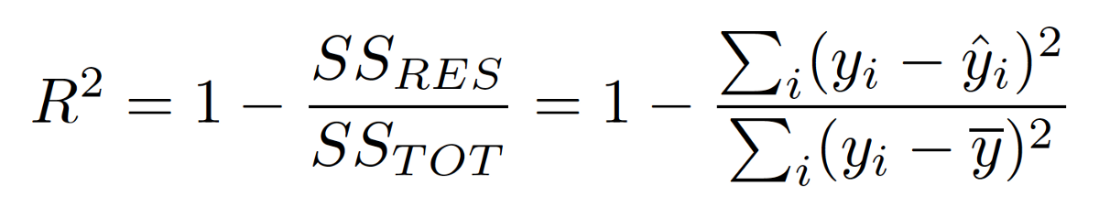
Feature Selection Impacts
Models will internally already have some aspect of weighting feature impacts.
Trees choose to use different features, regression coefficients can shrink (maybe to 0).
Removing a useless feature won’t really make performance jump, since it’s already deemphasized.
Remember R2 – the proportion of variance explained by the model:
R2 of 1 is perfect correlation and perfect predictions, x tells us y. 0 is no correlation.
Added features rarely have absolutely no correlation with the target, so they contribute something.
Could add many bad features to a few good ones to get a higher R2.
Think of multicorrelation examples – we can remove redundant features and r2 is basically unchanged.
Adjusted R2 measures the correlation, adjusted for size of data and # of features.
Similar concept to regularization – there’s a penalty (to overcome) for making the model larger.

Slide 8

Ways to select Features

Slide 9
How to do Selection
There are several methods to evaluate how good a feature is, each different.
They may agree, but they may not – it can vary, somewhat unpredictably.
If several methods say a feature is less important, it probably is.
If several methods say a feature is more important, it probably is.
There are a few complications to this:
Relationships, in complex data, might not be so simple – e.g. combo of features to target.
Multicollinearity – multiple features containing the same information. Algorithm can’t weight importance of each feature since the important info could be sourced from multiple features.

Slide 10

Relative Importance in Multicollinearity (We’ll do Example – stats 023)
Multicollinearity, or having several features that convey the same information, can mess with feature importance.
Think about predicting MPG for semi-trucks:
Weight may be a factor – tare, gross, other (?)
These are different, but convey similar info – weight.
Bigger trucks likely have both increase, so they mirror e/o.
If a model can ‘get’ weight from 2+ values, which matters?
This doesn’t make the model worse, but tuning features becomes much less clear – which feature matters?

Slide 11
Variance Based Selection
If all of the rows of a feature have the same value, it won’t be helpful in distinguishing.
If the target changes, but this feature doesn’t, it can’t really be helping much.
For example:
Suppose you were trying to predict US Supreme Court predictions and the ”college type attended” for each judge is a feature. 8/9 attended an Ivy League (Harvard or Yale). Knowing that a justice attended Ivy League won’t help distinguish predictions, since they all did.
This matters much more with small datasets, to reduce dimensionality.
Assuming you have enough data, the low variance feature might matter a bunch, but only in a few scenarios, so keeping it would be better.

Slide 12
Univariate Selection
Univariate selection looks at the characteristics of one variable at a time.
Based on correlation or a correlation-y metric – the more a feature is correlated with the target, the more likely it is to be predictive.
The more X tells us about Y, the better the feature is.
Regression:
F_regression (correlation)
Mutual_info_regression (information gain)
Classification:
F_classif (ANOVA)
Chi2 (~correlation)
Mutual_info_classif (information gain)

Slide 13
Univariate Implementation
Select k best: select the best k features based on the metric.
Select percentile: select the best percentage of features based on the metric.
Note – relationships in data don’t have to be one-to-one with target:
I.e. a combination of factors can have a relationship, as a unit, with the target.
The best model is not necessarily the X most correlated features.
For high-dimensional data, the relative importance of any single feature becomes harder to know.
The more complex the relationships, the more complex a model is needed (and more data).

Slide 14
Internal Selection
One type of feature selection we have used is the “built in” selection in models.
Trees and Lasso regression both select out less important features.
Select from Model:
Select from model lets us “borrow” the feature selection of algorithms and apply it as a filter.
E.g. we can use a tree’s feature importance as a step to select features, then pass that dataset to a different model to predict.
Filtered Dataset
Data
Feature Importance Model (Lasso/Tree)
Prediction Model

Slide 15
Recursive Elimination
Recursive elimination does what it says, removes features one at a time.
The entire feature set is modeled.
The least important feature is booted.
Rinse and repeat until the criteria for # of features is reached.
RFECV – Implements a “grid search” with cross validation to choose number of features:
Recursive Feature Elimination with Cross Validation.
Will choose number of features with the best score.
Good for pipelines! Auto-select the best set of features.

Slide 16
Weirder Stuff
There’s a handful of other ways to select features that are less common.
Permutation Importance - calculated after a model has been fitted.
Randomly shuffle a single column of the validation data, leaving the target and all other columns in place, and then measure the performance of the model with the new data against the performance of the model with the original data. The drop in model performance measures the importance of the variable you just shuffled.
Target mean performance – a convoluted process someone published in a competition (http://proceedings.mlr.press/v7/miller09/miller09.pdf)

Slide 17

Where we’re going, we don’t need Feature Selection

Slide 18
Do we Select?
As noted, removing features makes the model more ‘efficient’ but doesn’t normally raise the ceiling.
Selecting features makes the most sense when:
There’s some substantial domain knowledge where you know something about importance.
In our scenarios, the features are kind of random values, in reality they’re measurements of actual real stuff.
The process needs to be somewhat understandable or explainable.
The training data is limited, as a too high wide/tall ratio will tend to overfitting. If data is limited, it matters.
Simple is (usually) better for most cases in practice.
Feature selection will make more of an impact with smaller, simpler models and data.
Can unlock better performance on large models by allowing quicker trials.
In many real-life scenarios, bias error might not be the worst. E.g. a bank will default to ‘generalizing’.
Work ‘up’ in complexity – there’s no use getting 2% better from a model that is 20x larger (usually).

Slide 19
Feature Selection’s Buddies
PCA – extracts portions of the “value” from each feature, composed into new features.
Not feature selection as none of the features actually goes away in the same sense.
Can provide many of the same benefits, or better. E.g. example with pixels.
Bigger/better models – large models, like NNs, learn feature selection given enough data.
Complex scenarios may allow the model to learn this better than is possible with this stuff.
The model can learn the importance of features, and even different representations of them.
In high-dimension things (generative, image rec., NLP, etc…) each feature tends to not have a specific value that someone can evaluate manually – a pixel or part of a sound wave doesn’t have the relationship to a target that “income” or “age” do. A large model with large data is basically able to figure these complex relationships out – we can’t really do it up front.

Slide 20
Conclusion
In most real situations, you probably want to do something like:
Make a baseline model with minimal prep & use domain knowledge & metrics to trim the feature set.
Continue trimming to see where/if there’s a dropoff in performance. (e.g. 10f = 90%, 9f = 81%)
Make a model with whatever set of features ‘matter’, evaluate if this is sufficient.
This is for tabular ‘real-life’ data (like ours), with a human-manageable number of features.
But, if you want complex data & maximal performance, then big models keeping most/all is good.
You need a large model capable of learning complex relationships, and enough data to allow it.
These scenarios are often unstructured data, building off of what works is smart.
Shrinking models can also allow for other devices (phones, watches, rpi, etc…) to run things.
For us, we can use metrics, and be reasonable – we don’t have the domain know/constraints.

